Slide 1

BMS COLLEGE OF ENGINEERING
(Autonomous Institute, Affiliated to VTU, Belagavi)
DEPARTMENT OF MACHINE LEARNING
(UG Program: B.E. in Artificial Intelligence and Machine Learning)
Course : NLP for LLM
Course Code: 24AM7PCLLM
Sentiment Analysis using a Transformer-Based Model
Date: 25-11-2025
Presented By,
Student Name & USN :
Harsha Swaroop 1BM22AI054
Diksha CR 1BM22AI046
Faculty In-Charge:
Dr. Sowmya Lakshmi BS
Assistant Professor
Department of Machine Learning
BMS College of Engineering
Semester & Section: 7A

Slide 2
Introduction
Domain: Sentiment Analysis (NLP) to classify text as Positive or Negative.
Model: Utilizes DistilBERT, a faster and lighter Transformer model derived from BERT.
Mechanism: Uses Self-Attention to understand context and word relationships, going beyond simple keyword matching.
Objective: Build a high-precision system for analyzing movie reviews that outperforms classical machine learning.

Slide 3
Objectives
⚙️ Build (Implementation): Design and fine-tune a DistilBERT model for binary sentiment classification on the IMDB dataset.
🧹 Clean (Optimization): Preprocess raw text data to ensure compatibility with Transformer architecture.
📊 Measure (Evaluation): Assess model performance using Accuracy, Precision, Recall, and F1-Score.
🚀 Apply (Application): Analyze the model's contextual understanding and demonstrate its potential for real-time opinion mining.

Slide 4
Real-Time Application
Problem: Manual analysis of thousands of reviews is slow, biased, and inefficient. Solution: Automated, real-time sentiment classification using AI. Key Use Cases:
Streaming (Netflix/Prime): Analyze viewer reaction to adjust content strategy.
E-Commerce: Summarize product feedback to detect quality issues.
Social Media: Monitor brand reputation and public sentiment spikes.
Customer Support: Auto-escalate negative feedback to human agents.

Slide 5
System Architecture
Model: DistilBERT (A lighter, faster version of BERT). Core Components:
Tokenizer: Splits text into subwords; adds [CLS] (start) and [SEP] (end) tokens.
Embeddings: Combines word meaning with position information.
Encoder: 6 Transformer layers using Self-Attention to understand context.
Classification Head: Final layer that outputs probabilities for "Positive" vs. "Negative".

Slide 6
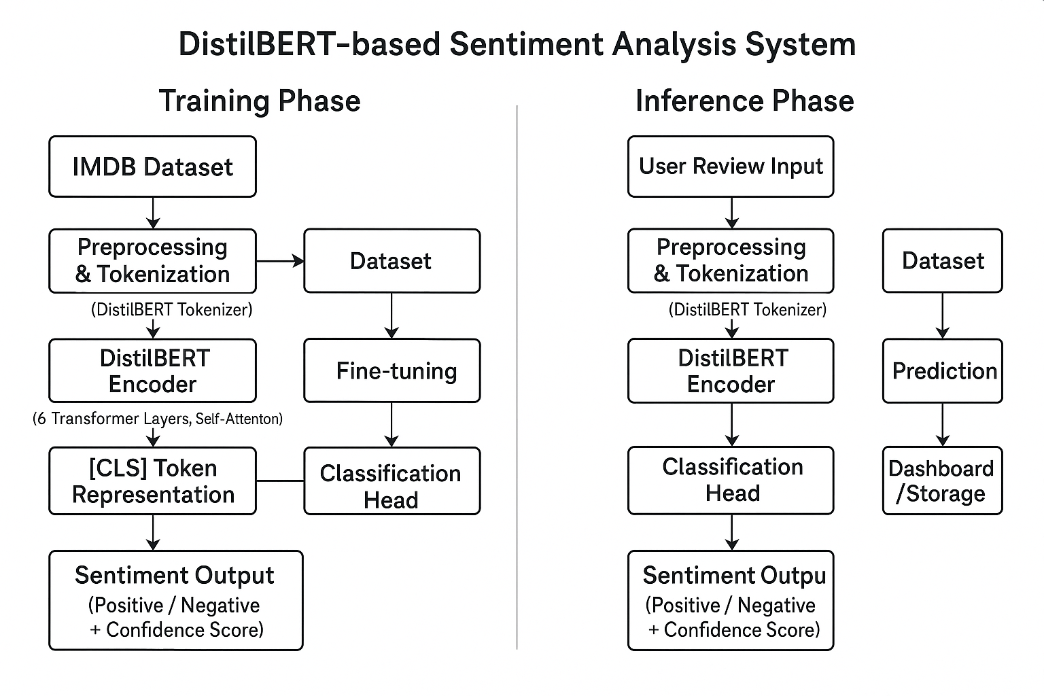
Fig 1.1 System Architecture

Slide 7
Methodology
Dataset: IMDB Movie Reviews (50,000 samples; 25k Train / 25k Test).
Preprocessing:
Tokenization & Padding (Max length: 256 tokens).
Generation of Attention Masks.

Slide 8
Training Strategy:
Technique: Fine-tuning a pre-trained DistilBERT model.
Optimizer: AdamW (Adaptive Moment Estimation).
Loss Function: Cross-Entropy Loss.

Slide 9
Implementation
Tech Stack: Python, Hugging Face Transformers, PyTorch. Workflow:
Load API: Fetch distilbert-base-uncased from Hugging Face.
Process Data: Convert text to Input IDs and Attention Masks.
Fine-Tune: Train on IMDB data (Batch size: 16, Learning Rate: 2e-5).
Inference: Model predicts sentiment label for unseen reviews.
Github Repository: LLM AAT Repo

Slide 10
Results & Analysis
Observed Performance:
Recall (Negative): 1.00 (Perfect identification of negatives).
Recall (Positive): 0.00 (Failed to identify positives).
Overall Accuracy: ~53%.
Key Insight: The model exhibited class bias, defaulting to "Negative" predictions.
Cause: Insufficient training epochs (1 epoch) prevented the model from learning complex positive patterns.

Slide 11
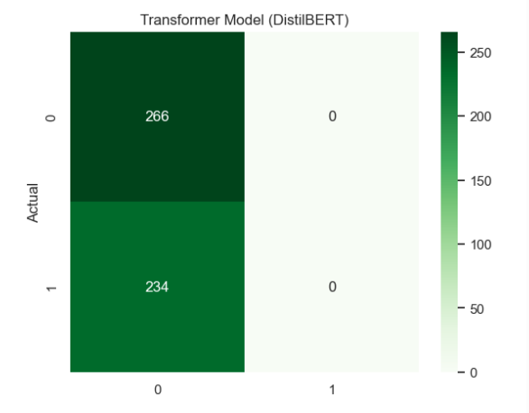
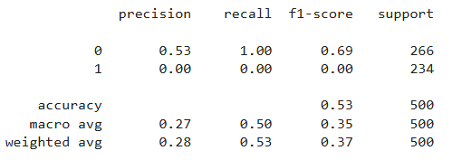
Fig 1.3 Classification report of DistilBERT
Fig 1.2 Confusion matrix showing performance of DistilBERT

Slide 12
Thank You!

