Slide 1
CMOS Ring Oscillator for On-Chip Clock Generation
2310040040-Rahul
2310040042-Harsha
2310040050-Bharat
2310049145-Raghu

Slide 2
Problem Statement
Modern SoCs require reliable on-chip clock sources for timing and synchronization.
External crystal oscillators increase system cost and board area. Fixed-frequency ring oscillators lack flexibility.
There is a need for a CMOS-based, tunable on-chip clock generator. A ring oscillator with a capacitor bank provides a practical solution.

Slide 3
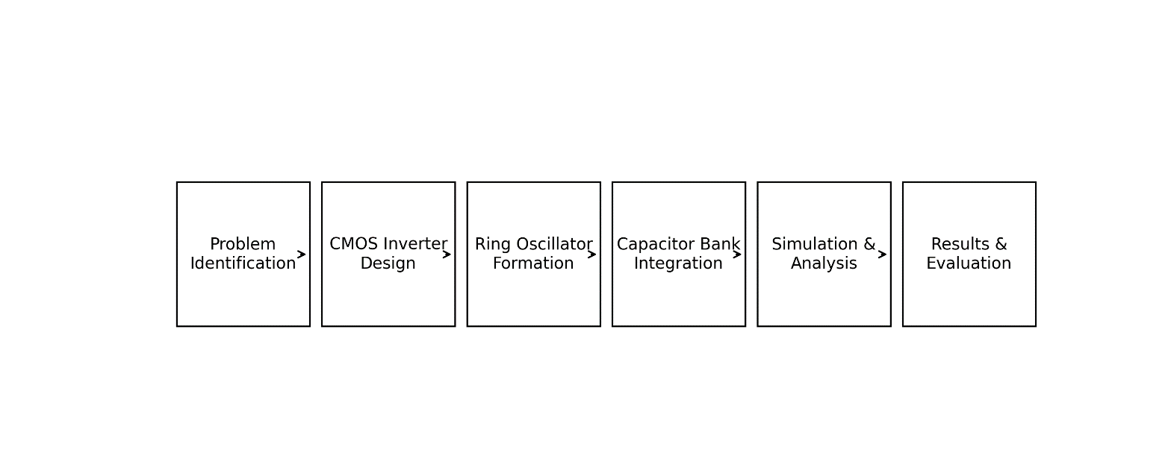
Key Insights
CMOS ring oscillators are widely used for on-chip clock generation. Oscillation frequency depends on inverter delay and stage count.
Load capacitance significantly affects the oscillation frequency. Ring oscillators are used in SoCs, BIST, and PLL/VCO systems. Capacitor banks enable frequency tuning.

Slide 4
Reference Papers Studied
B. Razavi
CMOS VLSI Design: A Circuits and Systems Perspective
Studied CMOS inverter operation, propagation delay, and basic ring oscillator principles used for on-chip clock generation.
J. M. Rabaey, A. Chandrakasan, B. Nikolic
Digital Integrated Circuits
Referred for timing analysis, delay modeling, and the impact of load capacitance on switching speed and clock frequency.

Slide 5
Future Implementation
. Implement the complete transistor-level schematic of the CMOS ring oscillator.
. Integrate and verify the capacitor bank block for frequency tuning.
. Analyze frequency variation for different capacitor combinations.

