Slide 1


Data Analytics Internship Report
This report summarizes my internship experience, focusing on three key data analytics dashboard tasks completed using Power BI. It outlines the learning objectives, activities, skills developed, challenges faced, and overall impact of my internship.
by Harsha Vardhan

Slide 2

Introduction
This report details my internship focused on developing data analytics dashboards using Power BI. It explores the tasks undertaken, the skills acquired, and the challenges encountered, providing a comprehensive overview of my internship journey.

Slide 3

Background
The internship involved working on Power BI dashboards to analyze and visualize Twitter engagement data. The primary goal was to create interactive visualizations that provide insights into tweet performance based on specific conditions and time constraints.

Slide 4
Learning Objectives
Master Power BI tools and functionalities for data analysis and visualization.
Gain hands-on experience with Power BI for data visualization.
Understand data filtering and transformation techniques.
Learn how to apply conditional constraints to data representation.
Enhance problem-solving skills through real-world analytics tasks.

Slide 5
Activities and Tasks
The internship revolved around creating dynamic data analytics dashboards in Power BI. Through working with diverse data sources, visualization methods, and analysis strategies, it offered a comprehensive exploration of the data analytics landscape.

Slide 6
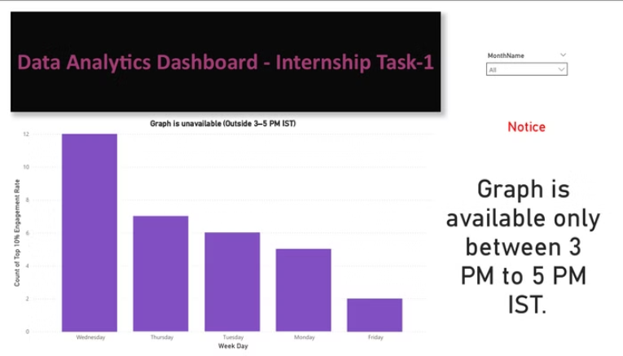
Task 1: Engagement Rate Analysis
Objective
Methodology
Analyze engagement rates across different days of the week and identify the top 10% of posts based on their engagement rate.
Developed a Power BI dashboard to visualize engagement rates by day of the week and highlight the top 10% of posts based on their engagement rate.

Slide 7
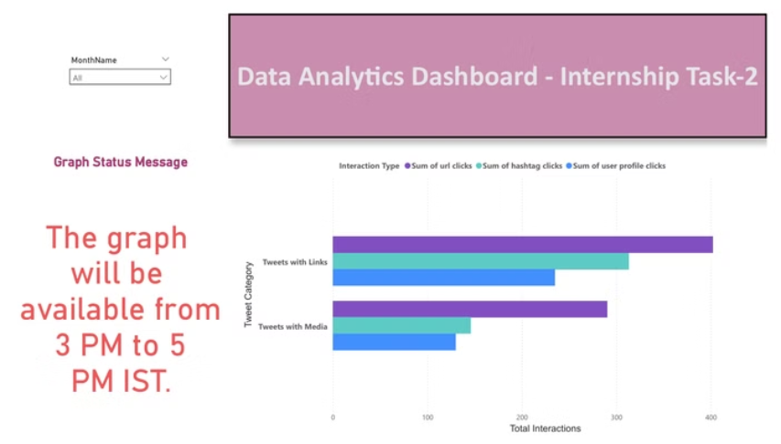
Task 2: Interaction Type Analysis
The goal was to analyze user interaction types, including URL clicks, hashtag clicks, and user profile clicks, for different message statuses. This provided insights into user behavior and engagement patterns. The dashboard was designed to be interactive, allowing users to filter data by time, message status, and interaction type.

Slide 8
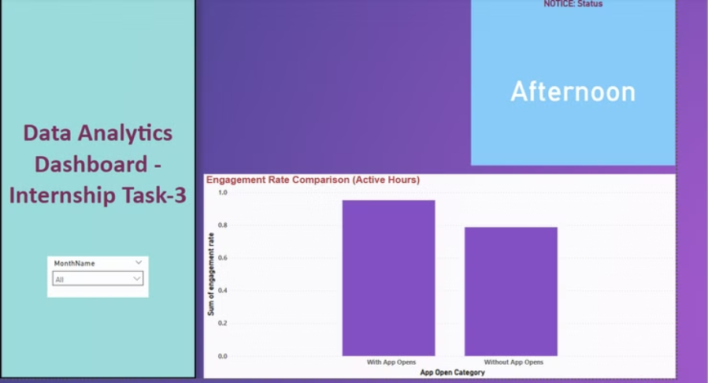
Task 3: App Open Category Analysis
The objective was to analyze the app open categories and identify the most popular categories based on user behavior. This involved creating a dashboard to visualize the frequency of app opens for different categories, providing insights into user preferences and usage patterns.

Slide 9
Skills and Competencies
Data Cleaning and Transformation: Learned to clean and transform data using Power Query in Power BI.
Data Visualization: Developed proficiency in creating various data visualizations like charts, graphs, and tables to present insights effectively.
Interactive Dashboard Design: Gained experience in designing interactive dashboards with filters, slicers, and drill-down capabilities.
Data Analysis: Learned to analyze data trends, identify patterns, and extract meaningful insights from the dashboards.

Slide 10
Feedback and Evidence
Successfully implemented conditional visibility for dashboards based on time constraints.
Improved accuracy in tweet filtering, ensuring only relevant data was displayed.
My ability to implement advanced data visualization techniques in Power BI was recognized, highlighting the efficient structuring of dashboards and data analysis workflows.

Slide 11
Challenges and Solutions
Challenge: Handling complex filtering conditions for tweets. Solution: Used DAX functions and Power Query to refine datasets.
Challenge: Implementing time-based visibility constraints. Solution: Utilized Power BI scheduling features and conditional formatting.
Challenge: Ensuring data accuracy and integrity. Solution: Cross-verified data with different filters and aggregation methods.

Slide 12
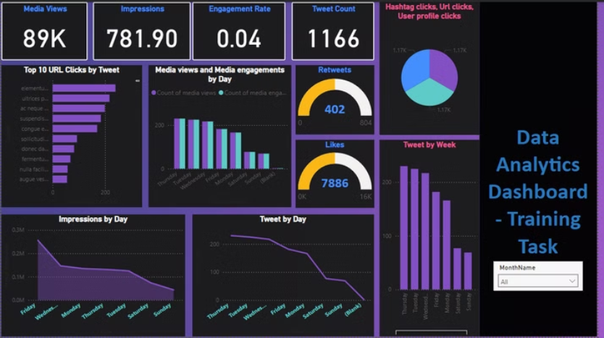
Outcomes and Impact
Developed three well-structured dashboards that met specific problem statements, and also training period task to enhance understanding of data analytics and visualization.
Gained proficiency in Power BI for data analytics and visualization.
Enhanced ability to apply logic-based constraints to real-world datasets.

Slide 13
Conclusion
This internship provided valuable hands-on experience in data analytics, specifically focused on developing interactive dashboards using Power BI. Through the completion of three challenging tasks and a training task, I gained a strong understanding of data visualization principles, data analysis techniques, and dashboard design best practices. This experience has equipped me with the essential skills and knowledge to contribute effectively to data-driven decision-making in future roles.

