Slide 1
Employee Data Analysis using Excel
STUDENT NAME:Deepa
REGISTER NO:312200169
DEPARTMENT: commerce
COLLEGE SIVET College

Slide 2
PROJECT TITLE
Employee Performance Analysis using Excel

Slide 3


AGENDA
Problem Statement
Project Overview
End Users
Our Solution and Proposition
Dataset Description
Modelling Approach
Results and Discussion
Conclusion
3/21/2024 Annual Review

Slide 4

PROBLEM STATEMENT
Here is the problem statement content:
Manual employee performance tracking and analysis is a time-consuming and labor-intensive process that can lead to:
- Inaccurate evaluations
- Inefficient use of resources
- Lack of transparency
- Missed opportunities for growth
- Insufficient data-driven decision-making
The current process relies heavily on:
- Manual data entry and tracking
- Spreadsheets with complex formulas and errors
- Limited visibility into performance metrics
- Subjective evaluations and biases

Slide 5

PROJECT OVERVIEW
This project aims to design and develop an automated employee performance analysis tool using Microsoft Excel. The objective is to create a user-friendly, data-driven, and transparent system that streamlines performance tracking, evaluation, and growth planning.
.

Slide 6

WHO ARE THE END USERS?
The primary users of this analysis are company managers and HR teams. They will use the insights gained from the data to make informed decisions about employee management, training programs, and performance improvement strategies.

Slide 7

OUR SOLUTION AND ITS VALUE PROPOSITION
Our solution involves using Excel to analyze performance data and identify key trends and patterns. This analysis will help the company understand the factors that drive high performance and identify areas where employees may need additional support. The value proposition is clear: by using data to guide decision-making, the company can boost productivity, reduce turnover, and improve employee satisfaction.

Slide 8
Dataset Description
The data set includes various performance metrics for employees, such as: - Employee ID - Department - Hours worked - Tasks completed - Attendance records - Performance ratings - Feedback from supervisors This data will be cleaned, organized, and analyzed in Excel to ensure accurate and useful insights.

Slide 9

THE "WOW" IN OUR SOLUTION
The standout feature of our solution is the use of interactive dashboards in Excel. These dashboards will allow managers to filter data by department, time period, or individual employee, and see real-time visualizations of performance trends. This makes it easy for them to quickly identify high performers or areas that need attention.
3/21/2024 Annual Review
9

Slide 10
MODELLING
We will use Excel functions and features such as pivot tables, charts, and conditional formatting to model the data. This will help us find correlations between different variables, such as the relationship between hours worked and tasks completed. We may also use Excel’s data analysis tools to perform regression analysis or other statistical methods to deepen our insights.
10

Slide 11
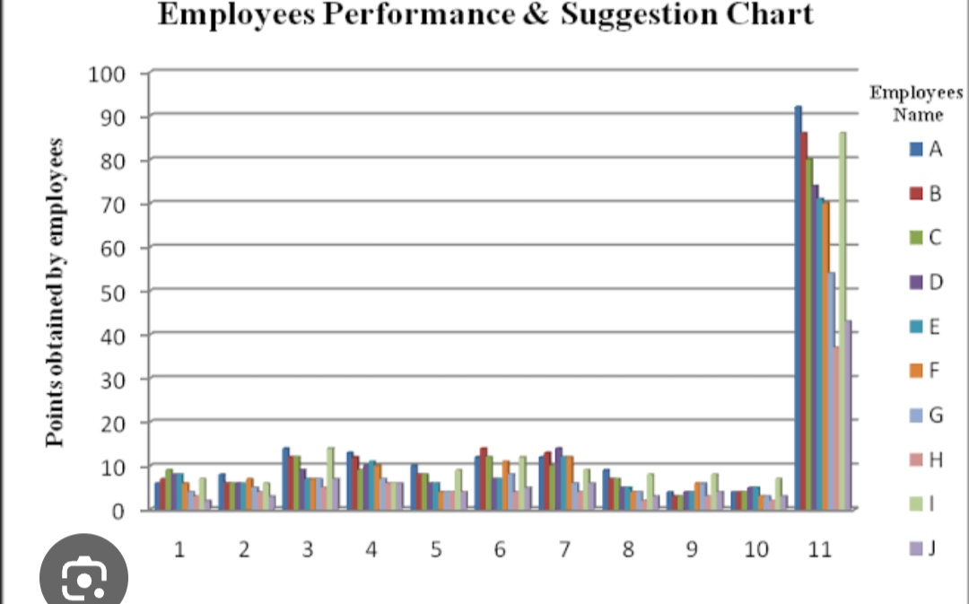
RESULTS
11

Slide 12
conclusion
In , this Excel-based employee performance analysis provides a comprehensive overview of how different factors influence employee productivity. By using the insights gained, the company can implement targeted strategies to improve performance across the board, leading to better outcomes for both employees and the business.

