Slide 1

Calwest E-Commerce Performance Summary
Harshaanth Thiyagaraja Kumar

Slide 2

Scenario
I am playing the role of a BI Analyst at Calwest Ecommerce, a fictitious e-commerce company that sells health-conscious products for people and their pets.
Today, I will be addressing the Product Management team with a summary of high-level company performance data.

Slide 3
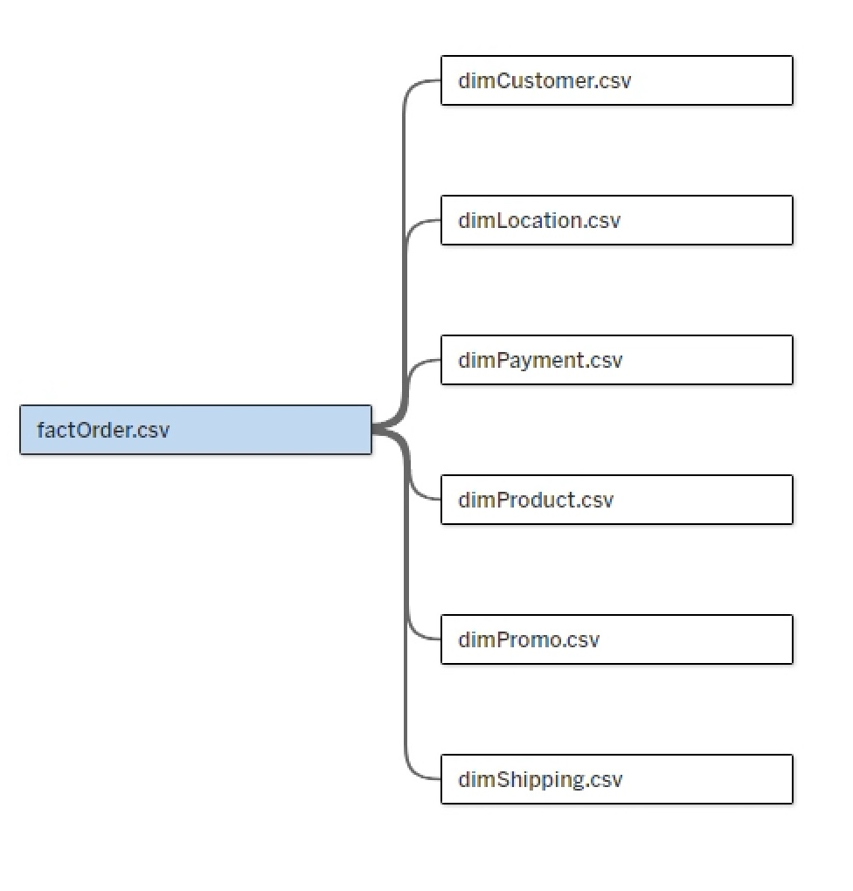
Data Model
The dataset contains over 12,000 records (rows) and 39 fields (columns) distributed across seven Excel files (.csv).
The data model includes six relationships, utilizing primary and foreign keys.

Slide 4
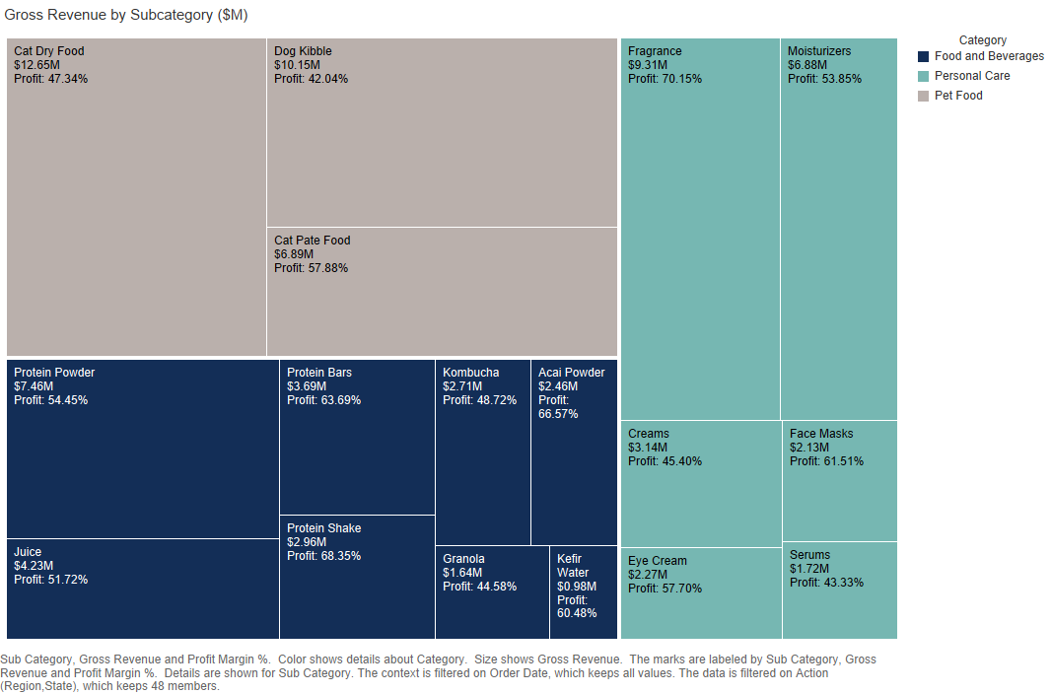
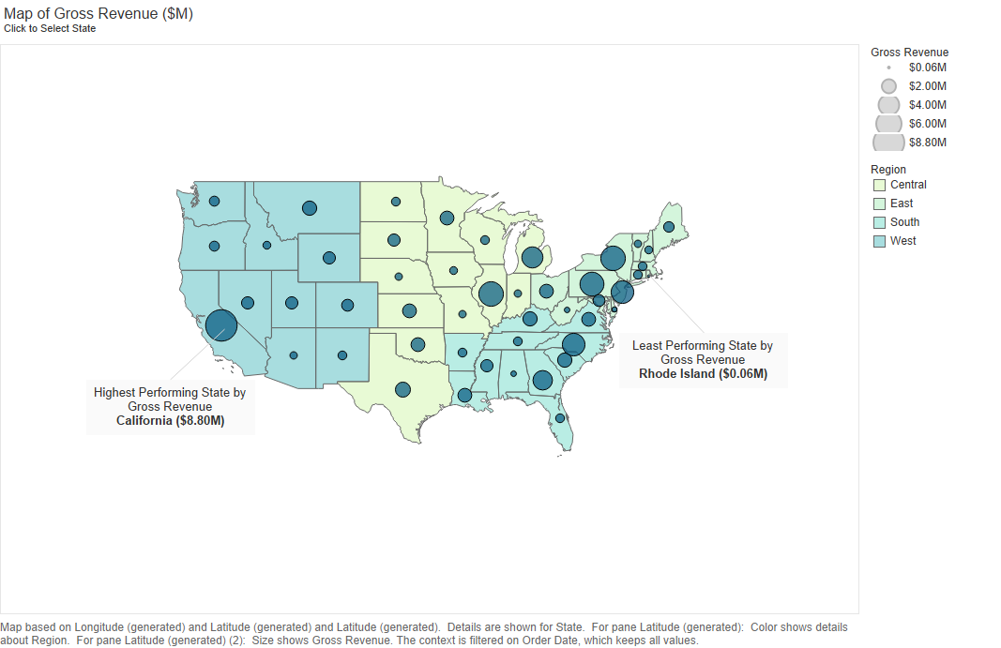

Slide 5
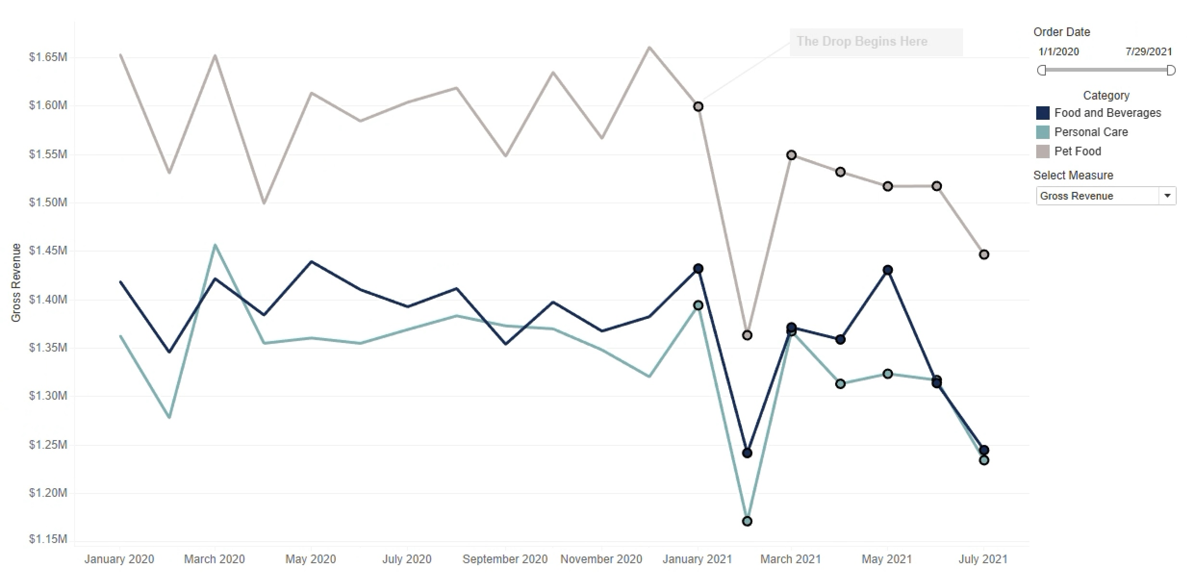
Looking at the change in Gross Revenue overtime there seems to be a dip from Jan 2021

Slide 6
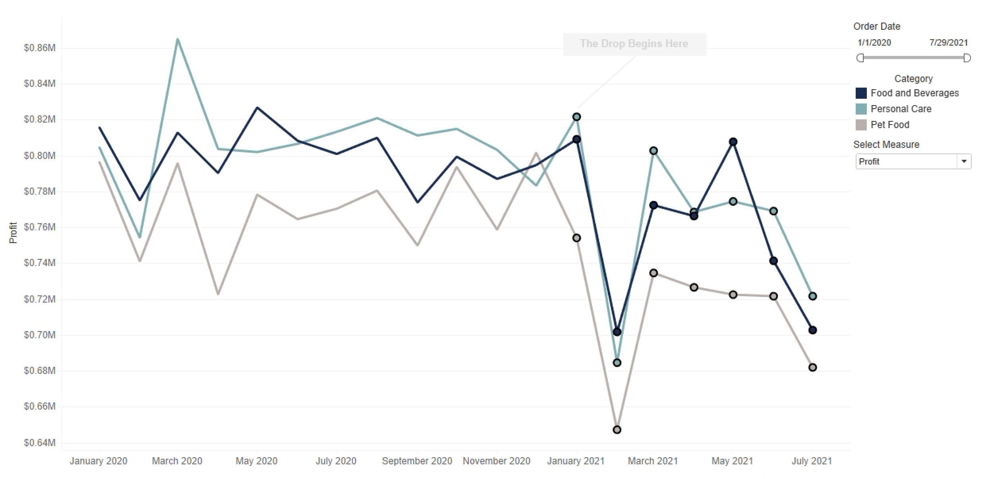
Similarly, Looking at the change in Profit overtime there also seems to be a dip from Jan 2021

Slide 7
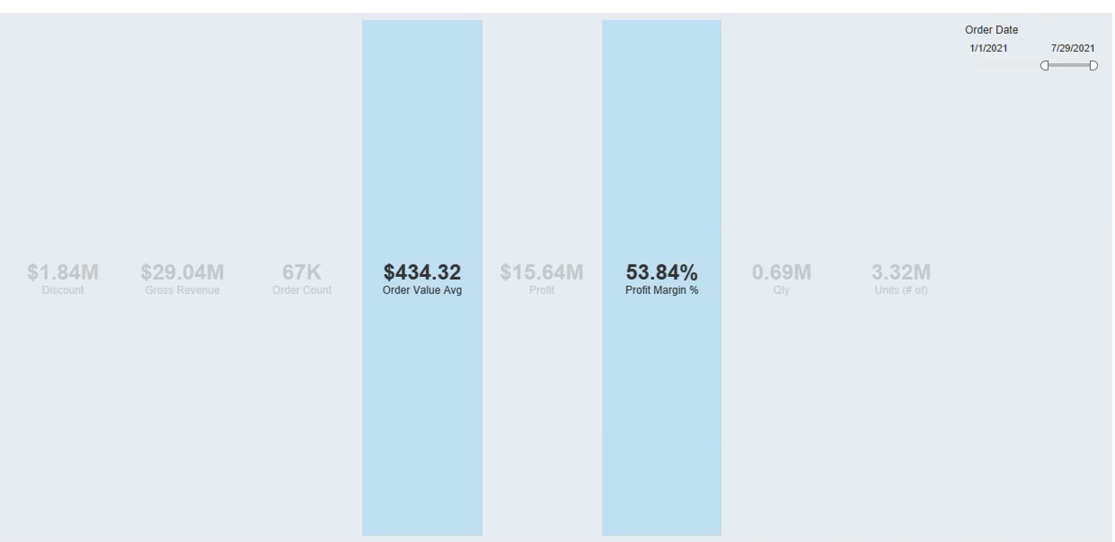
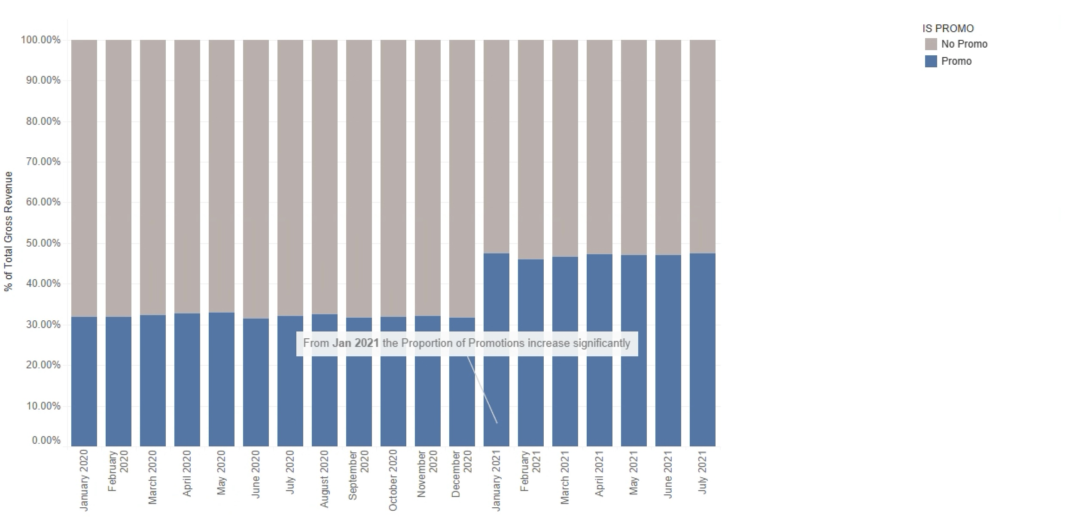
To Investigate further, when the KPI’S are filtered by Order Date. There is a Notable difference of (0.51%) drop in Profit Margin and ($4.5) drop in Order Value Avg from Jan 2021.
We can see that the proportion of orders with promo’s have significantly increased from Jan 2021. Which has influenced the drop in profit margin % and order value avg. from Jan 2021.
Recommendation: I recommend that the product management team prioritize increasing sales for personal care items, as they have the highest profit margin percentage compared to the other two product categories. Additionally, I suggest reducing promotion on products, as it has a significantly inversely proportional effect on profit margin percentage and gross revenue.

Slide 8
Visualizations

Slide 9
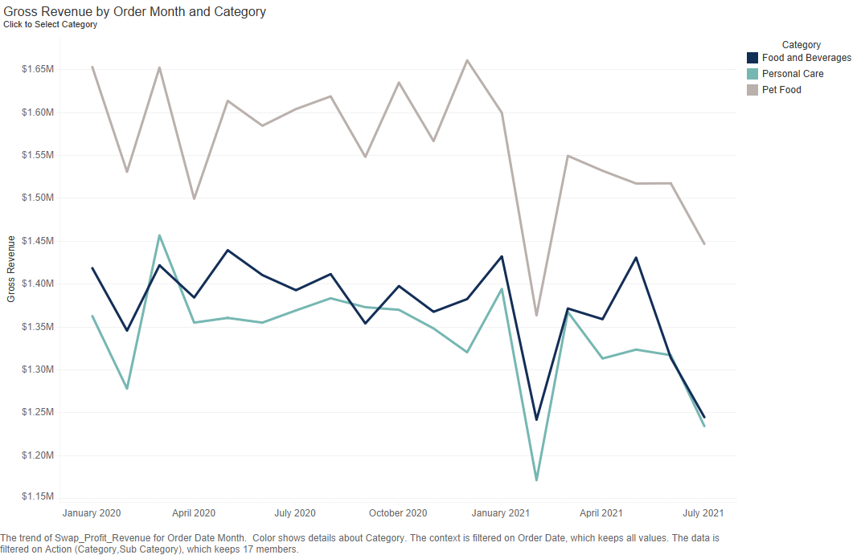

Slide 10
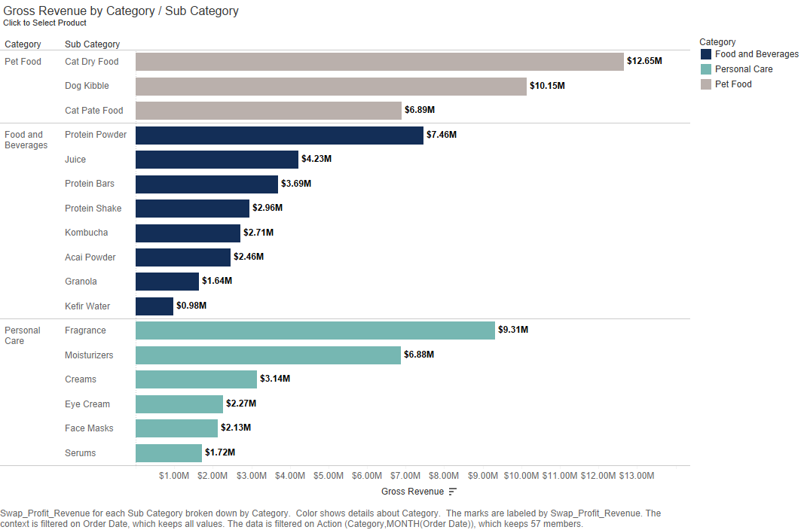

Slide 11
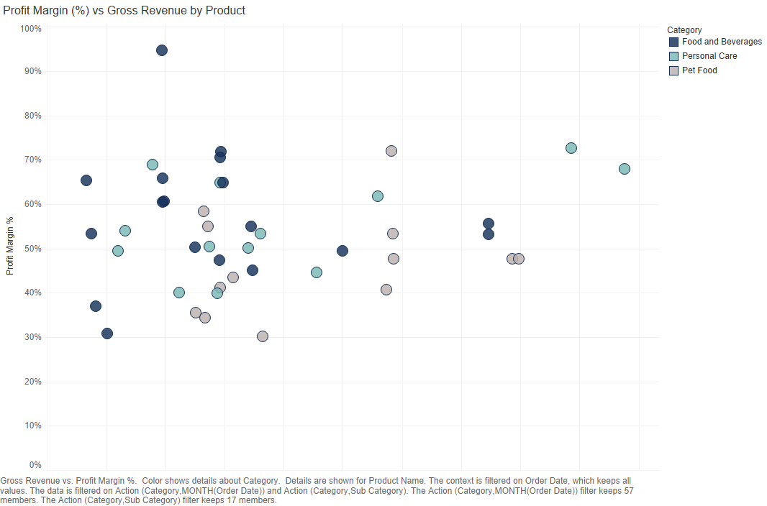

Slide 12
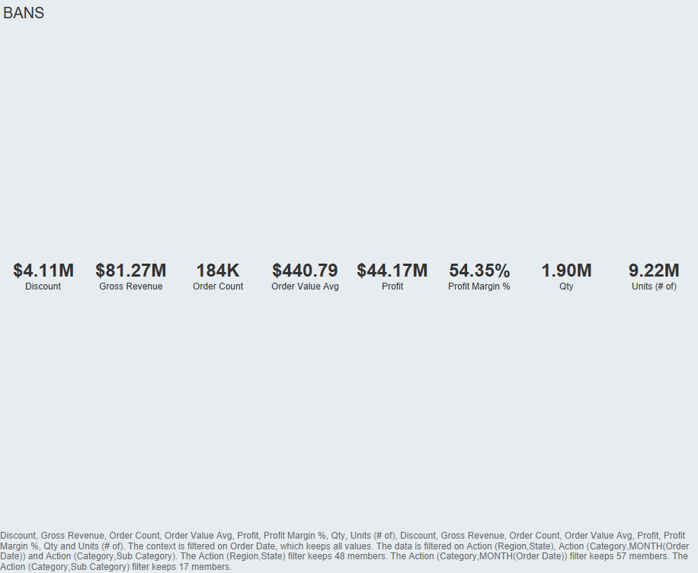

Slide 14
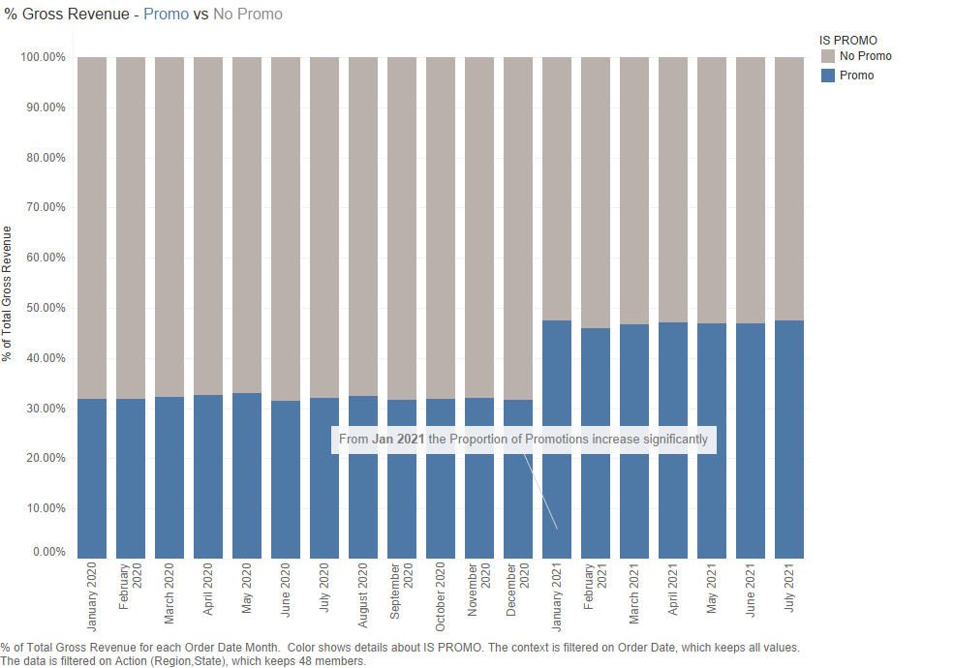

Slide 16
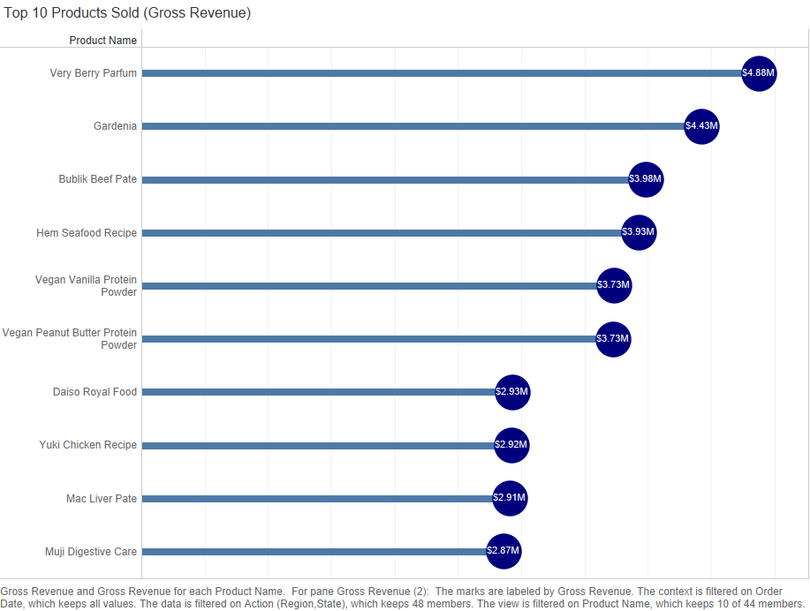

Slide 17
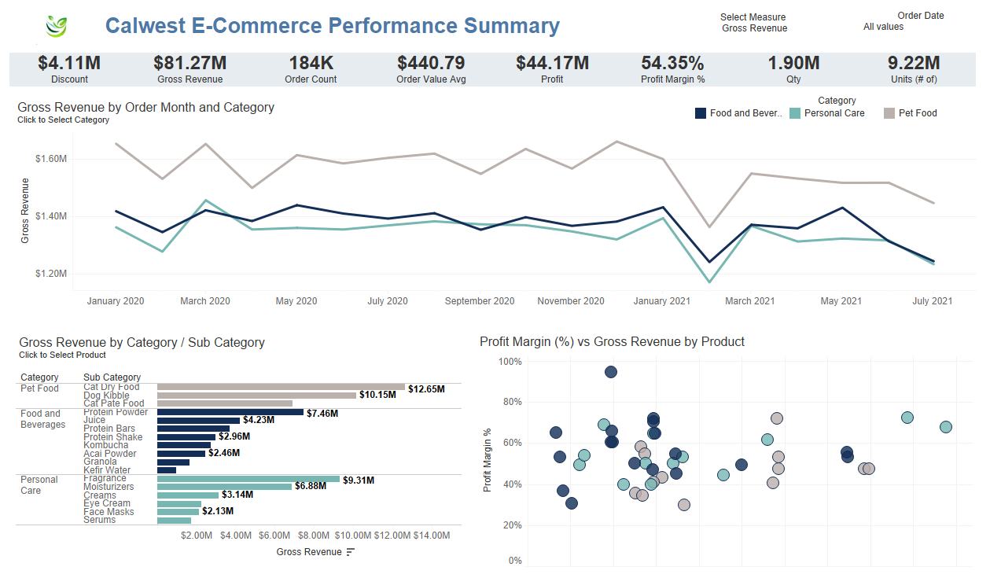

Slide 18
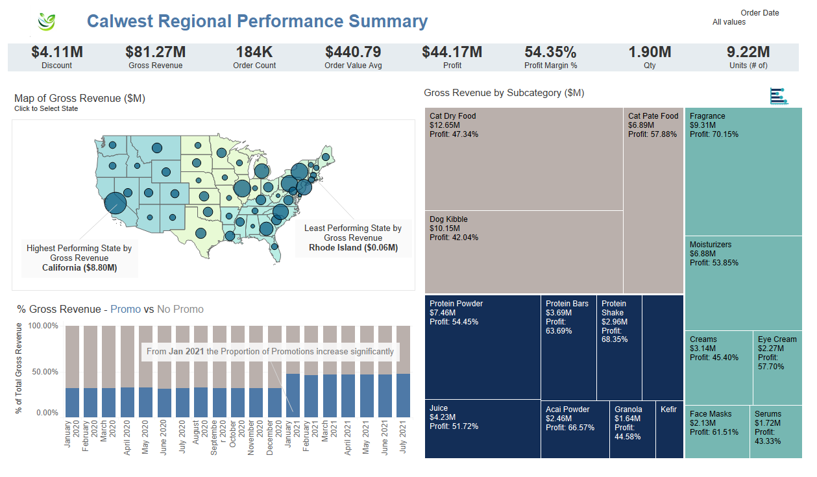

Slide 19
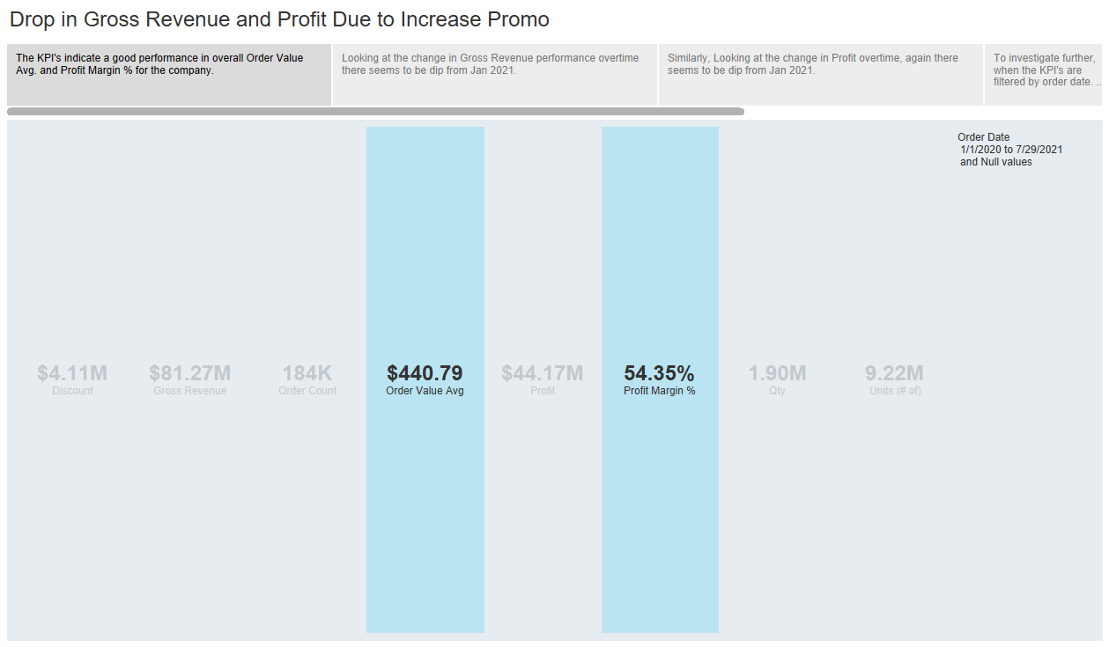

Slide 20
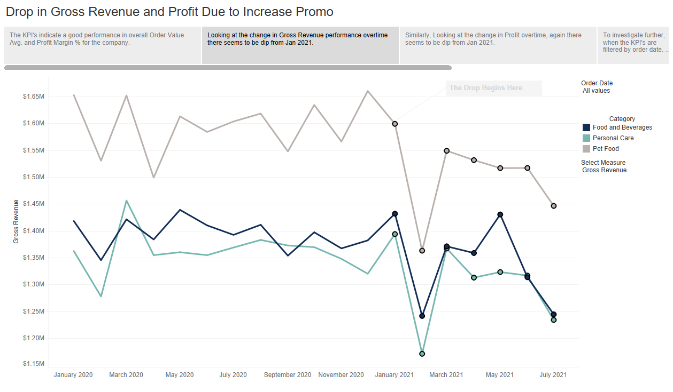

Slide 21
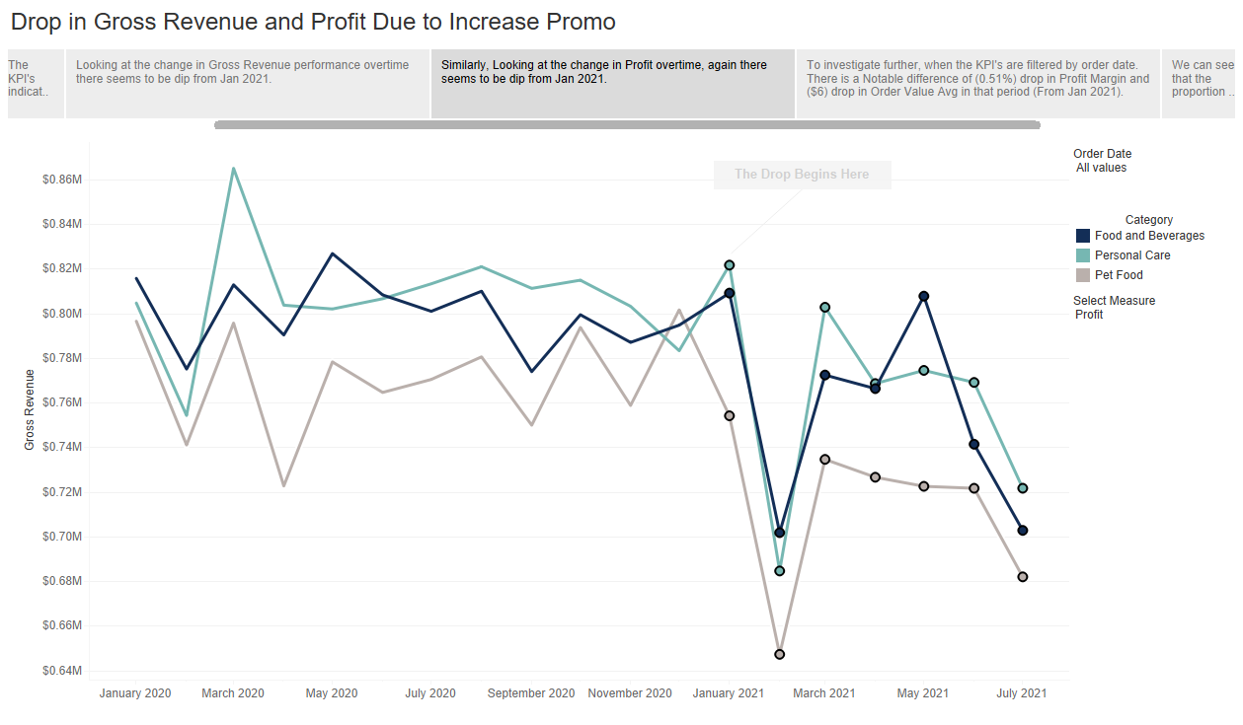

Slide 22
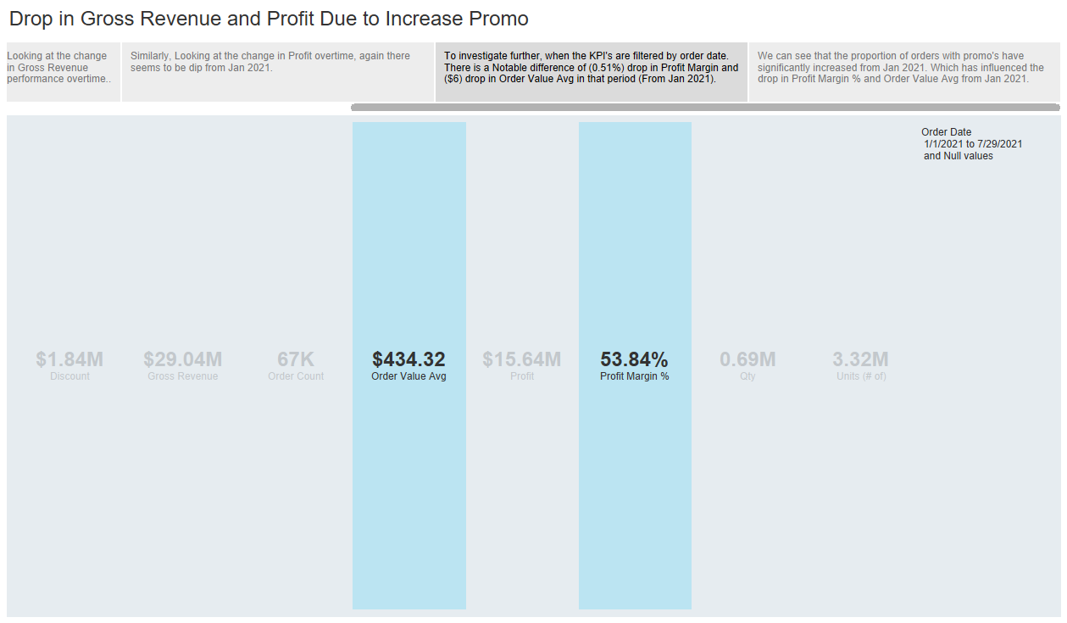

Slide 23
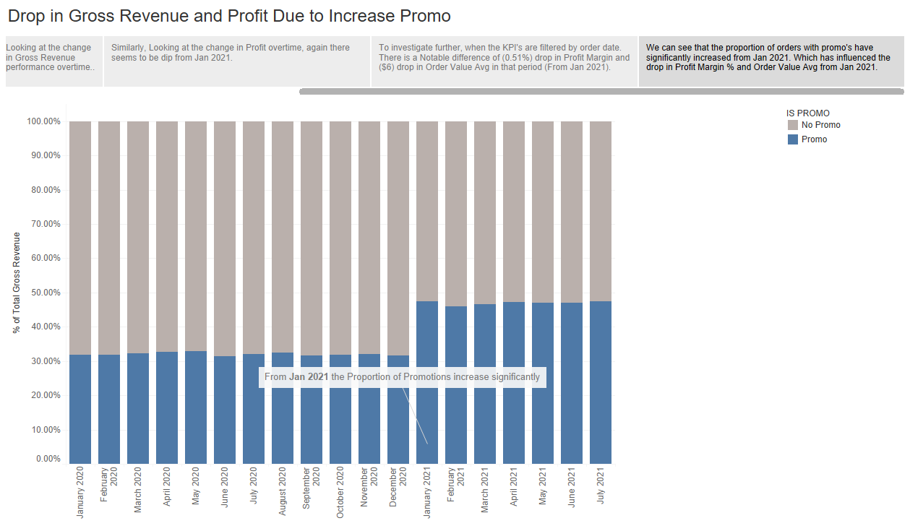

Slide 24
Thank You!

