Slide 1


Department of Information Technology
WIT, Solapur
PROJECT DESIGN PRESENTATION
FutureVerse: A Machine Learning-Based Framework for Sugarcane Growth Prediction and Intelligent Farming Recommendation
GROUP NO: | A18
GUIDE : Ms. V. V. Manglaram

Slide 2
1. PROJECT OVERVIEW
FutureVerse
A Machine Learning-Based Framework for Sugarcane Growth Prediction and Intelligent Farming Recommendations
Problem Statement
Proposed Solution
• Sugarcane growth and yield depend on soil pH, N-P-K, temperature, humidity, rainfall, irrigation and crop age.
• Field conditions vary, making it difficult to combine all factors for reliable prediction.
• Farmers need simple, data-driven guidance rather than isolated technical analysis.
• Use machine learning to predict sugarcane growth (%) and estimated yield (tons/hectare).
• Compare multiple regression models and select the best-performing model using validation metrics.
• Convert predictions into fertilizer, irrigation, crop-management and soil-improvement recommendations.
Team Members
Project Guide
Expected Outcome
• Abhishek Danole — A-21
• Harsh Abad — A-01
• Paras Danole — A-22
• Ms. V.V. Manglaram
• Assistant Professor
• Farmer-friendly web decision-support system
• Prediction + practical recommendations
FutureVerse: ML Framework for Sugarcane Growth & Yield Prediction
1

Slide 3
2. OVERALL SYSTEM ARCHITECTURE
Dataset
Preprocessing
Model Training
Evaluation
Saved Model
• Historical agricultural data
• Soil • Weather • Crop
• Validate inputs
• Handle missing values
• Normalize / select features
• Decision Tree
• Random Forest
• Gradient Boosting
• XGBoost
• MAE
• RMSE
• R²
• Select best model
• Best model + preprocessor
• Ready for prediction
RUNTIME / FARMER WORKFLOW
1. Farmer Input
2. REST API
3. Preprocessing
4. Prediction
5. Recommendations
• Soil pH & NPK
• Weather
• Irrigation
• Crop age
• FastAPI backend
• Validate request
• Return results
• Same trained pipeline
• Transform features
• Selected ML model
• Growth (%)
• Yield (t/ha)
• Fertilizer
• Irrigation
• Crop / soil advice
Farmer Dashboard
• Growth % | Estimated Yield (t/ha) | Farm Status | Recommended Actions
FutureVerse: ML Framework for Sugarcane Growth & Yield Prediction
2

Slide 4
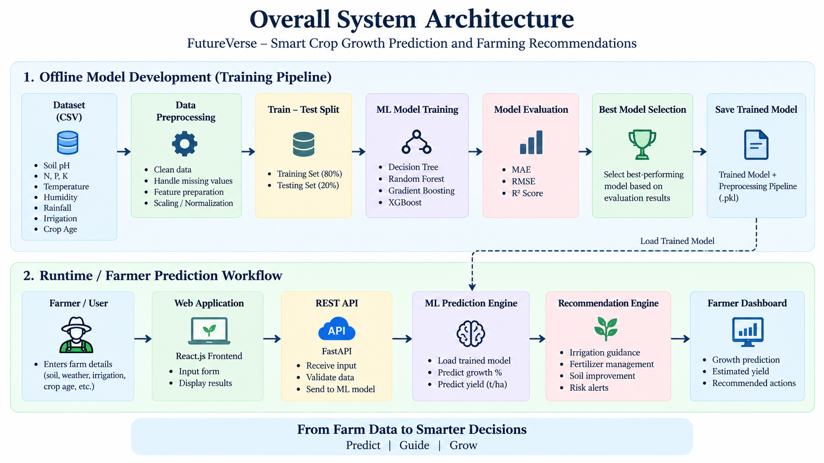
2. OVERALL SYSTEM ARCHITECTURE
2. OVERALL SYSTEM ARCHITECTURE

Slide 5
3. MODULE DESIGN
1
User Input Module
2
Validation & Preprocessing
3
ML Prediction Engine
Collect soil pH, N, P, K, temperature, humidity, rainfall, irrigation and crop age.
Validate values, handle missing data, normalize numerical features and select relevant inputs.
Train/use Decision Tree, Random Forest, Gradient Boosting and XGBoost regression models.
4
Best Model Selection
5
Recommendation Engine
6
Result Generation
Evaluate MAE, RMSE and R²; select the best-performing model on validation data.
Generate fertilizer, irrigation, crop-management and soil-improvement guidance.
Display predicted growth, estimated yield and recommendations through the dashboard.
FutureVerse: ML Framework for Sugarcane Growth & Yield Prediction
3

Slide 6
4. DATA / DATABASE / WORKFLOW DESIGN
DATA-PROCESSING PIPELINE
Dataset Structure
• Input features:
• Soil pH • Nitrogen • Phosphorus • Potassium
• Temperature • Humidity • Rainfall
• Irrigation • Crop age
•
• Target outputs:
• Sugarcane Growth (%)
• Estimated Yield (tons/hectare)
•
• Data handling:
• Validation • Missing values
• Normalization / scaling • Feature selection
1
Load Dataset
Historical agricultural records
2
Clean & Validate
Check ranges and missing values
3
Prepare Features
Normalize / select relevant inputs
4
Split Data
Training and validation/test sets
5
Train Models
Four regression algorithms
6
Evaluate & Select
MAE, RMSE, R²
7
Save Pipeline
Selected model + preprocessing
8
Predict & Recommend
Growth, yield and actions
Core prediction workflow does not require a traditional database for permanent farmer/crop storage; inputs can be processed at runtime.
FutureVerse: ML Framework for Sugarcane Growth & Yield Prediction
4

Slide 7
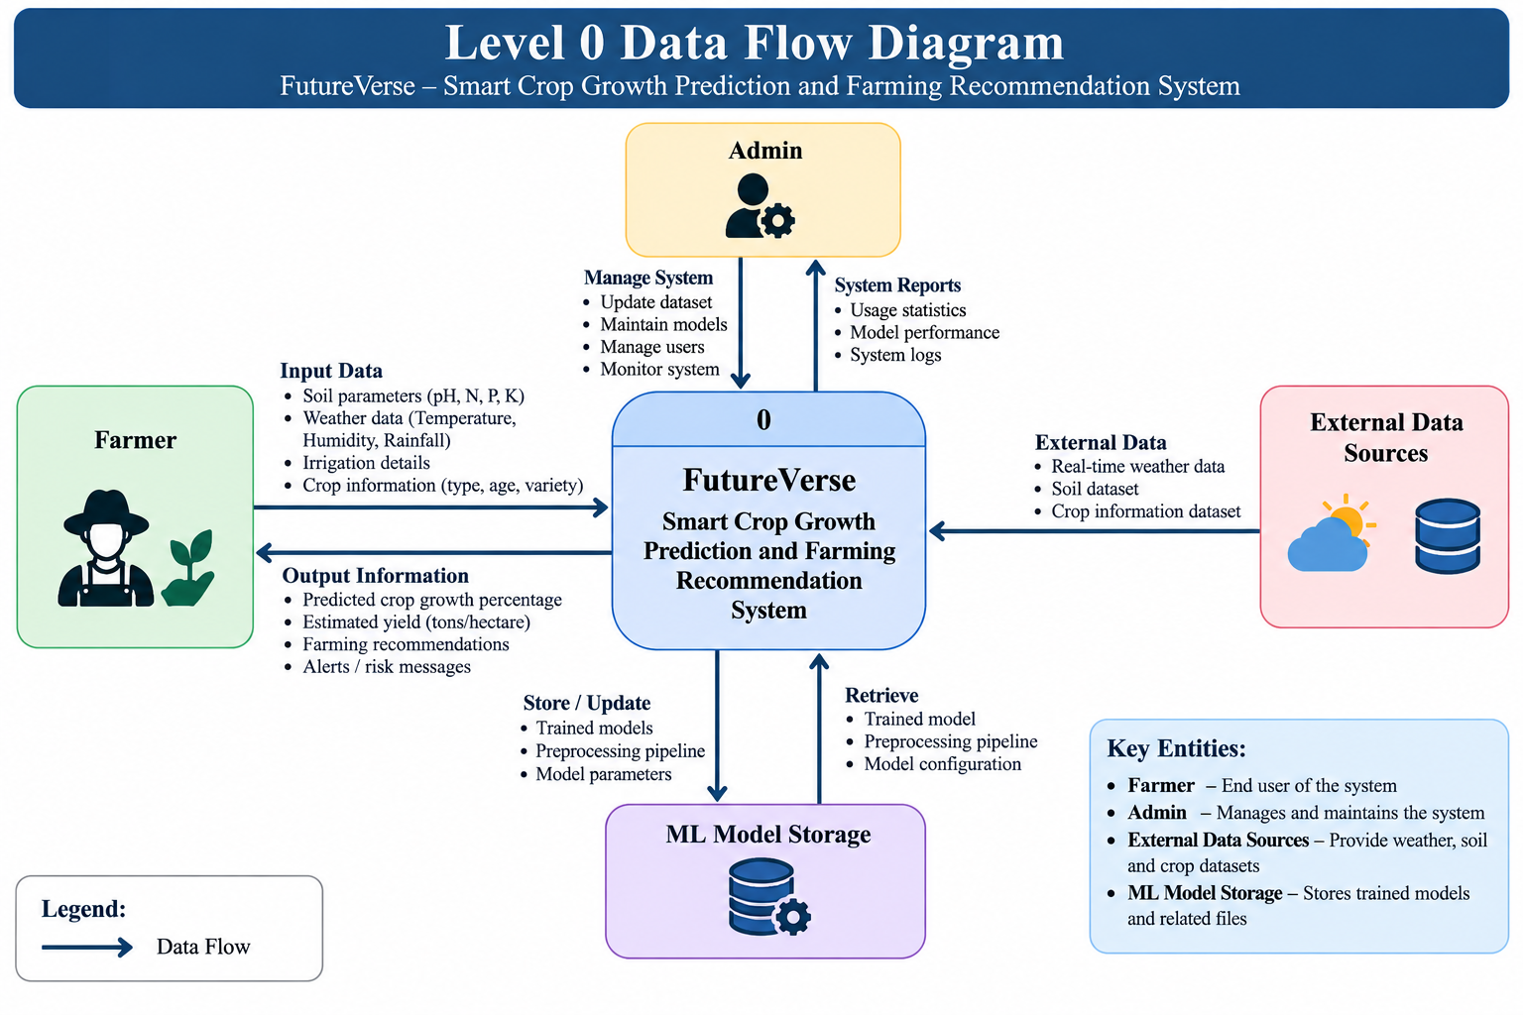
4. DATA / DATABASE / WORKFLOW DESIGN
DATA-PROCESSING PIPELINE
1
Load Dataset
Historical agricultural records
2
Clean & Validate
Check ranges and missing values
3
Prepare Features
Normalize / select relevant inputs
4
Split Data
Training and validation/test sets
5
Train Models
Four regression algorithms
6
Evaluate & Select
MAE, RMSE, R²
7
Save Pipeline
Selected model + preprocessing
8
Predict & Recommend
Growth, yield and actions

Slide 8
5. CORE TECHNICAL DESIGN
Machine Learning Prediction
Intelligent Recommendation Engine
1. Prepare input features from soil, weather, irrigation and crop age.
2. Train four regression models:
• Decision Tree Regressor
• Random Forest Regressor
• Gradient Boosting Regressor
• XGBoost Regressor
3. Evaluate using MAE, RMSE and R².
4. Select the best-performing model empirically.
5. Predict Growth (%) and Estimated Yield (t/ha).
Prediction results + field conditions
• → Fertilizer application guidance
• → Irrigation scheduling guidance
• → Crop management practices
• → Soil improvement strategies
REST API & Runtime Flow
• React frontend sends farmer inputs to the REST API.
• Backend validates and preprocesses the request using the trained pipeline.
• Selected ML model generates prediction.
• Recommendation engine converts results into understandable actions.
• Dashboard displays the final output.
FutureVerse: ML Framework for Sugarcane Growth & Yield Prediction
5

Slide 9
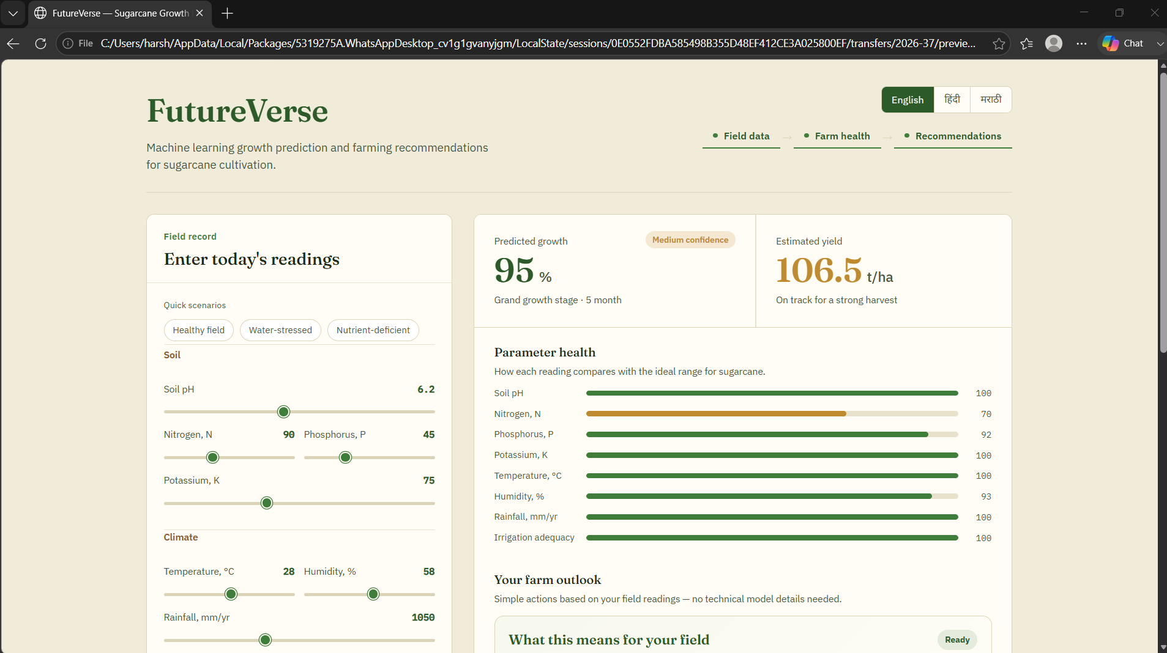
6. UI / PROTOTYPE / WIREFRAMES
FutureVerse: ML Framework for Sugarcane Growth & Yield Prediction
6

Slide 10
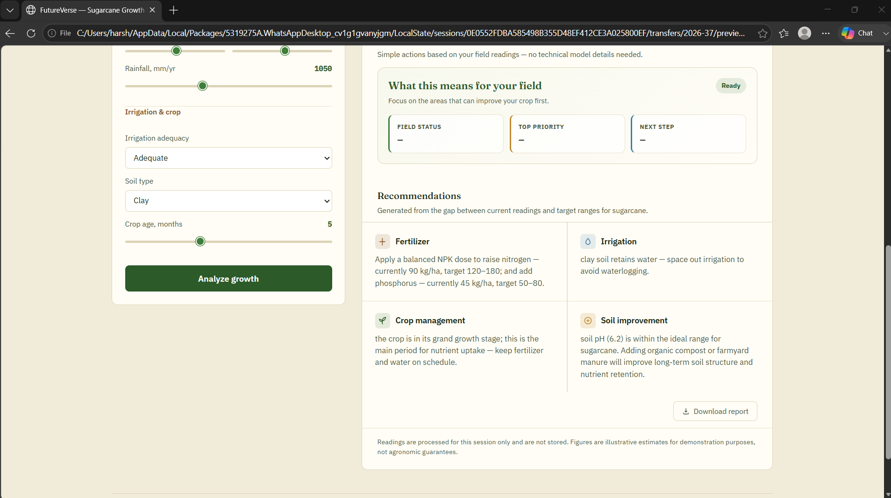

Slide 11
7. TECHNOLOGY STACK & IMPLEMENTATION STATUS
Frontend
Backend & ML
Data / Platform
• React.js
• JavaScript ES6+
• HTML5
• CSS3
• Bootstrap
• Interactive dashboard
• Python 3.11
• FastAPI / RESTful API
• Scikit-learn
• XGBoost
• Pandas & NumPy
• Matplotlib
• Joblib
• CSV / dataset files for training
• Runtime processing of farmer inputs
• No traditional database required for core workflow
• Windows 11 / Ubuntu 22.04
• Client-server architecture
FutureVerse: ML Framework for Sugarcane Growth & Yield Prediction
7

Slide 12
QUESTIONS

Slide 13
THANK YOU !

