Slide 1
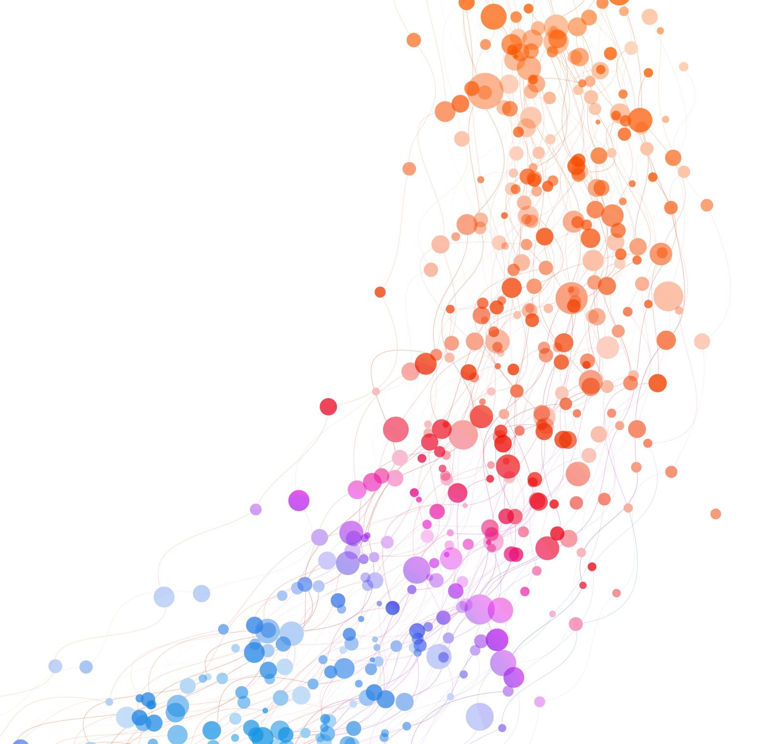
Image Caption Generator using CNN-LSTM
Abhinaya Movva
Harsha Kolla

Slide 2
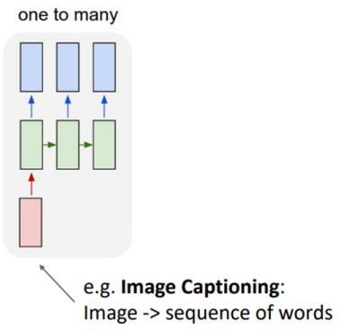
Introduction:
This project is based upon image captioning using CNN-LSTM deep learning model.
The image captioning problem is formulated as a one-to-many prediction model sequence.
Get image embedding using a pre-trained CNN model
Train a LSTM based sequence to sequence model to map the image embedding to text

Slide 3
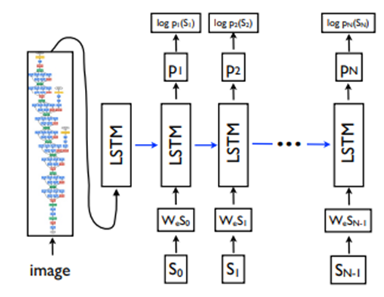
Architecture/Objective function

Slide 4
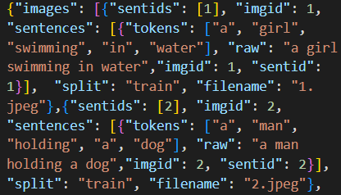
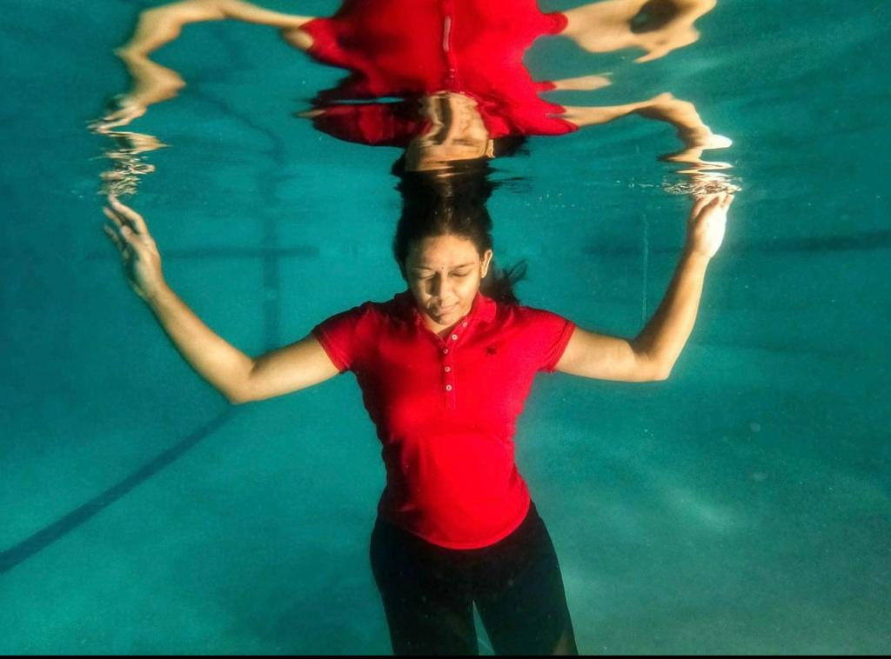
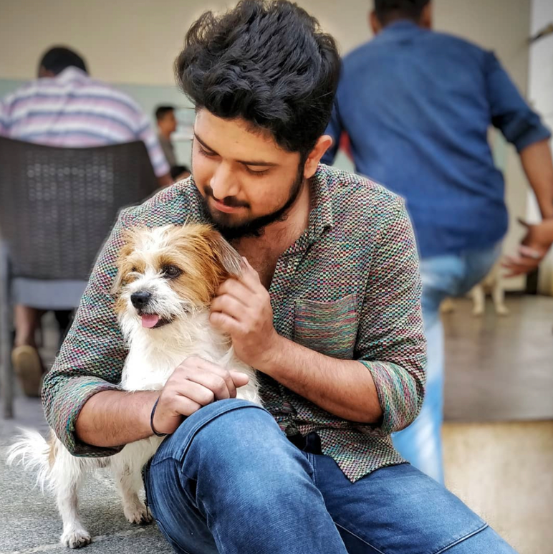
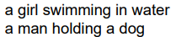
Contributions/Dataset
We have created simple and easy trainable caption following the format subject -> verb-> object
We have kept the subject to man, woman, boy, girl
Object is limited to basic day to day activity
Created custom json file for the loader to map our dataset.
Hyperparameter tuning
Mini Network

Slide 5
Results
Pretrained Model:
Lr= 0.4, Bleu score = 1.1e-231
Lr= 0.02, Bleu score = 1.25e-231
Mini network:
Lr= 0.1, Bleu score = 1.07e-231
Lr= 0.00256, Bleu score = 1.47e-231

