Slide 1

Exploratory Data Analysis
NLP: Resume Extractor
31/01/2024

Slide 2
Agenda
Executive Summary
Problem Statement
EDA
Hypothesis Tests

Slide 3
Executive
Summary
HR often finds the manual evaluation of resumes in bulk, filled with excessive information, to be a tedious and hectic process. Automating this task by employing various file formats (CV), along with Natural Language Processing techniques such as word parsing, chunking, regex parsing, and/or Named Entity Recognition, can efficiently extract details like name, email address, physical address, educational qualifications, and work experience within seconds from numerous documents.

Slide 4
Problem Statement
The challenge arises when HR or hiring managers review resumes, as they often encounter an overwhelming amount of irrelevant information that requires careful examination. This tedious process makes it challenging and time-intensive for them to pinpoint the most qualified candidates. To tackle this issue, a proposed solution involves leveraging Named Entity Recognition (NER) within Natural Language Processing (NLP). This advanced technology can autonomously recognize and categorise key details in resumes, such as the candidate's name, educational history, work experience, and skills. Implementing NER streamlines the candidate shortlisting process, significantly enhancing efficiency for HR professionals and reducing their time and effort investment.

Slide 5
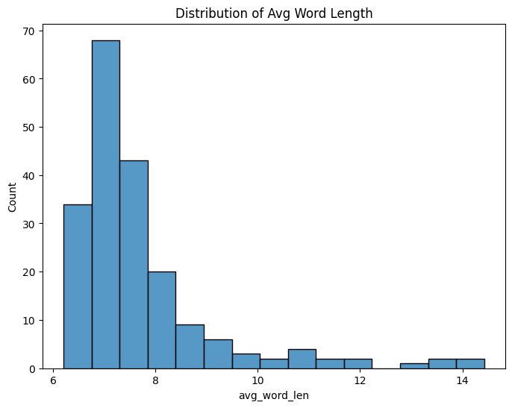
Exploratory Data Analysis
The plot unmistakably indicates that the average word length is 7 words.

Slide 6
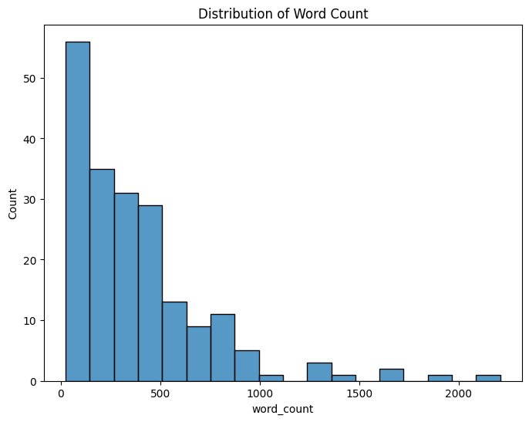
Exploratory Data Analysis
Based on the graph provided, it can be inferred that the majority of resumes have fewer than 500 words.

Slide 7
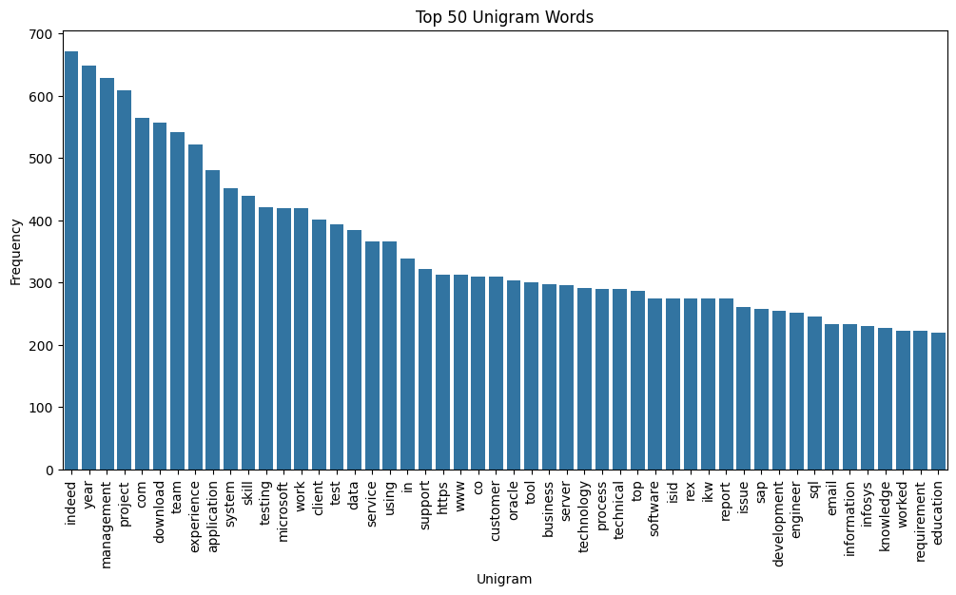
Exploratory Data Analysis
The most common words are 'Indeed,' 'Year,' and 'Management,' ranking as the top three in frequency.

Slide 8
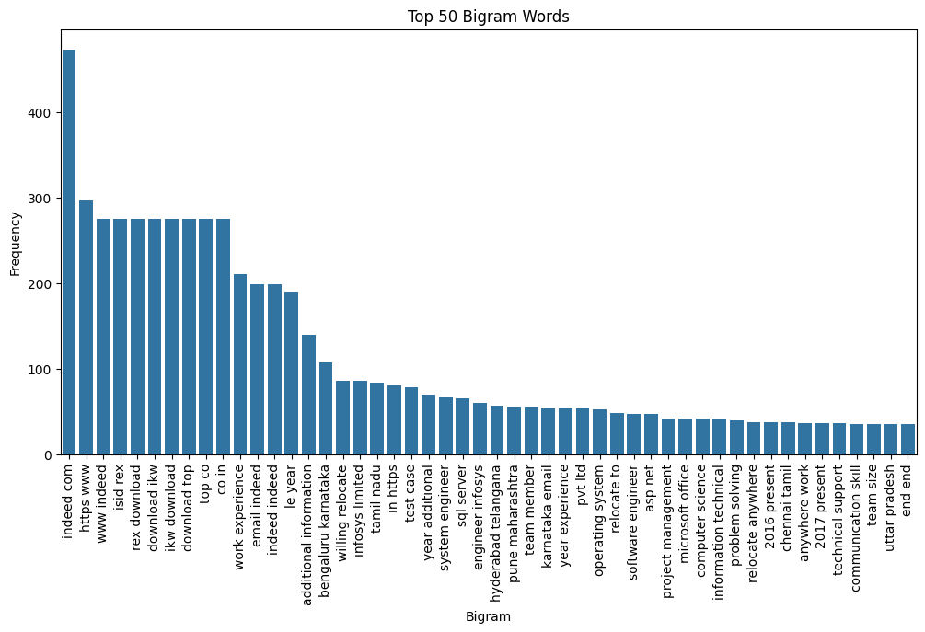
Exploratory Data Analysis
The most frequently occurring word pairs are 'Work experience,' 'Email indeed,' and 'Additional information,' which could be valuable.

Slide 9
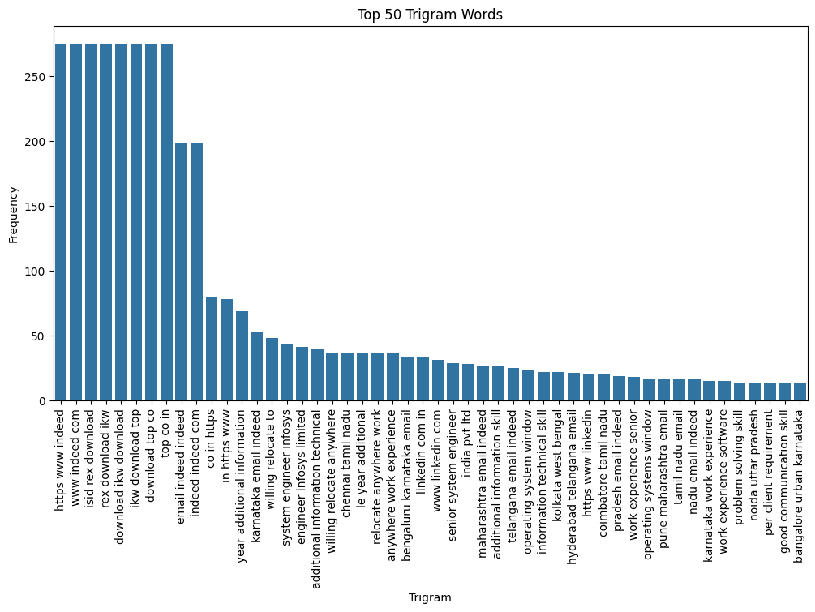
Exploratory Data Analysis
The top three frequently occurring words together are 'Year additional information,' 'Karnataka email indeed,' and 'Willing relocate to,' which could be beneficial.

Slide 10
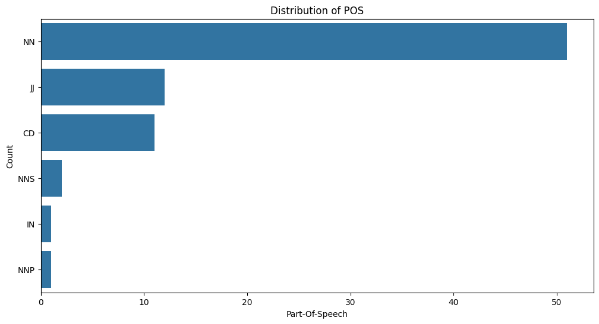
Exploratory Data Analysis
The most commonly used is 'Singular noun,' followed by 'Adjective or numeral,' 'Numeral (cardinal),' 'Proper plural noun,' 'Singular proper noun,' and 'Preposition or conjunction, subordinating' in that order.

Slide 11
➢ I plotted the word count distribution and found that my resume, along with most others, contained at most 500 words.
➢ Next, I wanted to analyze the frequency of each word occurring in the dataset. I created the distribution of Unigram words, Bigram words, and even Trigram words to examine the most frequent words individually, in pairs, and three words at a time, respectively.
➢ I conducted the distribution of Part of Speech to discover that the majority of words in my resume were singular nouns.

Slide 12
The model we selected is the SpaCy NER Model
Through our analysis and search, we concluded that Linear models are not an option.
Due to time constrains, we were not able to delve deep into Deep Learning approaches that could have made of a great alternative for our case.
Additionally, other ensemble models such as Bagging and Bootstrapping were not serving our purpose.
Model Recommendation and Selection:

Slide 13
We used Python’s SpaCy module for training the NER model.
SpaCy’s models are statistical and every “decision” they make is a prediction. This prediction is based on the examples the model has seen during training.
The model is then shown the unlabelled text and will make a prediction.
Because we know the correct answer, we can give the model feedback on its prediction in the form of an error gradient of the loss function that calculates the difference between the training example and the expected output. The greater the difference, the more significant the gradient and the updates to our model.
At each iteration, the training data is shuffled to ensure the model doesn’t make any generalisations based on the order of examples.
The model is tested on and the predicted summarized resumes are stored as separate .txt files for each resume.
Summarization of Resumes with NER Training Model with SpaCy:

Slide 14
Thank You

