Slide 1

The Library Resource Management Application
Name: G. Harsha Charan Reddy
Roll No: 2520030200
Branch: CSE
Cluster: 1
Section: 3
Under the Supervision of:
________________________

Slide 2
Abstract
The Library Resource Management Application is a modern, web-based system designed to efficiently manage library resources through an interactive and user-friendly interface. Built using HTML5, CSS3, and JavaScript, the application enables users to search, filter, borrow, return, and manage books seamlessly. It incorporates semantic HTML structure, responsive design using Flexbox and Grid, and dynamic UI components such as animated statistics, progress indicators, and toast notifications. The system organizes books by genre, status, and availability, ensuring structured catalog management while maintaining a visually appealing and accessible layout.

Slide 3
The application implements core programming concepts such as objects, arrays, arrow functions, DOM manipulation, event handling, and browser local storage for data persistence. It includes robust client-side form validation, exception handling, and real-time updates to maintain data accuracy and usability. Additional features such as borrow records tracking, active loan monitoring, filtering mechanisms, and dynamic rendering of book cards enhance operational efficiency. Overall, the system demonstrates the practical integration of front-end development technologies to create a functional, scalable, and interactive digital library management solution

Slide 4
Existing System
Libraries mostly use manual or semi-digital systems.
Book records maintained in registers or spreadsheets.
Searching books takes more time.
Borrow and return tracking is not automated.
High chance of human errors.
Difficult to generate reports and statistics.

Slide 5
Proposed System
A web-based application to manage library resources.
Allows users to search books by title, author, or genre.
Provides catalog view of all available books.
Enables book borrowing and return tracking.
Maintains borrow records and member details.
Provides real-time statistics and updates.

Slide 6
Project Details
Search books by title, author, or category
• Borrow and return books
• Admin can add or remove books
• Maintain records of borrowed books
• Display book availability status

Slide 7
Software Requirements
Front End Technologies:
HTML, CSS, JavaScript
Back End Technologies:
Java, MySQL / Oracle, Tomcat Server

Slide 8
Hardware Requirements
Processor: Intel i3 or higher
RAM: Minimum 4GB
Storage: 500GB
System: Laptop/Desktop
Internet Connection

Slide 9
Project Requirements and Design
Architecture Types:
2‑Tier Architecture (Front End + Back End)
3‑Tier Architecture (Front End + Application Server + Database)
Front End: HTML, CSS, JavaScript
Back End: Server with Java
Database: MySQL / Oracle

Slide 10
Project Modules
Home Dashboard
Displays statistics and recently added books
Book Catalog
Shows all books in the library
Borrow Module
Allows members to borrow books
Borrow Records
Stores all borrow transactions
Add Book Module
Allows librarian to add new books

Slide 11
Objectives
To develop a user-friendly library management system.
To simplify book searching and borrowing.
To maintain accurate records of books and members.
To reduce manual work and errors.
To improve resource management efficiency.

Slide 12
CO’s Attainments – FWD
CO1
Understand HTML structure and semantic tags.
CO2
Apply CSS layouts, Flexbox, Grid, and animations.
CO3
Implement JavaScript objects, arrays, and functions.
CO4
Perform DOM manipulation and event handling.
CO5
Implement form validation and browser storage.

Slide 13
CO’s Attainments – DSA
CO1 — Catalog & Search + Sorting Visualizer
CO2 — Linked List ADT
CO3 — Stack, Queue, Heap
CO4 — Hash Table & Collections

Slide 14
System Architecture
User Interface Layer
HTML structure
CSS styling
Responsive design
Application Logic Layer
JavaScript functions
DOM manipulation
Form validation
Data Layer
LocalStorage for storing books and records
Arrays and objects for data handling

Slide 15
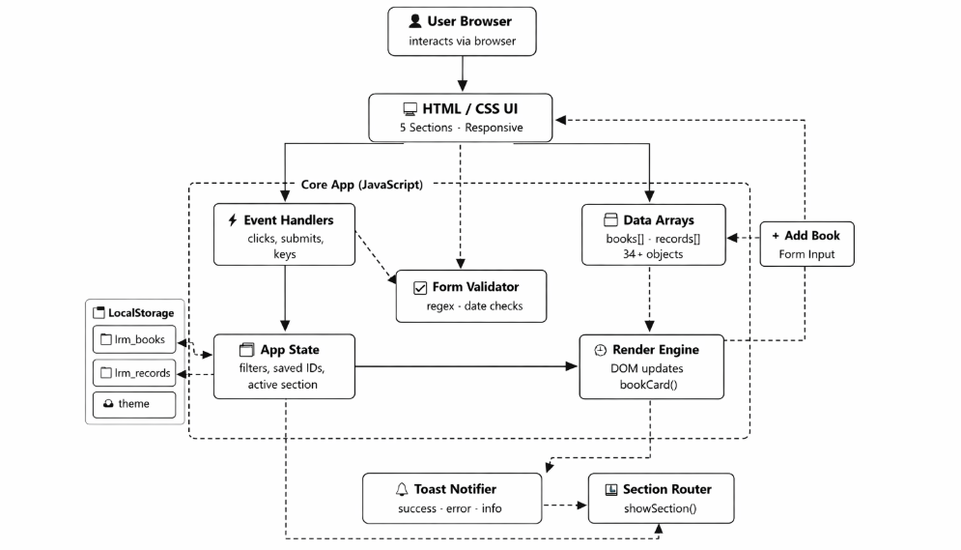
System Architecture

Slide 16
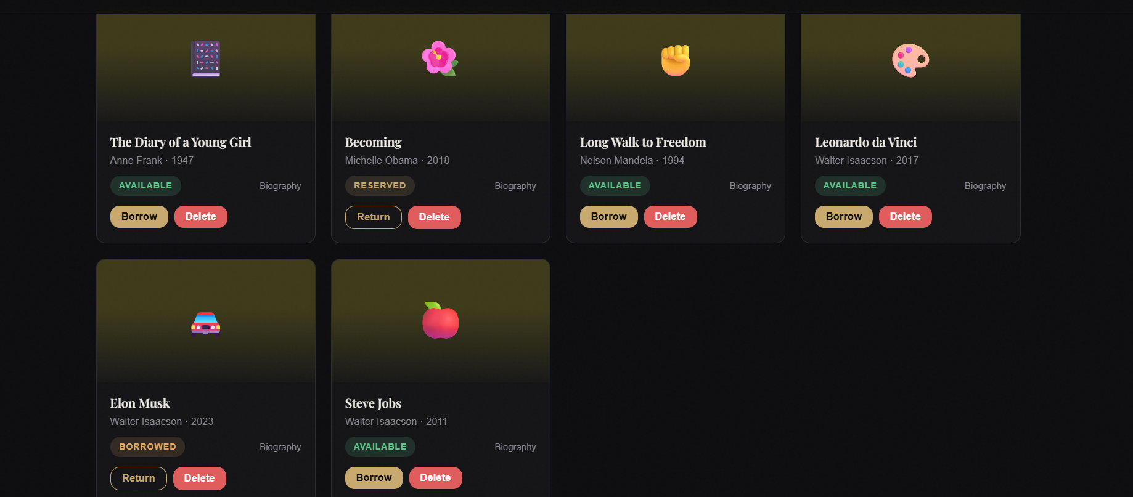
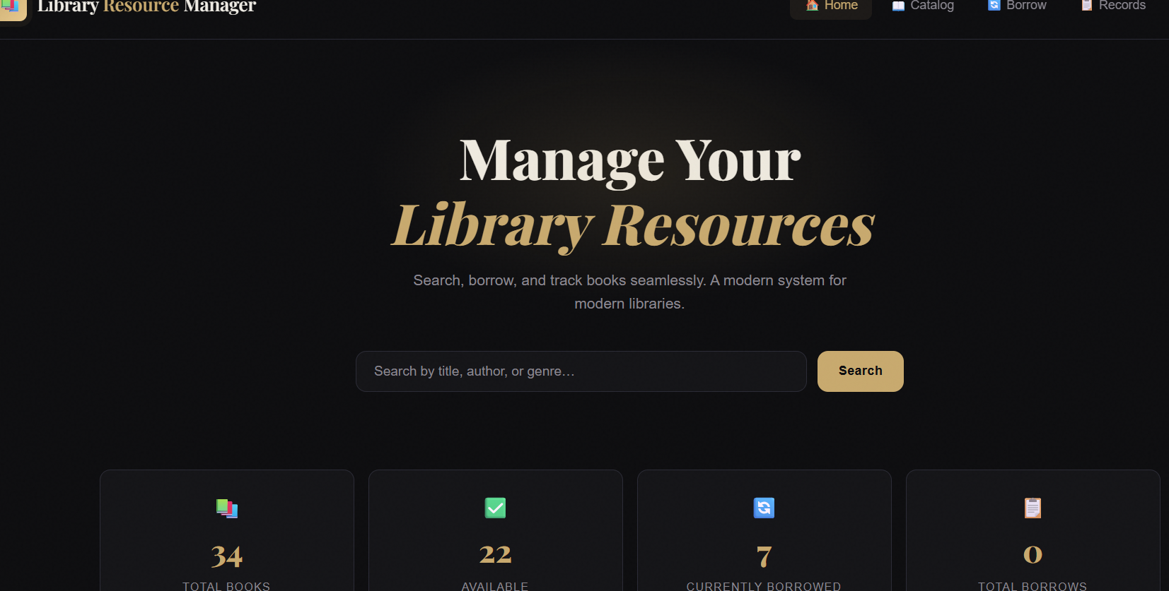
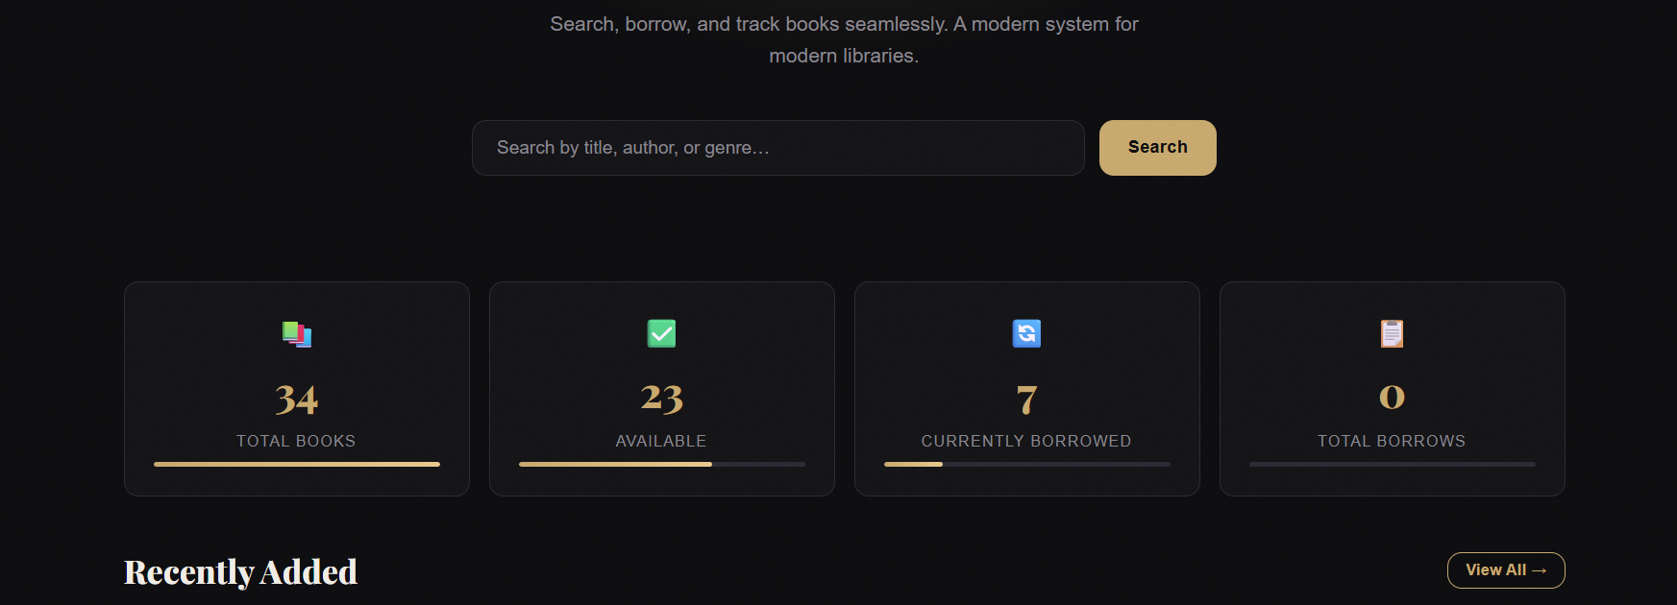
Screenshots for FWD

Slide 17
Future Enhancements
Integrate a database system (MySQL / MongoDB) for better data storage instead of LocalStorage.
Implement user authentication and login system for librarians and members.
Add barcode or QR code scanning for faster book borrowing and returning.
Develop admin dashboard for advanced book and member management.
Implement fine calculation system for late book returns.
Add email or SMS notifications for due date reminders.
Enable online book reservation system.
Convert the application into a mobile-friendly or mobile app version.
Integrate analytics and reports for library usage statistics.

Slide 18
Conclusion
The Library Resource Management System simplifies library operations by digitizing book search, borrowing, and record management, improving efficiency and user experience.

Slide 19
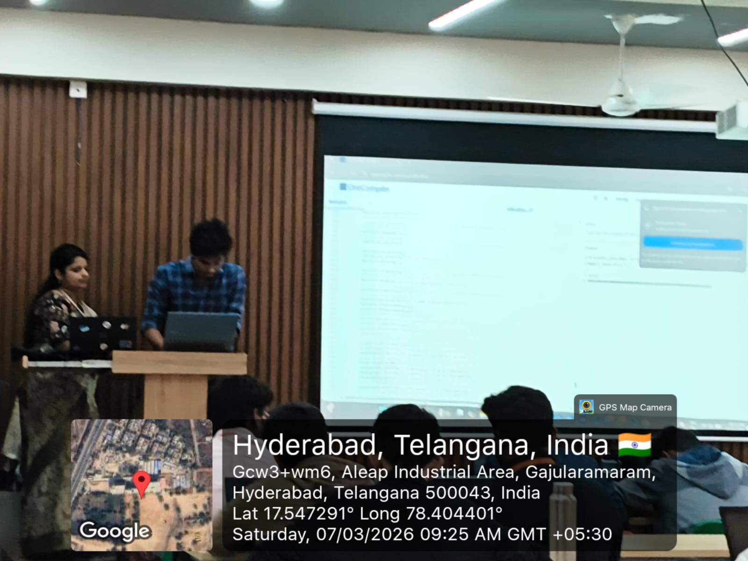
GEO TAG Photo

