Slide 1
Competitor Sales Analysis in Power BI
Prepared by:
CH.HARSHA

Slide 2
Project Objective
Analyze Sintec's sales performance across regions.
Compare sales against competitors to identify trends and growth areas.
Generate actionable insights for strategic decision-making.

Slide 3
Data Cleaning and Transformation
1. Imported and consolidated sales datasets.
2. Removed irrelevant columns and null values.
3. Ensured correct data formats (e.g., currency, dates).
4. Merged regional data for unified analysis.

Slide 4
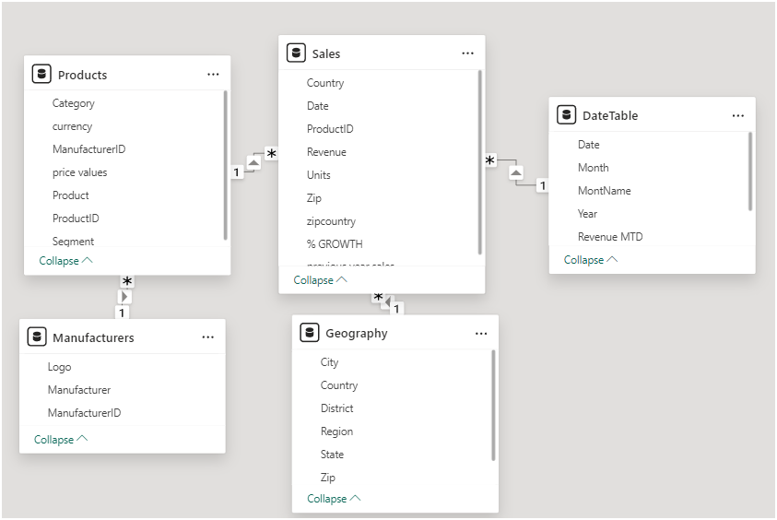
Data Model Overview
Show the relationships between tables (e.g., Sales, Regions, Products, Dates).
Highlight key metrics: Revenue, Market Share, Growth Rate.

Slide 5
Sales Analysis Visualizations
1. Sales by Manufacturer: Compare Sintec’s revenue with competitors.
2. Revenue Over Time: Identify trends in sales growth.
3. Product Performance: Analyze category-wise sales contributions.
4. Market Share Analysis: Visualize regional and global market share.

Slide 6
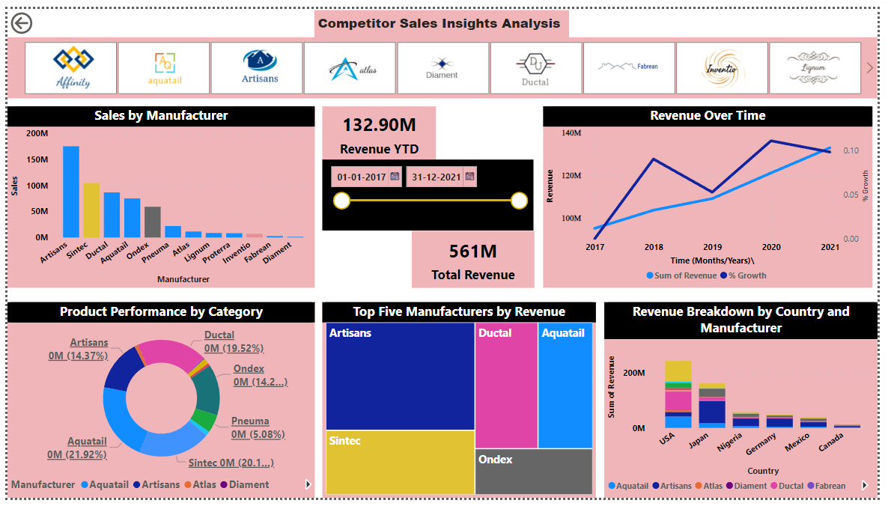

Slide 7
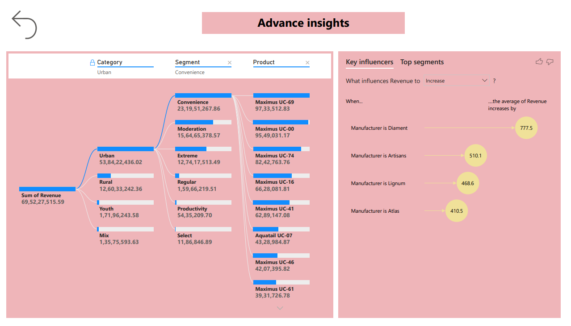

Slide 8
Growth Analysis
Sintec’s global market share: 20.17%.
Top competitor in Germany: Artisans (50%+ market share).
Highest growth year: 2021(10%).

Slide 9
AI-Based Visualizations
1. Key Influencers: Factors driving sales growth.
2. Decomposition Tree: Insights into sales by regions and products.

Slide 10
User-Friendly Features
1. Slicers: Filter by region, manufacturer, or product.
2. Drillthrough: Detailed views for specific regions/products.
3. Bookmarks: Highlighting key insights.

Slide 11
Key Insights
Sintec is leading in the USA but needs to improve in Germany.
Growth in 2021 indicates strong recovery post-pandemic.
Focus on underperforming regions to expand global market share.
Recommendations:
1. Invest in marketing in Germany.
2. Expand product portfolio in high-growth regions.
3. Monitor competitor strategies closely.

