Slide 1
MediChat: AI-Driven Medical Information Assistant
Revolutionizing Healthcare with AI-Powered Data Retrieval and Responses
Presented by
CH HARSHA

Slide 2
Introduction to MediChat
What is MediChat?
Overview: MediChat is an AI chatbot that helps healthcare professionals retrieve patient information from medical documents using advanced NLP techniques and machine learning.
Key Features:
AI-driven patient data retrieval
Integration of Google Gemini for real-time responses
Fast data search with FAISS vector database
Technologies Used:
Google Gemini, LangChain, HuggingFace, FAISS, Flask

Slide 3
The Workflow of MediChat
Step 1: Load PDF documents from the 'pdf/' folder.
Step 2: Preprocess the documents using NLP techniques.
Step 3: Split the documents into manageable chunks.
Step 4: Generate embeddings from the chunks using HuggingFace.
Step 5: Store the embeddings in the FAISS vector database.
Step 6: Perform similarity search for relevant information based on the query.

Slide 4
Text Preprocessing in NLP
Why Preprocess?
Raw text from documents can contain irrelevant information, word variations, and noise that can confuse the AI.
NLP preprocessing cleans the text by breaking it into simpler, more meaningful components.
Key Techniques:
Tokenization: Breaking text into words.
Stop word Removal: Eliminating common, unimportant words.
Lemmatization: Converting words to their base form.

Slide 5
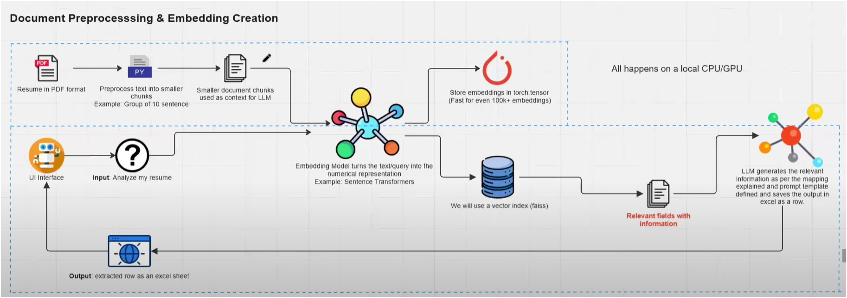




Slide 6
Key Steps in the Code
Document Loading: data = loader.load()
Text Splitting: chunks = splitter.split_documents(data)
Embedding Generation: embeddings = HuggingFaceEmbeddings(model_name="sentence-transformers/all-MiniLM-L6-v2")
FAISS Vector Database: vectordatabase = FAISS.from_documents(chunks, embeddings)
Similarity Search: vectordatabase.similarity_search(query, top_k=2)

Slide 7
6.Google Generative AI Integration:
Step 1: Configure API key for Google Generative AI
Step 2: Use LangChain to wrap Google Generative AI for context-based responses
Step 3: Query the model with patient-related data and receive the response
Example Use Case
Query: "Tell me about the details of the patient with ID 1001."
Response: "Patient Rajesh Kumar (ID 1001), admitted on January 5, 2024, is currently experiencing shortness of breath and chest discomfort, likely due to an asthma exacerbation."

Slide 8
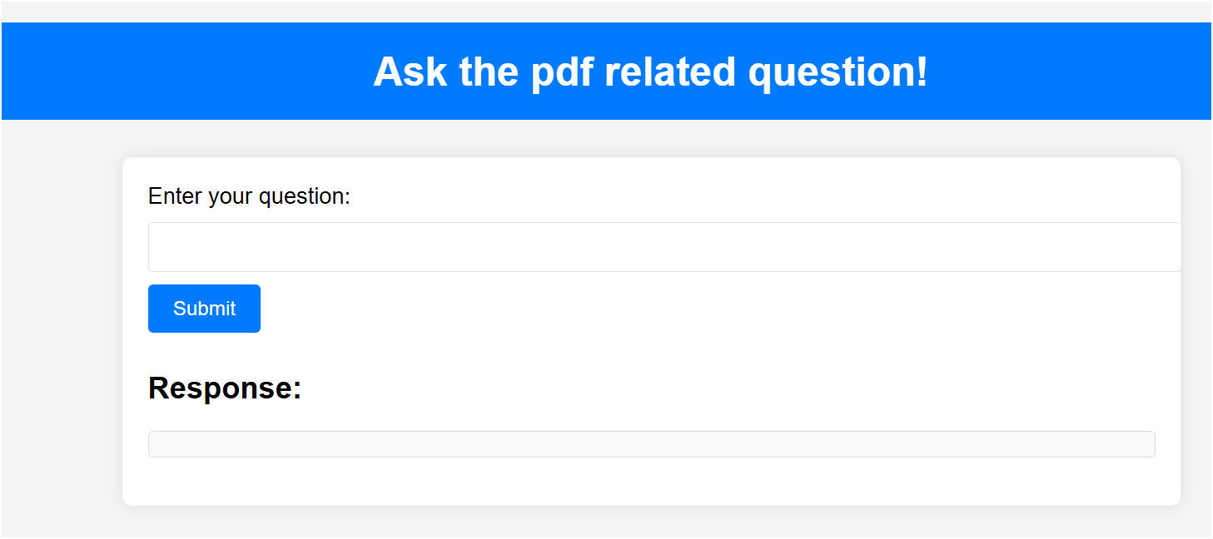
Conclusion
MediChat integrates AI, document retrieval, and real-time data to help healthcare professionals with quick, accurate patient data retrieval.
Technologies like Google Gemini, FAISS, and LangChain enable context-aware, intelligent responses.
The solution is built with Flask for a user-friendly web interface.

