Slide 1
DESIGN PROJECT – I · SEMESTER III · B.TECH, CYBER SECURITY
CryptoGuard
A Measured Password and File-Security Workbench
Malepati Sree Harsha · Register No. 23CU0340018
DISC · Hindustan Institute of Technology and Science, Chennai · 2024–25
Notes:
Introduce yourself and the one-line problem.

Slide 2
THE PROBLEM
Strength meters hide the attacker's speed
▸ A meter says “centuries” — but at how many guesses per second?
▸ That speed depends mostly on the server's storage scheme, not the user
▸ Online checkers ask you to send secrets to a third party
▸ Goal: a local workbench that makes these trade-offs measurable
CryptoGuard · Design Project – I
2 / 13
Notes:
Open with the question: centuries at what speed? The answer depends on MD5 vs PBKDF2.

Slide 3
OBJECTIVES
What CryptoGuard does
▸ Explainable password analysis with stated assumptions
▸ CSPRNG passwords and passphrases
▸ AES-256-GCM file encryption, PBKDF2 key derivation
▸ Integrity digests and hash identification
▸ Bounded John the Ripper demo on bundled hashes
▸ Measured KDF benchmark (novel component)
CryptoGuard · Design Project – I
3 / 13

Slide 4
LITERATURE & GAP
What exists, and what is missing
▸ Entropy scores mispredict real attacks (Weir 2010; Kelley 2012)
▸ zxcvbn models patterns, but still assumes one attacker speed
▸ NIST/OWASP give KDF parameters — as text only
▸ Gap: no learner tool measures storage cost in password-character units
CryptoGuard · Design Project – I
4 / 13

Slide 5
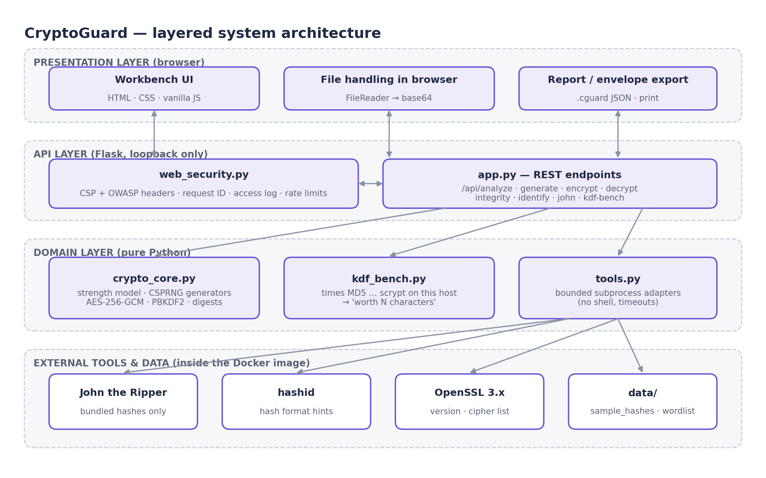
DESIGN
Layered architecture
CryptoGuard · Design Project – I
5 / 13

Slide 6
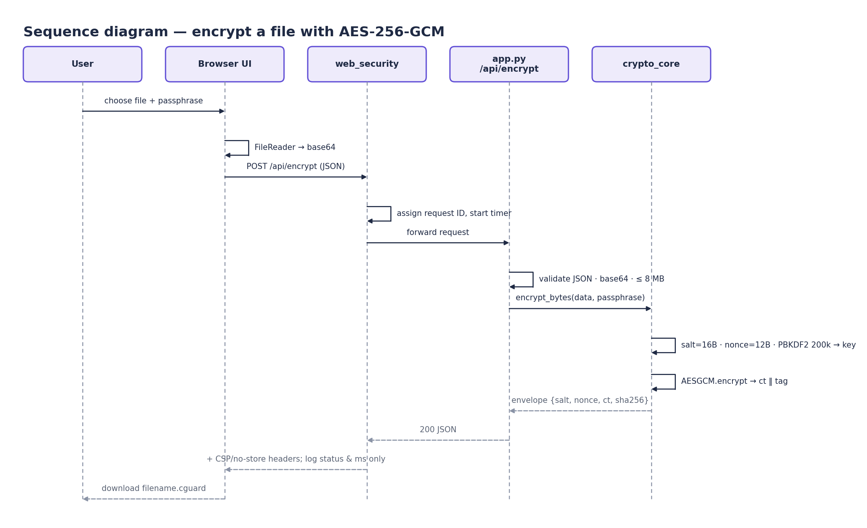
KEY FLOW
Encrypting a file, end to end
CryptoGuard · Design Project – I
6 / 13

Slide 7
NOVEL COMPONENT
Turning hash cost into password characters
▸ Time each scheme on the host for ~0.15 s
▸ Slowdown k = rate(MD5) / rate(scheme)
▸ One random character multiplies keyspace by c
▸ So the scheme is worth log(k) / log(c) characters
▸ The password only sets c and n — never hashed or logged
CryptoGuard · Design Project – I
7 / 13

Slide 8
SECURITY ENGINEERING
Built the way it teaches
▸ Strict CSP, anti-clickjacking, nosniff, no-referrer
▸ Request IDs; logs never contain bodies
▸ Rate limits on John and the benchmark (HTTP 429)
▸ Tools called without a shell, fixed paths, timeouts
▸ Non-root container, loopback-only port
CryptoGuard · Design Project – I
8 / 13

Slide 9
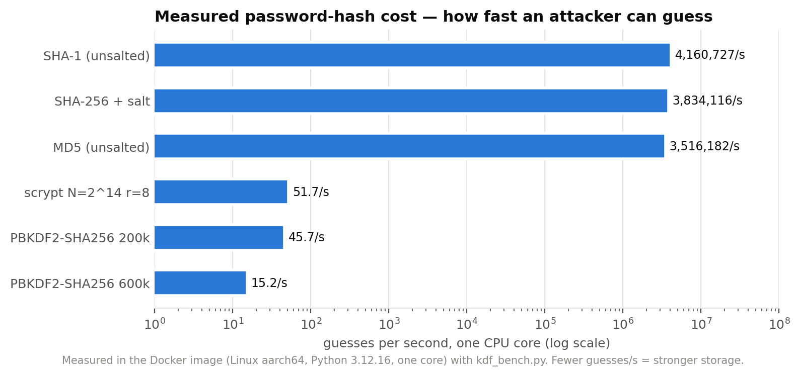
RESULTS
Measured on the Docker image
3.5 M/s
15.2/s
231,328×
+2.71
MD5 guesses, one core
PBKDF2-600k guesses
slowdown
equivalent characters
CryptoGuard · Design Project – I
9 / 13

Slide 10
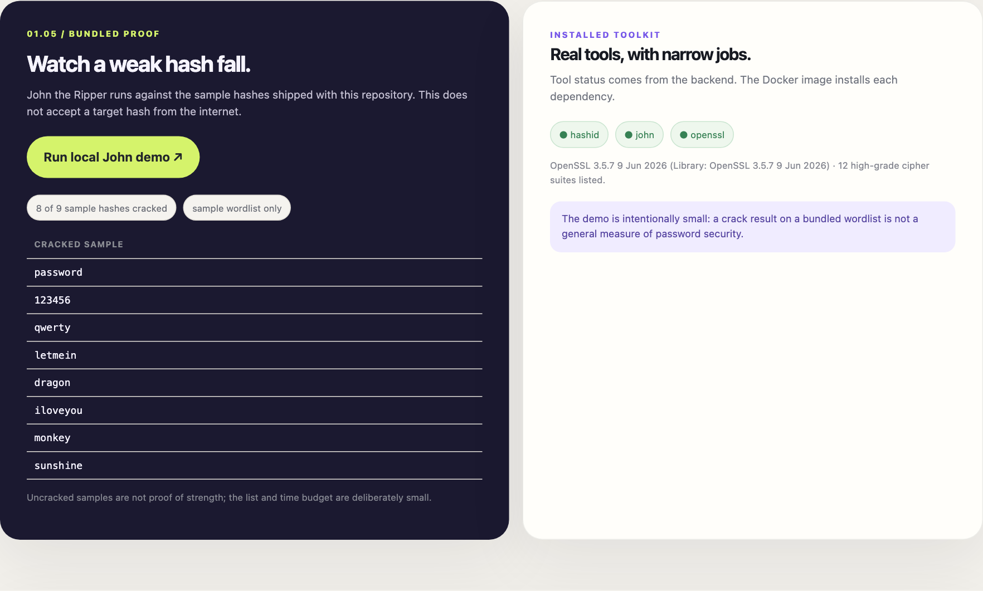
RESULTS
It works — with real tools
▸ John cracked 8/9 weak sample hashes
▸ GCM rejects wrong passphrase and tampering
▸ 14/14 automated tests pass
▸ p50 < 5 ms for non-KDF endpoints
CryptoGuard · Design Project – I
10 / 13

Slide 11
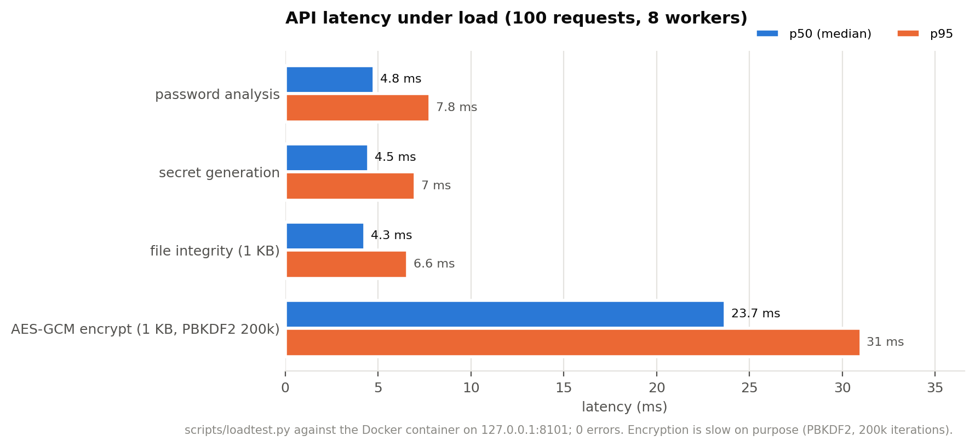
TESTING
Unit, integration, security, performance
▸ 14 pytest cases incl. 5 security tests
▸ Playwright UI checks on the Docker build
▸ Load test: 0 errors across 400 requests
CryptoGuard · Design Project – I
11 / 13

Slide 12
HONEST LIMITS
Limitations and future work
▸ Heuristic over-rates l33t dictionary words → add zxcvbn-style matching
▸ Single-core CPU benchmark misses GPU speed and scrypt's memory advantage
▸ Add bcrypt / Argon2id and a Hashcat GPU measurement
▸ Versioned envelope format with interoperability tests
CryptoGuard · Design Project – I
12 / 13

Slide 13
CONCLUSION
Storage choices deserve the same visibility as password rules
▸ PBKDF2-600k vs MD5 ≈ +2.7 random characters, free for the user
▸ Local, private, hardened, tested and containerised
▸ Foundation for Design Projects II and III
▸ Thank you — questions?
CryptoGuard · Design Project – I
13 / 13

