Slide 1
DESIGN PROJECT – III · SEMESTER V · B.TECH, CYBER SECURITY
ThreatScope
A Reproducible SOC Detection Lab with Ground-Truth Rule Evaluation
Malepati Sree Harsha · Register No. 23CU0340018
DISC · Hindustan Institute of Technology and Science, Chennai · 2025–26
Notes:
Introduce yourself and the one-line problem.

Slide 2
THE PROBLEM
Rules tuned by intuition, tools that can hurt
▸ SIEMs are heavy and opaque for learners
▸ Detection rules rarely ship with ground-truth measurements
▸ Nmap / ZAP misuse = scanning systems you don't own
▸ Goal: a safe, measurable SOC lab
ThreatScope · Design Project – III
2 / 13

Slide 3
OBJECTIVES
What ThreatScope does
▸ 4 log sources + PCAP → typed events
▸ 5 sliding-window rules mapped to MITRE ATT&CK
▸ TShark + Suricata offline; Nmap + ZAP on an isolated target
▸ Ground-truth benchmark with threshold sweeps
▸ Analyst console with evidence and playbooks
ThreatScope · Design Project – III
3 / 13

Slide 4
LITERATURE & GAP
What exists, and what is missing
▸ Snort / Suricata / Zeek: network signatures
▸ Wazuh, commercial SIEMs: complete but heavy
▸ Sommer & Paxson (2010): evaluation lacks ground truth
▸ Gap: every rule shipped with a reproducible measurement
ThreatScope · Design Project – III
4 / 13

Slide 5
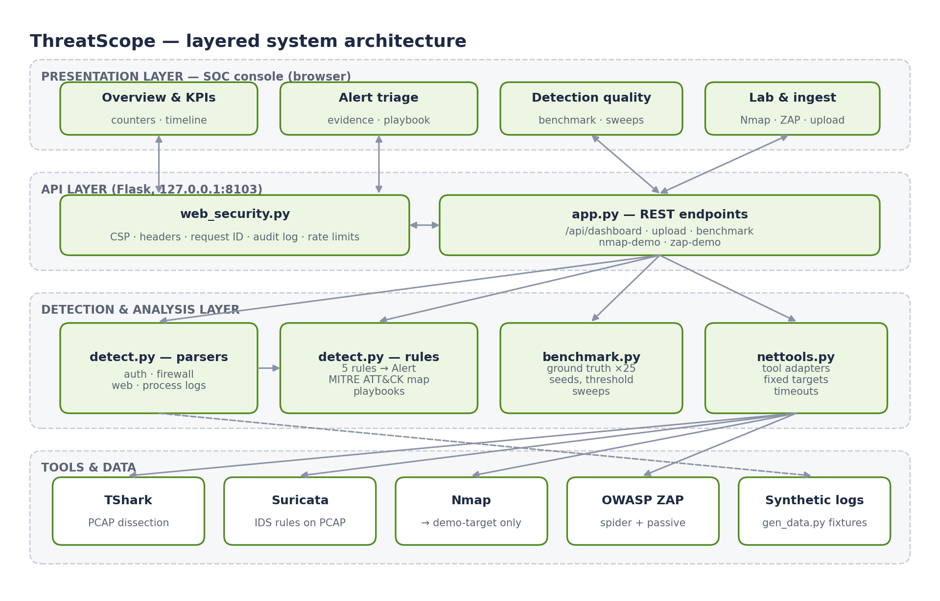
DESIGN
Architecture
ThreatScope · Design Project – III
5 / 13

Slide 6
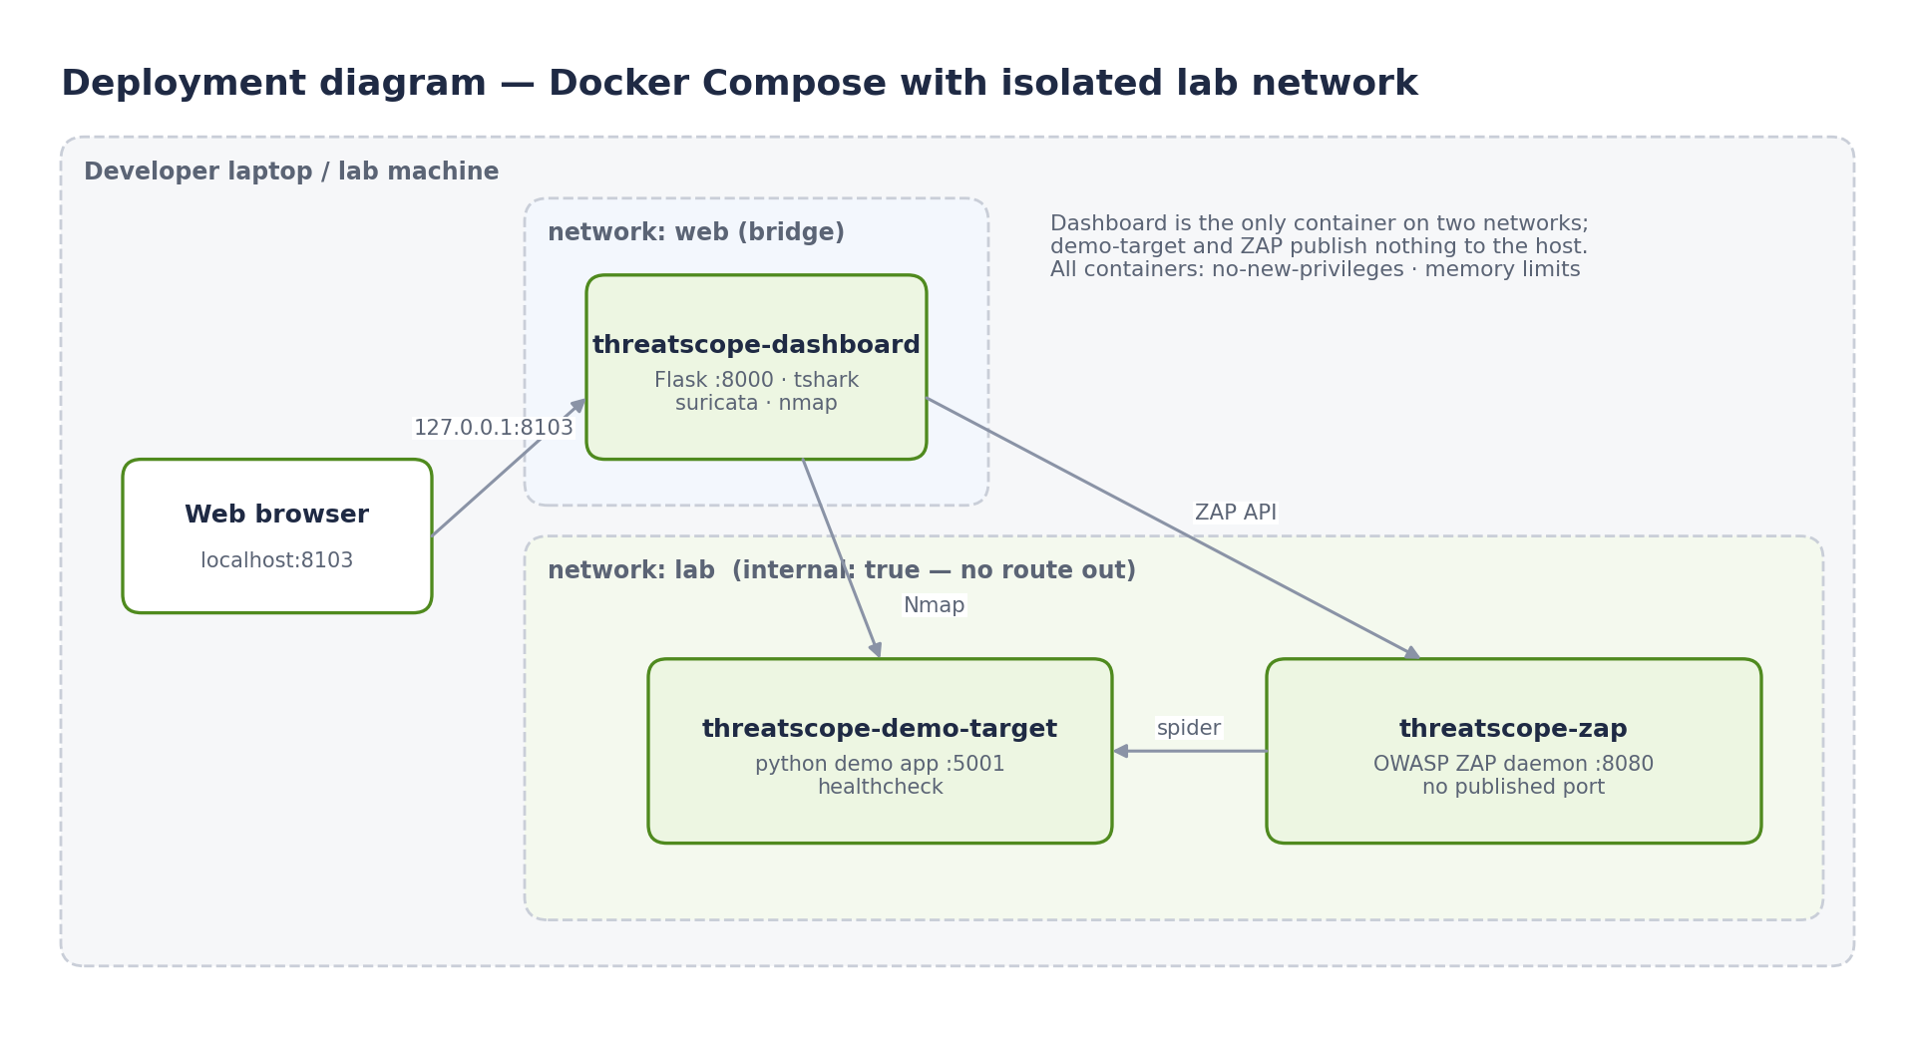
SAFETY BY DESIGN
Isolated lab network
▸ Targets are constants in code
▸ lab network is internal: true
▸ Only the dashboard publishes a port — on 127.0.0.1
▸ Fixed a Compose bug that hid the console
ThreatScope · Design Project – III
6 / 13

Slide 7
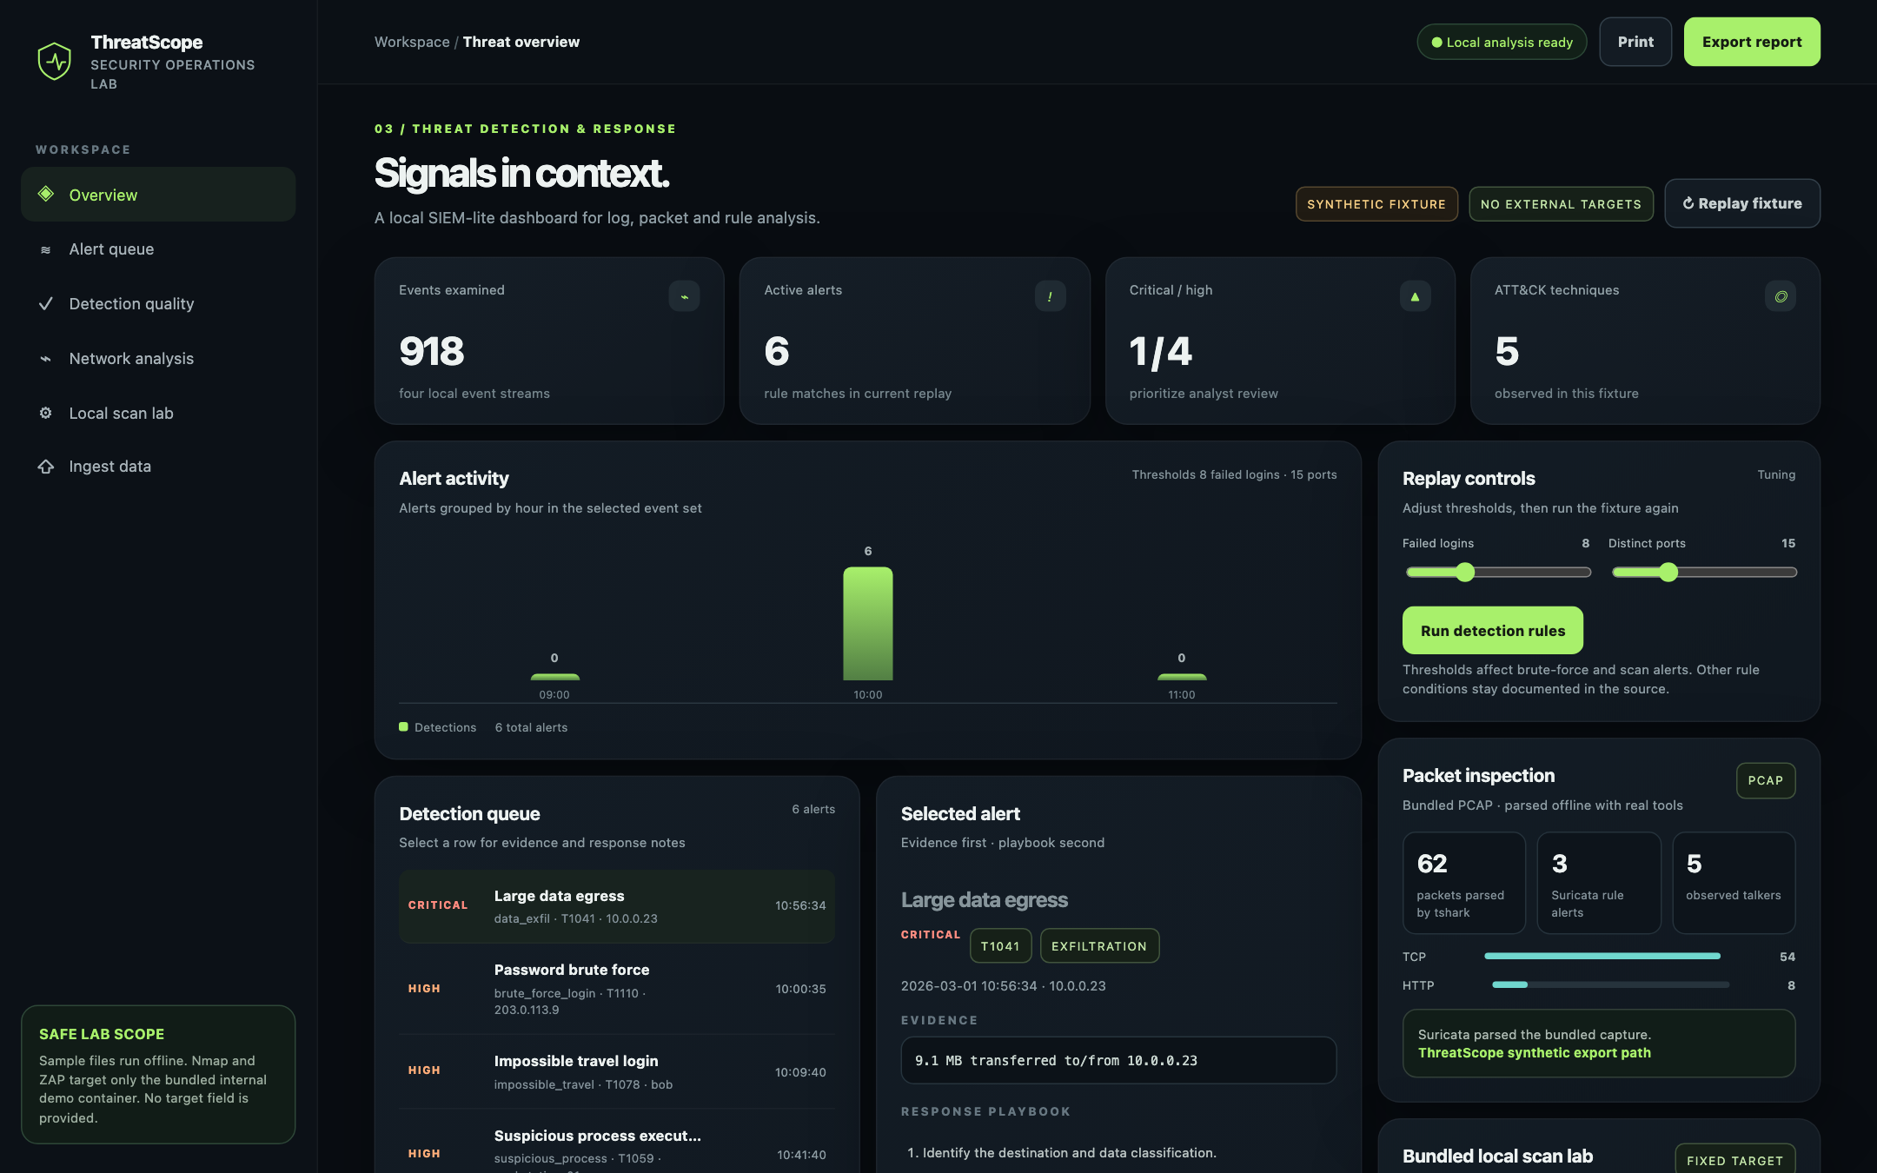
CONSOLE
Signals in context
ThreatScope · Design Project – III
7 / 13

Slide 8
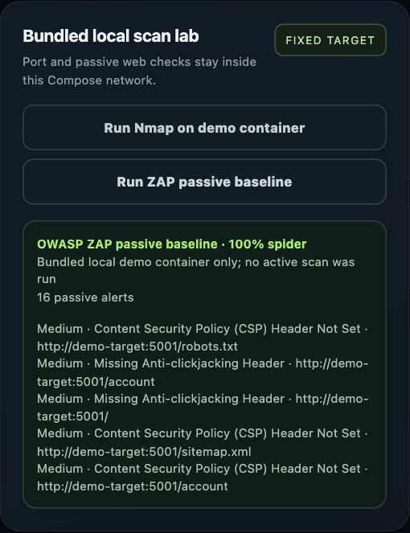
REAL TOOLS
TShark, Suricata, Nmap, ZAP
▸ TShark: 62 packets; Suricata: 3 alerts
▸ Nmap: 5001/tcp open on demo-target
▸ ZAP: 16 passive findings
▸ Each ZAP finding = a control ThreatScope applies itself
ThreatScope · Design Project – III
8 / 13

Slide 9
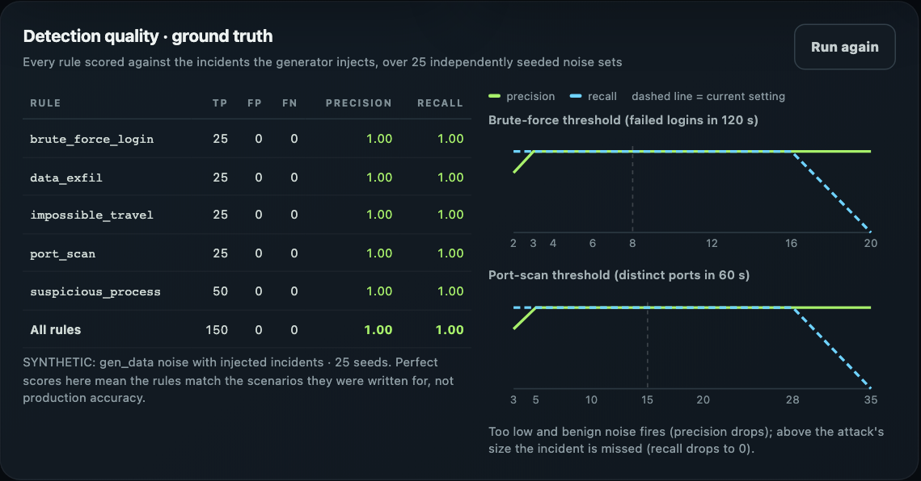
RESULT
Ground truth: every incident, no noise
150
0
0
5
true positives (25 seeds)
false positives
missed incidents
ATT&CK techniques
ThreatScope · Design Project – III
9 / 13

Slide 10
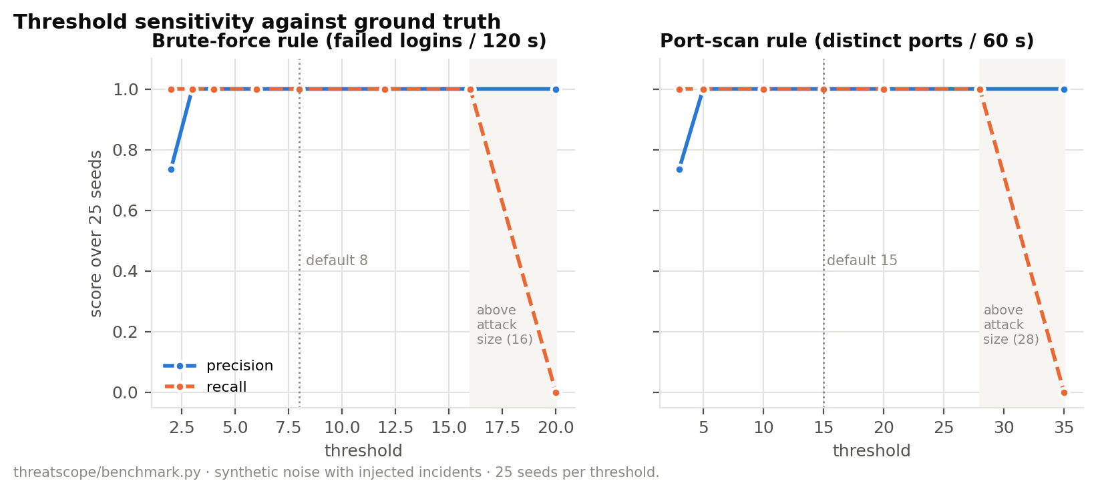
RESULT
Threshold sweeps find the safe band
ThreatScope · Design Project – III
10 / 13

Slide 11
SECURITY
Hardening the platform itself
▸ Strict CSP and OWASP headers
▸ Audit log for scans and auth failures; no bodies logged
▸ Rate limits: Nmap 4/min, ZAP 2/min, uploads 20/min
▸ Optional bearer-token auth (constant-time)
▸ 13/13 tests pass
ThreatScope · Design Project – III
11 / 13

Slide 12
HONEST LIMITS
Limitations and future work
▸ Synthetic, simple telemetry → perfect scores are expected
▸ No cross-source actor correlation yet
▸ Single shared token; no roles
▸ Next: Sigma rules, licensed dataset replay, case management
ThreatScope · Design Project – III
12 / 13

Slide 13
CONCLUSION
Measured detection engineering, safely
▸ Five ATT&CK rules, real tools, isolated by design
▸ Ground truth: 150 TP, 0 FP; sweeps show operating bands
▸ Built on Design Projects I (secure tooling) and II (evaluation)
▸ Thank you — questions?
ThreatScope · Design Project – III
13 / 13

