Slide 1
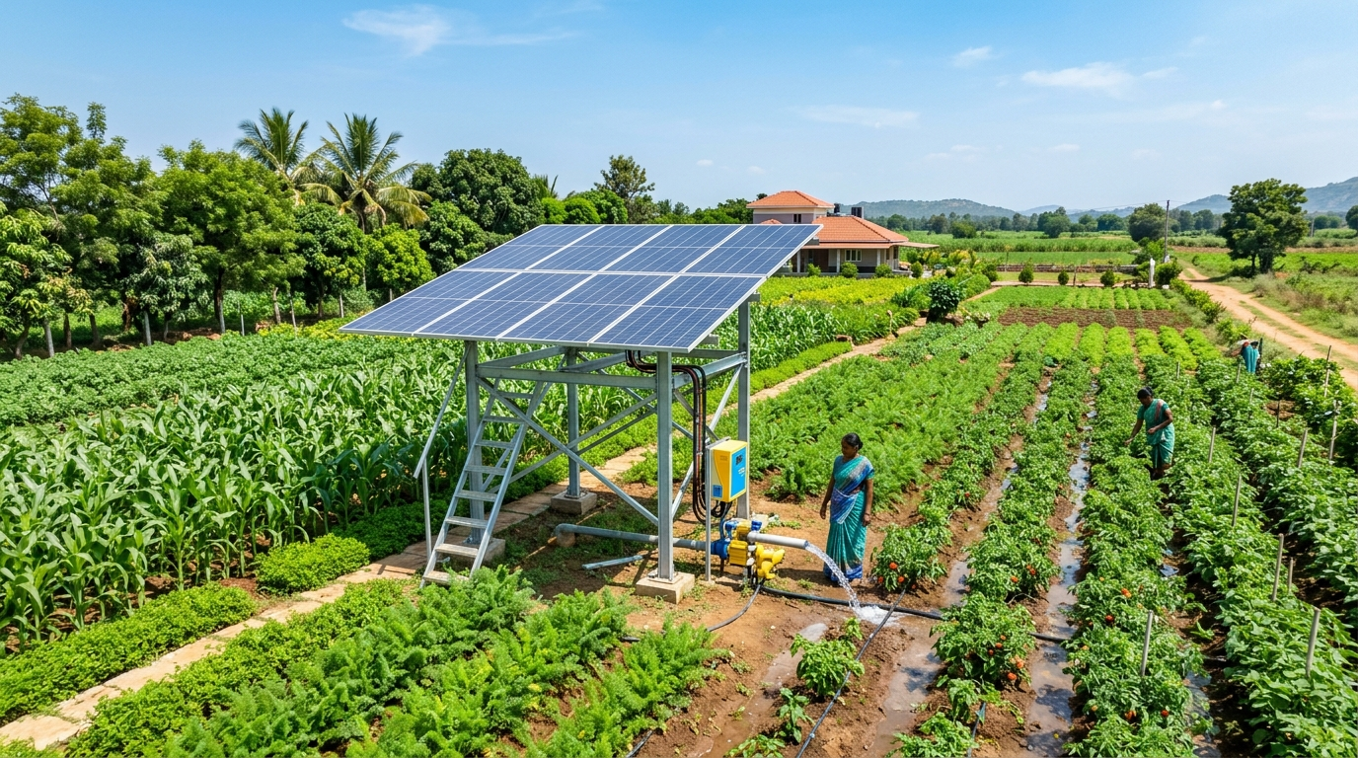
🌱 AGRITECH & AI INNOVATION TRACK
AquaVolt AI
Explainable Water & Energy Decision Support for Sustainable Agriculture
Smart Water. Smart Energy. Sustainable Farming.
VALUE PROPOSITION
An explainable decision-support system that helps farmers decide WHEN to irrigate by combining farm profile, soil condition, borewell state, weather likelihood, and solar availability into one practical recommendation.
🕳️ Borewell Aware
Protects aquifers & motor dry-runs
☀️ Solar Synchronized
Irrigates during peak sunlight
👨‍🌾 Farmer In Control
Explainable human-in-the-loop advice
SOLAR-POWERED BOREWELL INTEGRATION
Harmonizing crop water needs, subterranean borewell recharge limits, and daylight solar generation into a unified, practical decision layer.
🟢 IMPLEMENTED FULL-STACK MVP
React 18 • TypeScript • Vite • Tailwind CSS • FastAPI • SQLite • JWT • Recharts • Multilingual
AquaVolt AI • Smart Water. Smart Energy. Sustainable Farming. • Competition Pitch Deck

Slide 2
THE CORE PROBLEM
02 / 13
Farmers Don't Have One Problem. They Have Many Variables.
Irrigation today relies on crude rules ('run pump 2–3 hours') or pure guesswork because variables are disconnected.
🌱 Crop Requirement
Growth stage, transpiration rate, dynamic water demand
🪴 Soil Condition
Moisture saturation %, absorption rate, root zone status
4 CRITICAL UNANSWERED QUESTIONS
❓ When should I irrigate?
Is today optimal, or is rain expected in 3 hours?
❓ How long should I pump?
Will running 2 hours dry out the aquifer and burn the motor?
❓ When should the borewell recover?
How many minutes does this specific aquifer need to recharge?
❓ When is solar energy most useful?
Is free sunlight aligned with actual soil moisture deficits?
☁️ Weather & Rain
Ambient temperature, humidity, precipitation probability
🕳️ Borewell State
Dynamic water column depth, recharge rate, depletion risk
🌊 Water Flow Rate
Discharge LPM, drawdown speed, yield degradation
⚙️ Pump Operation
Motor horsepower, load rating, dry-run vulnerability
☀️ Solar Generation
Daylight solar irradiance, kW capacity, cloud cover
⚡ THE FRAGMENTED REALITY
No single factor tells the whole story. Disconnected data forces farmers into risky guesswork.
CORE PROBLEM STATEMENT
How can we combine all these disconnected factors and provide the farmer with ONE simple, practical irrigation decision?
MULTIPLE DISCONNECTED FACTORS ➔ ONE DIFFICULT IRRIGATION DECISION
AquaVolt AI • Smart Water. Smart Energy. Sustainable Farming. • Competition Pitch Deck

Slide 3
GAP ANALYSIS
03 / 13
Why Traditional Irrigation Logic Falls Short
Single-variable systems and rigid assumptions fail to address the interconnected nature of water and solar energy.
❌ Fixed Pump Runtime
Pumps operate on static 2-3 hour schedules regardless of seasonal soil moisture or weather.
❌ Soil Moisture Only
Sensors detect dry soil but ignore whether the borewell has sufficient water column to pump.
❌ Solar-Only Decisions
Solar pumps run whenever sunlight is available, even when soil is already saturated, wasting water.
❌ Manual Guesswork
Farmers cannot safely gauge underground aquifer levels, risking motor burnouts and dry-runs.
❌ Blind Automation
Traditional automated switches trigger without explaining WHY or checking upcoming rain forecasts.
⚠️ TRADITIONAL IRRIGATION LOGIC
✓ Full-Spectrum Multi-Factor Synthesis
Synthesizes Crop Stage + Soil Moisture + Borewell Level + Solar Output + Weather Forecast jointly.
✓ Recovery-Aware Timing
Enforces borewell recharge intervals to prevent aquifer over-depletion and pump cavitation.
✓ Solar Window Alignment
Identifies peak daytime sunlight windows to pump when solar electricity is 100% free.
✓ Weather-Aware Delays
Automatically postpones irrigation when rain probability indicates natural precipitation is imminent.
✓ Explainable Directives
Delivers transparent WHAT, WHY, and WHEN guidance keeping the farmer fully in control.
🌿 AQUAVOLT AI MULTI-CONDITION APPROACH
CURRENT PROTOTYPE: Multi-condition deterministic decision support • ROADMAP: Farm-specific dynamic borewell modeling
AquaVolt AI • Smart Water. Smart Energy. Sustainable Farming. • Competition Pitch Deck

Slide 4
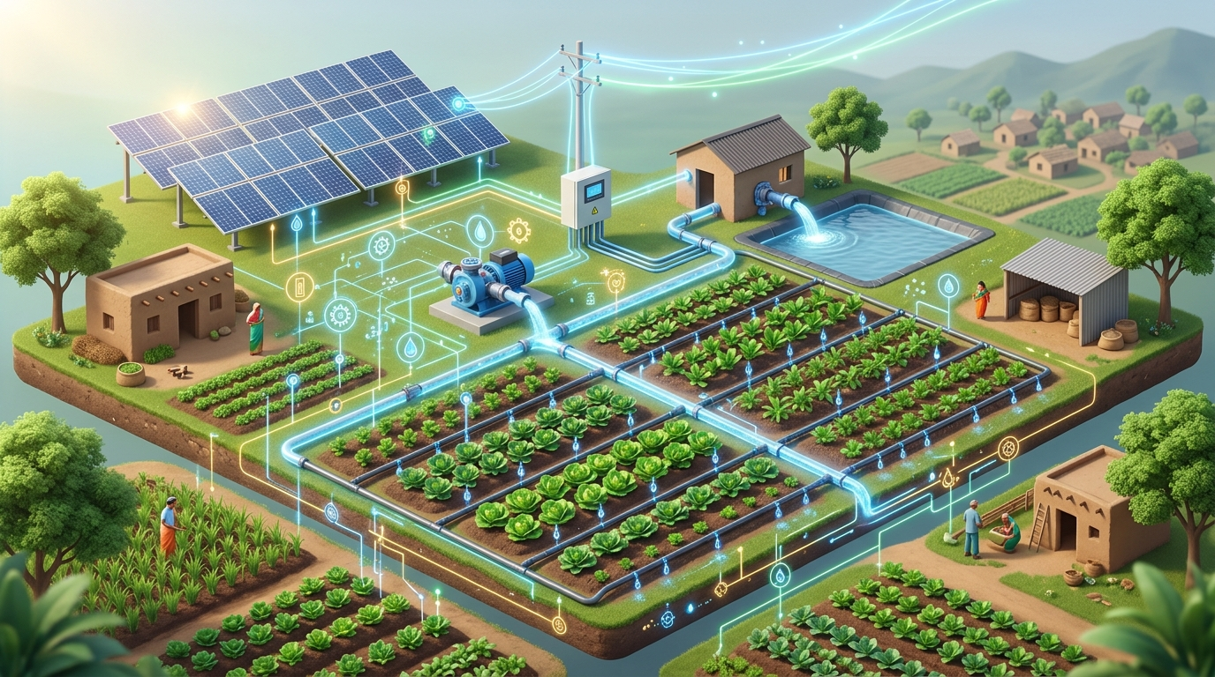
OUR SOLUTION
04 / 13
From Farm Telemetry to One Explainable Decision
AquaVolt AI harmonizes multi-source agricultural inputs into clear, actionable, and explainable farmer guidance.
01 | FARM DATA INPUTS
• 🌱 Farm Profile: Crop, Growth Stage, Acreage • 🪴 Soil Moisture: Recorded / Seeded % Reading
• 🕳️ Borewell State: Level Status & Depth • ☀️ Solar Output: Daylight Generation Status • ☁️ Weather Context: Rain likelihood & temp
02 | AQUAVOLT DECISION ENGINE
• ⚙️ Deterministic Multi-Condition Rules • 🛡️ Priority Safety & Incomplete Data Checks
• ☀️ Solar-Water Synchronization Engine • ⏱️ Optimal Irrigation Window Scheduling
03 | EXPLAINABLE OUTPUT (WHAT + WHY + WHEN)
• 🎯 WHAT: Concrete Action (e.g. SOLAR_WINDOW) • 💡 WHY: Transparent contributing factors
• ⏰ WHEN: Recommended timing / delay window
04 | FARMER IN CONTROL
• 👨‍🌾 Human-in-the-loop: Farmer makes final decision • 📱 Responsive web interface (Mobile & Desktop)
• 🌐 Localized in English, Marathi & Hindi
CONCEPTUAL PIPELINE: SOLAR ➔ PUMP ➔ WATER ➔ CROP
Harmonizing energy availability with crop water deficits through a digital decision layer, keeping the farmer informed and in command.
NOT A BLACK-BOX PUMP SWITCH • EXPLAINABLE MULTI-FACTOR DECISION SUPPORT • FARMER IN CONTROL
AquaVolt AI • Smart Water. Smart Energy. Sustainable Farming. • Competition Pitch Deck

Slide 5
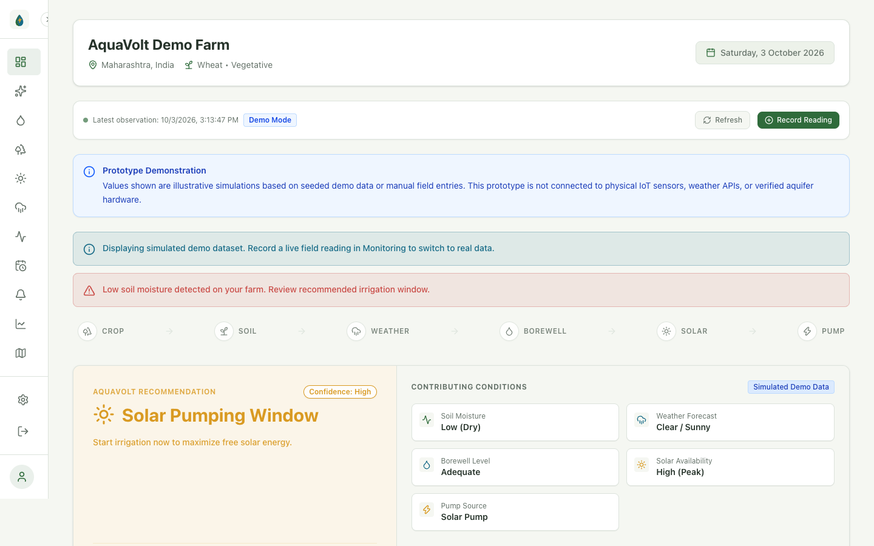
LIVE WORKING PRODUCT
05 / 13
Real Product Dashboard: Live Operational Hub
Live farm telemetry, dynamic recommendation banner, and status monitors running on the actual React + FastAPI stack.
DASHBOARD ARCHITECTURE & FEATURES
🌱 Farm Context & Identity
Displays active farm name, crop type (Cotton - Flowering), and acreage loaded directly from SQLite database.
⚡ Live Decision Banner
Shows active SOLAR_WINDOW recommendation with 'High' confidence and key contributing factors.
📊 Multi-Factor Telemetry
Real-time cards for Soil Moisture (28% - Low), Borewell Level (Adequate), Solar Output (High), and Weather (Clear).
🔔 Smart Alerts & Activity Log
Warns about critical soil moisture deficits and displays the timestamped history of observations.
🌐 Multilingual Switching
Instant language switching between English, Marathi, and Hindi across all navigation and cards.
PROTOTYPE DEMONSTRATION: Captured from running Chrome browser at localhost:5173 • Uses seeded telemetry to validate decision logic
AquaVolt AI • Smart Water. Smart Energy. Sustainable Farming. • Competition Pitch Deck

Slide 6
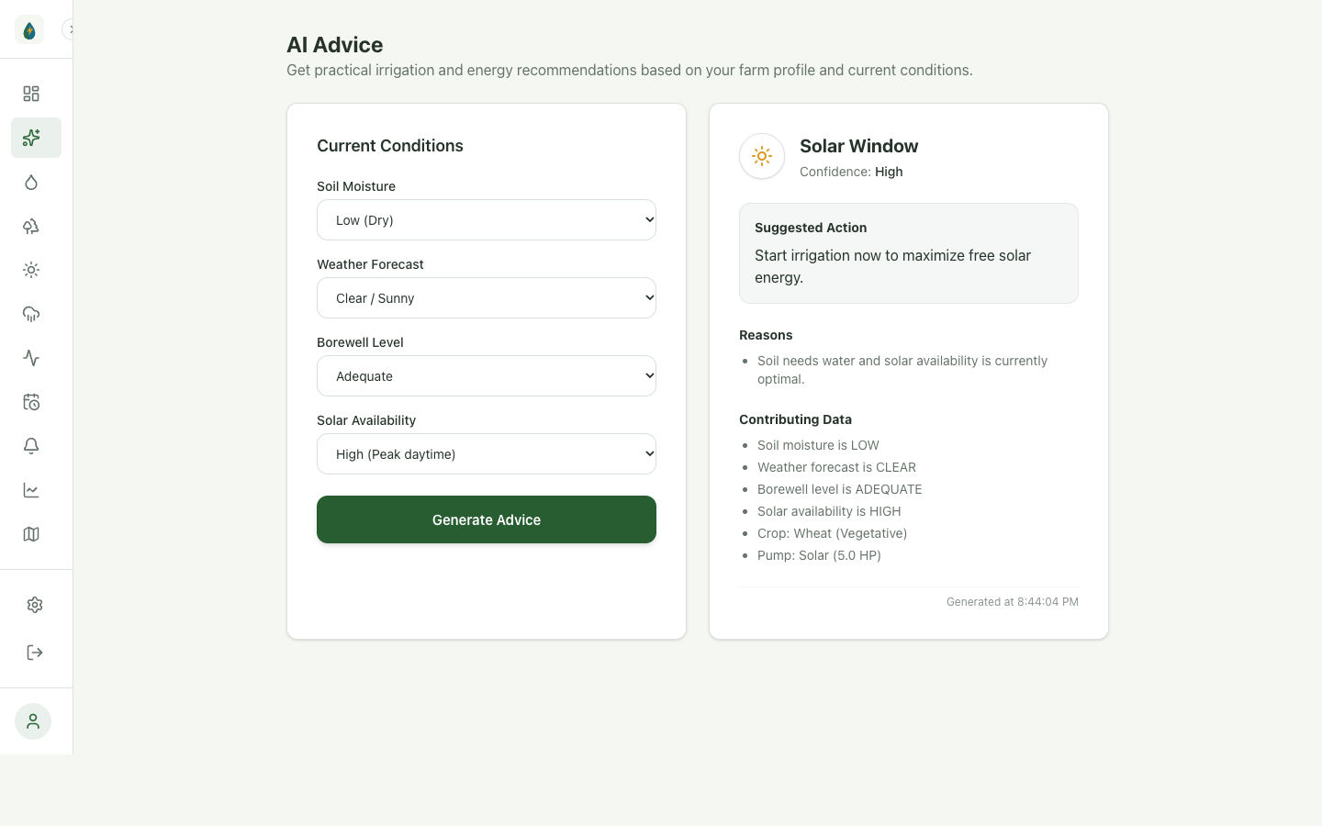
CORE DECISION ENGINE
06 / 13
The Decision Engine: Real-Time Explainable Advice
Demonstrating the core regression-tested scenario: Low Soil Moisture + High Solar + Solar Pump → SOLAR_WINDOW.
REGRESSION-TESTED SCENARIO ANALYSIS
1. Farm Conditions Evaluated:
• 🪴 Soil Moisture: LOW (28% — Below threshold)
• ☀️ Solar Availability: HIGH (Peak midday sun)
• ⚙️ Solar Pump: YES (Equipped with solar system)
• 🕳️ Borewell Level: ADEQUATE (Safe water column)
• ☁️ Weather: CLEAR (0% rain forecasted)
2. Deterministic Engine Output:
RECOMMENDATION: SOLAR_WINDOW (Confidence: High)
WHAT (Directive): Optimal solar irrigation window identified.
WHY (Rationale): Soil moisture is low and solar availability is high with active solar pump. Zero grid/battery strain.
WHEN (Suggested): Irrigate now during daytime solar window.
3. Code Verification:
Implemented in backend/services/advice_engine.py
Validated by test_advice_engine.py regression tests.
DETERMINISTIC, EXPLAINABLE LOGIC • ZERO HALLUCINATION • FARMER REMAINS IN CONTROL
AquaVolt AI • Smart Water. Smart Energy. Sustainable Farming. • Competition Pitch Deck

Slide 7
INTELLIGENCE PIPELINE
07 / 13
How the Decision is Made: Transparent 5-Stage Evaluation
Replacing opaque black-box algorithms with a deterministic, explainable, and multi-condition evaluation pipeline.
STAGE 01
COLLECT
Ingests farm profile (crop type, pump HP, solar pump flag) alongside latest field monitoring telemetry.
STAGE 02
VALIDATE
Validates input boundaries. Triggers INSUFFICIENT_DATA if core moisture or solar readings are missing.
STAGE 03
SAFETY CHECK
Checks priority overrides: Rain forecasted ➔ RAIN_DELAY. Soil saturated ➔ WAIT. Borewell critical ➔ RECOVERY.
STAGE 04
SYNCHRONIZE
If moisture low + solar pump + high solar ➔ SOLAR_WINDOW. If low solar ➔ WAIT. If grid pump ➔ IRRIGATION_NEEDED.
STAGE 05
EXPLAIN
Constructs farmer-facing WHAT, WHY, and WHEN directives with confidence scoring served via FastAPI REST API.
🔵 FUTURE INTELLIGENCE LAYER (PLANNED RESEARCH ROADMAP)
• 📡 Live IoT Telemetry: Automated ingestion from LoRaWAN soil moisture probes, water-level sensors & flow meters.
• ☁️ Live Weather API: Real-time Doppler radar & hyper-local precipitation forecast synchronization.
• 🕳️ Borewell Modeling: Aquifer recharge velocity characterization modeled per individual farm borewell.
• ⚡ Mathematical Optimization: Continuous water-energy cost-benefit optimization balancing tariffs and yield.
CLOSED-LOOP CONTINUUM: COLLECT ➔ VALIDATE ➔ SAFETY CHECK ➔ SYNCHRONIZE ➔ EXPLAIN
AquaVolt AI • Smart Water. Smart Energy. Sustainable Farming. • Competition Pitch Deck

Slide 8

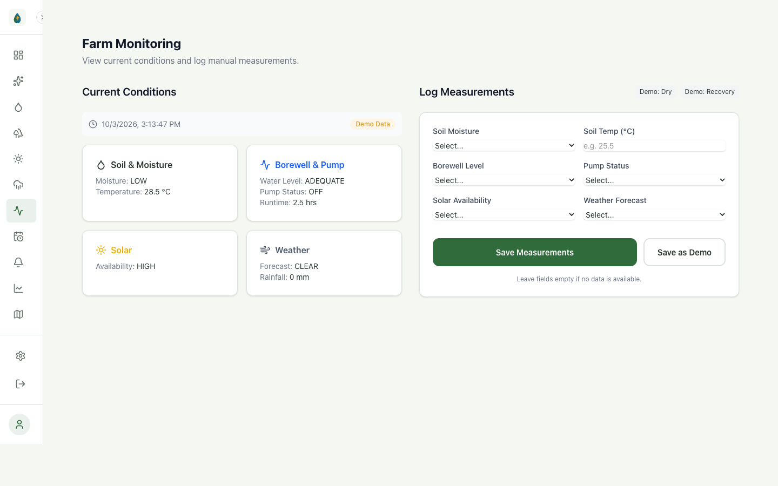
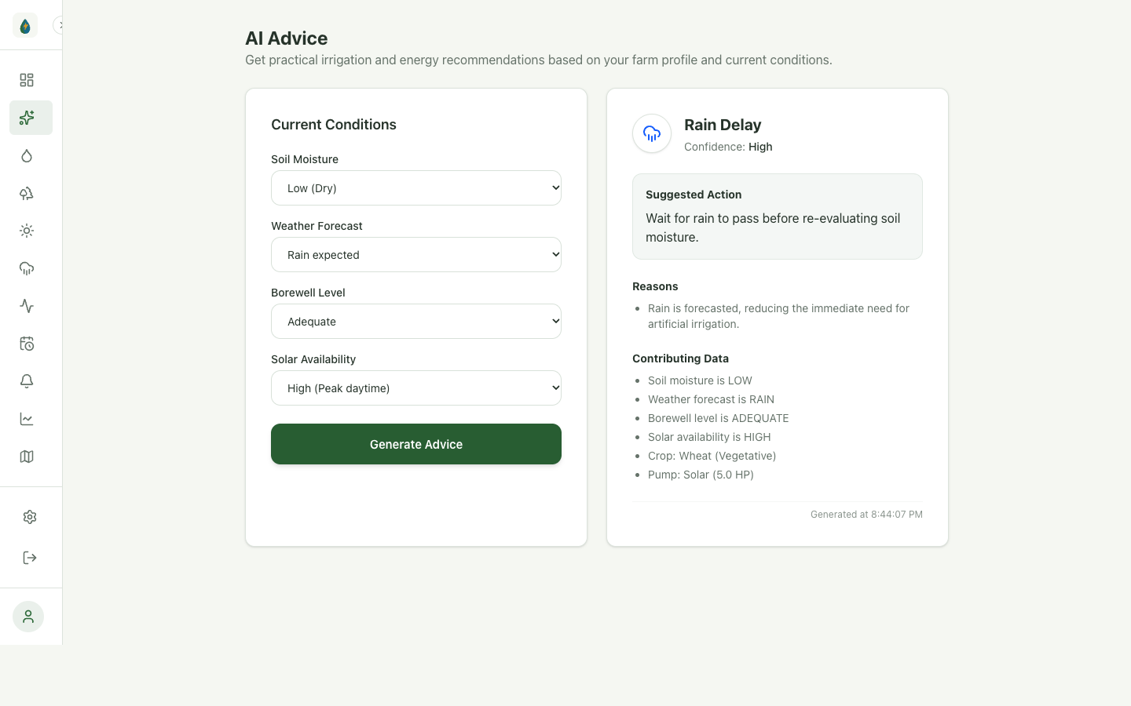
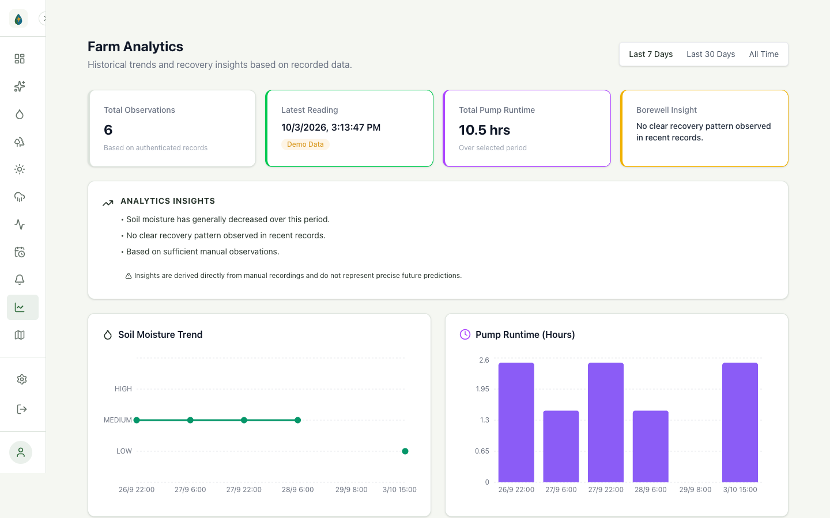
PRODUCT CAPABILITIES
08 / 13
Four Core Implemented Modules: End-to-End Workflow
Every module is fully developed, connected to the FastAPI backend, and verified with real browser screenshots.
01 | Executive Farm Dashboard
Live farm context, active decision banners, alerts, and system health monitors.
✓ Live & Persisted
02 | Field Telemetry Logging
Record, persist, and view historical soil moisture, water status, and solar levels.
✓ Live & Persisted
03 | AI Advice & Weather Logic
Explainable multi-condition irrigation recommendation (shown: Rain Delay postponement).
✓ Live & Persisted
04 | Historical Trend Analytics
Interactive Recharts visualizations across 7-day, 30-day, and all-time observation periods.
✓ Live & Persisted
ALL MODULES LIVE AND FUNCTIONAL • AUTHENTICATED FARMER SESSIONS • SQLITE PERSISTENCE
AquaVolt AI • Smart Water. Smart Energy. Sustainable Farming. • Competition Pitch Deck

Slide 9
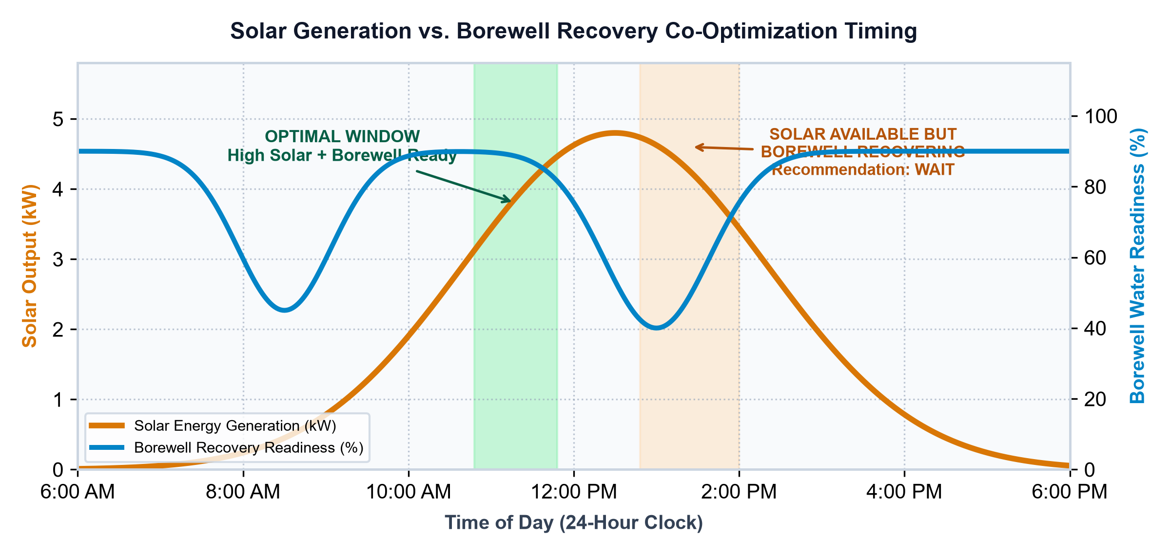
STRATEGIC CO-OPTIMIZATION
09 / 13
Don't Just Use Solar. Use It When Water Needs It.
Solar-powered pumping solves clean energy, but does NOT solve groundwater depletion without intelligent timing.
THE THREE SIDES OF AQUAVOLT CO-OPTIMIZATION
💧 WATER SIDE: PRESERVE GROUNDWATER
Avoids unnecessary extraction, respects aquifer recharge limits, and prevents motor burnout caused by dry-run cavitation.
⚡ ENERGY SIDE: MAXIMIZE SOLAR EFFICIENCY
Utilizes zero-cost solar energy during peak irradiance hours, minimizing reliance on expensive grid tariffs or diesel gensets.
🌱 CROP SIDE: PRECISION HYDRATION
Delivers water strictly according to crop stage needs and root zone moisture deficits, avoiding crop root asphyxiation.
CRITICAL CO-OPTIMIZATION PRINCIPLE
“Solar availability alone does NOT mean the pump should run. If soil moisture is already adequate or rain is coming, pumping simply depletes the aquifer. AquaVolt synchronizes solar power with genuine crop water deficits.”
🎯 UNIFIED RESULT: OPTIMAL IRRIGATION TIMING
Identifies the practical time slice where high solar generation, safe borewell reserve, and genuine soil moisture deficit converge — giving farmers total confidence.
☀️ SUN ➔ ⚡ PANELS ➔ 🔋 AVAILABLE ENERGY ➔ ⚙️ PUMP ➔ 💧 WATER ➔ 🌱 CROP
AquaVolt AI • Smart Water. Smart Energy. Sustainable Farming. • Competition Pitch Deck

Slide 10
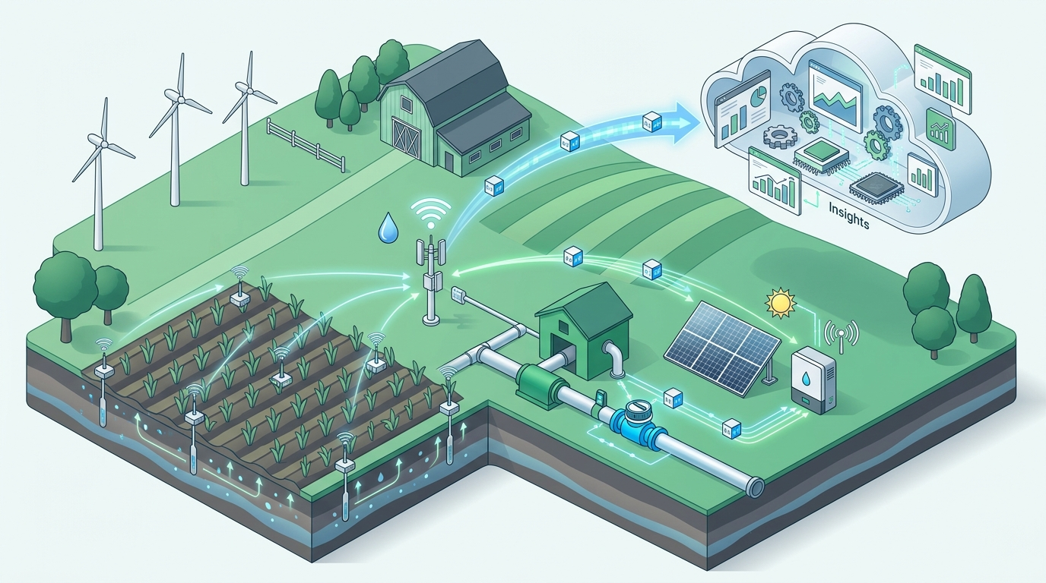
TECHNICAL BLUEPRINT
10 / 13
Full-Stack Architecture: Built for Scalability & Security
End-to-end modern stack connecting reactive frontend interfaces to Python FastAPI services and persistent SQLite storage.
LAYER 1: FARMER PRESENTATION LAYER
React 18 • TypeScript • Vite • Tailwind CSS • Lucide Icons • Responsive Mobile & Desktop Layouts
LAYER 2: SECURE API & AUTHENTICATION
FastAPI REST API • OAuth2 Password Bearer • JWT Token Security • Bcrypt Password Hashing
LAYER 3: DECISION & ANALYTICS ENGINE
Deterministic Multi-Condition Rules • Priority Safety Checks • Recharts Trend Visualizations
LAYER 4: BACKEND & DATA PERSISTENCE
Python 3.9+ • SQLite (data/aquavolt.db) • SQLAlchemy ORM • User Scoped Farm Isolation
CONCEPTUAL IOT ARCHITECTURE (ROADMAP)
Future hardware telemetry: Wireless LoRa soil sensors, pipe flow meters, solar inverter telemetry, and cloud synchronization — designed to plug into the current FastAPI backend.
LAYER 5: MULTILINGUAL FOUNDATION
English, Marathi, and Hindi Translation Architecture with Modular Key Dictionaries
🟢 CURRENT STACK: React 18 • Vite • FastAPI • SQLite • JWT • Recharts
🔵 FUTURE TARGETS: IoT Sensors • Weather API • Inverter Telemetry • ML
AquaVolt AI • Smart Water. Smart Energy. Sustainable Farming. • Competition Pitch Deck

Slide 11
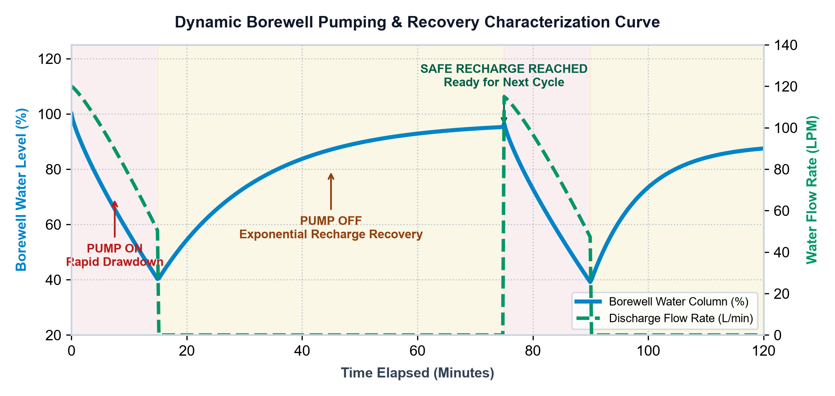
SIGNATURE INNOVATION
11 / 13
Toward Farm-Specific Borewell Intelligence
Every borewell behaves differently. AquaVolt is designed to evolve from basic level monitoring toward dynamic aquifer characterization.
THE 6-PHASE BOREWELL OBSERVATION CYCLE
1. BEFORE PUMPING
Assesses baseline resting water column depth & equilibrium.
2. PUMP START
Tracks initial drawdown velocity and motor power load.
3. DURING PUMPING
Monitors discharge flow rate (LPM) changes & drawdown slope.
4. PUMP CUT-OFF
Detects safe threshold drop to prevent motor dry-running.
5. RECOVERY PHASE
Tracks aquifer recharge speed & inflow recovery slope.
6. NEXT PUMPING WINDOW
Calculates optimal timestamp when safe water depth is restored.
⚠️ ILLUSTRATIVE FUTURE CHARACTERIZATION MODEL — NOT MEASURED LIVE AQUIFER DATA
AquaVolt's core research premise is that borewells undergo steep drawdowns and non-linear recharge. The graph illustrates the target dynamic behavior model intended for future IoT telemetry.
ILLUSTRATIVE TARGET: 15-min Extraction ➔ Flow Drops ➔ Pump Cut-off ➔ ~1 hr Recovery ➔ Safe Next Window
AquaVolt AI • Smart Water. Smart Energy. Sustainable Farming. • Competition Pitch Deck

Slide 12
ROADMAP & IMPACT
12 / 13
Roadmap & Realistic Impact Targets
Disciplined separation of tested production features, near-term development, and long-term research.
🟢 CURRENT • Implemented Now
• Full React + Vite web platform
• Secure JWT auth & farm profile isolation
• Multi-step farm onboarding & profile editing
• Field monitoring logging & persistent SQLite
• Deterministic Advice Engine (Solar Window, Rain Delay)
• Executive Dashboard with live alert cards
• Interactive Recharts Analytics (7d / 30d / All)
• English, Marathi & Hindi localization base
• Seeded demo dataset & test suite
🟡 NEXT • Near-Term Phase
• Live Weather API synchronization
• Physical IoT sensor gateway integration
• Solar panel inverter telemetry ingestion
• Automated SMS & WhatsApp alert notifications
• Expanded regional language coverage
• Basic borewell recharge recovery timing
• Pump runtime hour tracking hardware
• Regional solar irradiance lookup
• Farmer feedback loop integration
🔵 FUTURE • Long-Term Vision
• Predictive ML irrigation demand models
• Dynamic aquifer drawdown modeling
• Water-energy mathematical co-optimization
• Automated pump relay with manual override
• Multi-farm FPO regional water management
• Satellite soil moisture verification
• Carbon credit & energy offset tracking
• Aquifer depletion risk forecasting
• Autonomous schedule execution
REALISTIC SUSTAINABILITY & OPERATIONAL IMPACT AREAS (DESIGN TARGETS — NO FABRICATED % STATS)
💧 Water: Designed to prevent unnecessary groundwater over-extraction.
⚡ Energy: Designed to maximize free daytime solar generation.
🌱 Crop: Supports hydration matched to crop growth requirements.
🕳️ Borewell: Enforces recovery-aware timing to prevent motor burnout.
👨‍🌾 Farmer: Eliminates complex guesswork with explainable directives.
DISCIPLINED PRODUCT PROGRESSION: MVP VALIDATED TODAY ➔ CONNECTED TOMORROW ➔ OPTIMIZED IN FUTURE
AquaVolt AI • Smart Water. Smart Energy. Sustainable Farming. • Competition Pitch Deck

Slide 13
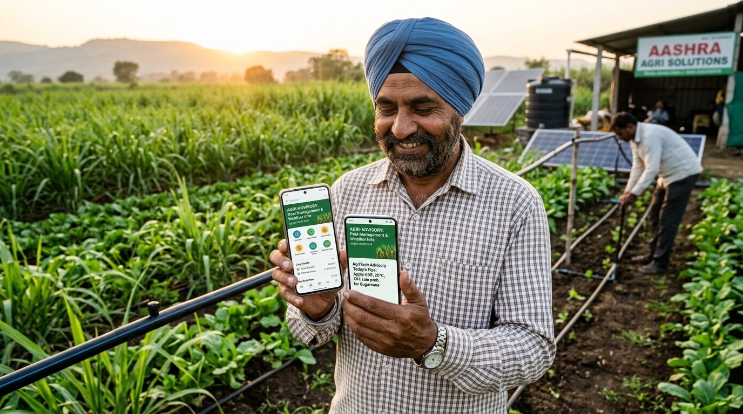
From Farm Data to Smarter Decisions.
AquaVolt AI
Smart Water. Smart Energy. Sustainable Farming.
FARM DATA ➔ DECISION ENGINE ➔ EXPLAINABLE ADVICE ➔ TIMING
💧 Use Water Wisely
Avoid unnecessary extraction and respect aquifer health limits.
☀️ Use Energy Intelligently
Harness free solar power during optimal daytime windows.
FINAL PROJECT POSITIONING
“AquaVolt AI is an explainable water-energy decision-support system for agriculture that combines farm, soil, borewell, weather and solar conditions to recommend when irrigation should happen — while keeping the farmer in control.”
Next Planned Evolution: Live IoT telemetry, weather API sync, dynamic aquifer modeling, and predictive optimization.
🟢 MVP COMPLETED & SYSTEM TESTED • HACKATHON OCTOBER 2026
🕳️ Protect The Borewell
Eliminate dry-run risks through dynamic recovery-aware timing.
👨‍🌾 Keep Farmer In Control
Transparent, explainable recommendations with human-in-the-loop.
CORE MISSION & PROMISE
“One recommendation. Multiple conditions. Farmer in control. AquaVolt delivers practical decision support that safeguards both water security and agricultural livelihoods.”
AquaVolt AI • Smart Water. Smart Energy. Sustainable Farming. • Competition Pitch Deck

