Slide 1



Slide 2



01CE1301 – Data Structure
Unit - 1
Introduction to Data Structure
Prof. Chirag Bhalodia
Department of Computer Engineering

Slide 3


Outline
Data Management concepts
Data types – primitive and non-primitive
Types of Data Structure – linear and non-linear
Abstract Data Types

Slide 4

Data Management Concepts

Slide 5

Data Management Concepts
What is Data?
Data is the basic fact or entity that is utilized in calculation or manipulation.
There are two different types of data - Numeric data and Alphanumeric data.
When a programmer collects such type of data for processing, he would require to store them in computer’s main memory.
The process of storing data items in computer’s main memory is called representation.
Data to be processed must be organized in a particular fashion, these organization leads to structuring of data, and hence the mission to study the Data Structures.

Slide 6
Data Types

Slide 7
Data Types
What is Data types?
A data type is a classification of data, which can store a specific type of information.
Data Type = Basic Data Type = Primitive Data Type

Slide 8
Data Types
Primitive Data Types
A primitive data type is predefined by the language and is named by a reserved keyword.
Primitive data types are predefined, supported by C language.
int, char, float, double.

Slide 9
Data Types
Non-primitive Data Types
Non-Primitive data types are not defined by C language, but are created by the programmer.
They are created using the basic data types.
Example:
Linked List
Stacks
Queue
Graph

Slide 10
Types of Data Structure

Slide 11
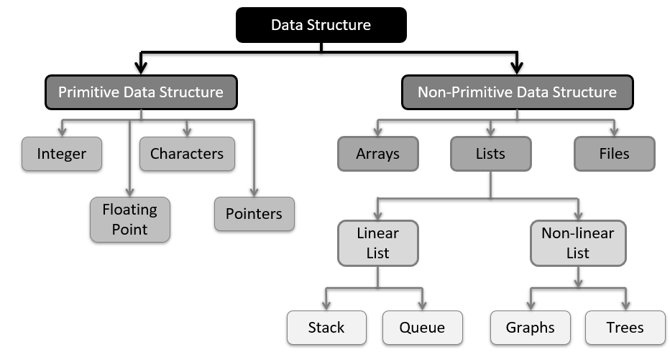
Types of Data Structure

Slide 12
Primitive Data Structure
Primitive data structures
Primitive data structures are basic structures and are directly operated upon by machine instructions.
Integers, floats, character and pointers are examples of primitive data structures.

Slide 13
Non-Primitive Data Structure
Non primitive data structure
These are derived from primitive data structures.
The non-primitive data structures emphasize on structuring of a group of homogeneous or heterogeneous data items.
Examples of Non-primitive data type are Array, List, and File.

Slide 14

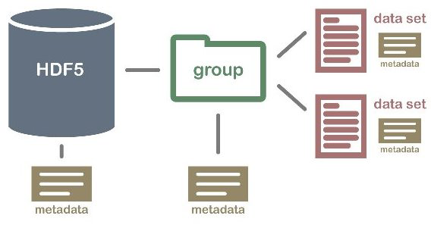
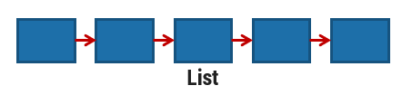
Non-Primitive Data Structure
Array: An array is a fixed-size sequenced collection of elements of the same data type.
List: An ordered set containing variable number of elements is called as Lists.
File: A file is a collection of logically related information. It can be viewed as a large list of records consisting of various fields.
File

Slide 15
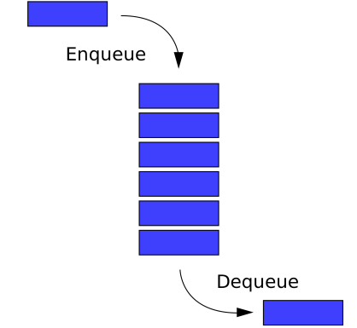
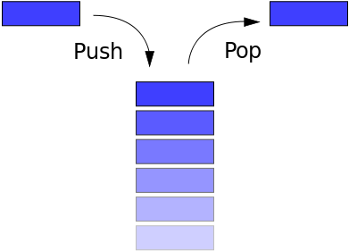
Linear Data Structure
Linear data structures
A data structure is said to be Linear, if its elements are connected in linear fashion by means of logically or in sequence memory locations.
Examples of Linear Data Structure are Stack and Queue.
Stack
Queue

Slide 16
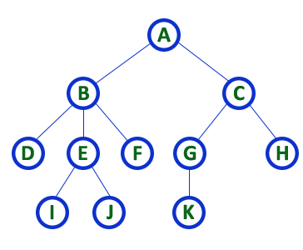
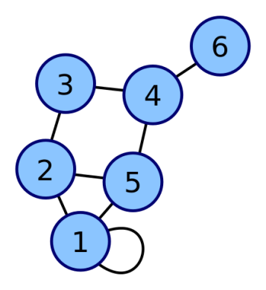
Non-linear Data Structure
Nonlinear data structures
Nonlinear data structures are those data structure in which data items are not arranged in a sequence.
Examples of Non-linear Data Structure are Tree and Graph.
Tree
Graph

Slide 17
Abstract Data Types

Slide 18
Abstract Data Types
Abstract Data type (ADT) is a type (or class) for objects whose behavior is defined by a set of values and a set of operations.
The definition of ADT only mentions what operations are to be performed but not how these operations will be implemented.
It does not specify how data will be organized in memory and what algorithms will be used for implementing the operations. It is called “abstract” because it gives an implementation-independent view.

Slide 19
Abstract Data Types
Example:
Whenever end user uses Stack, he is concerned about only the type of data and operations that can be performed on it.
Fundamentals of how the data is stored is invisible to users.
They will have push() and pop() functions only.

Slide 20
Data Structure

Slide 21
Introduction to Data Structure
What is Data Structure?
A data structure is a way of organizing all data items that considers not only the elements stored but also their relationship to each other.
We can also define data structure as a mathematical or logical model of a particular organization of data items.

Slide 22
Operation of Data Structure
Create: It results in reserving memory for program elements.
Destroy: It destroys memory space allocated for specified data structure.
Selection: It deals with accessing a particular data within a data structure.
Updation: It updates or modifies the data in the data structure.
Searching: It finds the presence of desired data item in the list of data items.
Sorting: It is a process of arranging all data items in a data structure in a particular order.
Merging: It is a process of combining the data items of two different sorted list into a single sorted list.
Splitting: It is a process of partitioning single list to multiple list.
Traversal: It is a process of visiting each and every node of a list in systematic manner.

Slide 23

Thank
You

