Slide 1

Department of CE
Sorting and Searching
Unit - 4
Sorting and searching
Data Structure (01CE1301)

Slide 2
Sorting
The arrangement of data in a preferred order is called sorting in the data structure.
By sorting data, it is easier to search through it quickly and easily.
The simplest example of sorting is a dictionary.
Before the era of the Internet, when you wanted to look up a word in a dictionary, you would do so in alphabetical order.
This made it easy.
What is a Sorting Algorithm?
A sorting algorithm is just a series of orders or instructions.
In this, an array is an input, on which the sorting algorithm performs operations to give out a sorted array.

Slide 3
Bubble Sort
Bubble Sort is the simplest sorting algorithm that works by repeatedly swapping the adjacent elements if they are in the wrong order.
This algorithm is not suitable for large data sets as its average and worst-case time complexity is quite high.

Slide 4
Working of Bubble sort
How does Bubble Sort Work?
Input: arr[] = {5, 1, 4, 2, 8}
First Pass:
• Bubble sort starts with very first two elements, comparing them to check which one is greater.
• ( 5 1 4 2 8 ) –> ( 1 5 4 2 8 ), Here, algorithm compares the first two elements, and swaps since 5 > 1.
• ( 1 5 4 2 8 ) –> ( 1 4 5 2 8 ), Swap since 5 > 4
• ( 1 4 5 2 8 ) –> ( 1 4 2 5 8 ), Swap since 5 > 2
• ( 1 4 2 5 8 ) –> ( 1 4 2 5 8 ), Now, since these elements are already in order (8 > 5), algorithm does not swap them

Slide 5
Second Pass:
• Now, during second iteration it should look like this:
• ( 1 4 2 5 8 ) –> ( 1 4 2 5 8 )
• ( 1 4 2 5 8 ) –> ( 1 2 4 5 8 ), Swap since 4 > 2
• ( 1 2 4 5 8 ) –> ( 1 2 4 5 8 )
• ( 1 2 4 5 8 ) –> ( 1 2 4 5 8 )
Third Pass:
• Now, the array is already sorted, but our algorithm does not know if it is completed.
• The algorithm needs one whole pass without any swap to know it is sorted.
• ( 1 2 4 5 8 ) –> ( 1 2 4 5 8 )
• ( 1 2 4 5 8 ) –> ( 1 2 4 5 8 )
• ( 1 2 4 5 8 ) –> ( 1 2 4 5 8 )
• ( 1 2 4 5 8 ) –> ( 1 2 4 5 8 )
• Run a nested for loop to traverse the input array using two variables i and j, such that 0 ≤ i < n-1 and 0 ≤ j < n-i-1
• If arr[j] is greater than arr[j+1] then swap these adjacent elements, else move on
• Print the sorted array

Slide 6
Bubble Sort
unsorted
Procedure bubble (T[1...n])
for i ← 1 to n-1 do
for j ← 1 to n-i do
if T[j] > T[j+1] then
T[j] ↔ T[j+1]
end if
end for
end for
unsorted
unsorted
unsorted
unsorted
sorted
sorted
sorted
sorted
unsorted
sorted
sorted
j
j
j
j
j
j
j
j
j
j
j
j
j
j
j
1
1
1
2
2
2
3
3
3
4
4
4
5
5
5
6
6
6
6
2
2
1
1
2
6
1
1
2
2
1
6
5
5
3
3
5
6
3
3
5
4
4
3
6
4
4
5
5
4
6
6
6
j+1
j+1
j+1
j+1
j+1
j+1
j+1
j+1
j+1
j+1
j+1
j+1
j+1
j+1
j+1

Slide 7
Bubble Sort
Best Case:
T(n) = O(n)
Worst Case:
T(n) = O(n²)
Average Case:
T(n) = O(n²)

Slide 8
Selection Sort
Selection sort is a simple and efficient sorting algorithm that works by repeatedly selecting the smallest (or largest) element from the unsorted portion of the list and moving it to the sorted portion of the list.
The algorithm repeatedly selects the smallest (or largest) element from the unsorted portion of the list and swaps it with the first element of the unsorted portion.
This process is repeated for the remaining unsorted portion of the list until the entire list is sorted.
One variation of selection sort is called “Bidirectional selection sort” which goes through the list of elements by alternating between the smallest and largest element, this way the algorithm can be faster in some cases.

Slide 9
Selection Sort
The algorithm maintains two subarrays in a given array.
• The subarray which already sorted.
• The remaining subarray was unsorted
In every iteration of the selection sort, the minimum element (considering ascending order) from the unsorted subarray is picked and moved to the beginning of the unsorted subarray.
After every iteration sorted subarray size increase by one and the unsorted subarray size decrease by one.

Slide 10
Selection Sort
sorted
unsorted
sorted
sorted
sorted
sorted
sorted
unsorted
unsorted
unsorted
unsorted
unsorted
Procedure selection (T[1...n])
for i ← 1 to n-1 do
min ← i
for j ← i+1 to n do
if T[j] < T[min] then
min ← j
end if
end for
T[min] ↔ T[i]
end for
j
i
j
i
j
j
i
j
i
j
j
j
j
j
j
j
j
j
j
6
1
1
1
1
2
2
2
2
1
6
3
3
3
5
5
4
4
4
3
6
6
5
5
4
4
5
5
6
1
6
1
2
2
2
6
6
3
5
5
3
3
6
4
4
min
min
min
min
min
min
min
min
min
min
min

Slide 11
Lets consider the following array as an example: arr[] = {64, 25, 12, 22, 11}
First pass:
For the first position in the sorted array, the whole array is traversed from index 0 to 4 sequentially. The first position where 64 is stored presently, after traversing whole array it is clear that 11 is the lowest value.
25 12 22 11
Thus, replace 64 with 11. After one iteration 11, which happens to be the least value in the array, tends to appear in the first position of the sorted list.
11 25 12 22 64
Second Pass:
For the second position, where 25 is present, again traverse the rest of the array in a sequential manner.
11 25 12 22 64
After traversing, we found that 12 is the second lowest value in the array and it should appear at the second place in the array, thus swap these values.
11 12 25 22 64

Slide 12
Third Pass:
Now, for third place, where 25 is present again traverse the rest of the array and find the third least value present in the array.
11 12 25 22 64
While traversing, 22 came out to be the third least value and it should appear at the third place in the array, thus swap 22 with element present at third position.
11 12 22 25 64
Fourth pass:
Similarly, for fourth position traverse the rest of the array and find the fourth least element in the array
As 25 is the 4th lowest value hence, it will place at the fourth position.
11 12 22 25 64
Fifth Pass:
At last the largest value present in the array automatically get placed at the last position in the array
The resulted array is the sorted array.
11 12 22 25 64

Slide 13
Selection Sort
Best Case:
T(n) = O(n²)
Worst Case:
T(n) = O(n²)
Average Case:
T(n) = O(n²)

Slide 14
Insertion Sort
Insertion sort is a simple sorting algorithm that works similar to the way you sort playing cards in your hands. The array is virtually split into a sorted and an unsorted part. Values from the unsorted part are picked and placed at the correct position in the sorted part.
Characteristics of Insertion Sort:
This algorithm is one of the simplest algorithm with simple implementation
Basically, Insertion sort is efficient for small data values
Insertion sort is adaptive in nature, i.e. it is appropriate for data sets which are already partially sorted.

Slide 15
Working of Insertion Sort algorithm:
Consider an example: arr[]: {12, 11, 13, 5, 6}
12 11 13 5 6
First Pass:
Initially, the first two elements of the array are compared in insertion sort.
12 11 13 5 6
Here, 12 is greater than 11 hence they are not in the ascending order and 12 is not at its correct position. Thus, swap 11 and 12.
So, for now 11 is stored in a sorted sub-array
11 12 13 5 6

Slide 16
Second Pass:
Now, move to the next two elements and compare them.
11 12 13 5 6
Here, 13 is greater than 12, thus both elements seems to be in ascending order, hence, no swapping will occur.
12 also stored in a sorted sub-array along with 11
Third Pass:
Now, two elements are present in the sorted sub-array which are 11 and 12
Moving forward to the next two elements which are 13 and 5
11 12 13 5 6
Both 5 and 13 are not present at their correct place so swap them
11 12 5 13 6
After swapping, elements 12 and 5 are not sorted, thus swap again
11 5 12 13 6
Here, again 11 and 5 are not sorted, hence swap again
5 11 12 13 6
Here, 5 is at its correct position

Slide 17
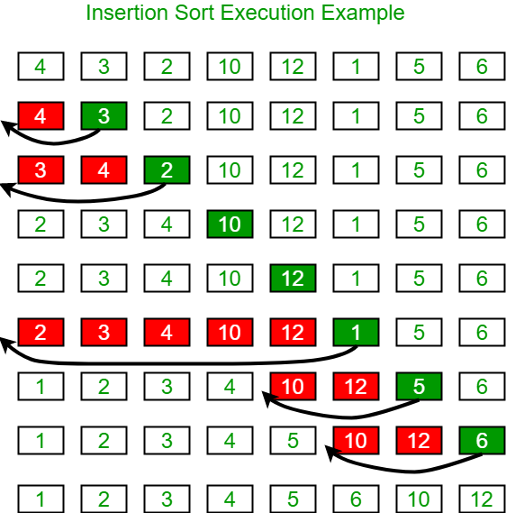
Fourth Pass:
• Now, the elements which are present in the sorted sub-array are 5, 11 and 12
• Moving to the next two elements 13 and 6
5 11 12 13 6
• Clearly, they are not sorted, thus perform swap between both
5 11 12 6 13
• Now, 6 is smaller than 12, hence, swap again
5 11 6 12 13
• Here, also swapping makes 11 and 6 unsorted hence, swap again
5 6 11 12 13
• Finally, the array is completely sorted.

Slide 18
Insertion Sort
sorted
Procedure insertion(T[1...n])
for i ← 1 to n do
curr ← T[i]
j ← i-1
while j >= 0 and T[j] > curr do
T[j+1] ← T[j]
j ← j-1
end while
T[j+1] ← curr;
end for
sorted
sorted
sorted
sorted
sorted
unsorted
unsorted
unsorted
unsorted
unsorted
unsorted
j
j
j
j
j
j
j
j
j
j
j
6
2
1
5
3
4
6
2
2
1
2
6
6
2
1
1
6
5
5
3
3
4
1
4
1
2
2
6
5
5
3
5
6
6
5
3
3
6
4
1
2
3
5
4
4
6
5
4
6
i
i
i
i
i
i
2
1
5
3
4
curr

Slide 19
Insertion sort
Best Case:
T(n) = O(n)
Worst Case:
T(n) = O(n²)
Average Case:
T(n) = O(n²)

Slide 20
Merge Sort
Merge sort is similar to the quick sort algorithm as it uses the divide and conquer approach to sort the elements.
It is one of the most popular and efficient sorting algorithm. It divides the given list into two equal halves, calls itself for the two halves and then merges the two sorted halves.
We have to define the merge() function to perform the merging.
The sub-lists are divided again and again into halves until the list cannot be divided further.
Then we combine the pair of one element lists into two-element lists, sorting them in the process.
The sorted two-element pairs is merged into the four-element lists, and so on until we get the sorted list.

Slide 21
Merge Sort
7
7
2
2
9
9
1
1
4
4
3
3
8
8
6
6
5
5
7
2
9
1
4
3
8
6
5
7
2
9
1
4
3
8
6
5
7
2
9
1
4
3
8
6
5
6
5
2
7
1
9
3
4
5
6
5
6
8
1
2
7
9
3
4
5
6
8
1
1
2
2
3
3
4
4
5
5
6
6
7
7
8
8
9
9

Slide 22
Merge Sort
0 1 2 3 4 5 6 7 8
7
2
9
9
9
1
1
4
3
3
8
8
6
6
5
5

Slide 23
Merge Sort
MergeSort(int arr[], int size){
int* tmp=new int[size];
MSort(arr, tmp, 0, size-1);
delete [] tmp;
}
MSort(int arr[], int tmp[], int start, int end){
if(start<end){
int mid=(start+end)/2;
MSort(arr, tmp, start, mid);
MSort(arr, tmp, mid+1, end);
Merge(arr, tmp, start, mid+1, end);
}
}

Slide 24
Merge Sort
0
0 1
1
2 3
4 5 6 7 8
7
2
2
7
9
1
4
3
8
6
5
Aptr
Bptr
0 1 2 3 4 5 6 7 8
2
7
idx
idx
idx

Slide 25
Merge Sort
0 1
0 1
2
2 3
2 3
3
4 5 6 7 8
2
2
7
7
9
9
1
1
1
9
4
3
8
6
5
Aptr
Bptr
0 1 2 3 4 5 6 7 8
1
9
idx
idx
idx

Slide 26
Merge Sort
0 1
0 1 2 3
2 3
4 5 6 7 8
2
7
1
2
1
7
9
9
4
3
8
6
5
Aptr
Aptr
Bptr
Bptr
0 1 2 3 4 5 6 7 8
1
2
7
9
idx
idx
idx
idx
idx

Slide 27
Merge Sort
Merge(int arr[], int tmp[], int startA,
int startB, int endB){
int aptr=startA;
int bptr=startB;
int idx=startA;
while(aptr < startB && bptr < endB+1){
if(arr[aptr] < arr[bptr]){
tmp[idx++]=arr[aptr++];
} else {
tmp[idx++]=arr[bptr++];
}
}
while(aptr < startB){
tmp[idx++]=arr[aptr++];
}
while(bptr < endB+1){
tmp[idx++]=arr[bptr++];
}
for(int i=startA; i<=endB; i++){
arr[i]=tmp[i];
}
}

Slide 28
Merge Sort
0 1 2 3
4 5
4
4 5 6 7 8
5
6 7 8
6 7 8
1
2
7
9
4
4
4
3
3
3
8
8
6
8
6
5
6
5
5
0 1 2 3 4 5 6 7 8

Slide 29
Merge Sort
0 1 2 3
4
4 5
5
6
6 7 8
7 8
7
8
1
2
7
9
4
3
3
4
8
8
6
6
6
5
5
5
Aptr
Bptr
0 1 2 3 4 5 6 7 8
3
4
idx
idx
idx

Slide 30
Merge Sort
0 1 2 3
4 5
6
7
7 8
8
1
2
7
9
3
4
8
6
5
6
5
Aptr
Bptr
0 1 2 3 4 5 6 7 8
5
6
idx
idx

Slide 31
Merge Sort
0 1 2 3
4 5
6
6 7 8
7 8
1
2
7
9
3
4
8
5
6
5
8
6
Aptr
Bptr
Bptr
0 1 2 3 4 5 6 7 8
5
6
8
idx
idx
idx

Slide 32
Merge Sort
0 1 2 3
4 5 6 7 8
4 5
6 7 8
1
2
7
9
3
3
4
4
5
5
6
6
8
8
Aptr
Aptr
Bptr
Bptr
Bptr
0 1 2 3 4 5 6 7 8
3
4
5
6
8
idx
idx
idx
idx
idx

Slide 33
Merge Sort
0 1 2 3
0 1 2 3 4 5 6 7 8
4 5 6 7 8
1
1
2
2
7
3
9
4
5
3
6
4
7
5
8
6
9
8
Aptr
Aptr
Aptr
Aptr
Bptr
Bptr
Bptr
Bptr
Bptr
0 1 2 3 4 5 6 7 8
1
2
3
4
5
6
7
8
9
idx
idx
idx
idx
idx
idx
idx
idx
idx

Slide 34
Merge Sort
Best Case:
T(n) = O(nlog(n))
Worst Case:
T(n) = O(nlog(n))
Average Case:
T(n) = O(nlog(n))

Slide 35
Quick Sort
Quicksort picks an element as pivot, and then it partitions the given array around the picked pivot element.
In quick sort, a large array is divided into two arrays in which one holds values that are smaller than the specified value (Pivot), and another array holds the values that are greater than the pivot.
After that, left and right sub-arrays are also partitioned using the same approach.
It will continue until the single element remains in the sub-array.

Slide 36
Quick Sort
pivotpt
pivotpt
7
3
2
9
1
1
4
9
4
5
3
7
8
6
5
4
9
i
i
j
j
i
j
i
j
j
j

Slide 37
Quick Sort
pivotpt
pivotpt
1
3
1
2
3
2
2
3
1
4
5
7
8
6
9
i
j
j
i

Slide 38
Quick Sort
1
1
2
3
4
5
7
8
6
9

Slide 39
Quick Sort
1
1
2
2
3
3
3
4
5
7
8
6
9

Slide 40
Quick Sort
pivotpt
pivotpt
1
2
3
4
5
7
6
9
8
8
9
6
9
8
9
i
i
j
j
i
i

Slide 41
Quick Sort
partition(int arr[], int left, int right){
int pivotpt = (left+right)/2;
int pivot = arr[pivotpt];
swap(arr[pivotpt], arr[right]);
pivotpt = right;
int i = left;
int j = right-1;
while(i<j){
while(i< right-1 && arr[i]<pivot)
i++;
while(j > 0 && arr[j]>pivot)
j--;
if(i<j)
swap(arr[i++], arr[j--]);
}
if(i==j && arr[i] < arr[pivotpt])
i++;
swap(arr[i], arr[pivotpt]);
return i;
}
quick(int arr[], int left, int right){
int p;
if(left<right){
p=partition(arr, left, right);
quick(arr, left, p-1);
quick(arr, p+1, right);
}
}

Slide 42
Quick Sort
pivotpt
pivotpt
1
2
3
4
5
6
7
7
6
8
9
i
j
i
i

Slide 43
Quick Sort
pivotpt
pivotpt
1
2
3
4
6
5
5
6
5
6
7
8
9
j
i

Slide 44
Quick Sort
1
1
2
2
3
3
4
4
5
6
7
8
9

Slide 45
Quick Sort
1
2
3
4
5
6
6
7
7
8
8
9
9

Slide 46
Quick Sort
1
2
3
4
5
6
7
8
8
9
9
9
9

Slide 47
Quick Sort
1
2
3
4
5
6
7
8
9

Slide 48
Quick Sort
Best Case:
T(n) = O(nlog(n))
Worst Case:
T(n) = O(n²)
Average Case:
T(n) = O(nlog(n))

Slide 49
Linear Search
Linear search in C to find whether a number is present in an array. If it's present, then at what location it occurs. It is also known as a sequential search.
we compare each element with the element to search until we find it or the list ends.

Slide 50
Linear Search pseudo code
for(i=0; i<n; i++)
{
if(a[i] == data)
{
Printf(“element found at location: %d”, i);
Break;
}
}
If(i == n){
printf(“element not found”);
}

Slide 51
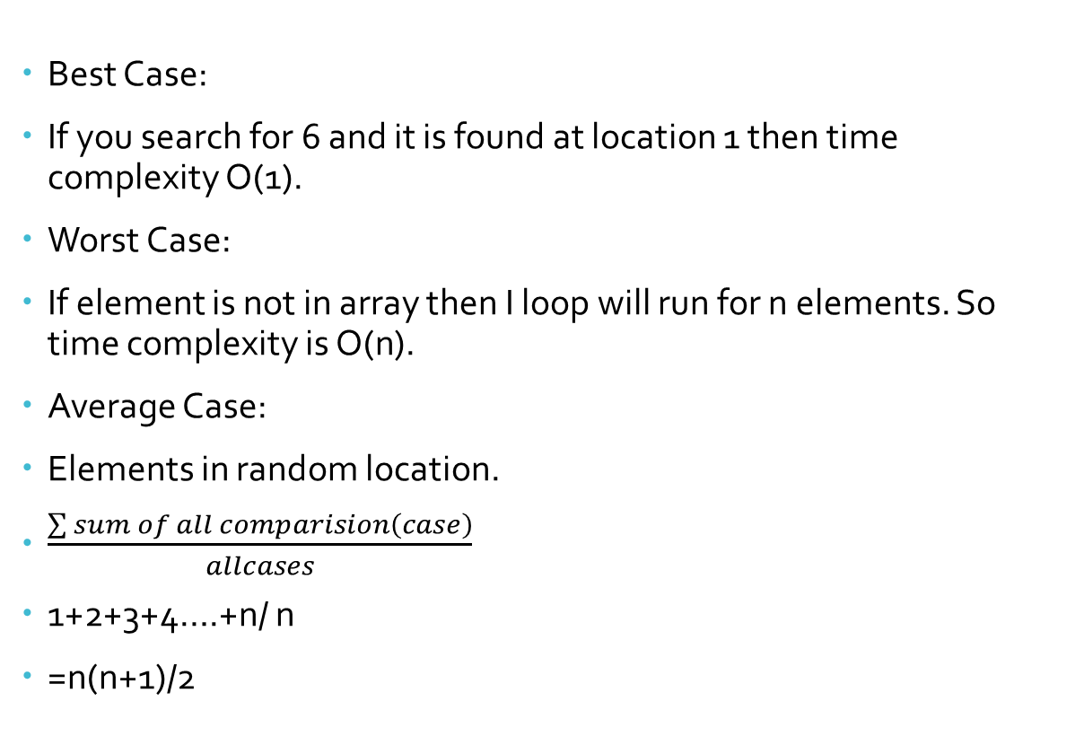
Time Analysis
Best Case:
If you search for 6 and it is found at location 1 then time complexity O(1).
Worst Case:
If element is not in array then I loop will run for n elements. So time complexity is O(n).
Average Case:
Elements in random location.
$\frac{\sum{sum of all comparision\left(case\right)}}{allcases}$
1+2+3+4….+n/ n
=n(n+1)/2

Slide 52
Binary Search
Binary search will take less time than linear search.
Precondition: Array must be sorted. If array is not sorted we can not apply algorithm.
Working Principle:
Search a sorted array by repeatedly dividing the search interval in half.
We basically ignore half of the elements just after one comparison.
Compare data with the middle element.
If data matches with middle element, we return the mid index.
Else If data > mid element, then data can only lie in right half subarray after the mid element. So we trace for right half.
Else (data is smaller) trace for the left half.

Slide 53
3 Cases
Data == mid , return mid
Data< mid , high = mid-1
Data> mid, low= mid+1

Slide 54
Binary Search

Slide 55
Binary Search Example
0 | 1 | 2 | 3 | 4 | 5 | 6 | 7 | 8 | 9
5 | 9 | 17 | 23 | 25 | 45 | 59 | 63 | 71 | 89
low
high
Data = 59
Low | High | mid
0 | 9 | 4
mid = low + high / 2
0 | 1 | 2 | 3 | 4 | 5 | 6 | 7 | 8 | 9
5 | 9 | 17 | 23 | 25 | 45 | 59 | 63 | 71 | 89
low
mid
high
Data = 59 a[mid]= a[4]= 25
data> a[mid] -------→ case 3
low= mid+1

Slide 56
Binary Search Example
0 | 1 | 2 | 3 | 4 | 5 | 6 | 7 | 8 | 9
5 | 9 | 17 | 23 | 25 | 45 | 59 | 63 | 71 | 89
low
high
Data = 59
Low | High | mid
0 | 9 | 4
5 | 9 | 7
0 | 1 | 2 | 3 | 4 | 5 | 6 | 7 | 8 | 9
5 | 9 | 17 | 23 | 25 | 45 | 59 | 63 | 71 | 89
low
mid
high
Data = 59 a[mid]= a[7]= 63
Data < a[mid] -------→ case 2
High = mid- 1

Slide 57
Binary Search Example
0 | 1 | 2 | 3 | 4 | 5 | 6 | 7 | 8 | 9
5 | 9 | 17 | 23 | 25 | 45 | 59 | 63 | 71 | 89
low
high
Data = 59
Low | High | mid
0 | 9 | 4
5 | 9 | 7
5 | 6 | 5
0 | 1 | 2 | 3 | 4 | 5 | 6 | 7 | 8 | 9
5 | 9 | 17 | 23 | 25 | 45 | 59 | 63 | 71 | 89
low
high
mid
Data = 59 a[mid]= a[5]= 45
Data > a[mid] -------→ case 3
Low = mid+1

Slide 58
Binary Search Example
0 | 1 | 2 | 3 | 4 | 5 | 6 | 7 | 8 | 9
5 | 9 | 17 | 23 | 25 | 45 | 59 | 63 | 71 | 89
low
high
Data = 59
Low | High | mid
0 | 9 | 4
5 | 9 | 7
5 | 6 | 5
6 | 6 | 6
0 | 1 | 2 | 3 | 4 | 5 | 6 | 7 | 8 | 9
5 | 9 | 17 | 23 | 25 | 45 | 59 | 63 | 71 | 89
high
mid
Data = 59 a[mid]= a[6]= 59
Data = a[mid] -------→ case 1
Return mid --→ 59 found.
low

Slide 59
Binary Search Example (if data is not found)
0 | 1 | 2 | 3 | 4 | 5 | 6 | 7 | 8 | 9
5 | 9 | 17 | 23 | 25 | 45 | 59 | 63 | 71 | 89
low
high
Data = 60
Low | High | mid
0 | 9 | 4
0 | 1 | 2 | 3 | 4 | 5 | 6 | 7 | 8 | 9
5 | 9 | 17 | 23 | 25 | 45 | 59 | 63 | 71 | 89
low
mid
high
Data = 60 a[mid]= a[4]= 25
data> a[mid] -------→ case 3
low= mid+1

Slide 60
Binary Search Example (if data is not found)
0 | 1 | 2 | 3 | 4 | 5 | 6 | 7 | 8 | 9
5 | 9 | 17 | 23 | 25 | 45 | 59 | 63 | 71 | 89
low
high
Data = 60
Low | High | mid
0 | 9 | 4
5 | 9 | 7
0 | 1 | 2 | 3 | 4 | 5 | 6 | 7 | 8 | 9
5 | 9 | 17 | 23 | 25 | 45 | 59 | 63 | 71 | 89
low
mid
high
Data = 60 a[mid]= a[7]= 63
Data < a[mid] -------→ case 2
High = mid-1

Slide 61
Binary Search Example (if data is not found)
0 | 1 | 2 | 3 | 4 | 5 | 6 | 7 | 8 | 9
5 | 9 | 17 | 23 | 25 | 45 | 59 | 63 | 71 | 89
low
high
Data = 60
Low | High | mid
0 | 9 | 4
5 | 9 | 7
5 | 6 | 5
0 | 1 | 2 | 3 | 4 | 5 | 6 | 7 | 8 | 9
5 | 9 | 17 | 23 | 25 | 45 | 59 | 63 | 71 | 89
low
high
mid
Data = 60 a[mid]= a[5]= 45
data> a[mid] -------→ case 3
low= mid+1

Slide 62
Binary Search Example (if data is not found)
0 | 1 | 2 | 3 | 4 | 5 | 6 | 7 | 8 | 9
5 | 9 | 17 | 23 | 25 | 45 | 59 | 63 | 71 | 89
high
low
Data = 60
Low | High | mid
0 | 9 | 4
5 | 9 | 7
5 | 6 | 5
6 | 6 | 6
0 | 1 | 2 | 3 | 4 | 5 | 6 | 7 | 8 | 9
5 | 9 | 17 | 23 | 25 | 45 | 59 | 63 | 71 | 89
high
mid
Data = 60 a[mid]= a[6]= 59
data> a[mid] -------→ case 3
low= mid+1
low

Slide 63
Binary Search Example (if data is not found)
0 | 1 | 2 | 3 | 4 | 5 | 6 | 7 | 8 | 9
5 | 9 | 17 | 23 | 25 | 45 | 59 | 63 | 71 | 89
high
low
Data = 60
Low | High | mid
0 | 9 | 4
5 | 9 | 7
5 | 6 | 5
6 | 6 | 6
7 | 6 | 6
If (low> high) we should stop. And return -1. element is not found.

Slide 64
Algorithm for Binary Search
BINARY-SEARCH(A, low, high, data)
if( low<= high){
mid = floor((start+end)/2)
if (A[mid]== data){
return mid
}
if (A[mid]>data){
return BINARY-SEARCH(A, low, mid-1, data)
}
if( A[mid]<data){
return BINARY-SEARCH(A, mid+1, high, data)
}
return FALSE // in case, element is not in the array
}

Slide 65
Time Complexity
O(logn) – Worst Case
O(1)- Best Case.

Slide 66
Thank you

