Slide 1
DATA SCIENCE SKILL-BASED ASSESSMENT | CH15
Road Safety Insight
Understand Accidents • Discover Risk Patterns • Support Safer Roads
Executive Briefing: Multi-Source Data Quality Audit, Empirical EDA, ML Severity Prediction & Decision Platform
Notice: All records reflect computer-generated educational synthetic data. Location names and numbers are illustrative.

Slide 2
PHASE 1 & PHASE 2 ARCHITECTURE
Data Ingestion, Quality Assessment & Cleaning Pipeline
Planted Quality Issues Detected
• Raw Ingestion: 6,040 accident records; 6,000 records each in roads, weather, traffic, and vehicles.
• 40 Duplicate Incidents: Placed in accidents.csv; deduplicated to 6,000 unique incident IDs.
• 24 Invalid Severities: Unknown (8), Critical (6), 0 (5), 5 (5); excluded from modeling.
• 115 Inconsistent Road Types: Case and whitespace variations standardized into 5 classes.
• 18 Speed Limit Outliers: Negative (-20..-1) and extreme values (>200 km/h) imputed by road-type median.
• 300 Blank Weather Rows: Mode imputation for conditions, median for rainfall and visibility.
• 24 Traffic Volume Outliers: Imputed via road-type and peak-flag grouped medians.
Integration & Cleaning Verification
• Common Key: incident_id validated across all 5 tables (100% key intersection).
• 1-to-1 Cardinality: Verified join integrity; zero unintended row multiplication or cartesian join expansion.
• Final Clean Cohort: Exactly 5,976 validated, integrated incidents preserved.
• 149 Missing Locations: Categorized explicitly as 'Unknown Location' to preserve valid accident records.
• Temporal Feature Engineering: Derived hour, day of week, month, peak flag, and weekend indicators.
• Audit Trail: Full reconciliation exported to data_quality_report.csv and Excel audit sheet.
Cleaned Cohort Profile (N = 5,976)
• Minor Severity: 4,100 incidents (68.61% baseline share).
• Serious Severity: 1,645 incidents (27.53% baseline share).
• Fatal Severity: 231 incidents (3.87% critical minority).
• Severe Cohort (Serious + Fatal): 1,876 incidents (31.39%).
• Road Types: Urban Arterial (26.6%), Collector (21.9%), Service (19.9%), Highway Link (17.6%), Residential (14.4%).
• Weather Conditions: Clear (50.8%), Cloudy (24.9%), Light Rain (14.1%), Fog (5.4%), Heavy Rain (5.2%).
• Primary Vehicles: Cars (39.9%), Motorcycles (26.9%), Auto-rickshaws (9.7%), Trucks (8.1%).

Slide 3
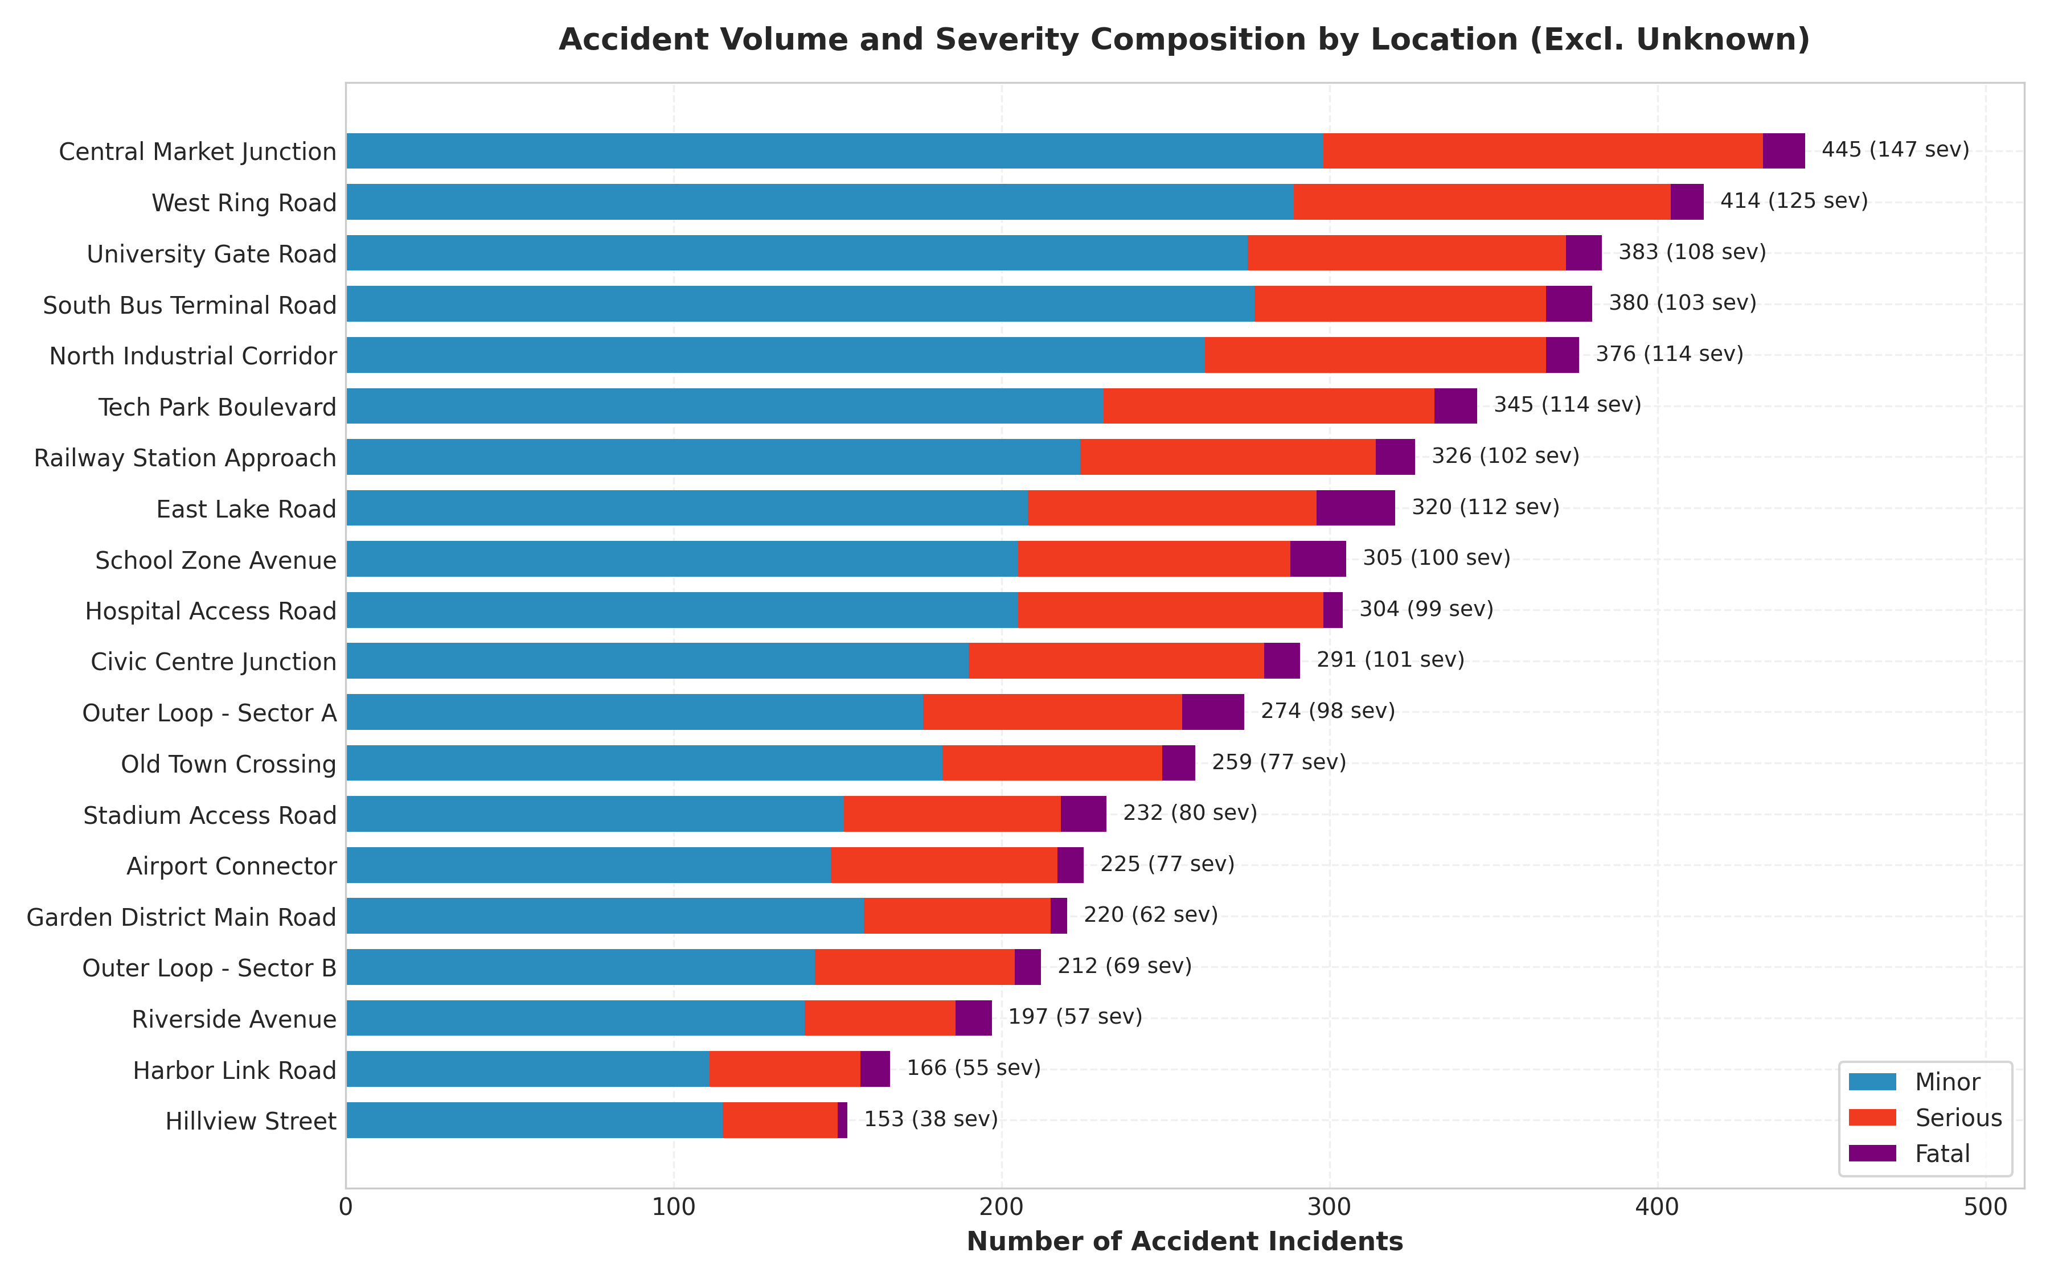
PHASE 3 EXPLORATORY DATA ANALYSIS
Corridor Hotspot Analysis & Severity Concentration
Spatial Hotspot Insights
• Volume Leader: Central Market Junction recorded the highest overall accident volume (445 incidents; 147 severe crashes).
• Fatal Corridor Leader: East Lake Road recorded the highest fatal crash count across all corridors (24 fatal-severity crashes, 7.50% fatal crash share across 320 crashes).
• Secondary Lethality Corridors: Outer Loop - Sector A exhibited 19 fatal crashes (6.93%), and School Zone Avenue recorded 17 fatal crashes (5.57%).
• Lowest Incident Site: Hillview Street recorded the fewest incidents (153 total) and lowest severe share (24.8%).
• Key Policy Takeaway: High crash frequency does NOT equal highest fatal crash share. Municipal road safety teams must deploy dual-track interventions: congestion calming at high-volume sites and physical crash cushions at high-severity corridors. (Distinguish observed counts from exposure-adjusted risk).

Slide 4
PHASE 3 EMPIRICAL PATTERNS
Multi-Dimensional Risk Factors: Time, Weather & Modes
Temporal & Weather Risk Patterns
• Rush-Hour Spikes: Accidents peak sharply during morning (08:00, 547 incidents) and evening (18:00, 608 incidents) commutes.
• Peak Congestion Share: Designated peak hours account for 3,624 incidents (60.6% of all recorded accidents).
• Night Fatal Crash Share: Night hours (21:00-04:59) represent only 9.6% of volume (573 crashes) but exhibit the HIGHEST fatal crash share at 4.71%, nearly double the Afternoon share (2.70%).
• Fog Multiplier Effect: Dense Fog (323 incidents) escalates fatal crash share to 8.10% and combined severe crash share to 45.48% (vs 28.6% under Clear skies).
• Precipitation Impact: Light Rain elevated severe crash share to 39.31%, highlighting slick surface risks.
Infrastructure & Road User Vulnerabilities
• Highway Link Hazard: Highway Links exhibited a 6.03% fatal crash share, more than 2.2x higher than Collector Roads (2.68%).
• Speed Limit Association: Fatal crashes occurred on road segments with a mean nominal speed limit of 48.4 km/h, compared to 44.3 km/h for minor crashes.
• Junction Geometries: Flyovers and Midblock segments recorded the highest fatal crash shares (5.03% and 4.88%), whereas Roundabouts had the lowest (2.47%).
• Vulnerable Road Users: Motorcycles recorded 5.06% fatal and 30.65% serious injury shares (35.71% total severe), highest among motorized transport.
• Passenger Cars: Recorded the lowest fatal crash share among motorized vehicles at 3.48% (71.8% minor).

Slide 5
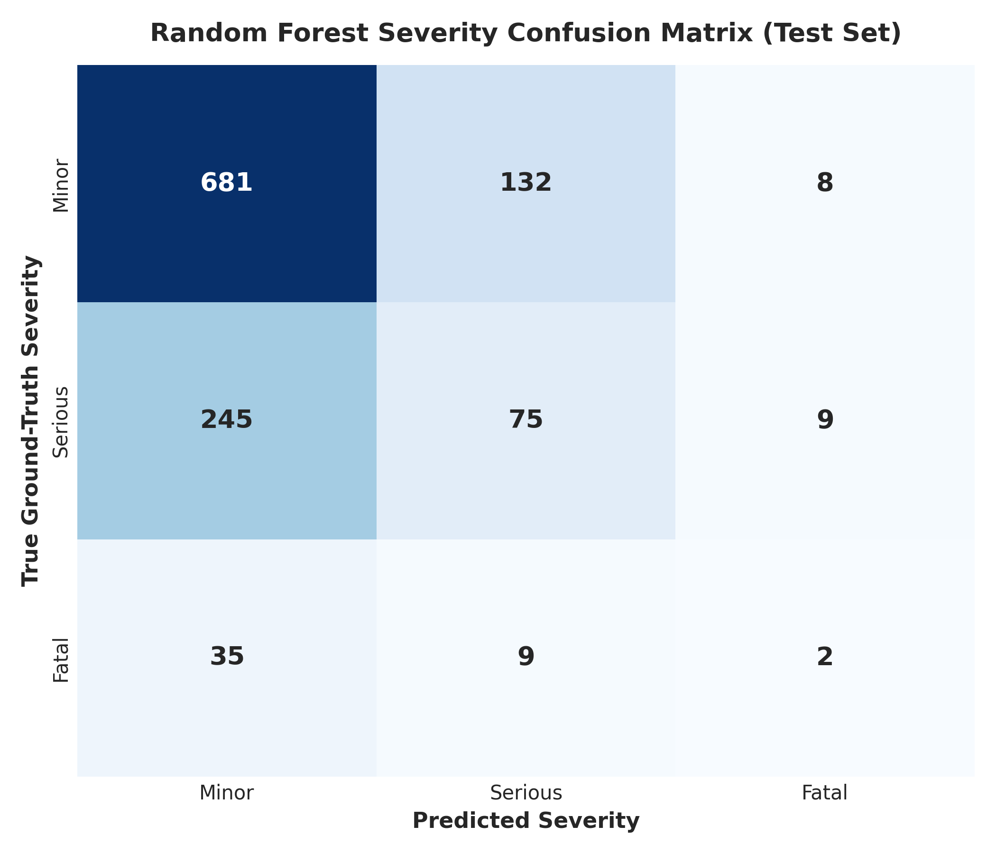
PHASE 5 PREDICTIVE ANALYTICS
Supervised Machine Learning Model & Evaluation
Model Methodology, Metrics & Limitations
• Pipeline Architecture: Scikit-learn Pipeline with ColumnTransformer (imputation + scaling + OneHotEncoder) and RandomForestClassifier (150 trees, max_depth=10).
• Leakage Prevention: Preprocessor fitted strictly on training partition (4,780 rows). Evaluated on untouched 20% stratified test set (1,196 rows).
• Overall Accuracy: 63.38% on untouched holdout test data.
• Macro F1-Score: 0.3670 | Weighted F1-Score: 0.6027.
• Class-Wise Performance: Minor (F1: 0.76, Recall: 83.0%), Serious (F1: 0.28, Recall: 22.8%), Fatal (F1: 0.06, Recall: 4.3%).
• Severe Class Imbalance: Extreme rarity of Fatal crashes (3.9%) and Serious injuries (27.5%) causes lower minority recall; balanced class weights prevented majority-class collapse.
• Feature Association: Visibility, traffic volume, and speed limit are top associative features. These describe model correlations, NOT physical crash causality.

Slide 6
PHASE 8 DECISION INTELLIGENCE
Strategic Safety Recommendations & Roadmap
Targeted Action Recommendations
• 1. Corridor-Specific Engineering Audits: Conduct urgent geometric and barrier safety audits along East Lake Road and Outer Loop Sector A to address high fatal crash counts.
• 2. Night-Time Speed Enforcement: Deploy automated radar speed enforcement and upgrade retroreflective street lighting between 21:00 and 04:00 to address the elevated 4.71% night fatal crash share.
• 3. Dynamic Weather Warning Systems: Install Variable Message Signs (VMS) on Highway Links and Flyovers to enforce dynamic speed reductions during Fog and heavy rain.
• 4. Dedicated Two-Wheeler Corridors: Implement physical barrier separation and motorcycle-safe crash barriers along Urban Arterials and collector links.
• 5. Congestion Management at Market Sites: Optimize traffic signal phases and pedestrian grade separation at Central Market Junction to suppress collision frequency.
Implementation Roadmap & Limitations
• Phase 1 (Months 1-3): Rapid deployment of high-visibility enforcement and fog warning signage at top 5 severe corridors.
• Phase 2 (Months 4-6): Midblock junction redesign, flyover barrier reinforcement, and streetlight retrofitting.
• Phase 3 (Months 7-12): Integration of continuous sensor feeds into the deployed Streamlit Intelligence Platform for real-time risk scoring.
• Critical Analytical Limitation: The synthetic dataset lacks exposure denominators (vehicle-km travelled, total traffic volumes for non-accident periods).
• Exposure Caution: Reported metrics represent incident proportions, not per-exposure accident probabilities. Future phases must incorporate telematics exposure data.

