Slide 1
Household Daily Expense Analysis

Slide 2
1. Problem Statement & Objectives
A family wants to understand its daily household spending.
Analyze grocery, utilities, medical, travel, education and other expenses.
Identify high-value and recurring expenses.
Understand payment behaviour and pending payments.
Give simple recommendations for better expense management.

Slide 3
2. Database & Tables
Database: household_expenses
Main tables:
• expense_categories – expense categories
• expense_subcategories – detailed expense types
• family_members – family member details
• payment_methods – Cash, UPI, Cards, etc.
• vendors – stores/service providers
• expenses – main expense transaction data

Slide 4
3. Data & Expense Records
Sample data includes household expenses from January 2026.
Examples: Kirana, vegetables, milk, electricity, property tax.
Medical, restaurant, petrol, train tickets, college fees and mobile recharge are also included.
Important fields: date, amount, member, vendor, payment method, recurring status and paid status.

Slide 5
4. SQL Analysis Performed
/*Part A — Basic Expense Analysis
1. Household Expense Overview
The family wants to see its complete expense history.
Display:
• Expense ID
• Expense Date
• Amount
• Description
• Payment Status*/
SELECT
expense_id,
expense_date,
amount,
description,
paid_status
FROM expenses
ORDER BY expense_id;

Slide 6
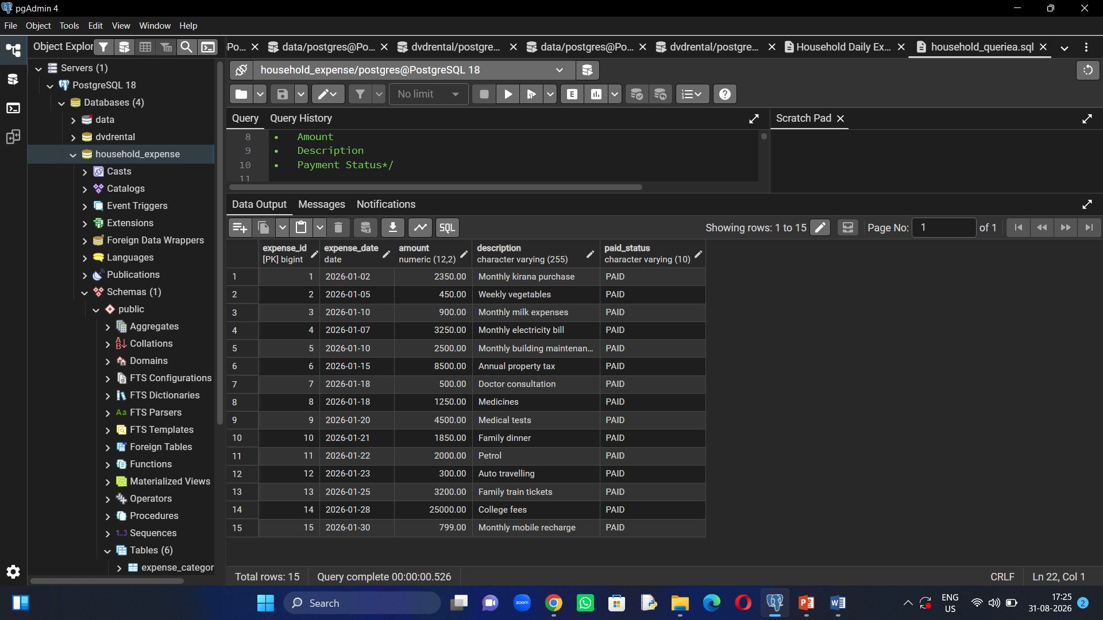

Slide 7
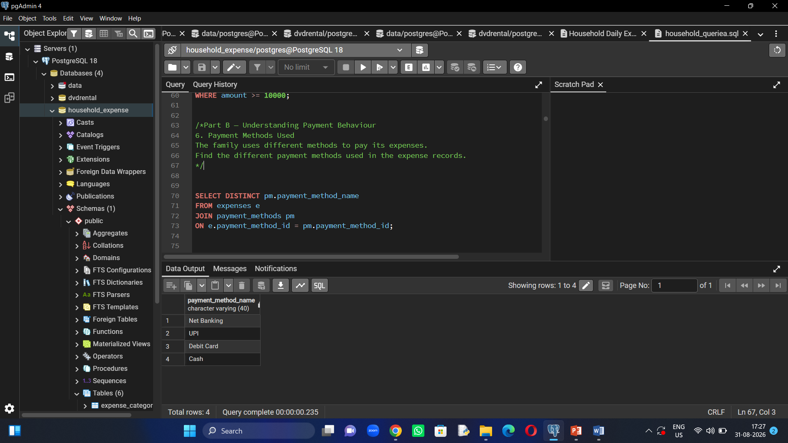

Slide 8
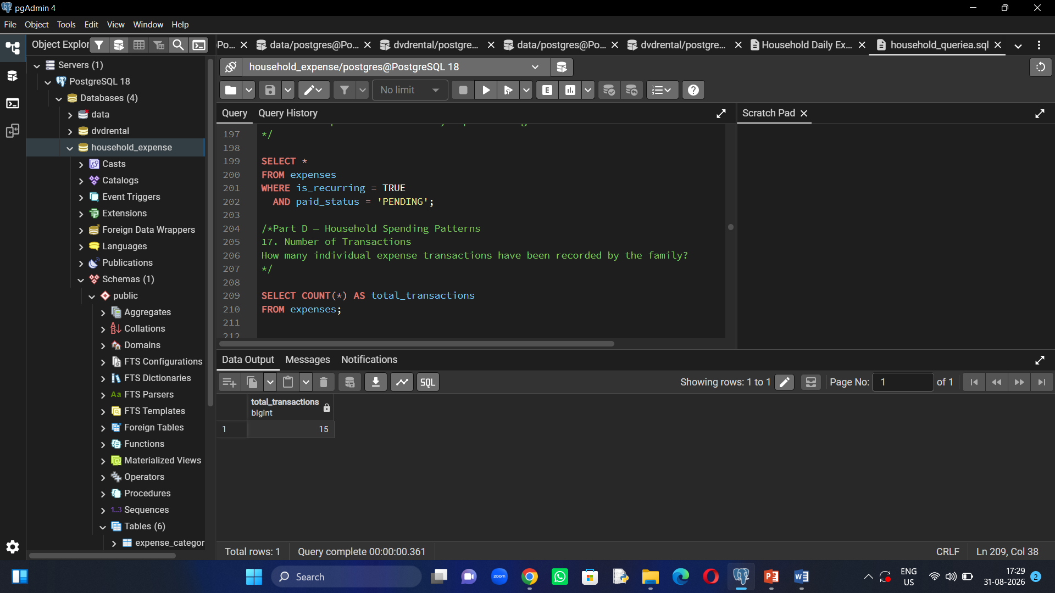

Slide 9
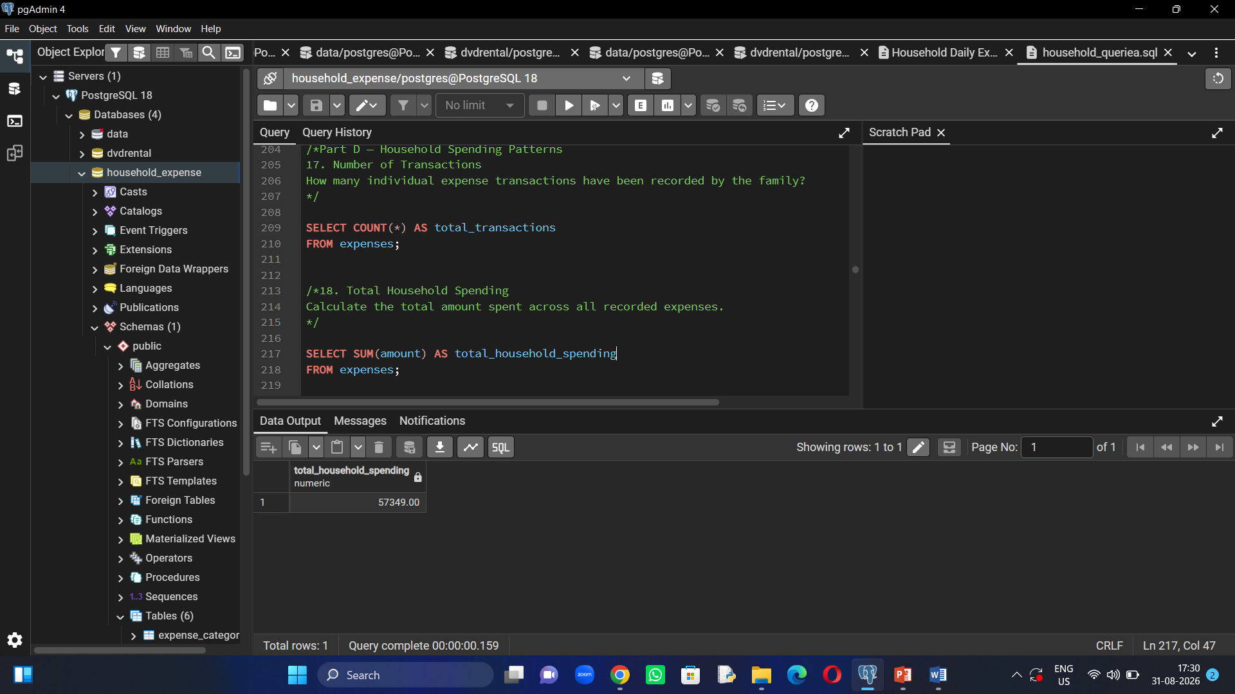

Slide 10
5. Important Findings from Sample Data
Total recorded spending: ₹59,299
Highest individual expense: ₹25,000 (College Fees)
Recurring expenses include milk, electricity, maintenance, property tax, college fees and mobile recharge.
UPI, Cash, Debit Card and Net Banking are among the payment methods used.
High-value expenses need attention for better budgeting.

Slide 11
6. Conclusion & Recommendations
The project helped me understand how SQL can solve a real-life financial problem.
Household expenses can be grouped and analyzed systematically.
Track recurring commitments every month.
Review high-value expenses such as education, property tax and other large payments.
Maintain complete vendor and bill information.
Use the analysis to plan a better household budget.

