Slide 1
Personal Household Expense Management & Analysis

Slide 2
Business Understanding
Household expenses are frequent and spread across many categories.
Manual tracking makes it difficult to know where money is going.
The database provides a systematic record and supports analysis.

Slide 3
Objectives
Record and categorize household expenses.
Track family members, vendors and payment methods.
Identify high-value and recurring expenses.
Compare expenditure across three months.
Find opportunities to control unnecessary expenditure.

Slide 4
Constraints & Challenges
Frequent small-value transactions.
Different payment methods and vendors.
Maintaining consistent data entry.
Protecting sensitive financial information.

Slide 5
Data Understanding
Period: June–August 2026
Transactions: 63
Categories: 6 | Subcategories: 12
Members: 2 | Payment methods: 4
Total expenditure: ₹175,950

Slide 6
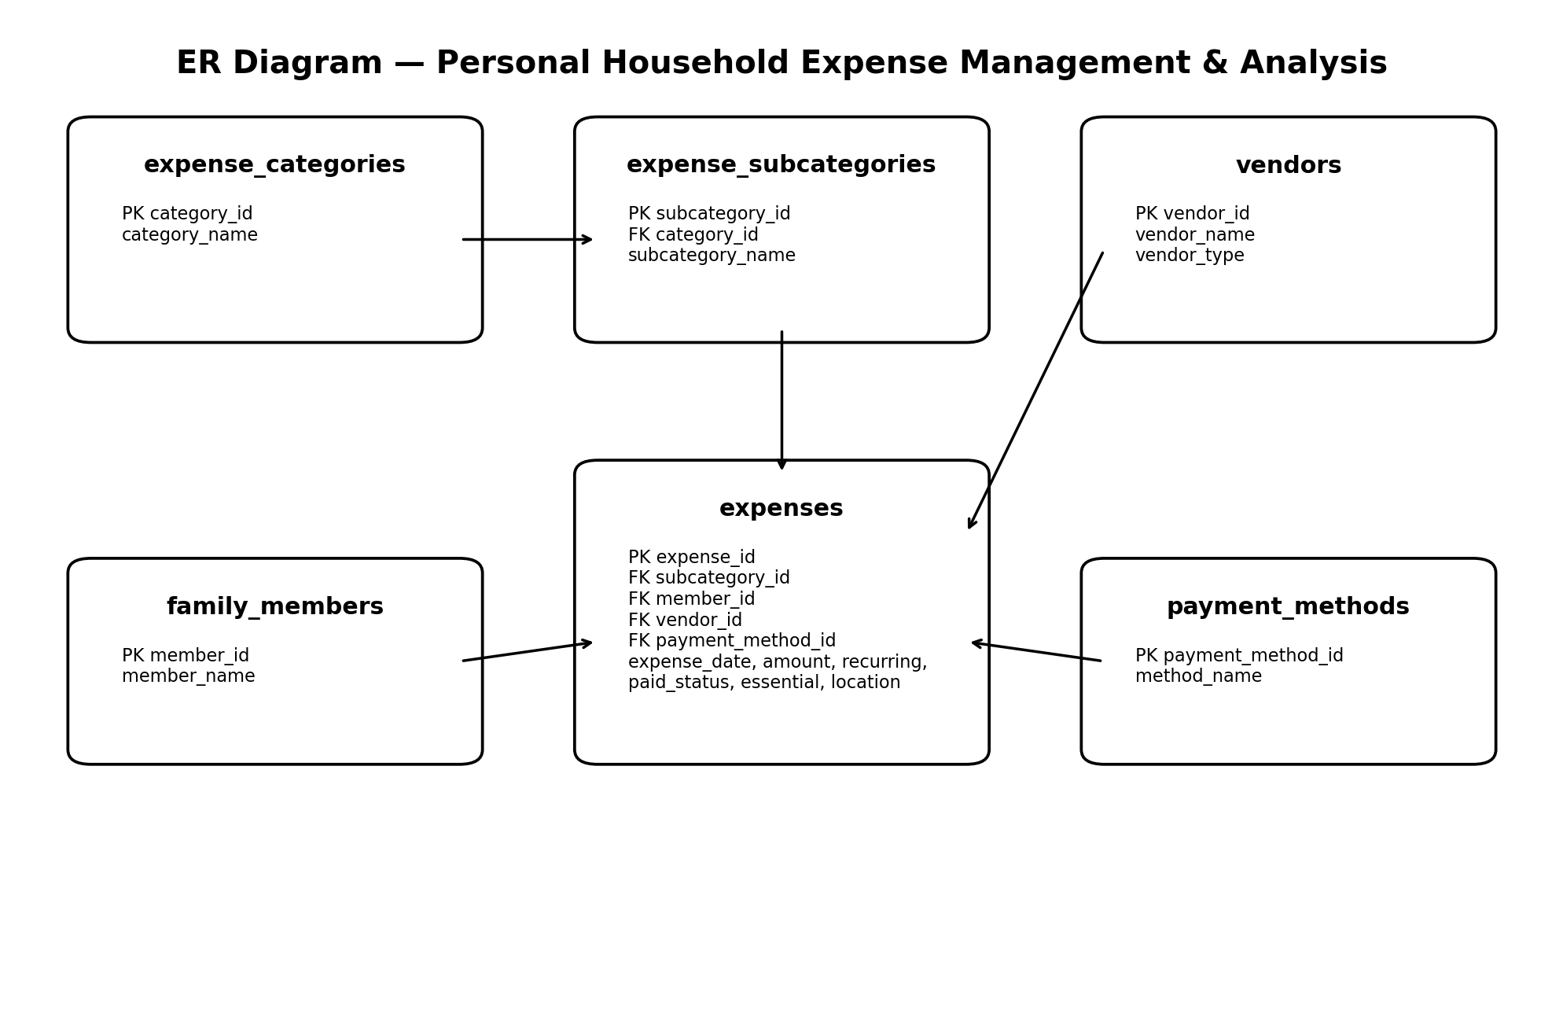
Database Design / ER Diagram

Slide 7
Three-Month Analysis
August: ₹58,650
July: ₹58,650
August: ₹58,650
Average transaction: ₹2,792.86
Highest individual expense: ₹20,000

Slide 8
Key Insights
Total expenditure across the three-month period is ₹175,950.00.
Car EMI, class fees and house maintenance are the largest recurring financial commitments.
Food-related expenses such as grocery, vegetables and milk occur frequently, even when individual transactions are small.
Recurring commitments represent a major share of total spending and should be reviewed during budgeting.
Digital payments (UPI, debit card and bank transfer) are used for several high-value transactions, while cash is used for smaller day-to-day purchases.

Slide 9
Recommendations & Conclusion
Set budgets for frequent discretionary spending.
Review high-value recurring commitments regularly.
Compare monthly totals and transaction counts.
Maintain consistent vendor/payment data.
Three-month expenditure: ₹175,950

