Slide 1
OnboardIQ
DE Hackathon 26
AI Powered Enterprise Customer Onboarding
From Customer Sign Up to Customer Value: Faster, Smarter, AI Powered
Presented By:
TEAM: SpecFlow AI
Shishank, Ankit, Apurva, Harshada & Harshal

Slide 2
DE Hackathon 26
AGENDA
THE ONBOARDING PROBLEM
FROM MANUAL TO INTELLIGENT
BEHIND THE INTELLIGENCE
SEE IT IN ACTION
THE VALUE WE DELIVER
Q/A

Slide 3
THE ONBOARDING PROBLEM
DE Hackathon 26
Customers can sign a contract in days. Onboarding them can still take months.
80–90%
Manual
onboarding
activities
3–4
Months
delayed
time-to-
value
6–12
Weeks of
onboarding
effort
60%+
Rework
from late
data issues
2–3x
Higher
migration
risk
70%+
SME
Dependency
limiting
scalability

Slide 4
FROM MANUAL TO INTELLIGENT
DE Hackathon 26
What If Onboarding Had a Copilot?
Turn data chaos into clarity​
Find hidden risks before they find you​
Meet OnboardIQ:
Your Enterprise Onboarding
Copilot
Map systems intelligently, not manually​
Create migration plans at the speed of AI​
Know exactly when you're ready to migrate​
Chart the fastest path to go-live​

Slide 5
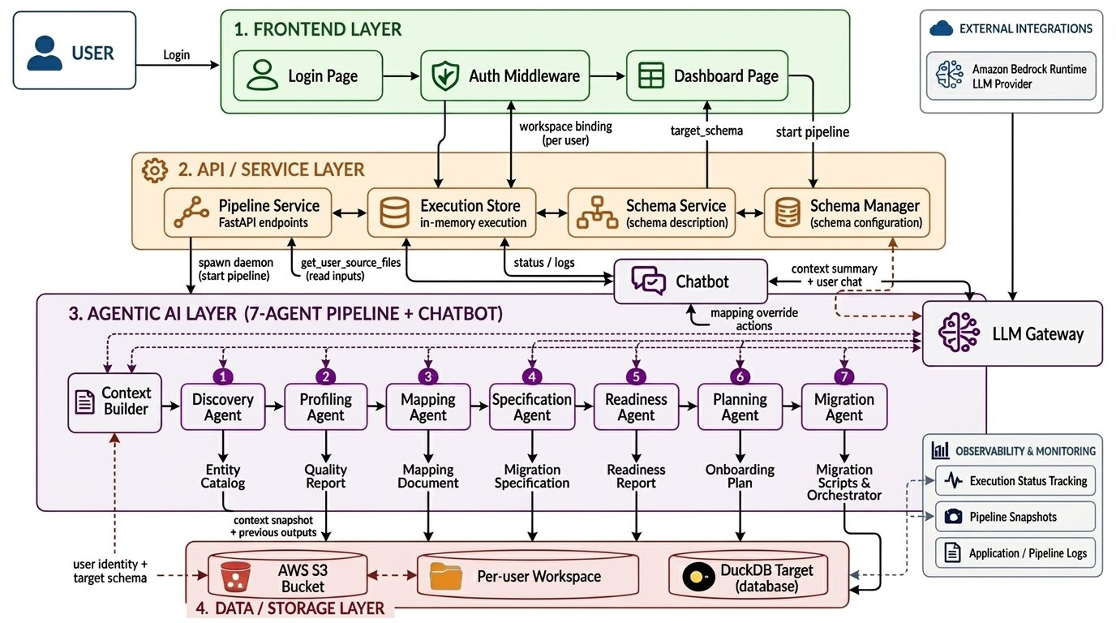
BEHIND THE INTELLIGENCE
DE Hackathon 26

Slide 6
SEE IT IN ACTION
DE Hackathon 26
From Customer Data to Onboarding Intelligence in Minutes

Slide 7
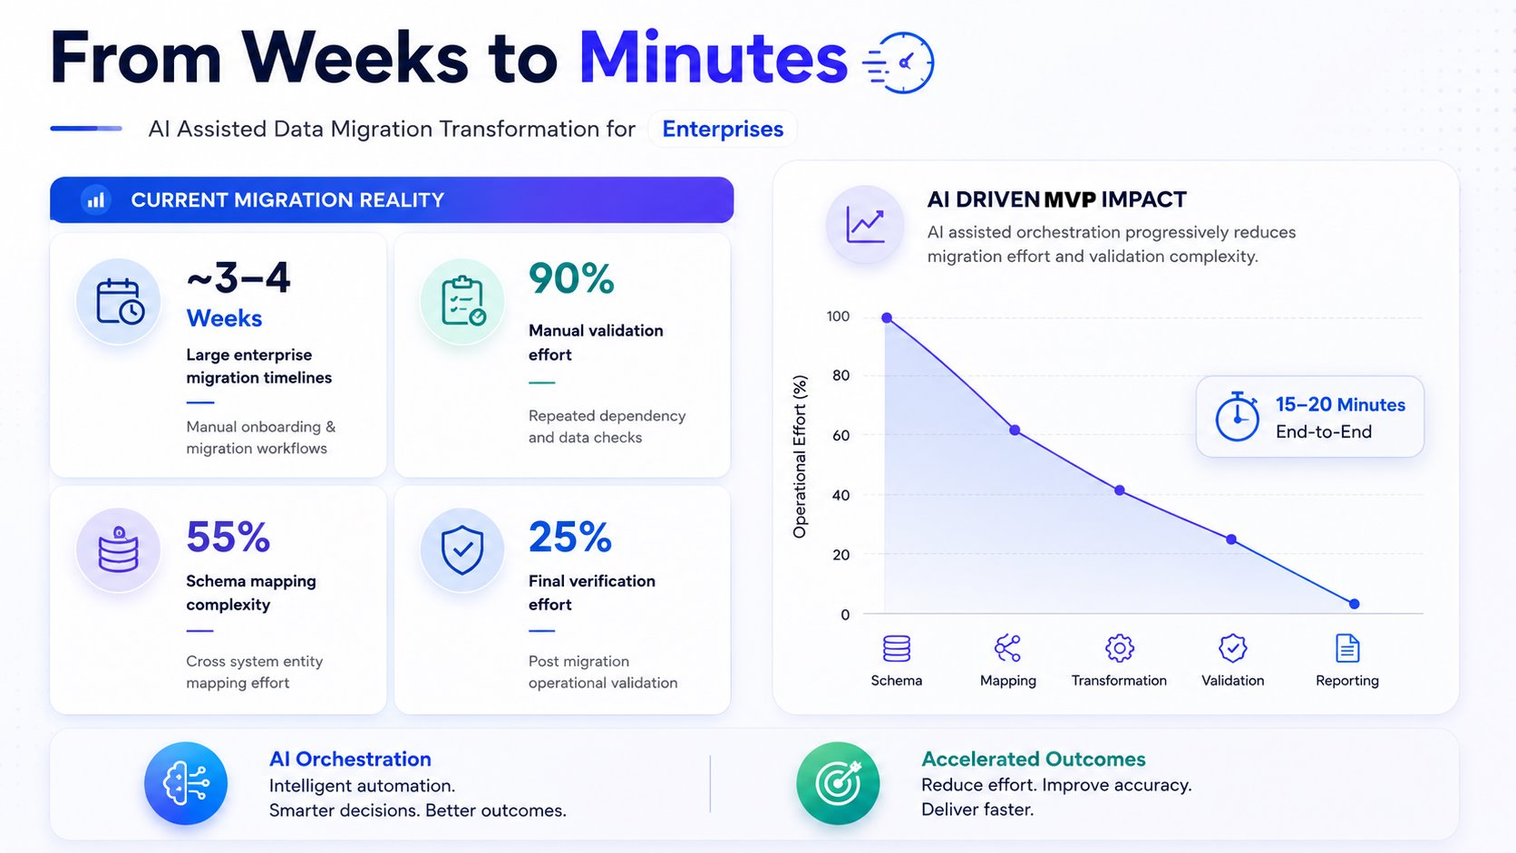
DE Hackathon 26
THE VALUE WE DELIVER

Slide 8
THANK YOU
DE Hackathon 26
Q/A

