Slide 1

Gokhale Education Society’s R. H. Sapat College of Engineering, Management Studies and Research, Nashik - 422 005, (M.S.), INDIA
Seminar on,
Mobile Cloud Computing
In partial fulfilment of requirement for the degree
Third Year Computer Engineering
By
Name:Shinde Harshada Bhausaheb
Exam Seat no:71837760F
Roll no:49
Under the guidance of,
Prof.Mandlik Sir

Slide 2
Index
-Introduction
-Literature review
-Problem Statement
-What is MCC
-Architecture
-Why choosing MCC
-Support to MCC
-Application
-Challenges
-The Future of MCC
-Advantage
-Disadvantage
-Conclusion
-Reference
GESCOE Department of Computer

Slide 3
Introduction:
-Cloud computing provides on-demand, scalable, device-independent and reliable services to its users.
-The aim of mobile cloud computing (MCC) is to use cloud computing techniques for storage and processing of data on mobile devices, and hence to reduce their limitations.
- The term MCC was introduced just after the concept of cloud computing that was launched in mid-2007.
-Since then, it has been drawing attention of organizations to reduce the development cost of mobile applications.
-It provides the mobile users and researchers a variety of mobile services at low cost.
GESCOE Department of Computer

Slide 4
Literature Review:
Mobile Cloud Computing is a computing technology that user uses resources of different clouds and network technologies to provide mobile user with high computational power and storage capacity at back end with limited resources at front end that is, on mobile devices.
GESCOE Department of Computer

Slide 5
Problem Statement:
Mobile cloud computing
And
we should adopt it!
GESCOE Department of Computer

Slide 6
What is MCC?
-Improvement in data storage capacity and processing power.
-Improved synchronization of data due to “store in one place,accessible from anywhere”.
-Improved reliability and scalability.
-Ease of integration.

Slide 7
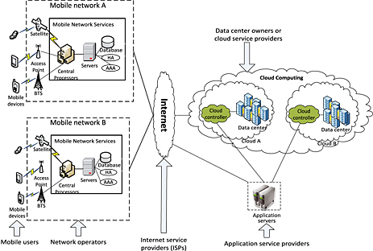
Architecture:
GESCOE Department of Computer

Slide 8
Why Choosing MCC?
i. Rapid Development
ii. Flexible
iii. Secure
GESCOE Department of Computer

Slide 9
Support to Mobile Cloud Computing?
-Hosting Services
-Functionality Outsourcing
-Web Analytics
-Hardware Augmentation
GESCOE Department of Computer

Slide 10
Application:
- Sensing capability
- Maintaining privacy and security of user data
- Data storage and reliability
- Biometric Application
- Mobile Vehicular Cloud
- Application in Social Cloud
- Mobile Multimedia Storage
GESCOE Department of Computer

Slide 11
Challenges:
-Low bandwidth
-Security and Privacy
-Service Availability
-Alteration of Networks
-Limited Energy source
GESCOE Department of Computer

Slide 12
The Future of Mobile Cloud Computing
-Longer Battery Life
-Massive Storage Space
-Evolved techniques for synching data
-Improved Facilities for Processing
-Exceptional User Experience
-Opportunity to Adopt New Technology
GESCOE Department of Computer

Slide 13
Advantage:
-Flexibility
-Multiple platform Support
-Cost efficient
-Real time Data Availability
-Backup and Recovery
GESCOE Department of Computer

Slide 14
Disadvantage:
-Data Security
-Connectivity and Performance Issue
-Dependency
-Internet Connection Required
GESCOE Department of Computer

Slide 15
Conclusion:
Mobile Cloud is integrating a lot and it is helping many companies. Generating high and hardware is expensive and mobile Cloud eliminates the cost of it. With the help of mobile Cloud, the efforts save and the work is done in the time limit cloud computing stretch to reduce the maintenance cost and enhance data safety and privacy. In mobile Cloud reducing resource consumption achieve by programming architecture and supporting cloud and mashup. This leads to the fact that the future generation of the mobile application is highly dependent on the cloud.
GESCOE Department of Computer

Slide 16
References:
https://ieeexplore.ieee.org/document/8095716
https://www.irjet.net/archives/V5/i3/IRJET-V5I3910.pdf
https://data-flair.training/blogs/cloud-computing-tutorial/
GESCOE Department of Computer

Slide 17
Thank You
GESCOE Department of Computer

