Slide 1
Capstone Project-1 (Exploratory Data Analysis) World Bank Global Education Analysis

Slide 2
Team Member
Er. Mudita Garg(mudita.garg.99@gmail.com),
Pankaj Kumar Yadav ( pankajkumaryadav1500420@gmail.com),
Harshada Gore(harshada1442@gmail.com)

Slide 3
Points for Discussion :
Data Summary
Showing Null Values
No. of country in Region and Various Income Group.
Population growth % of various countries categories by Income Group.
Percentage ratio of "Developed Countries" and "Developing countries“
GDP (Gross domestic product) of 3 top and bottom countries of "Developed Countries" and "Developing countries“
Deep analysis of education scenario in India
Analysis of Adjusted net enrolment rate calculated
Find the correlation between factors on affecting the GDP of India
Comparing India with neighboring countries - Pakistan, Nepal, Bhutan, China, Sri Lanka in Gross Enrolment Ratio (2010)
Variation in performance of Females and Males in PISA and TIMSS
Conclusion

Slide 4
Data Summary :
"EdStatsCountry.csv" data : contains list of all countries that are present in the data (total of 241 countries) - along with other features specific to the country like - Region, Income Group specific to the country etc.
"EdStatsData.csv" data : contains each country, with list of indicators (3665 unique indicators); contains measurement value for each indicator from years 1970 to 2017; from 2020 to 2100 - contains projections
"EdStatsSeries.csv" data : contains list of all indicators and the definition of each indicator
"EdStatsFootNote.csv" data : It contains the estimations and uncertainty bounds for each year - looks like some years are missing
"EdStatsCountry-Series.csv" data : It contains indicators and data sources for certain countries

Slide 5
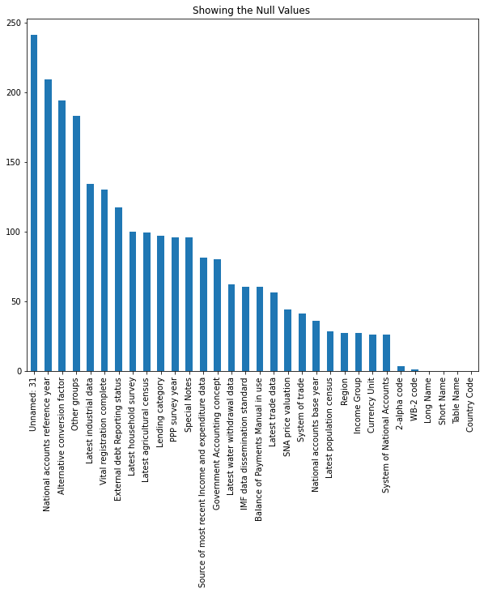
"EdStatsCountry.csv" data

Slide 6
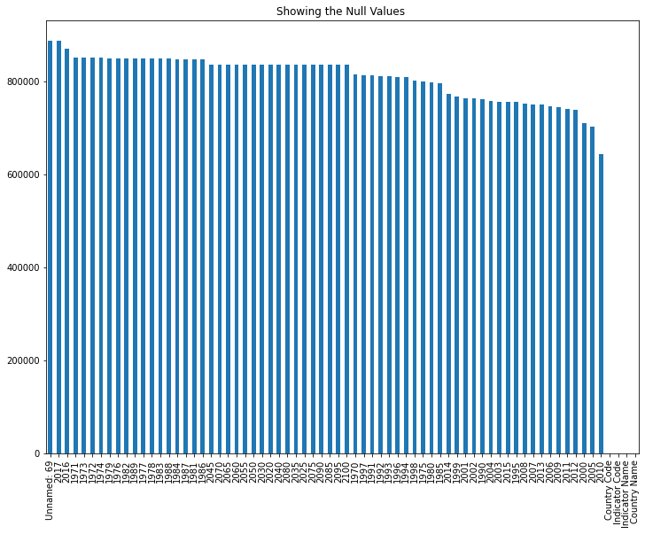
"EdStatsData.csv" data

Slide 7
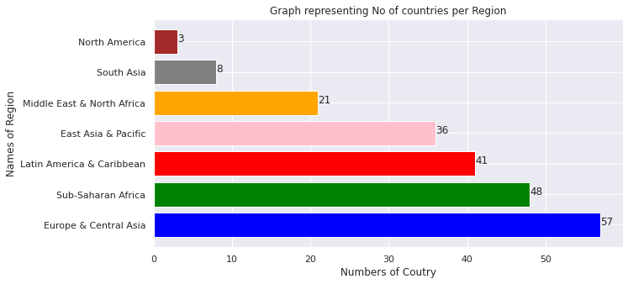
In this section the countries, which are part of the World Bank, have been counted based on the region. Europe and central Asia have the highest participation (57 countries).

Slide 8
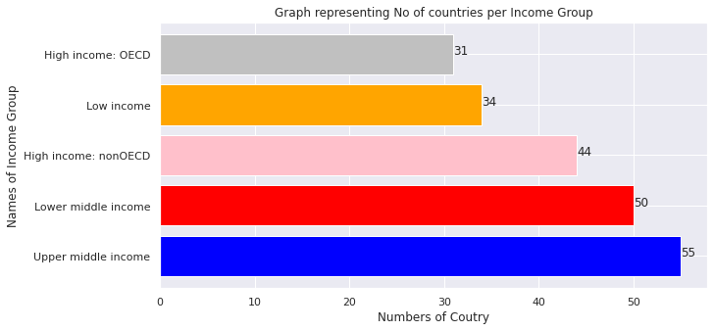
Next task is to count the number of countries falling in various income groups.
Here we can easily found that how many countries belongs from which 'Income Group'.

Slide 9
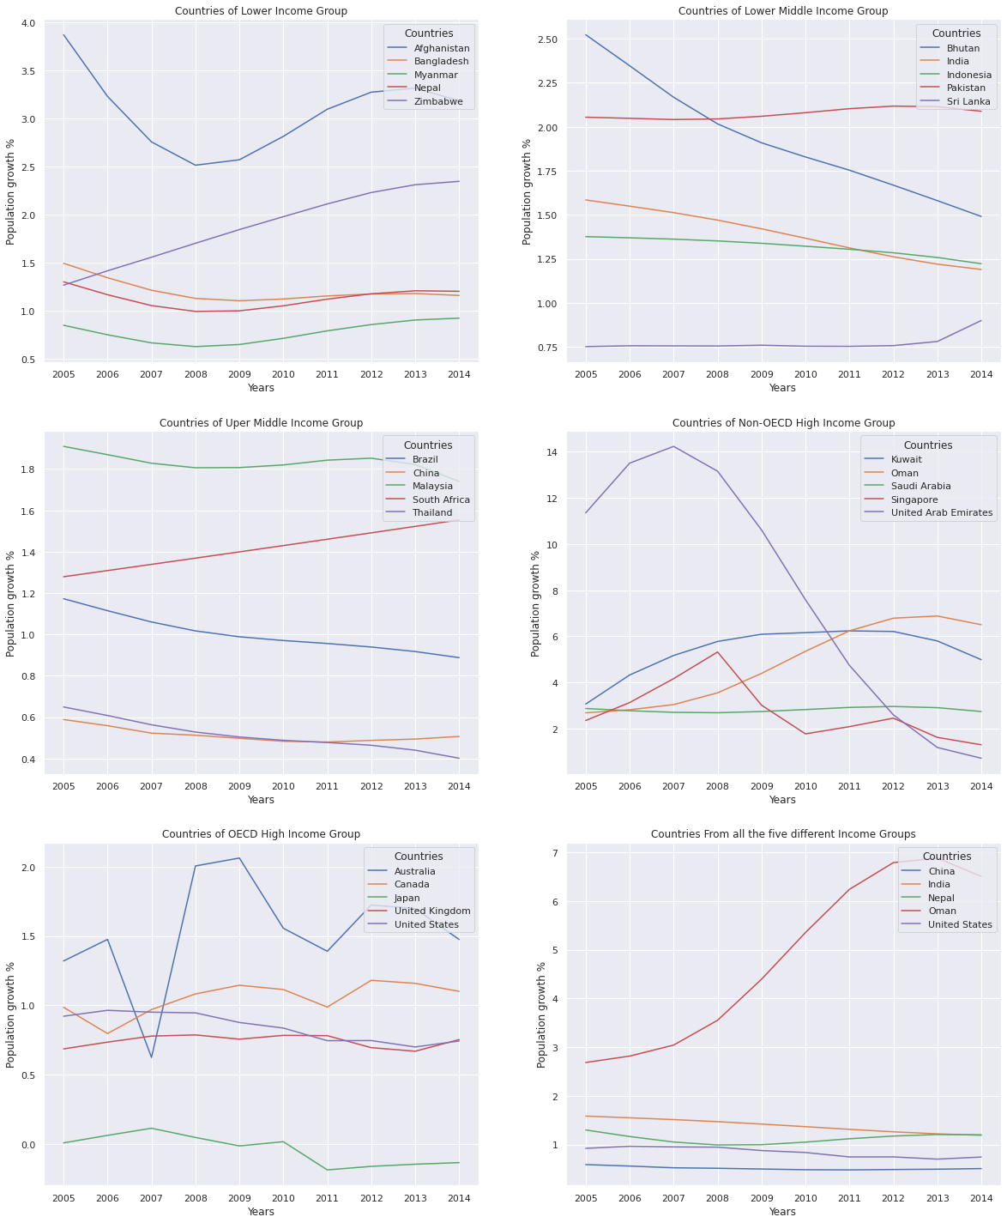
Based on the income group, last five years data of percentage population growth has been analyzed for selected/renowned countries. Countries fall in ‘Lower and Lower-middle Income’ needs to worry about their population growth (example: Afghanistan, Zimbabwe).

Slide 10
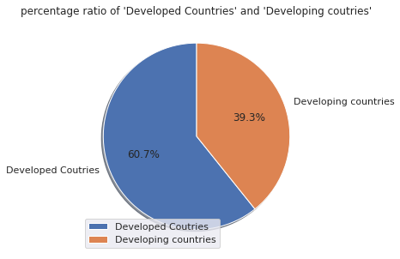
According to World Bank Global Education 60.7% countries across in the world are Developed Countries
According to World Bank Global Education 39.3% countries across in the world are Developing Countries

Slide 11
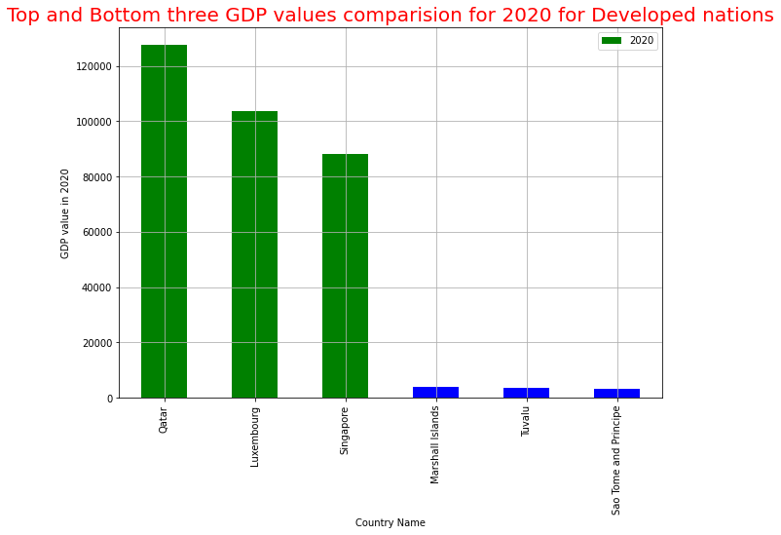
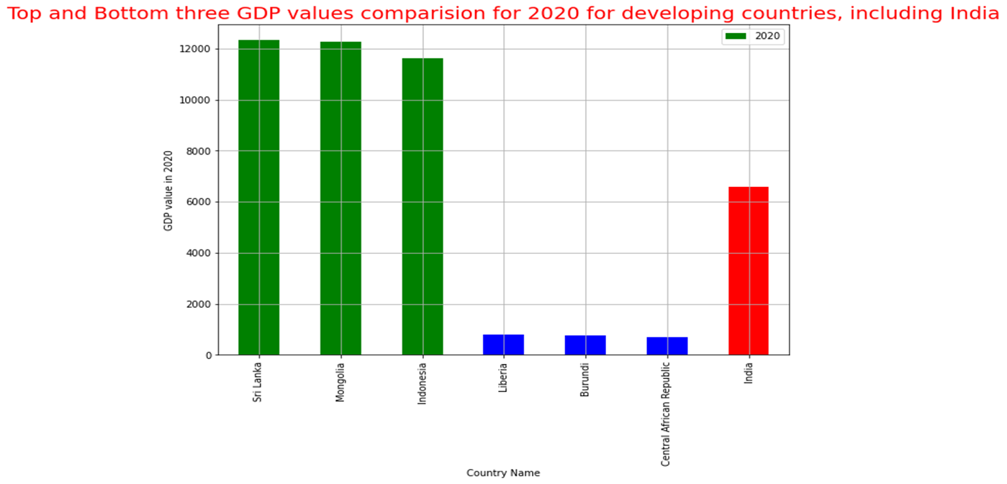
India is a part of developing nations.
GDP analysis for both developed and developing sections has been made to show the highest and lowest GDP countries in both sections. Qatar (exceeding 120000) has the highest GDP in 2020(developed nation).

Slide 12


Now, lets focus on the Education of Young Generation (Age: 20 to 40) for even years from the past two decades
Barro-Lee: Age Group Education Analysis

Slide 13
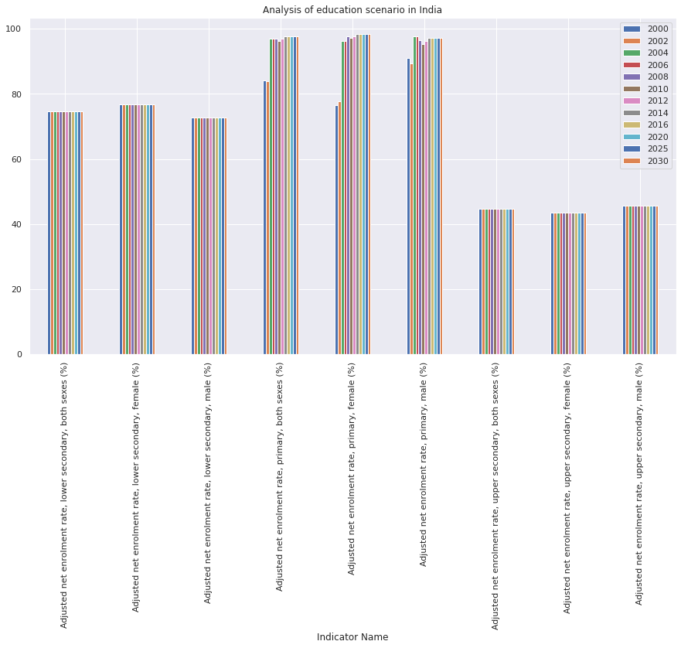
Adjusted net enrolment rate calculated by dividing the number of children in the official primary school age who are enrolled in primary or secondary education by the population of the same age group and multiplying by 100.

Slide 14
GDP analysis is also done by observing the factors influencing it directly and indirectly.
Expenditure analysis on these various categories is also performed to gather insights with respect to the peer countries. Capital Expenditure trends have also been compared in the proceeding sections . Analysis of Adjusted net enrolment rate calculated on the Barro-Lee Dataset is performed on the following age groups.
Barro-Lee: 20-24 age group education analysis
Barro-Lee: 25-29 age group education analysis
Barro-Lee: 30-34 age group education analysis
Barro-Lee: 35-39 age group education analysis.

Slide 15
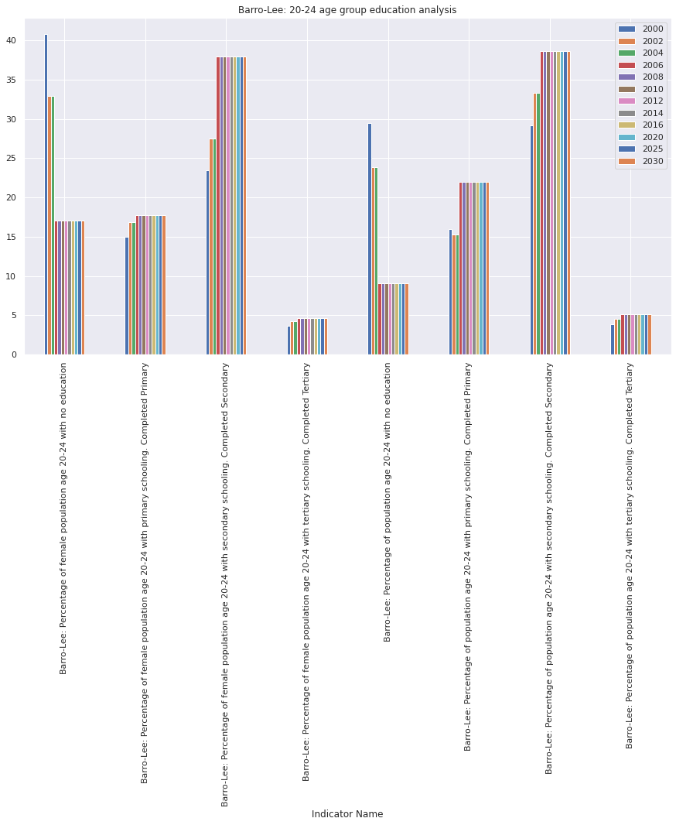

Slide 16
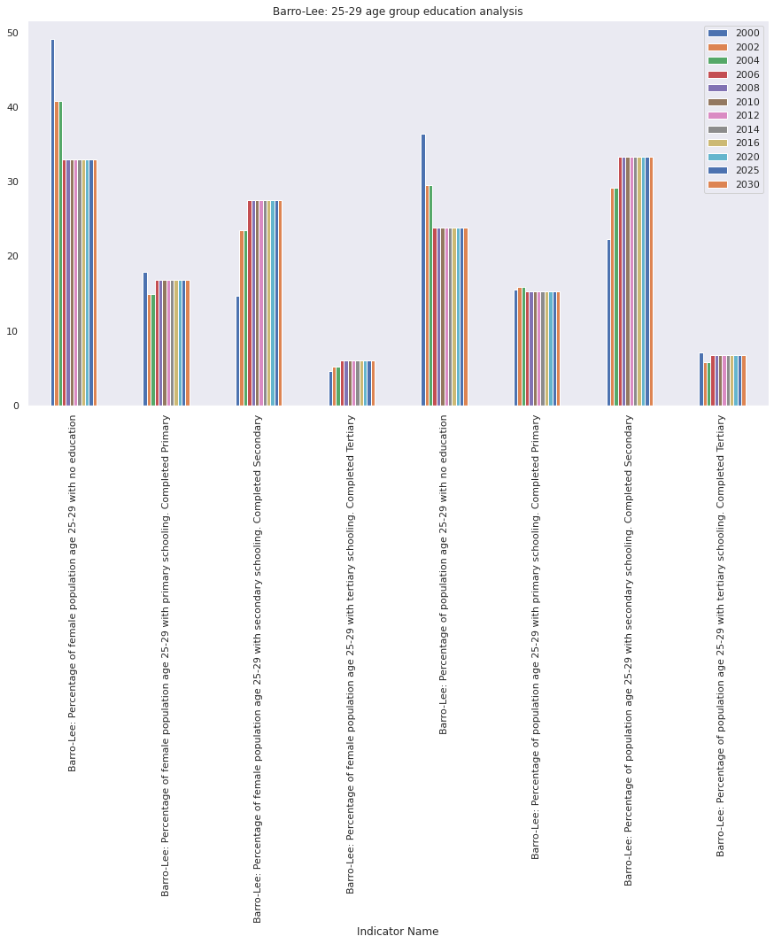

Slide 17
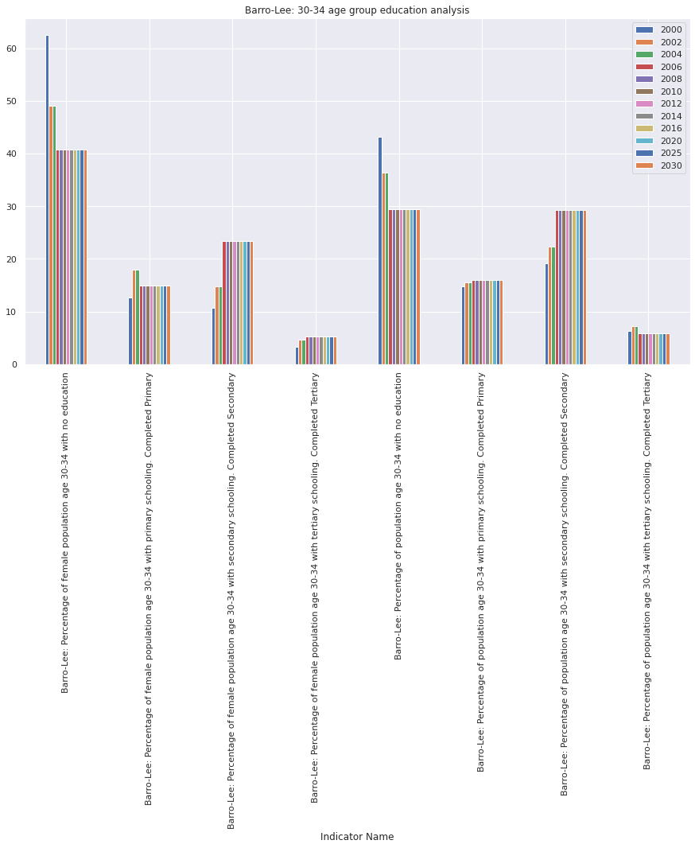

Slide 18
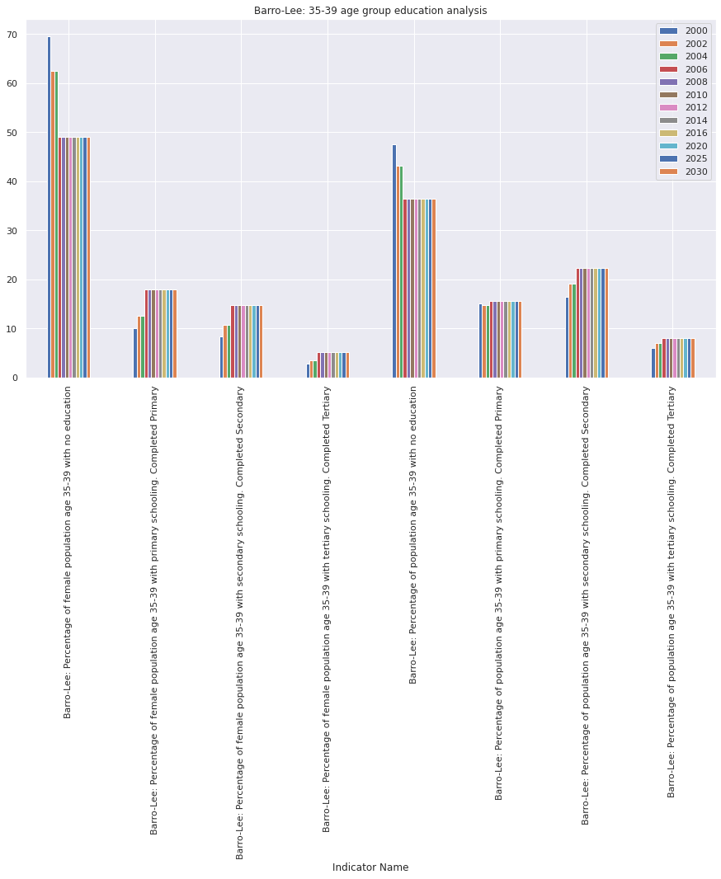

Slide 19
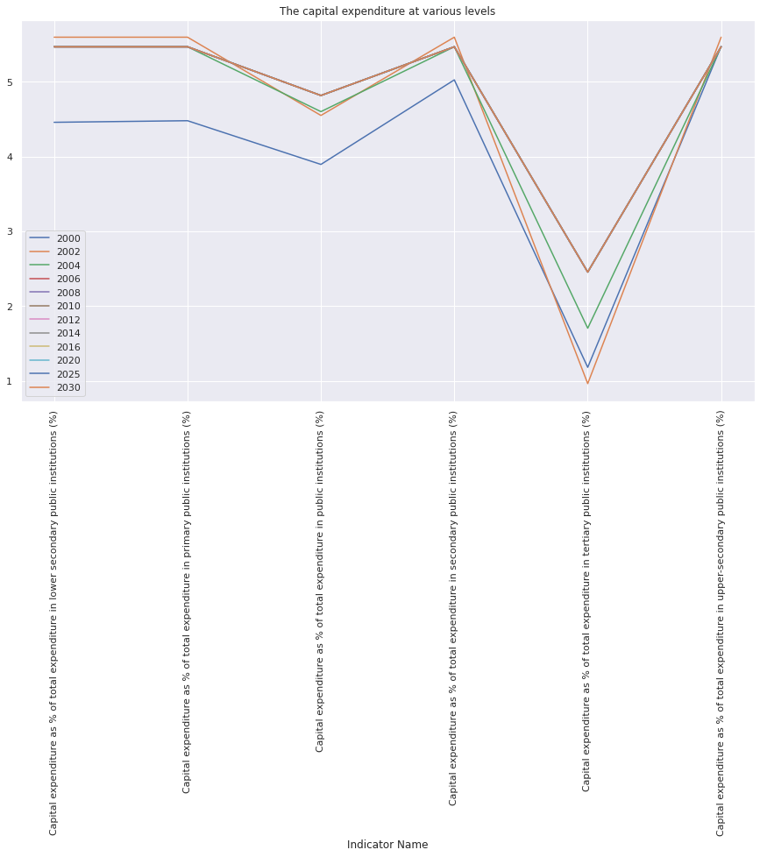
Capital expenditure on public institutes at various levels show that it is very less for the tertiary section.

Slide 20
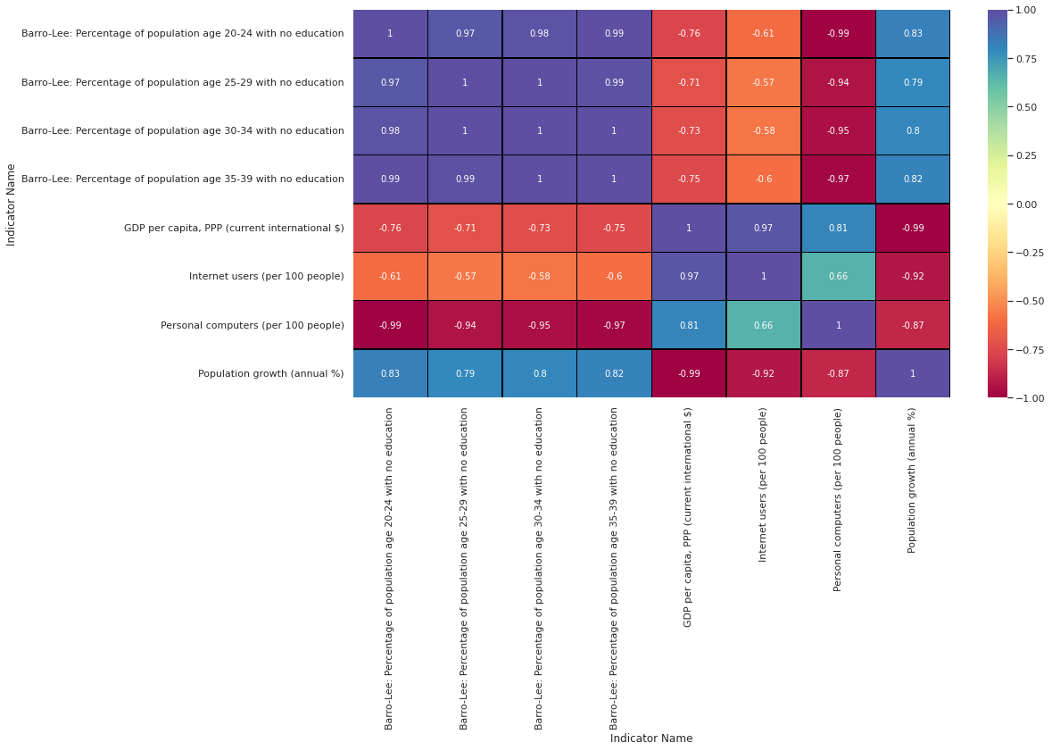
Heatmap shows GDP is inversely proportional to ‘no education’ and population growth and its directly proportional to the technology.

Slide 21
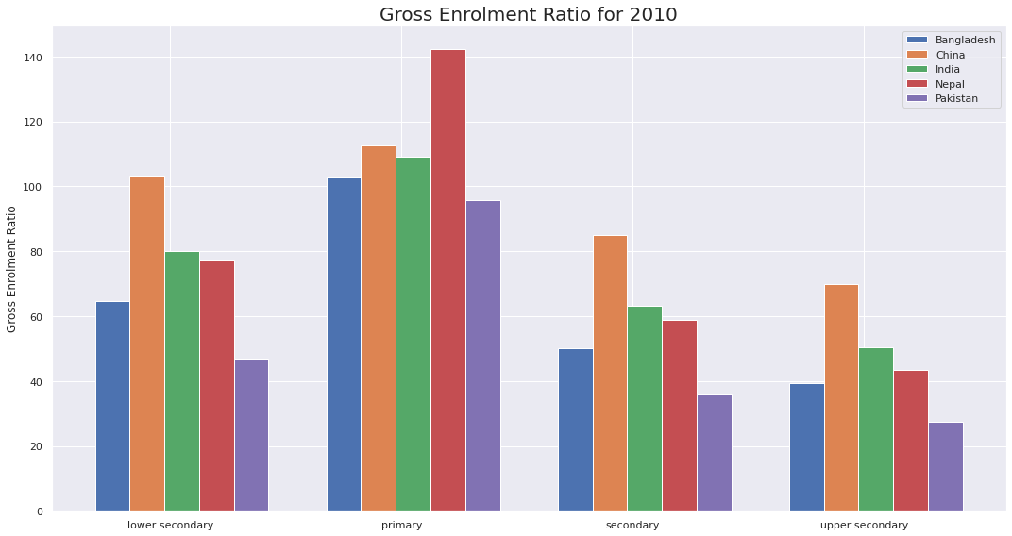
Gross Enrollment Ratio for Bangladesh, China, Nepal, India and Pakistan has been plotted for 2010. It shows that all the countries, especially Nepal, are focusing on Primary Education.

Slide 22
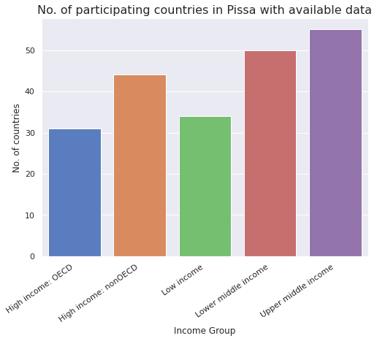
The Program for International Student Assessment (PISA) is an international assessment that measures 15-year-old students' reading, mathematics, and science literacy every 3 years.

Slide 23
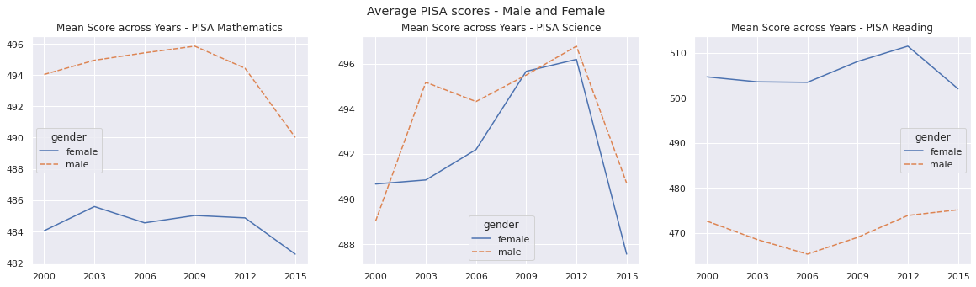
PISA Mathematics: Male at higher side and female at lower side, shows the vast difference between them.
PISA Science: Male and female performed equally same, but going lower in 2015.
PISA Reading : Female at higher side and male at lower side, shows the vast difference between them.

Slide 24
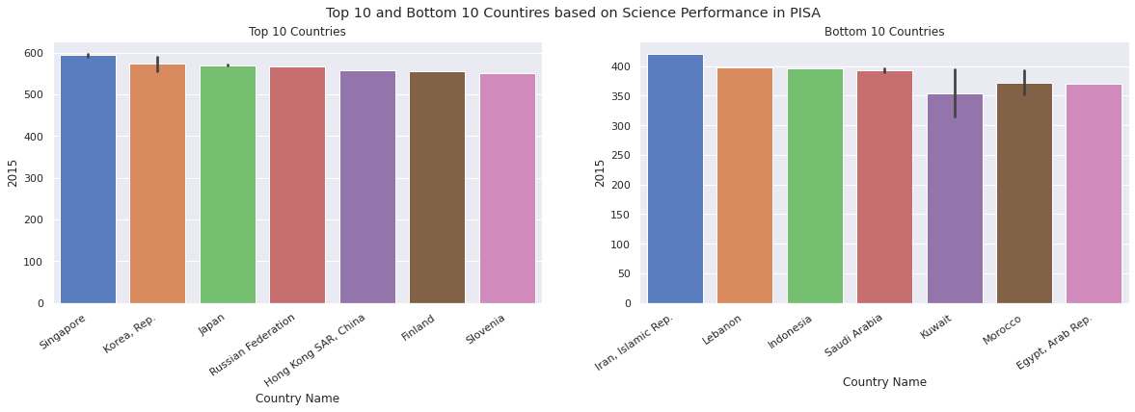
Science Performance PISA Analysis for top and bottom ten countries is done in Mathematics and Science. Singapore is at the top and Egypt, Arab Rep. is at the bottom.

Slide 25

Trends in International Mathematics and Science Study (TIMSS)

Slide 26
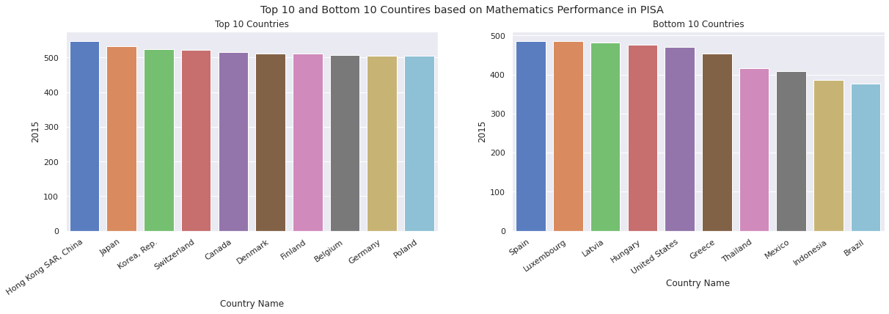
Mathematics Performance PISA Analysis for top and bottom ten countries is done in Mathematics and Science. Hong Kong SAR, China is at the top and Brazil is at the bottom.

Slide 27
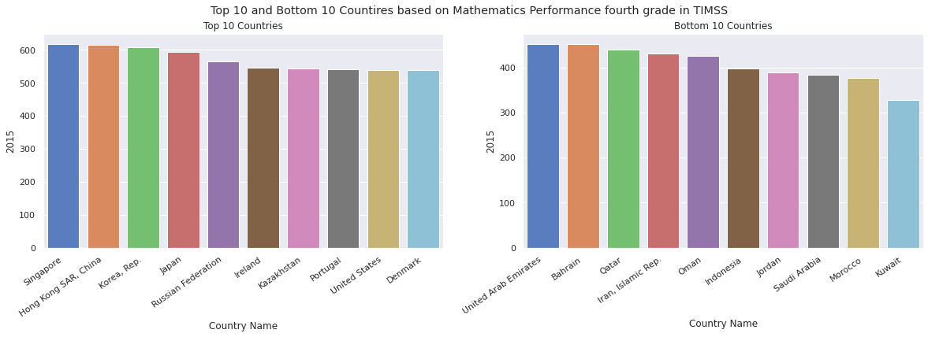

Slide 28
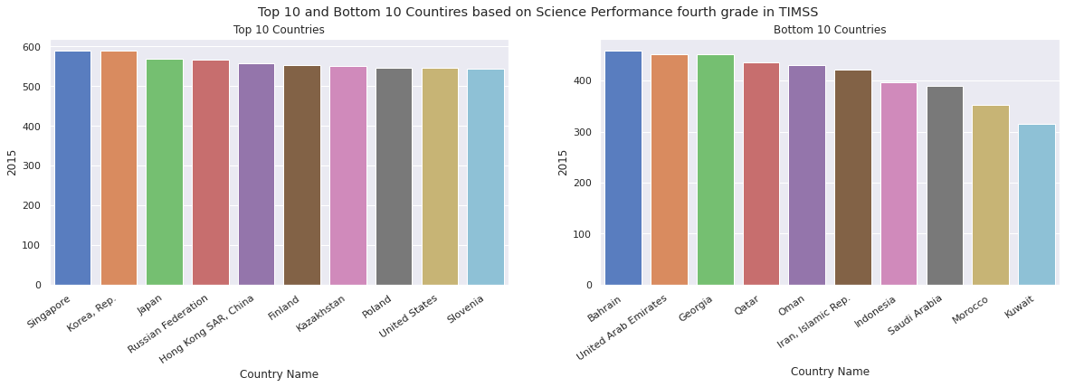
TIMSS Analysis for top and bottom ten countries is done in Mathematics and Science. Singapore is at the top and Kuwait is at the bottom.

Slide 29
Conclusion :
This study shows that most of the countries, whether developed and developing, are part of the World Bank, that's why the region with a high number of countries has high involvement.
The population growth analysis, based on income, indicates that the country's government of low, middle wages should implement some laws to control the population growth.
GDP bars show that highly developed countries have GDP exceeding 120000 and top developing countries have GDP exceeding 12000. This indicates a very vast difference in terms of economics of the country.
Education analysis of the youth shows that literacy rate is increasing over the years but still females are lacking behind compared to the total population literacy. Government and individuals should pay attention to education.
Literacy rate and technical advancement, directly influencing the GDP of the Country, should be increased.
PISA and TIMSS analysis show that it's quite different for male and females in the Mathematics and Reading field.

Slide 30


