Slide 1
E-WASTE MANAGEMENT IN RAJASTHAN
Generation • Collection • EPR • Recycling • Informal Sector • Sustainability
Academic presentation based on the Rajasthan project dataset and RSPCB public records

Slide 2
1. Rajasthan E-Waste Overview
7.54 Mt
Estimated generation
2926.0 kt
Collected in project dataset
20
Districts covered
91.7%
EPR target achievement
• Jaipur is the highest-generation district in the project dataset.
• Major urban and industrial centres dominate generation.
• Rajasthan has an established formal ecosystem of authorized recyclers, refurbishers and EPR-authorized producers.
• RSPCB publishes authorized-facility and collection information.
Rajasthan E-Waste Management | Slide 2

Slide 3
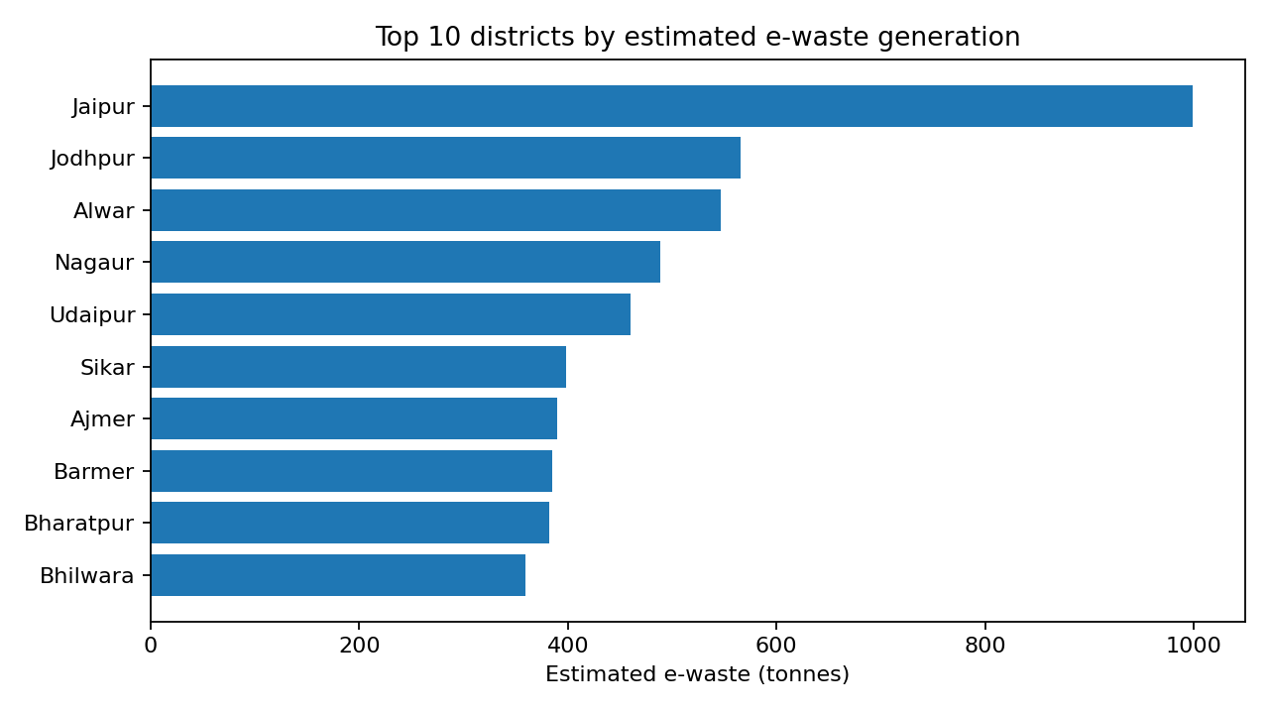
2. District-wise E-Waste Generation
Estimated project values
• Jaipur – 999.5 t
• Jodhpur – 566.0 t
• Alwar – 546.5 t
• Udaipur – 460.0 t
• Bharatpur, Sikar, Ajmer and Bhilwara are also significant contributors.
Rajasthan E-Waste Management | Slide 3

Slide 4
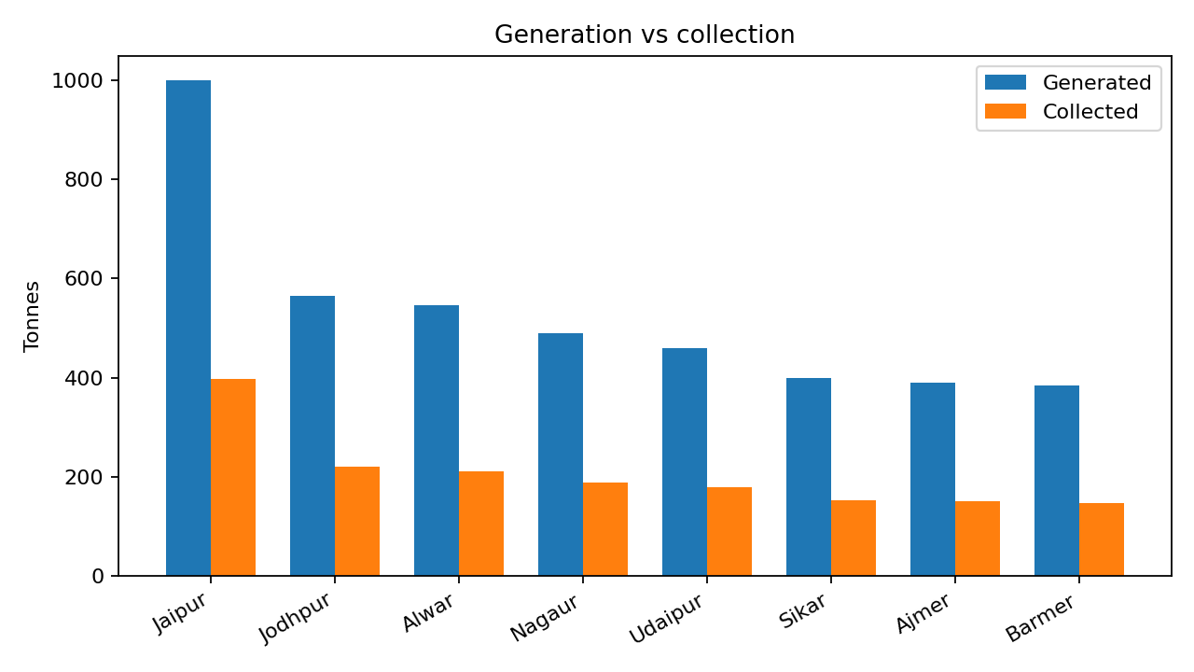
3. Collection and EPR Performance
Project collection-log dataset
• Collection recorded: 2926.0 kt across the 20-district dataset.
• Overall EPR target achievement: 91.7%.
• Collection capacity varies by district.
• The figures are academic estimates and should not be presented as official RSPCB statistics.
Rajasthan E-Waste Management | Slide 4

Slide 5
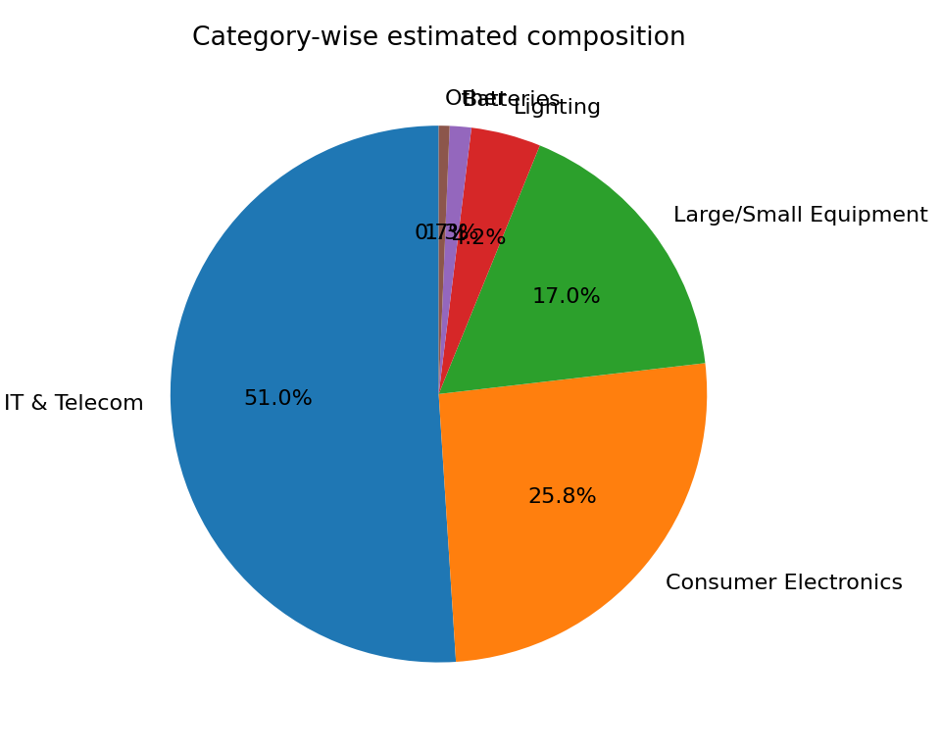
4. E-Waste Composition in the Project Dataset
• IT & Telecom is the largest category in the project model.
• Consumer electronics is the second-largest category.
• Lighting, batteries and other items form smaller shares.
• Composition values are project assumptions, not laboratory measurements.
Rajasthan E-Waste Management | Slide 5

Slide 6
5. Authorized E-Waste Companies / Facilities in Rajasthan
Selected current RSPCB-listed facilities
Facility | Location | Activity | Capacity
ETCO E-Waste Recycler Pvt. Ltd. | Jaipur | Recycling & Refurbishing | 4,490 MTA
Adatte E-Waste Management Pvt. Ltd. | Alwar/Tijara | Recycling & Dismantling | 1,780 MTA
GS International | Sikar | Dismantling & Refurbishing | 600 MTA
Shukla E-waste Processor | Bhiwadi | Recycling | 680 MTA
SAS Tech E-waste Recycling Solutions | Churu | Recycling & Refurbishing | 1,050 MTA
Telsys Green Web Recycling Pvt. Ltd. | Jaipur/Chomu | Recycling & Refurbishing | 13,200 MTA
Universal E-Waste Recycling Pvt. Ltd. | Khairthal-Tijara | Recycling & Refurbishing | 6,920 MTA
WORTECH Engineers Pvt. Ltd. | Jaipur | Recycling | 19,800 TPA
Rajasthan E-Waste Management | Slide 6

Slide 7
6. EPR-Authorized Producers in Rajasthan
Current RSPCB public list – 13 entries
• ETCO E-Waste Recycler Pvt. Ltd. – Jaipur
• Integratedmobi Tech Pvt. Ltd. – Chittorgarh
• Allied Electronics & Magnetics Ltd. – Udaipur
• ITG Software Engineering India Pvt. Ltd. – Jaipur
• Lipi Data Systems Ltd. – Udaipur
• Greenlet Recyclers Pvt. Ltd. – Jaipur
• Pragya Global Pvt. Ltd. – Jaipur
• Kumbhat International – Jodhpur
• Toshita International LLP – Jaipur
• Greenscape Eco Management Pvt. Ltd. – Alwar
• Texmaco Rail & Engineering Ltd. – Jaipur
• R. K. Impex – Jaipur
• Jiya Impex – Jaipur
Rajasthan E-Waste Management | Slide 7

Slide 8
7. Policy & Institutional Framework
• E-Waste (Management) Rules, 2022 – national EPR framework.
• CPCB – national registration, EPR and compliance framework.
• RSPCB – state authorization, monitoring and public information.
• RSPCB provides lists of authorized recyclers/dismantlers/refurbishers, EPR-authorized producers and collection facilities.
• Rajasthan has also conducted dedicated e-waste collection-drive initiatives.
Rajasthan E-Waste Management | Slide 8

Slide 9
8. Informal Sector, Environment & Health
• Informal collectors remain important for reaching dispersed e-waste streams.
• Formal integration should provide registration, training, PPE and links to authorized recyclers.
• Project monitoring includes soil, water and air observations at selected hotspots.
• Selected project entries flag elevated heavy metals/dust, indicating the need for periodic monitoring.
• Safe dismantling and controlled recycling reduce exposure to hazardous substances.
Rajasthan E-Waste Management | Slide 9

Slide 10
9. Key Challenges
• Uneven collection infrastructure across districts.
• High dependence on informal collection/dismantling.
• Limited public awareness of authorized disposal routes.
• Need for stronger EPR tracking and enforcement.
• Recycling capacity is concentrated around industrial clusters.
• Need for continuous environmental and occupational-health monitoring.
Rajasthan E-Waste Management | Slide 10

Slide 11
10. Recommendations for Rajasthan
• Expand district-level collection points and mobile collection drives.
• Integrate informal collectors through registration, training and safety equipment.
• Strengthen digital EPR tracking and target verification.
• Promote repair, refurbishment and reuse before recycling.
• Use GIS/AI for generation forecasting and collection-gap mapping.
• Increase awareness in schools, colleges, offices and households.
• Encourage investment in safe material recovery and modern recycling facilities.
Rajasthan E-Waste Management | Slide 11

Slide 12
11. Conclusion
• Rajasthan faces a growing e-waste challenge alongside urbanization and digitalization.
• The project dataset identifies Jaipur, Jodhpur, Alwar and other urban/industrial districts as major generation centres.
• The state already has a formal ecosystem of authorized recyclers, refurbishers and EPR-authorized producers.
• The next priority is to connect generation, collection, EPR and recycling through a transparent, safe and circular system.
• Better collection, formal-sector integration and public awareness can improve resource recovery and reduce environmental risks.
Rajasthan E-Waste Management | Slide 12

Slide 13
12. Sources & Data Note
• Rajasthan State Pollution Control Board (RSPCB) – E-Waste Management portal.
• RSPCB – List of Dismantlers / Re-furbishers / Recyclers Authorized by RSPCB (updated 24 July 2026).
• RSPCB – List of Producers granted EPR Authorization in Rajasthan (updated 24 July 2026).
• RSPCB – E-Waste Collection Drive 2025 resources.
• Rajasthan project E-Waste Management Tracker – district generation and collection dataset.
Data note: district generation/collection values are project estimates; use verified CPCB/RSPCB figures for official reporting.
Rajasthan E-Waste Management | Slide 13

