Slide 1

Data Management and Database Design
Blood Donation Management System
Group:17
Presented By:
Raksha Israni: 002925990
Nitant Jatale: 002776669
Parth Kalani: 002766306
Shobhitha Rajanand: 002650740
Harshada Kailas Bagal: 002913267

Slide 2
Problem Statement and Goals
Problem Statement:
Around 118.5 million units of donated blood are collected globally every year, although more units would need to be collected to meet the needs of transfusion of all the patients in the world - World Health Organization (WHO)
Obtaining timely supplies of blood from donors and making them readily available for patients in need is a problem of huge concern for the health care industry.
Goals:
The purpose of the database system is to:
Maintain data for available units of blood.
Maintains donor and recipient information such as name, address, telephone number, date of birth, and medical history.
Retain data from donation drives to assist in emergency cases.
Maintain transaction details between donor and recipient to track blood consumption.
Keep donor card information current to facilitate future access.
Analyze the data to understand how many patients have received blood in a timely manner.
Use the data to analyze the blood requirements in Boston based on the demographics and share this information with hospitals and blood banks so that the efficacy of the system can be increased.
Use the data to determine whether the blood collected was never donated.

Slide 3
Entity-Relationship Diagram

Slide 4
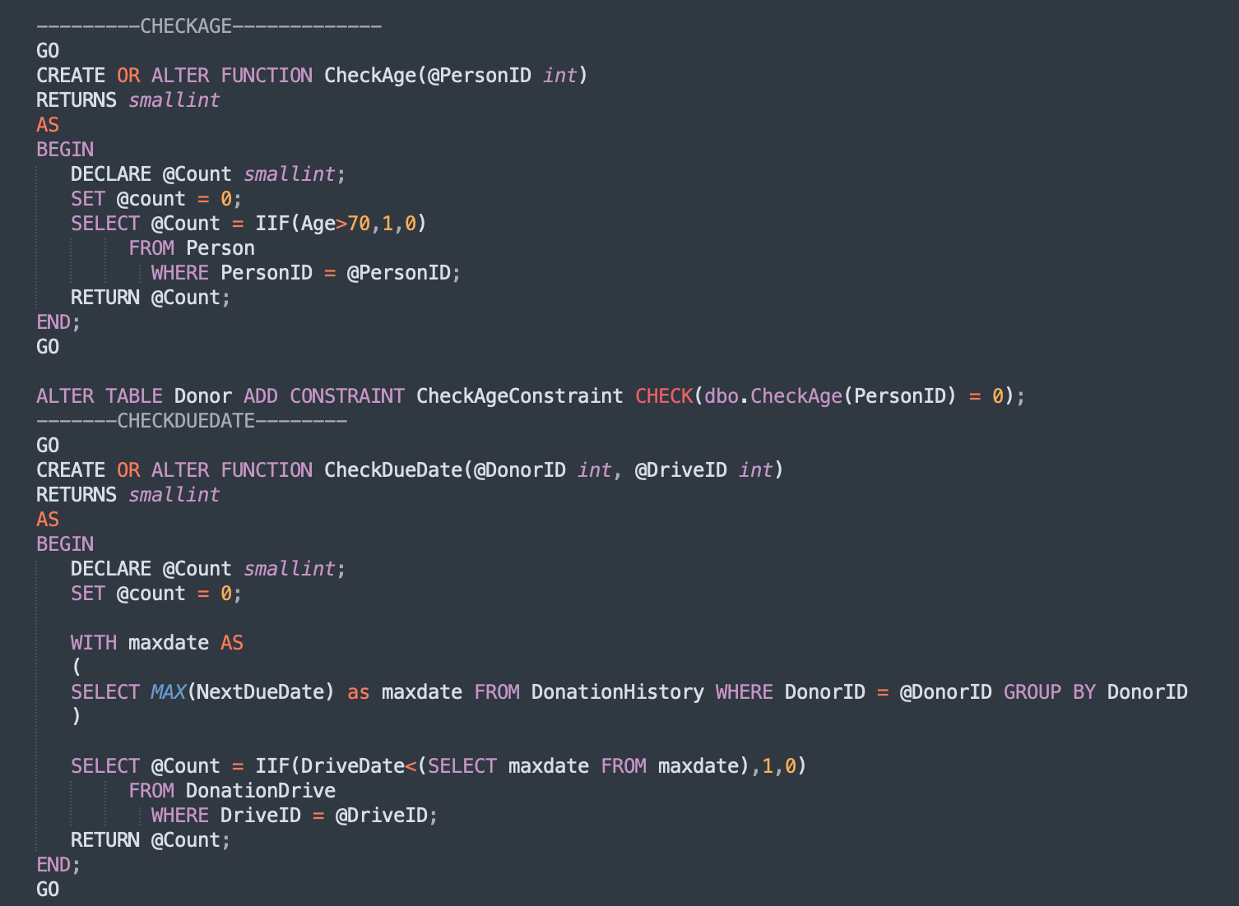
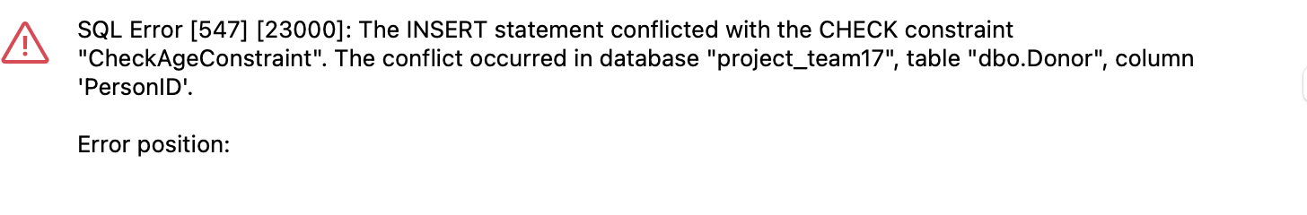
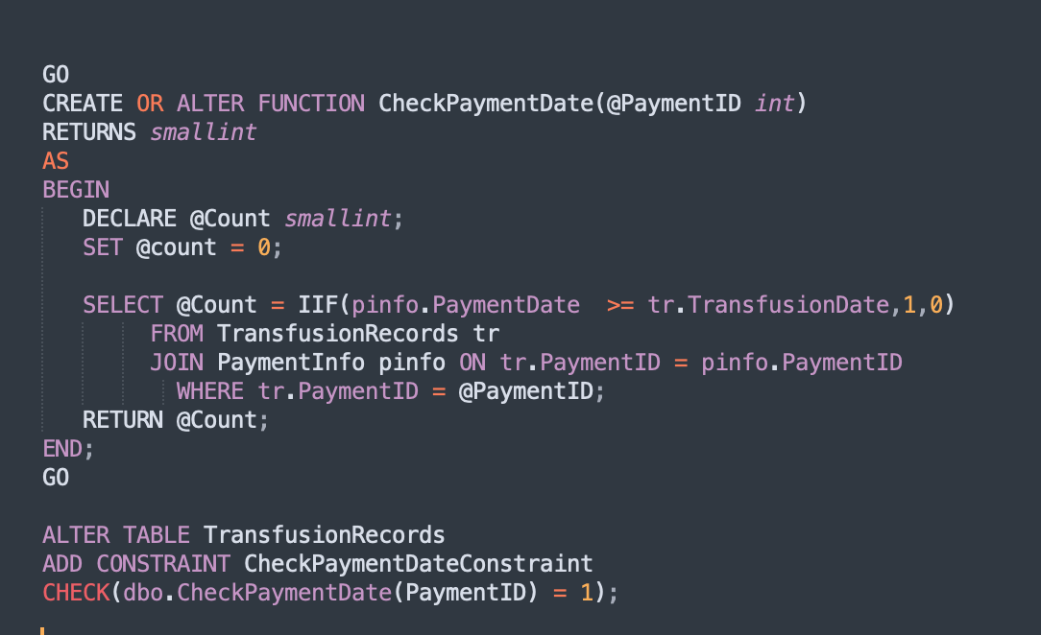
Table- Level check constraints
CHECKAGE, CHECKDUEDATE CHECKPAYMENTDATE

Slide 5
Triggers
Next Due Date
Update Payment
Update SSN
Set Transfer Eligibility
Update Availability

Slide 6
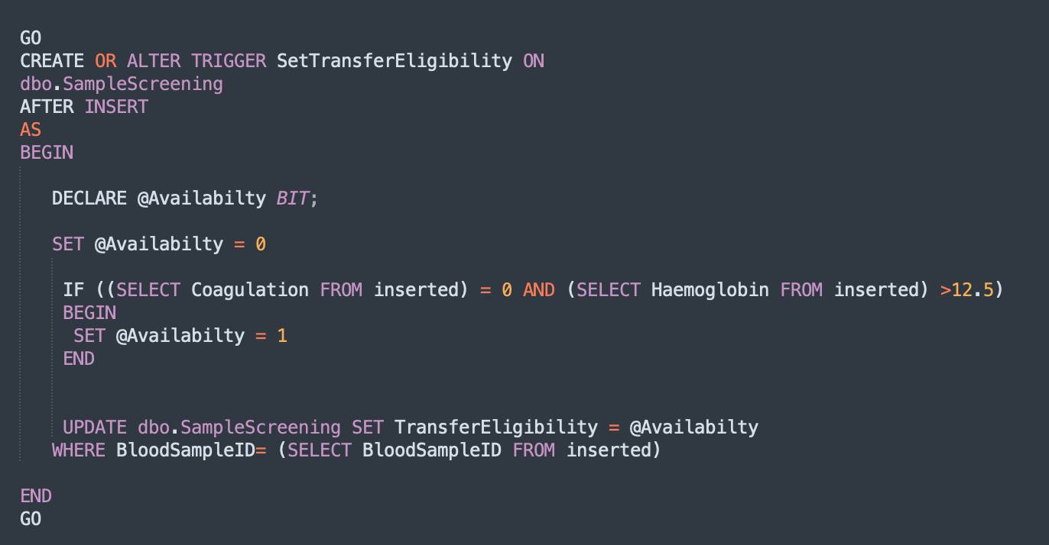
SetTransferEligibilty
Triggers

Slide 7
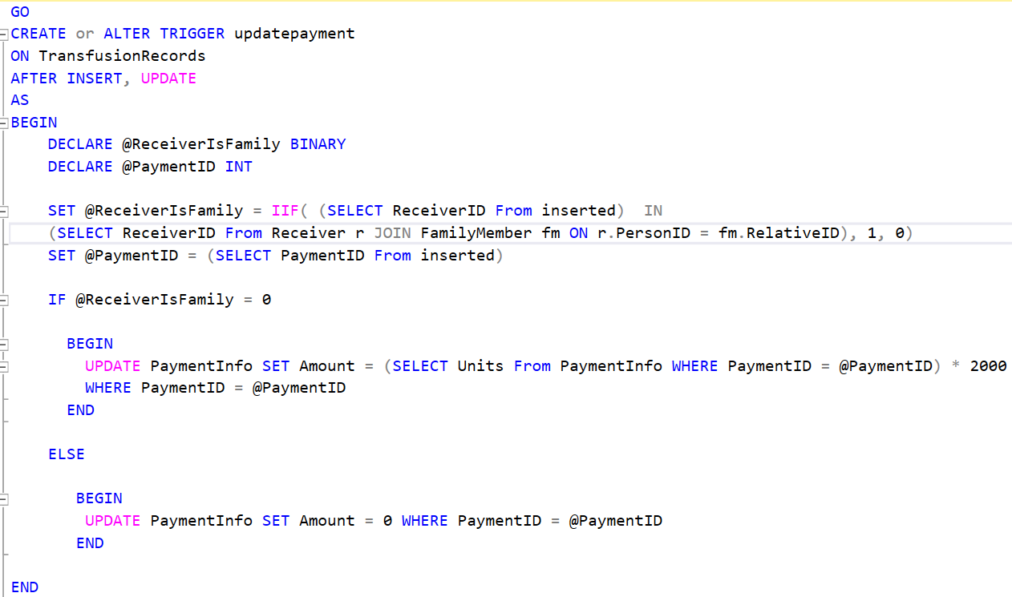
Triggers
UpdatePayment

Slide 8
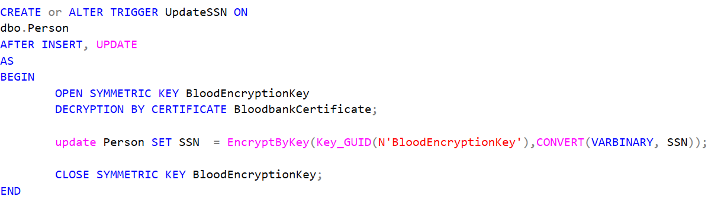
Triggers-Data-Enryption

Slide 9
Views
Collected blood never donated
Count of transfusion per hospital
Donation count for every organization
Percentage of Blood Used
Top blood donated for each zip code

Slide 10
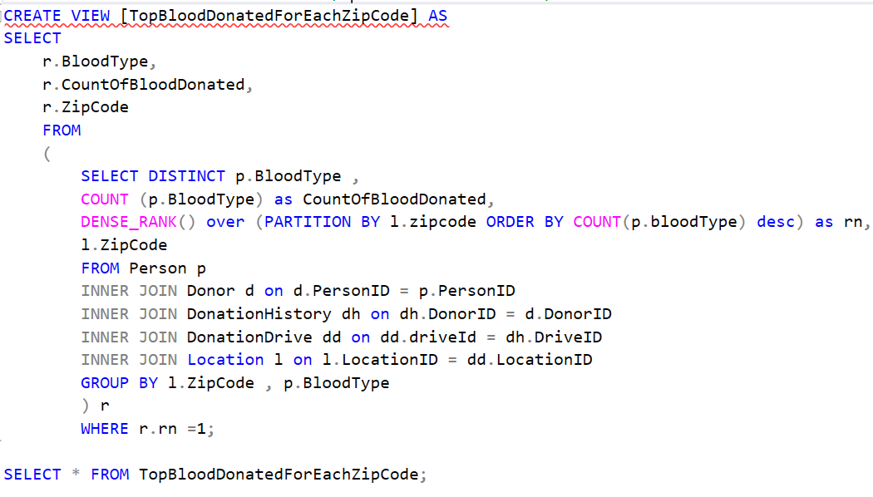
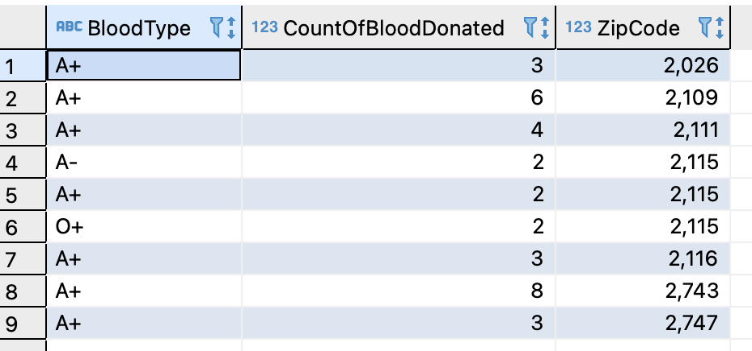
Views
TopBloodDonatedForEachZipCode

Slide 11
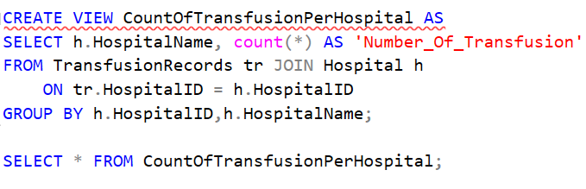
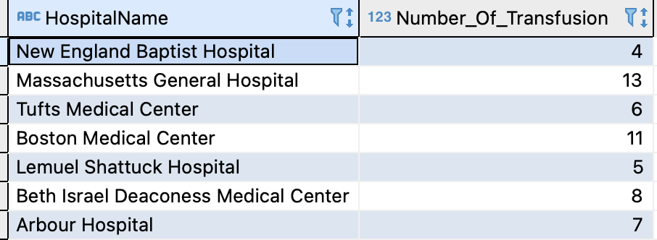
Views
CountOfTransfusionPerHospital

Slide 12
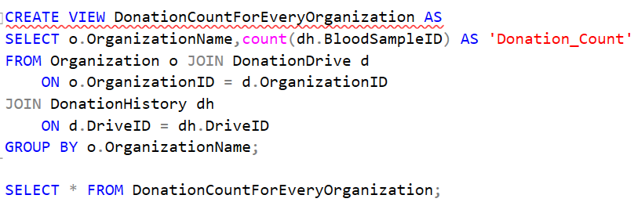
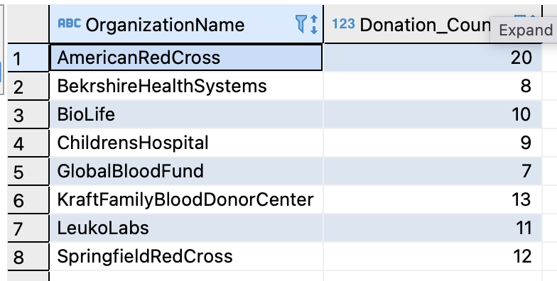
Views
DonationCountForEveryOrganisation

Slide 13
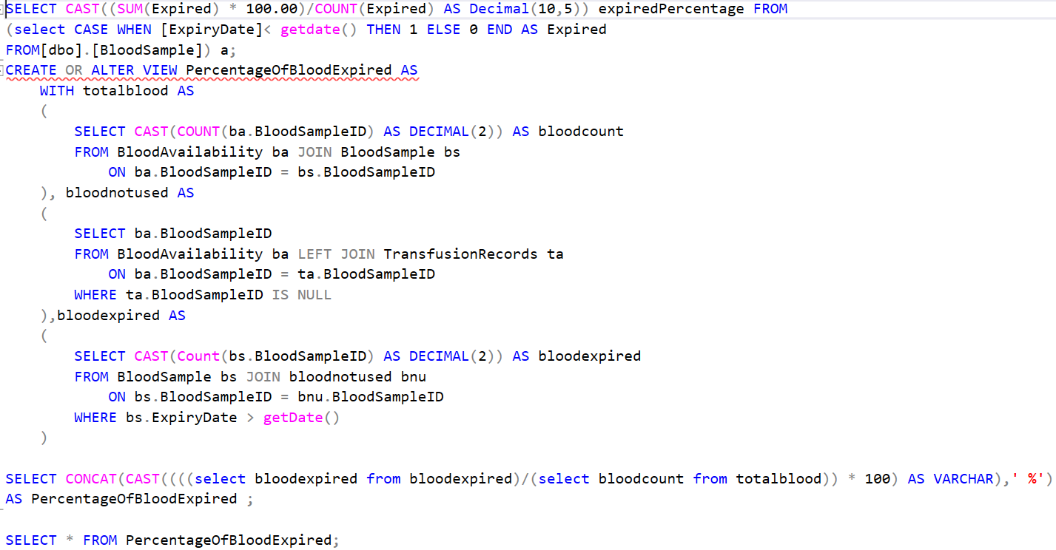
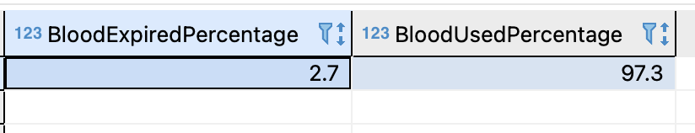
Views
PercentageOfBloodExpired

Slide 14
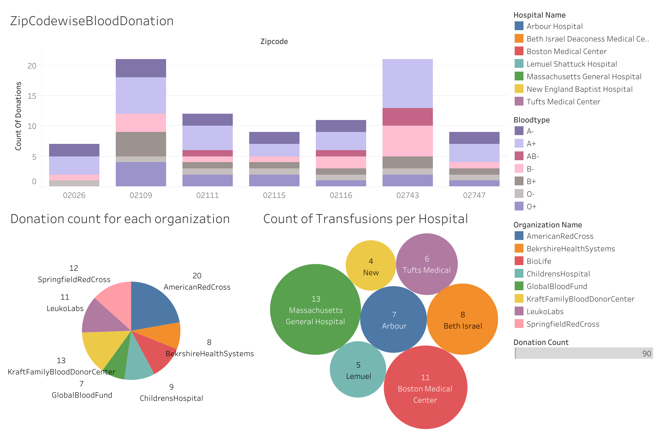
Dashboards

Slide 15


Together, We saved a life. Thank You!

