Slide 1
IBM University Engagement Project Submission
“Exploring the Power of Agentic AI with IBM Granite and LangFlow”

Slide 2

Project Tile – [Social Media Agent ]
Domain of Project – [ Social Media]
Student Name | Recent Passport Photo | Email ID | Mobile number [WhatsApp]
Harshada Kishor Dive |  | diveharshada5@gmail.com | 9022631428

Slide 3
Problem Statement -
Problem Statement : Social Media Agent
The Challenge
Brands, influencers, and organizations struggle to keep up with the fast-paced and fragmented world of social media. Content trends evolve hourly, audience sentiment shifts rapidly, and competitor strategies are difficult to track. Managing multiple platforms often leads to scattered insights, missed engagement opportunities, and ineffective campaigns. The challenge is not only to collect social media data but also to analyze, predict, and recommend actions in real time.
The Objective
Build an agentic AI application that acts as an intelligent social media companion. The solution should:
Fuse Multichannel Data :- Collect and synthesize content, comments, hashtags, and competitor posts from platforms like X, LinkedIn, Instagram, and Facebook into unified insights.
Enable Multimodal Interaction :- Accept user inputs (text, images, or voice prompts) and generate creative post drafts, captions, or campaign ideas aligned with brand tone.
Create a Predictive & Agentic Layer :- Forecast trending hashtags, audience sentiment shifts, and competitor engagement patterns while suggesting the best posting schedules.
Visualize Social Media Pulse :- Provide a dashboard with real-time analytics—engagement trends, influencer mapping, sentiment tracking, and campaign performance forecasts.

Slide 4
Proposed Solution -
Proposed Solution: PulseAI: Intelligent Social Media
PulseAI is an Agentic AI-powered Social Media Intelligence Platform designed to help brands, influencers, and organizations manage their social media presence more effectively. The system continuously collects and unifies data from multiple platforms such as X, LinkedIn, Instagram, and Facebook, including posts, comments, hashtags, engagement metrics, and competitor activities. Using IBM Langflow for workflow orchestration and IBM Granite Models for AI-driven analysis, the platform transforms raw social media data into actionable business insights.
The solution leverages multiple AI agents to perform specialized tasks such as trend detection, sentiment analysis, competitor monitoring, audience behavior prediction, and content generation. Based on real-time analysis, the platform recommends the best posting time, trending hashtags, content ideas, captions, and campaign strategies to maximize audience engagement. Users can also interact with the system through text, image, or voice prompts to receive personalized marketing recommendations.
All insights are presented through an interactive dashboard featuring real-time analytics, sentiment distribution, influencer mapping, engagement tracking, campaign performance forecasts, and AI-generated recommendations. By combining predictive analytics with autonomous decision-making, PulseAI enables businesses to make data-driven marketing decisions, improve campaign effectiveness, and respond quickly to changing social media trends.

Slide 5
Technology Used
Layer | Technology
Frontend | React.js, Tailwind CSS
Backend | FastAPI / Flask
AI Orchestration | IBM Langflow
AI Models | IBM Granite LLM
Agent Framework | IBM Orchestrate
Database | MongoDB
Vector Database | ChromaDB
Data Processing | Pandas, NumPy
APIs | X API, LinkedIn API, Instagram Graph API, Facebook Graph API
Visualization | Plotly / Chart.js
Authentication | JWT / OAuth
Deployment | Docker, IBM Cloud

Slide 6
Langflow component Used -
Component | Purpose
Chat Input | Accept user query
API Request Component | Fetch live social media data
Prompt Template | Build structured prompts
IBM Granite LLM | Analyze trends & generate insights
Agent Component | Decide next actions autonomously
Retriever | Retrieve historical campaign data
Memory | Store conversation/user context
Conditional Router | Route requests to different workflows
Python Function | Calculate engagement metrics
JSON Parser | Structure API responses
Output Component | Dashboard & report generation

Slide 7
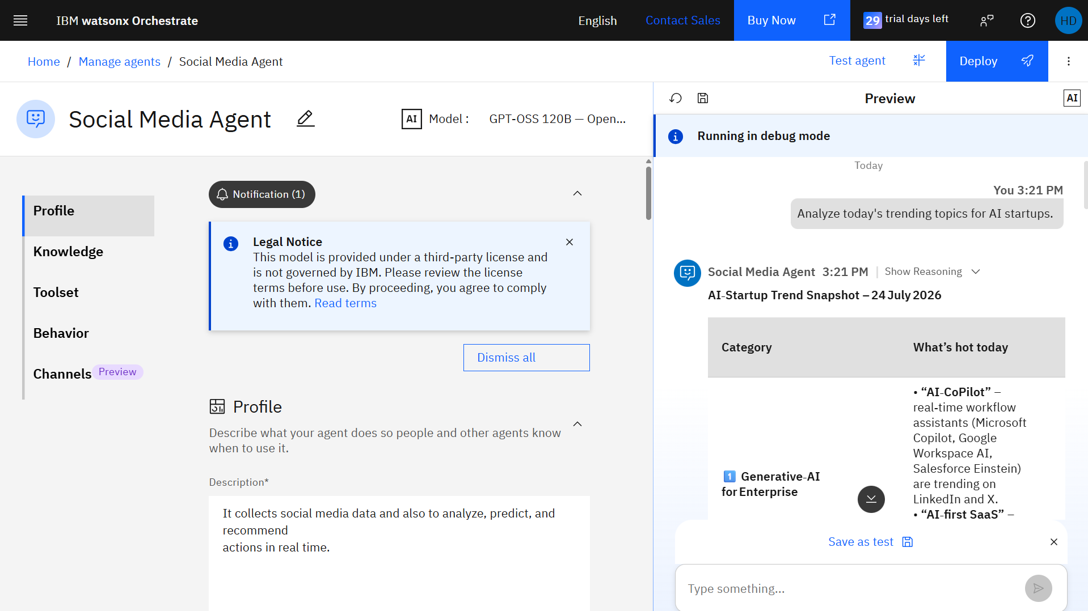
Langflow workflow -

Slide 8
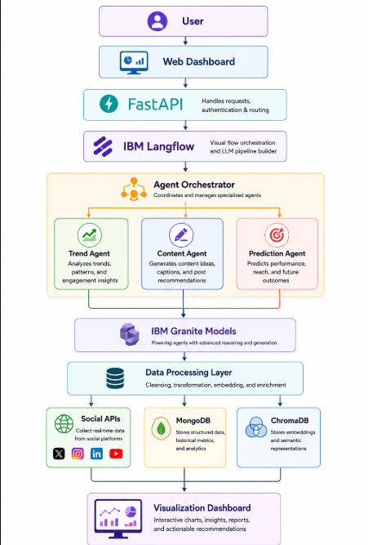
Architecture blueprint

Slide 9

Role of Agentic AI in the solution
Role of Agentic AI :
Agentic AI transforms the platform from a passive analytics tool into an autonomous marketing assistant.
Responsibilities
Continuously monitors multiple social media platforms.
Detects emerging trends automatically.
Predicts audience engagement before posting.
Generates captions, hashtags, and campaign ideas.
Suggests the optimal posting schedule.
Compares competitor strategies.
Recommends marketing actions without requiring manual analysis.
Learns from previous campaign performance for continuous improvement.

Slide 10
Novelty and Uniqueness
Existing Solutions
Usually limited to one platform.
Mainly provide historical analytics.
Require manual interpretation.
Do not proactively recommend actions.
Limited AI-generated content capabilities.
PulseAI Innovations
Multi-platform unified intelligence engine.
Autonomous Agentic AI decision-making.
Real-time trend prediction instead of historical reporting.
AI-generated captions tailored to audience sentiment.
Competitor strategy monitoring.
Predictive campaign performance forecasting.
Adaptive learning using previous campaign outcomes.
Single dashboard combining analytics, recommendations, and content creation.

Slide 11
Git Hub Link
Please create public github repository (Enable Add README button while creating repository) with format –
Please test and Paste the working Github URL –
https://github.com/harshadadive/Social-Media-Agent/tree/main
·
·
·

Slide 12
Future Scope
Voice-based interaction with the AI assistant.
AI-generated reels, images, and short videos.
Automated campaign publishing across platforms.
Influencer discovery and collaboration recommendations.
Brand reputation crisis detection with instant alerts.
Regional and multilingual sentiment analysis.
Personalized marketing strategies using customer segmentation.
Integration with CRM platforms (Salesforce, HubSpot).
·
·
·

Slide 13
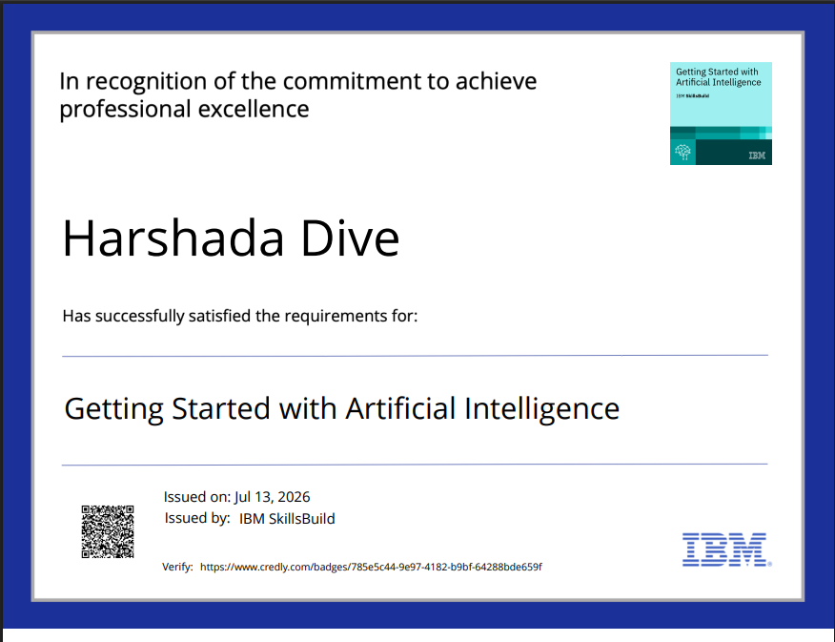
Certificates Earned:
Please add your credly certificate

Slide 14
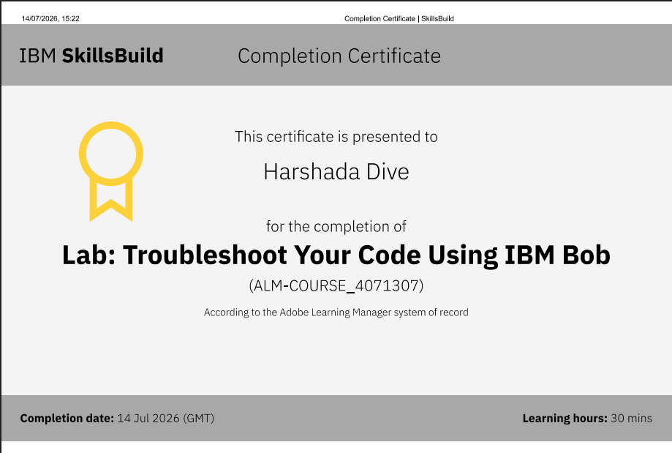
Certificates Earned:​
Add your IBM BOB Certificate

Slide 15


