Slide 1
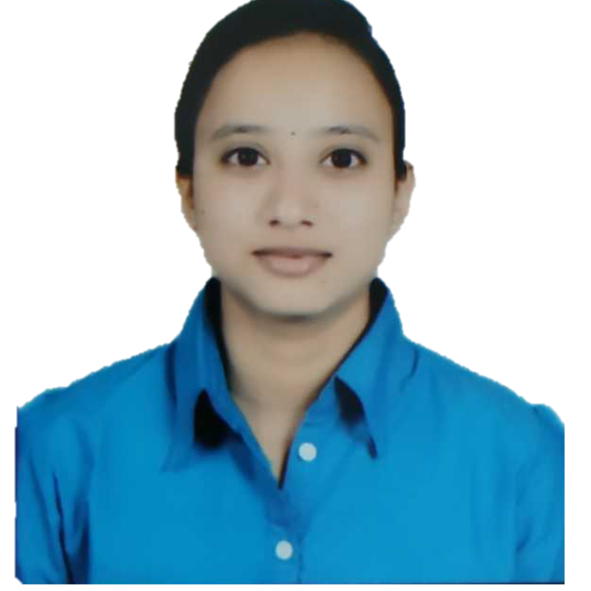

HARSHADA GANGANE
Bachelor of Engineering
Computer Science : 2016 - 2021
Analyst/Software Engineer
Skills
Java 8 /J2EE | Java Basics, OOPS, Generics, Collections, Arrays, Loops Junit.
Spring Data JPA | Implement DAO layer using spring Data repositories, Transaction Management
React | Components, Services, Modules, Routing, Forms & Validation.
Database | MySQL
UI Tech | HTML 5 & CSS 3,JavaScript, Reusable templates, Optimized UI Designed
Tools | Git, Postman, MS Office
Add On skills | Fluent Communications, Team management, Time management, Leadership Skills, Adaptive Learning
Pune
harshada.khandu-gangane@capgemini.com
+919158203488
A4
Full Stack Developer
Hands on experience in creating Web Application with Spring boot, React
Proficient in creating Single page Web Application in React with Authentication with route guards, Angular template driven forms, react routing, CSS, bootstrap
Understanding of deploying spring boot applications in React environment on an intermediate level.
Willingness to learn new technologies and implement them to further improve my knowledge.
Online Food Delivery Application
Completed the case study of Online Food Delivery Application using spring boot microservice architecture along with Swagger, Junit for testing, responsive UI using React Framework, Bootstrap and CSS. Also, best practices are implemented in the application.

