Slide 1
Zomato Power-BI Dashboard
Developed an interactive Power BI dashboard for Zomato using five datasets: food, restaurant, users, orders, and menu. Conducted data cleaning, merging, and creation of new columns to ensure data accuracy and consistency.
Created custom tables, measures, and advanced DAX queries to extract key insights on user behaviour, sales, and restaurant performance. Build relationships between datasets for integrated analysis.
Enhanced dashboard aesthetics with images and implemented interactive buttons for seamless page navigation.
The project resulted in a visually appealing, data-driven tool to support strategic decisions and performance monitoring.

Slide 2
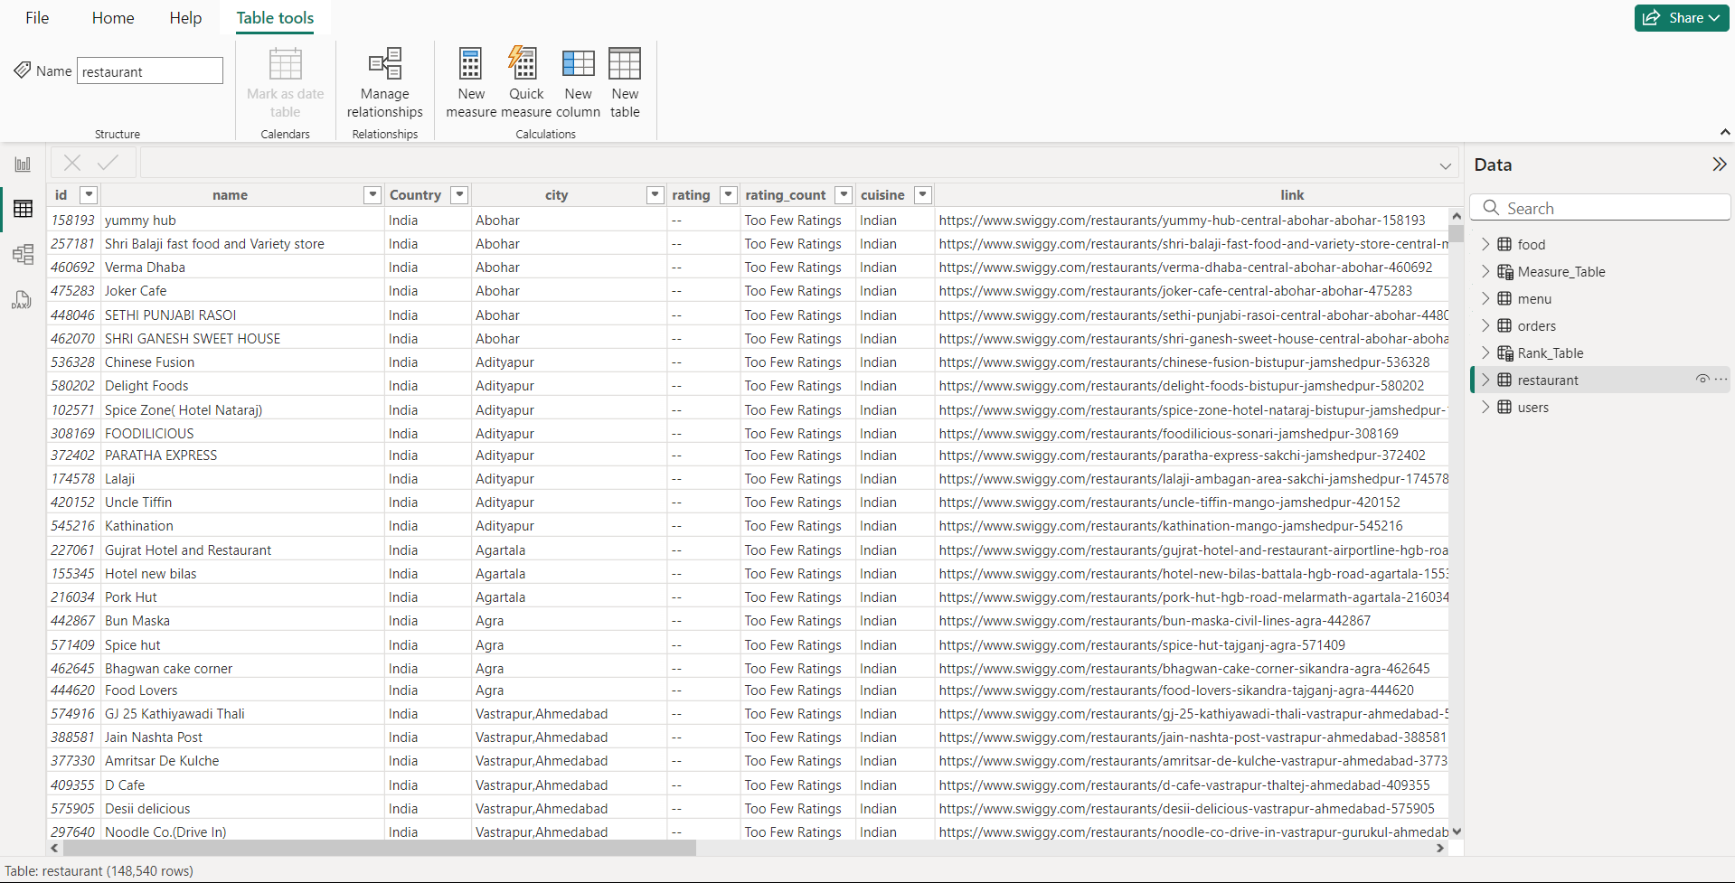
Table View :

Slide 3
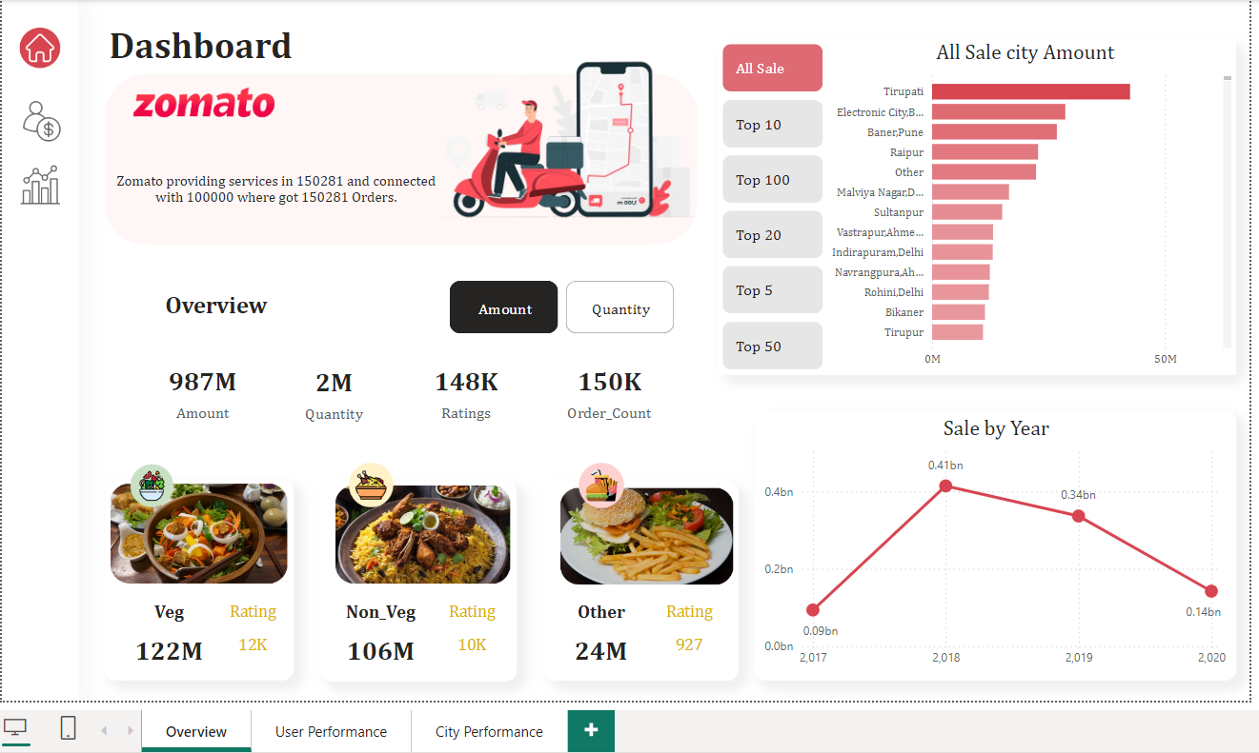
Dashboard :

Slide 4
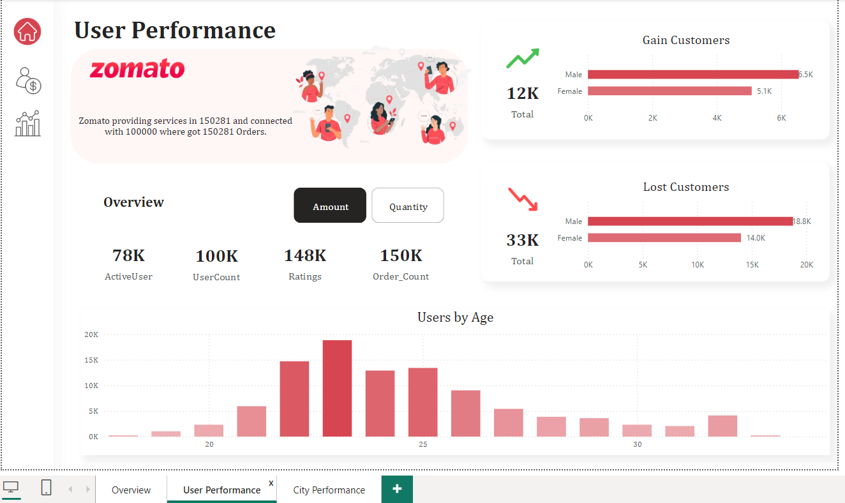
User Performance :

Slide 5
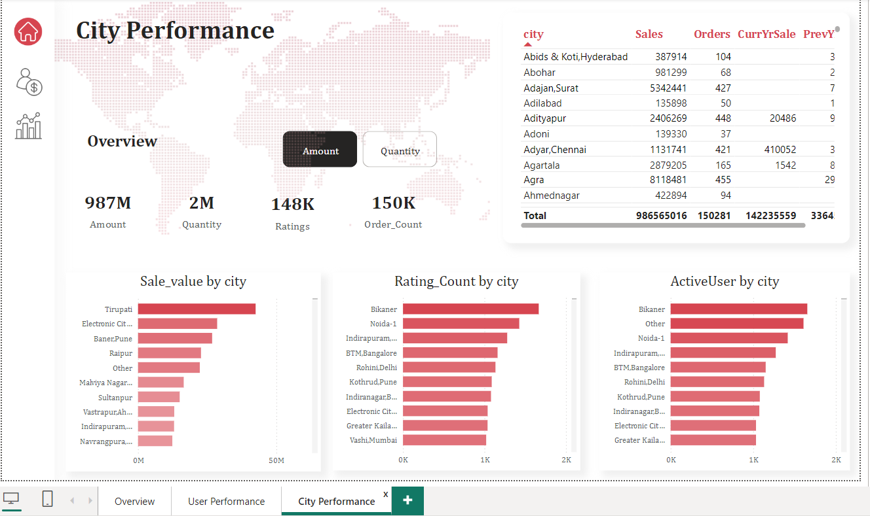
City Performance :

Slide 6
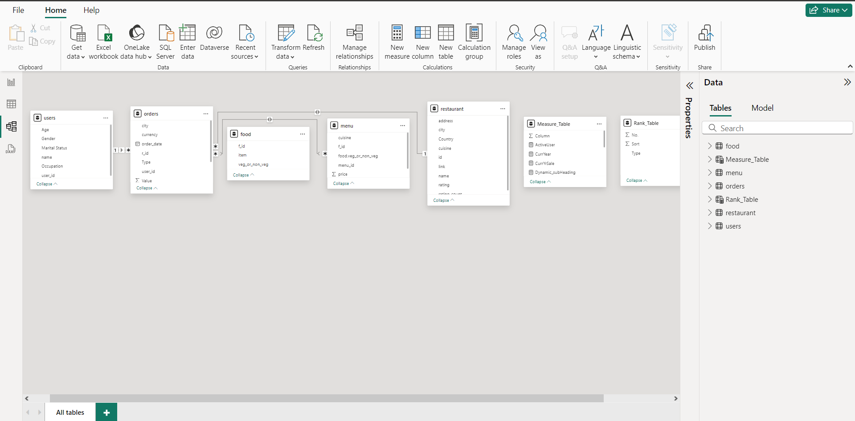
Model View :

