Slide 1
SUPPLY CHAIN / LOGISTICS • CAPSTONE ANALYTICS PROJECT
Supply Chain Intelligence
Optimizing Delivery Performance and Demand Forecasting
PRESENTER
TOOLS
Harshada Kardile
Excel · SQL · Power BI · Statistical Analysis
DATE
19 June 2026

Slide 2
PROJECT OVERVIEW
Project Overview & Objectives
A growing e-commerce retailer faces a severe on-time delivery shortfall, rising logistics costs, and frequent stockouts during peak demand.
Leadership tasked the analytics team with finding the key drivers behind these issues using the full order, supplier, and inventory dataset.
Scope: 10,000 orders · 15 suppliers · 6,000 monthly inventory records · 200 SKUs — analyzed end-to-end in Excel, SQL, and Power BI.
-15%
Reduce delivery delays within two quarters
-10%
Lower logistics cost per order within two quarters
Fewer
Stockouts during peak demand periods
BUSINESS USE CASES
› Delivery performance analysis by carrier, route & category
› SKU-level demand forecasting (4–8 week horizon)
› Supplier segmentation by lead time, defect rate & cost
› Cost attribution by region, carrier & product category
› Root-cause analysis of delay drivers
Supply Chain Intelligence Project
2

Slide 3
THE PROBLEM
Business Problem & Stakeholder Map
16.48% on-time delivery, rising logistics cost ($325.52/order), and a 44.28% stockout rate are putting peak-season revenue and customer retention at risk.
Executive Leadership
Logistics & Carrier Ops
Owns the 15% delay and 10% cost targets; needs the Executive Overview KPI page.
Manages carrier contracts and routing; needs the Delivery Performance breakdown.
Inventory & Warehouse Teams
Procurement / Supplier Mgmt
Owns stock levels and reorder points; needs the Demand Forecast page.
Owns supplier contracts; needs the Supplier Segmentation personas.
Supply Chain Intelligence Project
3

Slide 4
DATA FOUNDATION
Dataset Overview
Sheet | Rows | Cols | Description
Orders | 10,000 | 25+ | Core transactional data — orders, deliveries, costs, delays
Suppliers | 15 | 11 | Supplier performance metrics for cluster analysis
Inventory | 6,000 | 13+ | Monthly stock levels for 200 SKUs across 30 months
Monthly_KPI_Summary | 30 | 12 | Pre-aggregated KPIs by month for dashboard use
Data_Dictionary | 48 fields | — | Field definitions for all columns
DATA QUALITY AUDIT — ORDERS TABLE
NOTE ON DATA CONDITION
✓ 0 duplicate Order_IDs across 10,000 rows
Supplied in a pre-cleaned analytical state. Wrangling focused on derived columns, pivot summaries, and SQL schema design rather than repairing messy raw data — documented here for transparency.
✓ 0 null values in any Orders column
✓ 0 fully duplicate rows
✓ Carrier & region fields standardized (8 carriers, 7 regions)
Supply Chain Intelligence Project
4

Slide 5
DATA QUALITY
Data Quality Findings
✓
Completeness
✓
Uniqueness
No missing values across Order_ID, dates, carrier, region, cost, or delay fields in the cleaned Orders table.
Order_ID is unique across all 10,000 rows; no duplicate transactions detected.
✓
Consistency
!
Schema mismatch found
Carrier names (8 distinct) and region labels (7 distinct) are standardized with no spelling variants.
Initial SQL inventory schema did not match the final cleaned Inventory columns; corrected before submission.
Supply Chain Intelligence Project
5

Slide 6
EXCEL ANALYSIS
Excel Analysis Highlights
Calculated Columns Added
Avg Delay by Carrier (days)
Delivery Delay Days — actual vs. promised delivery date
Lead Time — purchase order to goods receipt, by supplier
Cost per Unit Shipped — shipping cost ÷ order quantity
Pivot Table Summaries Built
Average delay and order count by carrier
Order value and shipping cost by region & carrier
Delay totals by product category
On-time rate spans 47.9% (DHL) down to 0.4% (XpressBees).
Full pivot detail available in the Pivot_Tables sheet of the cleaned workbook.
Supply Chain Intelligence Project
6

Slide 7
SQL ANALYSIS
SQL Analysis Highlights
Extraction Queries
Sample Query — Regional Carrier Ranking (DENSE_RANK)
Orders filtered by date range, carrier, and region to support targeted root-cause checks.
WITH RegionalCarrierPerformance AS (
SELECT region, carrier,
COUNT(order_id) AS shipment_volume,
ROUND(AVG(delivery_delay_days),2)
AS average_transit_delay,
DENSE_RANK() OVER (
PARTITION BY region
ORDER BY AVG(delivery_delay_days) DESC)
AS performance_rank
FROM orders
GROUP BY region, carrier )
SELECT * FROM RegionalCarrierPerformance
WHERE performance_rank <= 2
ORDER BY region, performance_rank;
Aggregation Queries
Carrier performance: shipments, avg delay, delay std. dev., on-time %, and unit shipping cost — grouped by carrier.
Window Functions
DENSE_RANK() flags the 2 worst carriers per region; rolling 3-month AVG() tracks SKU demand trend.
Supply Chain Intelligence Project
7

Slide 8
ADVANCED ANALYTICS
Three Methods Implemented
Two methods required by the project brief — all three completed.
IMPLEMENTED
IMPLEMENTED
ALSO COMPLETED
A. Delivery Delay Regression
B. Time-Series Demand Forecasting
C. Supplier & Route Segmentation
Multiple Linear Regression predicting Delivery_Delay_Days from weight, distance, carrier, category, season & warehouse.
Moving Average and Exponential Smoothing applied to the top-20 SKUs by total units sold.
Z-score clustering across lead time, defect rate & fill rate — a 3rd method beyond the 2 required.

Slide 9
ADVANCED ANALYTICS · REGRESSION
Regression Model — Results & Evaluation
0.173
0.171
2.07 days
1.41 days
R² (model fit)
Adjusted R²
RMSE
MAE
Strongest Delay Drivers (vs. Aramex baseline carrier)
Variable | Effect on Delay | Interpretation
Carrier: DHL | −1.74 days | Significantly faster than baseline
Carrier: FedEx | −1.51 days | Significantly faster than baseline
Carrier: XpressBees | +1.05 days | Significantly slower than baseline
Shipment Weight | +0.026 days/kg | Each extra kg adds delay, all else equal
Shipment Distance | Not significant | p = 0.40 — distance alone does not predict delay
Carrier choice is the dominant driver of delay — far larger than weight or distance.
Supply Chain Intelligence Project
9

Slide 10
ADVANCED ANALYTICS · FORECASTING
Demand Forecasting — Results & Evaluation
Top 20 SKUs (by total units sold) forecasted using a 3-month Moving Average and Exponential Smoothing (α = 0.30).
Avg MAPE by Method vs. Target
Honest finding, not a hidden failure
Both methods fall well short of the 15% MAPE target — reported transparently rather than tuned to look better.
Root cause: SKU-level monthly demand is highly volatile and intermittent; simple time-series methods can't capture these swings.
Implication: near-term inventory should rely on safety stock and reorder points, not point forecasts alone.
Supply Chain Intelligence Project
10

Slide 11
CLUSTER ANALYSIS
Supplier Segmentation — Method
All 15 suppliers standardized on four z-score features (Lead Time, Defect Rate, Fill Rate, Cost per Unit) so each weighs equally.
K-Means run by hand in Excel: seed centroids from risk-sorted suppliers, assign each to its nearest centroid, recompute, and repeat until stable.
K selected with the Elbow Method on Within-Cluster Sum of Squares (WCSS) — the sharp drop ends at K=3, so K=3 is retained: Preferred Partner, Under Watch, Critical.
Elbow Method — WCSS
K | WCSS
1 | 15.4
2 | 8.7
3 | 4.3 ← elbow
4 | 3.9
MANUAL K-MEANS
True K-Means, executed by hand in Excel (no Python / clustering libraries permitted). Centroids and assignments were iterated to convergence manually, and K=3 was confirmed with an elbow-method check on within-cluster sum of squares — every step auditable in the workbook.
Sharp WCSS drop ends at K=3 (4.3); K=4 improves only to 3.9 — marginal. K=3 selected.
DISTANCE FEATURES (Z-SCORED)
Lead Time · Defect Rate · Fill Rate · Cost per Unit
Supply Chain Intelligence Project
11

Slide 12
SUPPLIER SEGMENTATION
Cluster Personas & Recommendations
Preferred Partner
Under Watch
Critical
6 SUPPLIERS
4 SUPPLIERS
5 SUPPLIERS
SUPPLIERS
SUPPLIERS
SUPPLIERS
Bosch India, Samsung Logistics, Godrej, Dabur, Asian Paints, Cipla Pharma
Reliance Industries, Mahindra Logistics, Amazon Seller Svcs, ITC Agri-Business
Tata Supply Co., Flipkart Wholesale, Havells, LG Electronics, Dr. Reddy's
RECOMMENDATION
RECOMMENDATION
RECOMMENDATION
Increase order volume; candidates for long-term contracts.
Monitor monthly; set improvement checkpoints before renewal.
Review contracts; identify backup suppliers and corrective plans.
Supply Chain Intelligence Project
12

Slide 13
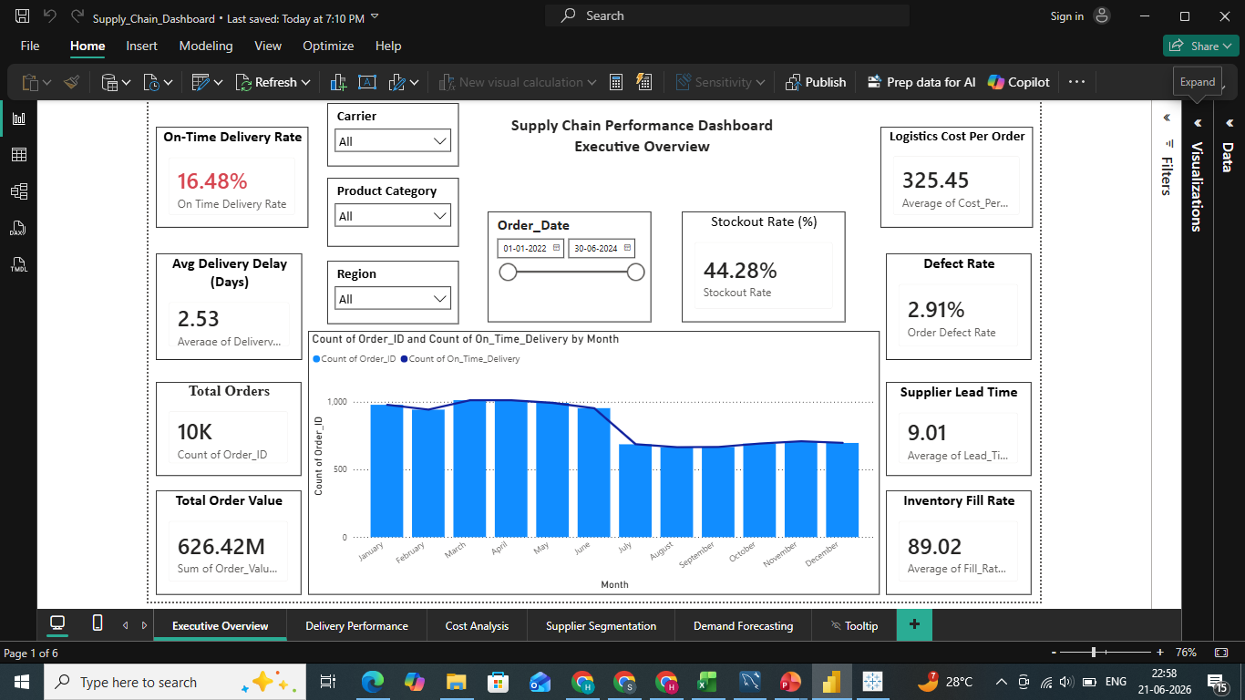
KPI DASHBOARD
Executive Overview Page
Page Contents
All 8 business KPIs as scorecards (On-Time Delivery, Avg Delay, Cost/Order, Fill Rate, Lead Time, Forecast MAPE, Defect Rate, Stockout Rate)
Monthly order volume trend (column + line combo)
4 required slicers: Carrier, Region, Product Category, Order Date
Power BI · Executive Overview
16.48%
Live On-Time Delivery Rate (unfiltered) — matches the SQL/Excel analysis exactly.
Supply Chain Intelligence Project
13

Slide 14
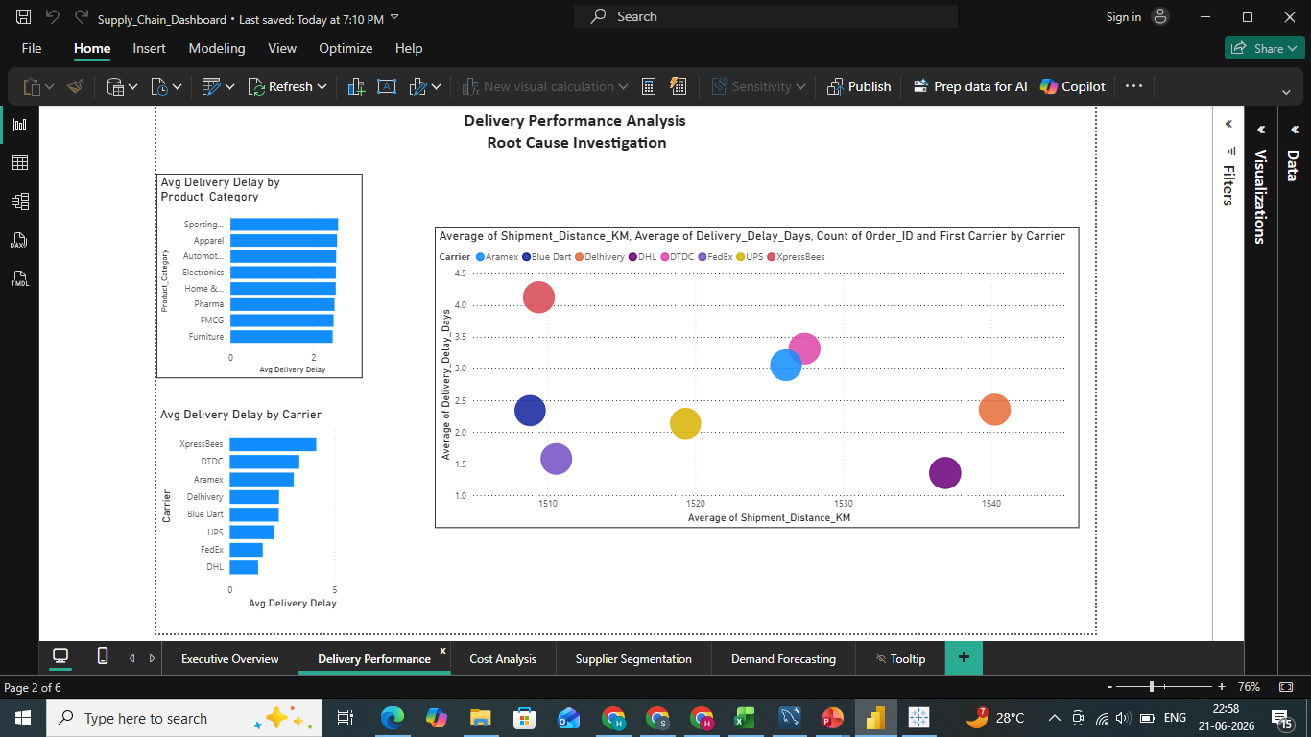
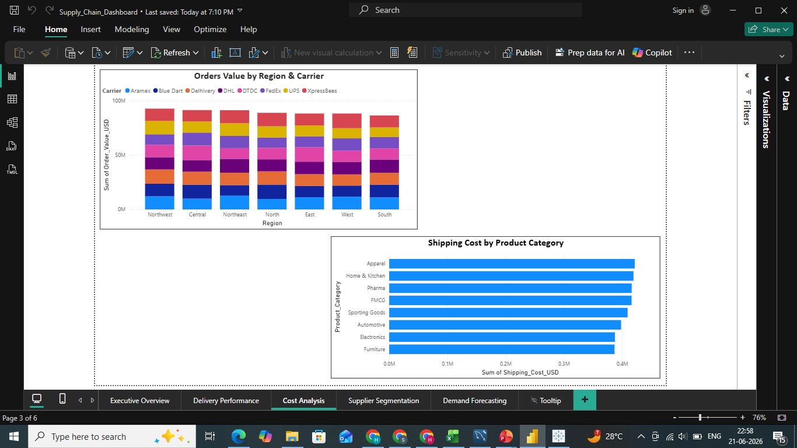
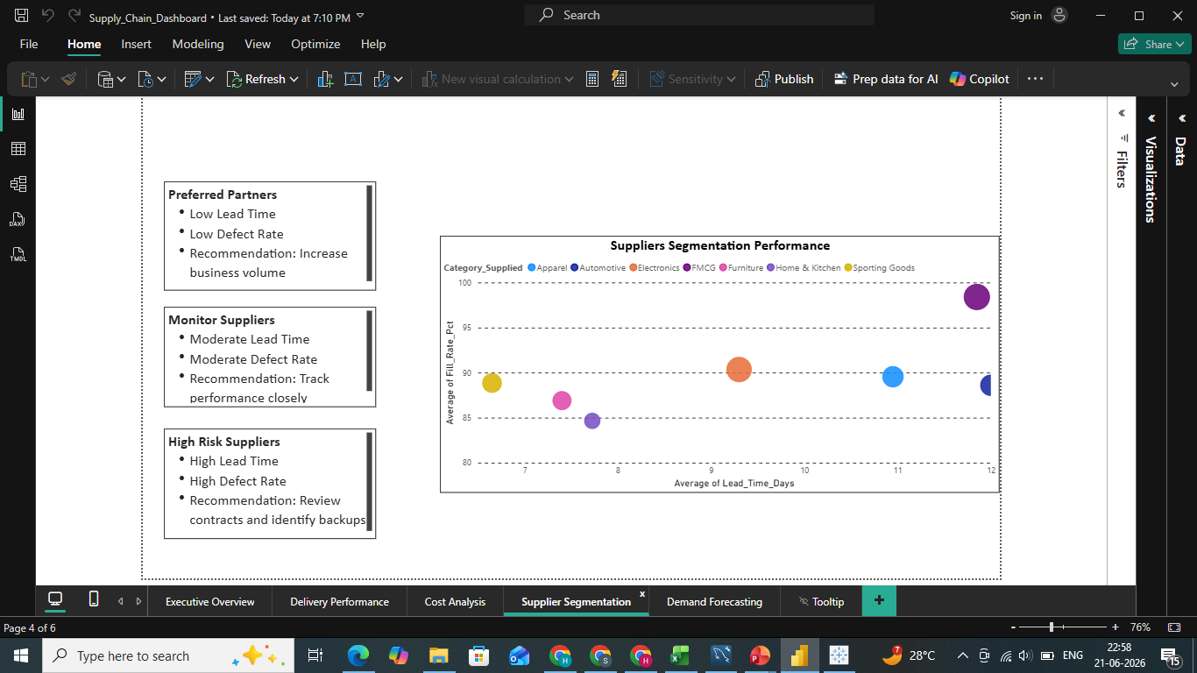
KPI DASHBOARD
Delivery, Cost & Segmentation Pages
[ Screenshot ]
[ Screenshot ]
[ Screenshot ]
Delivery Performance
Cost Analysis
Supplier Segmentation
Avg delay by carrier & product category; distance-vs-delay scatter by carrier.
Order value by region & carrier (stacked); shipping cost by product category.
Defect rate vs. lead time scatter; persona cards with recommendations.
Supply Chain Intelligence Project
14

Slide 15
KEY FINDINGS
Key Findings & Business Insights
01
Carrier choice dominates delay
DHL averages 1.35 days delay (48% on-time); XpressBees averages 4.13 days (0.4% on-time) — a gap larger than any other modeled factor.
02
Delay is regional, not just carrier-driven
Northeast (1.3% on-time) and Northwest (4.8% on-time) underperform across all carriers — pointing to route/infrastructure issues, not vendor selection alone.
03
Weight matters; distance doesn't (much)
Each extra kg of shipment weight adds ~0.03 days of delay; shipment distance is not statistically significant once carrier is controlled for.
Supply Chain Intelligence Project
15

Slide 16
KEY FINDINGS
Key Findings & Business Insights (cont.)
04
Demand forecasting needs a different approach
Top-20 SKU forecasts show 76–84% MAPE — demand is too volatile for simple time-series methods; safety stock should drive near-term planning.
05
Supplier quality is unevenly distributed
5 of 15 suppliers (one-third) fall into the Critical cluster on lead time and defect rate — a concentrated, addressable risk.
06
Defect and stockout rates are the largest gaps
Defect rate (9.91% vs. 2% target) and stockout rate (44.28% vs. 3% target) are furthest from target — bigger gaps than delivery delay itself.
Supply Chain Intelligence Project
16

Slide 17
RECOMMENDATIONS
Prioritized by Impact vs. Effort
Vertical axis = business impact · Horizontal axis = implementation effort
Quick Wins
Strategic Bets
HIGH IMPACT · LOW EFFORT
HIGH IMPACT · HIGH EFFORT
1 Shift carrier volume on worst routes
4 Raise safety stock for top-20 SKUs
5 Add weight-based shipping surcharge
2 Replace / renegotiate Critical suppliers
3 Investigate NE / NW infrastructure
6 Audit the order-defect pipeline
Build-On
Watch
MED IMPACT · LOW EFFORT
LOWER PRIORITY · REVISIT LATER
7 Pilot fill-rate program with Preferred suppliers
No current recommendations in this quadrant
Supply Chain Intelligence Project
17

Slide 18
RECOMMENDATIONS
Detail & Expected Outcomes
# | Recommendation | Why it matters
1 | Shift volume from XpressBees/DTDC to DHL/FedEx on worst routes | Improves on-time rate toward the 90% target without new infrastructure spend
2 | Renegotiate or replace the 5 Critical suppliers | Reduces defect and lead-time risk concentrated in one-third of the base
3 | Investigate Northeast/Northwest delivery infrastructure | Addresses delay that persists across all carriers in these regions
4 | Raise safety stock for top-20 SKUs given ~77% forecast MAPE | Reduces stockout rate without waiting for a more accurate forecast model
5 | Add weight-based shipping surcharge or repacking step | Recovers cost from the +0.026 days/kg delay relationship in the regression
6 | Audit the order-defect pipeline (9.91% vs. 2% target) | Closes the single largest KPI gap on the dashboard
7 | Pilot a fill-rate improvement program with Preferred suppliers | Builds on proven reliability before extending to riskier suppliers
Supply Chain Intelligence Project
18

Slide 19
WRAP-UP
Limitations & Future Scope
Limitations
Future Scope
Regression explains ~17% of delay variance (R² = 0.173); unmeasured factors (warehouse handling, customs) likely explain more.
SKU-level forecasts (MAPE 76–84%) are not yet reliable enough for automated reorder triggers.
Supplier K-Means was computed manually on just 15 suppliers, so cluster boundaries are sensitive to individual outliers.
No Python forecasting/clustering libraries used, per guidelines — all analysis is Excel/SQL/Power BI native.
Incorporate promotional calendars and seasonality indices into the demand model.
Extend the regression to include warehouse dwell time once that data is captured.
Automate the supplier K-Means (with a fuller elbow / silhouette sweep) once the supplier base grows beyond ~15.
Build an automated monthly refresh of the Power BI dashboard once a live data connection is available.
Supply Chain Intelligence Project
19

Slide 20
REFERENCES & APPENDIX
Data source: Internal capstone dataset provided for academic/training purposes (GUVI / HCL Supply Chain Analytics Capstone) — not a public dataset URL, per project guidelines.
Supporting files: cleaned Excel workbook with documented transformation & analysis sheets; SQL scripts for schema, extraction, aggregation & window-function queries; Power BI dashboard (.pbix) with 5 interactive pages.
Full analytics detail is documented in the accompanying PDF report.
Thank You
Questions & Discussion

