Slide 1

Project Title -Seasonal Agriculture Performance Analysis
Student Name- Harshada Nanabhau Mali
College Name- R. C. Patel Educational Trust's
Institute of Management Research and Development, Shirpur
AICTE STU ID :STU6a5a433eac6fd1784300350

Slide 2

PROBLEM STATEMENT
Agricultural activities are influenced by seasonal variations in environmental conditions, farming practices, resource availability and market conditions. As a result, agricultural performance may differ from one season to another.
However, raw agricultural data does not clearly explain how agricultural performance changes across seasons or what patterns can be observed in different seasonal conditions.
The problem is to analyze the given agricultural dataset and investigate seasonal differences in agricultural performance by identifying meaningful patterns, trends, relationships andvariations within the available data.

Slide 3
Project Description
Seasonal Agriculture Performance Analysis is a data analysis project that examines agricultural activities across different seasons, crops, geographical regions, environmental conditions, resource usage, and economic outcomes. The project uses Python and statistical analysis techniques to clean and analyze the dataset, identify seasonal patterns and relationships, compare crop and regional performance, and study factors affecting yield, production, water efficiency, disease/pest risk, revenue, cost, and profit. The analysis provides data-driven insights and recommendations to support better seasonal agricultural planning and decision-making.

Slide 4

WHO ARE THE END USERS?
Farmers – To understand seasonal crop performance and improve farming decisions.
Agricultural Planners – To support seasonal and regional agricultural planning.
Agricultural Researchers – To study patterns, trends, and relationships in agricultural data.
Government & Agriculture Departments – To support evidence-based agricultural policies and programs.
Agricultural Consultants – To provide data-driven recommendations for crop and resource management.
Resource Managers – To improve the efficient use of water, fertilizer, and pesticides.
Agribusiness & Supply Chain Organizations – To understand production, revenue, and market-related patterns.
Data Analysts & Students – To explore agricultural datasets and develop analytical insights.

Slide 5

Technology Used
  Python – Main programming language for data analysis.
  Pandas – Data cleaning, transformation, and analysis.
  NumPy – Numerical and statistical calculations.
  Matplotlib – Data visualization and graphical analysis.
  Seaborn – Statistical visualizations such as heatmaps and relationship plots.
  SciPy – Statistical analysis, including ANOVA and correlation analysis.
  Jupyter Notebook – Environment for performing and documenting the complete analysis.
  CSV Dataset – Source format for the Seasonal Agriculture Performance dataset.

Slide 6
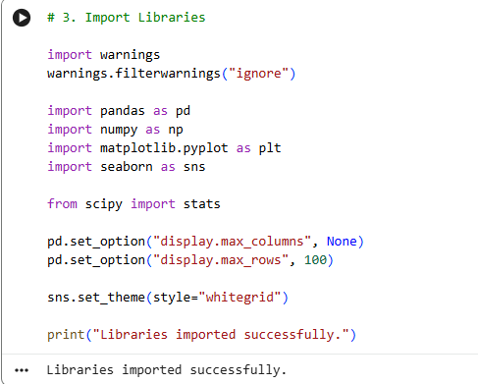
RESULTS
1. Dataset Overview
4,000 farms were analyzed across 8 states, 10 districts, 8 crops, and 3 seasons.
Kharif has the highest number of farms (1,779), followed by Rabi (1,627) and Zaid (594).

Slide 7
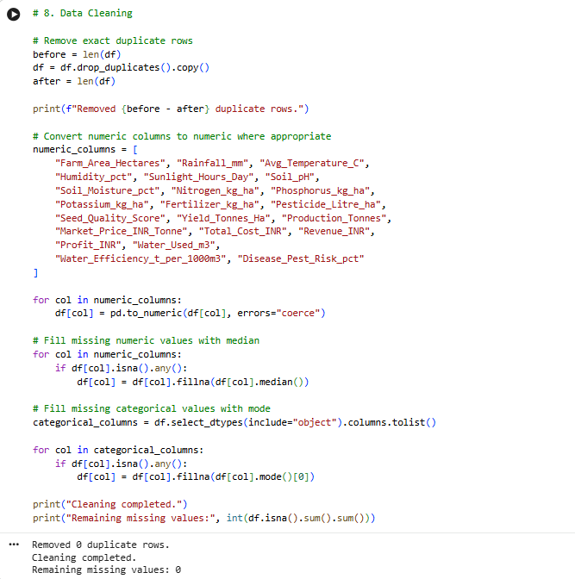
RESULTS
2. Data Cleaning
Duplicate records were checked and 0 duplicate rows were found.
Missing values were handled using appropriate median/mode imputation.
Final dataset has 0 remaining missing values.

Slide 8
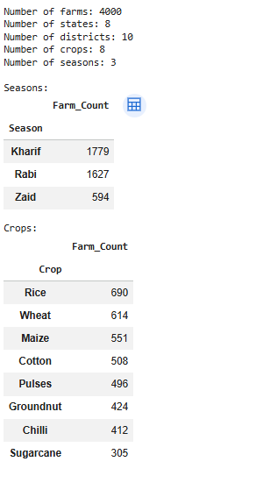
RESULTS
3. Seasonal Performance
Kharif has the highest average yield at approximately 5.61 tonnes/ha.
Rabi averages about 5.02 tonnes/ha.
Zaid has the lowest average yield at about 4.63 tonnes/ha.
The boxplot also shows several high-yield observations/outliers.

Slide 9
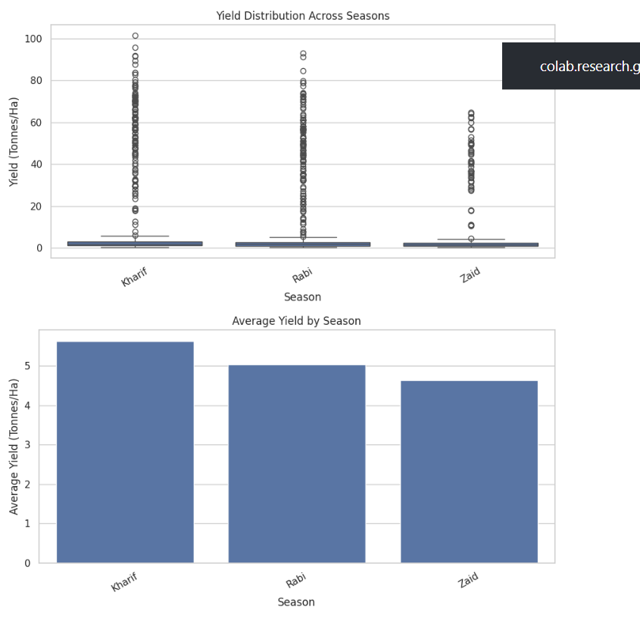
RESULTS
4. Crop Performance
Sugarcane has the highest average yield (46.64 tonnes/ha).
Maize follows at 2.71 tonnes/ha.
Pulses has the lowest average yield (0.92 tonnes/ha).
Sugarcane also shows the highest average water efficiency (30.48 tonnes/1,000 m³).

Slide 10
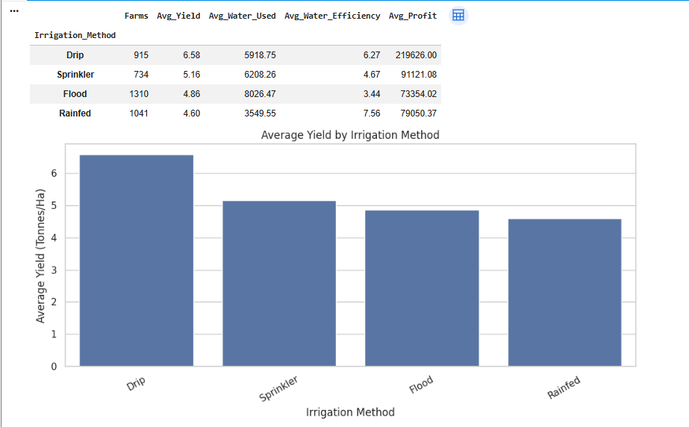
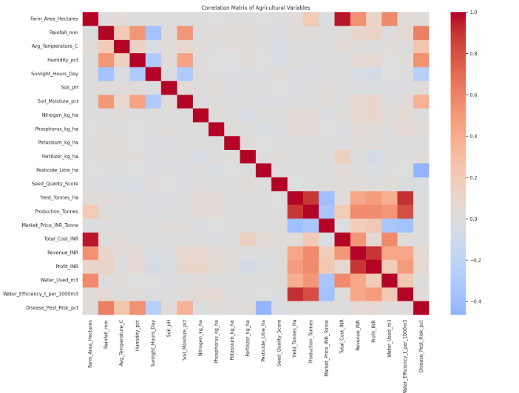
RESULTS
5. Irrigation & Water Efficiency
Drip irrigation has the highest average yield (6.58 tonnes/ha) and highest average profit.
Rainfed farming has the highest water efficiency (7.56 tonnes/1,000 m³).
This indicates that irrigation method can be an important factor when evaluating yield, water use, and profitability.

Slide 11
RESULTS
6. Correlation Analysis
The heatmap shows relationships among environmental, resource, production, and economic variables.
Yield has a strong positive relationship with production.
Revenue and profit also show strong relationships with production/economic variables.
Correlation indicates association, not necessarily causation.

Slide 12
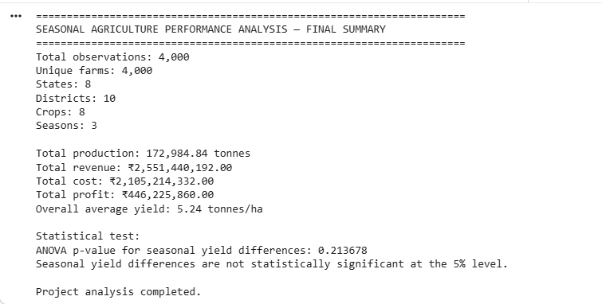
RESULTS
7. Overall Project Result
Total production: 172,984.84 tonnes
Total revenue: ₹2.55 billion
Total profit: ₹446.23 million
Overall average yield: 5.24 tonnes/ha
ANOVA p-value = 0.213678, so seasonal yield differences were not statistically significant at the 5% level.

Slide 13
Future scope
Predictive Analysis – Use Machine Learning to predict future crop yield, production, and profit.
Weather Data Integration – Integrate real-time weather data such as rainfall, temperature, and humidity.
Crop Recommendation System – Recommend suitable crops based on season, soil, weather, and historical performance.
Smart Resource Management – Optimize water, fertilizer, pesticide, and other resource usage.
Disease & Pest Prediction – Develop models to predict crop disease and pest risks.
Regional Expansion – Extend the analysis to more states, districts, crops, and farming conditions.
Interactive Dashboard – Develop an interactive Power BI/web dashboard for farmers and agricultural decision-makers.
AI-Based Decision Support – Build an AI-driven system that provides data-based recommendations for seasonal agricultural planning.

Slide 14
GitHub Link
https://github.com/harshadamali14-rgb/Seasonal-Agriculture-Performance-Analysis.git

Slide 15

VOIS Course completion certificate -
Course name- Data Visualization

Slide 16
Thank you
.
.

