Slide 1
ANGULAR

Slide 2
Why Angular?
Angular 1 is a JavaScript framework from Google which was used for the development of web applications.
Following are the reasons to migrate from Angular 1 to the latest version of Angular:
​​​​​​​Cross-Browser Compliant
Internet has evolved significantly from the time Angular 1.x was designed. Creating a web application that is cross-browser compliant was difficult with Angular 1.x framework. Developers had to come up with various workarounds to overcome the issues. Angular helps to create cross-browser compliant applications easily.
Typescript Support
Angular is written in Typescript and allows the user to build applications using Typescript. Typescript is a superset of JavaScript and more powerful language. The use of Typescript in application development improves productivity significantly.
Web Components Support
Component-based development is pretty much the future of web development. Angular is focused on component-based development. The use of components helps in creating loosely coupled units of application that can be developed, maintained, and tested easily.

Slide 3
Better support for Mobile App Development
Desktop and mobile applications have separate concerns and addressing these concerns using a single framework becomes a challenge. Angular 1 had to address the concerns of a mobile application using additional plugins. However, the Angular framework, addresses the concerns of both mobile as well as desktop applications.
Better performance
The Angular framework is better in its performance in terms of browser rendering, animation, and accessibility across all the components. This is due to the modern approach of handling issues compared to earlier Angular version 1.x.
Evolution of Angular Framework:

Slide 4
Let us now understand what is Angular and what kind of applications can be built using Angular:
Angular is an open-source JavaScript framework for building both mobile and desktop web applications.
Angular is exclusively used to build Single Page Applications (SPA).
Angular is completely rewritten and is not an upgrade to Angular 1.
Developers prefer TypeScript to write Angular code. But other than TypeScript, you can also write code using JavaScript (ES5 or ECMAScript 5).
Why most developers prefer TypeScript for Angular?
TypeScript is Microsoft’s extension for JavaScript which supports object-oriented features and has a strong typing system that enhances productivity.
TypeScript supports many features like annotations, decorators, generics, etc. A very good number of IDE’s like Sublime Text, Visual Studio Code, Nodeclipse, etc., are available with TypeScript support.
TypeScript code is compiled to JavaScript code using build tools like npm, bower, gulp, webpack, etc., to make the browser understand the code.

Slide 5
Features of Angular
Let us look at the features of Angular:
Easier to learn: Angular is more modern and easier for developers to learn. It is a more streamlined framework where developers will be focusing on writing JavaScript classes.
Good IDE support: Angular is written in TypeScript which is a superset of JavaScript and supports all ECMAScript 6 features. Many IDEs like Eclipse, Microsoft Visual Studio, Sublime Text, etc., have good support for TypeScript.
Familiar: Angular has retained many of its core concepts from the earlier version (Angular 1), though it is a complete re-write. This means developers who are already proficient in Angular 1 will find it easy to migrate to Angular.
Cross-Platform: Angular is a single platform that can be used to develop applications for multiple devices.
Performance: Angular performance has been improved a lot in the latest version. This has been done by automatically adding or removing reflect metadata from the polyfills.ts file which makes the application smaller in production.

Slide 6
Lean and Fast: Angular application's production bundle size is reduced by 100s of kilobytes due to which it loads faster during execution.
Bundle Budgets: Angular will take advantage of the bundle budgets feature in CLI which will warn if the application size exceeds 2MB and will give errors if it exceeds 5MB. Developers can change this in angular.json.
Simplicity: Angular 1 had 70+ directives like ng-if, ng-model, etc., whereas Angular has a very less number of directives as you use [ ] and ( ) for bindings in HTML elements.
Component-based:
Angular follows component-based programming which is the future of web development. Each component created is isolated from every other part of our application. This kind of programming allows us to use components written using other frameworks.
Inside a component, you can write both business logic and view.
Every Angular application must have one top-level component referred to as 'Root Component' and several sub-components or child components.

Slide 7
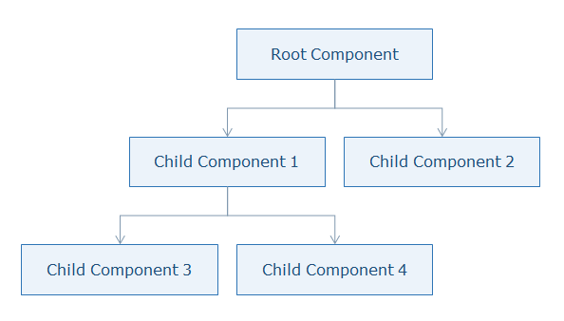
Let us see where Angular fits in the entire web application stack.

Slide 8
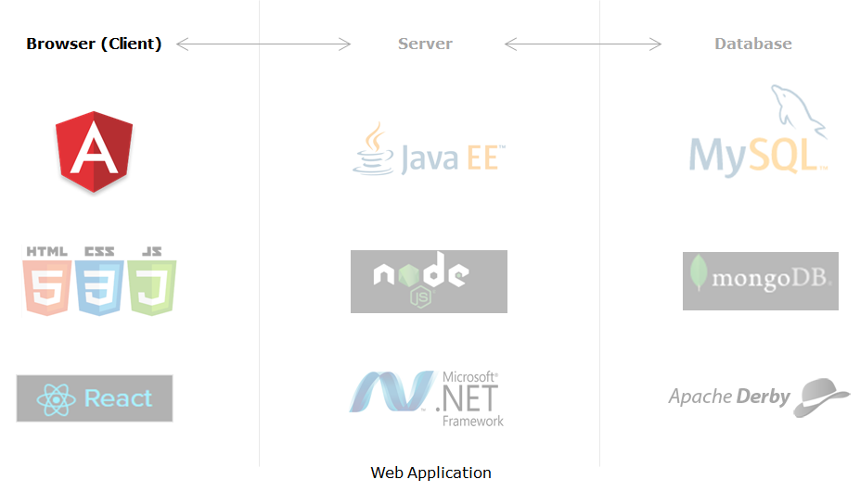
Angular places itself on the client-side in the complete application stack and provides a completely client-side solution for quick application development. Angular has absolutely no dependencies and also jells perfectly with any possible server-side technology like Java, NodeJS, PHP, etc., and any database like MongoDB, MySql.

Slide 9
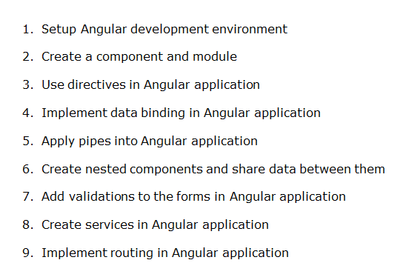
Angular Application Setup

Slide 10
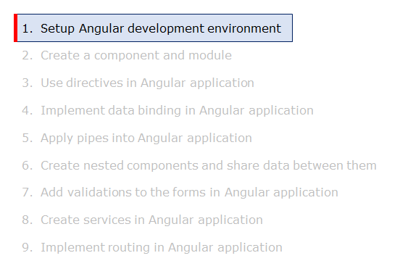

Slide 11
To develop an application using Angular on a local system, you need to set up a development environment that includes the installation of:
Node.js (^12.20.2 || ^14.15.5 || ^16.10.0) and npm (min version required 6.13.4)
Angular CLI
Visual Studio Code
Install Node.js and Visual Studio Code from their respective official websites.
Steps to install Angular CLI
Angular CLI can be installed using Node package manager using the command shown below
D:\> npm install -g @angular/cli
Test successful installation of Angular CLI using the following command
Note: Sometimes additional dependencies might throw an error during CLI installation but still check whether CLI is installed or not using the following command. If the version gets displayed, you can ignore the errors.

Slide 12
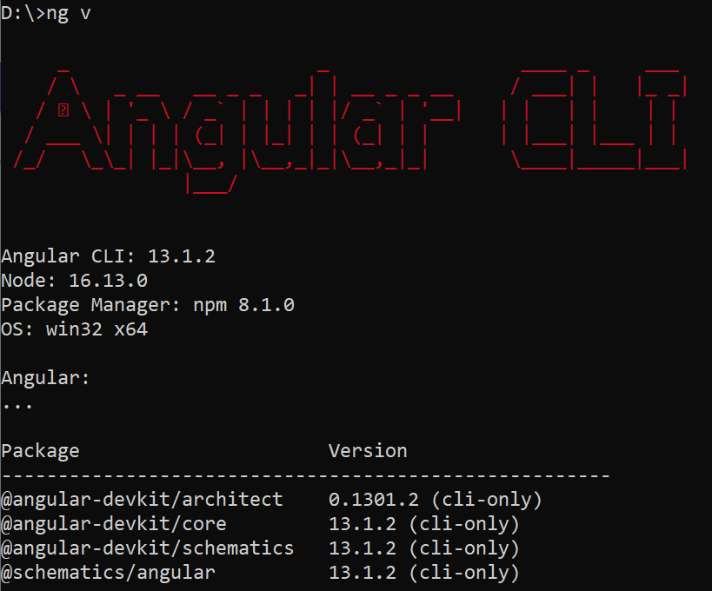
D:\> ng v

Slide 13
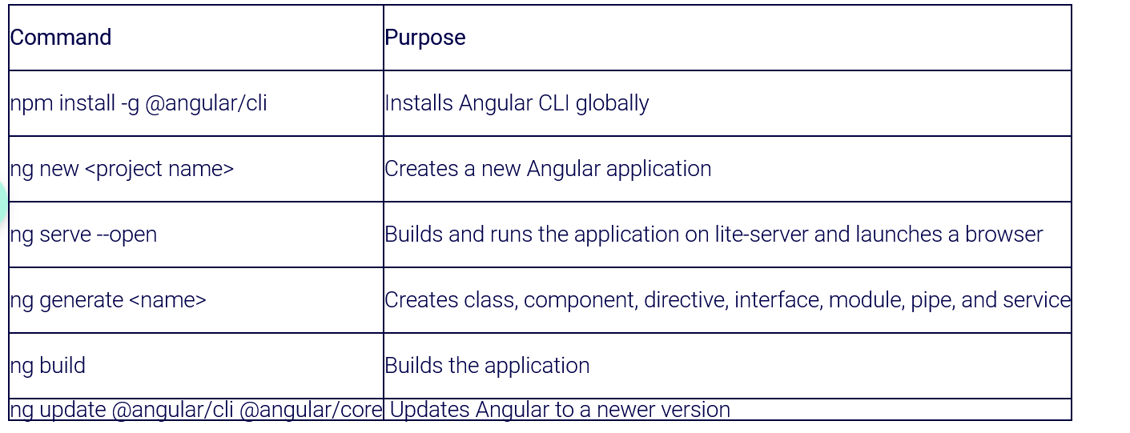
Angular CLI is a command-line interface tool to build Angular applications. It makes application development faster and easier to maintain.
Using CLI, you can create projects, add files to them, and perform development tasks such as testing, bundling, and deployment of applications.

Slide 14
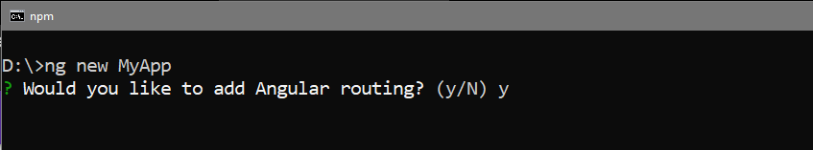
Demo : Creating an Angular Application
Highlights:
Creating an Angular application using Angular CLI
Exploring the Angular folder structure
Demosteps:
1. Create an application with the name 'MyApp' using the following CLI command
D:\>ng new MyApp
2. The above command will display two questions. The first question is as shown below. Typing 'y' will create a routing module file (app-routing.module.ts).

Slide 15
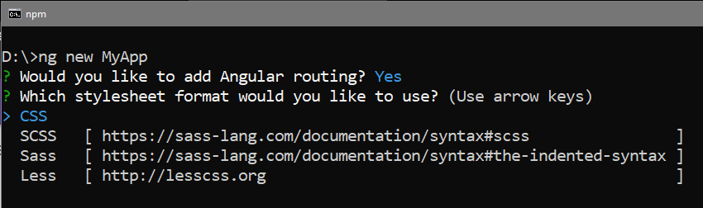
Next, you will learn about the app-routing.module.ts file.
3. The next question is to select the stylesheet to use in the application. Select CSS and press Enter as shown below:
This will create the following folder structure with the dependencies installed inside the node_modules folder.

Slide 16
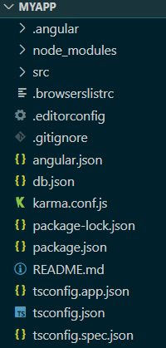
Note: If the above command gives errors while installing dependencies, navigate to the project folder in the Node command prompt and run "npm install" to install the dependencies manually.

Slide 17
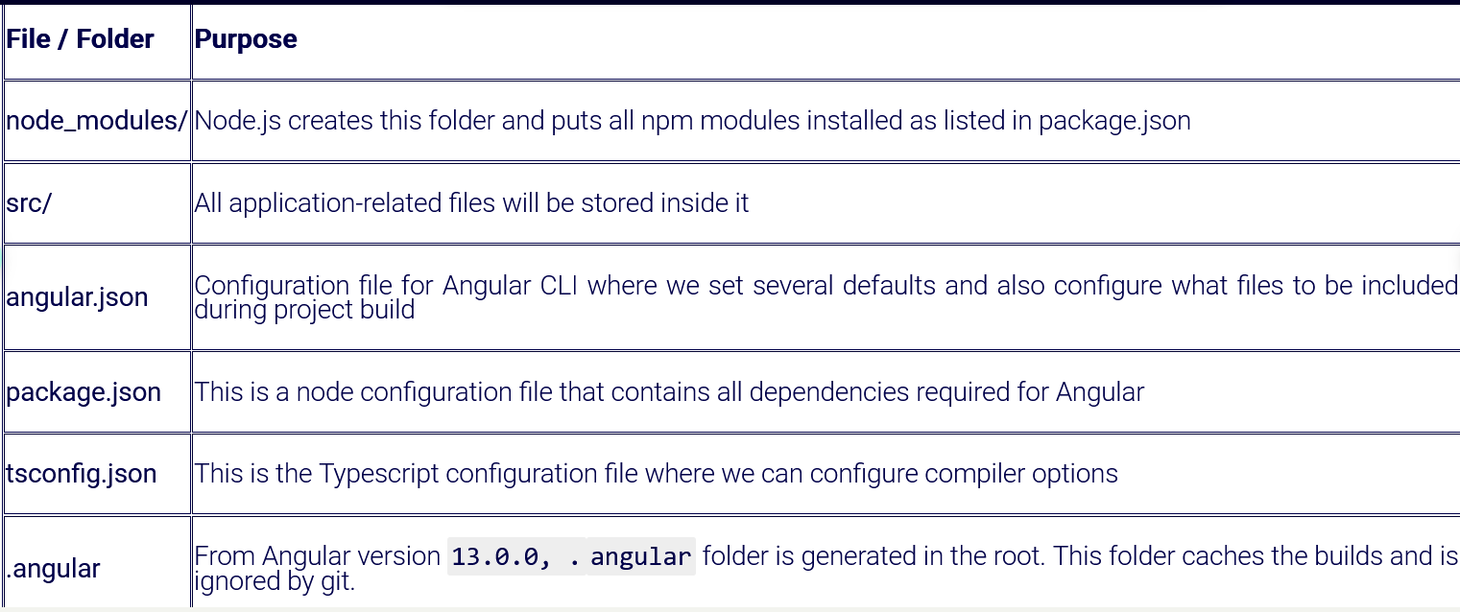

Slide 18
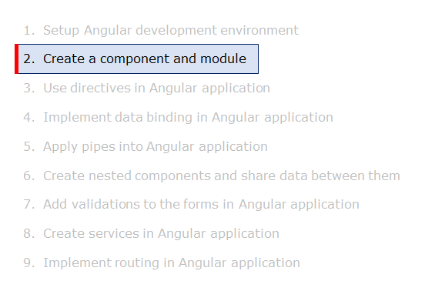
Components

Slide 19
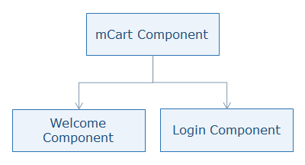
Why Components in Angular?
A component is the basic building block of an Angular application
It emphasize the separation of concerns and each part of the Angular application can be written independently of one another
It is reusable
For example, observe in the mCart application the topmost component is the mCart component(AppComponent) which consists of child components called Welcome component, Login component, etc.

Slide 20
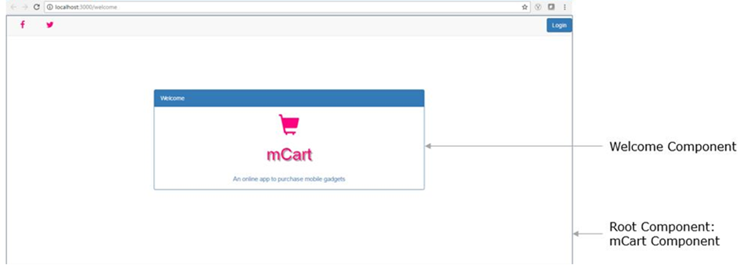

Slide 21
Modules
Modules in Angular are used to organize the application. It sets the execution context of an Angular application.
A module in Angular is a class with the @NgModule decorator added to it. @NgModule metadata will contain the declarations of components, pipes, directives, services that are to be used across the application.
Every Angular application should have one root module which is loaded first to launch the application.
Submodules should be configured in the root module.
In the app.module.ts file placed under the app folder, you have the following code:
To Generate Module write below command
Ng generate module <module_name>

Slide 22
import { BrowserModule } from '@angular/platform-browser';
import { NgModule } from '@angular/core';
import { AppRoutingModule } from './app-routing.module';
import { AppComponent } from './app.component';
@NgModule({
declarations: [
AppComponent
],
imports: [
BrowserModule,
AppRoutingModule
],
providers: [],
bootstrap: [AppComponent]
})
export class AppModule { }

Slide 23
Line 1: imports BrowserModule class which is needed to run the application inside the browser
Line 2: imports NgModule class to define metadata of the module
Line 5: imports AppComponent class from app.component.ts file. No need to mention the .ts extension as Angular by default considers the file as a .ts file
Line 8: declarations property should contain all user-defined components, directives, pipes classes to be used across the application. We have added our AppComponent class here
Line 11: imports property should contain all module classes to be used across the application
Line 15: providers' property should contain all service classes. You will learn about the services later in this course
Line 16: bootstrap declaration should contain the root component to load. In this example, AppComponent is the root component that will be loaded in the HTML page

Slide 24
Executing Angular Application
Execute the application and check the output.
Open terminal in Visual Studio Code IDE by selecting View Menu -> Integrated Terminal.
Type the following command to run the application
D:\MyApp>ng serve --open
ng serve will build and run the application
--open option will show the output by opening a browser automatically with the default port.
Note: If you get an error in the terminal like 'ng is not recognized', use the Node.js command prompt to run this command.
Use the following command to change the port number if another application is running on the default port(4200)

Slide 25
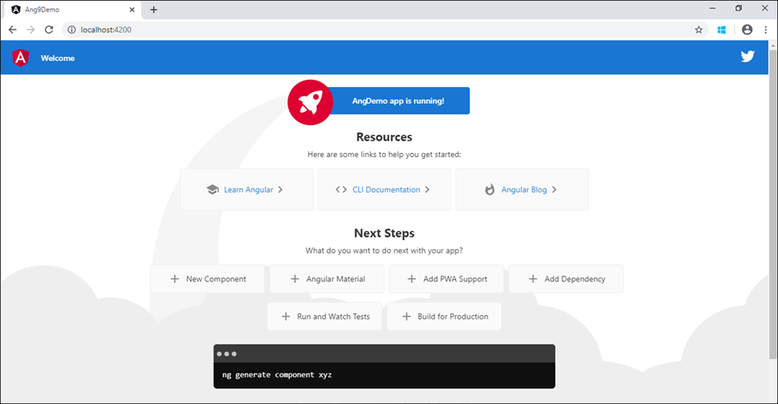
D:\MyApp>ng serve --open --port 3000
Following is the output of the MyApp Application

Slide 26

Demo : Creating a Component
Highlights:
Creating a component using Angular CLI
Exploring the files created
Demosteps:
Problem Statement: Creating a new component called hello and rendering Hello Angular on the page as shown below
1. In the same MyApp application created earlier, create a new component called hello using the following CLI command
D:\MyApp> ng generate component hello

Slide 27
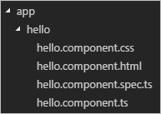
2. This command will create a new folder with the name hello with the following files placed inside it
3. Open hello.component.ts file and create a property called courseName of type string and initialize it to "Angular" as shown below in Line number 9
import { Component, OnInit } from '@angular/core';
@Component({
selector: 'app-hello',
templateUrl: './hello.component.html',
styleUrls: ['./hello.component.css']
})
export class HelloComponent implements OnInit {
courseName: string = "Angular";
constructor() { }
ngOnInit() {
}
}

Slide 28
4. Open hello.component.html and display the courseName as shown below in Line 2
<p>
Hello {{ courseName }}
</p>
5. Open hello.component.css and add the following styles for the paragraph element
p {
color:blue;
font-size:20px;
}
6. Open app.module.ts file and add HelloComponent to bootstrap property as shown below in Line 11 to load it for execution

Slide 29
import { NgModule } from '@angular/core';
import { BrowserModule } from '@angular/platform-browser';
import { AppRoutingModule } from './app-routing.module';
import { AppComponent } from './app.component';
import { HelloComponent } from './hello/hello.component';
@NgModule({
imports: [BrowserModule,AppRoutingModule],
declarations: [AppComponent, HelloComponent],
providers: [],
bootstrap: [HelloComponent]
})
export class AppModule { }
7. Open index.html and load the hello component by using its selector name i.e., app-hello as shown below in Line 11

Slide 30
<!doctype html>
<html lang="en">
<head>
<meta charset="utf-8">
<title>MyApp</title>
<base href="/">
<meta name="viewport" content="width=device-width, initial-scale=1">
<link rel="icon" type="image/x-icon" href="favicon.ico">
</head>
<body>
<app-hello></app-hello>
</body>
</html>
8. Now run the application by giving the following command
D:\MyApp>ng serve --open

Slide 31
ng g module admin
ng g component admin/user
import { NgModule } from '@angular/core';
import { CommonModule } from '@angular/common';
import { UserComponent } from './user/user.component';
@NgModule({
declarations: [
UserComponent
],
imports: [
CommonModule
],
exports: [
UserComponent
]
})
export class AdminModule { }

Slide 32
Add below line in to app.module
import { AdminModule } from './admin/admin.module';
@NgModule({
declarations: [
AppComponent,
DirectivesComponent
],
providers: [],
bootstrap: [AppComponent],
imports: [
BrowserModule,
AppRoutingModule,
AdminModule
]
})

Slide 33
Templates Basics
Introduction to Templates
Templates separate the view layer from the rest of the framework.
You can change the view layer without breaking the application.
Templates in Angular represents a view and its role is to display data and change the data whenever an event occurs
The default language for templates is HTML
Creating a template
Template can be defined in two ways:
Inline Template
External Template
You can create an inline template in a component class itself using the template property of the @Component decorator.
app.component.ts
Ng g c comp_name --inline-template

Slide 34

import { Component } from '@angular/core';
@Component({
selector: 'app-root',
template: `
<h1> Welcome </h1>
<h2> Course Name: {{ courseName }}</h2>
`,
styleUrls: ['./app.component.css']
})
export class AppComponent {
courseName = "Angular";
}
Line 5-8: You can even write HTML code inside the component using the template property. Use backtick character (`) for multi-line strings.
Output:

Slide 35
By default, Angular CLI uses the external template.
It binds the external template with a component using templateUrl option.
Example
app.component.html
<h1> Welcome </h1>
<h2> Course Name: {{ courseName }}</h2>
app.component.ts
import { Component } from '@angular/core';
@Component({
selector: 'app-root',
templateUrl:'./app.component.html',
styleUrls: ['./app.component.css']
})
export class AppComponent {
courseName = "Angular";
}

Slide 36
Line 5: templateUrl property is used to bind an external template file with the component
Output:
Demo : Templates
Highlights:
Using the inline template
Exploring the syntax of the inline template
Demosteps:
Consider HelloComponent created in the previous demo. Angular CLI has used external template option. Now use the inline template option.
Problem Statement: Moving HTML code of HelloComponent to the component class using an inline template which should display the following output

Slide 37
import { Component, OnInit } from '@angular/core';
@Component({
selector: 'app-hello',
template:`
<p>
Hello {{ courseName }}
</p>
`,
styleUrls: ['./hello.component.css']
})
export class HelloComponent implements OnInit {
courseName = "Angular";
constructor() { }
ngOnInit() {
}
}
2. Save the file and observe the output in the browser

Slide 38
Inline style: command to create inline Style: ng g c comp_name --inline-style only 3 files will create. .css file will not create @Component({ selector: 'app-footer1', templateUrl: './footer1.component.html', styles: [ ` p{color:red}` ] }) .html file <p>footer1 works!</p>

Slide 39
Elements of Template
The basic elements of template syntax:
HTML
Interpolation
Template Expressions
Template Statements
HTML
Angular uses HTML as a template language. In the below example, the template contains pure HTML code.
Interpolation
Interpolation is one of the forms of data binding where component’s data can be accessed in a template. For interpolation, double curly braces {{ }} is used.
Template Expressions
The text inside {{ }} is called as template expression.

Slide 40
{{ expression }}
Angular first evaluates the expression and returns the result as a string. The scope of a template expression is a component instance.
That means, if you write {{ courseName }}, courseName should be the property of the component to which this template is bound.
Template Statement
Template Statements are the statements that respond to a user event.
(event) = statement
For example (click) = "changeName()"
This is called event binding. In Angular, all events should be placed in ( ).
Example:
app.component.ts

Slide 41
...
export class AppComponent {
courseName = "Angular";
changeName() {
this.courseName = "TypeScript";
}
}
Line 5-7: changeName is a method of AppComponent class where you are changing courseName property value to "TypeScript"
app.component.html
<h1> Welcome </h1>
<h2> Course Name: {{ courseName }}</h2>
<p (click)="changeName()">Click here to change</p>

Slide 42
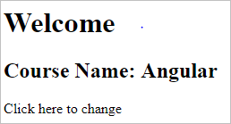
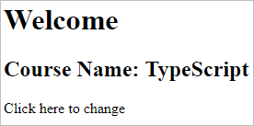
Line 3: changeName() method is bound to click event which will be invoked on click of a paragraph at run time. This is called event binding.
Output:
When a user clicks on the paragraph, the course name will be changed to 'Typescript'.

Slide 43
Demo : Elements of Template
Highlights:
Understanding the template elements
Responding to user actions
Demosteps:
Problem Statement: Adding an event to the hello component template and when it is clicked, it should change the courseName as shown below

Slide 44
1. Open hello.component.ts, add a method called changeName() as shown below in Line 12-14. Also, use external template hello.component.html.
import { Component, OnInit } from '@angular/core';
@Component({
selector: 'app-hello',
templateUrl: "./hello.component.html",
styleUrls: ['./hello.component.css']
})
export class HelloComponent implements OnInit {
courseName = "Angular";
constructor() { }
ngOnInit() {
}
changeName() {
this.courseName = "TypeScript";
}
}

Slide 45
2. Open hello.component.html and add a paragraph and bind it with changeName() method as shown in Line 3
<h1>Welcome</h1>
<h2>Course Name: {{ courseName }}</h2>
<p (click)="changeName()">Click here to change</p>
3. Save the files and check the output in the browser

Slide 46
Change Detection
How does Angular detect the changes and update the application at the respective places?
Angular uses its change detection mechanism to detect the changes and update the application at the respective places. Angular applications run faster than Angular 1.x applications due to the improved change detection mechanism.
What is the change detection mechanism, and how it helps to run Angular applications so fast?
Change Detection is a process in Angular that keeps views in sync with the models.
In Angular, the flow is unidirectional from top to bottom in a component tree. A change in a web application can be caused by events, Ajax calls, and timers which are all asynchronous.
Who informs Angular about the changes?
Zones inform Angular about the changes in the application. It automatically detects all asynchronous actions at run time in the application.

Slide 47
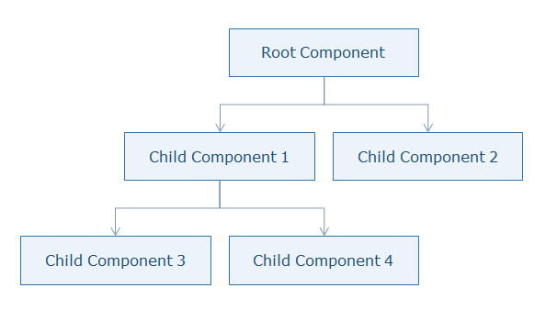
What does Angular do when a change is detected?
Angular runs a change detector algorithm on each component from top to bottom in the component tree. This change detector algorithm is automatically generated at run time which will check and update the changes at appropriate places in the component tree.
Angular is very fast though it goes through all components from top to bottom for every single event as it generates VM-friendly code. Due to this, Angular can perform hundreds of thousands of checks in a few milliseconds.

Slide 48
This welcome screen is created in the WelcomeComponent.
You can find the files related to WelcomeComponent in the welcome folder present inside the app folder (src --> app --> welcome).
1. Code for WelcomeComponent is present in the file welcome.component.ts.
import { Component } from '@angular/core';
@Component({
templateUrl: 'welcome.component.html',
styleUrls: ['welcome.component.css']
})
export class WelcomeComponent {
public pageTitle = 'Welcome';
constructor() {
}
}

Slide 49
Line 3-6: @Component marks the class as component and the component is bound with template and CSS file using templateUrl and styleUrls properties respectively.
Line 8: Creates a property called pageTitle and initialized it to “welcome”.
Line 11: This statement displays the login button at the top right corner of the page.
2. Code for WelcomeComponent template is present in the welcome.component.html file.

Slide 50
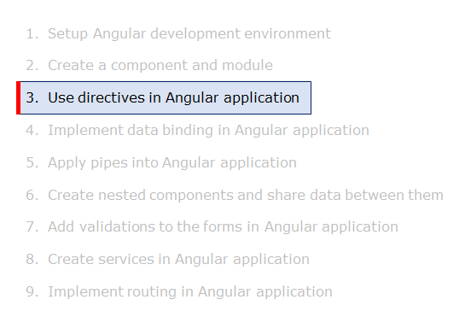
Structural Directives

Slide 51
Now that you are familiar with the concept of templates, let us now understand directives in Angular.
Directives are used to change the behavior of components or elements. It can be used in the form of HTML attributes.
You can create directives using classes attached with @Directive decorator which adds metadata to the class.
Why Directives?
It modify the DOM elements
It creates reusable and independent code
It is used to create custom elements to implement the required functionality
Types of Directives
There are three types of directives available in Angular

Slide 52
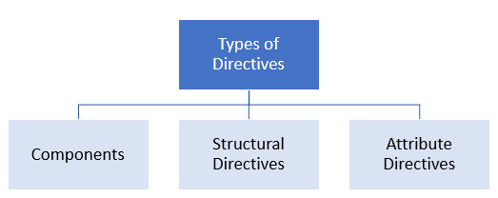
Components
Components are directives with a template or view.
@Component decorator is actually @Directive with templates
Structural Directives
A Structural directive changes the DOM layout by adding and removing DOM elements.
*directive-name = expression

Slide 53
Angular has few built-in structural directives such as:
ngIf
ngFor
ngSwitch
ngIf directive renders components or elements conditionally based on whether or not an expression is true or false.
Syntax:
*ngIf = "expression"
ngIf directive removes the element from the DOM tree.
Example:
app.component.ts

Slide 54
App.component.ts
import { Component } from '@angular/core';
@Component({
selector: 'app-root',
templateUrl: './app.component.html',
styleUrls: ['./app.component.css']
})
export class AppComponent {
show = true;
}
App.html
<button (click)="show = !show">{{show ? 'hide' : 'show'}}</button>
show = {{show}}
<br>
<div *ngIf="show">Text to show</div>

Slide 55
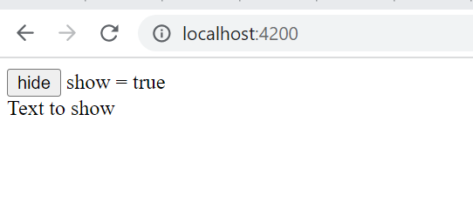
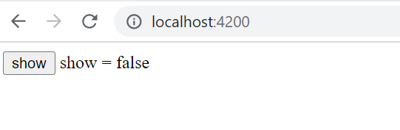
app.component.html
After click on hide button

Slide 56
The else binding points to an<ng-template> element labeled #elseBlock. The template can be defined anywhere in the component view
<button (click)="show = !show">{{show ? 'hide' : 'show'}}</button>
show = {{show}}
<br>
<div *ngIf="show; else elseBlock">Text to show</div>
<ng-template #elseBlock>Alternate text while primary text is hidden</ng-template>

Slide 57
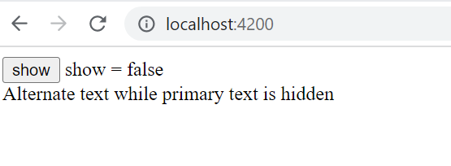
After click on hide button

Slide 58
*ngFor Directive
export class DirectivesComponent
{
title: string ="Top 10 Movies" ;
movies: Movie[] =[
{title:'Zootopia',director:'Byron Howard, Rich Moore',cast:'Idris Elba, Ginnifer Goodwin, Jason Bateman',releaseDate:'March 4, 2016'},
{title:'Batman v Superman: Dawn of Justice',director:'Zack Snyder',cast:'Ben Affleck, Henry Cavill, Amy Adams',releaseDate:'March 25, 2016'},
{title:'Captain America: Civil War',director:'Anthony Russo, Joe Russo',cast:'Scarlett Johansson, Elizabeth Olsen, Chris Evans',releaseDate:'May 6, 2016'},
{title:'X-Men: Apocalypse',director:'Bryan Singer',cast:'Jennifer Lawrence, Olivia Munn, Oscar Isaac',releaseDate:'May 27, 2016'},
]
}
class Movie {
title! : string;
director! : string;
cast! : string;
releaseDate! : string;
}

Slide 59
<div class='panel panel-primary'>
<div class='panel-heading'>
{{title}}
</div>
<div class='panel-body'>
<div class='table-responsive'>
<table class='table'>
<thead>
<tr>
<th>Title</th>
<th>Director</th>
<th>Cast</th>
<th>Release Date</th>
</tr>
</thead>
<tbody>
<tr *ngFor="let movie of movies; let i = index">
<td>{{i+1}}-{{movie.title}}</td>
<td>{{movie.director}}</td>
<td>{{movie.cast}}</td>
<td>{{movie.releaseDate}}</td>
</tr>
</tbody>
</table>
</div>
</div>
</div>

Slide 60
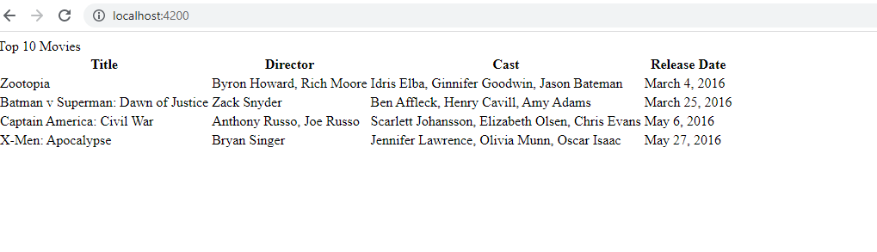

Slide 61
*ngSwitch Directive
export class DirectivesComponent
{ selectedValue: string= 'Two’;
}
Below code in HTML file
<div class='row' [ngSwitch]="selectedValue">
<div *ngSwitchCase="'One'">One is Pressed</div>
<div *ngSwitchCase="'Two'">Two is Selected</div>
<div *ngSwitchDefault>Default Option</div>
</div>

Slide 62
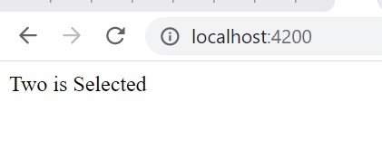

Slide 63
Creating custom Directive
Ng g directive redEl
Add below code into red-el.directives.ts
import { Directive, ElementRef } from '@angular/core';
@Directive({
selector: '[appRedEl]'
})
export class RedElDirective {
constructor(el:ElementRef) {
el.nativeElement.style.color = "red";
}
}
Check if directive imported in app module?
Add below code in HTML file
<p appRedEl>hello</p>

Slide 64
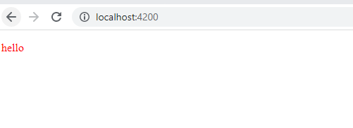

Slide 65
Built in Attribute ngStyle
Add below code in component.ts file
export class AppComponent {
myStyle={
width:'100px',
height:'150px',
background:'red',
color:'yellow',
border: '1px'
};
addStyles(){
this.myStyle['color']='white';
this.myStyle['border']="2px solid black";
}
}

Slide 66
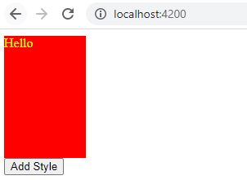
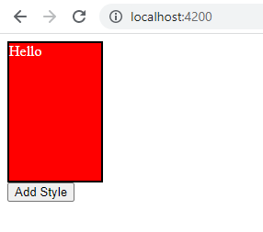
Add below code in HTML file
<div [ngStyle]="myStyle">Hello</div>
<button (click)="addStyles()">Add Style</button>

Slide 67
Build in Attribute ngClass
Add below code in to .css file
box{
width: 100px;
height: 100px;
background: red;
}
.border{
border: 2px solid black;
}
.circle{
border-radius: 50%;
}

Slide 68
Add below code into component.ts
export class AppComponent {
myClasses={
box:true,
border:false,
circle:false
}
changeShape(){
this.myClasses.border = !this.myClasses.border;
this.myClasses.circle = !this.myClasses.circle;
}
}
HTML file code
<div [ngClass]="myClasses">Hello</div>
<button (click)="changeShape()">Add Style</button>

Slide 69
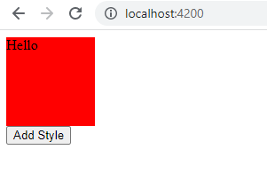
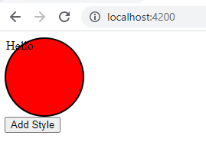
Output:

Slide 70
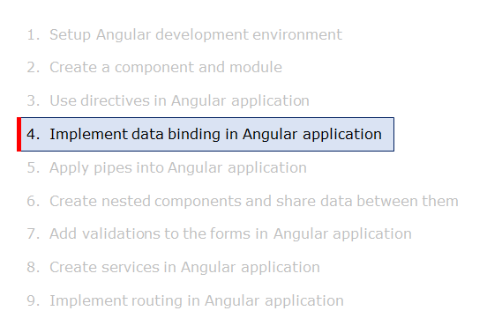
Property Binding

Slide 71
Data Binding is a mechanism where data in view and model are in sync. Users should be able to see the same data in a view which the model contains.
As a developer, you need to bind the model data in a template such that the actual data reflects in the view.
There are two types of data bindings based on the direction in which data flows.
One-way Data Binding
Two-way Data Binding

Slide 72
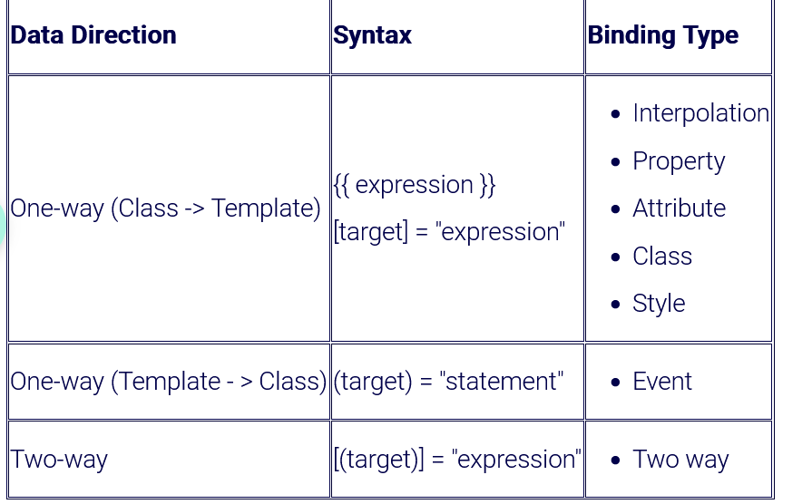

Slide 73
target in the above table refers to a property/event/attribute-name(rarely used).
One-way Data Binding
The following are one-way data binding types:
Property Binding
Attribute Binding
Class Binding
Style Binding
Event Binding
Let us now understand each type of binding with examples.
Property binding is used when its requried to set the property of a class with the property of an element
Syntax:
<img [src] = 'imageUrl' />
or
<img bind-src = 'imageUrl' />

Slide 74
Here the component's imageUrl property is bound to the value to the image element's property src.
Interpolation can be used as an alternative to property binding. Property binding is mostly used when it is required to set a non-string value.
Example:
First, create a folder called 'imgs' under the assets folder and copy any image into that folder.
app.component.ts
...
export class AppComponent {
imgUrl: string = 'assets/imgs/logo.jpg';
}
Line 3: Create a property called imgUrl and initialize it to the image path
app.component.html

Slide 75
<img [src]='imgUrl' width=200 height=100>
Line 1: Bind imgUrl property with src property. This is called property binding
Note: this can also be written as:
<img bind-src='imgUrl' width=200 height=100>

Slide 76
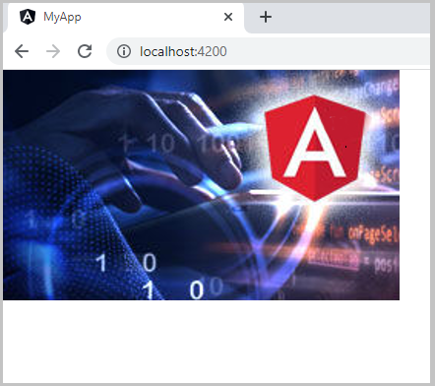
Demo : Property Binding
Highlights:
Understanding Property Binding
Binding element property with class property
Demosteps:
Problem Statement: Binding image with class property using property binding.

Slide 77
1. Write the following code in app.component.ts as shown below
import { Component } from '@angular/core';
@Component({
selector: 'app-root',
templateUrl: './app.component.html',
styleUrls: ['./app.component.css']
})
export class AppComponent {
imgUrl = 'assets/imgs/logo.png';
}
Create a folder named "imgs" inside src/assets and place a logo.png file inside it.
2. Write the following code in app.component.html as shown below
<img [src]='imgUrl'>
3. Save the files and check the output in the browser

Slide 78
Attribute Binding
Property binding will not work for a few elements/pure attributes like ARIA, SVG, and COLSPAN. In such cases, you need to go for attribute binding.
Attribute binding can be used to bind a component property to the attribute directly
For example,
<td colspan = "{{ 2+3 }}">Hello</td>
The above example gives an error as colspan is not a property. Even if you use property binding/interpolation, it will not work as it is a pure attribute. For such cases, use attribute binding.
Attribute binding syntax starts with prefix attr. followed by a dot sign and the name of an attribute. And then set the attribute value to an expression.
<td [attr.colspan] = "2+3">Hello</td>

Slide 79
Example:
app.component.ts
...
export class AppComponent {
colspanValue: string ="2";
}
Line 3: Create a property called value and initialize to 2
app.component.html
<table border=1>
<tr>
<td [attr.colspan]="colspanValue"> First </td>
<td>Second</td>
</tr>
<tr>
...
</tr>
</table>

Slide 80

Line 3: attr.colspan will inform Angular that colspan is an attribute so that the given expression is evaluated and assigned to it. This is called attribute binding.
Output:

Slide 81
Demo : Attribute Binding
Highlights:
Understanding attribute directive
Setting the value of an attribute
Demosteps:
Problem Statement: Binding colspan attribute of a table element to the class property to display the following output
1. Write the below-given code in app.component.ts

Slide 82
import { Component } from '@angular/core';
@Component({
selector: 'app-root',
templateUrl: './app.component.html',
styleUrls: ['./app.component.css']
})
export class AppComponent {
colspanValue = '2';
}
2. Write the below-given code in app.component.html
<table border=1>
<tr>
<td [attr.colspan]="colspanValue"> First </td>
<td>Second</td>
</tr>
<tr>
<td>Third</td>
<td>Fourth</td>
<td>Fifth</td>
</tr>
</table>

Slide 83
3. Save the files and check the output in the browser
Style and Event Binding
Style binding is used to set inline styles. Syntax starts with prefix style, followed by a dot and the name of a CSS style property.
Syntax:
[style.styleproperty]
Example:
<button [style.color] = "isValid ? 'blue' : 'red' ">Hello</button>
In component.ts file
isValid=false;
Here button text color will be set to blue if the expression is true, otherwise red.
Some style bindings will have a unit extension.
Example:

Slide 84
<button [style.font-size.px] = "isValid ? 3 : 6">Hello</button>
Here text font size will be set to 3 px if the expression isValid is true, otherwise, it will be set to 6px.
The ngStyle directive is preferred when it is required to set multiple inline styles at the same time.
User actions such as entering text in input boxes, picking items from lists, button clicks may result in a flow of data in the opposite direction: from an element to the component.
Event binding syntax consists of a target event with ( ) on the left of an equal sign and a template statement on the right.
Example:
<button (click) ="onSubmit(username.value,password.value)">Login</button>
OR
<button on-click = "onSubmit(username.value,password.value)">Login</button>

Slide 85
Two Way Data Binding
Two-way data binding is a mechanism where if model property value changes, it updates the element to which the property is bound and vice versa. It uses [()] (banana in a box) syntax.
Syntax:
[(ngModel)]
Example:
<input [(ngModel)] = "course.courseName">
Behind the scenes, this is equivalent to
<input [ngModel]="course.courseName" (ngModelChange)="course.courseName=$event">

Slide 86
app.component.ts
...
export class AppComponent {
name: string = "Angular";
}
Line 3: Create a property called name and initialize it to value 'Angular'
app.component.html
<input type="text" [(ngModel)]="name"> <br/>
<div>Hello , {{ name }}</div>
Line 1: Bind name property with text box using ngModel placed in [()] which is a representation of two-way data binding. Here whatever is typed in the textbox at run time will be assigned to the property name and when there is a change for the name property value, it will be auto-reflected in the textbox.
app.module.ts
To make two-way data binding i.e., [(ngModel)] work, import FormsModule class to the root module as shown below

Slide 87

app.module.ts
To make two-way data binding i.e., [(ngModel)] work, import FormsModule class to the root module as shown below
import { FormsModule } from '@angular/forms';
...
@NgModule({
imports: [
BrowserModule,
FormsModule
],
...
})
export class AppModule { }
Output:

Slide 88
Demo : Two Way Data Binding
Highlights:
Working with two-way data binding
Updating the element in action
Demosteps:
Problem Statement: Binding a textbox with a property using two-way data binding. The output is as shown below

Slide 89
1. Write the below-given code in app.component.ts
import { Component } from '@angular/core';
@Component({
selector: 'app-root',
templateUrl: './app.component.html',
styleUrls: ['./app.component.css']
})
export class AppComponent {
name = 'Angular';
}
2. Write the below-given code in app.component.html
<input type="text" [(ngModel)]="name"> <br/>
<div>Hello , {{ name }}</div>

Slide 90
3. Write the below-given code in app.module.ts
import { BrowserModule } from '@angular/platform-browser';
import { NgModule } from '@angular/core';
import { FormsModule } from '@angular/forms';
import { AppComponent } from './app.component';
@NgModule({
declarations: [
AppComponent
],
imports: [
BrowserModule,
FormsModule
],
providers: [],
bootstrap: [AppComponent]
})
export class AppModule { }
4. Save the files and check the output in the browser

Slide 91
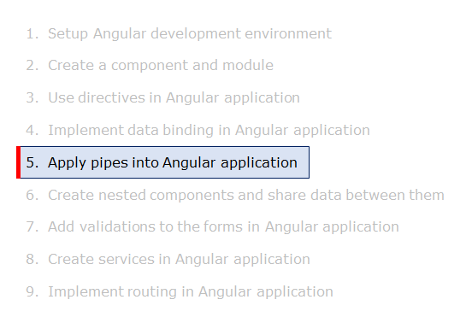
Built-in Pipes

Slide 92
Why Pipes?
Pipes provide a beautiful way of transforming the data inside templates, for the purpose of display.
Pipes in Angular
Pipes in Angular take an expression value as an input and transform it into the desired output before displaying it to the user. It provides a clean and structured code as you can reuse the pipes throughout the application, while declaring each pipe just once.
Syntax:
{{ expression | pipe }}
Example:
{{ "Angular" | uppercase }}
This will display ANGULAR

Slide 93
Various built-in pipes are provided by Angular for data transformations like transformation of numerical values, string values, dates, etc.. Angular also has built-in pipes for transformations for internationalization (i18n), where locale information is used for data formatting.
The following are commonly used built-in pipes for data formatting:
uppercase
lowercase
titlecase
currency
date
percent
slice
decimal

Slide 94
uppercase
This pipe converts the template expression into uppercase.
Syntax:
{{ expression | uppercase }}
Example:
{{ "Laptop" | uppercase }}
Output:
LAPTOP
lowercase
This pipe converts the template expression into lowercase.
Syntax:
{{ expression | lowercase }}

Slide 95
Example:
{{ "LAPTOP" | lowercase }}
Output:
laptop
titlecase
This pipe converts the first character in each word of the given expression into a capital letter.
Syntax:
{{ expression | titlecase }}
Example:
{{ "product details" | titlecase }}
Output:
Product Details

Slide 96

Demo : Built-in Pipes
Highlights:
Exploring some of the built-in pipes
Applying the pipes
Demosteps:
Problem Statement: Displaying the product code in lowercase and product name in uppercase using built-in pipes. The output is as shown below
1. Write the below-given code in app.component.ts

Slide 97
import { Component } from '@angular/core';
@Component({
selector: 'app-root',
templateUrl: './app.component.html',
styleUrls: ['./app.component.css']
})
export class AppComponent {
title = 'product details';
productCode = 'PROD_P001';
productName = 'Laptop';
}
2. Write the below-given code in app.component.html
<h3> {{ title | titlecase}} </h3>
<table style="text-align:left">
<tr>
<th> Product Code </th>
<td> {{ productCode | lowercase }} </td>
</tr>
<tr>
<th> Product Name </th>
<td> {{ productName | uppercase }} </td>
</tr>
</table>

Slide 98
3. Save the files and check the output in the browser
Passing Parameters to Angular Pipes
A pipe can also have optional parameters to change the output. To pass parameters, after a pipe name add a colon( : ) followed by the parameter value.
Syntax:
pipename : parametervalue
A pipe can also have multiple parameters as shown below
pipename : parametervalue1:parametervalue2
Below are the built-in pipes present in Angular, which accept optional parameters using which the pipe's output can be fine-tuned.
currency
This pipe displays a currency symbol before the expression. By default, it displays the currency symbol $
Syntax:

Slide 99
{{ expression | currency:currencyCode:symbol:digitInfo:locale }}
currencyCode is the code to display such as INR for the rupee, EUR for the euro, etc.
symbol is a Boolean value that represents whether to display currency symbol or code.
code: displays code instead of a symbol such as USD, EUR, etc.
symbol (default): displays symbol such as $ etc.
symbol-narrow: displays the narrow symbol of currency. Some countries have two symbols for their currency, regular and narrow. For example, the Canadian Dollar CAD has the symbol as CA$ and symbol-narrow as $.
digitInfo is a string in the following format
{minIntegerDigits}.{minFractionDigits} - {maxFractionDigits}
minIntegerDigits is the minimum integer digits to display. The default value is 1
minFractionDigits is the minimum number of digits to display after the fraction. The default value is 0
maxFractionDigits is the maximum number of digits to display after the fraction. The default value is 3
locale is used to set the format followed by a country/language. To use a locale, the locale needs to be registered in the root module.
For Example,to set locale to French (fr), add the below statements in app.module.ts

Slide 100
import { registerLocaleData } from '@angular/common';
import localeFrench from '@angular/common/locales/fr';
registerLocaleData(localeFrench);
Examples:
{{ 25000 | currency }} will display $25,000.00<br>
{{ 25000 | currency:'CAD' }} will display CA$25,000.00<br>
{{ 25000 | currency:'CAD':'code' }} will display CAD25,000.00<br>
{{ 25000 | currency:'CAD':'symbol':'6.2-3'}} will display CA$025,000.00<br>
{{ 25000 | currency:'CAD': 'symbol-narrow':'1.3'}} will display $25,000.000<br>
{{ 250000 | currency:'CAD':'symbol':'6.3'}} will display CA$250,000.000<br>
{{ 250000 | currency:'CAD':'symbol':'6.3':'fr'}} will display 250 000,000 CA$<br>
date
This pipe can be used to display the date in the required format
Syntax:
{{ expression | date:format:timezone:locale }}

Slide 101
An expression is a date or number in milliseconds
The format indicates in which form the date/time should be displayed. Following are the pre-defined options for it.
'medium' :equivalent to 'MMM d, y, h:mm:ss a' (e.g. Jan 31, 2018, 11:05:04 AM)
'short': equivalent to 'M/d/yy, h:mm a' (e.g. 1/31/2018, 11:05 AM)
'long': equivalent to 'MMMM d, y, h:mm:ss a z' (e.g. January 31, 2018 at 11:05:04 AM GMT+5)
'full': equivalent to 'EEEE, MMMM d, y, h:mm:ss a zzzz' (e.g. Wednesday, January 31, 2018 at 11:05:04 AM GMT+05:30)
'fullDate' : equivalent to 'EEEE, MMMM d, y' (e.g. Wednesday, January 31, 2018)
'longDate' : equivalent to 'MMMM d, y' (e.g. January 31, 2018)
'mediumDate' : equivalent to 'MMM d, y' (e.g. Jan 31, 2018)
'shortDate' : equivalent to 'M/d/yy' (e.g. 1/31/18)
'mediumTime' : equivalent to 'h:mm:ss a' (e.g. 11:05:04 AM)
'shortTime' : equivalent to 'h:mm a' (e.g. 11:05 AM)
'longTime': equivalent to 'h:mm a' (e.g. 11:05:04 AM GMT+5)
'fullTime': equivalent to 'h:mm:ss a zzzz' (e.g. 11:05:04 AM GMT+05:30)

Slide 102
Timezone to be used for formatting. For example, ’+0430’ (4 hours, 30 minutes east of the Greenwich meridian) If not specified, the local system timezone of the end-user's browser will be used.
import { registerLocaleData } from '@angular/common';
import localeFrench from '@angular/common/locales/fr';
registerLocaleData(localeFrench);
Examples:
{{ "6/2/2017" | date }} will display Jun 2, 2017<br>
{{ "6/2/2017, 11:30:45 AM" | date:'medium' }} will display Jun 2, 2017, 11:30:45 AM<br>
{{ "6/2/2017, 11:30:45 AM" | date:'mmss' }} will display 3045<br>

Slide 103
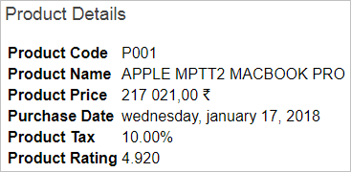
Demo : Passing Parameters to Angular Pipes
Highlights:
Understanding Built-in Pipes
Passing parameters to built-in pipes
Demosteps:
Problem Statement: Applying built-in pipes with parameters to display product details. The output is as shown below

Slide 104
We have applied currency pipe to product price with locale setting as 'fr' i.e., French. According to the French locale, the currency symbol will be displayed at the end of the price as shown in the above output.
1. Write the below-given code in app.component.ts
import { Component } from '@angular/core';
@Component({
selector: 'app-root',
templateUrl: './app.component.html',
styleUrls: ['./app.component.css']
})
export class AppComponent {
title = 'product details';
productCode = 'PROD_P001';
productName = 'Apple MPTT2 MacBook Pro';
productPrice = 217021;
purchaseDate = '1/17/2018';
productTax = '0.1';
productRating = 4.92;
}

Slide 105
2. Write the below-given code in app.component.html
<h3> {{ title | titlecase}} </h3>
<table style="text-align:left">
<tr>
<th> Product Code </th>
<td> {{ productCode | slice:5:9 }} </td>
</tr>
<tr>
<th> Product Name </th>
<td> {{ productName | uppercase }} </td>
</tr>
<tr>
<th> Product Price </th>
<td> {{ productPrice | currency: 'INR':'symbol':'':'fr' }} </td>
</tr>
<tr>
<th> Purchase Date </th>
<td> {{ purchaseDate | date:'fullDate' | lowercase}} </td>
</tr>

Slide 106
<tr>
<th> Product Tax </th>
<td> {{ productTax | percent : '.2' }} </td>
</tr>
<tr>
<th> Product Rating </th>
<td>{{ productRating | number:'1.3-5'}} </td>
</tr>
</table>
3. Write the below-given code in app.module.ts
import { BrowserModule } from '@angular/platform-browser';
import { NgModule } from '@angular/core';
import { AppComponent } from './app.component';
import { registerLocaleData } from '@angular/common';
import localeFrench from '@angular/common/locales/fr';
registerLocaleData(localeFrench);

Slide 107
@NgModule({
declarations: [
AppComponent
],
imports: [
BrowserModule
],
providers: [],
bootstrap: [AppComponent]
})
export class AppModule { }
4. Save the files and check the output in the browser

Slide 108
Custom Pipes
If you want to implement data transformations which are not offered by built-in pipes, such as displaying sorted data, displaying filtered data, etc., you can create custom pipes.
To create your own custom pipe, inherit the PipeTransform interface. PipeTransform interface has a transform method where custom pipe functionality needs to be written.
Syntax:
import { Pipe, PipeTransform } from '@angular/core';
@Pipe({
name: 'usdInr'
})
export class UsdInrPipe implements PipeTransform {
transform(value: unknown, ...args: unknown[]): unknown {
return null;
}
}

Slide 109
transform method has two arguments, the first one is the value of the expression passed to the pipe which needs to be tranformed and the second is the variable arguments. The pipe can have multiple arguments based on the number of parameters passed to the pipe. The transform method should return the final value.
Example:
Create a custom pipe called sort which can sort the product details based on name or price.
Create a pipe using the following CLI command
D:\MyApp> ng g pipe pipes/usdInr

Slide 110
Usd-inr.pipe.ts file
import { Pipe, PipeTransform } from '@angular/core';
@Pipe({
name: 'usdInr'
})
export class UsdInrPipe implements PipeTransform {
transform(value: number, ...args: number[]): unknown {
const [price] = args;
return value*args[0];
}
}
App.component.html
<h2>{{30|usdInr:30}}</h2>

Slide 111
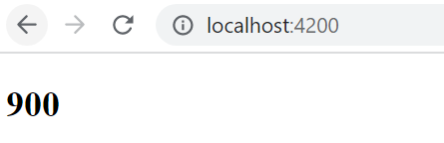

Slide 112
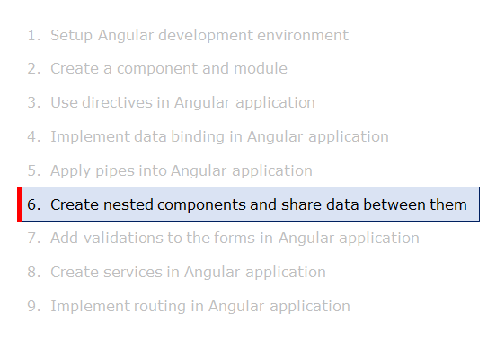
Nested Components Basics

Slide 113
Nested component is a component that is loaded into another component
The component where another component is loaded onto is called a container component/parent component.
The root component is loaded in the index.html page using its selector name. Similarly, to load one component into a parent component, use the selector name of the component in the template i.e., the HTML page of the container component
​​​​​​​Example for creating multiple components and load one into another::
Problem Statement: Create an AppComponent which displays a button to view courses list on click of it and another component called CoursesListComponent which displays courses list. When the user clicks on the button in the AppComponent, it should load the CoursesList component within it to show the courses list.

Slide 114
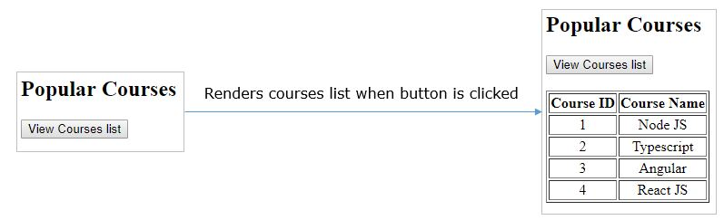
Create a component called the coursesList using the following CLI command
D:\MyApp>ng generate component coursesList
This command will create four files called courses-list.component.ts, courses-list.component.html,courses-list.component.css, courses-list.component.spec.ts and places them inside a folder called courses-list under the app folder as shown below

Slide 115
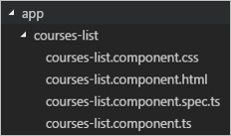
This command will also add the CoursesList component to the root module.
app.module.ts
...
import { CoursesListComponent } from './courses-list/courses-list.component';
@NgModule({
declarations: [
AppComponent,
CoursesListComponent
],
...
})
export class AppModule { }

Slide 116
Line 7: CoursesListComponent is added to the declarations property to make it available to all other components in the module.
courses-list.component.ts
...
export class CoursesListComponent {
courses = [
{ courseId: 1, courseName: 'Node JS' },
{ courseId: 2, courseName: 'Typescript' },
{ courseId: 3, courseName: 'Angular' },
{ courseId: 4, courseName: 'React JS' }
];
}
Line 3-8: courses is an array of objects where each object has properties called courseId and courseName
courses-list.component.html

Slide 117
<table border="1">
...
<tbody>
<tr *ngFor="let course of courses">
<td>{{course.courseId}}</td>
<td>{{course.courseName}}</td>
</tr>
</tbody>
</table>
Line 4-7: ngFor iterates over courses array and renders courseId and courseName values
Add the following code in courses-list.component.css
tr{
text-align:center;
}

Slide 118
Line 1-3: adds center alignment to a table row in an HTML page
app.component.html
...
<button (click)="show=true">View Courses list</button><br/><br/>
<div *ngIf="show">
<app-courses-list></app-courses-list>
</div>
Line 2: click event is bounded to button which will initialize show property to true when it is clicked
Line 4: It loads the CoursesList component only if the show property value is true.
Note:
Here AppComponent is called Parent component or container component as we are loading another component in it.
CoursesList component is called child component as it is being loaded in another component.

Slide 119
Demo : Nested Components
Highlights:
Creating a nested component
Loading nested component in a container component
Demosteps:
Problem Statement: Loading CourseslistComponent in the root component when a user clicks on the View courses list button as shown below

Slide 120
1. Create a component called coursesList using the following CLI command
D:\MyApp>ng generate component coursesList
The above command will create a folder with name courses-list with the following files
courses-list.component.ts
courses-list.component.html
courses-list.component.css
courses-list.component.spec.ts
2. CoursesListComponent class will be added in the app.module.ts file
import { BrowserModule } from '@angular/platform-browser';
import { NgModule } from '@angular/core';
import { AppComponent } from './app.component';
import { CoursesListComponent } from './courses-list/courses-list.component';
@NgModule({

Slide 121
declarations: [
AppComponent,
CoursesListComponent
],
imports: [
BrowserModule
],
providers: [],
bootstrap: [AppComponent]
})
export class AppModule { }
3. Write the below-given code in courses-list.component.ts

Slide 122
import { Component, OnInit } from '@angular/core';
@Component({
selector: 'app-courses-list',
templateUrl: './courses-list.component.html',
styleUrls: ['./courses-list.component.css']
})
export class CoursesListComponent {
courses = [
{ courseId: 1, courseName: "Node JS" },
{ courseId: 2, courseName: "Typescript" },
{ courseId: 3, courseName: "Angular" },
{ courseId: 4, courseName: "React JS" }
];
}
4. Write the below-given code in courses-list.component.html

Slide 123
<table border="1">
<thead>
<tr>
<th>Course ID</th>
<th>Course Name</th>
</tr>
</thead>
<tbody>
<tr *ngFor="let course of courses">
<td>{{ course.courseId }}</td>
<td>{{ course.courseName }}</td>
</tr>
</tbody>
</table>
5. Add the following code in courses-list.component.css

Slide 124
tr{
text-align:center;
}
6. Write the below-given code in app.component.html
<h2>Popular Courses</h2>
<button (click)="show = true">View Courses list</button><br /><br />
<div *ngIf="show">
<app-courses-list></app-courses-list>
</div>
7. Write the below-given code in app.component.ts
import { Component } from '@angular/core';
@Component({
selector: 'app-root',
templateUrl: './app.component.html',
styleUrls: ['./app.component.css']
})
export class AppComponent {
show!: boolean;
}

Slide 125
8. Save the files and check the output in the browser
Nested Components - exportAs Property
It is possible to access child component properties and methods in a container component by exporting child components using exportAs property
As discussed in the directives concept, exportAs property can be applied to components and directives.
Example:
In the example of the nested components, modify the courses-list.component.ts file as shown below:
import { Component, OnInit } from '@angular/core';
@Component({
selector: 'app-courses-list',
templateUrl: './courses-list.component.html',
styleUrls: ['./courses-list.component.css'],
exportAs: 'courselist'
})

Slide 126
export class CoursesListComponent {
courses = [
{ courseId: 1, courseName: 'Node JS' },
{ courseId: 2, courseName: 'Typescript' },
{ courseId: 3, courseName: 'Angular' },
{ courseId: 4, courseName: 'React JS' }
];
course!: any[];
changeCourse(name: string) {
this.course = [];
for (let i = 0; i < this.courses.length; i++) {
if (this.courses[i].courseName === name) {
this.course.push(this.courses[i]);
}
}
}
}
ine 7: CoursesListComponent is exported with 'courselist' name
Line 19: changeCourse() method will take course name as an input, fetches the course details, and assigns it to the course array
Modify courses-list.component.html as shown below

Slide 127
<table border="1" *ngIf="course">
<thead>
<tr>
<th>Course ID</th>
<th>Course Name</th>
</tr>
</thead>
<tbody>
<tr *ngFor="let c of course">
<td>{{c.courseId}}</td>
<td>{{c.courseName}}</td>
</tr>
</tbody>
</table>
Line 9: course array is rendered on the page in a table
Modify app.component.html as shown below

Slide 128
<h2> Popular Courses </h2>
Select a course to view
<select #course (change)="cl.changeCourse(course.value)">
<option value="Node JS">Node JS</option>
<option value="Typescript">Typescript</option>
<option value="Angular">Angular</option>
<option value="React JS">React JS</option>
</select>
<br/>
<br/>
<app-courses-list #cl="courselist"></app-courses-list>
Line 4-9: A drop down will be displayed with course names. When a course is selected, it invokes changeCourse() method of child component using the template variable 'cl'.
Line 13: It loads child component i.e., CoursesListComponent where the exported name courselist is bound to template variable called cl. Now using cl, the properties and methods of child component i.e., CoursesListComponent can be accessed in the parent component template.
Output:

Slide 129
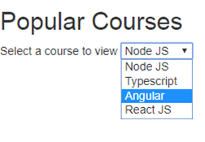
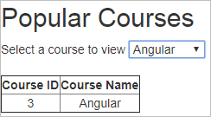
When a user selects an Angular course from the drop-down, it renders the below output

Slide 130
Passing data from Container Component to Child Component
Component communication is needed if data needs to be shared between the components
In order to pass data from container/parent component to child component, @Input decorator can be used.
A child component can use @Input decorator on any property type like arrays, objects, etc. making it a data-bound input property.
The parent component can pass value to the data-bound input property when rendering the child within it.
Example:
Problem Statement: Create an AppComponent that displays a dropdown with a list of courses as values in it. Create another component called CoursesList component and load it in AppComponent which should display the course details. When a user selects a course from the dropdown, corresponding course details should be loaded

Slide 131
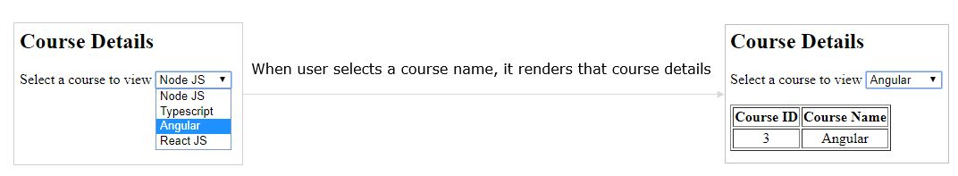
Open the courses-list.component.ts file used in the previous example
Add input setter method for property cName in the component as shown below in Line 18
...
export class CoursesListComponent {
...
course!: any[];
@Input() set cName(name: string) {
this.course = [];
for (var i = 0; i < this.courses.length; i++) {
if (this.courses[i].courseName === name) {
this.course.push(this.courses[i]);
}
}
}
}

Slide 132
Line 7: @Input() specifies that cName property will receive value from its container component
Line 9-13: for loop will iterate over courses array and it checks for the courseName validity. If it matches, it adds that object to the course array
courses-list.component.html
<table border="1" *ngIf="course.length>0">
...
<tbody>
<tr *ngFor="let c of course">
<td>{{c.courseId}}</td>
<td>{{c.courseName}}</td>
</tr>
</tbody>
</table>
Line 4-7: ngFor iterates on course array and displays courseId and courseName properties in a table
Add the following code in app.component.html

Slide 133
<h2>Course Details</h2>
Select a course to view
<select #course (change)="name = course.value">
<option value="Node JS">Node JS</option>
<option value="Typescript">Typescript</option>
<option value="Angular">Angular</option>
<option value="React JS">React JS</option></select
><br /><br />
<app-courses-list [cName]="name"></app-courses-list>
Line 2-7: It displays a drop-down to select a course to display its details. When the user selects a value, it assigns the selected value to the name property.
Line 9: This will load CoursesListComponent and passes the name property value to the cName property of CoursesListComponent class.
In App.component.ts
export class AppComponent {
name! : string;
}

Slide 134
Passing data from Child Component to Container Component
If a child component wants to send data to its parent component, then it must create a property with @Output decorator.
The only method for the child component to pass data to its parent component is through events. The property must be of type EventEmitter
Example:
Problem Statement: Create an AppComponent that loads another component called CoursesList component. Create another component called CoursesListComponent which should display the courses list in a table along with a register button in each row. When a user clicks on the register button, it should send that courseName value back to AppComponent where it should display the registration successful message along with courseName

Slide 135
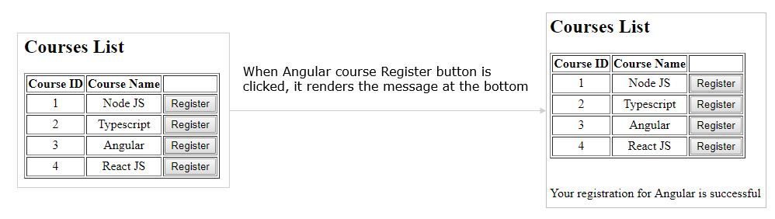
courses-list.component.ts
...
export class CoursesListComponent {
@Output() onRegister = new EventEmitter<string>();
...
register(courseName: string) {
this.onRegister.emit(courseName);
}
}

Slide 136
Line 3: Create a property called onRegister of type EventEmitter and attach @Output decorator which makes the property to send the data from child to parent
Line 7: this line emits the courseName value i.e, send the courseName value back to parent component.
courses-list.component.html
<table border="1">
...
<tbody>
<tr *ngFor="let course of courses">
<td>{{course.courseId}}</td>
<td>{{course.courseName}}</td>
<td><button (click)="register(course.courseName)">Register</button></td>
</tr>
</tbody>
</table>

Slide 137
Line 7: When the user clicks this button, it invokes the register method by passing courseName value.
app.component.html
<h2> Courses List </h2>
<app-courses-list (onRegister)="courseReg($event)"></app-courses-list>
<br/><br/>
<div *ngIf="message">{{message}}</div>
Line 3: Binds onRegister event with courseReg method of the parent component. When CoursesListComponent emits the value, onRegister event is triggered and it invokes courseReg method. $event holds the value emitted by CoursesListComponent
Line 6: This renders the message property value which holds the value emitted
app.component.ts

Slide 138
...
export class AppComponent {
message!: string;
courseReg(courseName: any) {
this.message = `Your registration for ${courseName} is successful`;
}
}
Line 6: courseReg method is invoked when onRegister event emits
Line 7: Assigns the string to message property which will be rendered in the template

Slide 139
Component Styling
Angular provides a mechanism for specifying component-specific styles which do not leak out into the rest of the page.
The following are the different ways to add styles to a component:
By using styleUrls metadata
By using styles metadata
Inline into the template
Using styleUrls property
The CSS styles declared in external files can be loaded into a component by using the stylesUrls property.
styleUrls is an array property where multiple CSS files can be loaded into a component.
Example:
app.component.html

Slide 140
<div class="highlight">
Container Component
</div>
<app-child></app-child>
app.component.css
.highlight {
border: 2px solid coral;
background-color: aliceblue;
text-align: center;
margin-bottom: 20px;
}
app.component.ts
import { Component } from '@angular/core';
@Component({
selector: 'app-root',
templateUrl: './app.component.html',
styleUrls: ['./app.component.css']
})
export class AppComponent {
}

Slide 141
Line 6: Specify the CSS styles in an external stylesheet and bind it to the component using styleUrls property
Create another component called ChildComponent using the following CLI command
D:\MyApp>ng generate component Child
child.component.ts
import { Component } from '@angular/core';
@Component({
selector: 'app-child',
templateUrl: './child.component.html',
styleUrls: ['./child.component.css'],
})
export class ChildComponent {
}
Line 6: External stylesheet called child.component.css is bound with the component using styleUrls property

Slide 142

child.component.css
.highlight {
border: 2px solid violet;
background-color: cornsilk;
text-align: center;
margin-bottom: 20px;
}
child.component.html
<div class="highlight">
Child Component
</div>
Output:

Slide 143
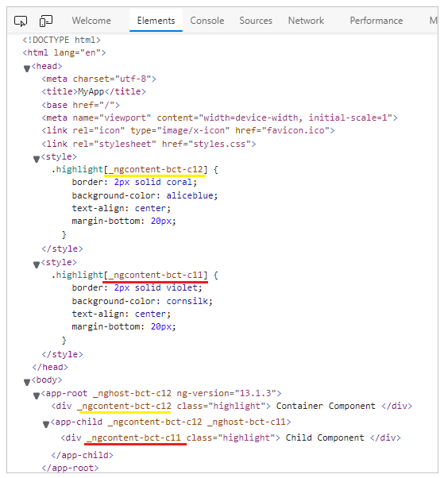
Browser Console(Press F12 inside the browser):

Slide 144
CSS styles can be added to a component by adding styles property to the component metadata. Styles is an array property where multiple CSS classes for a component can be defined.
Example:
app.component.ts
import { Component } from '@angular/core';
@Component({
selector: 'app-root',
templateUrl: './app.component.html',
styles: [`
.highlight {
border: 2px solid red;
background-color:AliceBlue;
text-align: center;
margin-bottom: 20px;
}
`],
})
export class AppComponent {
}

Slide 145
Line 6-13: Add CSS styles specific to this component in the styles property.
app.component.html
<div class="highlight">
Container Component
</div>
<app-child></app-child>
Line 1: CSS class i.e., the highlight is applied to the div tag
child.component.ts
import { Component, OnInit } from '@angular/core';
@Component({
selector: 'app-child',
templateUrl: './child.component.html',
styles: [
`
.highlight {
border: 2px solid yellow;
background-color: cornsilk;
text-align: center;

Slide 146
margin-bottom: 20px;
}
`,
],
})
export class ChildComponent {
constructor() { }
}
Line 6-13: Add CSS styles specific to this component in the styles property.
child.component.html
<div class="highlight">
Child Component
</div>

Slide 147

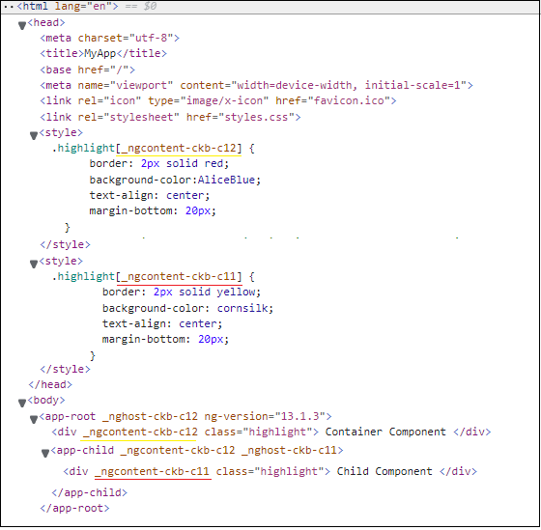
Output:
Browser Console(Press F12 inside the browser):

Slide 148
Another option to add CSS styles to the component is by using inline-style. The styles can be directly embedded in the HTML template using <style> tag.
Example:
Remove the highlight CSS class from the styles property in the app.component.ts file and add it to the app.component.html file as shown below:
<style>
.highlight {
border: 2px solid green;
background-color: aliceblue;
text-align: center;
margin-bottom: 20px;
}
</style>
<div class="highlight">Container Component</div>
<app-child></app-child>

Slide 149
Line 1-8: Add CSS styles inside the template using the style tag. These styles will be specific to this component
Similarly, remove CSS highlight class from styles property of child.component.ts file and add it to child.component.html file as shown below
<style>
.highlight {
border: 2px solid blue;
background-color: cornsilk;
text-align: center;
margin-bottom: 20px;
}
</style>
<div class="highlight">Child Component</div>
Line 1-8: Add CSS styles inside the template using a style tag. These styles will be specific to this component
Output:

Slide 150

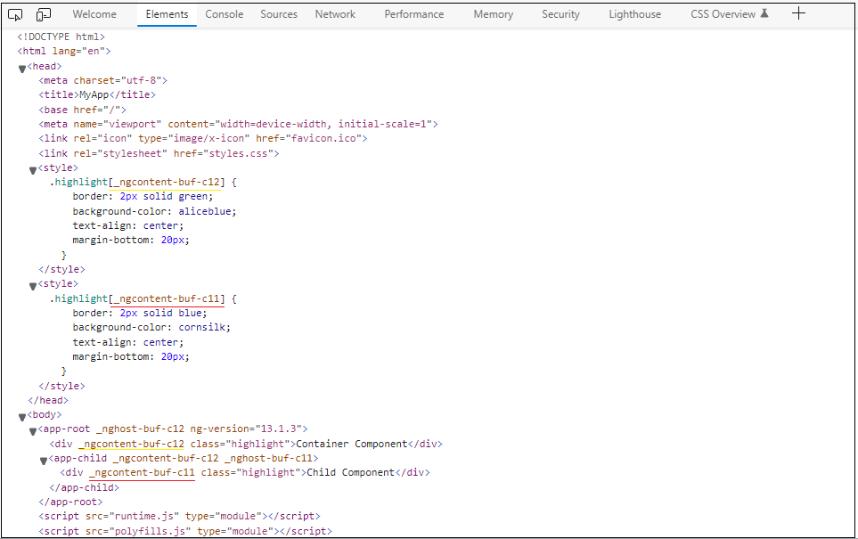
Browser Console(Press F12 inside the browser):

Slide 151
Demo : Component Styling
Highlights:
Adding CSS styles to components
Understanding the usage of styleUrls in applying a style
Demosteps:
Problem Statement: Applying CSS styles to components using styleUrls property. The output is as shown below:

Slide 152
1. Write the below-given code in app.component.ts
import { Component } from '@angular/core';
@Component({
selector: 'app-root',
templateUrl: './app.component.html',
styleUrls: ['./app.component.css']
})
export class AppComponent {
}
2. Write the below-given code in app.component.css
.highlight {
border: 2px solid coral;
background-color: aliceblue;
text-align: center;
margin-bottom: 20px;
}

Slide 153
3. Write the below-given code in app.component.html
<div class="highlight">
Container Component
</div>
<app-child></app-child>
4. Create another component called ChildComponent using the following CLI command
D:\MyApp>ng generate component Child
5. Write the below-given code in child.component.ts
import { Component } from '@angular/core';
@Component({
selector: 'app-child',
templateUrl: './child.component.html',
styleUrls: ['./child.component.css'],
})
export class ChildComponent {
}

Slide 154
6. Write the below-given code in child.component.css
.highlight {
border: 2px solid violet;
background-color: cornsilk;
text-align: center;
margin-bottom: 20px;
}
7. Write the below-given code in child.component.html
<div class="highlight">
Child Component
</div>
8. Save the files and check the output in the browser
9. Open developer tools in your chrome browser and go to the Elements tab

Slide 155
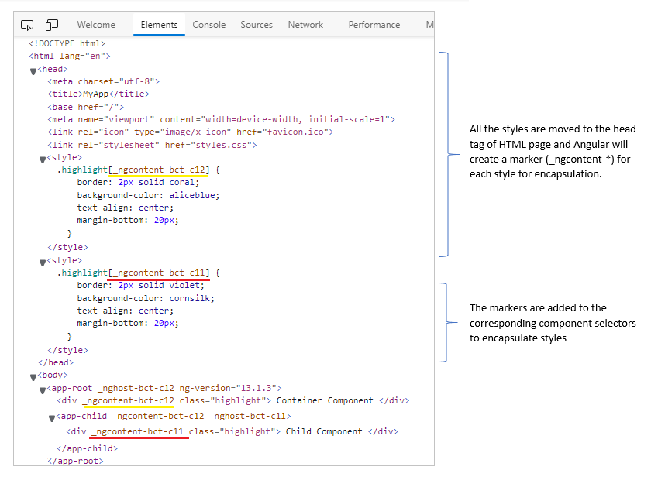

Slide 156
Component Life Cycle
A component has a life cycle that is managed by Angular. It includes creating a component, rendering it, creating and rendering its child components, checks when its data-bound properties change, and destroy it before removing it from the DOM.
Angular has some methods/hooks which provide visibility into these key life moments of a component and the ability to act when they occur.
Following are the lifecycle hooks of a component. The methods are invoked in the same order as mentioned in the table below:

Slide 157
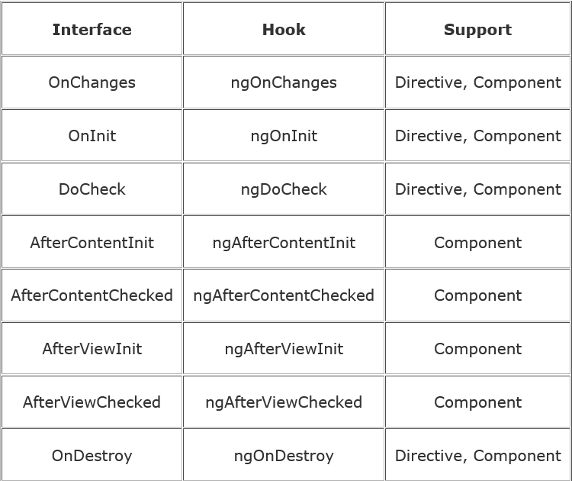

Slide 158
Syntax:
import { Component, OnInit, DoCheck, AfterContentInit, AfterContentChecked,
AfterViewInit, AfterViewChecked, OnDestroy } from '@angular/core';
...
export class AppComponent implements OnInit, DoCheck, AfterContentInit, AfterContentChecked,
AfterViewInit, AfterViewChecked, OnDestroy {
ngOnInit() { }
ngDoCheck() { }
ngAfterContentInit() { }
ngAfterContentChecked() { }
ngAfterViewInit() { }
ngAfterViewChecked() { }
ngOnDestroy() { }
}

Slide 159
Line 1: Import the interfaces of lifecycle hooks
Line 5-6: Inherit interfaces that have life cycle methods to override
Line 8-20: Override all lifecycle hooks
Lifecycle Hooks
ngOnChanges – It gets invoked when Angular sets data-bound input property i.e., the property attached with @Input(). This will be invoked whenever input property changes its value
ngOnInit – It gets invoked when Angular initializes the directive or component
ngDoCheck - It will be invoked for every change detection in the application
ngAfterContentInit – It gets invoked after Angular projects content into its view
ngAfterContentChecked – It gets invoked after Angular checks the bindings of the content it projected into its view
ngAfterViewInit – It gets invoked after Angular creates component’s views
ngAfterViewChecked – It gets invoked after Angular checks the bindings of the component’s views
ngOnDestroy – It gets invoked before Angular destroys directive or component

Slide 160
Example:
app.component.ts
import {
Component, OnInit, DoCheck, AfterContentInit, AfterContentChecked,
AfterViewInit, AfterViewChecked,
OnDestroy
} from '@angular/core';
@Component({
selector: 'app-root',
styleUrls: ['./app.component.css'],
templateUrl: './app.component.html'
})
export class AppComponent implements OnInit, DoCheck,
AfterContentInit, AfterContentChecked,
AfterViewInit, AfterViewChecked,
OnDestroy {
data = 'Angular';
ngOnInit() {
console.log('Init');
}

Slide 161
ngDoCheck(): void {
console.log('Change detected');
}
ngAfterContentInit(): void {
console.log('After content init');
}
ngAfterContentChecked(): void {
console.log('After content checked');
}
ngAfterViewInit(): void {
console.log('After view init');
}
ngAfterViewChecked(): void {
console.log('After view checked');
}
ngOnDestroy(): void {
console.log('Destroy');
}
}

Slide 162
Line 11-14: Inherit all lifecycle interfaces
Line 16-36: Override all the lifecycle methods and logging a message
Note: ngOnInit() is the first method to be invoked for AppComponent. Whenever data property value changes it invokes the ngDoCheck() method. All Init methods gets invoked only once at the beginning and from later whenever a change happens Angular invokes ngDoCheck, ngAfterContentChecked and ngAfterViewChecked methods
app.component.html
<div>
<h1>I'm a container component</h1>
<input type="text" [(ngModel)]='data'>
<app-child [title]='data'></app-child>
</div>

Slide 163
Line 3: textbox is bound with the data property
Line 4: Loads child component and data property is bound with the title property of the child component
child.component.ts
...
export class ChildComponent implements OnChanges {
@Input() title: string = 'I\'m a nested component';
ngOnChanges(changes: any): void {
console.log('changes in child:' + JSON.stringify(changes));
}
}
Line 4: title is an input property that receives value from App component
Line 6: Override ngOnChanges method which gets invoked whenever input property changes its value.
Note: Whenever the input property called title changes its value, Angular invokes ngOnChanges() method which takes the changes as a JSON object. The 'changes' parameter will have the previous value and the current value of the input property
child.component.html

Slide 164
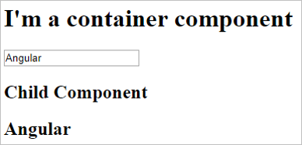
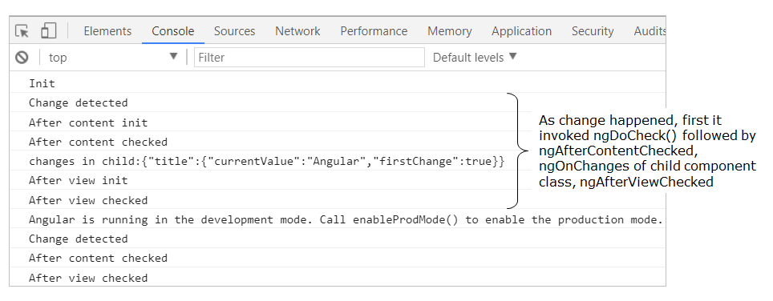
<h2>Child Component</h2>
<h2>{{title}}</h2>
Output:
Browser Console:

Slide 165
Demo : Component Life Cycle
Highlights:
Component lifecycle
Various lifecycle hooks
Demosteps:
Problem Statement: Overriding component life-cycle hooks and logging the corresponding messages to understand the flow. The output is as shown below

Slide 166
1. Write the below-given code in app.component.ts
import {
Component, OnInit, DoCheck, AfterContentInit, AfterContentChecked,
AfterViewInit, AfterViewChecked,
OnDestroy
} from '@angular/core';
@Component({
selector: 'app-root',
styleUrls: ['./app.component.css'],
templateUrl: './app.component.html'
})
export class AppComponent implements OnInit, DoCheck,
AfterContentInit, AfterContentChecked,
AfterViewInit, AfterViewChecked,
OnDestroy {
data = 'Angular';
ngOnInit() {
console.log('Init');
}
ngDoCheck(): void {
console.log('Change detected');
}

Slide 167
ngAfterContentInit(): void {
console.log('After content init');
}
ngAfterContentChecked(): void {
console.log('After content checked');
}
ngAfterViewInit(): void {
console.log('After view init');
}
ngAfterViewChecked(): void {
console.log('After view checked');
}
ngOnDestroy(): void {
console.log('Destroy');
}
}
2. Write the below-given code in app.component.html

Slide 168
<div>
<h1>I'm a container component</h1>
<input type="text" [(ngModel)]="data" />
<app-child [title]="data"></app-child>
</div>
3. Write the below-given code in child.component.ts
import { Component, OnChanges, Input } from '@angular/core';
@Component({
selector: 'app-child',
templateUrl: './child.component.html',
styleUrls: ['./child.component.css']
})
export class ChildComponent implements OnChanges {
@Input() title!: string;
ngOnChanges(changes: any): void {
console.log('changes in child:' + JSON.stringify(changes));
}
}

Slide 169
4. Write the below-given code in child.component.html
<h2>Child Component</h2>
<h2>{{title}}</h2>
5. Ensure FormsModule is present in the imports section of the AppModule.
6. Save the files and check the output in the browser

Slide 170
@ViewChild Decorator
@ViewChild Decorator
ViewChild decorator helps in accessing properties/methods of a child component, directive, or DOM element. ViewChild decorator returns the first element or directive matching the selector from the DOM.
ViewChild decorator creates an instance of a component/directive class in the parent component to access the properties or methods of that component /directive.
Accessing a child component using @ViewChild
@ViewChild allows the parent component to access the properties and methods of the child component.
@ViewChild decorator creates an instance of a child component in the parent component and the selector of the child component should be used in the parent component's template.
Add the below code in app.module.ts for loading child and container components.

Slide 171
...
@NgModule({
declarations: [
AppComponent,
TimerComponent
],
imports: [
BrowserModule
],
providers: [],
bootstrap: [AppComponent]
})
export class AppModule { }
Add the following code to timer.component.ts

Slide 172
import { Component } from '@angular/core';
@Component({
selector: 'app-timer',
templateUrl: './timer.component.html',
styleUrls: ['./timer.component.css'],
})
export class TimerComponent {
constructor() { }
flag = false;
count = 1;
begin() {
this.flag = true;
const start = setInterval(() => {
if (this.flag === false) {
clearInterval(start);
}
this.count += 1;
}, 1000);
}
end() {
this.flag = false;
}
}

Slide 173
Now instantiate timer.component.ts in the parent component using ViewChild decorator.
import { Component, ViewChild } from '@angular/core';
import { TimerComponent } from './timer/timer.component';
@Component({
selector: 'app-root',
templateUrl: './app.component.html',
styleUrls: ['./app.component.css']
})
export class AppComponent {
@ViewChild(TimerComponent) timerComponent!: TimerComponent;
startTimer() {
this.timerComponent.begin();
}
stopTimer() {
this.timerComponent.end();
}
}

Slide 174
Line 12: @ViewChild decorator creates an instance of TimerComponent in AppComponent.
Line 14-19: AppComponent can now access the properties/methods of TimerComponent after loading the selector of TimerComponent in the template of AppComponent.
Add the following code in timer.component.html
<p>{{ count }}</p>
Add the following code in app.component.html
<h3>Accessing component using @ViewChild</h3>
<br />
<br />
Timer Example :
<button type="button" (click)="startTimer()">Begin</button>
<button type="button" (click)="stopTimer()">End</button>
<br />
<app-timer></app-timer>

Slide 175
Accessing a native element using @ViewChild
A template reference variable can be accessed only in that template. If it's required to access it inside a component class, the @ViewChild decorator can be used.
@ViewChild requires the template variable name to be passed as its argument and allows the component to change the appearance or behavior of a given template element.
Observe the following code in app.component.html
<h3>Accessing Template variable using @ViewChild</h3>
<div>
Employee Name :
<input type='text' #empname>
<br/> Employee Number :
<input type='number' #empnumber>
</div>
Line 5-7: There are two input boxes in the above template with 'empname' and 'empnumber' as their respective template reference variables.
Add the below code to app.component.ts as shown below to access the native elements.

Slide 176
import { Component, ViewChild, AfterViewInit, ElementRef } from '@angular/core';
...
export class AppComponent implements AfterViewInit {
@ViewChild('empname') empName: ElementRef;
@ViewChild('empnumber') empNumber: ElementRef;
ngAfterViewInit() {
this.empName.nativeElement.style.color = 'blue';
this.empNumber.nativeElement.style.color = 'red';
}
}
Line 5-6: The corresponding ElementRef needs to be instantiated using @ViewChild as shown above in the component to access the native element.
Line 8: AfterViewInit hook is used to execute statements after a component view is fully initialized.

Slide 177
Demo : @ViewChild Decorator
Highlights:
Using @ViewChild to access properties and methods of a child component.
Demosteps:
Problem Statement: Accessing methods of child component using @ViewChild. The output is as shown below:

Slide 178
1. Write the below code in app.module.ts.
import { NgModule } from '@angular/core';
import { BrowserModule } from '@angular/platform-browser';
import { AppComponent } from './app.component';
import { TimerComponent } from './timer/timer.component';
@NgModule({
declarations: [
AppComponent,
TimerComponent
],
imports: [
BrowserModule,
],
providers: [],
bootstrap: [AppComponent]
})
export class AppModule { }
2. Write the below code in timer.component.ts.

Slide 179
import { Component } from '@angular/core';
@Component({
selector: 'app-timer',
templateUrl: './timer.component.html',
styleUrls: ['./timer.component.css'],
})
export class TimerComponent {
constructor() { }
flag = false;
count = 1;
begin() {
this.flag = true;
const start = setInterval(() => {
if (this.flag === false) {
clearInterval(start);
}
this.count += 1;
}, 1000);
}
end() {
this.flag = false;
}
}

Slide 180
3. Write the below code in app.component.ts.
import { Component, ViewChild } from '@angular/core';
import { TimerComponent } from './timer/timer.component';
@Component({
selector: 'app-root',
templateUrl: './app.component.html',
styleUrls: ['./app.component.css']
})
export class AppComponent {
@ViewChild(TimerComponent) timerComponent!: TimerComponent;
startTimer() {
this.timerComponent.begin();
}
stopTimer() {
this.timerComponent.end();
}
}
4. Write the following code in app.component.html.

Slide 181
<h3>Accessing component using @ViewChild</h3>
<br />
<br />
Timer Example :
<button type="button" (click)="startTimer()">Begin</button>
<button type="button" (click)="stopTimer()">End</button>
<br />
<app-timer></app-timer>
5. Add the following code in timer.component.html
<p> {{ count }} </p>
6. Save the files and check the output in the browser.

Slide 182
Highlights:
Using @ViewChild to access methods of a directive class in a component.
Demosteps:
Problem Statement: Accessing methods of a directive using @ViewChild. The output is as shown below:
Write the below code in app.module.ts
D:\My_app>ng generate directive color

Slide 183
import { NgModule } from '@angular/core';
import { BrowserModule } from '@angular/platform-browser';
import { AppComponent } from './app.component';
import { ColorDirective } from './color.directive';
@NgModule({
declarations: [
AppComponent,
ColorDirective
],
imports: [
BrowserModule,
],
providers: [],
bootstrap: [AppComponent]
})
export class AppModule { }
2. Add the following code in color.directive.ts

Slide 184
import { Directive, ElementRef, AfterViewInit } from '@angular/core';
@Directive({
selector: '[appColor]'
})
export class ColorDirective implements AfterViewInit {
constructor(private elementRef: ElementRef) { }
ngAfterViewInit() {
this.elementRef.nativeElement.style.color = 'green';
}
modify(color: string) {
this.elementRef.nativeElement.style.color = color;
}
}
3. Add the following code in app.component.ts

Slide 185
import { Component, ViewChild } from '@angular/core';
import { ColorDirective } from './color.directive';
@Component({
selector: 'app-root',
templateUrl: './app.component.html',
styleUrls: ['./app.component.css']
})
export class AppComponent {
@ViewChild(ColorDirective) colorDirective!: ColorDirective;
modifyColor(color: string) {
this.colorDirective.modify(color);
}
}
4. Add the below code in app.component.html

Slide 186
<h3>Accessing Directive using @ViewChild</h3>
<br />
<br />
@ViewChild Example :
<div appColor>Modify Color of this Content</div>
<br />
<br />
<div>
Modify Color :
<input type="radio" name="color" (click)="modifyColor('blue')" />Blue
<input type="radio" name="color" (click)="modifyColor('yellow')" />Yellow
<input type="radio" name="color" (click)="modifyColor('cyan')" />Cyan
</div>
5. Save the files and check the output in the browser

Slide 187
Highlights:
Using @ViewChild to access native elements using the ElementRef property.
Demosteps:
Problem Statement: Accessing Native Element in a component class using @ViewChild and modifying its properties. The output is as shown below:
1. Write the following code in app.module.ts

Slide 188
import { BrowserModule } from '@angular/platform-browser';
import { NgModule } from '@angular/core';
import { AppComponent } from './app.component';
@NgModule({
declarations: [
AppComponent
],
imports: [
BrowserModule
],
providers: [],
bootstrap: [AppComponent]
})
export class AppModule { }
2. Write the following code in app.component.html

Slide 189
<h3>Accessing Template variable using @ViewChild</h3>
<div>
<table>
<tr>
<td>Employee Name :</td>
<td>
<input type="text" #empname />
</td>
</tr>
<br />
<tr>
<td>Employee Number :</td>
<td>
<input type=“text" #empnumber />
</td>
</tr>
</table>
</div>
3. Write the following code in app.component.ts

Slide 190
import { Component, ViewChild, AfterViewInit, ElementRef } from '@angular/core';
@Component({
selector: 'app-root',
templateUrl: './app.component.html',
styleUrls: ['./app.component.css'],
})
export class AppComponent implements AfterViewInit {
@ViewChild('empname') empName!: ElementRef;
@ViewChild('empnumber') empNumber!: ElementRef;
ngAfterViewInit() {
this.empName.nativeElement.style.color = 'blue';
this.empNumber.nativeElement.style.color = 'red';
}
}
4. Save the files and check the output in the browser

Slide 191

Model Driven Forms or Reactive Forms

Slide 192
Introduction to Forms in Angular:
Forms are crucial part of web applications. Forms enable users to provide data input into the application in contexts like performing user registration, user sign-in, updating profile, entering sensitive information like payment information and for performing other data-entry based tasks.
Forms in Angular:
Angular has two different approaches in dealing with forms: reactive forms and template-driven forms.
Both reactive forms and template-driven forms:
can capture user-provided data,
can capture user input events,
can validate the user input, etc.
have their own approaches of processing and managing the form data:
In template-driven forms, you will create the form completely in the template and need to rely on directives to create and manipulate the underlying form object model. Since the template-driven forms do not scale that well, they are more suitable only when you want to add a simple small form to the application. For example: a signup form.
In reactive forms, you can control the form completely from the component class and hence you will get direct, explicit access to the underlying forms object model. Hence, reactive forms are also known as 'model-driven forms'. As reactive forms are more robust and scalable, they are more suitable for creating all kind of forms in an application, irrespective of the size of form.

Slide 193
Angular automatically tracks the changes happening to the form and form controls as and when user provides input and thereby controls the state and the validity of the form/form controls. Angular does this by associating respective keywords automatically for the forms/form controls depending on the context. The below table describes the details:
Install
D:\>my_app>npm install –g @angular/cli@14.0.0

Slide 194


Slide 195

Angular also has the following built-in CSS classes which get auto-applied depending on the state. Code can be written inside these CSS classes which can change the appearance of the control suitably as per context.

Slide 196
Following are the advantages of Reactive Forms/Model Driven Forms:
Unit testing(using the Jasmine framework) on the validation logic can be performed, as it is written inside the component class.
Form changes or events can be heard easily using reactive forms. Each FormGroup or FormControl has few events like valueChanges, statusChanges, etc., which can be subscribed to.
Reactive forms are used in creating medium to large scale applications
Due to the advantages of Reactive forms, in most Angular applications, Reactive Forms Approach is chosen when creating forms.
Step1:
To create a reactive form in Angular, FormBuilder class must be used. To make the FormBuilder class available, ReactiveFormsModule has to be imported in the root module.
Register the ReactiveFormsModule during bootstrapping, in the app.module.ts

Slide 197
import { BrowserModule } from '@angular/platform-browser';
import { NgModule } from '@angular/core';
import { ReactiveFormsModule } from '@angular/forms';
import { AppComponent } from './app.component';
import { RegistrationFormComponent } from './registration-form/registration-form.component';
@NgModule({
declarations: [
AppComponent,
RegistrationFormComponent
],
imports: [
BrowserModule,
ReactiveFormsModule
],
providers: [],
bootstrap: [AppComponent]
})
export class AppModule { }

Slide 198
Line 3: Import ReactiveFormsModule from @angular/forms module
Line 15: Add ReactiveFormsModule in the imports declaration to create reactive forms
Step 2:
Create a component called RegistrationForm using the following CLI command
ng generate component RegistrationForm
Step 3:
Add the below to app.component.html
<app-registration-form></app-registration-form>
Line 1: Loads RegistrationFormComponent in the root component
Step 4:
Bootstrap CSS framework (v3) is commonly used for adding basic structural layout and style for web applications. For structuring the RegistrationForm in this example, CSS classes from the Bootstrap CSS framework can be used.
To add Bootstrap CSS library to the application, install bootstrap as shown below:

Slide 199
ng add @ng-bootstrap/ng-bootstrap
Then, include boostrap.min.css file in angular.json file as shown below:
...
"styles": [
"src/styles.css",
"node_modules/bootstrap/dist/css/bootstrap.min.css"
],
"scripts": [
"node_modules/bootstrap/dist/js/bootstrap.min.js"
]
...
Note: When angular.json is modified, restart the server to see the changes reflected.
​ ​
Step 5:
Include the below code to registration-form.component.css

Slide 200
.ng-invalid:not(form) {
border-left: 5px solid #a94442; /* red */
}
Line 1-3: ng-valid CSS class changes left border of the textbox to green if form control has valid input
Line 5-7: ng-invalid CSS class changes left border of the textbox to red if form control has invalid data

Slide 201
Building Reactive Forms (Angular v13)
Add the following code in the registration-form.component.ts file
import { Component, OnInit } from '@angular/core';
import { FormBuilder, FormGroup, Validators } from '@angular/forms';
@Component({
selector: 'app-registration-form',
templateUrl: './registration-form.component.html',
styleUrls: ['./registration-form.component.css']
})
export class RegistrationFormComponent implements OnInit {
registerForm!: FormGroup;
submitted!:boolean;
constructor(private formBuilder: FormBuilder) { }
ngOnInit() {
this.registerForm = this.formBuilder.group({

Slide 202
firstName: ['', Validators.required],
lastName: ['', Validators.required],
address: this.formBuilder.group({
street: [],
zip: [],
city: []
})
});
}
}
Line 2: Import FormBuilder class to create a reactive form. Also, import FormGroup class to create a group of form controls and Validators for validation
Line 11: Create a property registerForm of type FormGroup
Line 14: Inject a FormBuilder instance using constructor
Line 17: formBuilder.group() method creates a FormGroup. It takes an object whose keys are FormControl names and values are their definitions
Line 18-24: Create form controls such as firstName, lastName, and address as a subgroup with fields street, zip, and city. These fields are form controls.

Slide 203
For each form control:
you can mention the default value as the first argument and
the list of validators as the second argument:
Validations can be added to the form controls using the built-in validators supplied by the Validators class.
For example: Configure built-in required validator for each control using [' ', Validators.required] syntax.
If multiple validators are to be applied, then use the syntax [' ', [Validators.required, Validators.maxlength(10)]].
registration-form.component.html
<div class="container">
<h1>Registration Form</h1>
<form [formGroup]="registerForm">
<div class="form-group">
<label>First Name</label>
<input type="text" class="form-control" formControlName="firstName">
<div *ngIf="registerForm.controls['firstName'].errors" class="alert alert-danger">
Firstname field is invalid.
<p *ngIf="registerForm.controls['firstName'].errors?.['required']">
This field is required!
</p>
</div>
</div>

Slide 204
<div class="form-group">
<label>Last Name</label>
<input type="text" class="form-control" formControlName="lastName">
<div *ngIf="registerForm.controls['lastName'].errors" class="alert alert-danger">
Lastname field is invalid.
<p *ngIf="registerForm.controls['lastName'].errors?.['required']">
This field is required!
</p>
</div>
</div>
<div class="form-group">
<fieldset formGroupName="address">
<legend>Address:</legend>
<label>Street</label>
<input type="text" class="form-control" formControlName="street">
<label>Zip</label>
<input type="text" class="form-control" formControlName="zip">
<label>City</label>
<input type="text" class="form-control" formControlName="city">
</fieldset>
</div>

Slide 205
<button type="submit" class="btn btn-primary" (click)="submitted=true">Submit</button>
</form>
<br/>
<div [hidden]="!submitted">
<h3> Employee Details </h3>
<p>First Name: {{ registerForm.get('firstName')?.value }} </p>
<p> Last Name: {{ registerForm.get('lastName')?.value }} </p>
<p> Street: {{ registerForm.get('address.street')?.value }}</p>
<p> Zip: {{ registerForm.get('address.zip')?.value }} </p>
<p> City: {{ registerForm.get('address.city')?.value }}</p>
</div>
</div>
Line 3: formGroup is a directive that binds HTML form with the FormGroup property created inside a component class. A FormGroup has been created in component with the name registerForm. Here form tag is bound with FormGroup name called registerForm
Line 6, 16: Two text boxes for first name and last name are bound with the form controls created in the component using formControlName directive
Line 7-13: A validation error message is displayed when the firstName is modified and has validation errors.

Slide 206

Line 17-22: A validation error message is displayed when the lastName is modified and has validation errors.
Line 35: When the submit button is clicked, it initializes the submitted property value to true
Line 38: div tag will be hidden if the form is not submitted
Line 39-44: Using the get() method of FormGroup, each FormControl value is fetched and rendered.
Save all the files and observe the output:

Slide 207


Slide 208
Demo : Reactive Forms
Highlights:
Reactive forms (Angular v13)
FormBuilder in creating a reactive form
Demosteps:
Problem Statement: Creating an employee registration form as a reactive form as shown below

Slide 210
1. Write the below-given code in app.module.ts
import { BrowserModule } from '@angular/platform-browser';
import { NgModule } from '@angular/core';
import { ReactiveFormsModule } from '@angular/forms';
import { AppComponent } from './app.component';
import { RegistrationFormComponent } from './registration-form/registration-form.component';
@NgModule({
declarations: [
AppComponent,
RegistrationFormComponent
],
imports: [
BrowserModule,
ReactiveFormsModule
],
providers: [],
bootstrap: [AppComponent]
})
export class AppModule { }

Slide 211
2. Create a component called RegistrationForm using the following CLI command
ng generate component RegistrationForm
3. Add the following code in the registration-form.component.ts file
import { Component, OnInit } from '@angular/core';
import { FormBuilder, FormGroup, Validators } from '@angular/forms';
@Component({
selector: 'app-registration-form',
templateUrl: './registration-form.component.html',
styleUrls: ['./registration-form.component.css']
})
export class RegistrationFormComponent implements OnInit {
registerForm!: FormGroup;
submitted!:boolean;
constructor(private formBuilder: FormBuilder) { }
ngOnInit() {
this.registerForm = this.formBuilder.group({

Slide 212
firstName: ['', Validators.required],
lastName: ['', Validators.required],
address: this.formBuilder.group({
street: [],
zip: [],
city: []
})
});
}
}
4. Write the below-given code in registration-form.component.html
<div class="container">
<h1>Registration Form</h1>
<form [formGroup]="registerForm">
<div class="form-group">
<label>First Name</label>
<input type="text" class="form-control" formControlName="firstName">
<div *ngIf="registerForm.controls['firstName'].errors" class="alert alert-danger">
Firstname field is invalid.

Slide 213
<p *ngIf="registerForm.controls['firstName'].errors?.['required']">
This field is required!
</p>
</div>
</div>
<div class="form-group">
<label>Last Name</label>
<input type="text" class="form-control" formControlName="lastName">
<div *ngIf="registerForm.controls['lastName'].errors" class="alert alert-danger">
Lastname field is invalid.
<p *ngIf="registerForm.controls['lastName'].errors?.['required']">
This field is required!
</p>
</div>
</div>
<div class="form-group">
<fieldset formGroupName="address">
<legend>Address:</legend>
<label>Street</label>
<input type="text" class="form-control" formControlName="street">
<label>Zip</label>

Slide 214
<input type="text" class="form-control" formControlName="zip">
<label>City</label>
<input type="text" class="form-control" formControlName="city">
</fieldset>
</div>
<button type="submit" class="btn btn-primary" (click)="submitted=true">Submit</button>
</form>
<br/>
<div [hidden]="!submitted">
<h3> Employee Details </h3>
<p>First Name: {{ registerForm.get('firstName')?.value }} </p>
<p> Last Name: {{ registerForm.get('lastName')?.value }} </p>
<p> Street: {{ registerForm.get('address.street')?.value }}</p>
<p> Zip: {{ registerForm.get('address.zip')?.value }} </p>
<p> City: {{ registerForm.get('address.city')?.value }}</p>
</div>
</div>

Slide 215
5. Write the below-given code in registration-form.component.css
.ng-invalid:not(form) {
border-left: 5px solid #a94442; /* red */
}
6. Write the below-given code in app.component.html
<app-registration-form></app-registration-form>
7. Save the files and check the output in the browser

Slide 216
Reactive Forms - updateOn Option
Angular runs the control validation process whenever a form control value changes. For example, if you have an input bounded to a form control, Angular runs the control validation for every keystroke.
A form with heavy validation requirements, updating on every keystroke can sometimes be too expensive.
Angular provides a new option that improves performance by delaying form control updates until blur or submit event.
The possible values for updateOn are:
1) change: Default. The value updates on every change.
2) blur: The value updates once the form lost its focus.
3) submit: The value updates once the form is submitted.
These validations can be used on both types of forms at the input level or at the form level using updateOn property.
In reactive form demo, modify registration-form.component.ts as shown below

Slide 217
import { Component, OnInit } from '@angular/core';
import { FormBuilder, FormGroup, Validators } from '@angular/forms';
@Component({
selector: 'app-registration-form',
templateUrl: './registration-form.component.html',
styleUrls: ['./registration-form.component.css']
})
export class RegistrationFormComponent implements OnInit {
registerForm!: FormGroup;
submitted!:boolean;
constructor(private formBuilder: FormBuilder) { }
ngOnInit() {
this.registerForm = this.formBuilder.group({
firstName: ['', { updateOn: 'blur', validators: [Validators.required] }],
lastName: ['', Validators.required],
address: this.formBuilder.group({
street: [],
zip: [],
city: []
})
});
}
}

Slide 218

Line 14: firstname will be updated with new value only on blur event.
Output
As shown below, the firstName will be updated on blur event.

Slide 219
Custom Validators in Reactive Forms
Need for custom validation:
While creating forms, there can be situations for which built-in validators are not available. Few such examples include validating a phone number, validating if the password and confirm password fields matches or not, etc.. In such situations, custom validators can be created to implement the required validation functionality.
Custom validation in Reactive Forms of Angular:
Custom validation can be applied to form controls of a Reactive Form in Angular.
Custom validators are implemented as separate functions inside the component.ts file.
these functions can be added to the list of other validators configured for a form control.
Implementing custom validation in Reactive Forms of Angular:
Add one more field called email inside the example used for ReactiveForms previously. The below are the validations to be applied to the 'email' field:
required,
checks for standard email pattern, for example: abc@something.com, abc@something.co.in, etc.
For implementing the for custom validation, add a separate function which checks for standard email pattern inside registration-form.component.ts as shown below:

Slide 220
import { Component, OnInit } from '@angular/core';
import { FormBuilder, FormControl, FormGroup, Validators } from '@angular/forms';
@Component({
selector: 'app-registration-form',
templateUrl: './registration-form.component.html',
styleUrls: ['./registration-form.component.css']
})
export class RegistrationFormComponent implements OnInit {
registerForm!: FormGroup;
submitted!:boolean;
constructor(private formBuilder: FormBuilder) { }
ngOnInit() {
this.registerForm = this.formBuilder.group({
firstName: ['', Validators.required],
lastName: ['', Validators.required],
address: this.formBuilder.group({
street: [],
zip: [],
city: []
}),
email: ['', validateEmail]
});

Slide 221
}
}
function validateEmail(c: FormControl): any {
let EMAIL_REGEXP = /^([a-zA-Z0-9_\-\.]+)@([a-zA-Z0-9_\-\.]+)\.([a-zA-Z]{2,5})$/;
return EMAIL_REGEXP.test(c.value) ? null : {
emailInvalid: {
message: "Invalid Format!"
}
};
}
Line 30-37: In this function, a regular expression pattern is taken for email and the input value of the form control is tested against the mentioned pattern. If the pattern matches, it means the entered input is valid and hence, the validation function returns null. Otherwise, the function returns an object with name 'emailInvalid' with one property called 'message' set to appropriate string message.
Line 21: Binds the required validator and the custom validator named validateEmail to the email field.

Slide 222
For tracking the custom validators in the Reactive Form's template (Angular v13), add HTML controls for the email field in the registration-form.component.html file as shown below:
<div class="container">
<h1>Registration Form</h1>
<form [formGroup]="registerForm">
<div class="form-group">
<label>First Name</label>
<input type="text" class="form-control" formControlName="firstName">
<div *ngIf="registerForm.controls['firstName'].errors" class="alert alert-danger">
Firstname field is invalid.
<p *ngIf="registerForm.controls['firstName'].errors?.['required']">
This field is required!
</p>
</div>
</div>
<div class="form-group">
<label>Last Name</label>
<input type="text" class="form-control" formControlName="lastName">
<div *ngIf="registerForm.controls['lastName'].errors" class="alert alert-danger">
Lastname field is invalid.

Slide 223
<p *ngIf="registerForm.controls['lastName'].errors?.['required']">
This field is required!
</p>
</div>
</div>
<div class="form-group">
<fieldset formGroupName="address">
<legend>Address:</legend>
<label>Street</label>
<input type="text" class="form-control" formControlName="street">
<label>Zip</label>
<input type="text" class="form-control" formControlName="zip">
<label>City</label>
<input type="text" class="form-control" formControlName="city">
</fieldset>
</div>
<div class="form-group">
<label>Email</label>
<input type="text" class="form-control" formControlName="email" />
<div *ngIf="registerForm.controls['email'].errors" class="alert alert-danger">
Email field is invalid.

Slide 224
<p *ngIf="registerForm.controls['email'].errors?.['required']">
This field is required!
</p>
<p *ngIf="registerForm.controls['email'].errors?.['emailInvalid']">
{{ registerForm.controls['email'].errors?.['emailInvalid'].message }}
</p>
</div>
</div>
<button type="submit" class="btn btn-primary" (click)="submitted=true">Submit</button>
</form>
<br/>
<div [hidden]="!submitted">
<h3> Employee Details </h3>
<p>First Name: {{ registerForm.get('firstName')?.value }} </p>
<p> Last Name: {{ registerForm.get('lastName')?.value }} </p>
<p> Street: {{ registerForm.get('address.street')?.value }}</p>
<p> Zip: {{ registerForm.get('address.zip')?.value }} </p>
<p> City: {{ registerForm.get('address.city')?.value }}</p>
<p>Email: {{ registerForm.get('email')?.value }}</p>
</div>
</div>

Slide 225

Line 44: Displays error message if email validation fails. errors object holds the error messages of all form controls
Output:

Slide 226


Slide 227
Demo : Custom Validators in Reactive Forms
Highlights:
Custom validator for a reactive form (Angular v13)
Custom validator to an HTML field
Demosteps:
Problem Statement: Creating a custom validator for an email field in the employee registration form ( reactive form) as shown below​​​​​​​

Slide 229
1. Write a separate function in registration-form.component.ts for custom validation as shown below.
import { Component, OnInit } from '@angular/core';
import { FormBuilder, FormControl, FormGroup, Validators } from '@angular/forms';
@Component({
selector: 'app-registration-form',
templateUrl: './registration-form.component.html',
styleUrls: ['./registration-form.component.css']
})
export class RegistrationFormComponent implements OnInit {
registerForm!: FormGroup;
submitted!:boolean;
constructor(private formBuilder: FormBuilder) { }
ngOnInit() {
this.registerForm = this.formBuilder.group({
firstName: ['',Validators.required],
lastName: ['', Validators.required],

Slide 230
address: this.formBuilder.group({
street: [],
zip: [],
city: []
}),
email: ['',[Validators.required,validateEmail]]
});
}
}
function validateEmail(c: FormControl): any {
let EMAIL_REGEXP = /^([a-zA-Z0-9_\-\.]+)@([a-zA-Z0-9_\-\.]+)\.([a-zA-Z]{2,5})$/;
return EMAIL_REGEXP.test(c.value) ? null : {
emailInvalid: {
message: "Invalid Format!"
}
};
}
2. Add HTML controls for the email field in the registration-form.component.html file as shown below

Slide 231
<div class="container">
<h1>Registration Form</h1>
<form [formGroup]="registerForm">
<div class="form-group">
<label>First Name</label>
<input type="text" class="form-control" formControlName="firstName">
<div *ngIf="registerForm.controls['firstName'].errors" class="alert alert-danger">
Firstname field is invalid.
<p *ngIf="registerForm.controls['firstName'].errors?.['required']">
This field is required!
</p>
</div>
</div>
<div class="form-group">
<label>Last Name</label>
<input type="text" class="form-control" formControlName="lastName">
<div *ngIf="registerForm.controls['lastName'].errors" class="alert alert-danger">
Lastname field is invalid.
<p *ngIf="registerForm.controls['lastName'].errors?.['required']">
This field is required!
</p>
</div>
</div>

Slide 232
<div class="form-group">
<fieldset formGroupName="address">
<legend>Address:</legend>
<label>Street</label>
<input type="text" class="form-control" formControlName="street">
<label>Zip</label>
<input type="text" class="form-control" formControlName="zip">
<label>City</label>
<input type="text" class="form-control" formControlName="city">
</fieldset>
</div>
<div class="form-group">
<label>Email</label>
<input type="text" class="form-control" formControlName="email" />
<div *ngIf="registerForm.controls['email'].errors" class="alert alert-danger">
Email field is invalid.
<p *ngIf="registerForm.controls['email'].errors?.['required']">
This field is required!
</p>
<p *ngIf="registerForm.controls['email'].errors?.['emailInvalid']">
{{ registerForm.controls['email'].errors?.['emailInvalid'].message }}
</p>
</div>

Slide 233
</div>
<button type="submit" class="btn btn-primary" (click)="submitted=true">Submit</button>
</form>
<br/>
<div [hidden]="!submitted">
<h3> Employee Details </h3>
<p>First Name: {{ registerForm.get('firstName')?.value }} </p>
<p> Last Name: {{ registerForm.get('lastName')?.value }} </p>
<p> Street: {{ registerForm.get('address.street')?.value }}</p>
<p> Zip: {{ registerForm.get('address.zip')?.value }} </p>
<p> City: {{ registerForm.get('address.city')?.value }}</p>
<p>Email: {{ registerForm.get('email')?.value }}</p>
</div>
</div>
3. Save the files and check the output in the browser

Slide 234

Dependency Injection

Slide 235
Dependency Injection (DI) is a mechanism where the required resources will be injected into the code automatically.
Angular comes with an in-built dependency injection subsystem.
Why Dependency Injection?
It is because DI:
allows developers to reuse the code across applications.
makes the code loosely coupled.
makes application development and testing much easier.
allows the developer to ask for the dependencies from Angular. There is no need for the developer to explicitly create/instantiate them.

Slide 236
Services Basics
A service in Angular is a class that contains some functionality that can be reused across the application. A service is a singleton object. Angular services are a mechanism of abstracting shared code and functionality throughout the application.
Angular Services come as objects which are wired together using dependency injection.
Angular provides a few inbuilt services also can create custom services.
Why Services?
Services can be used to:
share the code across components of an application.
make HTTP requests.
Creating a Service
To create a service class, use the following command:
ng generate service book

Slide 237
The above command will create a service class as shown below:
@Injectable({
providedIn:'root'
})
export class BookService
{
}
@Injectable() decorator makes the class injectable into application components.
Providing a Service
Following are the ways to provide services in an Angular application:
1. The first way to register service is to specify providedIn property using @Injectable decorator. This property is added by default when you generate a service using Angular CLI.
import { Injectable } from '@angular/core';
@Injectable({
providedIn: 'root'
})
export class BookService {}

Slide 238
Line 4: providedIn property registers BookService at the root level (app module).
When the BookService is provided at the root level, Angular creates a singleton instance of the service class and injects the same instance into any class that uses this service class. In addition, Angular also optimizes the application if registered through providedIn property by removing the service class if none of the components use it.
2. Services can also be provided across the application by registering it using the providers property in the @Ngmodule decorator of any module.
@NgModule({
imports: [BrowserModule],
declarations: [AppComponent, BookComponent],
providers: [BookService],
bootstrap: [AppComponent]
})

Slide 239
Line 4: When the service class is added in the providers property of the root module, all the directives and components will have access to the same instance of the service.
3. There is also a way to limit the scope of the service class by registering it in the providers' property inside the @Component decorator. Providers in component decorator and module decorator are independent. Providing a service class inside a component creates a separate instance for that component and its nested components.
import { BookService } from './book/book.service';
@Component({
selector: 'app-root',
styleUrls: ['./app.component.css'],
templateUrl: './app.component.html',
providers:[BookService]
})

Slide 240
Injecting a Service
The only way to inject a service into a component/directive or any other class is through a constructor.
Add a constructor in a component class with service class as an argument as shown below:
constructor(private bookService: BookService){ }
BookService will then be injected into the component through constructor injection by the framework.
Problem Statement: Create a Book Component which fetches book details like id, name and displays them on the page in a list format. Store the book details in an array and fetch the data using a custom service.
Create BookComponent by using the following CLI command.
D:\MyApp>ng generate component book

Slide 241
Create a file with the name book.ts under the book folder and add the following code.
export class Book {
id!: number;
name!: string;
}
Line 1-4: Create a Book class with two properties id and name to store book id and book name
Create a file with the name books-data.ts under the book folder and add the following code.
import { Book } from './book';
export var BOOKS: Book[] = [
{ "id": 1, "name": "HTML 5" },
{ "id": 2, "name": "CSS 3" },
{ "id": 3, "name": "Java Script" },
{ "id": 4, "name": "Ajax Programming" },
{ "id": 5, "name": "jQuery" },
{ "id": 6, "name": "Mastering Node.js" },
{ "id": 7, "name": "Angular JS 1.x" },
{ "id": 8, "name": "ng-book 2" },
{ "id": 9, "name": "Backbone JS" },
{ "id": 10, "name": "Yeoman" }
];

Slide 242

Line 3-14: Books is an array of type Book class which holds books objects where each object has id and name properties.
Create a service called BookService under the book folder using the following CLI command
D:\MyApp\src\app\book>ng generate service book
This will create two files called book.service.ts and book.service.spec.ts as shown below

Slide 243
Add the following code in book.service.ts
import { Injectable } from '@angular/core';
import { Book } from './book';
import { BOOKS } from './books-data';
@Injectable({
providedIn:'root'
})
export class BookService {
getBooks() {
return BOOKS;
}
}
Line 5-7: @Injectable() decorator makes the class as a service which can be injected into components of an application
Line 10-12: getBooks() method returns Books data.
Add the following code in the book.component.ts file

Slide 244
...
import { BookService } from './book.service';
import { Book } from './book';
...
export class BookComponent implements OnInit {
books!: Book[];
constructor(private bookService: BookService) { }
getBooks() {
this.books = this.bookService.getBooks();
}
ngOnInit() {
this.getBooks();
}
}
Line 2,3: Imports BookService, Book class into a component
Line 10: Inject BookService class using a constructor
Line 12: Invokes getBooks() method from BookService class which in turn returns the books data.
book.component.html

Slide 245
<h2>My Books</h2>
<ul class="books">
<li *ngFor="let book of books">
<span class="badge">{{book.id}}</span> {{book.name}}
</li>
</ul>
Line 3 - 5: ngFor iterates on books array and displays book id and name on the page
Add the following code in book.component.css which has styles for books
.books {
margin: 0 0 2em 0;
list-style-type: none;
padding: 0;
width: 15em;
}
.books li {
cursor: pointer;
position: relative;

Slide 246
left: 0;
background-color: #EEE;
margin: .5em;
padding: .3em 0;
height: 1.6em;
border-radius: 4px;
}
.books li:hover {
color: #607D8B;
background-color: #DDD;
left: .1em;
}
.books .badge {
display: inline-block;
font-size: small;
color: white;
padding: 0.8em 0.7em 0 0.7em;
background-color: #607D8B;
line-height: 1em;
position: relative;

Slide 247

left: -1px;
top: -4px;
height: 1.8em;
margin-right: .8em;
border-radius: 4px 0 0 4px;
}
Update app.component.html to contain below code:
<app-book></app-book>
Output:

Slide 248
Use Services to share the data and functionality only as they are ideal for sharing them across the app.
Always create a service with single responsibility as if it has multiple responsibilities, it will become difficult to test.
Always use @Injectable() decorator, as Angular injector is hierarchical and when it is provided to a root injector, it will be shared among all the classes that need a service.
If @Injectable() decorator is used, optimization tools used by Angular CLI production builds will be able to perform tree shaking and remove the unused services from the app.
When two different components need different instances of a service, provide the service at the component level.

Slide 249
Demo : Services
Highlights:
Creating a service
Injecting a service into a component
Demosteps:
Problem Statement: Create a Book Component which fetches book details like id, name and displays them on the page in a list format. Store the book details in an array and fetch the data using a custom service. The output is as shown below

Slide 250
1. Create BookComponent by using the following CLI command
D:\MyApp>ng generate component book
2. Create a file with the name book.ts under the book folder and add the following code.
export class Book {
id!: number;
name!: string;
}
3. Create a file with the name books-data.ts under the book folder and add the following code.
import { Book } from './book';
export let BOOKS: Book[] = [
{ id: 1, name: 'HTML 5' },
{ id: 2, name: 'CSS 3' },
{ id: 3, name: 'Java Script' },
{ id: 4, name: 'Ajax Programming' },
{ id: 5, name: 'jQuery' },
{ id: 6, name: 'Mastering Node.js' },

Slide 251
{ id: 7, name: 'Angular JS 1.x' },
{ id: 8, name: 'ng-book 2' },
{ id: 9, name: 'Backbone JS' },
{ id: 10, name: 'Yeoman' }
];
4. Create a service called BookService under the book folder using the following CLI command
D:\MyApp\src\app\book>ng generate service book
5. Add the following code in book.service.ts
import { Injectable } from '@angular/core';
import { BOOKS } from './books-data';
@Injectable({
providedIn: 'root'
})
export class BookService {
getBooks() {
return BOOKS;
}
}

Slide 252
6. Add the following code in the book.component.ts file
import { Component, OnInit } from '@angular/core';
import { Book } from './book';
import { BookService } from './book.service';
@Component({
selector: 'app-book',
templateUrl: './book.component.html',
styleUrls: ['./book.component.css']
})
export class BookComponent implements OnInit {
books!: Book[];
constructor(private bookService: BookService) { }
getBooks() {
this.books = this.bookService.getBooks();
}
ngOnInit() {
this.getBooks();
}
}

Slide 253
7. Write the below-given code in book.component.html
<h2>My Books</h2>
<ul class="books">
<li *ngFor="let book of books">
<span class="badge">{{book.id}}</span> {{book.name}}
</li>
</ul>
8. Add the following code in book.component.css which has styles for books
.books {
margin: 0 0 2em 0;
list-style-type: none;
padding: 0;
width: 13em;
}
.books li {
cursor: pointer;
position: relative;
left: 0;
background-color: #eee;

Slide 254
margin: 0.5em;
padding: 0.3em 0;
height: 1.5em;
border-radius: 4px;
}
.books li:hover {
color: #607d8b;
background-color: #ddd;
left: 0.1em;
}
.books .badge {
display: inline-block;
font-size: small;
color: white;
padding: 0.8em 0.7em 0 0.7em;
background-color: #607d8b;
line-height: 0.5em;
position: relative;
left: -1px;
top: -4px;
height: 1.8em;
margin-right: 0.8em;
border-radius: 4px 0 0 4px;
}

Slide 255
9. Add the following code in app.component.html
<app-book></app-book>
10. Save the files and check the output in the browser

Slide 256
RxJS Observables
RxJS
Reactive Extensions for JavaScript (RxJS) is a third-party library used by the Angular team.
RxJS is a reactive streams library used to work with asynchronous streams of data.
Observables, in RxJS, are used to represent asynchronous streams of data. Observables are a more advanced version of Promises in JavaScript
Why RxJS Observables?
Angular team has recommended Observables for asynchronous calls because of the following reasons:
Promises emit a single value whereas observables (streams) emit many values
Observables can be cancellable where Promises are not cancellable. If an HTTP response is not required, observables allow us to cancel the subscription whereas promises execute either success or failure callback even if the results are not required.
Observables support functional operators such as map, filter, reduce, etc.,
Create and use an observable in Angular
Example:
app.component.ts

Slide 257
import { Component } from '@angular/core';
import { Observable } from 'rxjs';
@Component({
selector: 'app-root',
styleUrls: ['./app.component.css'],
templateUrl: './app.component.html'
})
export class AppComponent {
data!: Observable<number>;
myArray: number[] = [];
errors!: boolean;
finished!: boolean;
fetchData(): void {
this.data = new Observable(observer => {
setTimeout(() => { observer.next(11); }, 1000),
setTimeout(() => { observer.next(22); }, 2000),
setTimeout(() => { observer.complete(); }, 3000);
});
this.data.subscribe((value) => this.myArray.push(value),
error => this.errors = true,
() => this.finished = true);
}
}

Slide 258
Line 2: imports Observable class from rxjs module
Line 11: data is of type Observable which holds numeric values
Line 16: fetchData() is invoked on click of a button
Line 17: A new Observable is created and stored in the variable data
Line 18-20: next() method of Observable sends the given data through the stream. With a delay of 1,2 and 3 seconds, a stream of numeric values will be sent. Complete() method completes the Observable stream i.e., closes the stream.
Line 22: Observable has another method called subscribe which listens to the data coming through the stream. Subscribe() method has three parameters. The first parameter is a success callback which will be invoked upon receiving successful data from the stream. The second parameter is an error callback which will be invoked when Observable returns an error and the third parameter is a complete callback which will be invoked upon successful streaming of values from Observable i.e., once complete() is invoked. After which the successful response, the data is pushed to the local array called myArray, if any error occurs, a Boolean value called true is stored in the errors variable and upon complete() will assign a Boolean value true in a finished variable.
app.component.html

Slide 259
<b> Using Observables!</b>
<h6 style="margin-bottom: 0">VALUES:</h6>
<div *ngFor="let value of myArray">{{ value }}</div>
<div style="margin-bottom: 0">ERRORS: {{ errors }}</div>
<div style="margin-bottom: 0">FINISHED: {{ finished }}</div>
<button style="margin-top: 2rem" (click)="fetchData()">Fetch Data</button>
Line 4: ngFor loop is iterated on myArray which will display the values on the page
Line 6: {{ errors }} will render the value of errors property if any
Line 8: Displays finished property value when complete() method of Observable is executed
Line 10: Button click event is bound with fetchData() method which is invoked and creates an observable with a stream of numeric values
Output:

Slide 260
Server Communication using HttpClient
Most front-end applications communicate with backend services using HTTP Protocol
While making calls to an external server, the users must continue to be able to interact with the page. That is, the page should not freeze until the HTTP request returns from the external server. So, all HTTP requests are asynchronous.
HttpClient from @angular/common/http to communicate must be used with backend services.
Additional benefits of HttpClient include testability features, typed request and response objects, request and response interception, Observable APIs, and streamlined error handling.
HttpClientModule must be imported from @angular/common/http in the module class to make HTTP service available to the entire module. Import HttpClient service class into a component’s constructor. HTTP methods like get, post, put, and delete are made used off.
JSON is the default response type for HttpClient
Making a GET request:
The following statement is used to fetch data from a server
this.http.get(url)

Slide 261
http.get by default returns an observable
Using Server communication in the example used for custom services:
Add HttpClientModule to the app.module.ts to make use of HttpClient class
...
import { HttpClientModule } from '@angular/common/http';
...
@NgModule({
imports: [BrowserModule, HttpClientModule],
...
})
export class AppModule { }
Line 2: imports HttpClientModule from @angular/common/http module
Line 6: Includes HttpClientModule class to make use of HTTP calls
Add getBooks() method to BookService class in book.service.ts file as shown below

Slide 262
import { Injectable } from '@angular/core';
import { HttpClient, HttpErrorResponse, HttpHeaders } from '@angular/common/http';
import { Observable, throwError } from 'rxjs';
import { catchError, tap } from 'rxjs/operators';
import { Book } from './book';
@Injectable({
providedIn:'root'
})
export class BookService {
constructor(private http: HttpClient) { }
getBooks(): Observable<Book[]> {
return this.http.get<Book[]>('http://localhost:3020/bookList').pipe(
tap((data: any) => console.log('Data Fetched:' + JSON.stringify(data))),
catchError(this.handleError));
}
...
}

Slide 263
Line 2: Imports HttpClient class from @angular/common/http module.
Line 3: Imports Observable class from rxjs module
Line 4: Imports rxjs operators
Line 13: Injects HttpClient class into a service class
Line 16-18: Makes an asynchronous call (ajax call) by using the get() method of HttpClient class. This method makes an asynchronous call to the server URL and fetches the data. HttpClient receives the JSON response as of type object. To know the actual structure of the response, an interface must be created and specified that interface name as a type parameter i.e., get<Book[]>. The pipe function defines a comma-separated sequence of operators. Here a sequence of observables is defined by listing operators as arguments to pipe function instead of dot operator chaining. The tap operator is to execute some statements once a response is ready which is mostly used for debugging purposes and catchError operator is used to handling the errors.
Line 18: handleError is an error-handling method that throws the error message back to the component
Error handling
What happens if the request fails on the server, or if a poor network connection prevents it from even reaching the server?
There are two types of errors that can occur. The server might reject the request, returning an HTTP response with a status code such as 404 or 500. These are error responses.

Slide 264
Or something could go wrong on the client-side such as a network error that prevents the request from completing successfully or an exception thrown in an RxJS operator. These errors produce JavaScript ErrorEvent objects.
HttpClient captures both kinds of errors in its HttpErrorResponse and it can be inspected for the response to find out what really happened.
There must be error inspection, interpretation, and resolution in service not in the component.
Add the following error handling code in the book.service.ts file
import { Injectable } from '@angular/core';
import { HttpClient, HttpErrorResponse, HttpHeaders } from '@angular/common/http';
import { catchError, tap } from 'rxjs/operators';
import { Observable, throwError } from 'rxjs';
import { HttpErrorResponse } from '@angular/common/http';
import { Book } from './book';
@Injectable({
providedIn: 'root'
})

Slide 265
export class BookService {
...
private handleError(err: HttpErrorResponse): Observable<any> {
let errMsg = '';
if (err.error instanceof Error) {
// A client-side or network error occurred. Handle it accordingly.
console.log('An error occurred:', err.error.message);
errMsg = err.error.message;
} else {
// The backend returned an unsuccessful response code.
// The response body may contain clues as to what went wrong,
console.log(`Backend returned code ${err.status}`);
errMsg = err.error.status;
}
return throwError(()=>errMsg);
}
}

Slide 266
Line 5: HttpErrorResponse module class should be imported to understand the nature of the error thrown
Line 18-21: An instance of Error object will be thrown if any network or client-side error is thrown
Line 22-26: Handling of errors due to unsuccessful response codes from the backend
Modify the code in the book.component.ts file as shown below
...
export class BookComponent implements OnInit {
books!: Book[];
errorMessage!: string;
constructor(private bookService: BookService) { }
getBooks() {
this.bookService.getBooks().subscribe({
next: books => this.books = books,
error:error => this.errorMessage = error
})
}
ngOnInit() {
this.getBooks();
}
}

Slide 267
Line 7: Inject the BookService class into the component class through the constructor
Line 9-14: Invokes the service class method getBooks() which makes an HTTP call to the books.json file. The getBooks() of the service class returns an Observable.
An observable in Angular begins to publish values only when someone has subscribed to it. To retrieve the value contained in the Observable returned by getBooks() of service, subscribe to the observable by calling the subscribe() method and pass an observer object which can listen to the three types of notifications that an observable can send: next, error and complete.

Slide 268


Slide 269

book.component.html
...
<ul class="books">
<li *ngFor="let book of books">
<span class="badge">{{book.id}}</span> {{book.name}}
</li>
</ul>
<div class="error" *ngIf="errorMessage">{{errorMessage}}</div>
Line 2-6: Displays books details
Line 8: Displays error message when HTTP get operation fails
Output:

Slide 270
Making a POST request:
HttpClient.post() method posts data to the server. It takes two parameters.
Data - data to be sent to the server
HttpOptions - to specify the required headers to be sent along with the request.
Add addBook() method to BookService class in book.service.ts file as shown below
import { Injectable } from '@angular/core';
import { HttpClient } from '@angular/common/http';
import { Observable, throwError } from 'rxjs';
import { catchError, tap } from 'rxjs/operators';
import { Book } from './book';
@Injectable({
providedIn: 'root'
})

Slide 271
export class BookService {
constructor(private http: HttpClient) { }
...
addBook(book: Book): Observable<any> {
const options = new HttpHeaders({ 'Content-Type': 'application/json' });
return this.http.post('http://localhost:3020/addBook', book, { headers: options }).pipe(
catchError(this.handleError));
}
...
}
Line 16-20: Makes an asynchronous call (ajax call) by using the post() method of HttpClient class. This method makes an asynchronous call to the server URL and sends the data along with the headers. HttpClient receives the JSON response as of type object. The Pipe function lets you define a comma-separated sequence of operators. Here, a sequence of observables is defined by listing operators as arguments to pipe function instead of dot operator chaining. catchError operator is used to handle the errors.
Line 19: handleError is an error-handling method that throws the error message back to the component
Modify the code in the book.component.ts file as shown below

Slide 272
...
export class BookComponent implements OnInit {
books!: Book[];
errorMessage!: string;
constructor(private bookService: BookService) { }
getBooks() {
this.bookService.getBooks().subscribe({
next: books => this.books = books,
error:error => this.errorMessage = <any>error
})
}
addBook(bookId: string, name: string): void {
let id=parseInt(bookId)
this.bookService.addBook({id, name })
.subscribe({next:(book: any) => this.books.push(book)});
}
ngOnInit(): void {
this.getBooks();
}
}

Slide 273
Line 7: Inject the BookService class into the component class through the constructor
Line 15-19: Invokes the service class method addBook() which makes an HTTP call to server URL and the Observable containing the response is returned. You can subscribe to the observable and use the 'next' callback to handle the successfully returned value, as needed.
Making a PUT request
HttpClient.put() method completely replaces the resource with the updated data. It is like POST requests except for updating an existing resource.
Add updateBook() method to BookService class in book.service.ts file as shown below:

Slide 274
import { Injectable } from '@angular/core';
import { HttpClient } from '@angular/common/http';
import { Observable, throwError } from 'rxjs';
import { catchError, tap } from 'rxjs/operators';
import { Book } from './book';
@Injectable({
providedIn: 'root'
})
export class BookService {
constructor(private http: HttpClient) { }
...
updateBook(book: Book): Observable<any> {
const options = new HttpHeaders({ 'Content-Type': 'application/json' });
return this.http.put<any>('http://localhost:3020/update', book, { headers: options }).pipe(
tap((_: any) => console.log(`updated hero id=${book.id}`)),
catchError(this.handleError)
);
}
...
}

Slide 275
Line 16-20: Makes an asynchronous call (ajax call) by using the put() method of HttpClient class. This method makes an asynchronous call to the server URL and sends the data along with the headers as that of POST requests. HttpClient receives the JSON response as of type object. Pipe function defines a comma-separated sequence of operators. Here a sequence of observables is defined by listing operators as arguments to pipe function instead of dot operator chaining. tap operator is to execute some statements once a response is ready which is mostly used for debugging purposes and catchError operator is used to handle the errors.
Line 20: handleError is an error-handling method that throws the error message back to the component.
Modify the code in the book.component.ts file as shown below

Slide 276
...
export class BookComponent implements OnInit {
books!: Book[];
errorMessage!: string;
constructor(private bookService: BookService) { }
getBooks() {
this.bookService.getBooks().subscribe({
next: books => this.books = books,
error:error => this.errorMessage = <any>error
})
}
addBook(bookId: string, name: string): void {
let id=parseInt(bookId)
this.bookService.addBook({id, name })
.subscribe({next:(book: any) => this.books.push(book)});
}
updateBook(bookId: string, name: string): void {
let id=parseInt(bookId)
this.bookService.updateBook({ id, name })
.subscribe({next:(book: any) => this.books = book});
}
ngOnInit(): void {
this.getBooks();
}
}

Slide 277
Line 7: Inject the BookService class into the component class through the constructor.
Line 20-24: Invokes the service class method updateBook() which makes an HTTP call to server URL and the Observable containing the response is returned. You can subscribe to the observable and use the 'next' callback to handle the successfully returned value, as needed.

Slide 278
Making a DELETE request :
HttpClient.delete() method deletes the resource by passing the bookId parameter in the request URL.
Add deleteBook() method to BookService class in book.service.ts file as shown below
import { Injectable } from '@angular/core';
import { HttpClient } from '@angular/common/http';
import { Observable, throwError } from 'rxjs';
import { catchError, tap } from 'rxjs/operators';
import { Book } from './book';
@Injectable({
providedIn: 'root'
})
export class BookService {
constructor(private http: HttpClient) { }
booksUrl = 'http://localhost:3020/bookList';
...
deleteBook(bookId: number): Observable<any> {
const url = `${this.booksUrl}/${bookId}`;
return this.http.delete(url).pipe(
catchError(this.handleError));
}
...
}

Slide 279
Line 18-21: Makes an asynchronous call (ajax call) by using delete() method of HttpClient class. HttpClient receives the JSON response as of type object. Pipe function defines a comma-separated sequence of operators. catchError operator is used to handle the errors.
Line 21: handleError is an error-handling method that throws the error message back to the component.
Modify the code in the book.component.ts file as shown below
...
export class BookComponent implements OnInit {
books!: Book[];
errorMessage!: string;
constructor(private bookService: BookService) { }
getBooks() {
this.bookService.getBooks().subscribe({
next: books => this.books = books,
error:error => this.errorMessage = <any>error
})
}

Slide 280
addBook(bookId: string, name: string): void {
let id=parseInt(bookId)
this.bookService.addBook({id, name })
.subscribe({next:(book: any) => this.books.push(book)});
}
updateBook(bookId: string, name: string): void {
let id=parseInt(bookId)
this.bookService.updateBook({ id, name })
.subscribe({next:(book: any) => this.books = book});
}
deleteBook(bookId: string): void {
let id=parseInt(bookId)
this.bookService.deleteBook(id)
.subscribe({next:(book: any) => this.books = book});
}
ngOnInit(): void {
this.getBooks();
}
}

Slide 281
Line 7: Inject the BookService class into the component class through the constructor
Line 25-29: Invokes the service class method deleteBook() which makes an HTTP call to server URL and the Observable containing the response is returned. You can subscribe to the observable and use the 'next' callback to handle the successfully returned value, as needed.

Slide 282
Some of the best practices of server communication are:
Always use services to talk to the server as components' responsibility is only to present the data.
Data services should be responsible for asynchronous calls, local storage, or any other data operations as it will become easier to test the data calls.
The information like headers, HTTP methods, caching, error handling, etc., are irrelevant to components and they need to be in a service class. A service encapsulates these details and it will be easier to test the components with mock service implementations.

