Slide 1
JavaScript

Slide 2
About JavaScript
JavaScript was introduced as a full-fledged client-side language used for developing web applications in 1995. JavaScript is easy to learn, debug, and test. It is an event-based, platform-independent, and an interpreted language with all the procedural programming capabilities.
Web applications that were developed using server-side programming languages like Java and Dot Net involved travel of user requests all the way from the client(browser) to the server hosting the application. The multiple request-response cycles between client and server who were consuming both time and network bandwidth.
JavaScript got introduced as a Client-Side programming language with the capability of executing user requests on the Client-Side. This could help in reducing the number of request-response cycles between client and server and decrease the network bandwidth thus reducing the overall response time.
Later, in 1997 ECMAScript established a standard for the scripting languages that redefined the core features any scripting language should have and how to implement those features. From then, JavaScript evolved year after year with every new version of ECMAScript introducing new features. Developers prefer JavaScript to create dynamic, interactive, and scalable web applications as it helps developers in extending the functionalities of the web pages effectively.

Slide 3

This course will enable you to understand the features of ECMA and help to develop more robust web applications using JavaScript and handle user requests on the Client-Side.
Target audience: Developers
Why we need JavaScript?
When an application is loaded on the browser, there is a 'SignUp' link on the top right corner.

Slide 4
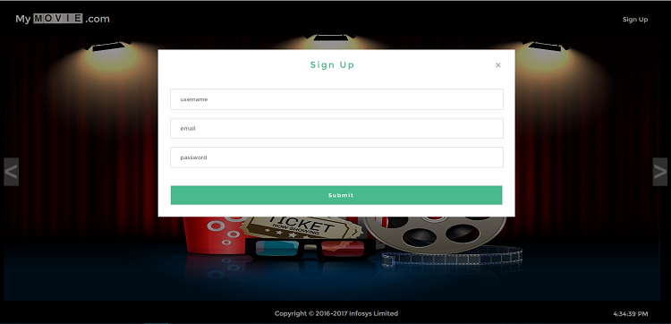
When this link is clicked, the 'SignUp' form is displayed. It contains three fields - 'Username', 'Email', and 'Password' and in some cases a 'Submit' button as well.
When data is entered in the fields and the button is clicked, then data entered in the fields will be validated and accordingly,next view page loaded. If data is invalid, an error message is displayed, if valid, the application navigates to homepage

Slide 5
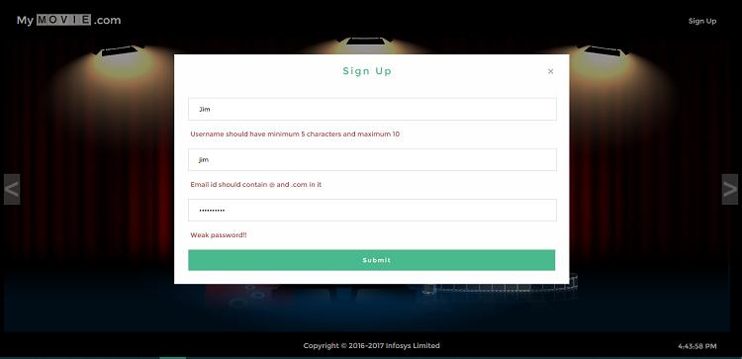
How to handle the user click, validate the user data, and display the corresponding view?
To implement the requirement of handling user action like a click of a button or link and to respond to these requests by displaying the expected output, server-side languages like Java/JSP can be used as shown in the below diagram.

Slide 6
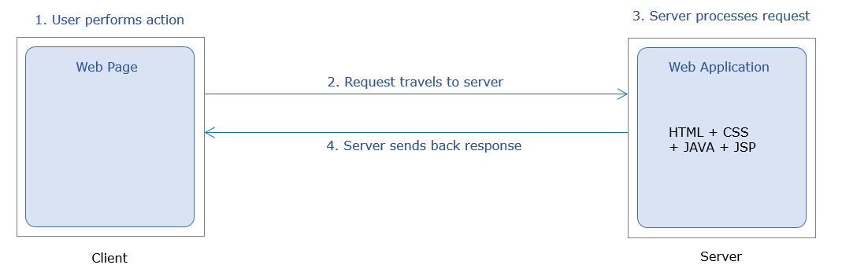
But server-side languages have certain limitations such as :-
Multiple request-response cycles to handle multiple user requests
More network bandwidth consumption
Increased response time
If client-side scripting language JavaScript is used then, this can be done without consulting the server as can be seen in the below diagram.

Slide 7
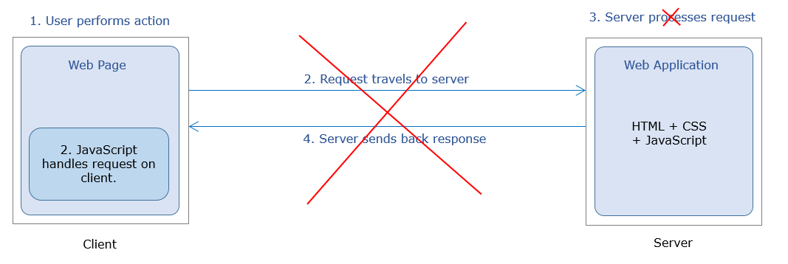
The home page of MyMovie.com contains the SignUp link. The user performs click action on this link. The user action is handled on the client side itself with the help of the JavaScript code. This code arrives on the client along with the home page of the application.
When invoked on click of the link, this code executes on the client-side itself to validate the user-entered data and accordingly display the corresponding view.

Slide 8
Following are the advantages of this approach:
No need for back and forth request-response cycles
Less network bandwidth consumption
In comparison to Java: JavaScript provides a 35% decrease in average response time and Pages being served 200ms faster.
About ES6:
JavaScript was introduced as a client-side scripting language in 1995.
ECMAScript established a standard for scripting languages in 1997.
ES is a parent of many scripting languages like TypeScript, JScript, ActionScript, and JavaScript.
JavaScript evolved year after year with every new version of ECMAScript introducing new features.
ES6 also called ES2015.
ES6 introduces new transformed syntax to extend existing JavaScript constructs to meet the demands of complex applications written in JavaScript.

Slide 9


What is JavaScript?
JavaScript is the programming language for web users to convert static web pages to dynamic web pages.
Web page designed using HTML and CSS is static.
JavaScript combined with HTML and CSS makes it dynamic.

Slide 10
None of the IE browsers significantly support the latest features (the new Microsoft Edge browser does)
So, to overcome these drawbacks, the conversion of JavaScript code written using the latest syntax to browser understandable code takes place using the transpilers such as Babel, Traceur, TypeScript, etc.
Thus, after the code is transpiled,it will be cross-browser compatible.
JavaScript code can be embedded within the HTML page or can be written in an external file.
There are three ways of writting JavaScript depending on the platform :
Inline Scripting
Internal Scripting
External Scripting

Slide 11
When JavaScript code are written within the HTML file itself, it is called internal scripting.
Internal scripting, is done with the help of HTML tag : <script> </script>
This tag can be placed either in the head tag or body tag within the HTML file.
JavaScript code written inside <head> element is as shown below :
<html>
<head>
<script>
//internal script
</script>
</head>
<body>
</body>
</html>

Slide 12
JavaScript code written inside <body> element is as shown below :
<html>
<head>
</head>
<body>
<script>
//inline script
</script>
</body>
</html>
JavaScript code can be written in an external file also. The file containing JavaScript code is saved with the extension *.js (e.g. fileName.js)
To include the external JavaScript file, the script tag is used with attribute 'src' as shown in the below-given code-snippet:

Slide 13
<html>
<head>
<!-- *.js file contain the JavaScript code -->
<script src="*.js"></script>
</head>
<body>
</body>
</html>
Example:
Demo.js :-
let firstName="Rexha";
let lastName ="Bebe";
console.log(firstName+" "+lastName);

Slide 14
Demo.html :-
<html>
<head>
<script src="Demo.js"></script>
</head>
<body>
</body>
</html>
NOTE: In external file, JavaScript code is not written inside <script> </script> tag.
The below-mentioned points can help you choose between any two ways of writing the script based on some parameters.

Slide 15
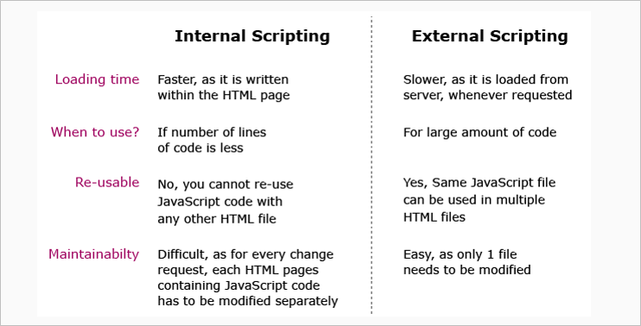
Note: External scripting is used throughout this course. But due to the platform built-in feature,HTML code cannot be explicitly linked to external script using <script></script> tag. HTML code that are used to write is automatically linked to JavaScript code written on that page.

Slide 16
Summary : Getting started with JavaScript
In this module, you have learnt about:
The need for JavaScript as a scripting language
What JavaScript is
Different ways to write JavaScript code

Slide 17
Environment Setup: Internal
To work with JavaScript, you can use
Editor (Visual Studio Code IDE recommended)
Browser (Google Chrome recommended)
As JavaScript works properly on any Browser or OS, you can choose any of them based on your preference.
It is also possible to write JavaScript code using Editors. You can use simple editors such as notepad or go for an IDE like Visual Studio Code which offers IntelliSense support and syntax error highlighter that makes coding easier.
To reduce development time,IDE can be used as it has built-in features.
In Visual Studio Code, extensions can be added that will speed up development and helps code to a higher standard by providing linting.

Slide 18
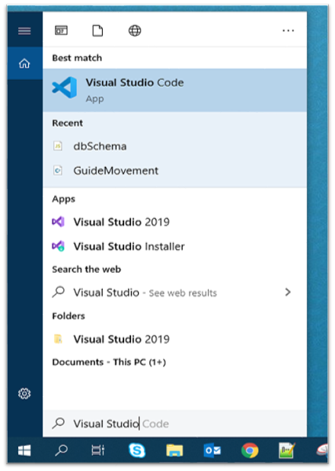
Steps to execute JavaScript code:
Open Visual Studio Code from your start menu.

Slide 19
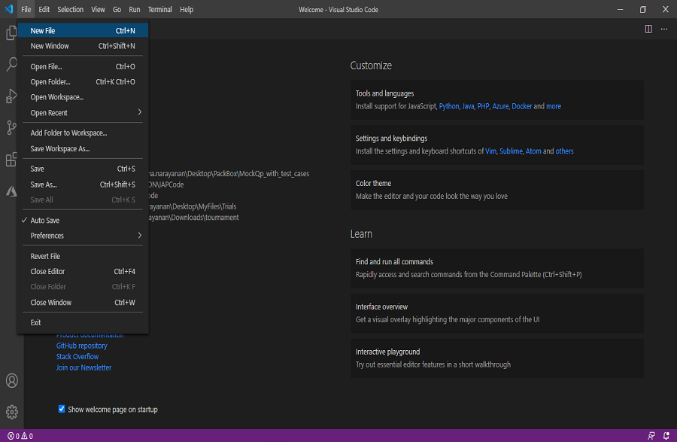
Once Visual Studio Code is launched, Go to the File menu in the Menu bar, select the New File option.

Slide 20
Create the below-mentioned two files (index.js and index.html) and type the below-given code.
index.js file:
console.log("This content is from external JavaScript file");
index.html
<html>
<head>
<title>JavaScript Intoduction</title>
<script>
console.log("This content is from script tag within <head> tag");
</script>
</head>
<script src="index.js"></script>
<body>
</body>
</html>

Slide 21
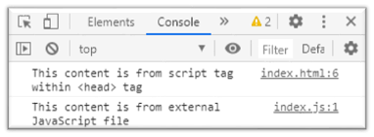
Rendering of index.html file will execute the JavaScript code written within the file and also the code in index.js which is included in index.html.
Output:
For the output, copy the index.html file path into the browser. Go to the developer tool in the browser, there in the console option, the output is as shown below:
In the above example, to render the HTML file, the path of the HTML file is copied into the browser. But in this case, each time any changes are done in the code the page must be refreshed for the changes to reflect.
There is a solution to this in the Visual Studio Code. It provides an option to add extensions to render the code in a server.

Slide 22
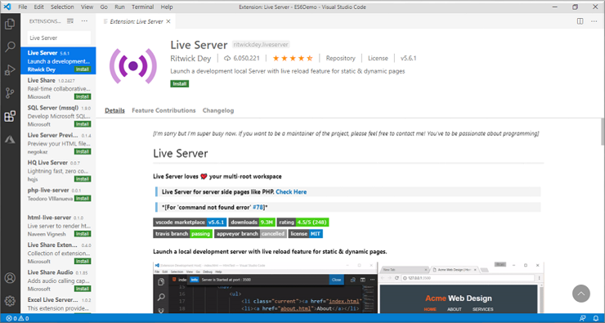
Need for Live Server:
Visual Studio Code provides an extension called Live Server using which HTML page can be rendered and any changes that developers make further will be automatically detected and rendered properly.
Adding Live Server:
1. Go to the extension tab in Visual Studio Code and search for Live Server and click on the install button that is visible in.

Slide 23
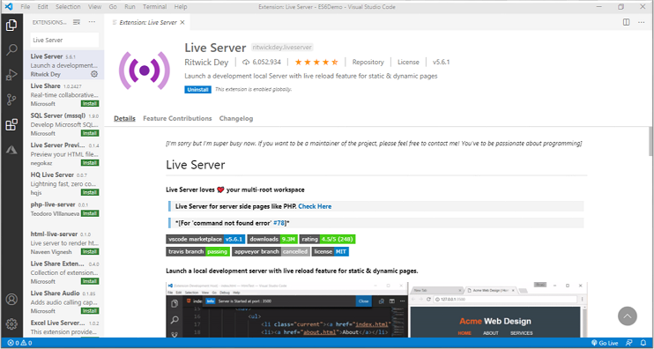
2. Once it gets installed,there will be a screen with an uninstall button option as shown below and the Live Server is ready to render the HTML pages.

Slide 24
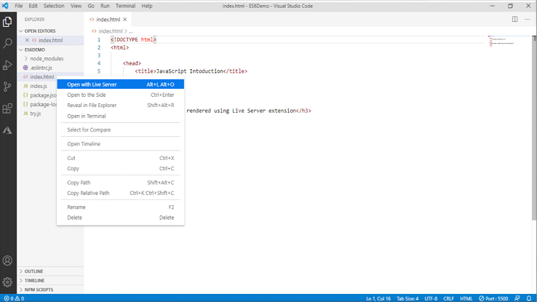
3. To render an HTML page, right-click on the intended HTML page in the Explore tab and select the ‘Open with Live Server’ option.

Slide 25
Working with Identifiers
To model the real-world entities,they have to be named to use it in the JavaScript program.
Identifiers are those names that help in naming the elements in JavaScript.
Example:
firstName;
placeOfVisit;
Identifiers should follow below rules:
The first character of an identifier should be letters of the alphabet or an underscore (_) or dollar sign ($).
Subsequent characters can be letters of alphabets or digits or underscores (_) or a dollar sign ($).
Identifiers are case-sensitive. Hence, firstName and FirstName are not the same.
Reserved keywords are part of programming language syntax and cannot be used as identifiers.

Slide 26
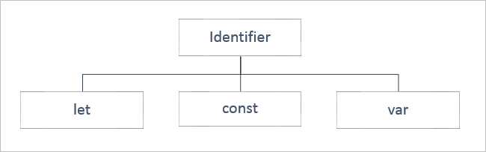
Type of Identifiers
The identifiers in JavaScript can be categorized into three as shown below. They can be declared into specific type based on:
The data which an identifier will hold and
The scope of the identifier

Slide 27
An identifier declared using ‘let’ keyword has a block scope i.e., it is available only within the block in which it is defined.
The value assigned to the identifier can be done either at the time of declaration or later in the code and can also be altered further.
All the identifiers known so far vary in their scope and with respect to the data it holds.
Example:
let name="William";
console.log("Welcome to JS course, Mr."+name);
let name = "Goth"; /* This will throw an error because the identifier 'name' has been already declared and we are redeclaring the variable, which is not allowed using the 'let' keyword. */
console.log("Welcome to JS course, Mr."+name);
Note: As a best practice, use the let keyword for identifier declarations that will change their value over time or when the variable need not be accessed outside the code block. For example, in loops, looping variables can be declared using let as they are never used outside the block.

Slide 28
The identifier to hold data that does not vary is called 'Constant' and to declare a constant, 'const' keyword is used, followed by an identifier. The value is initialized during the declaration itself and cannot be altered later.
The identifiers declared using 'const' keyword have block scope i.e., they exist only in the block of code within which they are defined.
Example:
const pi = 3.14;
console.log("The value of Pi is: "+pi);
pi = 3.141592; /* This will throw an error because the assignment to a const needs to be done at the time of declaration and it cannot be re-initialized. */
console.log("The value of Pi is: "+pi);
Note: As a best practice, the const declaration can be used for string type identifiers or simple number, functions or classes which does not need to be changed or value

Slide 29
For example, if A4 size paper is referred, then the dimension of the paper remains the same, but its colour can vary.
The identifiers declared to hold data that vary are called 'Variables' and to declare a variable, the 'var' keyword is optionally used.
The value for the same can be initialized optionally. Once the value is initialized, it can be modified any number of times later in the program.
Talking about the scope of the identifier declared using ‘var’ keyword, it takes the Function scope i.e., it is globally available to the Function within which it has been declared and it is possible to declare the identifier name a second time in the same function.
Example:
var name = "William";
console.log("Welcome to JS course, Mr." + name);
var name = "Goth"; /* Here, even though we have redeclared the same identifier, it will not throw any error.*/
console.log("Welcome to JS course, Mr." + name);

Slide 30
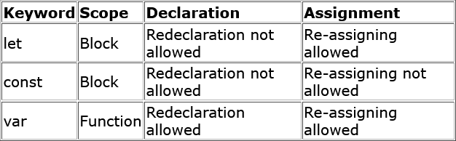
Below table shows the difference between let, const and var.

Slide 31
Tryout : Identifiers
Problem Statement:
Observe the output to see the declaration of different identifiers i.e. var, let, and const.
Activity:
Create two more variables named celsiusScale using let and NORMAL_FAHREN using const for storing the normal temperature and calculated temperature in celsius.
Note: You can execute this tryout in your Visual Studio Code IDE or any other editor in case of any issue in executing/viewing response in the below- given pane.

Slide 32
HTML
<!DOCTYPE html>
<html>
<head>
<title>Identifier Demo</title>
<style>
body {
padding-top: 10px;
}
</style>
</head>
<body class="container-fluid">
<div class="panel panel-primary">
<div class="panel-heading">
<h3>Body Temperature</h3>
</div>

Slide 33
<div class="panel-body">
<script>
var tempFahrenheit = 99;
let TempFahrenheit = 99;
// let TempFahrenheit=99; Redeclaration is not allowed
const TEMP_CELSIUS = 38;
// document.write() is used to write content onto the HTML page
document.write("Default temperature (var) is: " + tempFahrenheit + "</span>");
document.write("<br/>");
document.write("Default temperature (let) is: " + TempFahrenheit + "</span>");
document.write("<br/>");
document.write("Normal body temperature in Celsius is: " + TEMP_CELSIUS + "</span>");
</script>
</div>
</div>
</body>
</html>

Slide 34
CSS
body{
padding-top: 10px;
}
JavaScriprt
var tempFahrenheit=99;
let TempFahrenheit=99;
//let TempFahrenheit=99; Redeclaration is not allowed
const TEMP_CELSIUS = 38;
// document.write() is used to write content onto the HTML page
document.write("Default temperature (var) is: <span class=\"blinking\">"+tempFahrenheit+"</span>");
document.write("<br/>");
document.write("Default temperature (let) is: <span class=\"blinking\">"+TempFahrenheit+"</span>");
document.write("<br/>");
document.write("Normal body temperature in Celsius is: <span class=\"blinking\">" + TEMP_CELSIUS + "</span>");

Slide 35
Working with Data Types
To be able to proceed with the manipulation of the data assigned to the variables, it is mandatory for a programming language to know the type of value or the type of data that the variable holds.
That is because the operations or manipulations that must be applied on a variable will be specific to the type of data that a variable will hold.
For example, the result of add operation on two variables will vary based on the fact whether the value of both the variables is numeric or textual.
To handle such situation, data types are used.
Data type mentions the type of value assigned to a variable.
In JavaScript, the type is not defined during variable declaration. Instead, it is determined at run-time based on the value it is initialized with.
Hence, JavaScript language is a loosely typed or dynamically typed language.
Example:

Slide 36
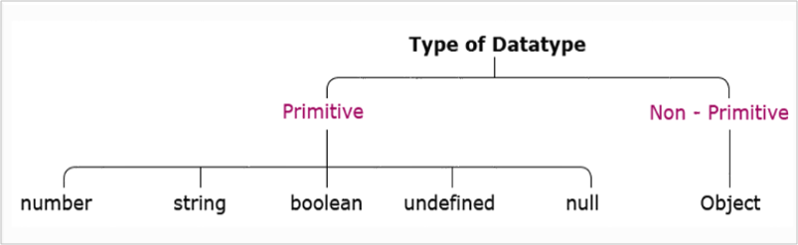
let age = 24; //number
let name = “Tom” //string
let qualified = true; //boolean
Also, there can be same variable of different types in JavaScript code based on the value that is assigned to it.
For example, if let age = 24, the variable 'age' is of type number. But if, let age = "Twenty-Four", variable 'age' is of type string.
JavaScript defines the following data types:
Next, let us understand each data type in detail.

Slide 37
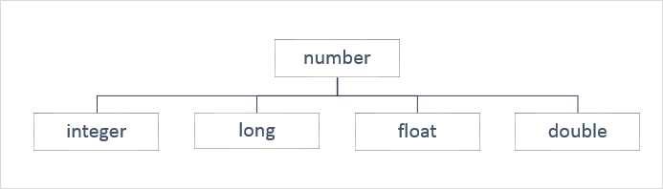
Primitive Data Types
The data is said to be primitive if it contains an individual value.
Let us explore each of the primitive data types individually.
Number
To store a variable that holds a numeric value, the primitive data type number is used. In almost all the programming languages a number data type gets classified as shown below:

Slide 38
But in JavaScript. the data type number is assigned to the values of type integer, long, float, and double. For example, the variable with number data type can hold values such as 300, 20.50, 10001, and 13456.89.
Constant of type number can be declared like this:
Example:
const pi = 3.14; // its value is 3.14
const smallestNaturalNumber = 0; // its value is 0
In JavaScript, any other value that does not belong to the above-mentioned types is not considered as a legal number. Such values are represented as NaN (Not-a-Number).
Example:
let result = 0/0; // its value is NaN
let result = "Ten" * 5; //its value is NaN

Slide 39
String
When a variable is used to store textual value, a primitive data type string is used. Thus, the string represents textual values. String values are written in quotes, either single or double.
Example:
let personName= “Rexha”; //OR
let personName = ‘Rexha’; // both will have its value as Rexha
You can use quotes inside a string but that shouldn't match the quotes surrounding the string. Strings containing single quotes must be enclosed within double quotes and vice versa.
Example:
let ownership= "Rexha's"; //OR
let ownership = 'Rexha"s';

Slide 40
This will be interpreted as Rexha's and Rexha"s respectively. Thus, use opposite quotes inside and outside of JavaScript single and double quotes.
But if you use the same quotes inside a string and to enclose the string:
Example:
let ownership= "Rexha"s"; //OR
let ownership = 'Rexha's';
It is a syntax error.
Thus, remember, strings containing single quotes must be enlosed within double quotes and strings containing double quotes must be enclosed within single quotes.
To access any character within the string, it is important to be aware of its position in the string.
The first character exists at index 0, next at index 1, and so on.

Slide 41
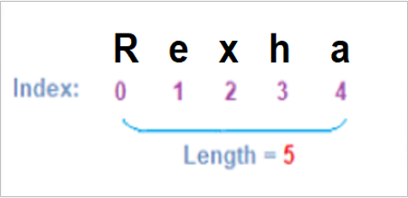
Literals
Literals can span multiple lines and interpolate expressions to include their results.
Example:
let firstName="Kevin";
let lastName="Patrick";
console.log("Name: "+firstName+" "+lastName+"\n Email:"+firstName+"_"+lastName+"@abc.com");
/*
OUTPUT:
Name: Kevin Patrick
Email:Kevin_Patrick@abc.com
*/

Slide 42
Here, '+' is used for concatenation of identifiers and static content, and '\n' for a new line.
To get the same output, literals can be used as shown below:
let firstName="Kevin";
let lastName="Patrick";
console.log(`Name:${firstName} ${lastName}
Email: ${firstName}_${lastName}@abc.com`);
/*
OUTPUT:
Name: Kevin Patrick
Email:Kevin_Patrick@abc.com
*/
Using template literal, multiple lines can be written in the console.log() in one go.
So, the template literal notation enclosed in ``(backticks) makes it convenient to have multiline statements with expressions and the variables are accessed using ${} notation.

Slide 43
Boolean
When a variable is used to store a logical value that can always be true or false then, primitive data type Boolean is used. Thus, Boolean is a data type which represents only two values: true and false.
Values such as 100, -5, “Cat”, 10<20, 1, 10*20+30, etc. evaluates to true whereas 0, “”, NaN, undefined, null, etc. evaluates to false.
Undefined
When the variable is used to store "no value", primitive data type undefined is used.
Any variable that has not been assigned a value has the value undefined and such variable is of type undefined. The undefined value represents "no value".
Example 1:
let custName; //here value and the data type are undefined
The JavaScript variable can be made empty by assigning the value undefined.
Example 2:

Slide 44
let custName = "John"; //here value is John and the data type is String
custName = undefined; //here value and the data type are undefined
null
The null value represents "no object".
Null data type is required as JavaScript variable intended to be assigned with the object at a later point in the program can be assigned null during the declaration.
Example 1:
let item = null;
// variable item is intended to be assigned with object later. Hence null is assigned during variable declaration.
If required, the JavaScript variable can also be checked if it is pointing to a valid object or null.
Example 2:
document.write(item==null);

Slide 45
BigInt is a special numeric type that provides support for integers of random length.
A BigInt is generated by appending n to the end of an integer literal or by calling the function BigInt that generates BigInt from strings, numbers, etc.
Example:
const bigintvar = 67423478234689887894747472389477823647n;
OR
const bigintvar = BigInt("67423478234689887894747472389477823647");
const bigintFromNumber = BigInt(10); // same as 10n
common math operations can be done on BigInt as regular numbers. But BigInt and regular numbers cannot be mixed in the expression.
Example:
alert(3n + 2n); // 5
alert(7n / 2n); // 3
alert(8n + 2); // Error: Cannot mix BigInt and other types

Slide 46
Here the division returns the result rounded towards zero, without the decimal part. Thus, all operations on BigInt return BigInt.
BigInt and regular numbers must be explicitly converted using either BigInt() or Number(), as shown below:
Example:
let bigintvar = 6n;
let numvar = 3;
// number to bigint
alert(bigintvar + BigInt(numvar)); // 9
// bigint to number
alert(Number(bigintvar ) + numvar); // 9
In the above example, if the bigintvar is too large that it won’t fit the number type, then extra bits will be cut off.

Slide 47
Talking about comparison and boolean operations on BigInt, it works fine.
Example:
alert( 8n > 2n ); // true
alert( 4n > 2 ); // true
Even though numbers and BigInts belong to different types, they can be equal ==, but not strictly equal ===.
Example:
alert( 5 == 5n ); // true
alert( 5 === 5n ); // false
When inside if or other boolean operations, BigInts behave like numbers.
Example:
if (0n) {
// never executes
}

Slide 48
BigInt 0n is falsy, other values are considered to be truthy.
Boolean operators, such as ||, && and others also work perfectly with Bigints similar to numbers.
Example:
alert( 1n || 2 );
// 1, here 1n is considered truthy
alert( 0n || 2 );
// 2, here 0n is considered falsy

Slide 49
Non-Primitive Data Types
The data type is said to be non-primitive if it is a collection of multiple values.
The variables in JavaScript may not always hold only individual values which are with one of the primitive data types.
There are times a group of values are stored inside a variable.
JavaScript gives non-primitive data types named Object and Array, to implement this.
Objects
Objects in JavaScript are a collection of properties and are represented in the form of [key-value pairs].
The 'key' of a property is a string or a symbol and should be a legal identifier.
The 'value' of a property can be any JavaScript value like Number, String, Boolean, or another object.
JavaScript provides the number of built-in objects as a part of the language and user-defined JavaScript objects can be created using object literals
Syntax:
{
key1 : value1,
key2 : value2,
key3 : value3
};

Slide 50
Example:
let mySmartPhone = {
name: "iPhone",
brand: "Apple",
platform: "iOS",
price: 50000
};
Array
The Array is a special data structure that is used to store an ordered collection, which cannot be achieved using the objects.
There are two ways of creating an array:
let dummyArr = new Array();
//OR
let dummyArr = [];

Slide 51
Either array can be declared as empty and can be assigned with value later, or can have the value assigned during the declaration.
Example:
digits =[1,2,3,"four"];
A single array can hold multiple values of different data types.

Slide 52
Tryout : Data Types
Problem Statement:
Observe what happens when the variable is declared and different type of values are stored. Also, observe the ouput for the below code.
Activity:
Create two different variables to store FirstName and LastName and then display the entire details of the Employee using template literal.

Slide 53
HTML
<!DOCTYPE html>
<html>
<head>
<title>Datatypes Demo</title>
<style>
body {
padding-top: 10px;
}
</style>
</head>
<body class="container-fluid">
<div class="panel panel-primary">
<div class="panel-heading">
<h3>Boolean Values</h3>
</div>

Slide 54
<div class="panel-body">
<script>
let empName = "Philip Jackson",
empAge = 26,
isConfirmed = 0,
bonous = undefined,
designation = "System Engineer",
promotions = null;
document.write("<b> Primitives and Non-Primitive Data types </b> <br /><br>");
document.write("Employee Details: <br/>");
document.write("<br/>Employee Name:"+empName);
</script>
</div>
</div>
</body>
</html>

Slide 55
CSS
body {
padding-top: 10px;
}
JavaScript
let empName = "Philip Jackson",
empAge = 26,
isConfirmed = 0,
bonous = undefined,
designation = "System Engineer",
promotions = null;
document.write("<b> Primitives and Non-Primitive Data types </b> <br /><br>");
document.write("Employee Details: <br/>");
document.write("<br/>Employee Name:"+empName);

Slide 56
Working With Operators

