Slide 1
JavaScript

Slide 2
About JavaScript
JavaScript was introduced as a full-fledged client-side language used for developing web applications in 1995. JavaScript is easy to learn, debug, and test. It is an event-based, platform-independent, and an interpreted language with all the procedural programming capabilities.
Web applications that were developed using server-side programming languages like Java and Dot Net involved travel of user requests all the way from the client(browser) to the server hosting the application. The multiple request-response cycles between client and server who were consuming both time and network bandwidth.
JavaScript got introduced as a Client-Side programming language with the capability of executing user requests on the Client-Side. This could help in reducing the number of request-response cycles between client and server and decrease the network bandwidth thus reducing the overall response time.
Later, in 1997 ECMAScript established a standard for the scripting languages that redefined the core features any scripting language should have and how to implement those features. From then, JavaScript evolved year after year with every new version of ECMAScript introducing new features. Developers prefer JavaScript to create dynamic, interactive, and scalable web applications as it helps developers in extending the functionalities of the web pages effectively.

Slide 3

This course will enable you to understand the features of ECMA and help to develop more robust web applications using JavaScript and handle user requests on the Client-Side.
Target audience: Developers
Why we need JavaScript?
When an application is loaded on the browser, there is a 'SignUp' link on the top right corner.

Slide 4
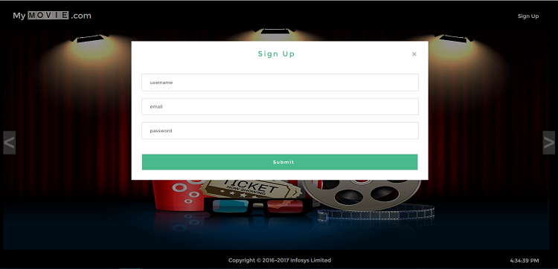
When this link is clicked, the 'SignUp' form is displayed. It contains three fields - 'Username', 'Email', and 'Password' and in some cases a 'Submit' button as well.
When data is entered in the fields and the button is clicked, then data entered in the fields will be validated and accordingly,next view page loaded. If data is invalid, an error message is displayed, if valid, the application navigates to homepage

Slide 5
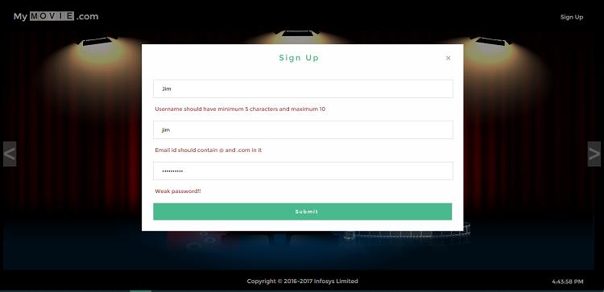
How to handle the user click, validate the user data, and display the corresponding view?
To implement the requirement of handling user action like a click of a button or link and to respond to these requests by displaying the expected output, server-side languages like Java/JSP can be used as shown in the below diagram.

Slide 6
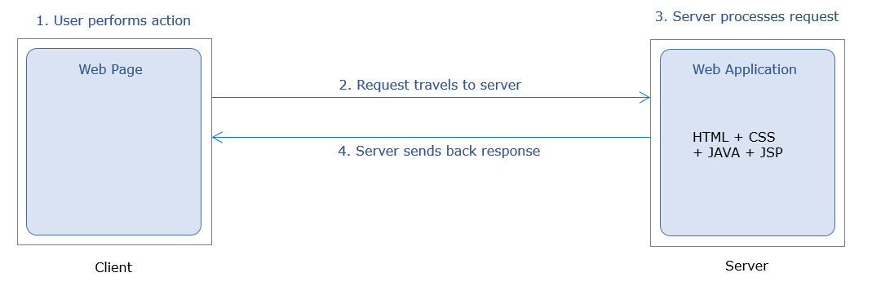
But server-side languages have certain limitations such as :-
Multiple request-response cycles to handle multiple user requests
More network bandwidth consumption
Increased response time
If client-side scripting language JavaScript is used then, this can be done without consulting the server as can be seen in the below diagram.

Slide 7
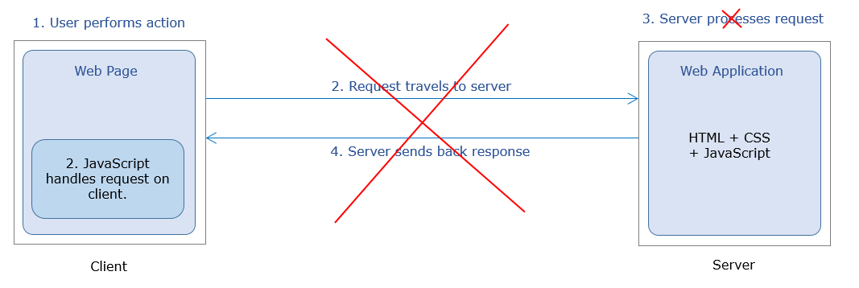
The home page of MyMovie.com contains the SignUp link. The user performs click action on this link. The user action is handled on the client side itself with the help of the JavaScript code. This code arrives on the client along with the home page of the application.
When invoked on click of the link, this code executes on the client-side itself to validate the user-entered data and accordingly display the corresponding view.

Slide 8
Following are the advantages of this approach:
No need for back and forth request-response cycles
Less network bandwidth consumption
In comparison to Java: JavaScript provides a 35% decrease in average response time and Pages being served 200ms faster.
About ES6:
JavaScript was introduced as a client-side scripting language in 1995.
ECMAScript established a standard for scripting languages in 1997.
ES is a parent of many scripting languages like TypeScript, JScript, ActionScript, and JavaScript.
JavaScript evolved year after year with every new version of ECMAScript introducing new features.
ES6 also called ES2015.
ES6 introduces new transformed syntax to extend existing JavaScript constructs to meet the demands of complex applications written in JavaScript.

Slide 9


What is JavaScript?
JavaScript is the programming language for web users to convert static web pages to dynamic web pages.
Web page designed using HTML and CSS is static.
JavaScript combined with HTML and CSS makes it dynamic.

Slide 10
None of the IE browsers significantly support the latest features (the new Microsoft Edge browser does)
So, to overcome these drawbacks, the conversion of JavaScript code written using the latest syntax to browser understandable code takes place using the transpilers such as Babel, Traceur, TypeScript, etc.
Thus, after the code is transpiled,it will be cross-browser compatible.
JavaScript code can be embedded within the HTML page or can be written in an external file.
There are three ways of writting JavaScript depending on the platform :
Inline Scripting
Internal Scripting
External Scripting

Slide 11
When JavaScript code are written within the HTML file itself, it is called internal scripting.
Internal scripting, is done with the help of HTML tag : <script> </script>
This tag can be placed either in the head tag or body tag within the HTML file.
JavaScript code written inside <head> element is as shown below :
<html>
<head>
<script>
//internal script
</script>
</head>
<body>
</body>
</html>

Slide 12
JavaScript code written inside <body> element is as shown below :
<html>
<head>
</head>
<body>
<script>
//inline script
</script>
</body>
</html>
JavaScript code can be written in an external file also. The file containing JavaScript code is saved with the extension *.js (e.g. fileName.js)
To include the external JavaScript file, the script tag is used with attribute 'src' as shown in the below-given code-snippet:

Slide 13
<html>
<head>
<!-- *.js file contain the JavaScript code -->
<script src="*.js"></script>
</head>
<body>
</body>
</html>
Example:
Demo.js :-
let firstName="Rexha";
let lastName ="Bebe";
console.log(firstName+" "+lastName);

Slide 14
Demo.html :-
<html>
<head>
<script src="Demo.js"></script>
</head>
<body>
</body>
</html>
NOTE: In external file, JavaScript code is not written inside <script> </script> tag.
The below-mentioned points can help you choose between any two ways of writing the script based on some parameters.

Slide 15
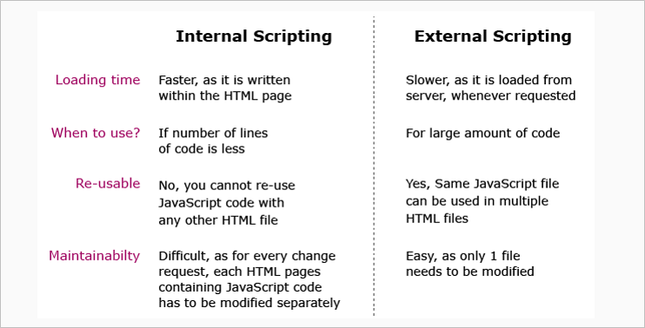
Note: External scripting is used throughout this course. But due to the platform built-in feature,HTML code cannot be explicitly linked to external script using <script></script> tag. HTML code that are used to write is automatically linked to JavaScript code written on that page.

Slide 16
Summary : Getting started with JavaScript
In this module, you have learnt about:
The need for JavaScript as a scripting language
What JavaScript is
Different ways to write JavaScript code

Slide 17
Environment Setup: Internal
To work with JavaScript, you can use
Editor (Visual Studio Code IDE recommended)
Browser (Google Chrome recommended)
As JavaScript works properly on any Browser or OS, you can choose any of them based on your preference.
It is also possible to write JavaScript code using Editors. You can use simple editors such as notepad or go for an IDE like Visual Studio Code which offers IntelliSense support and syntax error highlighter that makes coding easier.
To reduce development time,IDE can be used as it has built-in features.
In Visual Studio Code, extensions can be added that will speed up development and helps code to a higher standard by providing linting.

Slide 18
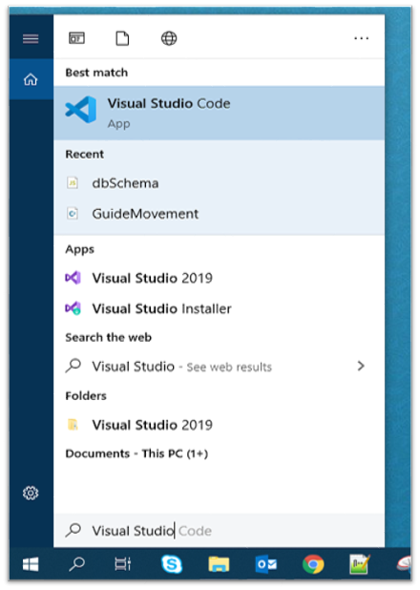
Steps to execute JavaScript code:
Open Visual Studio Code from your start menu.

Slide 19
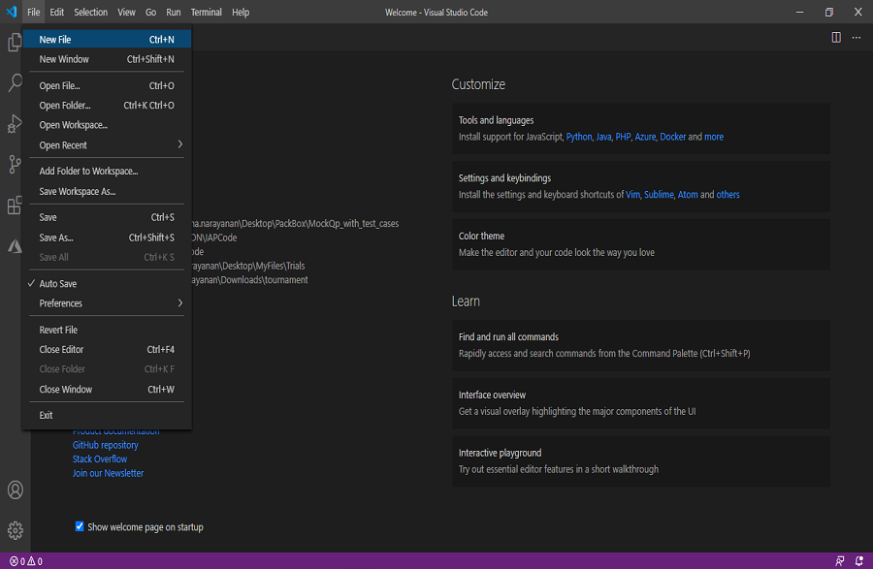
Once Visual Studio Code is launched, Go to the File menu in the Menu bar, select the New File option.

Slide 20
Create the below-mentioned two files (index.js and index.html) and type the below-given code.
index.js file:
console.log("This content is from external JavaScript file");
index.html
<html>
<head>
<title>JavaScript Intoduction</title>
<script>
console.log("This content is from script tag within <head> tag");
</script>
</head>
<script src="index.js"></script>
<body>
</body>
</html>

Slide 21
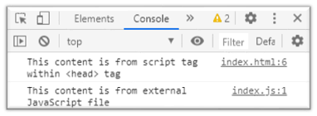
Rendering of index.html file will execute the JavaScript code written within the file and also the code in index.js which is included in index.html.
Output:
For the output, copy the index.html file path into the browser. Go to the developer tool in the browser, there in the console option, the output is as shown below:
In the above example, to render the HTML file, the path of the HTML file is copied into the browser. But in this case, each time any changes are done in the code the page must be refreshed for the changes to reflect.
There is a solution to this in the Visual Studio Code. It provides an option to add extensions to render the code in a server.

Slide 22
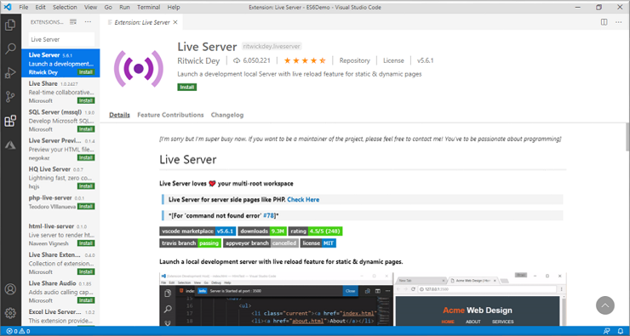
Need for Live Server:
Visual Studio Code provides an extension called Live Server using which HTML page can be rendered and any changes that developers make further will be automatically detected and rendered properly.
Adding Live Server:
1. Go to the extension tab in Visual Studio Code and search for Live Server and click on the install button that is visible in.

Slide 23
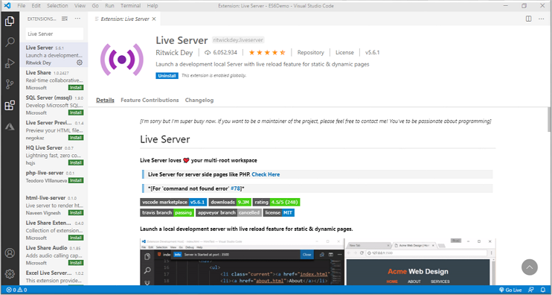
2. Once it gets installed,there will be a screen with an uninstall button option as shown below and the Live Server is ready to render the HTML pages.

Slide 24
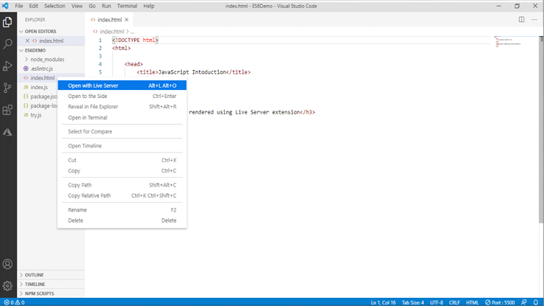
3. To render an HTML page, right-click on the intended HTML page in the Explore tab and select the ‘Open with Live Server’ option.

Slide 25
Working with Identifiers
To model the real-world entities,they have to be named to use it in the JavaScript program.
Identifiers are those names that help in naming the elements in JavaScript.
Example:
firstName;
placeOfVisit;
Identifiers should follow below rules:
The first character of an identifier should be letters of the alphabet or an underscore (_) or dollar sign ($).
Subsequent characters can be letters of alphabets or digits or underscores (_) or a dollar sign ($).
Identifiers are case-sensitive. Hence, firstName and FirstName are not the same.
Reserved keywords are part of programming language syntax and cannot be used as identifiers.

Slide 26
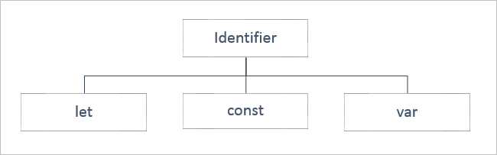
Type of Identifiers
The identifiers in JavaScript can be categorized into three as shown below. They can be declared into specific type based on:
The data which an identifier will hold and
The scope of the identifier

Slide 27
An identifier declared using ‘let’ keyword has a block scope i.e., it is available only within the block in which it is defined.
The value assigned to the identifier can be done either at the time of declaration or later in the code and can also be altered further.
All the identifiers known so far vary in their scope and with respect to the data it holds.
Example:
let name="William";
console.log("Welcome to JS course, Mr."+name);
let name = "Goth"; /* This will throw an error because the identifier 'name' has been already declared and we are redeclaring the variable, which is not allowed using the 'let' keyword. */
console.log("Welcome to JS course, Mr."+name);
Note: As a best practice, use the let keyword for identifier declarations that will change their value over time or when the variable need not be accessed outside the code block. For example, in loops, looping variables can be declared using let as they are never used outside the block.

Slide 28
The identifier to hold data that does not vary is called 'Constant' and to declare a constant, 'const' keyword is used, followed by an identifier. The value is initialized during the declaration itself and cannot be altered later.
The identifiers declared using 'const' keyword have block scope i.e., they exist only in the block of code within which they are defined.
Example:
const pi = 3.14;
console.log("The value of Pi is: "+pi);
pi = 3.141592; /* This will throw an error because the assignment to a const needs to be done at the time of declaration and it cannot be re-initialized. */
console.log("The value of Pi is: "+pi);
Note: As a best practice, the const declaration can be used for string type identifiers or simple number, functions or classes which does not need to be changed or value

Slide 29
For example, if A4 size paper is referred, then the dimension of the paper remains the same, but its colour can vary.
The identifiers declared to hold data that vary are called 'Variables' and to declare a variable, the 'var' keyword is optionally used.
The value for the same can be initialized optionally. Once the value is initialized, it can be modified any number of times later in the program.
Talking about the scope of the identifier declared using ‘var’ keyword, it takes the Function scope i.e., it is globally available to the Function within which it has been declared and it is possible to declare the identifier name a second time in the same function.
Example:
var name = "William";
console.log("Welcome to JS course, Mr." + name);
var name = "Goth"; /* Here, even though we have redeclared the same identifier, it will not throw any error.*/
console.log("Welcome to JS course, Mr." + name);

Slide 30
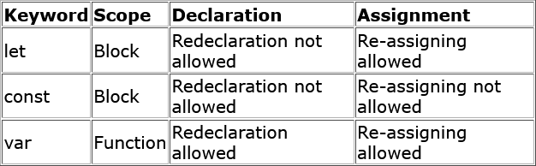
Below table shows the difference between let, const and var.

Slide 31
Tryout : Identifiers
Problem Statement:
Observe the output to see the declaration of different identifiers i.e. var, let, and const.
Activity:
Create two more variables named celsiusScale using let and NORMAL_FAHREN using const for storing the normal temperature and calculated temperature in celsius.
Note: You can execute this tryout in your Visual Studio Code IDE or any other editor in case of any issue in executing/viewing response in the below- given pane.

Slide 32
HTML
<!DOCTYPE html>
<html>
<head>
<title>Identifier Demo</title>
<style>
body {
padding-top: 10px;
}
</style>
</head>
<body class="container-fluid">
<div class="panel panel-primary">
<div class="panel-heading">
<h3>Body Temperature</h3>
</div>

Slide 33
<div class="panel-body">
<script>
var tempFahrenheit = 99;
let TempFahrenheit = 99;
// let TempFahrenheit=99; Redeclaration is not allowed
const TEMP_CELSIUS = 38;
// document.write() is used to write content onto the HTML page
document.write("Default temperature (var) is: " + tempFahrenheit + "</span>");
document.write("<br/>");
document.write("Default temperature (let) is: " + TempFahrenheit + "</span>");
document.write("<br/>");
document.write("Normal body temperature in Celsius is: " + TEMP_CELSIUS + "</span>");
</script>
</div>
</div>
</body>
</html>

Slide 34
CSS
body{
padding-top: 10px;
}
JavaScriprt
var tempFahrenheit=99;
let TempFahrenheit=99;
//let TempFahrenheit=99; Redeclaration is not allowed
const TEMP_CELSIUS = 38;
// document.write() is used to write content onto the HTML page
document.write("Default temperature (var) is: <span class=\"blinking\">"+tempFahrenheit+"</span>");
document.write("<br/>");
document.write("Default temperature (let) is: <span class=\"blinking\">"+TempFahrenheit+"</span>");
document.write("<br/>");
document.write("Normal body temperature in Celsius is: <span class=\"blinking\">" + TEMP_CELSIUS + "</span>");

Slide 35
Working with Data Types
To be able to proceed with the manipulation of the data assigned to the variables, it is mandatory for a programming language to know the type of value or the type of data that the variable holds.
That is because the operations or manipulations that must be applied on a variable will be specific to the type of data that a variable will hold.
For example, the result of add operation on two variables will vary based on the fact whether the value of both the variables is numeric or textual.
To handle such situation, data types are used.
Data type mentions the type of value assigned to a variable.
In JavaScript, the type is not defined during variable declaration. Instead, it is determined at run-time based on the value it is initialized with.
Hence, JavaScript language is a loosely typed or dynamically typed language.
Example:

Slide 36
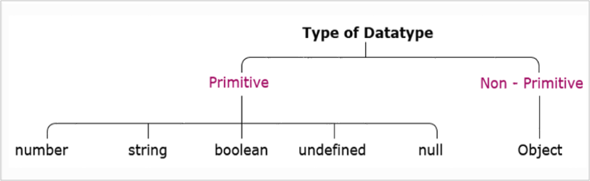
let age = 24; //number
let name = “Tom” //string
let qualified = true; //boolean
Also, there can be same variable of different types in JavaScript code based on the value that is assigned to it.
For example, if let age = 24, the variable 'age' is of type number. But if, let age = "Twenty-Four", variable 'age' is of type string.
JavaScript defines the following data types:
Next, let us understand each data type in detail.

Slide 37
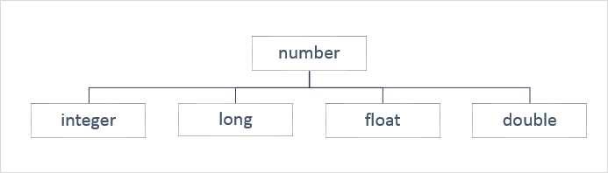
Primitive Data Types
The data is said to be primitive if it contains an individual value.
Let us explore each of the primitive data types individually.
Number
To store a variable that holds a numeric value, the primitive data type number is used. In almost all the programming languages a number data type gets classified as shown below:

Slide 38
But in JavaScript. the data type number is assigned to the values of type integer, long, float, and double. For example, the variable with number data type can hold values such as 300, 20.50, 10001, and 13456.89.
Constant of type number can be declared like this:
Example:
const pi = 3.14; // its value is 3.14
const smallestNaturalNumber = 0; // its value is 0
In JavaScript, any other value that does not belong to the above-mentioned types is not considered as a legal number. Such values are represented as NaN (Not-a-Number).
Example:
let result = 0/0; // its value is NaN
let result = "Ten" * 5; //its value is NaN

Slide 39
String
When a variable is used to store textual value, a primitive data type string is used. Thus, the string represents textual values. String values are written in quotes, either single or double.
Example:
let personName= “Rexha”; //OR
let personName = ‘Rexha’; // both will have its value as Rexha
You can use quotes inside a string but that shouldn't match the quotes surrounding the string. Strings containing single quotes must be enclosed within double quotes and vice versa.
Example:
let ownership= "Rexha's"; //OR
let ownership = 'Rexha"s';

Slide 40
This will be interpreted as Rexha's and Rexha"s respectively. Thus, use opposite quotes inside and outside of JavaScript single and double quotes.
But if you use the same quotes inside a string and to enclose the string:
Example:
let ownership= "Rexha"s"; //OR
let ownership = 'Rexha's';
It is a syntax error.
Thus, remember, strings containing single quotes must be enlosed within double quotes and strings containing double quotes must be enclosed within single quotes.
To access any character within the string, it is important to be aware of its position in the string.
The first character exists at index 0, next at index 1, and so on.

Slide 41
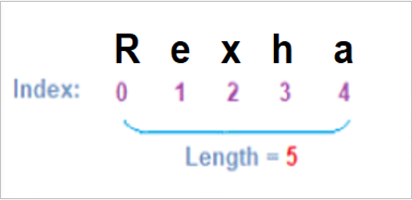
Literals
Literals can span multiple lines and interpolate expressions to include their results.
Example:
let firstName="Kevin";
let lastName="Patrick";
console.log("Name: "+firstName+" "+lastName+"\n Email:"+firstName+"_"+lastName+"@abc.com");
/*
OUTPUT:
Name: Kevin Patrick
Email:Kevin_Patrick@abc.com
*/

Slide 42
Here, '+' is used for concatenation of identifiers and static content, and '\n' for a new line.
To get the same output, literals can be used as shown below:
let firstName="Kevin";
let lastName="Patrick";
console.log(`Name:${firstName} ${lastName}
Email: ${firstName}_${lastName}@abc.com`);
/*
OUTPUT:
Name: Kevin Patrick
Email:Kevin_Patrick@abc.com
*/
Using template literal, multiple lines can be written in the console.log() in one go.
So, the template literal notation enclosed in ``(backticks) makes it convenient to have multiline statements with expressions and the variables are accessed using ${} notation.

Slide 43
Boolean
When a variable is used to store a logical value that can always be true or false then, primitive data type Boolean is used. Thus, Boolean is a data type which represents only two values: true and false.
Values such as 100, -5, “Cat”, 10<20, 1, 10*20+30, etc. evaluates to true whereas 0, “”, NaN, undefined, null, etc. evaluates to false.
Undefined
When the variable is used to store "no value", primitive data type undefined is used.
Any variable that has not been assigned a value has the value undefined and such variable is of type undefined. The undefined value represents "no value".
Example 1:
let custName; //here value and the data type are undefined
The JavaScript variable can be made empty by assigning the value undefined.
Example 2:

Slide 44
let custName = "John"; //here value is John and the data type is String
custName = undefined; //here value and the data type are undefined
null
The null value represents "no object".
Null data type is required as JavaScript variable intended to be assigned with the object at a later point in the program can be assigned null during the declaration.
Example 1:
let item = null;
// variable item is intended to be assigned with object later. Hence null is assigned during variable declaration.
If required, the JavaScript variable can also be checked if it is pointing to a valid object or null.
Example 2:
document.write(item==null);

Slide 45
BigInt is a special numeric type that provides support for integers of random length.
A BigInt is generated by appending n to the end of an integer literal or by calling the function BigInt that generates BigInt from strings, numbers, etc.
Example:
const bigintvar = 67423478234689887894747472389477823647n;
OR
const bigintvar = BigInt("67423478234689887894747472389477823647");
const bigintFromNumber = BigInt(10); // same as 10n
common math operations can be done on BigInt as regular numbers. But BigInt and regular numbers cannot be mixed in the expression.
Example:
alert(3n + 2n); // 5
alert(7n / 2n); // 3
alert(8n + 2); // Error: Cannot mix BigInt and other types

Slide 46
Here the division returns the result rounded towards zero, without the decimal part. Thus, all operations on BigInt return BigInt.
BigInt and regular numbers must be explicitly converted using either BigInt() or Number(), as shown below:
Example:
let bigintvar = 6n;
let numvar = 3;
// number to bigint
alert(bigintvar + BigInt(numvar)); // 9
// bigint to number
alert(Number(bigintvar ) + numvar); // 9
In the above example, if the bigintvar is too large that it won’t fit the number type, then extra bits will be cut off.

Slide 47
Talking about comparison and boolean operations on BigInt, it works fine.
Example:
alert( 8n > 2n ); // true
alert( 4n > 2 ); // true
Even though numbers and BigInts belong to different types, they can be equal ==, but not strictly equal ===.
Example:
alert( 5 == 5n ); // true
alert( 5 === 5n ); // false
When inside if or other boolean operations, BigInts behave like numbers.
Example:
if (0n) {
// never executes
}

Slide 48
BigInt 0n is falsy, other values are considered to be truthy.
Boolean operators, such as ||, && and others also work perfectly with Bigints similar to numbers.
Example:
alert( 1n || 2 );
// 1, here 1n is considered truthy
alert( 0n || 2 );
// 2, here 0n is considered falsy

Slide 49
Non-Primitive Data Types
The data type is said to be non-primitive if it is a collection of multiple values.
The variables in JavaScript may not always hold only individual values which are with one of the primitive data types.
There are times a group of values are stored inside a variable.
JavaScript gives non-primitive data types named Object and Array, to implement this.
Objects
Objects in JavaScript are a collection of properties and are represented in the form of [key-value pairs].
The 'key' of a property is a string or a symbol and should be a legal identifier.
The 'value' of a property can be any JavaScript value like Number, String, Boolean, or another object.
JavaScript provides the number of built-in objects as a part of the language and user-defined JavaScript objects can be created using object literals
Syntax:
{
key1 : value1,
key2 : value2,
key3 : value3
};

Slide 50
Example:
let mySmartPhone = {
name: "iPhone",
brand: "Apple",
platform: "iOS",
price: 50000
};
Array
The Array is a special data structure that is used to store an ordered collection, which cannot be achieved using the objects.
There are two ways of creating an array:
let dummyArr = new Array();
//OR
let dummyArr = [];

Slide 51
Either array can be declared as empty and can be assigned with value later, or can have the value assigned during the declaration.
Example:
digits =[1,2,3,"four"];
A single array can hold multiple values of different data types.

Slide 52
Tryout : Data Types
Problem Statement:
Observe what happens when the variable is declared and different type of values are stored. Also, observe the ouput for the below code.
Activity:
Create two different variables to store FirstName and LastName and then display the entire details of the Employee using template literal.

Slide 53
HTML
<!DOCTYPE html>
<html>
<head>
<title>Datatypes Demo</title>
<style>
body {
padding-top: 10px;
}
</style>
</head>
<body class="container-fluid">
<div class="panel panel-primary">
<div class="panel-heading">
<h3>Boolean Values</h3>
</div>

Slide 54
<div class="panel-body">
<script>
let empName = "Philip Jackson",
empAge = 26,
isConfirmed = 0,
bonous = undefined,
designation = "System Engineer",
promotions = null;
document.write("<b> Primitives and Non-Primitive Data types </b> <br /><br>");
document.write("Employee Details: <br/>");
document.write("<br/>Employee Name:"+empName);
</script>
</div>
</div>
</body>
</html>

Slide 55
CSS
body {
padding-top: 10px;
}
JavaScript
let empName = "Philip Jackson",
empAge = 26,
isConfirmed = 0,
bonous = undefined,
designation = "System Engineer",
promotions = null;
document.write("<b> Primitives and Non-Primitive Data types </b> <br /><br>");
document.write("Employee Details: <br/>");
document.write("<br/>Employee Name:"+empName);

Slide 56
Working With Operators
Operators in a programming language are the symbols used to perform operations on the values.
Operands: Represents the data.
Operator: Performs certain operations on the operands.
let sum = 5 + 10;
The statement formed using the operator and the operands are called Expression.
In the above example, 5+10 is an expression.
The values are termed as operands.
The symbol ‘+’ is the operator which indicates which operation needs to be performed.

Slide 57
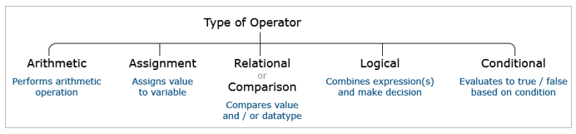
Operators and Types of Operators
Operators are categorized into unary, binary, and ternary based on the number of operands on which they operate in an expression.
JavaScript supports the following types of operators:
Arithmetic operators are used for performing arithmetic operations

Slide 58
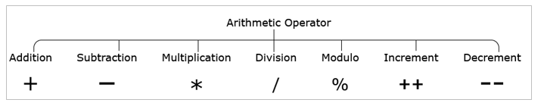
let sum = 5 + 3; // sum=8
let difference = 5 – 3; // difference=2
let product = 5 * 3; // product=15
let division = 5/3; // division=1
let mod = 5%3; // mod=2
let value = 5;
value++; // increment by 1, value=6
let value = 10;
value--; // decrement by 1, value=9

Slide 59
Arithmetic operator '+' when used with string type results in the concatenation.
let firstName = "James";
let lastName = "Roche";
let name = firstName + " " + lastName; // name = James Roche
Arithmetic operator ‘+’ when used with a string value and a numeric value, it results in a new string value.
let strValue="James";
let numValue=10;
let newStrValue= strValue + " " + numValue; // newStrValue= James 10
Assignment operators are used for assigning values to the variables.

Slide 60
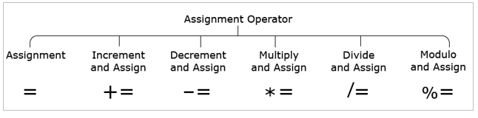
let num = 30; // num=30
let num += 10; // num=num+10 => num=40
let num -= 10; // num=num-10 => num=20
let num *= 30; // num=num*30 => num=900
let num /= 10; // num=num/10 => num=3
let num %= 10; // num=num%10 => num=0

Slide 61
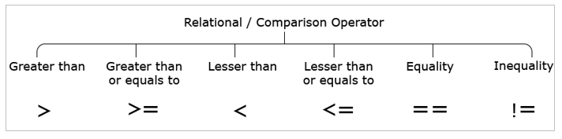
Relational operators are used for comparing values and the result of comparison is always either true or false.
Relational operators shown below do implicit data type conversion of one of the operands before comparison.
10 > 10; //false
10 >= 10; //true
10 < 10; //false
10 <= 10; //true
10 == 10; //true
10 != 10; //false

Slide 62
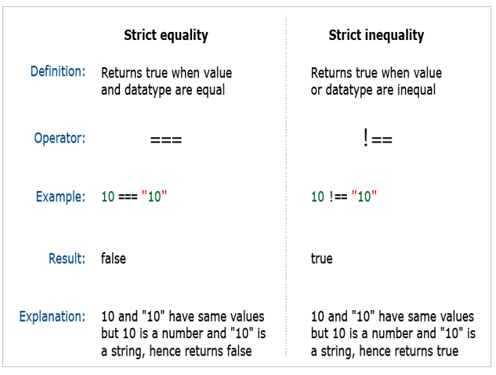
Relational operators shown below compares both the values and the value types without any implicit type conversion.

Slide 63
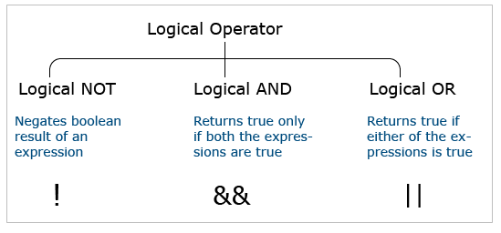
Strict equality (===) and strict inequality (!==) operators consider only values of the same type to be equal.
Hence, strict equality and strict inequality operators are highly recommended to determine whether two given values are equal or not.
Note: As a best practice, you should use === comparison operator when you want to compare value and type, and the rest of the places for value comparison == operator can be used.
Logical operators allow a program to make a decision based on multiple conditions. Each operand is considered a condition that can be evaluated to true or false.

Slide 64
!(10 > 20); //true
(10 > 5) && (20 > 20); //false
(10 > 5) || (20 > 20); //true
"typeof" is an operator in JavaScript.
JavaScript is a loosely typed language i.e., the type of variable is decided at runtime based on the data assigned to it. This is also called dynamic data binding.
As programmers, if required, the typeof operator can be used to find the data type of a JavaScript variable.
The following are the ways in which it can be used and the corresponding results that it returns.
typeof "JavaScript World" //string
typeof 10.5 // number
typeof 10 > 20 //boolean
typeof undefined //undefined
typeof null //Object
typeof {itemPrice : 500} //Object

Slide 65
Tryout : Operators
Problem Statement:
Observe the output by confirming given body temperature value in Fahrenheit is higher or lower than the normal body temperature in Fahrenheit.
Activity:
You are suggested to assign values of body temperature in Celsius and then try to convert that temperature in Fahrenheit.
HTML
<!DOCTYPE html>
<html>
<head>
<title>Operators Demo</title>
<style>
body {
padding-top: 10px;
}

Slide 66
</style>
</head>
<body class="container-fluid">
<div class="panel panel-primary">
<div class="panel-heading">
<h3>Body Temperature</h3>
</div>
<div class="panel-body">
<p>Your body temperature is higher than the normal:
<span class="blinking">
<script>
let tempFahren = 99;
const NORMAL_FAHREN = 98.6;
let tempCelsius;
const THIRTYTWO = 32;
const TEMP = 1.8;
tempCelsius = (tempFahren - THIRTYTWO) / TEMP;
let fever = tempFahren > NORMAL_FAHREN;
document.write(fever);

Slide 67
document.write("<br/>");
document.write("Your temperature is Celsius : " + tempCelsius);
document.write("<br/>");
document.write(typeof (fever));
document.write("<br/>");
document.write(typeof (tempFahren));
</script>
</span>
</p>
</div>
</div>
</body>
</html>

Slide 68
CSS
.blinking{
animation:blinkingText 1.8s infinite;
background-color: yellow;
color: red;
}
@keyframes blinkingText{
0%{ color: #000; }
49%{ color: transparent; }
50%{ color: transparent; }
99%{ color:transparent; }
100%{ color: #000; }
}

Slide 69
Working with Statements and Expressions
Statements are instructions in JavaScript that have to be executed by a web browser. JavaScript code is made up of a sequence of statements and is executed in the same order as they are written.
A Variable declaration is the simplest example of a JavaScript statement.
Syntax:
var firstName = "Newton" ;
Other types of JavaScript statements include conditions/decision making, loops, etc.
White (blank) spaces in statements are ignored.
It is optional to end each JavaScript statement with a semicolon. But it is highly recommended to use it as it avoids possible misinterpretation of the end of the statements by JavaScript engine.

Slide 70
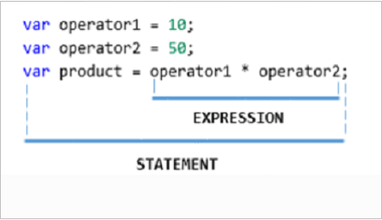
While writing client-logic in JavaScript, variables and operators are often combined to do computations. This is achieved by writing expressions.
Different types of expressions that can be written in JavaScript are:
10 + 30; //Evaluates to numeric value
"Hello" + "World"; //Evaluates to string value
itemRating > 5; //Evaluates to boolean value
(age > 60): "Senior citizen": "Normal citizen";
/* Evaluates to one string value based on whether condition is true or false.
If the condition evaluates to true then the first string value "Senior citizen" is assigned otherwise the second string value is assigned "Normal citizen" */
Example of an expression in a statement:

Slide 71
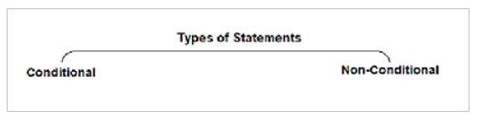
In JavaScript, the statements can be classified into two types.
Conditional Statements:
Conditional statements help you to decide based on certain conditions.
These conditions are specified by a set of conditional statements having boolean expressions that are evaluated to a boolean value true or false.
Non-Conditional Statements:
Non-Conditional statements are those statements that do not need any condition to control the program execution flow.

Slide 72
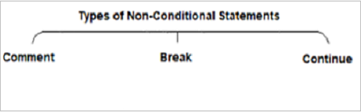
Non - Conditional Statements
Non-Conditional statements are those statements that do not need any condition to control the program execution flow.
In JavaScript, it can be broadly classified into three categories as follows:
Comments
Comments in JavaScript can be used to prevent the execution of a certain lines of code and to add information in the code that explains the significance of the line of code being written.
JavaScript supports two kinds of comments.

Slide 73
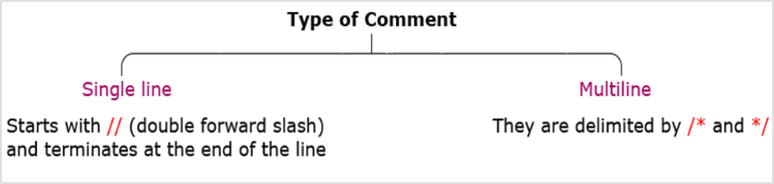
Example:
// Formula to find the area of a circle given its radius
var areaOfCircle = 2 * pi * radius;
/*Formula to find the area of a circle based on
given its radius value.
*/
var areaOfCircle = 2 * pi * radius;
Note: As a best practice, it is recommended to use comments for documentation purposes and avoid using it for code commenting.

Slide 74
While iterating over the block of code getting executed within the loop, the loop may be required to be exited if certain condition is met.
The 'break' statement is used to terminate the loop and transfer control to the first statement following the loop.
Syntax:
break;
Below example shows for loop with five iterations which increment variable "counter".
When loop counter = 3, loop terminates.
Also, shown below is the value of the counter and loopVar for every iteration of the loop.

Slide 75
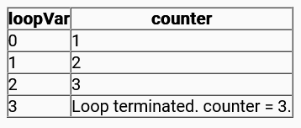
var counter = 0;
for (var loop = 0; loop < 5; loop++) {
if (loop == 3)
break;
counter++;
}
The 'if' statement used in the above example is a conditional / decision-making statement.

Slide 76
There are times when during the iteration of the block of code within the loop, the block execution may be required to be skipped for a specific value and then continue to execute the block for all the other values. JavaScript gives a 'continue' statement to handle this.
Continue statement is used to terminate the current iteration of the loop and continue execution of the loop with the next iteration.
Syntax:
continue;
Below example shows for loop with five iterations which increment variable "counter".
When loop counter = 3, the current iteration is skipped and moved to the next iteration.
Also, shown below is the value of the counter and the variable loop for every iteration of the loop.

Slide 77
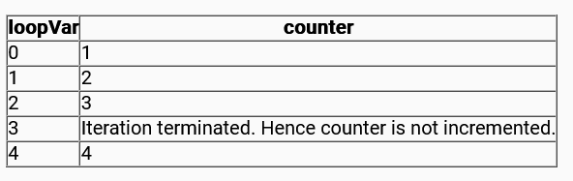
var counter = 0;
for (var loop = 0; loop < 5; loop++) {
if (loop == 3)
continue;
counter++;
}
The 'if' statement used in the example is a conditional / decision-making statement.

Slide 78
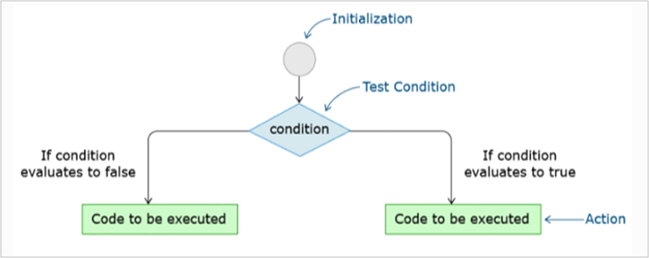
Types of Conditional Statements
Conditional statements help in performing different actions for different conditions.
It is also termed as decision-making statements.
JavaScript supports two decision-making statements:

Slide 79
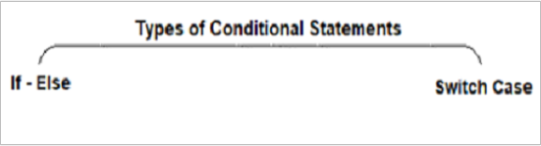
It is a conditional operator that evaluates to one of the values based on whether the condition is true or false.
It happens to be the only operator in JavaScript that takes three operands. It is mostly used as a shortcut of 'if-else' condition.
Example:
let workingHours = 9.20;
let additionalHours;
(workingHours > 9.15) ? additionalHours = "You have positive additional hours" : additionalHours = "You have negative additional hours";
console.log(additionalHours);

Slide 80
If Statement
The 'if' statement evaluates the expression given in its parentheses giving a boolean value as the result.
You can have multiple 'if' statements for multiple choice of statements inside an 'if' statement.
There are different flavors of if-else statement:
Simple 'if' statement
if -else
if–else–if ladder
Let us see each of them in detail.
if statement
The 'if' statement is used to execute a block of code if the given condition evaluates to true.
Syntax:
if (condition) {
// block of code that will be executed, if the condition is true
}

Slide 81
Example:
let num1 = 12;
if (num1 % 2 == 0) {
console.log("It is an even number!!");
}
// OUTPUT: It is an even number!! Because 12%2 evaluates to true
The 'else' statement is used to execute a block of code if the given condition evaluates to false.
Syntax:
if (condition) {
// block of code that will be executed, if the condition is true
}
else {
// block of code that will be executed, if the condition is false
}

Slide 82
Example:
let num1 = 1;
if (num1 % 2 == 0) {
console.log("It is an even number!!");
}
else{
console.log("It is an odd number!!");
}
//OUTPUT: It is an odd number!! Because in if 1%2 evaluates to false and moves to else condition
if...else ladder is used to check for a new condition when the first condition evaluates to false.
Syntax:
if (condition1) {
// block of code that will be executed if condition1 is true
}
else if (condition2) {
// block of code that will be executed if the condition1 is false and condition2 is true
}

Slide 83
else {
// block of code that will be executed if the condition1 is false and condition2 is false
}
Example:
let marks = 76;
if (marks >= 75) {
console.log("Very Good");
}
else if (marks < 85 && marks >= 50) {
console.log("Good");
}
else {
console.log("Needs Improvement");
}
// OUTPUT: Needs Improvement, Because the value of marks is 46 which doesn't satisfy the first two condition checks.

Slide 84
Switch Statement
The Switch statement is used to select and evaluate one of the many blocks of code.
Syntax:
switch (expression) {
case value1: code block;
break;
case value2: code block;
break;
case valueN: code block;
break;
default: code block;
}
'break' statement is used to come out of the switch and continue execution of statement(s) the following switch.
Example:
For the given Employee performance rating (between 1 to 5), displays the appropriate performance badge.

Slide 85
var perfRating = 5;
switch (perfRating) {
case 5:
console.log("Very Poor");
break;
case 4:
console.log("Needs Improvement");
break;
case 3:
console.log("Met Expectations");
break;
case 2:
console.log("Commendable");
break;
case 1:
console.log("Outstanding");
break;
default:
console.log("Sorry!! Invalid Rating.");
}
OUTPUT: Very Poor

Slide 86
The break statements allow to get control out of the switch once we any match is found.
Example:
For the given Employee performance rating (between 1 to 5), displays the appropriate performance badge.
var perfRating = 3;
switch (perfRating) {
case 5:
console.log("Very Poor");
break;
case 4:
console.log("Needs Improvement");
break;
case 3:
console.log("Met Expectations");
break;
case 2:
console.log("Commendable");
break;

Slide 87
case 1:
console.log("Outstanding");
break;
default:
console.log("Sorry!! Invalid Rating.");
}
/*
OUTPUT:
Met Expectation
*/
The reason for the above output is, first perfRating value is checked against case 5 and it does not match. Next, it is checked against case 4 and it also does not match. Next, when it is checked against case 3. it got a match hence “Met Expectation” is displayed, and the break statement moves the execution control out of the switch statement.

Slide 88
Consider the below code snippet without break statement:
var perfRating = 5;
switch (perfRating) {
case 5:
console.log("Very Poor");
case 4:
console.log("Needs Improvement");
case 3:
console.log("Met Expectations");
case 2:
console.log("Commendable");
case 1:
console.log("Outstanding");
default:
console.log("Sorry!! Invalid Rating.");
}

Slide 89
/*
OUTPUT:
Very Poor
Needs Improvement
Met Expectations
Commendable
Outstanding
Sorry!! Invalid Rating.
*/
The reason for the above output is, initially perfRating is checked against case 5 and it got matched, hence 'Very Poor' is displayed. But as the break statement is missing, the remaining cases including default got executed.

Slide 90
A scenario in which the default statement gets executed.
var perfRating = 15;
switch (perfRating) {
case 5:
console.log("Very Poor");
break;
case 4:
console.log("Needs Improvement");
break;
case 3:
console.log("Met Expectations");
break;
case 2:
console.log("Commendable");
break;
case 1:
console.log("Outstanding");
break;
default:
console.log("Sorry!! Invalid Rating.");
}

Slide 91
/*
OUTPUT:
Sorry!! Invalid Rating.
*/
The reason for the above output is, here perfRating = 15 does not match any case values.
Hence, the default statement got executed.

Slide 92
Tryout : Statements and Expressions
Problem Statement:
Observe the output to see the effect of the switch-case. Also, observe if the person is with fever or not from given normal body temperature and actual body temperature.
Activty:
You are suggested to try the code and observe the output by changing varieties of choices in switch case. Also, check the effect of the default statement in the switch by assigning appropriate value.

Slide 93
HTML
<!DOCTYPE html>
<html>
<head>
<title>Statements &amp; Expression Demo</title>
</head>
<body class="container-fluid">
<div class="panel panel-primary">
<div class="panel-heading">
<h3>Statement &amp; Expression Demo</h3>
</div>
<div class="panel-body">
</div>
</div>
</body>
</html>
CSS
body {
padding-top: 10px;
}

Slide 94
JavaScript
let choice = 1;
let tempFahrenheit = 104;
const THIRTYTWO = 32;
const TEMP = 1.8;
const NORMAL_CELSIUS = 37;
let result1 = tempFahrenheit - THIRTYTWO;
let result2 = result1 / TEMP;
switch (choice) {
case 1:
document.write("Your body temperature in Celsius is: " + result2 + "<br>");
result2 > NORMAL_CELSIUS ? document.write("You have fever, take rest!")
: document.write("You are absolutely OK!! Enjoy");
break;
case 2:
document.write("No, I don't want to check whether i have fever or not<br>");
break;
default:
document.write("Sorry wrong choice provided<br>");
}

Slide 95
Working With Loops
In JavaScript code, specific actions may have to be repeated a number of times.
For example, consider a variable counter which has to be incremented five times.
To achieve this, increment statement can be wiritten five times as shown below:
let counter = 0;
/* Same statement repeated 5 times */
counter++;
counter++;
counter++;
counter++;
counter++;
Looping statements in JavaScript helps to execute statement(s) required number of times without repeating code.

Slide 96
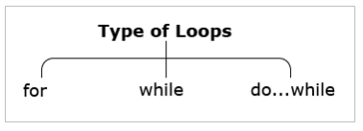
Types of Loops
JavaScript supports popular looping statements as shown below:
Let us understand each of them in detail.

Slide 97
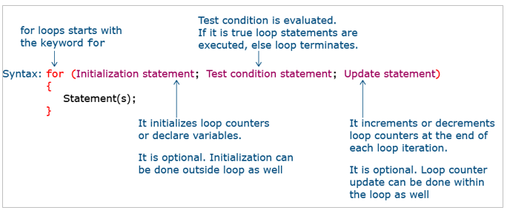
For Loop
'for' loop is used when the block of code is expected to execute for a specific number of times. To implement it, use the following syntax.

Slide 98
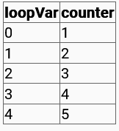
Example: Below example shows incrementing variable counter five times using 'for' loop:
Also, shown below is output for every iteration of the loop.
let counter = 0;
for (let loopVar = 0; loopVar < 5; loopVar++) {
counter = counter + 1;
console.log(counter);
}
Here, in the above loop
let loopVar=0; // Initialization
loopVar < 5; // Condition
loopVar++; // Update
counter = counter + 1; // Action
To understand loops better refer the below table:

Slide 99
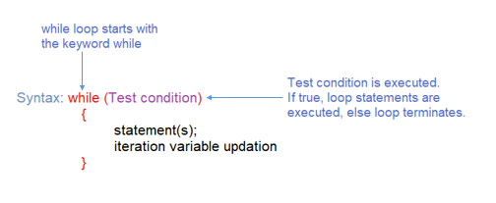
While Loop
'while' loop is used when the block of code is to be executed as long as the specified condition is true. To implement the same, the following syntax is used:
The value for the variable used in the test condition should be updated inside the loop only.

Slide 100

Example: The below example shows an incrementing variable counter five times using a 'while' loop.
Also, shown below is the output for every iteration of the loop.
let counter = 0;
let loopVar = 0;
while (loopVar < 5) {
console.log(loopVar);
counter++;
loopVar++;
console.log(counter);
}
Here, in the above loop
let counter=0; // Initialization
let loopVar=0; // Initialization
loopVar < 5; // Condition
loopVar++; // Update
counter++; // Action
To understand loops better refer the below table:

Slide 101
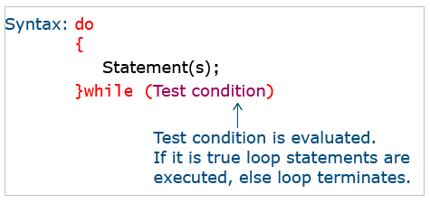
Do-While Loop
'do-while' is a variant of 'while' loop.
This will execute a block of code once before checking any condition.
Then, after executing the block it will evaluate the condition given at the end of the block of code.
Now the statements inside the block of code will be repeated till condition evaluates to true.
To implement 'do-while' loop, use the following syntax:
The value for the variable used in the test condition should be updated inside the loop only.

Slide 102
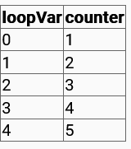
Example: Below example shows incrementing variable counter five times using 'do-while' loop:
Also, shown below is output for every iteration of the loop.
let counter = 0;
let loopVar = 0;
do {
console.log(loopVar);
counter++;
loopVar++;
console.log(counter);
}
while (loopVar < 5);
Here, in the above loop
let counter=0; // Initialization
let loopVar=0; // Initialization
loopVar < 5; // Condition
loopVar++; // Update
counter++; // Action
To understand loops better refer the below table:

Slide 103
Tryout : For Loops
Problem Statement:
Execute the following code and observe the output to see the effect of 'for' loops.
Activity:
Try the code with different set of arrays.
<html>
<head>
<style>
body {
padding-top: 10px;
}
</style>
</head>
<body class="container-fluid">
<div class="panel panel-primary">
<div class="panel-heading">
<h3>For Loop</h3>
</div>

Slide 104
<div class="panel-body">
<script>
var loopVar = 0;
var courses = ["HTML", "CSS", "JS", "Bootstrap", "Angular", "ReactJS"];
for(loopVar=0;loopVar<courses.length;loopVar++)
{
document.write(courses[loopVar]);
document.write("<br/>");
}
</script>
</div>
</div>
</body>
</html>

Slide 105
Tryout : While Loop
Problem Statement:
Execute the following code and observe the output to see the effect of 'while' loop.
Activity:
Try the code to generate different multiplication tables.
<html>
<head>
<style>
body {
padding-top: 10px;
}
</style>
</head>
<body class="container-fluid">
<div class="panel panel-primary">
<div class="panel-heading">
<h3>while Loop</h3>
</div>

Slide 106
<div class="panel-body">
<script>
var loopVar = 1;
while (loopVar <= 10) {
document.write("2 *" + loopVar +"=");
document.write(2 * loopVar);
document.write("<br/>");
loopVar++;
}
</script>
</div>
</div>
</body>
</html>

Slide 107
Tryout : Do-While Loop
Problem Statement:
Observe the output to see the effect of the 'do-while' loop in which the user is able to calculate the simple interest until the user keeps pressing 'Y’.
Activity:
Try the code with different set of values for principal,rate of interest and number of years.
<!DOCTYPE html>
<html>
<head>
<title>Loops Demo</title>
<style>
body {
padding-top: 10px;
}
</style>
</head>

Slide 108
<body class="container-fluid">
<div class="panel panel-primary">
<div class="panel-heading">
<h3>do-while Loop</h3>
</div>
<div class="panel-body">
<script>
let ch;
do {
execute();
ch = prompt("Press Y to continue");
} while (ch == "Y");
function execute() {
//Functions from No.1 to No.6 are Built-In Functions
//1. alert
alert("Let us calculate SI");
//2. prompt
let P = prompt("Please enter Principal Amount");

Slide 109
let R = prompt("Please enter Rate of Interest ");
let N = prompt("Please enter Number of Years ");
document.write("You have entered P : " + P + "<br><br>");
document.write("You have entered R : " + R + "<br><br>");
document.write("You have entered N : " + N + "<br><br>");
//3. confirm
let decision = confirm("Shall we proceed to calculate SI?");
if (decision) console.log("You decided to proceed" + "<br><br>");
else console.log("You decided not to proceed" + "<br><br>");
//4. eval
eval(P * R * N);
document.write("Calculated SI is " + (eval(P * R * N)) / 100 + "<br><br>");
}
</script>
</div>
</div>
</body>
</html>

Slide 110
Working with Functions
The JavaScript engine can execute JavaScript code in two different modes:
Immediate mode
As soon as the webpage loads on the browser, JavaScript code embedded inside it, executes without any delay.
Deferred mode
Execution of JavaScript code is deferred or delayed until any user action like data input, button click, drop-down selection, etc. takes place.
The JavaScript code understood so far was running in immediate mode. As soon as the page is loaded in the browser, the script gets executed line by line without any delay.
But in real-world application development, it is not possible to wait for sequential execution of the code written for the huge applications. JavaScript provides a solution to this problem in the form of JavaScript functions.
Functions are one of the integral components of JavaScript. A JavaScript function is a set of statements that performs a specific task. They become a reusable unit of code.
In JavaScript, functions are first-class objects. i.e., functions can be passed as an argument to other functions, it can be a return value of another function or can be assigned as a value to a variable. JavaScript leverages this behavior to extend its capabilities.

Slide 111
Types of Functions
JavaScript has two types of functions.
1. User-defined functions
JavaScript allows to write own functions called as user-defined functions. The user-defined functions can also be created using a much simpler syntax called arrow functions.
2. Built-in functions
JavaScript provides several predefined functions that perform tasks such as displaying dialog boxes, parsing a string argument, timing-related operations, and so on.

Slide 112
Declaring and Invoking Function
To use a function, it must be defined or declared and then it can be invoked anywhere in the program.
A function declaration also called a function definition, consists of the function keyword, followed by:
Function name
A list of parameters to the function separated by commas and enclosed in parentheses, if any.
A set of JavaScript statements that define the function, also called a function body, enclosed in curly brackets {…}.
Syntax for Function Declaration:
function function_name(parameter 1, parameter 2 , …, parameter n) {
//statements to be executed
}
Example:
function multiply(num1, num2) {
return num1 * num2;
}

Slide 113
The code written inside the function body will be executed only when it is invoked or called.
Syntax for Function Invocation:
function_name(argument 1, argument 2, ..., argument n);
Example:
multiply (5,6);

Slide 114
Arrow Function
In JavaScript, functions are first-class objects. This means, that you can assign a function as a value to a variable. For example,
let sayHello = function () {
console.log("Welcome to JavaScript");
};
sayHello();
Here, a function without a name is called an anonymous function which is assigned to a variable sayHello.
JavaScript has introduced a new and concise way of writing functions using arrow notation. The arrow function is one of the easiest ways to declare an anonymous function.
Example:
let sayHello = () => {
console.log("Welcome to JavaScript");
};
sayHello();

Slide 115
There are two parts to the Arrow function syntax:
let sayHello = ()
This declares a variable sayHello and assigns a function to it using () to just say that the variable is a function.
2. => { }
This declares the body of the function with an arrow and the curly braces.
Below are a few scenarios of arrow functions.
Syntax 1: Multi-parameter, multi-line code:
If code is in multiple lines, use {}.
calculateCost = (ticketPrice, noOfPerson)=>{
noOfPerson= ticketPrice * noOfPerson;
return noOfPerson;
}
console.log(calculateCost(500, 2));
// 1000

Slide 116
Syntax 2: No parameter, single line code:
If the code is single line, {} is not required. The expression is evaluated and automatically returned.
trip = () => "Let's go to trip."
console.log(trip());
// Let's go to trip.
Syntax 3: One parameter, single line code:
If only one parameter, then () is not required.
trip = place => "Trip to " + place;
console.log(trip("Paris"));
// Trip to Paris
Syntax 4: One parameter, single line code:
if only one parameter, use '_' and do not use a variable name also.
trip = _ => "Trip to " + _;
console.log(trip("Paris"));
// Trip to Paris

Slide 117
Arrow function also adds a great difference with respect to the context object – 'this' reference.
Consider the below code where a regular function is defined within a method:
const myObject = {
items: [1],
myMethod() {
console.log(this == myObject) // true
this.items.forEach(function() {
console.log(this === myObject) // false
console.log(this === window); // true
});
}
};
myObject.myMethod();
A regular function defines its 'this' value based on how the function is invoked.
In the above-mentioned example, the myObject defines 'this' as an instance of itself. So, in line 4, the reference to 'this' points to the myObject itself. The regular function is used within the forEach() method. So, inside of the regular function, 'this' points to the window global object.
If the same logic is re-written using the arrow function as below:

Slide 118
const myObject = {
items: [1],
myMethod() {
console.log(this == myObject) // => true
this.items.forEach(() => {
console.log(this === myObject) // => true
console.log(this === window); // => false
});
}
};
myObject.myMethod();
Arrow functions do not have their own 'this'. If 'this' is accessed, then its value is taken from the outside of the arrow function. So, in the above-mentioned code, the value of 'this' inside the arrow function equals to the value of 'this' of the outer function, that is, myObject.

Slide 119
Function Parameters
Function parameters are the variables that are defined in the function definition and the values passed to the function when it is invoked are called arguments.
In JavaScript, function definition does not have any data type specified for the parameters, and type checking is not performed on the arguments passed to the function.
JavaScript does not throw any error if the number of arguments passed during a function invocation doesn’t match with the number of parameters listed during the function definition. If the number of parameters is more than the number of arguments, then the parameters that have no corresponding arguments are set to undefined.
function multiply(num1, num2) {
if (num2 == undefined) {
num2 = 1;
}
return num1 * num2;
}
console.log(multiply(5, 6)); // 30
console.log(multiply(5)); // 5

Slide 120
JavaScript introduces an option to assign default values in functions.
function multiply(num1, num2 = 1) {
return num1 * num2;
}
console.log(multiply(5, 5)); //25
console.log(multiply(10)); //10
console.log(multiply(10, undefined)); //10
In the above example, when the function is invoked with two parameters, the default value of num2 will be overridden and considered when the value is omitted while calling.
Rest parameter syntax allows to hold an indefinite number of arguments in the form of an array.
Syntax:
function(a, …args) {
//…
}

Slide 121
The rest of the parameters can be included in the function definition by using three dots ( … ) followed by the name of the array that will hold them.
Example:
function showNumbers(x, y, …z) {
return z;
}
console.log(showNumbers(1, 2, 3, 4, 5)); // [3,4,5]
console.log(showNumbers(3, 4, 5, 6, 7, 8, 9, 10)); // [5,6,7,8,9,10]
The rest parameter should always be the last parameter in the function definition.
Destructuring gives a syntax which makes it easy to unpack values from arrays, or properties from objects, into different variables.
Array destructuring in functions
Example:

Slide 122
let myArray = ["Andrew", "James", "Chris"];
function showDetails([arg1, arg2]) {
console.log(arg1); // Andrew
console.log(arg2); // James
}
showDetails(myArray);
In the above example, the first two array elements ‘Andrew’ and 'James’ have been destructured into individual function parameters arg1 and arg2.
Object destructuring in functions
Example:
let myObject = { name: "Mark", age: 25, country: "India" };
function showDetails({ name, country }) {
console.log(name, country); // Mark India
}
showDetails(myObject);
The properties name and country of the object have been destructured and captured as a function parameter.

Slide 123
Nested Function
In JavaScript, it is perfectly normal to have functions inside functions. The function within another function body is called a nested function.
The nested function is private to the container function and cannot be invoked from outside the container function.
Example:
function giveMessage(message) {
let userMsg = message;
function toUser(userName) {
let name = userName;
let greet = userMsg + " " + name;
return greet;
}
userMsg = toUser("Bob");
return userMsg;
}
console.log(giveMessage("The world says hello dear: "));
// The world says hello dear: Bob

Slide 124
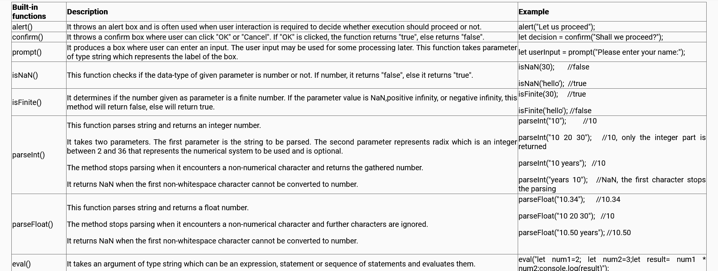
Built-in Functions
JavaScript comes with certain built-in functions. To use them, they need to be invoked.
Below is the table with some of these built-in functions to understand their significance and usage.

Slide 125
Variable Scope in Functions
Variable declaration in the JavaScript program can be done within the function or outside the function. But the accessibility of the variable to other parts of the same program is decided based on the place of its declaration. This accessibility of a variable is referred to as scope.
JavaScript scopes can be of three types:
Global scope
Local scope
Block scope
Variables defined outside function have Global Scope and they are accessible anywhere in the program.
Example:

Slide 126
//Global variable
var greet = "Hello JavaScript";
function message() {
//Global variable accessed inside the function
console.log("Message from inside the function: " + greet);
}
message();
//Global variable accessed outside the function
console.log("Message from outside the function: " + greet);
//Message from inside the function: Hello JavaScript
//Message from outside the function: Hello JavaScript
Variables declared inside the function would have local scope. These variables cannot be accessed outside the declared function block.
Example:

Slide 127
function message() {
//Local variable
var greet = "Hello JavaScript";
//Local variables are accessible inside the function
console.log("Message from inside the function: " + greet);
}
message();
//Local variable cannot be accessed outside the function
console.log("Message from outside the function: " + greet);
//Message from inside the function: Hello JavaScript
//Uncaught ReferenceError: greet is not defined
If a local variable is declared without the use of keyword 'var', it takes a global scope.
Example:

Slide 128
//Global variable
var firstName = "Mark";
function fullName() {
//Variable declared without var has global scope
lastName = "Zuckerberg";
console.log("Full Name from inside the function: " + firstName + " " + lastName);
}
fullName();
console.log("Full Name from outside the function: " + firstName + " " + lastName);
//Full Name from inside the function: Mark Zuckerberg
//Full Name from outside the function: Mark Zuckerberg
In 2015, JavaScript introduced two new keywords to declare variables: let and const.
Variables declared with 'var' keyword are function-scoped whereas variables declared with 'let' and 'const' are block-scoped and they exist only in the block in which they are defined.
Consider the below example:

Slide 129
function testVar() {
if (10 == 10) {
var flag = "true";
}
console.log(flag); //true
}
testVar();
In the above example, the variable flag declared inside 'if' block is accessible outside the block since it has function scope
Modifying the code to use 'let' variable will result in an error:
function testVar() {
if (10 == 10) {
let flag = "true";
}
console.log(flag); //Uncaught ReferenceError: flag is not defined
}
testVar();

Slide 130
The usage of 'let' in the above code snippet has restricted the variable scope only to 'if' block.
'const' has the same scope as that of 'let' i.e., block scope.
JavaScript interpreter follows the process called hoisting.
Hoisting means all the variable and function declarations wherever they are present throughout the program, gets lifted and declared to the top of the program. Only the declaration and not the initialization gets hoisted to the top.
If a variable is tried to access without declaration, the Reference Error is thrown.
Let us declare and initialize the variable in the code but after it is accessed.
console.log("First name: "+firstName); //First name: undefined
var firstName = "Mark";
Because of Hoisting, the code is interpreted as below by the interpreter:

Slide 131
var firstName;
console.log("First name: "+firstName); // First name: undefined
firstName ="Mark";
Hoisting here helps interpret to find the declaration at the top of the program and thus reference error goes away. But interpreter says that the variable is not defined. This is because hoisting only lifted the variable declaration on the top and not initialization.
Variables declared using 'let' and 'const' are not hoisted to the top of the program.
Example:
console.log("First name: "+firstName);
let firstName = "Mark";
The above code throws an error as ”Uncaught ReferenceError: Cannot access 'firstName' before initialization”

Slide 132
Tryout : Functions
Problem Statement:
Observe the output to check the execution of built-in functions, as well as user-defined functions in which simple interest is calculated.
Activity:
You are suggested to create one more function named to calculate Compound Interest.
<!DOCTYPE html>
<html>
<head>
<title>Functions Demo</title>
<style>
body {
padding-top: 10px;
}
</style>
</head>

Slide 133
<body class="container-fluid">
<div class="panel panel-primary">
<div class="panel-heading">
<h3>Functions</h3>
</div>
<div class="panel-body">
<script>
function execute() //User defined Function
{
//Functions from No.1 to No.6 are Built-In Functions
//1. alert
alert("Let us calculate SI");
//2. prompt
let P = prompt("Please enter Principal Amount");
let R = prompt("Please enter Rate of Interest ");
let N = prompt("Please enter Number of Years ");
document.write("You have entered P : " + P + "<br><br>");
document.write("You have entered R : " + R + "<br><br>");
document.write("You have entered N : " + N + "<br><br>");

Slide 134
//3. confirm
let decision = confirm("Shall we proceed to calculate SI?");
if (decision) console.log("You decided to proceed" + "<br><br>");
else console.log("You decided not to proceed" + "<br><br>");
//4. eval
eval(P * R * N);
document.write("Calculated SI is " + (eval(P * R * N)) / 100 + "<br><br>");
//5. setTimeout
function executeMe1() {
document.write("Function timeout !!!" + "<br><br>");
}
setTimeout(executeMe1, 3000);
//6.setInterval
function executeMe2() {
//execute();
document.write("Function called at regular interval !!!" + "<br><br>");
}
setInterval(executeMe2, 3000);
}

Slide 135
</script>
</div>
</div>
<button onclick="execute();">Click Here to Calculate SI</button>
</body>
</html>

Slide 136
Working With Classes
In 2015, JavaScript introduced the concept of the Class.
Classes and Objects in JavaScript coding can be created similar to any other Object-Oriented language.
Classes can also have methods performing different logic using the class properties respectively.
The new feature like Class and Inheritance eases the development and work with Classes in the application.
JavaScript is an object-based language based on prototypes and allows to create hierarchies of objects and to have inheritance of properties and their values.
The Class syntax is built on top of the existing prototype-based inheritance model.

Slide 137
Creating and Inherting Classes
Classes
In 2015, ECMAScript introduced the concept of classes to JavaScript
The keyword class is used to create a class
The constructor method is called each time the class object is created and initialized.
The Objects are a real-time representation of any entity.
Different methods are used to communicate between various objects, to perform various operations.
Example:
The below code demonstrates a calculator accepting two numbers to do addition and subtraction operations.

Slide 138
class Calculator {
constructor(num1, num2){ // Constructor used for initializing the class instance
/* Properties initialized in the constructor */
this.num1 = num1;
this.num2 = num2;
}
/* Methods of the class used for performing operations */
add() {
return this.num1 + this.num2;
}
subtract() {
return this.num1 - this.num2;
}
}
let calculator = new Calculator(300, 100); // Creating Calculator class object or instance
console.log("Add method returns" + calculator.add()); // Add method returns 400.
console.log("Subtract method returns" + calculator.subtract()); // Subtract method returns 200.

Slide 139
Static methods can be created in JavaScript using the static keyword like in other programming languages. Static values can be accessed only using the class name and not using 'this' keyword. Else it will lead to an error.
In the below example, display() is a static method and it is accessed using the class name.
class Calculator {
constructor(num1, num2) { // Constructor used for initializing the class instance
/* Properties initialized in the constructor */
this.num1 = num1;
this.num2 = num2;
}
/* static method */
static display() {
console.log("This is a calculator app");
}
/* Methods of the class used for performing operations */
add() {
return this.num1 + this.num2;
}

Slide 140
subtract() {
return this.num1 - this.num2;
}
}
/*static method display() is invoked using class name directly. */
Calculator.display();
The output of the above code is :
This is a calculator app

Slide 141
Tryout : Classes
Problem Statement:
Observe the output which helps to understand the concept of class and inheritance.
Activity:
You are suggested to create one more class and implement inheritance and observe your output by creating more objects of the class.
<!DOCTYPE html>
<html>
<head>
<title>Classes Demo</title>
<script>
class Vehicle {
constructor(make, model) {
this.make = make;
this.model = model;
}
}

Slide 142
Inheritance
In JavaScript, one class can inherit another class using the extends keyword. The subclass inherits all the methods ( both static and non-static ) of the parent class.
Inheritance enables the reusability and extensibility of a given class.
JavaScript uses prototypal inheritance which is quite complex and unreadable. But, now you have 'extends' keyword which makes it easy to inherit the existing classes.
Keyword super can be used to refer to base class methods/constructors from a subclass
Example:
The below code explains the concept of inheritance.

Slide 143
class Vehicle {
constructor(make, model) {
/* Base class Vehicle with constructor initializing two-member attributes */
this.make = make;
this.model = model;
}
}
class Car extends Vehicle {
constructor(make, model, regNo, fuelType) {
super(make, model); // Sub class calling Base class Constructor
this.regNo = regNo;
this.fuelType = fuelType;
}
getDetails() {
/* Template literals used for displaying details of Car. */
console.log(`${this.make},${this.model},${this.regNo},${this.fuelType}`);
}
}
let c = new Car("Hundai", "i10", "KA-016447", "Petrol"); // Creating a Car object
c.getDetails();

Slide 144
Subclassing Built-ins
The keywords, class and extends, help developers to create classes and implement inheritance in the application where user-defined classes can be created and extended. Similarly, the built-in classes can be subclassed to add more functionality.
Example:
To display the array items, the built-in Array class can be extended as mentioned below.
class MyArray extends Array {
constructor(...args) {
super(...args);
}
display() {
let strItems = "";
for (let val of this) {
strItems += `${val} `;
}
console.log(strItems);
}
}
let letters = new MyArray("Sam", "Jack", "Tom");
letters.display();

Slide 145
Note that display is not the method present in Array built-in class. The MyArray subclasses the Array and adds to it. The output of the above code is given below.
Sam Jack Tom
Best Practice: Class methods should be either made reference using this keyword or it can be made into a static method.

Slide 146
class Car extends Vehicle {
constructor(make, model, regNo, fuelType) {
super(make, model);
this.regNo = regNo;
this.fuelType = fuelType;
}
getDetails() {
document.write(`${this.make},${this.model},${this.regNo},${this.fuelType}`);
}
}
let cObj1 = new Car("Hundai", "i10", "KA01-6447", "Petrol");
cObj1.getDetails();
</script>
</head>
</html>

Slide 147

Working With Events
When the interaction happens, the event triggers. JavaScript event handlers enable the browser to handle them. JavaScript event handlers invoke the JavaScript code to be executed as a reaction to the event triggered.
When execution of JavaScript code is delayed or deferred till some event occurs, the execution is called deferred mode execution. This makes JavaScript an action-oriented language.
Let us understand how JavaScript executes as a reaction to these events.

Slide 148
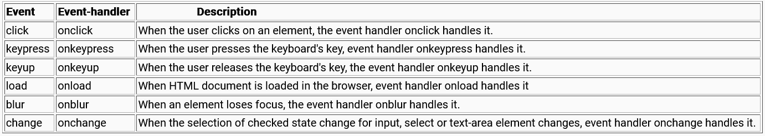
In-built Events and Handlers
Below are some of the built-in event handlers.

Slide 149
Wiring the Events
Event handlers are associated with HTML elements and are responsible to handle or listen to the event taking place on the respective element.
Syntax:
<html-element eventHandler="JavaScript code">
Example:
To listen to the click event on the paragraph element, it is done as shown below:
<p onclick="executeMe();">Para says !!! </p>
When the user clicks on element 'p', event handler 'onclick' listens to the event 'click' and executes the 'executeMe' code written in JavaScript file against the event handler.
Example:
1. Event Handler 'onclick' is associated with the HTML element 'p' to handle the 'click' on this element.

Slide 150
<html>
<head>
<script src="test.js"></script>
</head>
<body>
<p onclick="executeMe();">Para says !!! </p>
</body>
</html>
2. When the user clicks on element 'p', event handler 'onclick' listens to the event 'click' and executes the code written against the event handler. The corresponding code is the function 'executeMe' written in the "test.js" file.
function executeMe() {
alert('A click event has been triggered by the user');
}

Slide 151
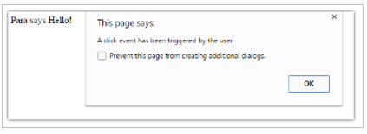
3. The function 'executeMe' will now execute.
As seen in event handling code, event-handler is a piece of JavaScript code put inside the HTML Paragraph element .
<p onclick="executeMe();">Para says !!! </p>
On the right-hand side of this code instead of invoking a function, lines of code can be directly written as shown below:
<p onclick="alert('A click event has been triggered by the user');">Para says !!! </p>

Slide 152
This is referred to as Inline Scripting where lines of JavaScript code is embedded inline to HTML elements.
However, due to tight coupling with the elements in which the code is written, this approach is not suggested. The alternate and much better approach is to use functions in JavaScript.
Best Practice: Event listeners are the most preferred way to handle events in JavaScript. One of the major points to use event listeners is, it does allow us to add multiple event listeners on the same element when compared with the "on" properties like onmouseclick, onmouseover, etc..

Slide 153
Exception Handling
Exception handling is accomplished with a try...catch statement. When the program encounters an exception, the program will terminate in an unfriendly manner. To protect against this, the code can be placed in a try...catch statement and avoid terminating the program unexpectedly.
Try statements: It lets the developer validate a block of code whether it will result in some errors or not.
Catch statements: It lets the developer handle the error without terminating the program in an unfriendly manner.
Throw statements: It helps the developer to create custom errors.
Finally statements: It lets the developer execute code, after the try and catch block execution, irrespective of the result.
Example:

Slide 154
<html>
<head>
<script>
let num1 = 100;
let num2 = 0;
try {
if (isNaN(num1) || isNaN(num2)) {
throw "Not a number"
}
else {
if (num2 == 0) {
throw "Divide by zero error";
}
else {
let result = num1 / num2;
}
}
}
catch (e) {
console.log("Error: " + e);
}

Slide 155
finally {
console.log("Some error occured");
}
</script>
</head>
<body>
</body>
</html>
Here, num2 is 0 so when you try to divide num1 by num2 it will throw Divide by zero error. Also, finally() is called whenever an error occurs. So as a result, two statements will be printed: "Divide by zero" and "Some error occurred".

Slide 156
Tryout : Event Handling
Problem Statement:
Observe the output of the below code to understand event handling in which it is checked whether values entered by the user are number or not, if not an error will be thrown.
Activity:
You are suggested to modify the output by assigning empty values for the variables and throw the error accordingly for those fields.
<!DOCTYPE html>
<html>
<head>
<title>Event Handling Demo</title>
<style>
body {
padding-top: 10px;
}
</style>
</head>

Slide 157
<body class="container-fluid">
<div class="panel panel-primary">
<div class="panel-heading">
<h3>Event Handling</h3>
</div>
<div class="panel-body">
<script>
function execute() //User defined Function
{
//Functions from No.1 to No.6 are Built-In Functions
//1. alert
alert("Let us calculate SI");
//2. prompt
let P = prompt("Please enter Principal Amount");
let R = prompt("Please enter Rate of Interest ");
let N = prompt("Please enter Number of Years ");

Slide 158
try {
if (isNaN(P) || isNaN(R) || isNaN(N)) {
throw "Not a number";
}
else {
document.write("You have entered P : " + P + "<br><br>");
document.write("You have entered R : " + R + "<br><br>");
document.write("You have entered N : " + N + "<br><br>");
//4. eval
eval(P * R * N);
document.write("Calculated SI is " + (eval(P * R * N)) / 100 + "<br><br>");
}
}
catch (e) {
document.write("Error: " + e + "<br>");
}
finally {
document.write("Some error occured" + "<br>");
}

Slide 159
//3. confirm
let decision = confirm("Shall we proceed to calculate SI?");
console.log(typeof (decision));
if (decision) console.log("You decided to proceed" + "<br><br>");
else console.log("You decided not to proceed" + "<br><br>");
}
execute();
</script>
</div>
</div>
</body>
</html>

Slide 160
Working with Objects
In any programming language when real-world entities are to be coded, then variables are used. For most of the scenarios, a variable to hold data that represents the collection of properties is required.
For instance, to create an online portal for the car industry, Car as an entity must be modelled so that it can hold a group of properties.
Such type of variable in JavaScript is called an Object. An object consists of state and behavior.
The State of an entity represents properties that can be modeled as key-value pairs.
The Behavior of an entity represents the observable effect of an operation performed on it and is modeled using functions.
Example:
A Car is an object in the real world.
State of Car object:

Slide 161
Color=red
Model = VXI
Current gear = 3
Current speed = 45 km / hr
Number of doors = 4
Seating Capacity = 5
The behavior of Car object:
Accelerate
Change gear
Brake

Slide 162
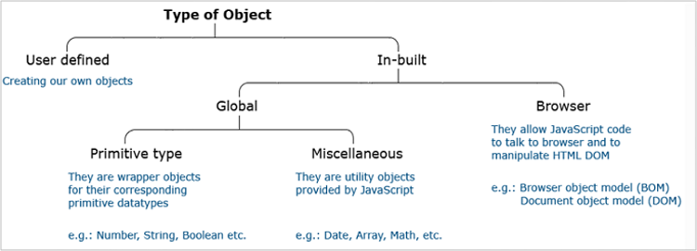
Types of Objects
JavaScript objects are categorized as follows:

Slide 163
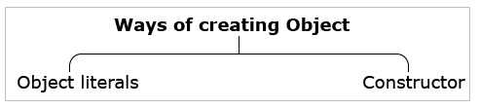
Creating Objects
In JavaScript objects, the state and behaviour is represented as a collection of properties
Each property is a [key-value] pair where the key is a string and the value can be any JavaScript primitive type value, an object, or even a function.
JavaScript objects can be created using two different approaches.
Objects can be created using object literal notation. Object literal notation is a comma-separated list of name-value pairs wrapped inside curly braces. This promotes the encapsulation of data in a tidy package. This is how the objects in JavaScript are created using the literal notation:
Syntax:

Slide 164
objectName = {
//-------------states of the object-----------
key_1: value_1,
key_2: value_2,
...
key_n: value_n,
//-------------behaviour of the object---------
key_function_name_1: function (parameter) {
//we can modify any of the property declared above
},
...
key_function_name_n: function(parameter) {
//we can modify any of the property declared above
}
}
Example:

Slide 165
//-------------states of the object---------
let myCar = {
name: "Fiat",
model: "VXI",
color: "red",
numberOfGears: 5,
currentGear: 3,
currentSpeed: 45,
//-------------Behaviour of the object---------
accelerate: function (speedCounter) {
this.currentSpeed = this.currentSpeed + speedCounter;
return this.currentSpeed;
},
brake: function (speedCounter) {
this.currentSpeed = this.currentSpeed - speedCounter;
return this.currentSpeed;
}
}

Slide 166
Below is the older syntax used to create object literals:
let name = "Arnold";
let age = 65;
let country = "USA";
let obj = {
name: name,
age: age,
country: country
};
Below is the modern way to create objects in a simpler way:
let name="Arnold";
let age=65;
let country="USA";
let obj={name,age,country};

Slide 167
The object literal property shorthand is syntactic sugar, which simplifies the syntax when literals are used in function parameters or as return values.
//Literal property without shorthand
function createCourse(name, status) {
return {type: "JavaScript", name: name, status: status};
}
function reviewCourse(name) {
return {type: "JavaScript", name: name};
}
/*Literal property with shorthand
when the property and the value identifiers have the same name,
the identifier can be omitted to make it implicit*/
function createCourse(name, status) {
return {type: "JavaScript", name, status};
}
function reviewCourse(name) {
return {type: "JavaScript", name};
}

Slide 168
Earlier in JavaScript to add a dynamic property to an existing object, below syntax was used.
let personalDetails = {
name: "Stian Kirkeberg",
country: "Norway"
};
let dynamicProperty = "age";
personalDetails[dynamicProperty] = 45;
console.log(personalDetails.age); //Output: 45
With newer updates in JavaScript after 2015 the dynamic properties can be conveniently added using hash notation and the values are computed to form a key-value pair.
let dynamicProperty = "age";
let personalDetails = {
name: "Stian Kirkeberg",
country: "Norway",
[dynamicProperty]: 45
};
console.log(personalDetails.age); //Output: 45

Slide 169
'this' keyword that is used in this case is a JavaScript pointer. It points to an object which owns the code in the current context.
It does not have any value of its own but is only the substitute for the object reference wherever it is used.
Example:
If used inside an object definition, it points to that object itself. If used inside the function definition, it points to the object that owns the function.
To create objects using function constructor, make use of 'new' keyword, and invoke the function. This initializes a variable of type object. The properties and methods of the object can be invoked using the dot or bracket operator.
Retrieving state using the dot operator:

Slide 170
myCar.name; //return "Fiat"
myCar.currentSpeed; //returns 45
Retrieving behavior using the dot operator:
myCar.accelerate(50);//invokes accelerate() with argument = 50
Retrieving state using the bracket operator:
myCar["name"]; //return "Fiat"
myCar["currentSpeed"]; //returns 45
Retrieving behavior using the bracket operator:
myCar["accelerate"](50); //invokes accelerate() with argument = 50

Slide 171
Built-In Global Objects
The Global object allows to declare variables and functions that can be accessed anywhere.
By default, these are built into the language or the environment.
They are different built-in objects in JavaScript,
Date
String
Math
RegEx
JSON
Let us understand each of these types in detail.

Slide 172
The built-in JavaScript object 'Date' allows us to work with dates and times displayed as part of the web page. It can be instantiated wherever required using one of the many constructors available.
Example:
let dateObject1 = new Date();
console.log("Date is: " + dateObject1);
//OUTPUT: Date is: Thu Jun 18, 2020, 22:17:36 GMT+0530 (India Standard Time)
OR
let dataObject2 = new Date(2020, 5, 18, 22, 20, 23, 0000);
console.log("Date is: "+dataObject2);
//OUTPUT: Date is: Thu Jun 18, 2020, 22:20:23 GMT+0530 (India Standard Time)
After the object of type 'Date' is ready, you can access and use the built-in methods. Most of the methods provided by the object 'Date' aim at getting a specific portion of the current time.

Slide 173
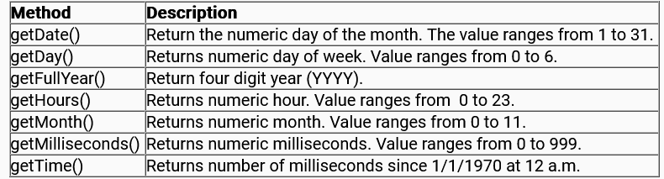
The below table is about the getter methods available on object Date.
Example:
let dateObject1 = new Date();
console.log("Date is: " + dateObject1.getDate());
console.log("Day is: " + dateObject1.getDay());
console.log("Year is: " + dateObject1.getYear());
console.log("Hours: " + dateObject1.getHours());
console.log("Month is: " + dateObject1.getMonth());
console.log("Time is: " + dateObject1.getTime());
console.log("Millisecond: " + dateObject1.getMilliseconds());

Slide 174
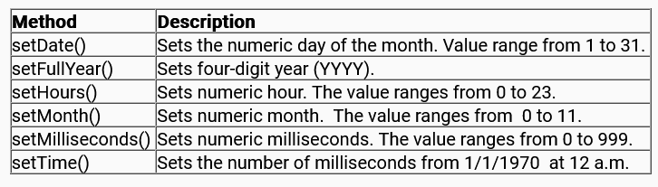
/*
OUTPUT:
Date is: 18
Day is: 4
Year is: 120
Horrs: 22
Month is: 5
Time is: 1592499518512
Millisecond: 512
*/
Setter methods available on object Date are listed below:

Slide 175
Example:
let dateObject1 = new Date();
dateObject1.setDate(3);
dateObject1.setYear(1996);
dateObject1.setHours(8);
dateObject1.setMonth(7);
dateObject1.setMilliseconds(2000);
console.log("Date is: " + dateObject1.getDate());
console.log("Year is: " + dateObject1.getYear());
console.log("Hours: " + dateObject1.getHours());
console.log("Month is: " + dateObject1.getMonth());
console.log("Millisecond: " + dateObject1.getMilliseconds());
/*
OUTPUT:
Date is: 3
Year is: 96
Hours: 8
Month is: 7
Millisecond: 0
*/

Slide 176
This object is a wrapper for primitive type string that helps to store textual values.
It provides properties and methods to manipulate the given text without writing the code from scratch.
The string object consists of only one property, length. It is a read-only property that returns the length of the given string.
Example:
let myString = "Welcom to JavaScript Session";
console.log("Length is: " + myString.length);
/*OUTPUT: returns Length is: 28,
space between words are also considered as a character*/
charAt()
It retrieves a character that resides on the index passed as an argument
Example:

Slide 177
let myString = "Hello World";
console.log("Character at position 4 is : " + myString.charAt(3));
//Returns: Character in position 4 is: l
concat()
It accepts an unlimited number of string arguments, joins them, and returns the combined result as a new string.
Example:
let myStr1 = "Hello";
let myStr2 = " ";
let myStr3 = "World";
console.log("Concatenated string: "+myStr1.concat(myStr2,myStr3));
//Returns: Concatenated string: Hello World
indexOf()
It returns the index of the given character or maybe the given set of characters in a string passed as an argument.
Example:

Slide 178
let myString = "Hello World";
console.log("Index of character l is : "+myString.indexOf('l'));
//Returns: Index of character l is : 2
match()
It makes use of the regular expression to look for a specific string and returns all the strings that match.
Example:
let myStr = "Are you enjoying JavaScript?";
console.log(myStr.match(/you/));
/*Returns an array:
[
'you',
index: 4,
input: 'Are you enjoying JavaScript?',
groups: undefined
]
*/
console.log("string found at index position: "+myStr.match(/you/).index);
/*Returns: string found at index position: 4*/

Slide 179
replace()
It accepts the substring or the regular expression.Also, accepts the string that will be used for the replacement string. The idea is to replace all matches with the replacement string and provide the modified string.
Example:
let myStr = "Are you enjoying JavaScript?";
myStr = myStr.replace('you', 'they');
console.log(myStr);
//Returns Are they enjoying JavaScript?
search()
It searches for a match of regular expression in the given string and returns its position. If there is no match, it returns -1.
Example:

Slide 180
let myString1 = "can you find it?";
console.log("Occurrence of find in statement1: "+myString1.search('find'));
let myString2 = "Or you can not?";
console.log("Occurrence of find in statement2: "+myString2.search('find'));
/*Returns:
The Occurrence of find in statement1: 8,
The Occurrence of find in statement2: -1*/
split()
It splits the given string into the array of substrings where separator marks the index for split begin and end. Suppose, the string consists of a comma (,) then the given string in the argument will be split at every comma.
Example:
let myString = "Hello World";
console.log("Split string based on spaces: "+myString.split(" "));
//Returns: Split of string based on spaces: Hello,World

Slide 181
slice()
It extracts and returns part of a string. The Second parameter is optional.
If only one parameter is passed, it is the index from which string will start slicing from till the end of this string. If two parameters are passed, the string between these 2 index values is sliced.
Index value passed as the first parameter is included whereas index value passed as the second parameter is excluded.
Example:
let myString = "Hello World";
console.log("Slicing using 2 parameters: "+myString.slice(0,5));
console.log("Slicing using 1 parameter: "+myString.slice(5));
/*Returns:
Slicing using 2 parameters: Hello,
Slicing using 1 parameter: World*/

Slide 182
substring()
It extracts and returns part of a string. Compared to the slice() method, it can accept a negative parameter, meaning slicing should start from the end.
Example:
let myString = "Hello World";
console.log("Substring using 2 parameters: "+myString.substring(2,5));
console.log("Substring using 1 parameter: "+myString.substring(5));
/*Returns:
Substring using 2 parameters: llo
Substring using 1 parameter: World*/
substr()
It is like the substring() method.
The difference is, if the second parameter is provided, it takes the first parameter as start Index and second parameter as length for slicing string.
Example:

Slide 183
let myString = "Hello World";
console.log("Substr using 2 parameters: "+myString.substr(2,5));
console.log("Substr using 1 parameter: "+myString.substr(5));
/*Returns:
Substr using 2 parameters: llo W
Substr using 1 parameter: World*/
toLowerCase()
Converts characters in string to lowercase
Example:
let myString = "Hello World";
console.log("Lower case string: "+myString.toLowerCase());
//Returns: Lower case string: hello world
toUpperCase()
Converts characters in string to uppercase
Example:

Slide 184
let myString = "Hello World";
console.log("Upper case string: "+myString.toUpperCase());
//Returns: Upper case string: HELLO WORLD

Slide 185
The next object under the category of global objects in JavaScript is Math.
It is the JavaScript object that is used to make mathematical calculations on the web.
Properties and methods of this object can be called without instantiation of this object because the Math object cannot be instantiated.
Properties:
PI - holds the value of the ratio of the circle’s circumference to its diameter.
SQRT2 - holds the value of the square root of 2
Example:
Math.PI;//Returns 3.14159265358793
Math.SQRT2;//Returns 1.4142135623730951

Slide 186
max()
It accepts multiple numeric values and returns the maximum out of them.
Example:
Math.max(10,20,20.4,20.6,30.5);
//Returns: 30.5
min()
It accepts multiple numeric values and returns the minimum out of them
Example:
Math.min(10,20,20.4,20.6,30.5);
//Returns: 10
ceil()
It returns the upward rounded value of the given number.
Example:

Slide 187
Math.ceil(20.4);
//Returns: 21
floor()
It returns the downward rounded value of the given number.
Example:
Math.floor(20.4);
//Returns: 20
random()
It returns any random number between 0 and 1 inclusive of 0 and exclusive of 1.
Example:
Math.random();
//Returns: 0.19083299074925186

Slide 188
round()
It returns the value of the given number rounded to the nearest integer.
Example:
Math.round(30.5);
//Returns: 31
sqrt()
It returns square root of given number.
Example:
Math.sqrt(9);
//Returns: 3

Slide 189
JSON is an acronym for JavaScript Object Notation.
It is a lightweight data-interchange format used for storing and sharing data between client and server over the network.
For example, to store and share customer information over the web, this is how the corresponding JSON data will be like:
let data = {
"customers": [
{ "firstName": "Bob", "lastName": "Morry" },
{ "firstName": "Albert", "lastName": "Smith" },
{ "firstName": "Kate", "lastName": "Ward" }
]
};
//Where data is the JSON object and
//customers is the array name

Slide 190
In this code, the variable 'data' is exactly like the literal notation syntax used for object creation in JavaScript. Whereas there is a very small difference.
For JavaScript objects, the key is not put in quotes and if values are of string data type they can be put in single or double-quotes.
But for JSON object, it is mandatory to put the key inside double quotes and all the values of type string inside double quotes.
Example:
JavaScript Object: { firstName: "Sam", lastName: "Fernandes" }
//key need not be enclosed within quotes for JavaScript Objects
JSON Object: { "firstName": "Sam", "lastName": "Fernandes" }
//key must be enclosed within quotes for JSON Objects
JSON is a text-only format. It travels over the network as a string.

Slide 191
Following are the two methods provided by the JSON object.
parse()
Used to parse a string as JSON and helps the program to process objects.
Example:
let stringJSON = '{"firstName":"Sam","lastName":"Fernandes"}'
let obj = JSON.parse(stringJSON);
console.log(obj);
//OUTPUT: { firstName: 'Sam', lastName: 'Fernandes' }
stringify()
Returns the JSON string corresponding to the given object.
Example:
let dataJSON = { firstName: "Sam", lastName: "Fernandes" };
let obj = JSON.stringify(dataJSON);
console.log(obj);
//OUTPUT: {"firstName":"Sam","lastName":"Fernandes"}

Slide 192
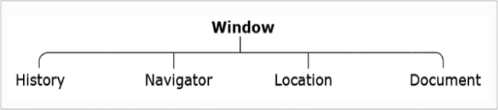
Browser Object Model
As you know that, JavaScript is capable of dynamically manipulating the content and style of HTML elements of the web page currently rendered on the browser. The content given for para during HTML creation or the style given for heading during HTML creation can be changed even after the page has arrived on the browser.
This dynamic manipulation of an HTML page on the client-side itself is achieved with the help of built-in browser objects. They allow JavaScript code to programmatically control the browser and are collectively known as Browser Object Model (BOM).
For programming purposes, the BOM model virtually splits the browser into different parts and refers to each part as a different type of built-in object. BOM is a hierarchy of multiple objects. 'window' object is the root object and consists of other objects in a hierarchy, such as, 'history' object, 'navigator' object, 'location' object, and 'document' object.

Slide 193
The HTML web page that gets loaded on the browser is represented using the 'document' object of the BOM model.
This object considers the web page as a tree which is referred to as Document Object Model(DOM). Each node of this tree represents HTML elements in the page as 'element' object and its attributes as properties of the 'element' object.
W3C provides DOM API consisting of properties and methods that help in traversal and manipulation of the HTML page.
Shown below is the HTML web page and it's corresponding DOM structure that can be accessed using DOM API methods and properties:
Sample HTML Code:

Slide 194
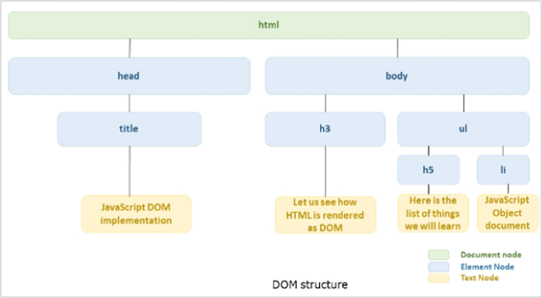
<html>
<head>
<title>JavaScript DOM Implementation</title>
</head>
<body>
<h3>Let us see how HTML is rendered as DOM</h3>
<ul>
<h5>Here is the list of things we will learn</h5>
<li>JavaScript Object Document</li>
</ul>
</body>
</html>
DOM Structure:

Slide 195
There are certain methods and properties that allow to traverse the DOM tree and manipulate content or style for the specified node representing the HTML element.
To access an element in the HTML page, following methods can be used on the 'document' object from DOM.
getElementById(x)
Finds element with id 'x' and returns an object of type element
Example:
<p id="p1"> Paragraph 1</p>
<p> Paragraph 2</p>
<script>
//Selects paragraph having id 'p1'
document.getElementById('p1');
</script>

Slide 196
getElementsByTagName(x)
Find element(s) whose tag name is 'x' and return NodeList, which is a list of element objects.
Example:
<p id="p1">Paragraph 1</p>
<p>Paragraph 2</p>
<script>
document.getElementsByTagName('p');
</script>
//OUTPUT:
//Paragraph 1
//Paragraph 2
getElementsByClassName()
Find element(s) whose class attribute's values is 'x' and returns NodeList, which is list of element objects
Example:

Slide 197
<p class="myClass">Paragraph 1</p>
<p>Paragraph 2</p>
<script>
//Selects paragraph having class = "myClass"
var x = document.getElementsByClassName('myClass');
</script>

Slide 198
Some of the other properties of the 'document' object to access the HTML element are:
the body returns body element. Usage: document.body;
the forms return all form elements. Usage: document.forms;
the head returns the head element. Usage: document.head;
the images return all image elements. Usage: document.images;
To manipulate the content of HTML page, the following properties of 'element' object given by DOM API can be used:
innerHTML
It gives access to the content within HTML elements like div, p, h1, etc. You can set/get a text.
Example:

Slide 199
<div id="div1">
<h1 id="heading1">Welcome to JavaScript Tutorial</h1>
<p id="para1" style="color: blue;">Let us learn DOM API</p>
</div>
<script>
//retieves current content
document.getElementById("heading1").innerHTML;
//sets new content
document.getElementById.innerHTML = "Heading generated dynamically"
</script>
attribute
It is used to set new values to given attributes.
Example:

Slide 200
<head>
<title>JavaScript DOM Implementation</title>
<style>
.div2 {
color: yellow;
}
</style>
</head>
<body>
<div id="div1">
<h1 id="heading1">Welcome to JavaScript Tutorial</h1>
<p id="para1" style="color: blue;">Let us learn DOM API</p>
</div>
<script>
document.getElementById("div1").attributes[0].value;
document.getElementById("div1").setAttribute('class', 'div2');
</script>
</body>

Slide 201
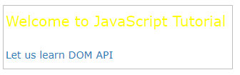
Output:
Initially, no color was applied to the heading, later the class ‘div2’ was added using setAttribute.
To manipulate the style of an HTML element, the following property of the 'element' object given by DOM API can be used:
style
It gives access to the style attribute of the HTML element and allows it to manipulate the CSS modifications dynamically.
Example:

Slide 202
<div id="div1">
<h1 id="heading1">Welcome to JavaScript Tutorial</h1>
<p id="para1" style="color: blue;">Let us learn DOM API</p>
</div>
<script>
//resets style property
document.getElementById("div1").style.color = "red";
</script>
So far, you know how the content and style for a given HTML page can be modified using the BOM model's object 'document’.
Suppose it is not required to update the HTML page but only certain properties of the browser window on which it is rendered. That is to navigate to a different URL and display a new web page, or close the web page or store some data related to the web page. Well, to implement this, an object that represents the entire browser window and allows us to access and manipulate the window properties is required. BOM model provides that 'window' object.
This object resides on top of the BOM hierarchy. Its methods give us access to the toolbars, status bars, menus, and even the HTML web page currently displayed.

Slide 203
Working with Arrays
Objects in JavaScript is a collection of properties stored as key-value pair.
Often, there is requirement for an ordered collection, where there are 1st, 2nd, 3rd element, and so on. For example, you need to store a list of students in a class based on their roll numbers
It is not convenient to use an object here, because objects don’t store the values in an ordered fashion. Also, a new property or element cannot be inserted "between" the existing ones.
This is why Array is used to store values in order.
Array in JavaScript is an object that allows storing multiple values in a single variable. An array can store values of any datatype. An array's length can change at any time, and data can be stored at non-contiguous locations in the array,
Example:

Slide 204
let numArr = [1, 2, 3, 4];
let empArr = ["Johnson", 105678, "Chicago"];
The elements of the array are accessed using an index position that starts from 0 and ends with the value equal to the length of the array minus 1.
Example:
let numArr = [1, 2, 3, 4];
console.log(numArr[0]); //1
console.log(numArr[3]); //4
Arrays can be created using the literal notation or array constructor.
Array Literal Notation:
Arrays are created using literal notation almost all the time.
Syntax:

Slide 205
let myArray = [element 1, element2,…, element N];
Example:
let colors = ["Red", "Orange", "Green"]
Array Constructor:
Arrays can be created using the Array constructor with a single parameter which denotes the array length. The parameter should be an integer between 0 and 232-1 (inclusive). This creates empty slots for the array elements. If the argument is any other number, a RangeError exception is thrown.
Syntax:
let myArray = new Array(arrayLength);
Example:

Slide 206
let colors = new Array(2);
console.log(colors.length); //2
//Assign values to an empty array using indexes
colors[0] = "Red";
colors[1] = "Green";
console.log(colors); //['Red','Green']
If more than one argument is passed to the Array constructor, a new Array with the given elements is created.
Syntax:
let myArray = new Array(element 1, element 2,…,element N);
Example:
let colors = new Array("Red", "Orange", "Green");

Slide 207
Combining and cloning Arrays using Spread operator
Spread operator is a new operator that was introduced as part of JavaScript in 2015. It consists of triple dots ( ... ) which helps in spreading out the elements of an array to a new variable.
When the spread operator is used in the function call, it expands the iterable object, i.e., array into the list of arguments.
Example:
let numArr = [10, 5, 20];
//spread turns array into the list of arguments
console.log(Math.max(...numArr)); // 20
Arrays can be merged using the spread syntax.
Example:

Slide 208
let arr1 = [3, 5, 1];
let arr2 = [8, 2, 6];
let newArr = [...arr1, ...arr2];
console.log(newArr); // [3,5,1,8,2,6]
Arrays can be combined with normal values.
Example:
let arr1 = [3, 5, 1];
let arr2 = [8, 2, 6];
let newArr = [0, ...arr1, 4, ...arr2];
console.log(newArr); // [0,3,5,1,4,8,2,6]
You can also use the spread operator to create a copy of an array.
Example:
let arr1 = [3, 5, 1];
let arrCopy = [...arr1];
arrCopy.push(4);
console.log(arrCopy);
//arrCopy becomes [3,5,1,4] and arr1 remains unaffected

Slide 209
Destructuring Arrays
JavaScript introduced the destructuring assignment syntax that makes it possible to unpack values from arrays or objects into distinct variables. So, how does this syntax help to unpack values from an array.
Example:
// [RN1] we have an array with the employee name and id
let empArr = ["Shaan", 104567];
// destructuring assignment
// sets empName = empArr[0]
// and empId = empArr[1]
let [empName, empId] = empArr;
console.log(empName); // Shaan
console.log(empId); // 104567
Destructuring assignment syntax is just a shorter way to write:
let empName = empArr[0];
let empId = empArr[1];

Slide 210
You can also ignore elements of the array using an extra comma.
Example:
let [empName, , location] = ["Shaan", 104567, "Bangalore"];
//Here second element of array is skipped and third element is assigned to location variable
console.log(empName); // Shaan
console.log(location); // Bangalore
Rest operator can also be used with destructuring assignment syntax.
Example:
let [empName, ...rest] = ["Shaan", 104567, "Bangalore"];
console.log(empName); // Shaan
console.log(rest); // [104567,'Bangalore']
Here, the value of the rest variable is the array of remaining elements and the rest parameter always goes last in the destructuring assignment.

Slide 211
Accessing Arrays
Array elements can be accessed using indexes. The first element of an array is at index 0 and the last element is at the index equal to the number of array elements – 1. Using an invalid index value returns undefined.
Example:
let arr = ["first", "second", "third"];
console.log(arr[0]); //first
console.log(arr[1]); //second
console.log(arr[3]); //undefined
Loop over an array
You can loop over the array elements using indexes.
Example:

Slide 212
let colors = ["Red", "Orange", "Green"];
for (let i = 0; i < colors.length; i++) {
console.log(colors[i]);
}
//Red
//Orange
//Green
JavaScript also provides for..of statement to iterate over an array.
Example:
let colors = ["Red", "Orange", "Green"];
// iterates over array elements
for (let color of colors) {
console.log(color);
}
//Red
//Orange
//Green

Slide 213
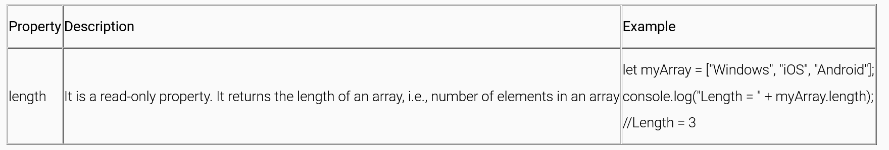
Array Methods
JavaScript arrays consist of several useful methods and properties to modify or access the user-defined array declaration.
Below is the table with property of JavaScript array:
Below is the table with methods to add/remove array elements:

Slide 214
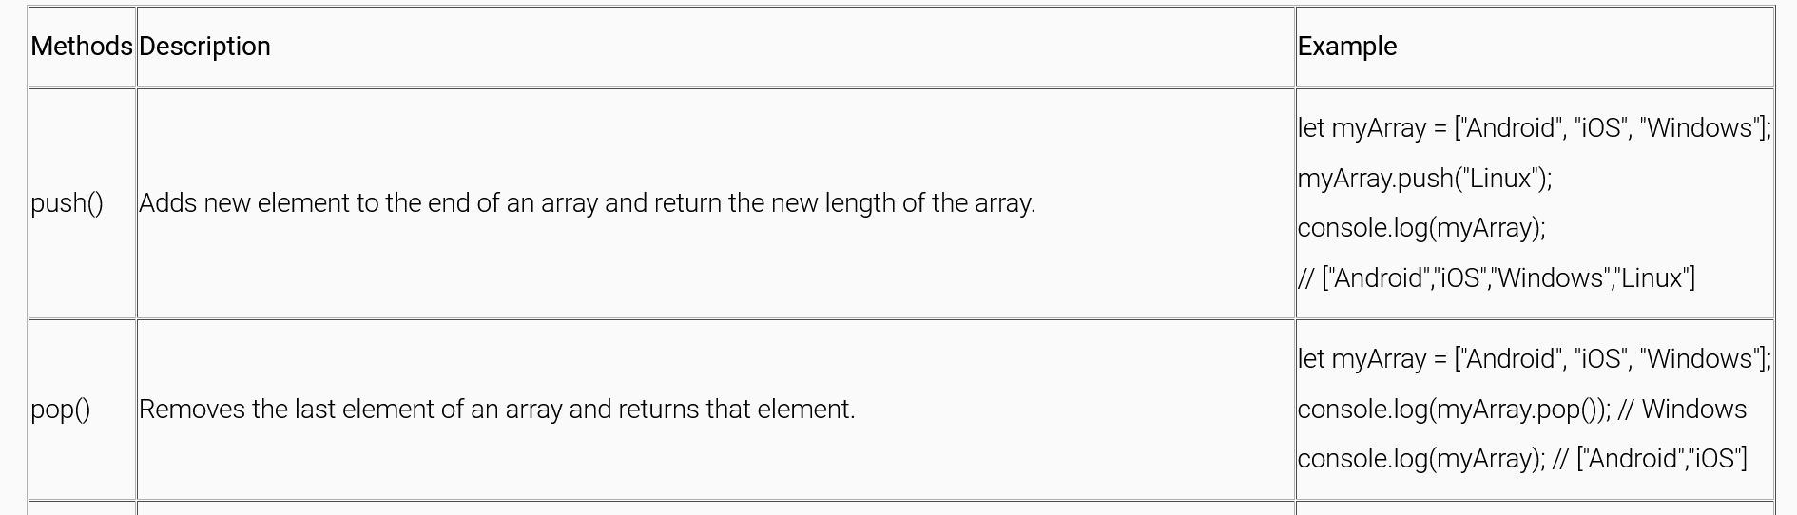

Slide 215
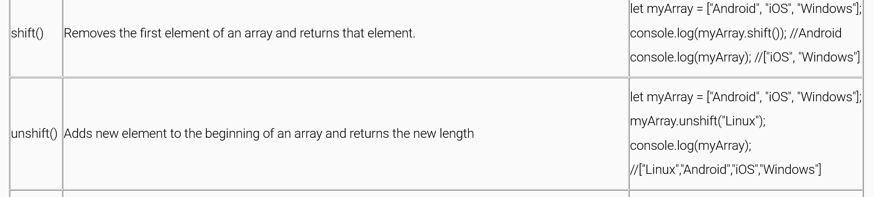

Slide 216
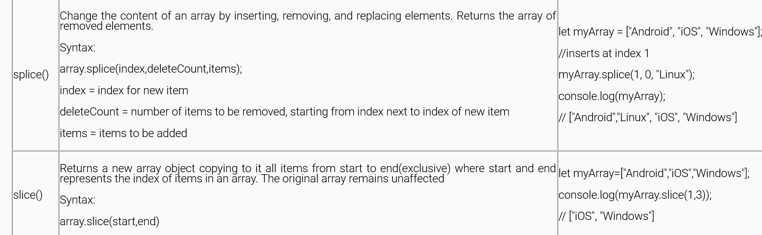

Slide 217


Below is the table with methods to search among array elements:

Slide 218


Slide 219


Slide 220


Slide 221

Below is the table with methods to iterate over array elements:

Slide 222

Below is the table with methods to transform an array:

Slide 223


Slide 224


Slide 225
Tryout : Iterables
Problem Statement:
Observe the output which helps to understand the concept of Arrays, Rest and Spread operators, and the concept of destructuring.
Activity:
You are suggested to create a new array and try the code by assigning different values to the variables used.
<!DOCTYPE html>
<html>
<head>
<title>Iterable Demo</title>
<script>
let Pdt_Price = [5000, 3000, 500];
const [Pdt1, Pdt2, Pdt3] = Pdt_Price;
document.write("Total Amount : " + (Pdt1+Pdt2+Pdt3) + "<br/>");

Slide 226
const [Pdt4,,Pdt5] = Pdt_Price;
document.write("Total Amount " + (Pdt4+Pdt5) + "<br/>");
let [ProductId, ...ProductName] = [1001,"Mobiles","Furniture","Tablets","Books"];
document.write("Product Id : " + ProductId + "<br/>");
document.write("Product Name : " + ProductName +"<br/>");
</script>
</head>
</html>

