Slide 1
JDBC

Slide 2
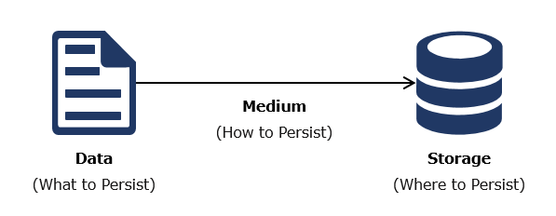
Introduction to JDBC
Data Persistence means for an application to persist and retrieve information from the non-volatile storage. Data is to be stored and retrieved from the central location. In order to achieve this, it is necessary to persist data in a common repository (like a database). The way of persisting the data into a common repository is called Data persistence.
The term Data persistence:

Slide 3
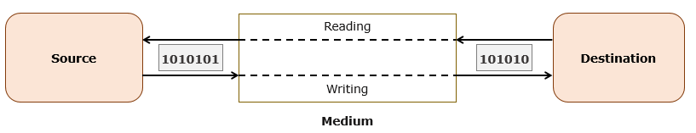
The persistence phenomenon contains three core components- Data, Medium, Storage. It is also necessary to know what to persist, how to persist and where to persist.
Medium is the thing that is used to transfer the data from source to destination. The data is transferred between source and destination in a serialized manner. To transfer the data efficiently in a serial manner, the mechanism used is called Serialization. Serialization is the method of converting all the data/objects to byte stream (0’s and 1’s) to transfer the data to the specified storage or repository.

Slide 4
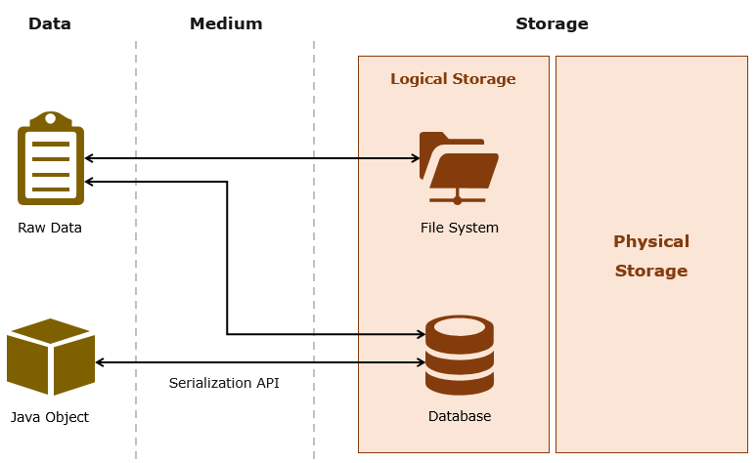
Serialization is one of the methods used to transfer the data efficiently between the source and destination. If we take the database as the destination, all the data will be transferred in the form of a byte stream in the medium between the source and database. The process of converting back from byte stream to data/object is called as Deserialization.

Slide 5
Now that we have discussed what data persistence is, let us see how we can implement the same in Java.
Let us see how can we store the data in the database, by using Java as the base technology. The Java application and the database have to be connected with some sort of API. The JDBC, a Java API serves for this purpose.
Java Database Connectivity or JDBC, is a Java API which is used to connect to a database and run queries on them. This API is consisted in the standard edition of Java (JavaSE), and requires JDBC drivers for database connection. The JDBC API can access tabular data from any relational database.
The JDBC API can be handy in managing database using Java programs or/and performing the following operations:
Connecting programs to the databases
Running queries and/or updating the data in the database
Obtaining results from the database after query execution.

Slide 6
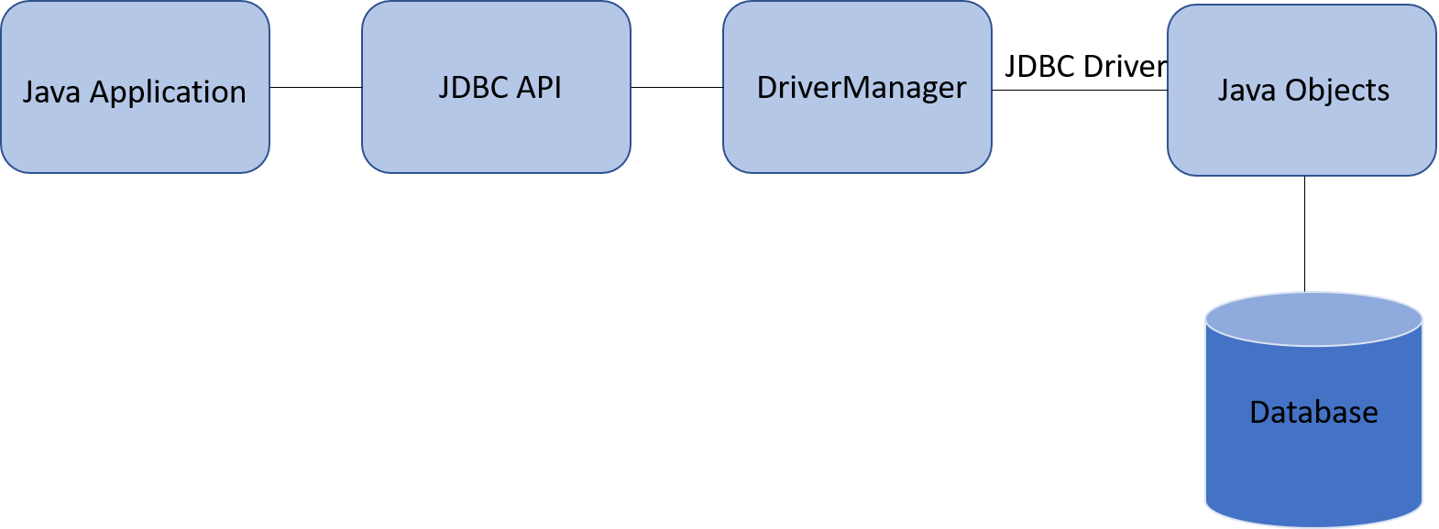
How a database is connected through JDBC:
Next, let us understand the concept of a 'driver'.

Slide 7
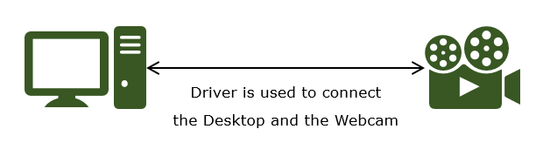
A driver is a software component that connects two dissimilar environments. For example, if you want to connect a web camera with your desktop, you need a Webcam Driver. The Webcam Driver is used to connect your desktop and Webcam is to transfer the data between them. Similarly, since a Java application and the database server are two completely heterogeneous environments, we need a JDBC driver to connect them.
The database vendors have to implement java.sql.Driver interface of JDBC API in order to build a driver class through which a Java application can connect and communicate with their database product. For this, we will be using a Type 4 or a pure java driver.
Now, to connect with a particular Database we need to give the credentials such as ConnectionURL, DriverClass, UserName, Password which we will discuss further.

Slide 8
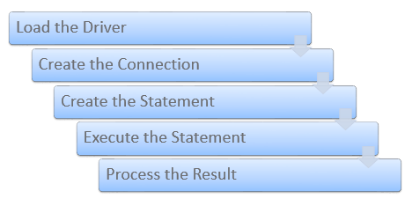
Working with JDBC involves the following sequence of steps:
A Data Source Object or a DriverManager establishes the connection.
static final String JDBC_DRIVER = "com.mysql.cj.jdbc.Driver";
//you can use com.mysql.jdbc.Driver as JDBC_DRIVER
// Registering the JDBC driver
Class.forName(JDBC_DRIVER);
//driver loading is automatically done in JDBC 9 or greater version

Slide 9
The connection to the database is controlled by a connection object. This connection object is used by the application to create statements. The Database URL, username and password are passed to the getConnection() method.
static final String DB_URL = "jdbc:mysql://localhost:3306/jdbc_demo";
static final String USER = "root";
static final String PASS = “root";
Connection connection = null;
connection = DriverManager.getConnection(DB_URL, USER, PASS);
Statement is used to execute SQL statements (For fetch operation).
Statement statement = null;
statement = connection.createStatement();

Slide 10
A ResultSet object, that contains the results of a query, is returned when a SQL Statement is executed.
String sql;
sql = "select * from employee";
ResultSet resultset = statement.executeQuery(sql);
Let us now see a small demo where we can fetch the values that are present in a pre-created database.

Slide 11
Let us see a simple demo where we perform a fetch operation using JDBC from a pre-created database. Note that MySQL DB is a pre-requisite for the following operations.
(Note: If you want to download or install the Mysql Server:
From the Software Center: Click Start -> search “Software Center” -> search for "MySQL Server " and Select MySQL Server 5.6.20. (or any other appro. version) and install it.
Before we see the code, we have to perform the following steps to connect to the database and execute the table scripts –
(Note: The steps to connect to the database may/may not be applicable in your current system)
Step 1 : To Start MySQL Server navigate to C:\Java Artifacts\MySQL\MySQL Server 5.6\bin (bin of location where mysql is placed) and open CMD with the same directory, as shown below:
Note : If Mysql path is already added in environment variable then you can directly open CMD and you can proceed as given below

Slide 12
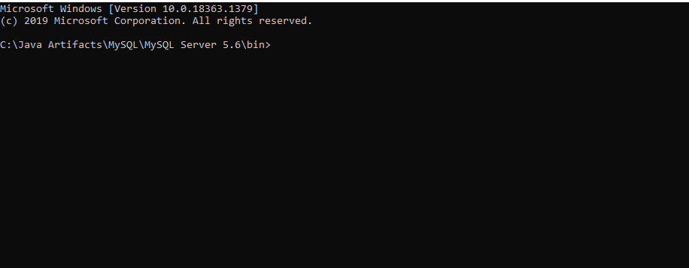
Type mysqld --console in the above prompt and press enter to start MySQL Server, If no process is running on port 3306, the server will successfully start as shown below:

Slide 13
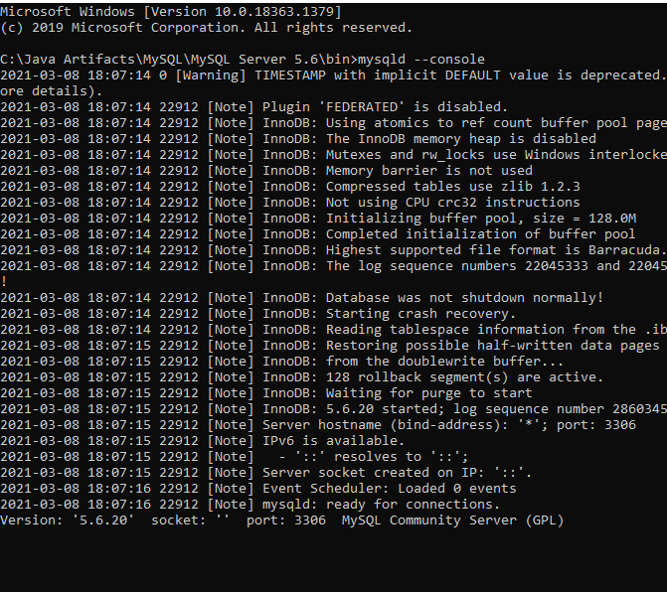

Slide 14
Note: “Ready For Connections” signifies, the server is successfully started
Step 2 : Connect to MySQL server to run the table script.
Open New CMD with directory C:\Java Artifacts\MySQL\MySQL Server 5.6\bin as shown below:
Note : If Mysql path is already added in environment variable then you can directly open CMD and you can proceed as given below

Slide 15
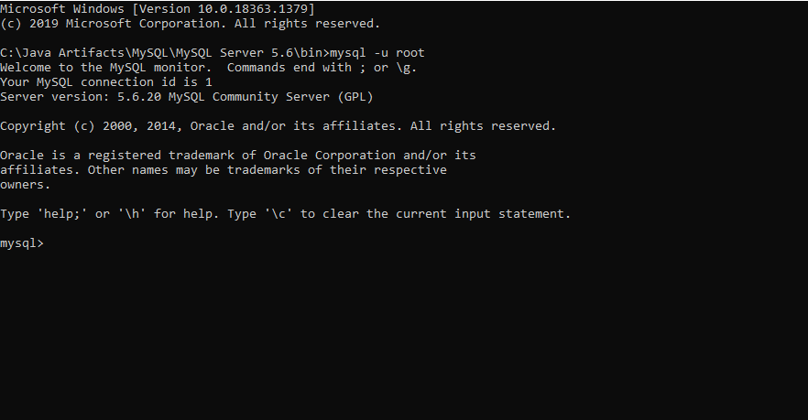
Type mysql -u root in above prompt and press on Enter, to connect to MySQL server as shown below

Slide 16
Note: Getting Mysql prompt signifies you have successfully connected to MySQL server, at this prompt you can execute SQL commands.
Step 3: Execute the following table scripts:
create database jdbc_demo;
use jdbc_demo;
drop table employee;
create table employee(
emp_id int,
emp_name varchar(30),
emp_age int
);
insert into employee values(101, 'Alex', 24);
insert into employee values(102, 'Martin', 24);

Slide 17
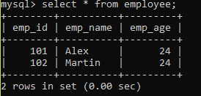
Step 4: Check if the values have been successfully inserted in the database:
Execute the following statement:
select * from employee
You should be able to get an output as such:
Next, let us see how we can use Java for connecting to the database and performing the fetch operation using JDBC.

Slide 18
Highlights:
Understanding Java API to connect Java application to SQL database.
Exploring the Retrieve operation in JDBC
Problem Statement:
To fetch all the values in the pre-existing 'employee' database.
package application;
import java.sql.Connection;
import java.sql.DriverManager;
import java.sql.ResultSet;
import java.sql.SQLException;
import java.sql.Statement;
import org.apache.commons.logging.Log;
import org.apache.commons.logging.LogFactory;

Slide 19
public class EmployeeDetails {
private static final Log LOGGER = LogFactory.getLog(EmployeeDetails.class);
static final String JDBC_DRIVER = "com.mysql.cj.jdbc.Driver";
static final String DB_URL = "jdbc:mysql://localhost:3306/jdbc_demo";
// Provide your own database credentials
static final String USER = "root";
static final String PASS = “root";
public static void main(String[] args) {
Connection connection = null;
Statement statement = null;
try {
// Registering the JDBC driver
Class.forName(JDBC_DRIVER);
// Opening a connection
connection = DriverManager.getConnection(DB_URL, USER, PASS);

Slide 20
statement = connection.createStatement();
String sql;
// Executing the query
sql = "select * from employee";
ResultSet resultset = statement.executeQuery(sql);
// Extracting the result
// The next() method moves the cursor forward by one row from it current
// position in the resultset
while (resultset.next()) {
// getInt() gets the value of a column as integer
// getString() gets the value of a column as string
// Retrieve by column id
int id = resultset.getInt(1);
String name = resultset.getString(2);
int age = resultset.getInt(3);
// Displaying the values
LOGGER.info("Id: " + id+", Name: " + name+", Age: " + age);
}

Slide 21
// Closing the connection
resultset.close();
statement.close();
connection.close();
} catch (SQLException se) {
// This handles errors for JDBC
System.out.println(se);
} catch (Exception e) {
// This handles errors for Class.forName
LOGGER.info(e);
} finally {
// finally block closes all the resources
try {
if (statement != null)
statement.close();
} catch (SQLException se2) {
LOGGER.info(se2);
}
try {
if (connection != null)
connection.close();
} catch (SQLException se) {
LOGGER.info(se);
}
}
}
}

Slide 22

Connection gets established by calling getConnection() on passing database credentials like URL, username,password
Once the connection is established, a statement is executed for the select query.
Execute the imported project. After running the EmployeeDetails.java class, you should get the following output.

Slide 23
Best Practices - JDBC
Just like any other concept in Java, JDBC also comes with its own best practices, we will be discussing only a few like,
Use finally block to close all resources
Use try-with-resources block
Use finally block to close all resources:
In enterprise applications, the developers might have opened connections to databases or files to process data. Most databases have a limit on how many users can be connected at a time and these connections and resources are very costly. So It is always a good practice to close all open connections when they are no more required. But as we know if an exception is thrown at any point, the rest of the code will not be executed including the code to close/terminate the open connections. So when an exception occurs and if it is handled using the try-catch block, the developer can use the finally block to terminate all open connections.
Here is an example that follows bad practice to close database connections.

Slide 24
Connection connection = null;
try{
connection = DriverManager.getConnection("URL","USERNAME","PASSWORD");
//code to process data
//an exception is thrown here if data does not exist
connection.close(); //line 6
}catch(Exception e){
//code to handle exception
}
In the above example, if an exception is thrown in the try block before connection.close() is executed, the database connection that was opened will never be closed.
Now, here is an example of how to properly close database connections using the finally block.

Slide 25
Connection connection = null;
try{
connection = DriverManager.getConnection("URL","USERNAME","PASSWORD");
//code to process data
//an exception is thrown here if data does not exist
}catch(Exception e){
//code to handle exception
}finally{
if(connection == null || connection.isOpen()){
connection.close();
}
}
From the above code, even if an exception occurs in the try block and since the code to close connection is given in the finally block, any open connections will always be closed. Since the finally block will always get executed irrespective of whether an exception occurs or not.
Note: Before closing any connection, it is always a good practice to check if the connection is open or not null.

Slide 26
With Java 7, a new try-with-resources was introduced. The main purpose of try-with-resources was to automate the process of opening and closing resource connections(database or files). To brief the previous statement, when the execution reaches the try-with-resources, a database connection is opened, and this open connection is used within the try block and closed automatically as soon as the execution comes out of the try block. Let us look at how to use the try-with-resources.
Syntax for try-with-resources : try ( <code to open resources> ) { }
try(Connection connection = DriverManager.getConnection("URL", "USERNAME", "PASSWORD"); //code to create a new connection
PreparedStatement preparedStatement = con.prepareStatement("SQL QUERY"); ){ //code to create a prepared statement
//code to process data using the statement and connection created
}catch(SQLException e){
//code to handle exception
}

Slide 27
Since try-with-resources takes away the responsibility of developers to open and close connections, it is more dependable and also the code becomes more compact and readable. So, it is recommended to use try-with-resources when dealing with files or database connections.

Slide 28
JDBC - Exercise 1
A Hotel wants an application that fetches the details of the guests who have been staying there. They already have a database that has the details. It includes two modules:
Get All Guest Details
Get All Guests By Name
Note: The table scripts have been provided in the project. Setup the database connection accordingly and execute the table scripts.
Method description:
getAllGuests():
This method displays all the details of all the guests present in the database.
Create the connection with the database by declaring all the required credentials and then by using the getConnection() method.
Create the query to display the details of all the guests in the database
Print the details
Handle any exception that can occur
Close the connection.

Slide 29

When this method is called, the expected output should be:
getGuestsByName():
This method displays the names of all the guests present in the database.
Create the connection with the database by declaring all the required credentials and then by using the getConnection() method.
Create the query to display the names of all the guests in the database
Print the details
Handle any exception that can occur
Close the connection.
When this method is called, the expected output should be:

Slide 30
