Slide 1
BatteryX AI
Case Study No. 2
Reusable AI-assisted digital platform for designing battery energy systems
Team Bit Manipulators
Amey Mohite · Harshad Khatale · Shambhu Gaikwad
Walchand College of Engineering, Sangli
Notes:
Good morning. We are Team Bit Manipulators from Walchand College of Engineering, Sangli, presenting Case Study 2: a reusable digital platform for designing battery energy systems. Our platform is BatteryX AI. Our promise in one line: change one parameter and see every consequence, across electrical, thermal, safety, mechanical and cost, with every number traceable to its inputs. In stage 1 we showed a browser prototype; in this stage we built the full platform and we will show only results we can reproduce live.
Objective: Introduce the team, the case study and the one-line promise of the platform.
Evidence required: None needed (identity slide).

Slide 2
One design change ripples across every subsystem
PROBLEM STATEMENT
Cells, connections, cooling, sensing, protection, packaging and controls must work together. Improving one parameter, such as capacity or charging speed, can worsen temperature, safety, weight, life or cost.
Design A: pack charge current 10 A → 20 A
1
Charge time (CC phase)
1.4 h → 0.7 h
twice as fast
Pain today
Electrical, thermal, safety and packaging data sit in separate tools
A faster-charge decision can silently push cells past thermal limits
Fuse, BMS and cell-limit conflicts are found late, at prototype stage
2
Heat per cell (I²R)
0.8 W → 3.2 W
×4 with current squared
3
Est. peak cell temperature
39.06 → 46.65 °C
TH-01 FAIL (limit 45 °C)
What engineers and students need
Virtually design, test, compare and improve configurations
See trade-offs across every subsystem before building hardware
Reach safe, efficient, reliable and affordable designs
4
Cell charge C-rate
0.5 C → 1.0 C
EL-01 WARN at datasheet max
Problem: TELIPORT S4 Case Study 2 (Tata Elxsi). Example: BatteryX engine output on illustrative stage-1 cell data (not a real product); model estimates, not measurements.
Notes:
The case study describes the core difficulty: a battery is a coupled system. Take one decision, doubling the charge current of our baseline module from 10 to 20 amps. Charging gets twice as fast, from 1.4 to 0.7 hours. But heat per cell grows with current squared, from 0.8 to 3.2 watts, so the estimated peak cell temperature rises from 39.06 to 46.65 degrees and crosses the 45 degree limit, and the cell is now at its datasheet charge-rate maximum. These numbers come straight from our engine using illustrative stage-1 data; they are model estimates, not measurements. The point is that one change touches four disciplines at once, and that is what engineers need to see before building hardware.
Objective: Show that we understand the battery design problem and why trade-offs are hard, using one concrete, reproducible example.
Evidence required: docs/DEMO_RESULTS.md scenario S9 (charge-current sweep) and S1/S2 thermal heat values; reproducible with backend/scripts/demo_scenarios.py.

Slide 3
Five case-study challenges, five engineered answers
EXISTING CHALLENGES
Challenge (case study) | What goes wrong in practice | How BatteryX responds
Data spread across disciplines | Each discipline keeps its own spreadsheet; interface conflicts surface late | One shared design document feeds 11 versioned models; rule checks catch fuse / BMS / cell mismatches
Energy, temperature, charge time, safety, size and cost must balance | Optimising one metric silently breaks another | Constraint-first comparison: a safety FAIL excludes a design; trade-offs listed against the baseline
Cell variation, ageing and conditions propagate to pack level | Nominal-cell calculations hide hot or weak cells | Seeded Monte-Carlo of cell tolerance, ageing scenarios, ambient and current sweeps
Limited test data, software and computing | Commercial tools are costly; datasheets are incomplete | Open stack on a laptop; missing data is flagged, never invented
A full pack is too large for a hackathon | Scope creep, nothing finished or tested | Scope fixed to a low-voltage 4S LFP solar-storage module; platform scales to 32S × 16P
Bottom line: every challenge in the brief maps to a working, tested feature you can see live.
Notes:
These five challenges are quoted from the case study. For each one we asked what actually goes wrong in practice and built a specific response. Data lives in separate disciplines, so we put everything in one shared design document that every model reads. Trade-offs are hard, so the comparison is constraint-first: a design that fails a safety check cannot win on score. Variation propagates, so we simulate cell tolerance statistically. Data and software are limited, so the platform runs on a laptop and flags missing datasheet values instead of guessing them. And because a full pack is too big for this competition, we fixed our demonstration scope to a low-voltage four-cell module while keeping the platform general.
Objective: Map every challenge listed in the case study to a concrete consequence and to our response, proving problem understanding.
Evidence required: Case study "Underlying Challenge" list; module list in docs/TECHNICAL_DOCUMENTATION.md; scope in BatteryX_Plan/BATTERYX_AI_PRD.md §1.4.

Slide 4
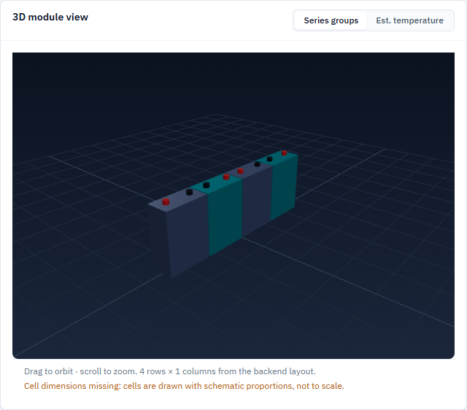
BatteryX AI: one workflow from requirement to traceable report
PROPOSED SOLUTION
Requirements
Cell
Topology
Simulate
Safety checks
Compare
Report
12 pages · 11 versioned models · 15 safety checks · 5 AI capabilities · AI explains, never computes
1
Physics computes
2
Rules check
Every number from versioned engine models
Units and model id on every result
15 deterministic safety checks
Datasheet and engineer limits, with sources
3
AI explains
4
Engineer decides
Claude reads engine results via tools
Every answer verified by the backend
Every input tagged with its source
Reports state assumptions and gaps
Live 3D module view generated from backend layout
Notes:
BatteryX AI is a web platform that takes a battery module from requirements to a traceable engineering report. You pick a cell from the database, choose the series-parallel topology, run electrical and thermal simulations, check protection and monitoring rules, compare alternatives and generate the report. Four principles keep it trustworthy: physics computes every number, deterministic rules check the limits, AI only explains results it receives from the engine, and the engineer makes the decision. The 3D view you see is generated from the backend's layout. Today the platform has 12 pages, 11 versioned engineering models and 15 safety checks, and we ran this whole workflow in a real browser as an automated test.
Objective: Explain what BatteryX AI is, its workflow and the principles that make it trustworthy.
Evidence required: Real-browser end-to-end run of this exact workflow: frontend/e2e/workflow.e2e.mjs, docs/screenshots/e2e-results.json (14/14 steps).

Slide 5
Simple layers, one deterministic engine, full traceability
SYSTEM ARCHITECTURE
Browser: React + Vite + Tailwind
12 pages · Recharts charts · Three.js 3D view · autosave · error boundaries
Traceability chain
Input
value + source tag
Model
id + version + equations
FastAPI backend (Python)
Engine
11 versioned models, NumPy / SciPy, pure functions
Rule engine
15 safety checks, max safe current
AI copilot
9 engine tools + answer verifier
Result
KPI with unit, ESTIMATE
Check
limit + limit source
MongoDB Atlas
cells · projects · conversations (SQLite fallback)
Claude API (server-side)
keys never reach the browser · Groq optional
Report
assumptions + gaps
Notes:
The architecture is deliberately simple. The browser app talks JSON to a FastAPI backend. Inside the backend the engine is pure and deterministic: the same functions serve the web pages, the AI tools and the tests. The rule engine applies fifteen checks. The AI copilot can only call engine and database tools, and a verifier checks its answers. Data lives in MongoDB Atlas, with an automatic SQLite fallback so the demo works offline. API keys stay on the server. On the right is the traceability chain: every input carries a source tag, every result names the model and version that computed it, and the report prints the whole chain.
Objective: Show a simple, feasible architecture and how results stay traceable from input to report.
Evidence required: docs/TECHNICAL_DOCUMENTATION.md §1 and §4; GET /health shows the active database; evaluation responses contain inputs and kpi_trace (test_audit.py::test_evaluation_traces_inputs_and_models).

Slide 6
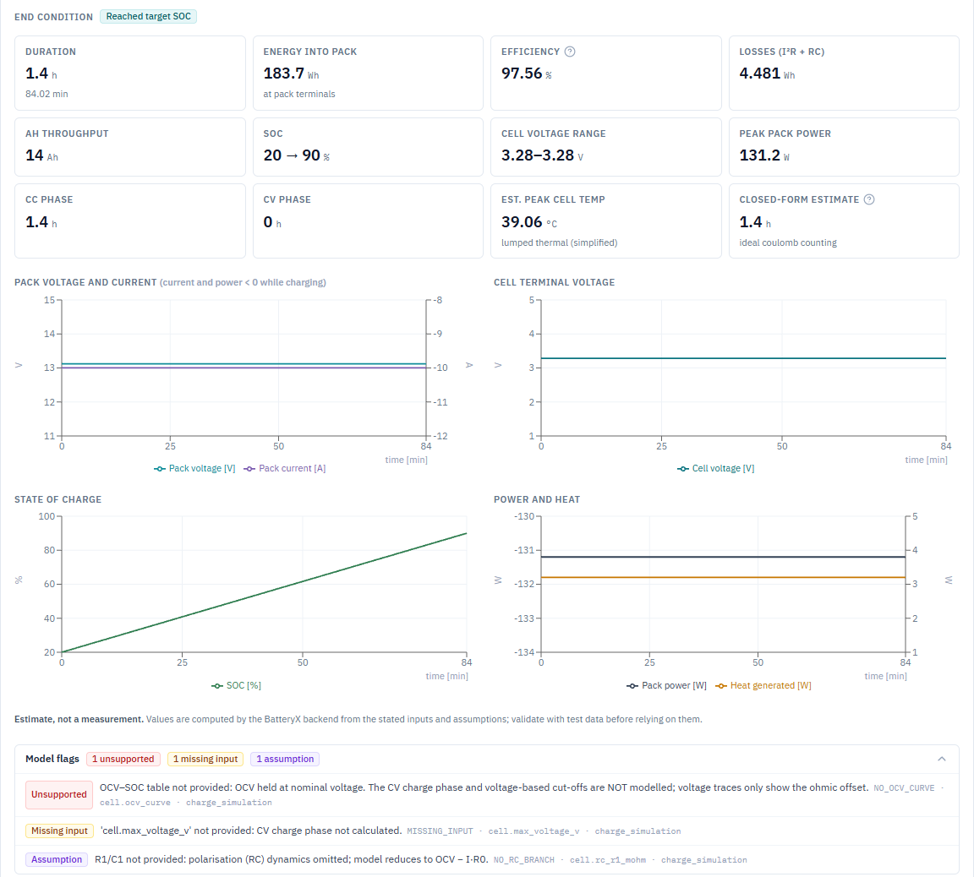
Stated equations, labelled fidelity, verified code
ENGINEERING AND SIMULATION MODULES
Configuration
Energy & power
S·P scaling: pack V, Ah, R
E = V·Ah, P = V·I − I²R
closed form
closed form
Electrical simulation
Thermal
1-RC ECM, CC-CV charge, CC/CP discharge
Lumped node coupled to electrical
time domain
simplified
BMS & safety
Mechanical
15 checks, max safe current (brentq)
Envelope, mass roll-up, busbar sizing
rule engine
closed form
Variation & ageing
Comparison
Seeded Monte-Carlo; linear ageing
Constraint-first weighted ranking
statistical / simplified
aggregation
Verified in 109 backend tests (not yet validated against measurements)
Energy conserved within 0.2 %
CC→CV switch at hand-calculated SOC
Thermal matches closed form (±0.01 K)
Matches stage-1 engine on A/B/C
Electrical page: KPIs, charts and model flags from the backend
Notes:
These are the eight engineering modules. Every one states its equations and assumptions, and every response carries the model's id, version and fidelity label, so we never hide that the thermal and ageing models are simplified. The electrical model is a one-RC equivalent circuit with a proper CC-CV charge. The screenshot is the real Electrical page: KPIs, four charts from the backend time series and, below, the model flags. Here they say the illustrative cell has no OCV curve, so the constant-voltage phase is not modelled. We verified every equation with hand calculations and analytical solutions, including energy conservation within 0.2 percent. Verification is not validation: we have not compared against measured battery data yet, and we say so.
Objective: Demonstrate engineering quality: stated equations, honest model fidelity, verified implementation.
Evidence required: backend/docs/ENGINEERING_MODELS.md; docs/AUDIT_REPORT.md §3 (formula and unit table with test names); pytest output.

Slide 7
An AI copilot that cannot invent engineering numbers
AI INTEGRATION AND INNOVATION
User request
Claude interprets
Calls 9 engine / DB tools
Engine computes (refs T1…)
Structured answer with sources
Backend verifier (+1 repair)
AI Design Copilot
AI Engineering Analyst
AI Safety Assistant
AI Optimization Advisor
AI Report Generator
Built-in guardrails
Incorrect claims the verifier rejects (automated tests)
Numbers come only from engine tool results
AI cannot edit assumptions or invent cells
Every claim cites a tool reference (T1, T2…)
Certification and "measured" wording rejected
Verification status shown on every answer
AI wrote | Verifier result
"Cells will last 6000 cycles" | ungrounded number
Claims 41.7 °C; engine said 39.058 °C | value mismatch
"Complies with IEC 62619" | certification claim
Invented cell part number | unknown cell
Invented datasheet URL | unverified reference
Proposed design never simulated | candidate not evaluated
Status: 25 copilot tests pass with a scripted model driving the real engine. The live Claude run is pending an API key.
Notes:
Our innovation is an AI copilot that is genuinely useful but cannot fabricate engineering numbers. When you ask it something, Claude decides which tools to call: the cell database, an evaluation, a simulation, the safety checks, a comparison or a sweep. The engine computes, and every tool result gets a reference like T1. Claude must answer in a structured format where every number cites its reference. Then our backend verifier checks the answer: every number must exist in the tool results, references must be real, cells must exist in the database, and wording that certifies safety or calls estimates "measured" is rejected. If anything fails, the model gets one chance to repair, and the user always sees the verification status. The table shows false claims our tests feed in on purpose, and each one is caught. To be transparent: we tested this with a scripted model driving the real engine; the live Claude run needs an API key, and our smoke-test script is ready for it.
Objective: Show the innovation: an AI copilot that is useful but structurally unable to fabricate engineering numbers, and be explicit about its test status.
Evidence required: backend/tests/test_copilot.py (incorrect-claim cases, repair round, tool guardrails, rate limits); backend/docs/COPILOT.md; a live transcript from scripts/copilot_smoke.py once a key is configured.

Slide 8
The engine finds the trade-off, the checks find the limit
PROTOTYPE DEMONSTRATION AND ACTUAL RESULTS
Estimate | A 4S1P | B spreader | C 4S2P
Usable energy [Wh] | 204.8 | 204.8 | 409.6
CC charge time [h] | 1.4 | 0.7 | 1.4
Peak cell temp [°C] | 39.06 | 42.63 | 39.06
Module mass [kg] | 2.3 | 2.62 | 4.3
Max safe charge [A] | 15.4 | 20 | 25
Checks WARN/FAIL | 0 | 1 | 0
Requirements missed | REQ-03 | none | REQ-02, REQ-03
Engine rank | 2 | 1 | 3
Key findings
Passive cooling (A): TH-01 FAIL from 20 A at 46.65 °C
Heat spreader (B): same 20 A, 42.63 °C, so the engine recommends B
4S2P (C): 409.6 Wh, but 4.3 kg misses the 3 kg target
TH-01 FAIL from 20 A (46.65 °C)
14/14 browser workflow steps, 0 errors
146 automated tests passing
0.04 s per full design evaluation
Illustrative stage-1 cell data (not a real product). Model estimates, not measurements. Source: docs/DEMO_RESULTS.md, regenerated by backend/scripts/demo_scenarios.py.
Notes:
These are actual outputs of the working prototype, reproducible by one script. Left: the charge-current sweep on design A with passive cooling. Peak temperature rises faster than linearly and crosses the 45 degree limit at 20 amps, which is why the rule engine flags TH-01. Right: the three designs. Design B uses the same 20 amps but adds a heat spreader and stays at 42.63 degrees, with a charge-rate warning because it runs at the cell's 1C maximum. Design C doubles energy but misses the 3 kilogram mass requirement. The engine recommends B: A misses the one-hour charge requirement, and the penalty puts it below B even though its raw score is higher. Below are our evidence numbers: the whole workflow passes in a real browser, 146 automated tests pass, and a full evaluation takes 0.04 s. All values are estimates based on illustrative cell data.
Objective: Present measurable, repeatable results from the working prototype, with their status clearly labelled.
Evidence required: docs/DEMO_RESULTS.md (S1–S3, S7, S9) regenerated by backend/scripts/demo_scenarios.py; docs/screenshots/e2e-results.json; pytest and vitest runs.

Slide 9
Measured feasibility, honest limits, a concrete validation path
FEASIBILITY, BUSINESS VIABILITY, LIMITATIONS
1
Feasibility (measured)
2
Business viability (hypotheses)
3
Limitations (honest)
0.04 s per full evaluation; 0.11 s for an A/B/C comparison
Runs on a student laptop; SQLite fallback works offline
146 automated tests; browser workflow 14/14
Open-source stack; AI is optional
Users: engineering students, labs, early-stage EV and storage start-ups
Value: earlier conflict detection, one-click traceable reports, reusable cell libraries
Model: free education tier, paid team workspace (not yet validated)
Scales: one engine for classroom, start-up and lab use
Illustrative cell only: 7 of 15 checks not evaluated
First-order models; single-node thermal
No validation against measurements yet
No authentication; Claude not yet run live
Validation roadmap (planned, not done)
1. Add a real datasheet cell
2. Live Claude run with saved transcripts
3. Compare the model with a public dataset
4. Supervised single-cell low-voltage test
5. Five-user study
Notes:
Feasibility is measured, not claimed: a full evaluation takes four hundredths of a second on a laptop, the whole stack is open source, and the database falls back to SQLite offline. Business viability is a set of hypotheses we have not validated yet: students, labs and early-stage start-ups who need faster, traceable design studies. We are open about the limitations. The only cell in the database is the illustrative stage-1 example, so seven of fifteen checks cannot run. The models are first-order. Nothing has been validated against measurements. There is no login yet, and the Claude copilot has not been run live. The roadmap closes these in order: a real datasheet cell first, then a live AI run, a public-dataset comparison, a supervised low-voltage single-cell test, and a small user study. All of these are planned, none are done.
Objective: Prove feasibility with measured facts, frame viability as hypotheses, state limitations openly and show how they will be closed.
Evidence required: Timings measured 2026-11-09 (docs/EVALUATION_MAPPING.md); docs/AUDIT_REPORT.md §5 (remaining gaps); docs/DEMO_RESULTS.md S6 (missing-data handling).

Slide 10
Change one parameter. See every consequence.
Impact and next step
Trade-offs before hardware
Traceable by design
AI that cannot fabricate
Electrical, thermal, safety, packaging, cost
A full re-evaluation takes 0.04 s
Input → model → result → check
Assumptions and gaps in every report
Numbers only from engine tools
Verifier rejects invented claims
Next: real datasheet cell → live AI run → supervised low-voltage validation test
Thank you · Questions and live demo
Notes:
To close. Impact: BatteryX makes battery design trade-offs visible before anyone builds hardware, and every number it shows can be traced back to its inputs, the model that computed it and the assumptions behind it. It uses AI to help engineers understand results without letting AI invent them. Future scope: a multi-node thermal model with cell-to-cell conduction, datasheet import with human confirmation, pack and rack scale, validation datasets and team accounts. Our immediate next step is to load a real cell datasheet and run a supervised low-voltage test to start validating the models. Change one parameter, see every consequence. Thank you, we are happy to take questions and to run any scenario live.
Objective: Close with the impact, the future scope and one clear message the judges remember.
Evidence required: All earlier evidence; the recommended next step is stated in the comparison output and in docs/EVALUATION_MAPPING.md.

