Slide 1
BatteryX AI
Case Study No. 2
Reusable AI-assisted digital platform for designing battery energy systems
Change one parameter. See every electrical, thermal, safety and packaging consequence, with every number traceable to the model that computed it.
Team Bit Manipulators
Amey Mohite · Harshad Khatale · Shambhu Gaikwad
Walchand College of Engineering, Sangli
Notes:
[0:00–0:30] Good morning. We are Team Bit Manipulators from Walchand College of Engineering, Sangli, presenting TELIPORT S4 Case Study 2: a reusable, AI-assisted platform for designing battery energy systems. Our platform is BatteryX AI.
One line: change one parameter and see every consequence – electrical, thermal, safety and packaging – with every number traceable to the model that computed it.
Everything we show today is reproducible: the numbers come from our engine and test runs on 10 November 2026, and we label what is an estimate, what is measured, and what is still missing.

Slide 2
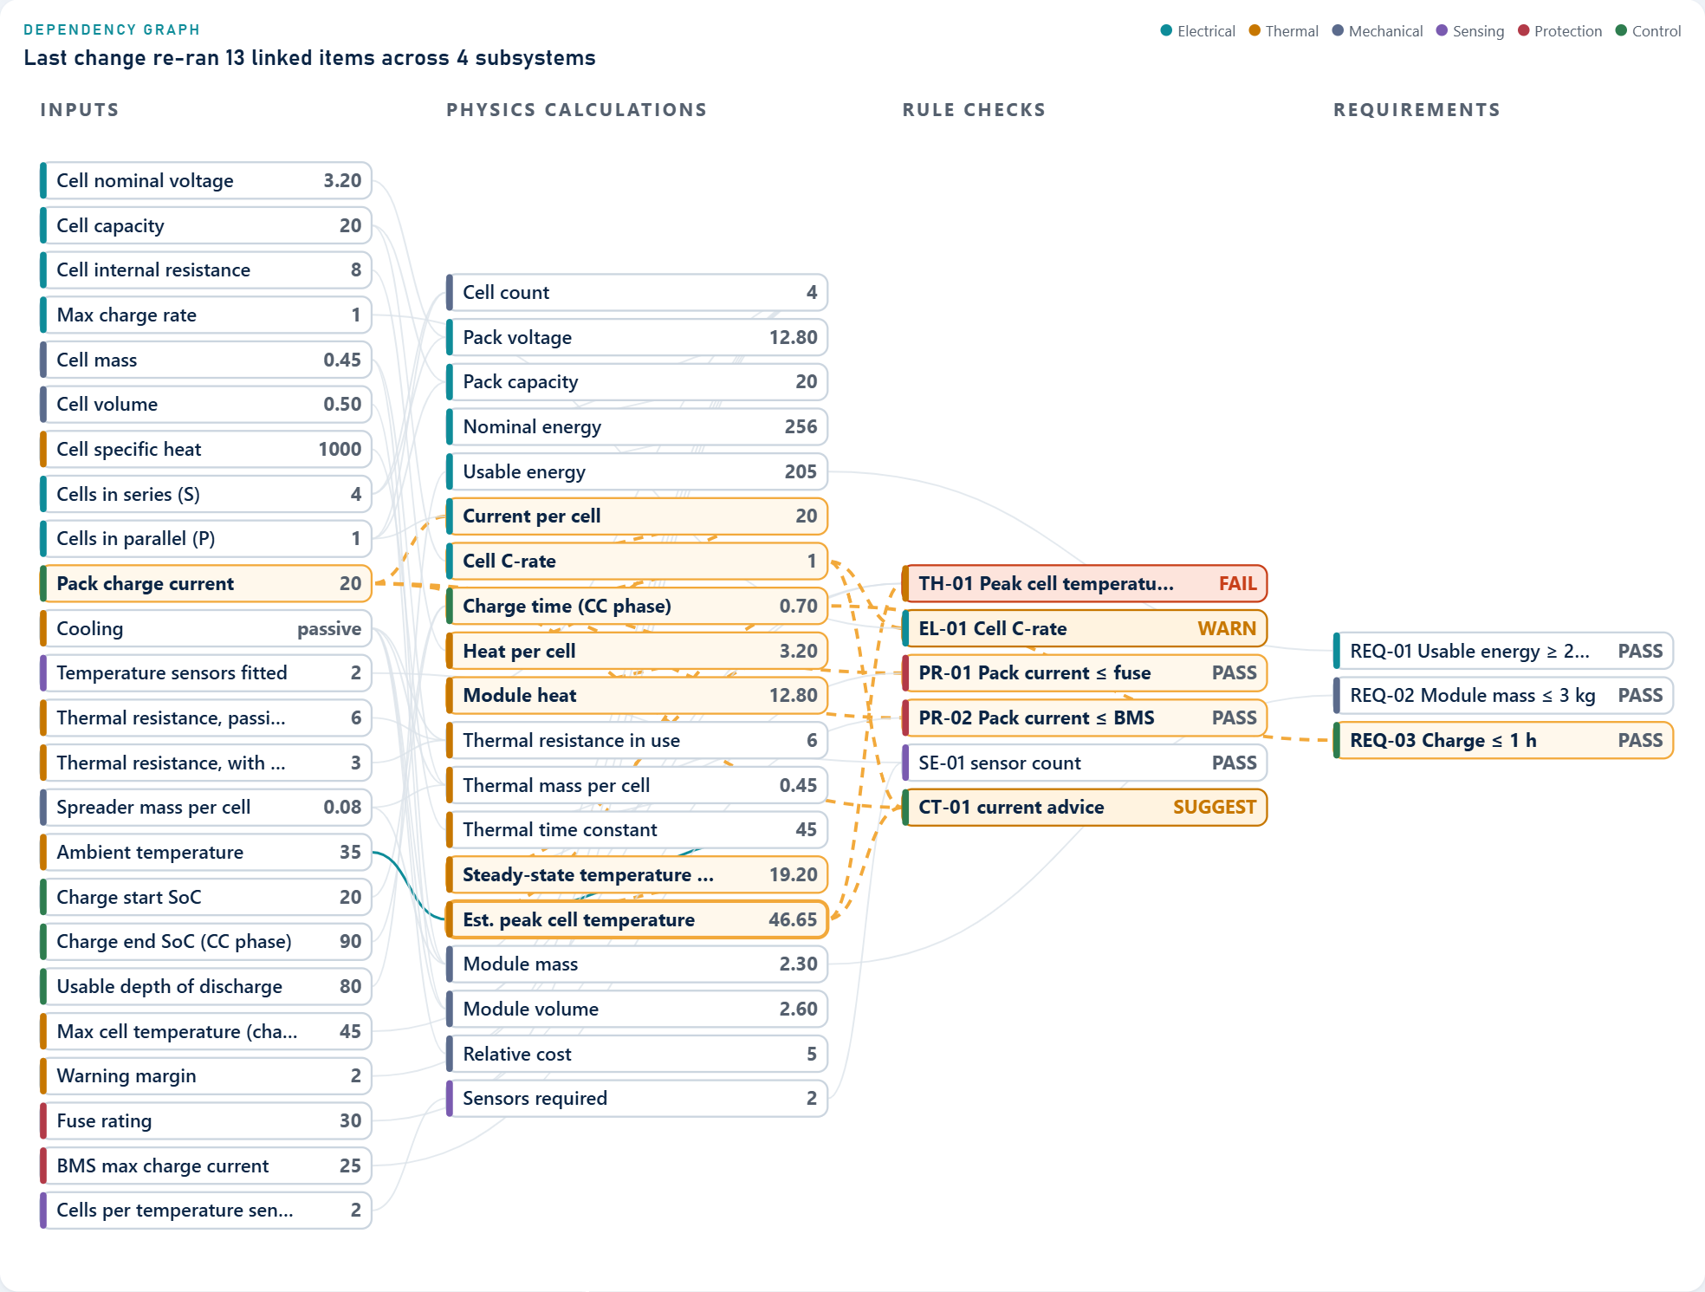
One design change ripples across every subsystem
PROBLEM STATEMENT
A battery module is a coupled system: cells, connections, cooling, sensing, protection, packaging and controls interact. Improve one parameter and another can silently get worse.
Example: Design A, pack charge current 10 A → 20 A
1.4 → 0.7 h
0.8 → 3.2 W
CC charge time
Heat per cell, I²·R0
twice as fast
×4: heat grows with current²
39.06 → 46.65 °C
0.5 → 1.0 C
Est. peak cell temperature
Cell charge C-rate
TH-01 FAIL (limit 45 °C)
EL-01 WARN at datasheet max
BatteryX live simulator: one charge-current change re-runs 13 linked items across 4 subsystems
Illustrative stage-1 cell EXAMPLE-LFP-20AH (not a real product) · model estimates, not measurements · source: docs/DEMO_RESULTS.md, regenerated 2026-11-10
Notes:
[0:30–1:15] The case study's core difficulty: a battery is a coupled system. One decision, doubling the baseline module's charge current from 10 to 20 amps, halves the constant-current charge time from 1.4 to 0.7 hours. But heat per cell is I squared R, so it goes from 0.8 to 3.2 watts, four times higher. The estimated peak cell temperature rises from 39.06 to 46.65 degrees and crosses our 45 degree limit, so TH-01 fails, and the cell now charges at its 1 C datasheet maximum, a warning.
On the right is our live simulator: change the charge current and you see the change propagate through 13 linked calculations and rule checks across 4 subsystems.
These are engine estimates on the illustrative stage-1 cell, not measurements.

Slide 3
Five case-study challenges, five implemented answers
CHALLENGES AND SOLUTIONS
# | Case-study challenge | Implemented in BatteryX | Evidence you can check
1 | Data and decisions spread across electrical, thermal, safety and mechanical work | One shared design document feeds all 11 engine models; 15 rule checks catch fuse / BMS / cell-limit conflicts | Scenario S5: fuse below BMS limit → 3 FAIL, 2 WARN found before hardware
2 | Energy, temperature, charge time, safety, size and cost must be balanced | Constraint-first comparison: any safety FAIL makes a design ineligible; −0.5 per unmet requirement; deltas vs baseline | Design comparison page; A/B/C ranking on slide 8
3 | Cell variation, ageing and conditions propagate to pack level | Seeded Monte-Carlo of capacity and resistance spread; ambient and current sweeps; ageing as a stated linear assumption | S8, 2000 builds, seed 7: highest parallel current share p95 54.46 %
4 | Limited test data, software and computing | Runs on a laptop with an open-source stack; every cell carries source and data status; missing values give NOT EVALUATED, never a guess | S6: cell with only V_nom and capacity → 15 of 15 checks NOT EVALUATED
5 | A full pack is too large to build and test here | Demo scope fixed to a low-voltage 4S LFP solar-storage module; the engine accepts up to 32S × 16P | API validation enforces the limits; scope in the PRD §1.4
Honest coverage: all five are implemented and tested in software; ageing is a linear assumption and nothing is validated against measured cells yet.
Notes:
[1:15–2:00] These are the five challenges listed in the case study. For each one, the middle column is what is actually implemented and the right column is evidence you can check in the app or in our generated results.
Spread-out data: one shared design document feeds all eleven models, and the rule checks catch mismatches, for example a fuse rated below the BMS limit gives three FAILs and two WARNs in scenario S5.
Trade-offs: the comparison is constraint-first, so a safety FAIL can never win on score.
Variation: a seeded Monte-Carlo shows the highest parallel current share reaching 54.46 percent at the 95th percentile.
Limited data: missing datasheet values give NOT EVALUATED, never a pass. With only voltage and capacity, all 15 checks are NOT EVALUATED.
Scope: we demonstrate a low-voltage 4S LFP module; the engine accepts up to 32S by 16P.
What is not done: ageing is a linear assumption and nothing is validated against measured cells yet.

Slide 4
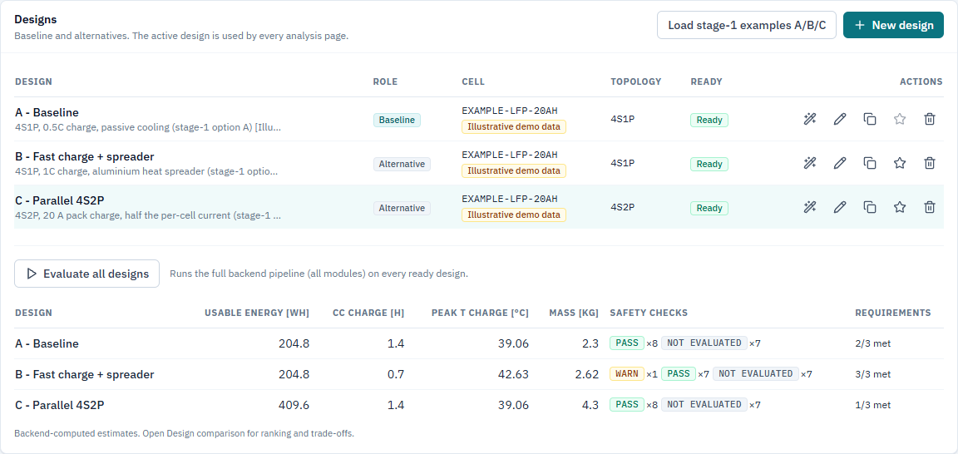
One workflow from requirements to a traceable report
PROPOSED SOLUTION
Requirements
Cell
Topology
Simulate
Safety
Compare
Report
targets with units
library + data status
S × P sizing
1-RC ECM + thermal
15 rule checks
constraint-first rank
assumptions + gaps
1
Physics computes
2
Rules check
Every number comes from a versioned engine model, with unit and model id
15 deterministic checks: PASS / WARN / FAIL / NOT EVALUATED, each with its limit source
3
AI explains
4
Engineer decides
The copilot calls engine tools; the backend verifies every number it writes
Inputs are tagged with their source; reports list assumptions and missing data
Projects page, browser test 2026-11-10: A/B/C evaluated by the backend; 7 checks NOT EVALUATED each
Notes:
[2:00–2:45] BatteryX AI takes a battery module from requirements to a traceable engineering report in seven steps: set requirements, pick a cell from the library, size the series-parallel topology, simulate, run the safety checks, compare alternatives and generate the report.
Four principles keep it trustworthy. Physics computes every number. Deterministic rules check the limits, and a check with missing data says NOT EVALUATED instead of passing. The AI only explains results it gets from the engine, and the backend verifies what it writes. The engineer decides.
The screenshot is the real Projects page from today's automated browser run: three designs evaluated by the backend, and you can see seven checks per design marked NOT EVALUATED because the illustrative cell lacks those datasheet values.

Slide 5
Three layers, one deterministic engine, keys stay on the server
SYSTEM ARCHITECTURE
Browser · React + Vite + Tailwind
Traceability chain on every result
12 app pages · Recharts charts · Three.js 3D module view · autosave · error boundaries
Input
value + source tag
REST / JSON
FastAPI backend (Python)
Model
id + version + equations
Engineering engine
Safety rule engine
AI copilot
11 versioned models · NumPy / SciPy · pure, deterministic functions
15 checks · PASS / WARN / FAIL / NOT EVALUATED · max safe current
9 engine and database tools · answer verifier · rate limit
Result
KPI + unit, labelled ESTIMATE
Check
limit + limit source
MongoDB Atlas
LLM provider (server-side only)
Report
assumptions + missing data
cells · projects · conversations · automatic SQLite fallback offline
Claude API, or Groq when no Anthropic key is set · keys read from the environment, never sent to the browser
Notes:
[2:45–3:20] The architecture is deliberately simple. The browser app talks JSON to a FastAPI backend. Inside it, the engineering engine is pure and deterministic: the same functions serve the web pages, the AI tools and the tests. The rule engine applies the fifteen checks. The AI copilot can only reach the engine and the database through nine tools, and a verifier checks its answers.
Data lives in MongoDB Atlas with an automatic SQLite fallback, so the demo also works offline. The language model runs server-side: Claude when an Anthropic key is configured, otherwise Groq. Keys are read from the environment and never reach the browser.
On the right is the traceability chain: every input has a source tag, every result names the model and version that produced it, every check names the source of its limit, and the report prints assumptions and missing data.

Slide 6
11 versioned models in 8 engineering categories
ENGINEERING INNOVATION
Configuration
Energy & time
Electrical
Thermal
configuration.series_parallel
energy.nominal
estimates.closed_form_time
electrical.ecm_1rc v1.0.1
thermal.lumped_single_node
V = S·V_cell, Q = P·Q_cell
R_pack = S·R0 / P
E_usable = V·Q·w
t_CC = ΔSOC / C-rate
V = OCV(SOC) − I·R0 − V1
1-RC model, CC-CV charge
T = T_amb + q·R_th·(1 − e^(−t/τ))
q = I²·R0, τ = m·c_p·R_th
closed form
closed form
simplified time domain
SIMPLIFIED: one node
Safety / BMS
Mechanical & cost
Variation & ageing
Comparison
bms.rule_checks
mechanical.grid_envelope
cost.bom_rollup
variation.monte_carlo
ageing.simplified_assumption
comparison.constraint_first_weighted
15 rule checks, each with limit source
max safe current solved by brentq
Busbar A = I / J_allow, R = ρL / A
relative cost index (not a price)
I_i = I·G_i / ΣG (seeded Monte-Carlo)
linear capacity retention
any FAIL ⇒ ineligible
rank = score − 0.5 × unmet reqs
rule check
closed form
statistical / ASSUMPTION
aggregation
Verification: done (automated tests vs hand calculations)
Validation: not done yet (needs measured cell data)
Energy conserved within 0.2 % · thermal = closed form ±0.01 K
CC→CV switch at hand-calculated SOC · stage-1 parity ±0.002
No comparison with measured batteries yet
Single thermal node: no cell-to-cell conduction, no CFD
Notes:
[3:20–4:05] A common question: is it eleven models or eight modules? Both. The engine has eleven versioned model IDs, grouped into eight engineering categories: energy and closed-form time estimates share a card, mechanical sits with cost, and variation with ageing.
Every result carries its model ID, version and a fidelity label, so we never hide that thermal is a single lumped node and ageing is a linear assumption, not a degradation model. The electrical model is a one-RC equivalent circuit with a proper CC-CV charge. The thermal model is the first-order solution shown: heat is I squared R0, the temperature rise is heat times thermal resistance, with time constant m c_p R_th. The maximum safe current is solved numerically with brentq.
Verification is not validation. Our tests check the implementation against hand calculations: energy conserved within 0.2 percent, thermal within a hundredth of a kelvin of the closed form. Validation against measured batteries has not been done, and we say so.

Slide 7
The AI explains engine results; it cannot invent them
AI INTEGRATION
Engineer asks
LLM plans tool calls
Engine computes
refs T1, T2…
Structured answer
every number cites a ref
Backend verifier
Shown with
verification status
One repair round if the verifier finds a problem · 5 capabilities: Design Copilot, Engineering Analyst, Safety Assistant, Optimization Advisor, Report Generator
LIVE RUN · 10 Nov 2026 · Groq gpt-oss-120b
The verifier rejects
Safety Assistant, design B: “Explain the safety checks for this design and what limits the charge current.”
Number not in any tool result
ungrounded
Number that differs from the engine
value mismatch
Attempt 1: REJECTED ungrounded_number: the answer contained “0.9”, which appears in no tool result or input
“Complies with IEC 62619”
certification
Invented cell or part number
unknown cell
Invented datasheet URL
unverified ref
Attempt 2: PASSED “Max safe charge current 20 A” [T2] · “Peak cell temperature 42.63 °C” [T2]; both equal the engine values
1 WARN (EL-01) and the NOT EVALUATED checks explained, with the missing datasheet inputs
Design proposed but never simulated
not evaluated
Scripted tests
35 tests: real engine, scripted model
Live Groq
4 verified answers; 2 bugs found, fixed
2 tool calls (safety_checks) · 4 API calls · 134 s, mostly free-tier quota waits
Live Claude
Not run yet: no Anthropic key
Notes:
[4:05–4:55] Our AI copilot is useful but structurally cannot fabricate engineering numbers. The model plans which tools to call; the engine computes; every tool result gets a reference like T1; the answer must cite a reference for every number; and our backend verifier checks it before the user sees it.
This is a real live run from today. We asked the Safety Assistant about design B. In its first answer the model wrote the number 0.9, which exists in no tool result. The verifier rejected it as an ungrounded number. After one repair round the answer passed: maximum safe charge current 20 amps and peak temperature 42.63 degrees, both cited to tool result T2 and both equal to the engine values.
To be precise about test status: 35 copilot tests use a scripted model driving the real engine. Live, we ran the copilot on Groq's gpt-oss-120b: four verified answers, and the live runs exposed two adapter bugs, an output cut-off and a tool-schema rejection, both fixed. We have not run Claude live because we do not have an Anthropic key; the Claude path is covered by scripted tests only.

Slide 8
Same charge time, lower temperature: the engine recommends B
WORKING PROTOTYPE AND RESULTS
Estimate | Design A | Design B | Design C
Topology · cooling | 4S1P · passive | 4S1P · spreader | 4S2P · passive
Pack charge current [A] | 10 | 20 | 20
Per-cell current [A] · C-rate | 10 · 0.5 C | 20 · 1.0 C | 10 · 0.5 C
CC charge time [h] | 1.4 | 0.7 | 1.4
Est. peak cell temp, charge [°C] | 39.06 | 42.63 | 39.06
Usable energy [Wh] | 204.8 | 204.8 | 409.6
Module mass [kg] | 2.3 | 2.62 | 4.3
Max safe charge current [A] | 15.4 | 20 | 25
Checks pass/warn/fail/not eval. | 8 / 0 / 0 / 7 | 7 / 1 / 0 / 7 | 8 / 0 / 0 / 7
Requirements not met | REQ-03 | none | REQ-02, REQ-03
Rank (score − 0.5 / unmet req.) | 2 (0.667 − 0.5) | 1 (0.598) | 3 (0.333 − 1.0)
Why B is cooler but not faster than A at 20 A: charge time depends only on current, t_CC = ΔSOC / C-rate = 0.7 h with either cooling. The spreader halves R_th (6 → 3 K/W), so the same I²R heat gives half the temperature rise.
REQ-01 usable energy ≥ 200 Wh · REQ-02 module mass ≤ 3.0 kg · REQ-03 CC charge time ≤ 1.0 h (team-set targets, not from the case study)
Recommended: B. Meets all three requirements with no FAIL. Open items: EL-01 WARN (charging at the cell's 1 C maximum) and 7 checks that need real datasheet data.
Illustrative stage-1 cell EXAMPLE-LFP-20AH (not a real product) · model estimates, not measurements · source: docs/DEMO_RESULTS.md, regenerated 2026-11-10
Notes:
[4:55–5:45] These are actual outputs of the working prototype, reproduced today by one script.
Left: peak temperature versus charge current, for the same cell with passive cooling and with the heat spreader. With passive cooling the 45 degree limit is crossed at 20 amps, 46.65 degrees. With the spreader, 20 amps gives 42.63 degrees. Notice that charge time does not change with cooling: it depends only on current, 0.7 hours at 20 amps in both cases. The spreader halves the thermal resistance, so the same I squared R heat produces half the temperature rise. That is why B is cooler than A at the same current, and faster than A only because B charges at 20 instead of 10 amps.
Right: the three designs, with the charge current in the first row: A charges at 10 amps, B at 20, C at 20 amps shared across two parallel cells, so 10 amps per cell. REQ-01 is usable energy of at least 200 watt-hours, REQ-02 mass at most 3 kilograms, REQ-03 charge time at most one hour; these are our team's targets, not the case study's. A misses REQ-03, C misses REQ-02 and REQ-03, and each miss costs 0.5 in the ranking. A has the highest raw score but drops to second after the penalty. The engine recommends B, with one open warning: it charges at the cell's 1 C maximum. All values are estimates on the illustrative cell.

Slide 9
Measured software, hypothesised business, stated limits
FEASIBILITY, BUSINESS VIABILITY AND LIMITATIONS
0.031 s
0.19 s
14 / 14
163
engine time per design evaluation
evaluation via the HTTP API
browser workflow steps passed
automated tests passing
median, n = 60
median, n = 30
0 browser errors
119 backend + 44 frontend
Measured on a student laptop on 10 Nov 2026. These are software measurements; battery figures elsewhere in the deck are model estimates.
1
Business viability
hypotheses, not validated
2
Current limitations
stated openly
3
Validation roadmap
in order
Users: engineering students, college labs, early-stage EV and storage start-ups
Value: conflicts found before hardware; one-click traceable reports; reusable cell libraries
Model idea: free education tier, paid team workspace
Only the illustrative cell in the library, so 7 of 15 checks are NOT EVALUATED
First-order electrical, single-node thermal, linear ageing
No user accounts yet; AI on Groq free tier takes 1–2 min per answer
1. Live AI run with saved transcript
DONE (Groq)
2. Add a real datasheet cell
PLANNED
3. Compare with a public cell dataset
PLANNED
4. Supervised low-voltage cell test
PLANNED
5. Live Claude run; five-user study
PLANNED
Notes:
[5:45–6:25] Feasibility is measured, not claimed. One full design evaluation takes 31 milliseconds of engine time on a student laptop, about 0.19 seconds through the HTTP API. Our automated browser test ran the whole workflow today, 14 of 14 steps with zero browser errors, and 163 automated tests pass. These are software measurements; they say nothing about real battery performance, which the deck only shows as model estimates.
Business viability is a set of hypotheses we have not validated: students, labs and early-stage start-ups that need faster, traceable design studies.
Limitations, stated openly: the library only has the illustrative cell, so 7 of 15 checks cannot run; the models are first-order; there are no user accounts; and on Groq's free tier an AI answer takes one to two minutes.
The validation roadmap: the live AI run is done on Groq. Next is a real datasheet cell, a comparison with a public cell dataset, and a supervised low-voltage single-cell test in a lab with proper electrical and thermal safety controls, then a live Claude run and a five-user study.

Slide 10
Change one parameter. See every consequence.
Impact and next step
Trade-offs before hardware
Traceable by design
AI that cannot fabricate
Electrical, thermal, safety, packaging and cost from one design document, re-evaluated in 0.031 s
Input → model → result → check → report, with assumptions and missing data in every report
Numbers only from engine tools; a live run showed the verifier rejecting an invented value
Next: real datasheet cell → public-dataset comparison → supervised low-voltage single-cell test
Thank you · Questions and live demo
Notes:
[6:25–7:00] To close. BatteryX makes battery trade-offs visible before anyone builds hardware: one design document, every subsystem re-evaluated in about 30 milliseconds. Every number is traceable from its input through the model and check to the report. And it uses AI to explain results without letting the AI invent them; today's live run showed the verifier catching an invented value.
Our next step is concrete: load a real cell datasheet, compare the models with a public cell dataset, and run a supervised low-voltage single-cell test.
Change one parameter, see every consequence. Thank you, we are happy to take questions and to run any scenario live.

