Slide 1

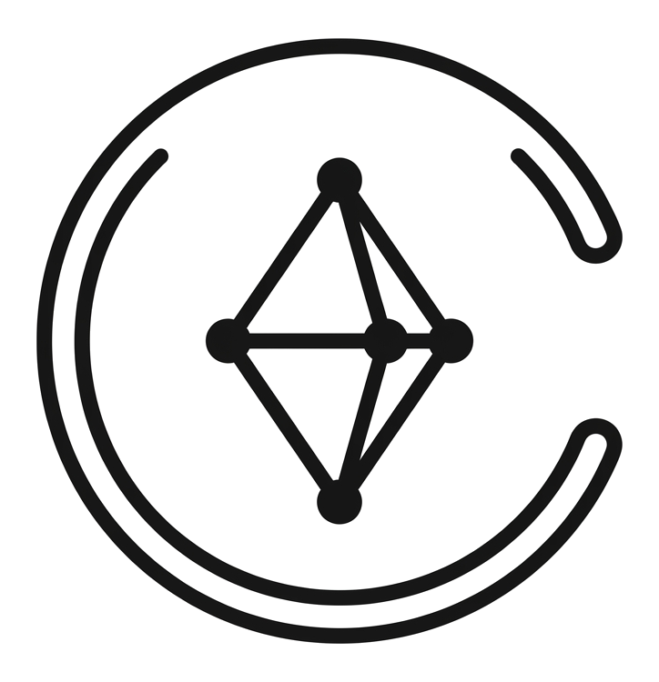

THEME 2 - JewelTech: Agentic Trust from Workshop Scale to Settlement
TOLA
तोला · WEIGH. HEAR. SIGN.
India's Two-Sided Gold Job-Work Ledger
Two Signatures on Every Gram · Zero-Float Deterministic Core · Indic Voice Read-Back
Prepared for
JanAI
MASS ENTREPRENEURSHIP CHALLENGE
TECH4BHARAT
GAVS HACKATHON 2026 · JEWELTECH

Slide 2
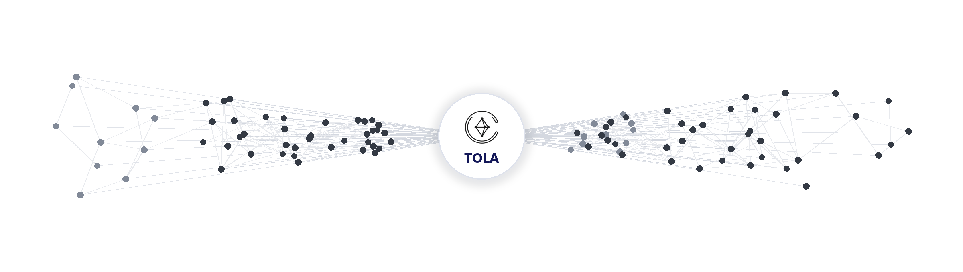
THE HIDDEN TRUTH
Every
Jeweller
ISSUES ₹4–5L GOLD
on paper slips and verbal
wastage norms (2–3% plain,
20–30% studded)
Every
Karigar
RISKS A MONTH'S PAY
on a single 1-gram dispute
(₹13,650–₹15,000 vs ₹15k wage)
with zero signed proof
Every
Jewellery ERP
RECORDS ONE SIDE
keeping mutable owner books
with no karigar login, voice,
or portable work history

Slide 3

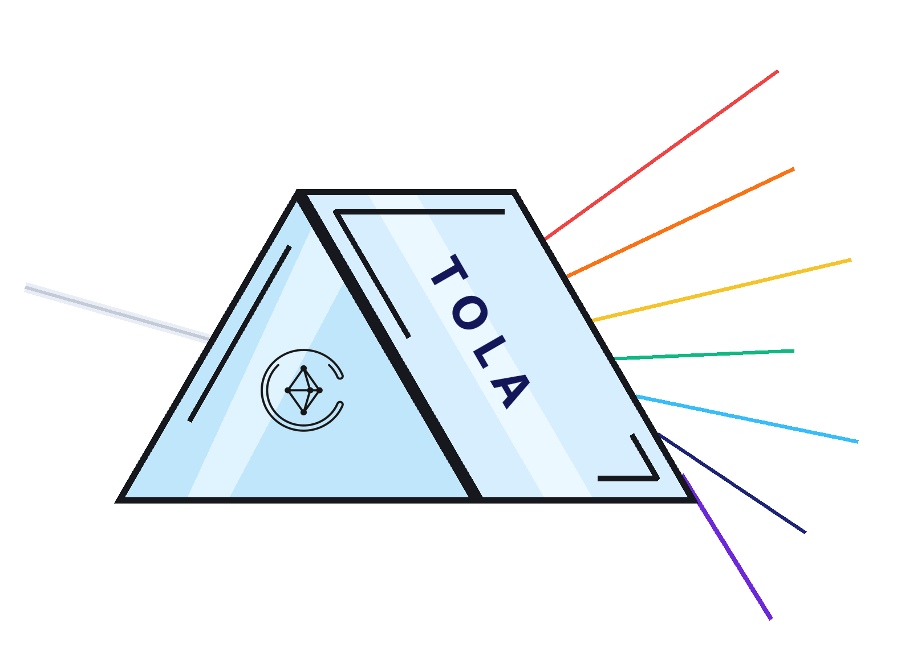







THE MISSING LAYER
SCALE-LOCKED WEIGHTS
Integer mg · USB/BLE & OCR
VOICE READ-BACK
Sarvam Bulbul v3 in Bengali/Hindi
PAPER BAHI-KHATA
One-Sided Slip & Verbal Norm
40.00 g Issued · '2.5% Ghaat'
No Karigar Copy · No Signature
DUAL SIGNATURES
Jeweller + Karigar Ed25519
HASH-CHAIN LEDGER
Append-only SHA-256 lineage
WORKSHOP FAILURE MODES
VARIANCE FLAGS
Deterministic M-05 rule engine
• Unilateral owner-side edits
• Month-end memory disputes
• Unrecorded scrap & dust loss
• Zero collateral for karigar credit
SETTLEMENT & GST
Direct UPI intent + Rule 55 PDF
WORK PASSPORT
Consented 7-day credit proof

Slide 4



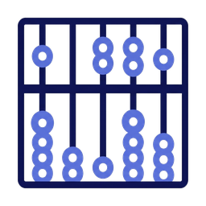

GOLD JOB-WORK WEDGE
TODAY
TOMORROW
FOUNDATION
Bengaluru Plain Gold Clusters
↓
Kolkata Bowbazar & Singur Hubs
↓
Mumbai Zaveri Bazaar (2.2L Karigars)
↓
Coimbatore, Rajkot & Thrissur
↓
Studded, Kundan & Silver Job-Work
↓
India's 6.1M Artisan Craft Economy
INITIAL CUSTOMER
CGST Section 143 & Rule 55
Job-Work Challan (PRIMARY)
22K PLAIN GOLD BENCH
CLUSTERS (BENGALURU)
BIS IS 1417 & HUID 2026
Automated Scale Direction
• Avenue Road, Chickpet &
Raja Market (250+ workshops)
• 5–30 karigars per shop;
15–30s counter handoff limit
• ₹79/karigar/mo entry SaaS
(15 yrs < one 1-gram dispute)
• Deployed via JanAI Cafe Doots
& KAVMS Jeweller Association
IIMA & XLRI Gold Wastage
Benchmarks (2–3% / 20–30%)
DPDP Act 2023 Spoken Consent
& CICRA 2005 Safe Boundary
RFC 8032 Ed25519 + RFC 8785
Canonical JSON Hash Chain
The ideal high-trust wedge into
India's ₹4–5L/karigar gold economy.
10 mg Scale Capture → Indic Voice Read-Back → Dual Ed25519 Signatures → Weekly Reconcile → Work Passport

Slide 5


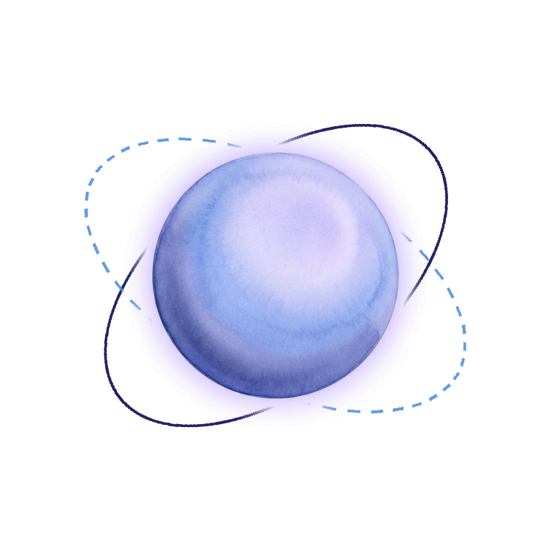






MEET TOLA
WEIGHS
Captures 10 mg scale reads
via USB, BLE, or photo OCR.
TRANSLATES
Converts colloquial ratti/ana
and Bengali voice into JSON.
Verbal Gold Issue →
Two-Sided Cryptographic
Truth
SPEAKS
Reads back weight & wastage
in Bengali, Hindi, or Kannada.
CHAINS
Links ISSUE, RETURN, SCRAP &
DUST in a SHA-256 hash chain.
WEIGH.
HEAR.
SIGN.
CO-SIGNS
Locks Jeweller + Karigar
Ed25519 keys on every row.
SETTLES
Triggers direct UPI labour pay
& Rule 55 GST challan PDF.
RECONCILES
Flags over-norm variance &
records voice rework notes.
UNLOCKS CREDIT
Exports a consented 7-day
Karigar Work Passport.
One Append-Only Ledger
of Workshop Truth

Slide 6






SYSTEM ARCHITECTURE
BENCH & INPUT
SOURCES
USB-OTG Scale (10 mg)
BLE GATT Scale (0x181D)
Scale Display OCR
Bengali / Hindi Voice
Scrap & Dust Pouches
Job-Work Order Norms
Offline PWA / IVR Queue
Physical Workshop Counter & Feature-Phone Edge Inputs
CAPTURE & VOICE
PIPELINE
Scale / OCR Parser
→
Sarvam Saaras v3 STT
→
Deterministic Numeral Parser
→
Spoken-vs-Scale Check
→
Sarvam Bulbul v3 TTS
→
Dual Ed25519 Sign Request
Transforms raw scale frames and code-mixed speech into human-confirmed signed events (≤ 20 seconds).
THE BRAIN
LEDGER-CORE DAG
Integer Milligram Math (Zero Float)
JobOrder #14
→
ISSUE 40.00g
→
RETURN 38.12g
→
SCRAP 0.50g
M-05 Variance Rules (OVER_NORM)
916 / 750 Fineness Conversion (ppt)
M-05 Flag (+380mg)
→
Co-Signed Adjust
→
SHA-256 Settlement
RFC 8785 Canonical JSON + SHA-256
Wastage Norm Engine (bps)
ISSUE → RETURN / SCRAP / DUST → DISPUTE_OPEN → ADJUSTMENT → SETTLEMENT
Dual Ed25519 Signature Verifier
LYZR AGENTIC
SERVICES
ManagerAgent
IntakeAgent
ReconcileAgent
SettleAgent
Output Validator
Off-hot-path router &
prompt-injection guard.
Extracts structured slip &
rework JSON from speech.
Renders slot-locked neutral
bilingual flag summaries.
Drafts settlement pack &
Rule 55 GST challan.
Enforces zero-new-digit &
blame-lexicon gates.
GOVERNANCE &
TRUST
✓ Zero AI Math Invariant
✓ Append-Only DB Triggers
✓ DPDP Voice Consent Log
✓ Tenant RLS Isolation
✓ 500-Event CI Eval Gate
✓ ₹38/mo AI Cost Cap
ROLE EXPERIENCE
& RAILS
Jeweller Bench Console
Karigar Voice PWA + IVR
Lender Work Passport View
Rule 55 GST Challan PDF
FastAPI 0.115 | PostgreSQL 16 (Append-Only) | Web Serial & Web Bluetooth | NPCI UPI Intent | Cloud Run (asia-south1)

Slide 7






TECHNOLOGY STACK
Indic Voice & Vision AI
Governed Agentic Layer
Backend & Ledger Core
Speech-to-Text: Sarvam Saaras v3 (Bengali, Hindi, Kannada)
Text-to-Speech: Sarvam Bulbul v3 (warm read-back)
Fallback STT: Self-hosted IndicConformer 600M
Scale Vision: Gemini 2.5 Flash-Lite 7-segment OCR
Numeral Parser: Deterministic ratti/ana/tola/mg
Orchestration: Lyzr Studio (Manager + 3 agents)
IntakeAgent: Slip & rework JSON extraction
ReconcileAgent: Slot-locked bilingual flag cards
SettleAgent: Settlement + Rule 55 challan
Guardrails: Zero-new-digit & blame filter
API Runtime: Python 3.12 + FastAPI 0.115
Ledger Engine: Pure-Python integer mg (0 float)
Database: PostgreSQL 16 + append-only triggers
Cache / Queue: Upstash Redis + Cloudflare R2
Isolation: Row-Level Security (tenant_id)
Frontend & Workshop UX
Hardware, Telecom & DPI Rails
Cryptography, Security & Ops
Bench & Phone: Next.js 15 + React 19 + TypeScript
Offline Queue: IndexedDB + Service Worker PWA
Styling & UI: Tailwind CSS 4 + HeroUI / shadcn
Typography: Noto Sans Bengali / Devanagari + Mono
Live Stream: Server-Sent Events (SSE) timeline
Wired Scale: Web Serial API (USB-OTG RS-232)
Wireless Scale: Web Bluetooth GATT (0x181D)
Feature Phone: Exotel / Twilio Missed-Call IVR
Labour Payout: NPCI UPI Deep-Link + Setu AA
Compliance: CGST Sec 143 / Rule 55 Challan PDF
Signatures: Ed25519 (RFC 8032) via PyNaCl
Hash Chain: RFC 8785 JCS + SHA-256
Device Keys: WebCrypto + Cloud KMS envelope
Deploy & CI: Cloud Run (asia-south1) + GitHub CI
Observability: OpenTelemetry + 500-event eval

Slide 8
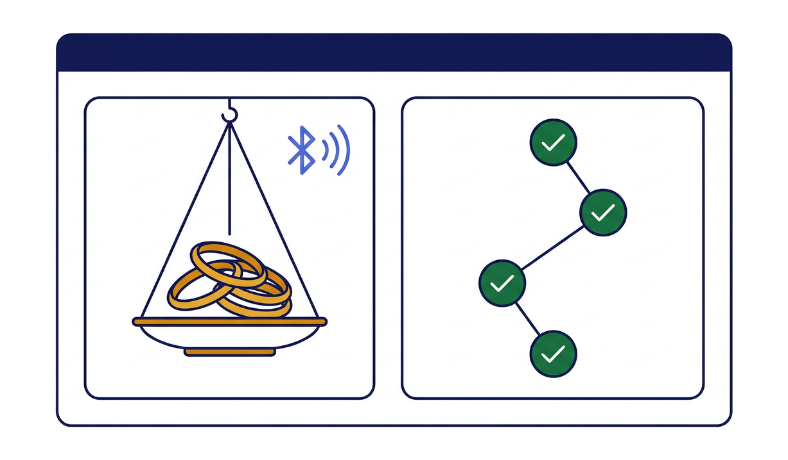
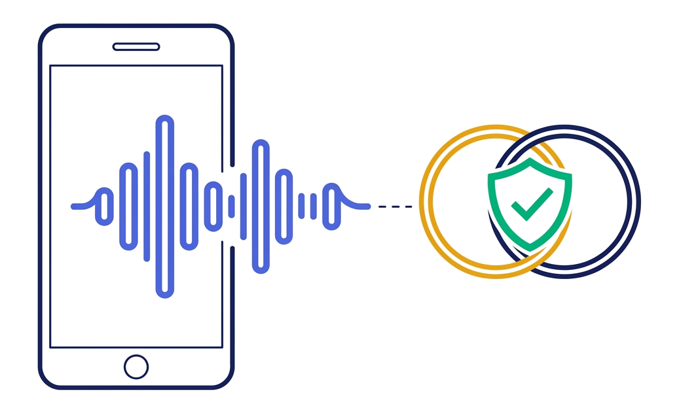
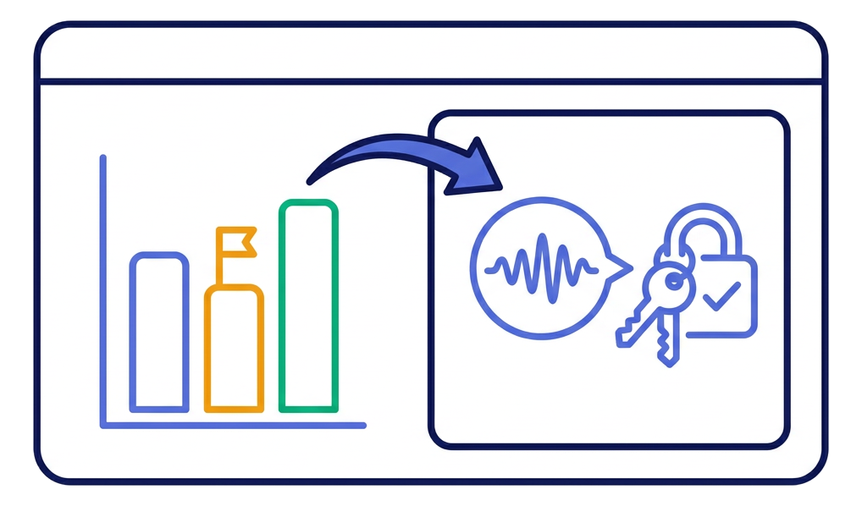
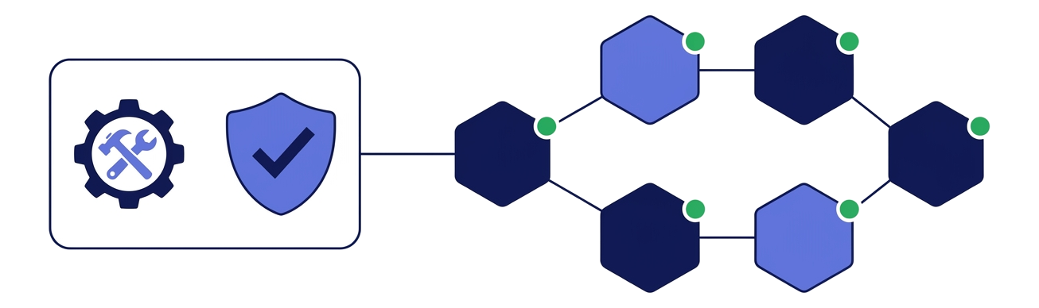
USER EXPERIENCE - PROTOTYPE
GITHUB REPO
LIVE STAGE DEMO
1. JEWELLER BENCH — SCALE CAPTURE & ISSUE
2. KARIGAR PHONE — BENGALI VOICE READ-BACK & SIGN
LIVE SCALE READ (USB / BLE)
BULBUL v3 VOICE READ-BACK (BENGALI)
40.000 g (40,000 mg)
“আপনি ৪০ গ্রাম ২২ ক্যারেট সোনা নিচ্ছেন...”
DECLARED FINENESS & PURE GOLD
KARIGAR SPOKEN CONFIRMATION
22K (916 ppt) → 36,640 mg fine
Confirmed on phone / IVR press 1
AGREED WASTAGE NORM (2.50%)
CRYPTOGRAPHIC CO-SIGNATURE
250 bps → 1,000 mg allowance
Karigar Ed25519 key locked on row
BENCH ACTION
TOTAL BENCH TIME
Jeweller signs ISSUE (Ed25519)
18 seconds · Zero typing
3. WEEKLY RECONCILE — +380 MG FLAG & VOICE DISPUTE
4. KARIGAR WORK PASSPORT & CHAIN VERIFIER
RETURN + SCRAP vs EXPECTED
VERIFIED VOLUME & ORDERS
38,120 mg + 500 mg (Loss: 1,380 mg)
15 Co-Signed Orders · 194.000 g 22K
DETERMINISTIC M-05 FLAG
DISPUTE-FREE TRACK RECORD
+380 mg OVER_NORM_v1 (Neutral)
93.3% Clean · +0.18% vs Norm
VOICE REWORK EVIDENCE
HASH-CHAIN AUDIT STATUS
Solder joint cracked twice (+130 mg)
8/8 SHA-256 & 16/16 Ed25519 PASS
SETTLEMENT + UPI LABOUR PAY
NBFC / SHG CREDIT EXPORT
₹5,040 paid · Rule 55 PDF ready
7-Day Consented PDF + QR Token
WEIGH. HEAR. SIGN. — 18-Second Bench Capture · Zero Typing · Live in Browser & Feature-Phone IVR

Slide 9




LIVE JOB-WORK SCENARIO
Order #14: Shetty Jewellers (Bengaluru) ↔ Rafiq Sheikh (Karigar) · 4 Plain 22K Bangles
SCALE CAPTURE & RETURN DIFFERENCE
GOVERNED AGENT FLAG & DUAL RESOLUTION
MONDAY ISSUE (CO-SIGNED)
THURSDAY RETURN (MEASURED)
1. M-05 Variance Engine
FLAGGED
• Gross 22K (916): 40,000 mg
• Fine Gold: 36,640 mg
• Agreed Norm: 2.50% (250 bps)
• Allowed Loss: 1,000 mg
• Signed: Shetty + Rafiq
• Finished Bangles: 38,120 mg
• Katran (Scrap) Return: 500 mg
• Total Accounted: 38,620 mg
• Actual Loss: 1,380 mg (3.45%)
• Over-Norm Delta: +380 mg
Actual loss 1,380 mg vs 1,000 mg norm → +380 mg (+95 bps).
2. ReconcileAgent Card
OPENED
Slot-locked Bengali + English card; zero blame words.
Karigar Bengali Voice Note (Saaras v3 STT):
“বাবু, দ্বিতীয় চুড়ির জোড় দুইবার ফেটে গেছে, দুবার রাঙ ঝালাই করতে হয়েছে।”
(“Babu, the second bangle joint cracked twice; had to solder-rework it twice.”)
3. Co-Signed Adjustment
RESOLVED
130 mg solder rework accepted; 250 mg balance settled.
ORDER #14 IMPACT METRICS
GENERATED AUDIT & CREDIT PACK
40.000 g
+380 mg
CGST Rule 55 Job-Work Challan PDF
Auto-filled HSN 7113, 40,000 mg issue, 38,620 mg return & signatures.
22K Issue Co-Signed
(36,640 mg Fine Gold)
Over-Norm Variance
Caught Deterministically
8-Event SHA-256 Hash-Chain Receipt
Cryptographic proof: 8/8 hashes valid & 16/16 Ed25519 signatures verified.
130 mg
₹5,040
Bilingual Settlement Summary + UPI
Bengali & English receipt with UTR reference for ₹5,040 labour payout.
Rework Allowance
Co-Signed Without Fight
UPI Labour Settled
in 45 Seconds vs 40 Min
Updated Karigar Work Passport
Order #14 appended: 15 verified orders, 194.000 g volume, QR token.

Slide 10
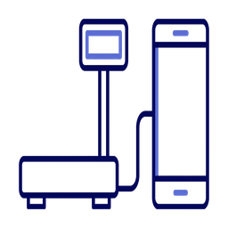



BHARAT DEPLOYMENT READINESS
Bench-ready. Karigar-ready. Audit-ready.
BENCH & CHANNELS | TRUST & CRYPTO | COMPLIANCE & DPI | UNIT ECONOMICS
USB, BLE & Camera Scale Works with ₹1,500–₹8,000 10 mg workshop scales. | Dual Ed25519 Co-Sign Every row requires Jeweller + Karigar keys. | CGST Sec 143 / Rule 55 One-tap statutory job-work challan PDF. | ₹38 / Month AI Cost Per active bench across 120 monthly events.
Bengali, Hindi, Kannada Code-mixed ratti/ana/tola & rework speech. | RFC 8785 + SHA-256 Chain Tamper-evident hash chain with DB triggers. | DPDP Act 2023 Consent Spoken language notice & signed consent hash. | ₹79 / Month Entry Plan 52% gross margin even on starter tier.
Offline IndexedDB Queue Zero bench downtime during power/net cuts. | Zero-AI-Math Invariant 100% deterministic integer milligram arithmetic. | BIS HUID 2026 Alignment Ready for automated scale-to-portal rules. | ₹249 / Month Gaddi Pro 85% gross margin with GST Challan & UPI.
Feature-Phone IVR Fallback Missed-call + Bulbul v3 callback + press 1. | Neutral Bilingual Flags Zero blame words; 500-event CI eval gate. | NBFC Work Passport Consented 7-day credential outside CICRA. | JanAI Doot Distribution Zero-CAC rollout via Bullion & Karigar sanghs.

Slide 11





ROADMAP
1
>
2
>
3
>
4
>
5
VALIDATE
STREET PILOT
CLUSTER LOOP
CREDIT & DPI RAILS
NATIONAL GOLD LEDGER
DAYS 1–15
DAYS 16–30
DAYS 31–60
DAYS 61–90
MONTH 6+
Core integer-mg ledger & DAG
Ed25519 + RFC 8785 hash chain
Sarvam Bengali/Hindi voice flow
Lyzr 4-agent governed pipeline
500-event deterministic eval
25 workshops in Raja Market
& Chickpet (Bengaluru cluster)
USB-OTG & BLE scale kits live
Weekly Friday hisab on Tola
Karigar Sangha co-sign audits
Expand to Bowbazar (Kolkata)
& Zaveri Bazaar (Mumbai)
Feature-phone IVR callback live
Rule 55 GST challan automation
JanAI Doot Sangh distribution
NBFC & Co-op Bank pilots on
Karigar Work Passport tokens
NPCI UPI Autopay & Setu AA
Tamil, Gujarati, Marathi packs
Self-hosted IndicConformer
BIS Hallmarking / HUID 2026
automated scale integration
Pan-India cluster coverage
Formal credit for 1M+ karigars
Standard trust layer for gold
OUTCOME
OUTCOME
OUTCOME
OUTCOME
OUTCOME
Working Dual-Track Prototype
(Built Today)
25 Benches · 150 Karigars
(Days 16–30)
250 Workshops · 1,500 Karigars
(Days 31–60)
1,000 Workshops · 1st Loans
(Days 61–90)
50,000+ Workshops Nationally
(Month 6+)

Slide 12
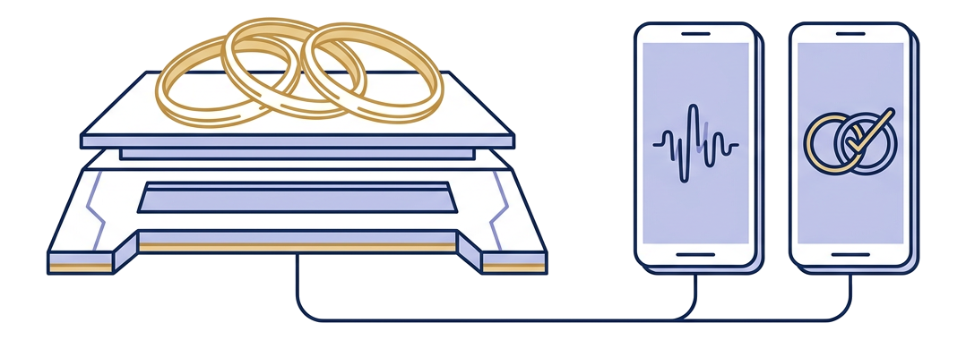
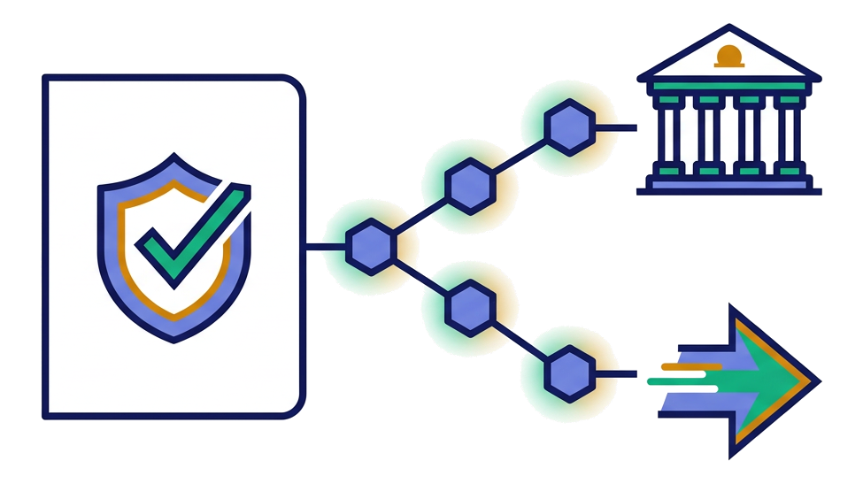
WHY WE ARE READY?
Built on Real Goldsmith Workshop Economics & Norms: Every rule in Tola is anchored in how Indian gaddis actually work — 22K (916) and 18K (750) fineness, item-specific wastage norms (2.5% plain bangles to 5.5% filigree), katran scrap and nyara dust recovery, and CGST Section 143 / Rule 55 job-work challans.
Working Dual-Track Codebase & Zero-Float Determinism: We didn't build a slideware wrapper. Our shared ledger-core enforces integer-milligram conservation, RFC 8785 canonical JSON + SHA-256 hash chaining, dual Ed25519 co-signatures, and a 4-agent Lyzr pipeline where AI never computes or rounds a single milligram.
Live Dual-Role Bench + Karigar Voice Prototype (Order #14 Verified)
Unit Economics & JanAI Doot Distribution That Scale: At ₹38/month in AI + telecom cost per active bench against ₹79–₹249/month SaaS tiers, Tola is gross-margin positive from Day 1 — and spreads cluster-by-cluster through Bullion Associations and Bengali Karigar Sanghas at near-zero CAC.
8/8 SHA-256 Hash-Chain & 16/16 Ed25519 Co-Signature Audit Pass
THANK YOU
TOLA · Two Signatures on Every Gram · Weigh. Hear. Sign.

