Slide 1
GITHUB COPILOT
Welcome to My Presentation
By Harshad Teli
Class: MCA-I | Roll No: 15

Slide 2
What is Git?
A distributed version control system
Tracks changes in source code
Keeps different versions of a project
Supports collaboration between developers
Works locally and connects to remote repositories
Workflow
Code → Add → Commit → Branch → Merge

Slide 3
What is GitHub?
A cloud-based platform for hosting Git repositories
Stores projects online
Supports collaboration, Pull Requests, Issues and Code Review
Widely used for open-source development
FLOW
Developer
↓
Git Repository
↓
GitHub
↓
Collaboration

Slide 4
What is GitLab?
A DevSecOps and software development platform
Provides Git repository management
Supports collaboration and code review
Provides CI/CD automation
Helps manage the software development lifecycle
PIPELINE
Code → Build → Test → Deploy

Slide 5
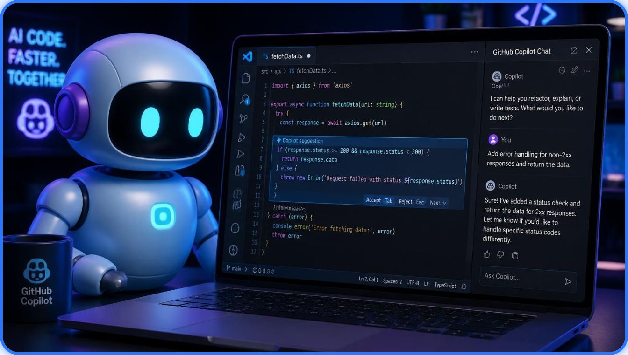
What is GitHub Copilot?
"YOUR AI PAIR PROGRAMMER"
An AI-powered coding assistant that helps developers write code faster
Generates code from natural-language instructions
Suggests code inside supported development environments
Helps explain, modify and debug code
Developer Idea → GitHub Copilot → Code → Application
"Less Typing. More Building."

Slide 6
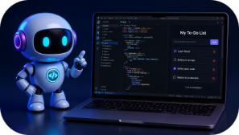
My Live Demonstration Workflow
COMMANDS
1
2
git init
git add .
git commit -m "Initial commit"
git remote add origin <repository-url>
git push -u origin main
Build
Upload
GitHub Copilot + VS Code
Git Commands + GitHub
Live Demo 1: Build a Small To-Do List Application
Live Demo 2: Upload the Project to GitHub
Project → git init → git add → git commit → git remote → git push → GitHub repository
Prompt → Copilot suggestion → To-Do app → Run
3
Explore
GitLab Interface + Environment Setup
Live Demo 3: Explore GitLab Interface and Environment Setup
GitLab → New Project → Repository → Environment Setup → Project Dashboard

Slide 7

Thank You
Questions?
GitHub Copilot
Your AI Pair Programmer
Harshad Teli | MCA-I | Roll No: 15

