Slide 1
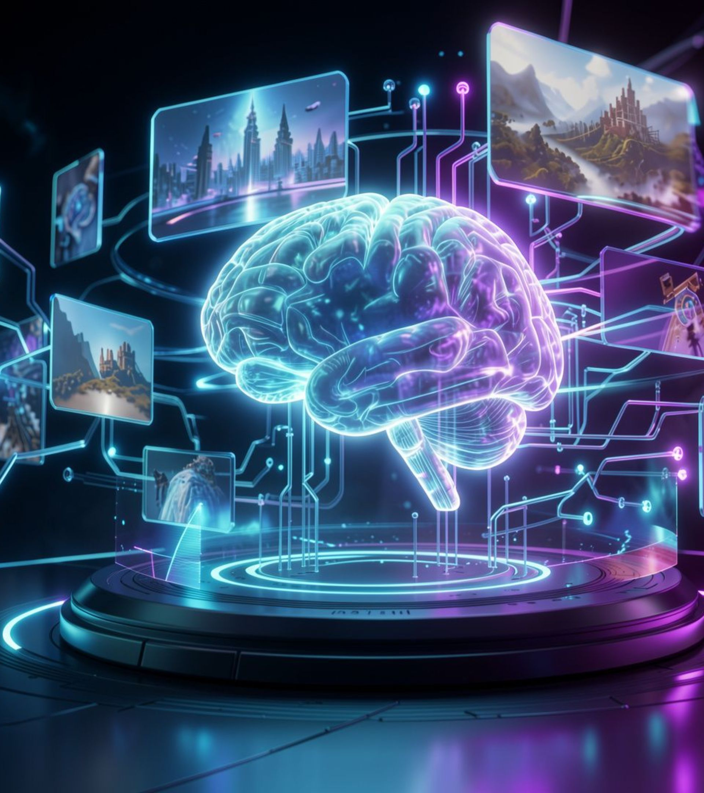
MCA-I · CLASSROOM TECHNOLOGY
PERCHANCE AI
Explore the World of Free AI Image Generation
Presented By: Harshad Teli | MCA-I | Roll No: 15

Slide 2
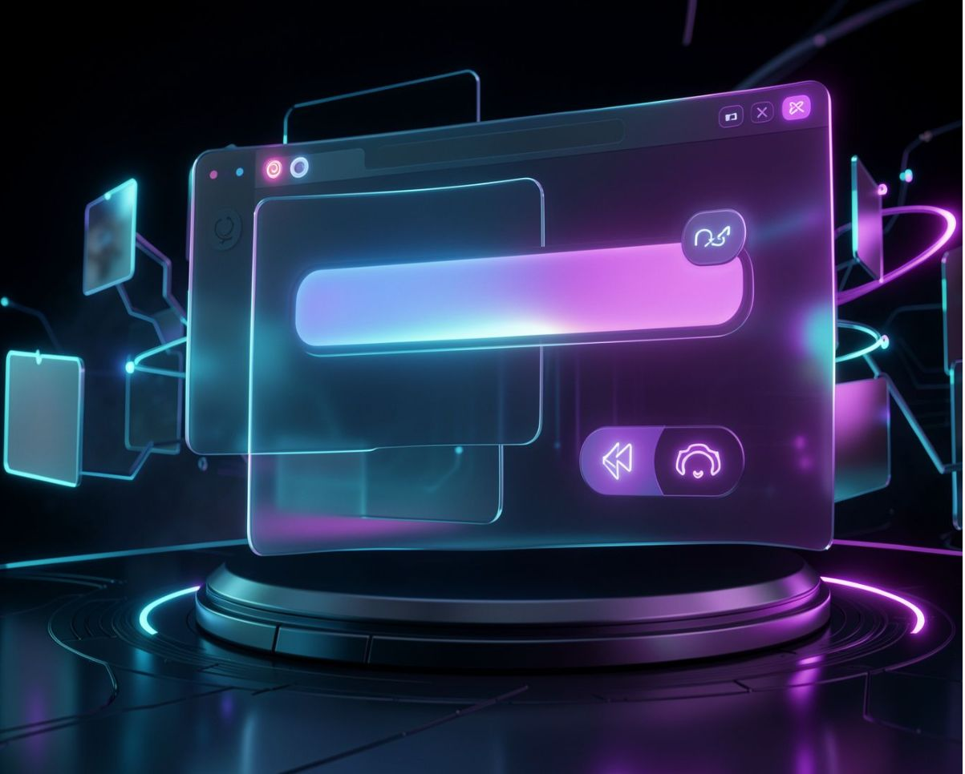
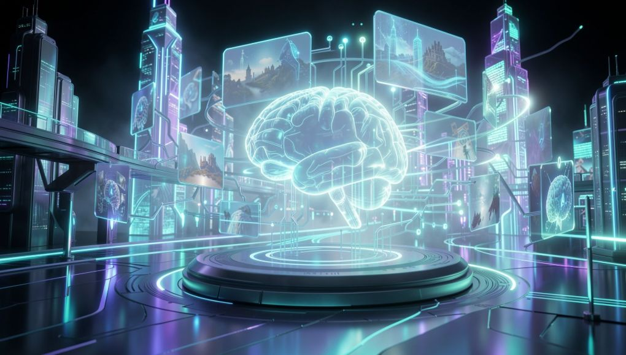
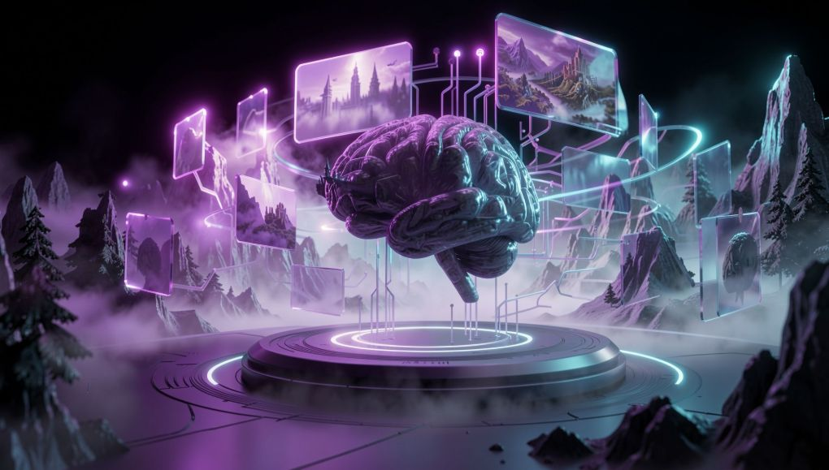
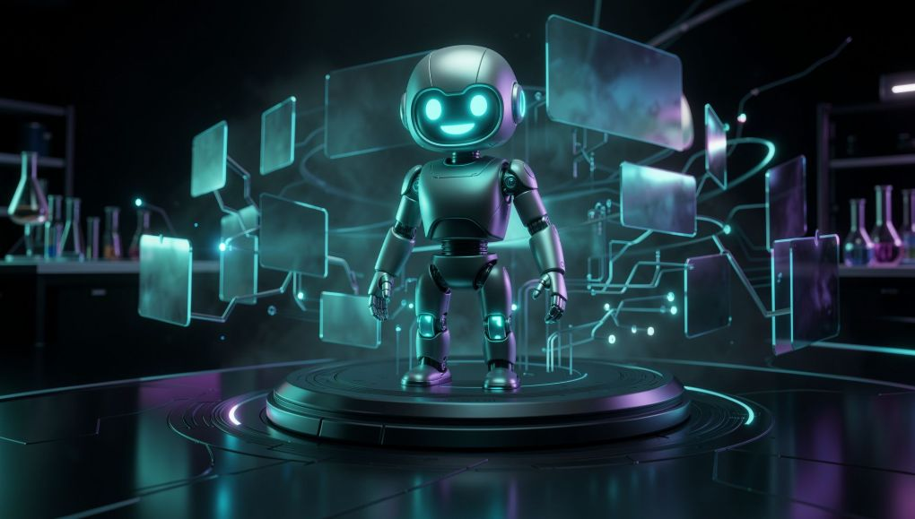
PERCHANCE AI · TEXT TO IMAGE
What is Perchance AI?
Online AI image-generation tool that turns text prompts into images.
BROWSER-BASED GENERATOR
Explore different visual styles through a simple, beginner-friendly interface. Some generators can be used without creating an account.
FUTURISTIC CITY
FANTASY LANDSCAPE
3D ROBOT

Slide 3




PERCHANCE AI · FROM PROMPT TO IMAGE
Features & Working Process
Describe the idea, let the generator interpret it, then keep the result that works.
TEXT PROMPT
AI PROCESSING
GENERATED IMAGE
DOWNLOAD
Enter a descriptive text prompt.
The AI interprets your words.
Preview the visual result.
Download if the option is available.
CORE FEATURES
OPEN → ENTER → GENERATE → PREVIEW → DOWNLOAD
Text-to-image generation · Different creative styles · Simple browser-based interface · No-sign-up access on supported generators · Image download options

Slide 4
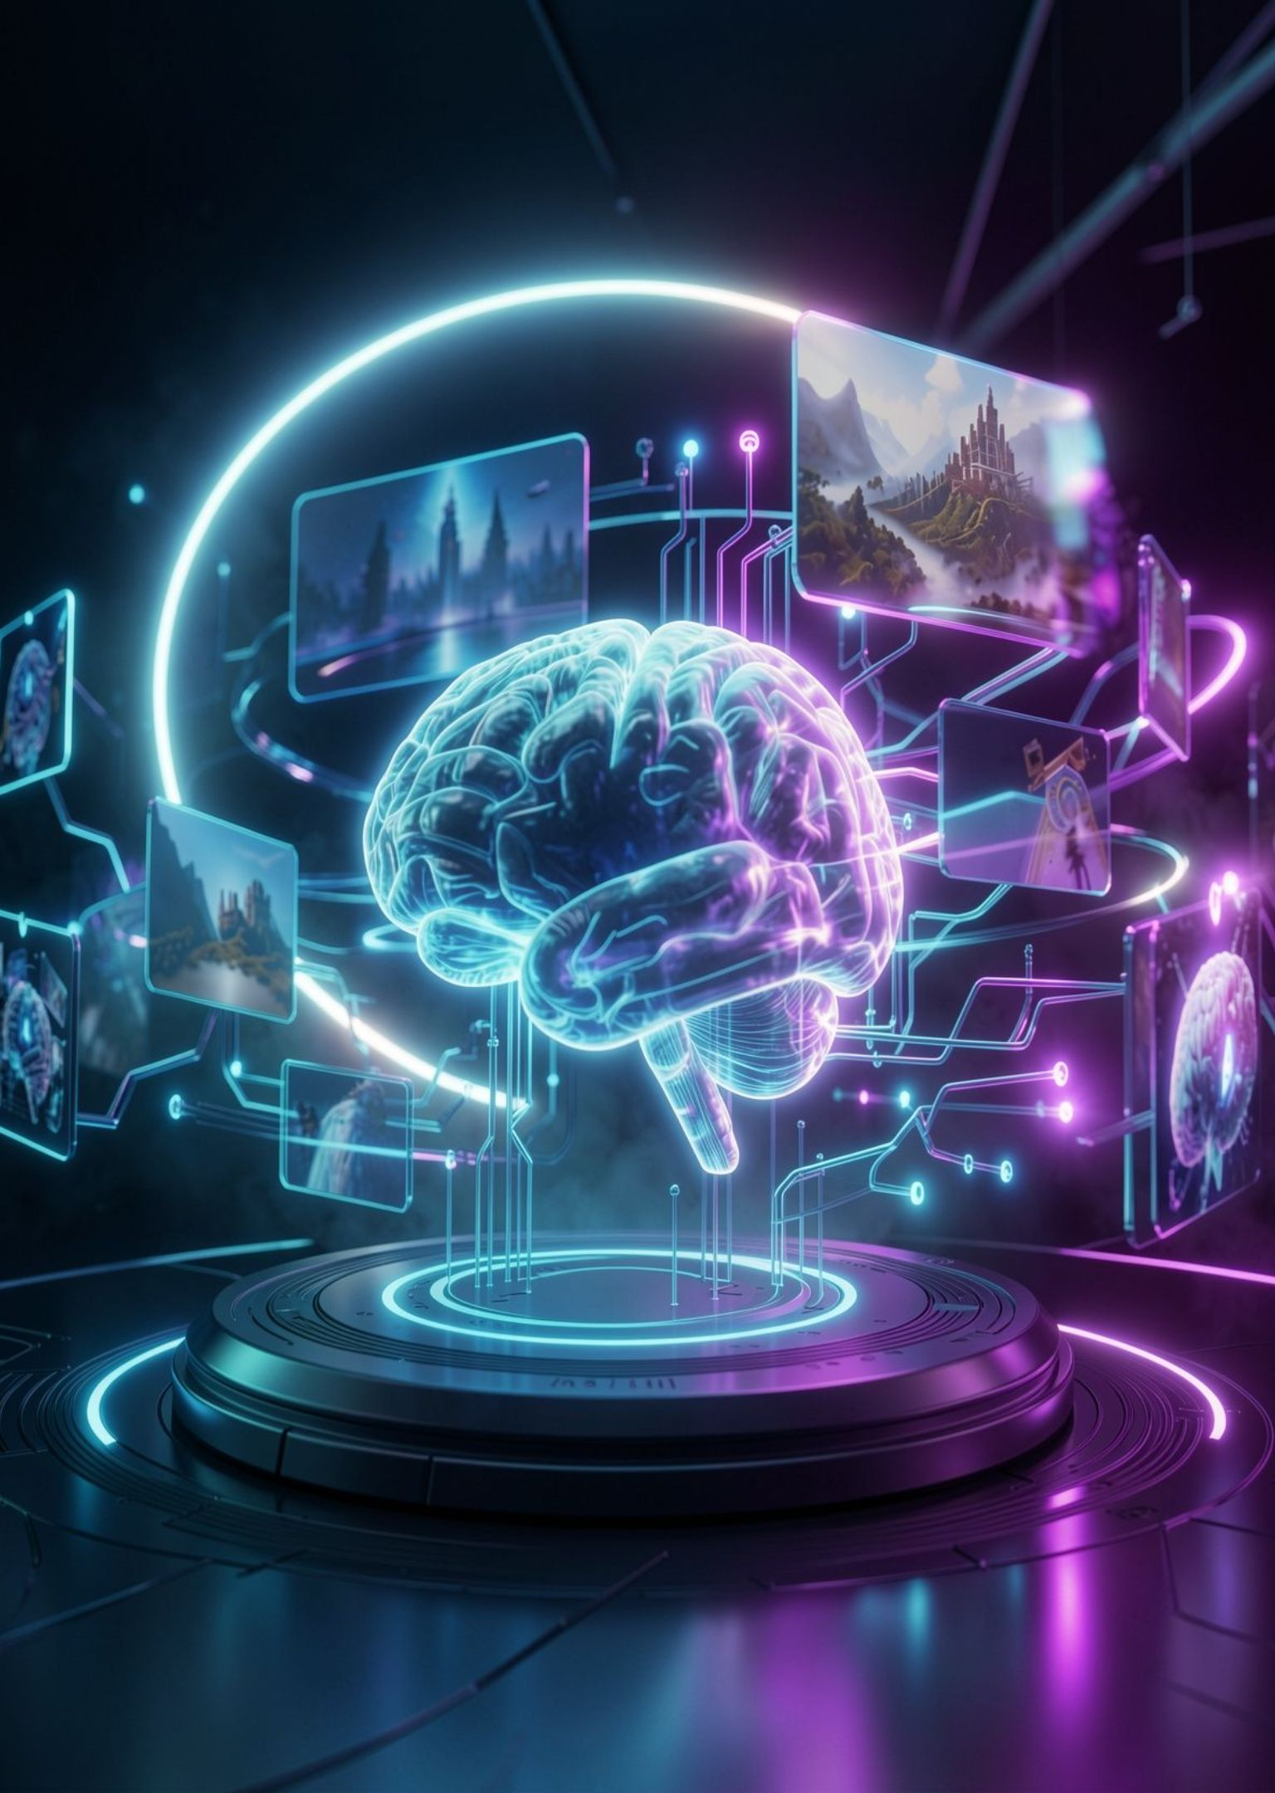
PERCHANCE AI · A PRACTICAL STARTING POINT
Why Use Perchance AI?
ADVANTAGES
LIMITATIONS
Easy to use
Useful for creative experimentation
Suitable for posters, concepts, and digital artwork
Some generators offer access without registration
Image quality and generation speed may vary.
Available features depend on the generator.
Check commercial-use permissions before publishing.
Perchance AI makes AI-powered image creation accessible for creative ideas and visual experimentation.
THANK YOU!
Official tool: https://perchance.org/
Presented By: Harshad Teli | MCA-I | Roll No: 15

