Slide 1

Retail Sales Analysis & Data Storytelling
Data Analytics Internship Project
HARSHAD UPADHYE

Slide 2

Project Overview
Objective
Explore
Analyse retail sales data to uncover actionable business insights, identify performance trends, and support strategic decision-making across categories, regions, and time periods.
Identify patterns in sales, region, and category data
Visualise
Build an interactive Power BI dashboard
Recommend
Deliver data-driven business recommendations

Slide 3
Dataset Overview
9,994
16
Total Rows
Columns
Retail transaction records
Features per record
Key Columns in the Dataset
Column
Description
Order Date
Date of each transaction
Category
Product category (e.g., Technology)
Region
Geographic sales region
Quantity
Units sold per order
Sales
Revenue generated per order

Slide 4

Data Cleaning & Preparation
Raw data was systematically cleaned and enriched to ensure accuracy and analytical readiness before any exploratory analysis was performed.
Remove Missing Values
Standardise Dates
Engineer Columns
Ready for Analysis
Feature engineering added Total Sales, Year, and Month columns, enabling time-series analysis and aggregated insights across the dataset.

Slide 5
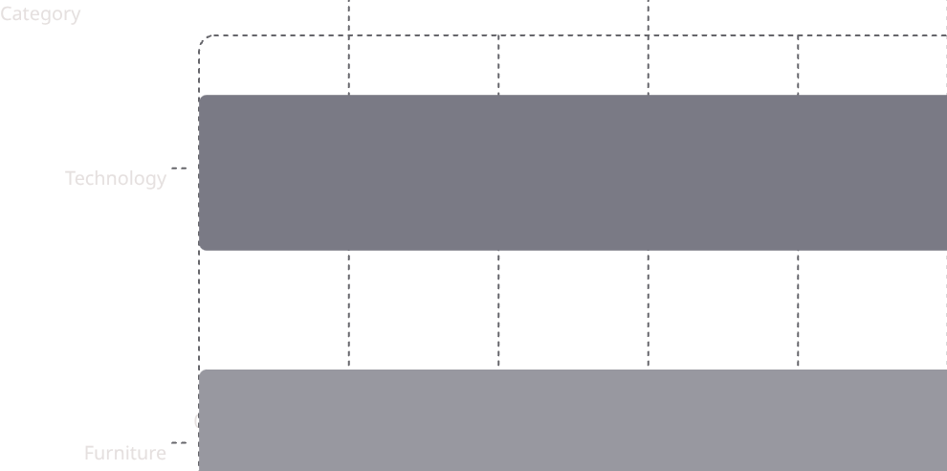
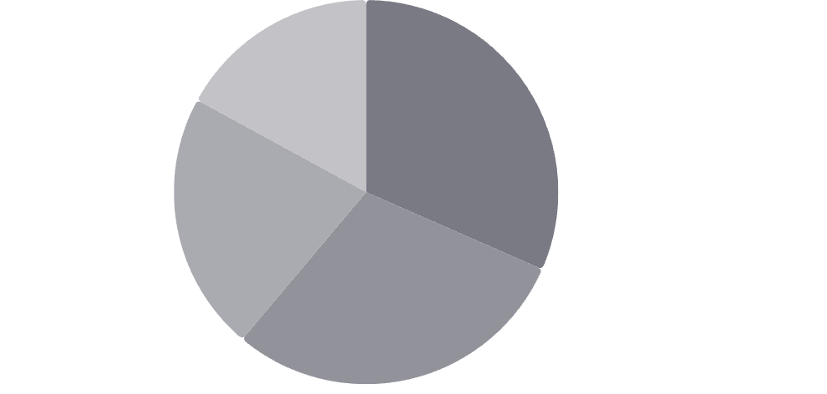

Exploratory Data Analysis
West·31.58%
·31.58%
·
East·29.55%
·29.55%
·
Central·21.82%
·21.82%
·
South·17.05%
·17.05%
·

Slide 6

Power BI Dashboard
$2.3M
9,994
Total Sales
Total Orders
$229
Avg. Sales
Dashboard Features
Interactive slicers by Region, Category, and Year
Dynamic filters for drill-down analysis
KPI cards with real-time metric updates
Trend lines and comparative bar charts

Slide 7
Key Insights
Technology Leads
West Dominates
Technology category generated the highest sales across all product segments
West region contributed the highest regional revenue share at ~31%
Seasonal Peaks
Sub-Category Growth
Sales surged in September, November, and December — clear seasonal patterns
Top sub-categories like Phones, Chairs, and Binders drove major business volume

Slide 8

Statistical Validation
Hypothesis Testing
1
2
An independent samples t-test was conducted to evaluate whether the West region's sales performance is statistically distinguishable from other regions.
H₀ — Null Hypothesis
H₁ — Alternate Hypothesis
No significant difference exists in sales performance across regions
West region has significantly higher sales than other regions
Result: p-value < 0.05 — the null hypothesis is rejected. West region sales are statistically significantly higher.

Slide 9




Business Recommendations
Target High-Performing Regions
Promote Top Products
Data-Driven Strategy
Lift Underperforming Segments
Embed Power BI dashboards into routine business reviews for continuous, evidence-based decisions
Increase marketing investment in the West and East regions to maximise revenue yield
Prioritise Technology sub-categories like Phones and Accessories in promotional campaigns
Investigate and address low-performing categories through targeted promotions and inventory adjustments

Slide 10

Thank You
Data analysis drives smarter decisions. EDA, dashboarding, and statistical storytelling together reveal the growth opportunities hidden within retail data.
Insights Delivered
Tools Used
EDA, statistics & dashboards
Python · Power BI · Statistics
Harshad Upadhye · Data Analytics Internship Project

