Slide 1
Secure Data hiding in image using steganography
CAPSTONE PROJECT
Presented By: Harshad Zalaniya
Student Name : Harshad Zalaniya
College Name & Department : B.H Gardi College Of Engineering
And Technology(Rajkot) Com.Eng

Slide 2
OUTLINE
Problem Statement
Technology used
Wow factor
End users
Result
Conclusion
Git-hub Link
Future scope

Slide 3
Problem Statement
In an era where data breaches and unauthorized access to sensitive information are rampant, traditional methods of data transmission are increasingly vulnerable.
This project addresses the challenge of securely hiding data within images using steganography, ensuring that confidential information remains concealed from prying eyes while maintaining the integrity of the cover image.

Slide 4
Technology used
The project utilizes advanced steganography techniques, primarily the Least Significant Bit (LSB) method for embedding data within images.
Additionally, image processing libraries such as “OpenCV” and “PIL” in Python are employed for image manipulation and data extraction.
Encryption algorithms may also be integrated to enhance data security before embedding..

Slide 5
Wow factors
Dual Security: Combines steganography with encryption for enhanced data protection.
Robustness: Utilizes advanced techniques that withstand common image manipulations.
User -Friendly Interface: Provides an intuitive application for users to easily hide and retrieve data.
Real-Time Processing: Capable of processing images quickly without noticeable degradation in quality.

Slide 6
End users
The primary end users of this technology include:
Individuals: For personal data protection and secure communication.
Businesses: To safeguard sensitive corporate information and intellectual property.
Government Agencies: For secure transmission of classified information.
IT Firms: Big MNCs mostly prefer secure information sharing and storing.
Digital Artists: To embed copyright information within their works.

Slide 7
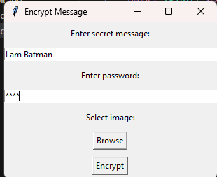
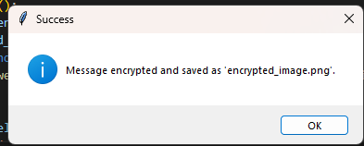
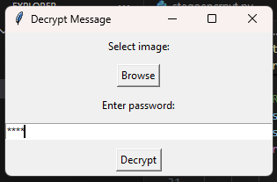
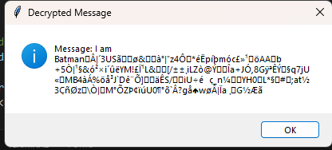
Results

Slide 8
Conclusion
The project successfully showcases the effectiveness of steganography as a means of secure data hiding within images. By leveraging advanced techniques and encryption, it provides a reliable solution for protecting sensitive information. The results affirm the potential of steganography in enhancing data security in various applications.

Slide 9
GitHub Link
https://github.com/harshadzalaniya/STEGANOGRAPHY-Data-Hiding-In-Image-

Slide 10
Future scope
Future work could explore the integration of machine learning algorithms to improve the robustness of steganography techniques against sophisticated attacks. Additionally, expanding the research to include other media types, such as audio and video, could further enhance the versatility of data hiding methods. Investigating the use of blockchain technology for secure data transmission could also be a promising avenue for future research.

Slide 11
THANK YOU

