Slide 1
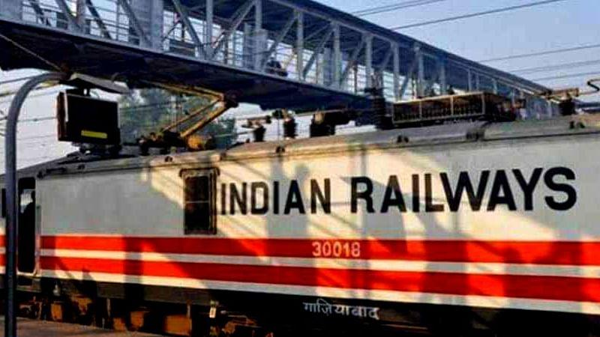
Submitted By:
Ishika Soni (2017EEB1145)
Harsha (2017meb1008)

Slide 2
Tables
Ticket
bookings_history
AC
pnr_train
Users
SL
102
105
104
101
103
Booking_system
Train
Admin

Slide 3
pnr=>PK
train_id
pnr_train
Users
ticket
username =>PK
email =>Unique
address
phone
CC
password
Pnr =>PK
date
Name =>PK
Age =>PK
Gender =>PK
coachNo
berthNo
username
pnr
bookings_history

Slide 4
db_username =>PK
db_password
Train
Admin
db_train_no=>PK
db_Sleeper
db_AC
db_trainNo=>PK
db_AC=>PK
db_Sleeper
db_date
Booking System
db_berthNo =>PK
db_berthType
sl
ac
db_berthNo =>PK
db_berthType

Slide 5
db_coachType => PK
db_BerthNo =>PK
db_bookStatus
db_coachNo =>PK
db_date =>PK
101
db_coachType => PK
db_BerthNo =>PK
db_bookStatus
db_coachNo =>PK
db_date =>PK
102
db_coachType => PK
db_BerthNo =>PK
db_bookStatus
db_coachNo =>PK
db_date =>PK
103
db_coachType => PK
db_BerthNo =>PK
db_bookStatus
db_coachNo =>PK
db_date =>PK
104
db_coachType => PK
db_BerthNo =>PK
db_bookStatus
db_coachNo =>PK
db_date =>PK
105

Slide 6
Booking system Procedure
Booking agent
Login
[Table : Users]
Go to user dashboard
Enter details :
Trainid
Date of Journey
Number of Passengers
Type of Coach: AC/Sleeper
Booking agent
Registeration
[Table : Users]
Checks: Same username and email can’t register twice
Only registered users can login
Trainid entered by booking agent should be released by admin on date of journey
No. of available seats should be more or equal to the no. of passengers in the selected coach
Enter details of passengers:
Name
Age
Gender
[Table : ticket]
TICKET
BOOKED
A unique PNR is generated and ticket is displayed

Slide 7
Train Release Procedure
Correct
Username/Password
Correct Train No
Admin Login
(Table: admin )
Enter train No
(Table: train )
Successful
Enter Date
Enter No of Sleeper Coaches
Enter No of AC Coaches
(Table : Booking System , train)
Success: Train Released
(Table[insertion]: Booking_System, 101, 102 ,103 ,104, 105)
Checks
Not a released train
Date not exceed advance booking timeline (15 days)
No of sleeper and AC coaches not exceed the maximum limit
Date >= today's date

Slide 8
Thank You

