Slide 1
1 Support Vector Machines: history
SVMs introduced in COLT-92 by Boser, Guyon & Vapnik. Became rather popular since.
Theoretically well motivated algorithm: developed from Statistical Learning Theory (Vapnik & Chervonenkis) since the 60s.
Empirically good performance: successful applications in many fields (bioinformatics, text, image recognition, ...)

Slide 2
3 Support Vector Machines: basics
[Boser, Guyon, Vapnik ’92],[Cortes & Vapnik ’95]
- ₋ margin
- -
-
margin
+
+
+
+
+
Nice properties: convex, theoretically motivated, nonlinear with kernels..

Slide 3
4 Preliminaries:
Machine learning is about learning structure from data.
Although the class of algorithms called ”SVM”s can do more, in this talk we focus on pattern recognition.
So we want to learn the mapping: X '→ Y, where x ∈ X is some object and y ∈ Y is a class label.
Let’s take the simplest case: 2-class classification. So: x ∈ R^{n}, y ∈ {±1}.

Slide 4
5 Training sets and prediction models
input/output sets X , Y
training set (x₁, y₁),... , (x_{m}, y_{m})
”generalization”: given a previously seen x ∈ X , find a suitable
y ∈ Y.
i.e., want to learn a classifier: y = f (x, α), where α are the parameters of the function.
For example, if we are choosing our model from the set of hyperplanes in R^{n}, then we have:
f (x, {w, b}) = sign(w · x + b).

Slide 5
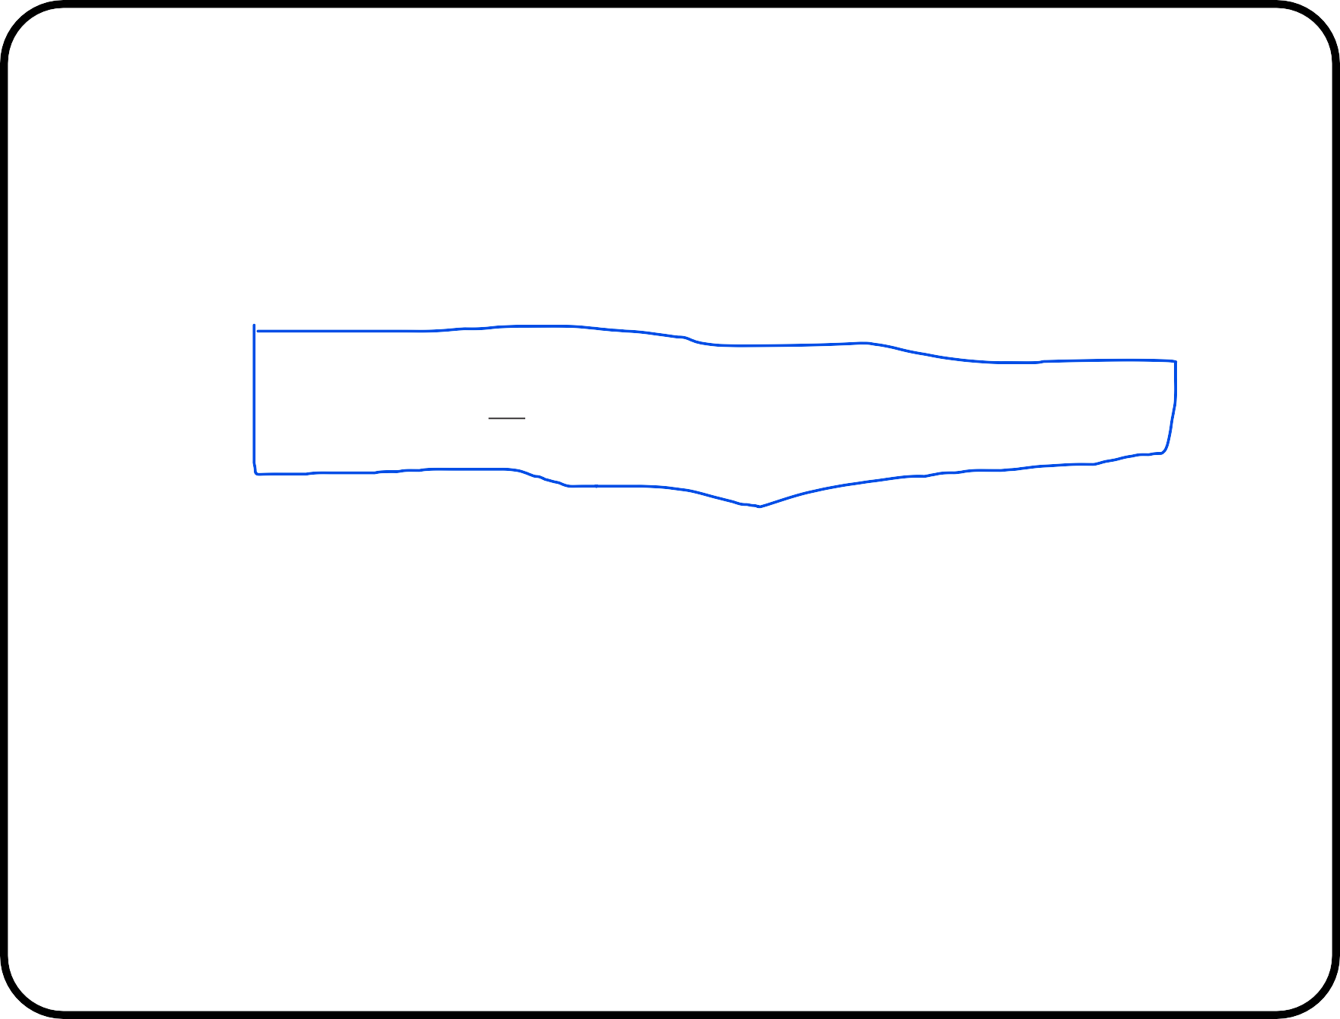
6 Empirical Risk and the true Risk
We can try to learn ƒ (x, α) by choosing a function that performs well on training data:
_{1 Σ}m
R_{emp}(α) = l(ƒ (x_{i}, α), y_{i}) = Training Error
m
i=1
where l is the zero-one loss function, l(y, yˆ) = 1, if y /= yˆ, and 0 otherwise. R_{emp} is called the empirical risk.
By doing this we are trying to minimize the overall risk:
∫
R(α) = l(ƒ (x, α), y)dP (x, y) = Test Error
where P(x,y) is the (unknown) joint distribution function of x and y.

Slide 6
7 Choosing the set of functions
What about ƒ (x, α) allowing all functions from X to {±1}? Training set (x₁, y₁),... , (x_{m}, y_{m}) ∈ X × {±1}
Test set x¯₁,..., x¯_{m¯} ∈ X ,
such that the two sets do not intersect. For any ƒ there exists ƒ ∗:
ƒ ∗(x_{i}) = ƒ (x_{i}) for all i
ƒ ∗(x_{j} ) /= ƒ (x_{j} ) for all j
Based on the training data alone, there is no means of choosing which function is better. On the test set however they give different results. So generalization is not guaranteed.
=⇒ a restriction must be placed on the functions that we allow.

Slide 7
8 VC dimension:
The VC dimension of a set of functions is the maximum number of points that can be separated in all possible ways by that set of functions. For hyperplanes in R^{n}, the VC dimension can be shown to be n + 1.
xxxxxxxxxxxxxxxxxx
xxxxxxxxxxxxxxxxxxxxxxxxxxxxxxxxxxxx
xxxxxxxxxxxxxxxxxxxxxxxxxxxxxxxxxxxxx
xxxxxxxxxxxxxxxxxx xxxxxxxxxxxxxxxxxx xxxxxxxxxxxxxxxxxx xxxxxxxxxxxxxxxxxx xxxxxxxxxxxxxxxxxxx
xxxxxxxxxxxxxxxxxxxxxxxxxxxxxxxxxxxx xxxxxxxxxxxxxxxxxxxxxxxxxxxxxxxxxxxx xxxxxxxxxxxxxxxxxxxxxxxxxxxxxxxxxxxx xxxxxxxxxxxxxxxxxxxxxxxxxxxxxxxxxxxx xxxxxxxxxxxxxxxxxxxxxxxxxxxxxxxxxxxx
xxxxxxxxxxxxxxxxxxxxxxxxxxxxxxxxxxxxxx
xxxxxxxxxxxxxxxxxxx xxxxxxxxxxxxxxxxxxx xxxxxxxxxxxxxxxxxxx xxxxxxxxxxxxxxxxxxx xxxxxxxxxxxxxxxxxxxx
x
xxxxxxxxxxxxxxxxxxxxxxxxxxxxxxxxxx
xxxxxxxxxxxxxxxxxxxxxxxxxxxxxxxxxxxxx xxxxxxxxxxxxxxxxxxxxxxxxxxxxxxxxxxxxx xxxxxxxxxxxxxxxxxxxxxxxxxxxxxxxxxxxxx xxxxxxxxxxxxxxxxxxxxxxxxxxxxxxxxxxxx
x
xxxxxxxxxxxxxxxxxxxxxxxxxxxxxxxxxxxx
x
xxxxxxxxxxxxxxxxxxxxxxxxxxxxxxxx
x
x
xxxxxxxxxxxxxxxxxxxxxxxxxxxxxx
xxxxxxxxxxxxxxxxxxxxxxxxxxxxxxxxxxxx
xxxxxxxxxxxxxxxxxxxxxxxxxxxx
xxxxxxxxxxxxxxxxxxxxxxxxxxxxxxxxxxx
xxxxxxxxxxxxxxxxxxxxxxxxxx
xxxxxxxxxxxxxxxxxxxxxxxxxxxxxxxxxxx
xxxxxxxxxxxxxxxxxxxx xxxxxxxxxxxxxxxxxxxx xxxxxxxxxxxxxxxxxxxx xxxxxxxxxxxxxxxxxxxx xxxxxxxxxxxxxxxxxxxx xxxxxxxxxxxxxxxxxxxxx xxxxxxxxxxxxxxxxxxxxx xxxxxxxxxxxxxxxxxxxxx xxxxxxxxxxxxxxxxxxxxx xxxxxxxxxxxxxxxxxxxxx xxxxxxxxxxxxxxxxxxxxxx xxxxxxxxxxxxxxxxxxxxxx xxxxxxxxxxxxxxxxxxxxxx xxxxxxxxxxxxxxxxxxxxxx
xxxxxxxxxxxxxxxxxxxxxxxx xxxxxxxxxxxxxxxxxxxxxx xxxxxxxxxxxxxxxxxxxx xxxxxxxxxxxxxxxxxxx xxxxxxxxxxxxxxxxx xxxxxxxxxxxxxxx xxxxxxxxxxxxx xxxxxxxxxxx
xxxxxxxxx xxxxxxx xxxxx xxx
x
xxxxxxxxxxxxxxxxxxxxxxxxxxxxxxxxxxx
xxxxxxxxxxxxxxxxxxxxxxxxxxxxxxxxxx xxxxxxxxxxxxxxxxxxxxxxxxxxxxxxxxxx xxxxxxxxxxxxxxxxxxxxxxxxxxxxxxxxxx
x
xxxxxxxxxxxxxxxxxxxxxxxxxxxxxxxxx
x
x
xxxxxxxxxxxxxxxxxxxxxxxxxxxxxxxxx
xxxxxxxxxxxxxxxxxxxxxxxxxxxxxxxxx
xxxxxxxxxxxxxxxxxxxxxxxxxxxxxxxx
xxxxxxxxxxxxxxxxxxxxxxxxxxxxxxxx
xxxxxxxxxxx xxxxxxxxxxxxxxxxxxxxxxxxxx
xxxxxxxxxxxxxxxxxxxxxxxxxxxxxxxx xxxxxxxxxxxxxxxxxxxxxxxxxxxxxxx xxxxxxxxxxxxxxxxxxxxxxxxxxxxxxx xxxxxxxxxxxxxxxxxxxxxxxxxxxxxxx xxxxxxxxxxxxxxxxxxxxxxxxxxxxxx xxxxxxxxxxxxxxxxxxxxxxxxxxxxxx
xxxxxxxxxxxxxxxxxxxxxx xxxxxxxxxxxxxxxxxxxxxx xxxxxxxxxxxxxxxxxxxxxxx xxxxxxxxxxxxxxxxxxxxxxx xxxxxxxxxxxxxxxxxxxxxxx
xxxxxxxxxxxxxxxxxxxxxxxxxxxxxxxxxxxxx xxxxxxxxxxxxxxxxxxxxxxxxxxxxxxxxxxxxx
x
xxxxxxxxxxxxxxxxxxxxxxxxxxxxxxxxxxxxx
xxxxxxxxxxxxxxxxxxxxxxxxxxxxxx
x
x
x
xxxxxxxxxxxxxxxxxxxxxxxxxxxxxxxxxxxxx
xxxxxxxxxxxxxxxxxxxxxxxxxxxxx
xxxxxxxxxxxxxxxxxxxxxxxxxxxxxxxxxxxxx
xxxxxxxxxxxxxxxxxxxxxxxxxxxxx
xxxxxxxxxxxxxxxxxxxxxxxxxxxxxxxxxxxxx
xxxxxxxxxxxxxxxxxxxxxxxxxxxxx
xxxxxxxxxxxxxxxxxxxxxxx xxxxxxxxxxxxxxxxxxxxxxx xxxxxxxxxxxxxxxxxxxxxxxx xxxxxxxxxxxxxxxxxxxxxxxx xxxxxxxxxxxxxxxxxxxxxxxx xxxxxxxxxxxxxxxxxxxxxxxx
xxxxxxxxxxxxxxxxxxxxxxxxxxxxxxxxxxxxx
xxxxxxxxxxxxxxxxxxxxxxxxxxxx
xxxxxxxxxxxxxxxxxxxxxxxxxxxxxxxxxxxxx xxxxxxxxxxxxxxxxxxxxxxxxxxxxxxxxxxxxx xxxxxxxxxxxxxxxxxxxxxxxxxxxxxxxxxxxxx xxxxxxxxxxxxxxxxxxxxxxxxxxxxxxxxxxxxx xxxxxxxxxxxxxxxxxxxxxxxxxxxxxxxxxxxxx xxxxxxxxxxxxxxxxxxxxxxxxxxxxxxxxxxxxx
xxxxxxxxxxxxxxxxxxxxxxxxxxxx xxxxxxxxxxxxxxxxxxxxxxxxxxxx xxxxxxxxxxxxxxxxxxxxxxxxxxx xxxxxxxxxxxxxxxxxxxxxxxxxxx xxxxxxxxxxxxxxxxxxxxxxxxxxx xxxxxxxxxxxxxxxxxxxxxxxxxx
xxxxxxxxxxxxxxxxxx
xxxxxxxxxxxxxxxxxxxxxxxxxxxxxxxxxxxxx
x
xxxxxxxxxxxxxxxxxxx xxxxxxxxxxxxxxxxxxx xxxxxxxxxxxxxxxxxxx xxxxxxxxxxxxxxxxxxx xxxxxxxxxxxxxxxxxx xxxxxxxxxxxxxxxxxx xxxxxxxxxxxxxxxxxx xxxxxxxxxxxxxxxxxx xxxxxxxxxxxxxxxxxx xxxxxxxxxxxxxxxxx xxxxxxxxxxxxxxxxx xxxxxxxxxxxxxxxxx xxxxxxxxxxxxxxxxx
x xxx
xxxxx xxxxxxx xxxxxxxxx xxxxxxxxxxx
xxxxxxxxxxxxx xxxxxxxxxxxxxx xxxxxxxxxxxxxxxx
xxxxxxxxxxxxxxxxxxxxxxxxxxxxxxxxxxxxx xxxxxxxxxxxxxxxxxxxxxxxxxxxxxxxxxxxxx xxxxxxxxxxxxxxxxxxxxxxxxxxxxxxxxxxxxx xxxxxxxxxxxxxxxxxxxxxxxxxxxxxxxxxxxxx xxxxxxxxxxxxxxxxxxxxxxxxxxxxxxxxxxxxx
x xx xx xx xxx xxx xxx xxxx xxxx xxxx xxxx
xxxxx
xxxxx xxxxx xxxxxx xxxxxx xxxxxx xxxxxxx xxxxxxx xxxxxxx xxxxxxx xxxxxxxx xxxxxxxx xxxxxxxx
x
x
xxxxxxxxxxxxxxxxxxxxxxxxxxxxxxxxxxxxx
x
x
xxxxxxxxxxxxxxxxxxxxxxxxxxxxxxxxxxxxx
xxxxxxxxxxxxxxxxxxxxxxxxxxxxxxxxxxxxx
xxxxxxxxxxxxxxxxxxxxxxxxxxxxxxxxxxxxx
xxxxxxxxxxxxxxxxxxxxxxxxxxxxxxxxxxxxx
xxxxxxxxxxxxxxxxxxxxxxxxxxxxxxxxxxxxx xxxxxxxxxxxxxxxxxxxxxxxxxxxxxxxxxxxxx xxxxxxxxxxxxxxxxxxxxxxxxxxxxxxxxxxxxx
xxxxxxxxxxxxxxxxx
xxxxxxxxxxxxxxxxxx xxxxxxxxxxxxxxxxxxxx xxxxxxxxxxxxxxxxxxxxxx xxxxxxxxxxxxxxxxxxxxxxxx xxxxxxxxxxxxxxxxxxxxxxxxxx
xxxxxxxxxxxxxxxxxxxxxxxxxxxxxxxxxxxxx
x
x
x
x
xxxxxxxxxxxxxxxxx
xxxxxxxxxxxxxxxxxxxxxxxxxxxxxxxxxxxxx
xxxxxxxxxxxxxxxx
xxxxxxxxxxxxxxxxxxxxxxxxxxxxxxxxxxxxx
xxxxxxxxxxxxxxxx
xxxxxxxxxxxxxxxxxxxxxxxxxxxxxxxxxxxxx
xxxxxxxxxxxxxxxx
xxxxxxxxxxxxxxxxxxxxxxxxxxxxxxxxxxxxx
xxxxxxxxxxxxxxxx xxxxxxxxxxxxxxxx xxxxxxxxxxxxxxx xxxxxxxxxxxxxxx xxxxxxxxxxxxxxx xxxxxxxxxxxxxxx xxxxxxxxxxxxxxx xxxxxxxxxxxxxxx xxxxxxxxxxxxxx xxxxxxxxxxxxxx xxxxxxxxxxxxxx xxxxxxxxxxxxxx xxxxxxxxxxxxxx xxxxxxxxxxxxx xxxxxxxxxxxxx xxxxxxxxxxxxx xxxxxxxxxxxxx
xxxxxxxxxxxxxxxxxxxxxxxxxxxx xxxxxxxxxxxxxxxxxxxxxxxxxxxxxx xxxxxxxxxxxxxxxxxxxxxxxxxxxxxxxx xxxxxxxxxxxxxxxxxxxxxxxxxxxxxxxxxx xxxxxxxxxxxxxxxxxxxxxxxxxxxxxxxxxxxx xxxxxxxxxxxxxxxxxxxxxxxxxxxxxxxxxxxx
xxxxxxxxxxxxxxxxxxxxxxxxxxxxxxxxxxx xxxxxxxxxxxxxxxxxxxxxxxxxx xxxxxxxxxxxxxxxxx
xxxxxxxx
x
xxxxxxxxxxxxxxxxxxxxxxxxxxxxxxxxxxxx
xxxxxxxxxxxxxxxxxxxxxxxxxxxxxxxxxxxxx
xxxxxxxxxxxxxxxxxxxxxxxxxxxxxxxxxxxx
xxxxxxxxxxxxxxxxxxxxxxxxxxxxxxxxxxxx
x
x xxxxxxxxxx xxxxxxxxxx
xxxxxxxxxx xxxxxxxxxx
xxxxxxxxxxxxxxxxxxxxxxxxxxxxxxxxxxxx xxxxxxxxxxxxxxxxxxxxxxxxxxxxxxxxxxxx xxxxxxxxxxxxxxxxxxxxxxxxxxxxxxxxxxxx xxxxxxxxxxxxxxxxxxxxxxxxxxxxxxxxxxxx xxxxxxxxxxxxxxxxxxxxxxxxxxxxxxxxxxxx xxxxxxxxxxxxxxxxxxxxxxxxxxxxxxxxxxxx xxxxxxxxxxxxxxxxxxxxxxxxxxxxxxxxxxxx
xxxxxxxxx xxxxxxxxx xxxxxxxxx
xxxxxxxxxxx xxxxxxxxxxx xxxxxxxxxxx
xxxxxxxxxxxx

Slide 8
9 VC dimension and capacity of functions
Simplification of bound:
Test Error ≤ Training Error + Complexity of set of Models
Actually, a lot of bounds of this form have been proved (different measures of capacity). The complexity function is often called a regularizer.
If you take a high capacity set of functions (explain a lot) you get low training error. But you might ”overfit”.
If you take a very simple set of models, you have low complexity, but won’t get low training error.

Slide 9
10 Capacity of hyperplanes
Vapnik & Chervonenkis also showed the following:
Consider hyperplanes (w · x) = 0 where w is normalized w.r.t a set of points X∗ such that: min_{i} |w · x_{i}| = 1.
The set of decision functions ƒ_{w} (x) = sign(w · x) defined on X∗ such that ||w|| ≤ A has a VC dimension satisfying
h ≤ R²A².
where R is the radius of the smallest sphere around the origin containing
X∗.
=⇒ minimize ||w||² and have low capacity
=⇒ minimizing ||w||² equivalent to obtaining a large margin classifier

Slide 10
<w, x> + b > 0
◆
●
●
◆
◆
<w, x> + b < 0
w
◆
●
●
{x | <w, x> + b = 0}
●

Slide 11
{x | <w, x> + b = +1}
{x | <w, x> + b = −1}
Note:
◆
<w, x₁> + b = +1
<w, x₂> + b = −1
=> <w, (x₁−x₂)> = 2
=>
❍
_{x} ❍
x₁
y_{i} = +1
2
> 2
||w||
◆
<
w
y_{i} = −1
w
,
,
(x −x ) =
◆
||w||
1 2
❍
❍
{x | <w, x> + b = 0}
❍

Slide 12
11 Linear Support Vector Machines (at last!)
So, we would like to find the function which minimizes an objective like: Training Error + Complexity term
We write that as:
_{1 Σ}m
l(ƒ (x_{i}, α), y_{i}) + Complexity term
m
i=1
For now we will choose the set of hyperplanes (we will extend this later), so ƒ (x) = (w · x)+ b:
_{1 Σ}m
l(w · x_{i} + b, y_{i}) + ||w||²
m
i=1
subject to min_{i} |w · x_{i}| = 1.

