Slide 1

Genba Sopanrao Moze Trust’s
Paravatibai Genba Moze College of Engineering
“Department of Computer Engineering”
Cyberbullying detection on social media
Using machine learning
Project Review III
by
1 Harsh Agarwal
2 Jagruti Jadhav
3 Babita Jaybhaye
4 Komal Nagar
Guided By
Prof. Shrikant Dhamdhere
Notes:
Kindly keep your Project title as the footer of each slide along with the slide no.
JSPM's BSIOTR , Computer Dept

Slide 2
Motivation/Background
There are three main motivation for this projecy, namely the grave nature of the menace of cyber-bullying, the algorithmic challenges in the fields of machine learning and natural language processing with respect to this problem, as well the dearth of technical solutions to tackle this problem

Slide 3
Introduction
Reynolds had defined cyberbullying as “willful and repeated harm inflicted through the medium of electronic text”
Al- Garadi, Varathan and Ravana had defined it as “be a sub-type of aggressive behavior in which an individual or group of individuals repeatedly attack, humiliate and/or exclude a relatively powerless person”
Most of the victims of cyberbullying are teens which does not report to parents and hence attackers not get identified to prevent this we had to go to select automatic detection than traditional method

Slide 4
Literature Survey (sample)
Sr. no.: | Authors | Methodology used | Dataset | Limitation
1 | Dinakar et al. 2011 | Supervised machine learning | YouTube | Victims and attackers not identified
3 | Reynolds et al. 2011 | Supervised machine learning | Form spring | Larger dataset should be used
4 | Niharika et al. 2020 | Elaborated on characteristics, forms of bullying, estimates of bullying, risk factors, side effects of bullying in India specific to adolescents going to school | Different social media platform | Lack of proper dataset
5 | Manuel et al. 2021 | Supervised machine learning | Vine | lack of dataset. evaluation based on time, instead of number of posts

Slide 5
Existing System
Existing system uses supervised machine learning technique to solve this problem general algorithms like Logistic regression, Navies bayes, Random forest, decision tree.
Features is based on textual and TF-IDF, word embedding are used to extract from text

Slide 6
Existing System
1. There are no large dataset available for detection of problem
the dataset is not properly annotated
2. User based features are not considered.

Slide 7
Problem Statement
Implement cyberbullying detection system using given dataset
To study impact of various standard ml algorithms along with different data processing techniques in improving accuracy

Slide 8
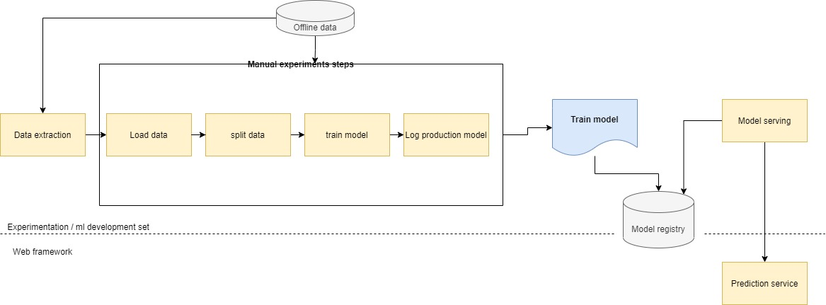
Proposed System Architecture

Slide 9
Proposed System Algorithm
Get the comment to be tested
Perform tokenization and remove stop words
Create Frequency dictionary
Create Feature array with help of dictionary
Split data into two parts training data and testing data
Train the SVM Model
Used the model to give prediction

Slide 10
Advantages
Manual, script-driven, and interactive process
Deployment is in form of prediction service which contains both API and webapp
Code had been modularized in form of pipelines for experimentation purpose

Slide 11
Expected Results/Outcome
The algorithm should be able to predict if comment had cyberbullying activities or not
Software should be able to give output with help of API

Slide 12
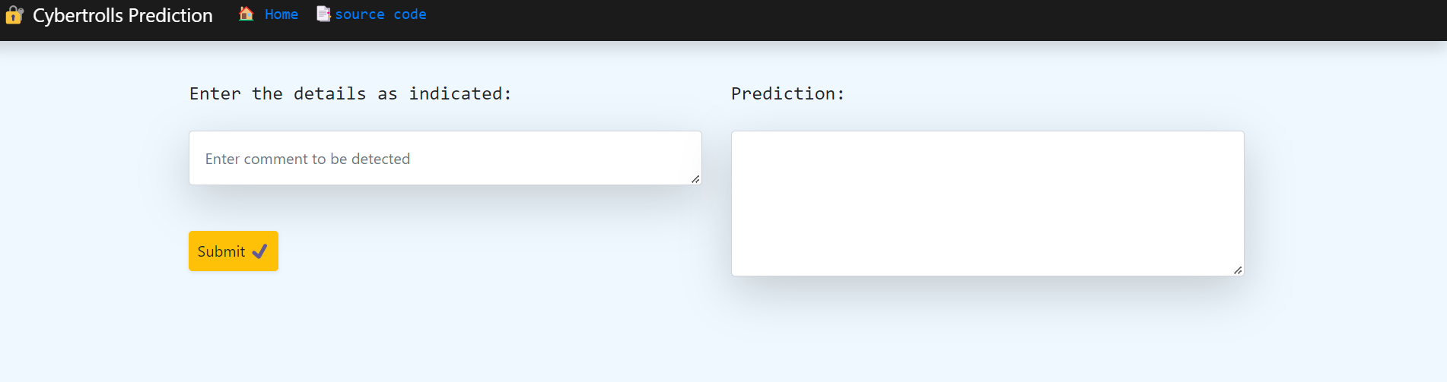
System Requirements
User Interface
User interface had a submit button. When user clicks submit button on a webpage it triggers the prediction function and in the text box it gives the prediction of sentence. The prototype user interface is as follows

Slide 13
System Requirements
Software Interface:
In this system there will be used of API named as MLFlow which will be used to store different models to solve the problem
The second API used in this system is called as DVC which is used for tracking the dataset changes

Slide 14
System Requirements
Communication
The communication can be done in two ways first one is between the browser and the server. Flask tool will be used to send queries and receive ones. HTTP will be used as the protocol And by using API where user had to send data in form of JSON once received by server it would return it in form of JSON only

Slide 15
Non-Functional Requirements
Usability
The system should be easy to use. The user should reach the prediction with one button press if possible.
The system also should be user friendly for admins.
Training the classifiers is used too many times.

Slide 16
Reliability
This software will be developed with machine learning, feature engineering and deep
learning techniques.
User provided data will be used to compare with result and measure reliability. With recent machine learning techniques, user gained data should be enough for reliability if enough data is obtained.
The maintenance period should not be a matter because the reliable version is always running on the server which allow users to access cyberbullying software.

Slide 17
Performance
Calculation time and response time should be as little as possible, because one of the software’s features is timesaving.
The capacity of servers should be as high as possible. Calculation and response times are very low, and this comes with that there can be so many sessions at the same times.
1 minute degradation of response time should be acceptable. The certain session limit also acceptable at early stages of development. It can be confirmed to user with “servers are not ready at this time” message.

Slide 18
Supportability
The system should require Python knowledge to maintenance. If any problem acquires in server side and machine learning methods, it requires code knowledge and machine learning background to solve.
Client-side problems should be fixed with an update and it also require code knowledge and network knowledge.

Slide 19
Project Scope and Feasibility
True solutions to reduce the problem of cyber-bullying requires a fundamental restructuring of mindsets and cultural change on a huge scale.
The purpose of this project is to underline the technology as an ally in mitigating its effects.
Teenagers expressing recollections of distressing events can be directed to targeted help or shown messages that might reduce their difficulty.

Slide 20
Different types of Risks
There are total five risk in this project they are as follows
1. Technology does not meet expectation
2. Lack of training on tool
3. Loss of Knowledge
4. Failures in production
5. Regulatory and ethical

Slide 21
Project’s Estimated Cost and Time
Time estimated to complete this project is 10.4 months
The estimated cost is 25$

Slide 22
Project’s End Users/ Applications
User can freely express their thoughts on social media.
Users will be free from social-anxiety
Users would less frequently delete post on social media and loss fear of trolling

Slide 23
Conclusion
We have proposed the method to automatically detect cyberbullying text . Multiple textual features and multiple machine learning algorithms are used to construct classification models.
With the experiments based on the collected comments, the quality of automatic cyberbullying detection is evaluated and the best model performs over 90% for the four criteria:
  Accuracy
  precision
  recall
  F-measure.
Extracting new bullying words from the current comments and using them to obtain new comments iteratively

Slide 24
REFERENCES
List out minimum 5 references
  K. Reynolds, A. Kontostathis, and L. Edwards, “Using machine learning to detect cyberbullying,”
  J. Bayzick, A. Kontostathis, and L. Edwards, “Detecting the presence of cyberbullying using computer software,” 2011.
  T. Nitta, F. Masui, M. Ptaszynski, Y. Kimura, R. Rzepka, and K. Araki, “Detecting cyberbullying entries on informal school websites based on category relevance maximization’’.
  R. R. Dalvi, S. B. Chavan, and A. Halbe, “Detecting a twitter cyberbullying using machine learning,”
  K. Dinakar, R. Reichart, and H. Lieberman, “Modeling the detection of textual cyberbullying,”

