Slide 1
Strings
An array of characters terminating with null character ‘\0’ called string
Strings
Series of characters treated as a single unit
Can include letters, digits and special characters (*, /, $)
String literal (string constant) - written in double quotes
"Hello“

Slide 2

Initialization of strings
String can be initialized in any one of the form.
char c[5]="abcd";
char c[5]={'a','b','c','d','\0'};

Slide 3
Reading String from user
C program to illustrate how to read string from terminal
#include <stdio.h>
int main()
{
char name[20];
printf("Enter name: ");
scanf("%s“, &name);
printf("Your name is %s.", name);
return 0;
}
Output:
Enter name: Dennis Ritchie
Your name is Dennis

Slide 4
C offers built-in string functions
Strcpy() - copy one string into another
strncpy() - copy only the left most n characters from source to destination
strcat() - append one string onto the right side of the other string
strncat() - concatenate only the leftmost n characters from source with the destination string.
strcmp() – compare alphabetic order of two strings
strlen() – return the length of a string
strrev() - reverses the characters in a particular string
strupr() - converts string lowercase to uppercase
strlwr () - converts string from uppercase to lowercase

Slide 5
Strcpy()
Syntax: strcpy()
strcpy(destinationstring, sourcestring)
Copies source string into destination string
For example
strcpy(str, “hello world”);
assigns “hello world” to the string str
Syntax:strncpy() strncpy(Destination_String,Source_String,no_of_characters);
copy only the left most n characters from source to destination
For example
strncpy(str, “hello world”, 5);
assigns “hello” to the string str

Slide 6
Strcat()
Syntax:
strcat(destination string, source string)
appends source string to right hand side of destination string
For example if “str” had value “big ”
strcat(str, “hello world”); appends “hello world” to the string “big ” to get “ big hello world”
Syntax:
strncat(destination string, source string, n)
appends the portion of the source string to right hand side of destination string
For example if “str” had value “a big ”
strcat(“big”, “hello ”,3); appends “hello world” to the string “a big ” to get “bighel”

Slide 7
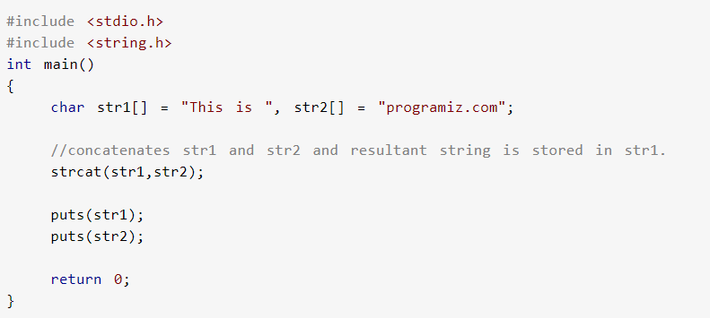
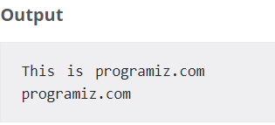

Slide 8
Strcmp()
Syntax:
strcmp(stringa, stringb)
Compares string a and string b alphabetically
Returns a negative value if the ASCII value of first unmatched character is less than second.
Returns a positive value if the ASCII value of first unmatched character is greater than second.
Returns 0 if they are equal
Note: lowercase characters are greater than Uppercase

Slide 9
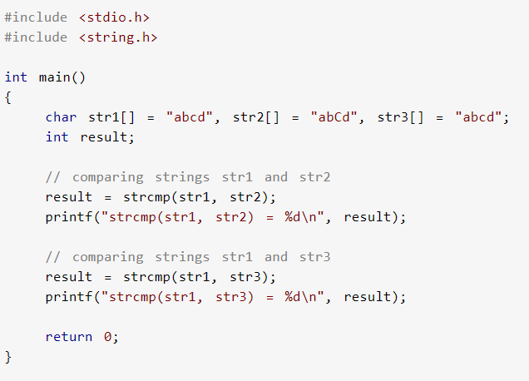

Slide 10
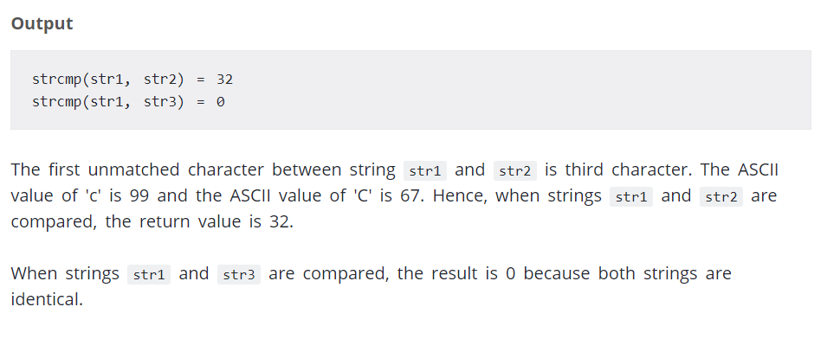

Slide 11
Strlen()
Syntax:
strlen(str) returns length of string excluding null character
strlen(“hello”) = 5 not 6 since \0 not counted

Slide 12
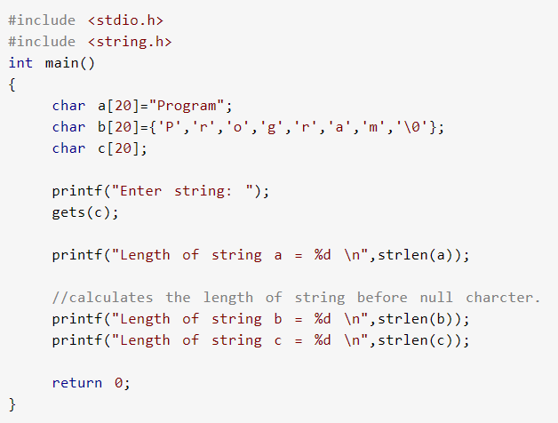

Slide 14
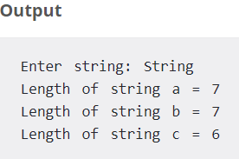

Slide 15
String reverse
#include <stdio.h>
#include <string.h>
int main()
{
char arr[100];
printf("Enter a string to reverse\n");
gets(arr);
strrev(arr);
printf("Reverse of the string is \n%s\n", arr);
return 0;
}

Slide 16
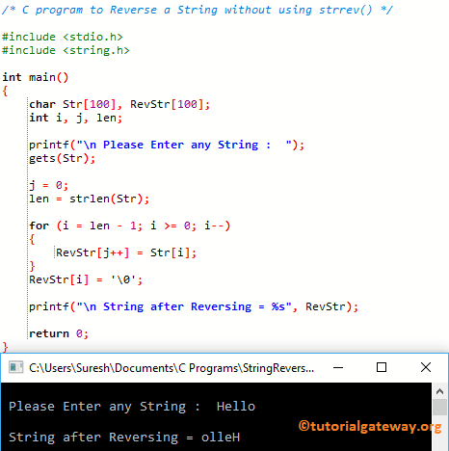
String Reverse without using Strrev () function

Slide 17
Palindrome program in C language
#include <stdio.h>
#include <string.h>
int main()
{
char a[100], b[100];
printf("Enter a string to check if it is a palindrome\n");
gets(a);
strcpy(b, a); // Copying input string
strrev(b); // Reversing the string
if (strcmp(a, b) == 0) // Comparing input string with the reverse string
printf("The string is a palindrome.\n");
else
printf("The string isn't a palindrome.\n");
return 0;
}

