Slide 1
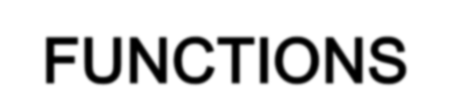

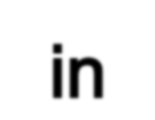

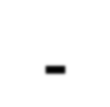
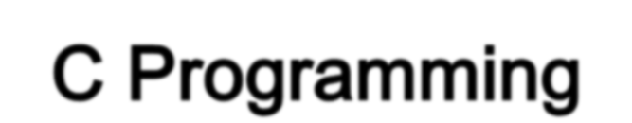




Slide 2




A function is a block of statements that performs a specific task.
A large program in c can be divided to many subprogram
The subprogram posses a self contain components and have well define purpose. The subprogram is called as a function
Basically a job of function is to do something
C program contain at least one function which is main().
Classification of Function
User define
function
Library
function
- main()
-printf()
-scanf()
-pow()
-ceil()

Slide 3



It is much easier to write a structured program where a large program can be divided into a smaller, simpler task.
Allowing the code to be called many times Easier to read and update
It is easier to debug a structured program where there error is easy to find and fix

Slide 4

C program doesn't execute the statement in function until the function is called.
When function is called the program can send the function information in the form of one or more argument.
When the function is used it is referred to as the called function
Functions often use data that is passed to them from the calling function
Data is passed from the calling function to a called function by specifying the variables in a argument list.
Argument list cannot be used to send data. Its only copy data/value/variable that pass
from the calling function.
The called function then performs its operation using the copies.

Slide 5


Provides the compiler with the description of functions that will be used later in the
program
Its define the function before it been used/called
Function prototypes need to be written at the beginning of the program.
The function prototype must have :
A return type indicating the variable that the function will be return
Syntax for Function Prototype
return-type function_name( arg-type name-1,...,arg-type name-n);
Function Prototype Examples
double squared( double number );
void print_report( int report_number );
int get_menu_choice( void);

Slide 6

It is the actual function that contains the code that will be execute.
Should be identical to the function prototype.
Syntax of Function Definition
return-type function_name( arg-type name-1,...,arg-type name-n) ---- Function header
{
declarations; statements; return(expression);
}
Function Body

Slide 7
Function Definition Examples
float conversion (float celsius)
{
float fahrenheit; fahrenheit = celcius*33.8 return fahrenheit;
}
The function name‟s is conversion
This function accepts arguments celcius of the type float. The function return a float value.
So, when this function is called in the program, it will perform its task which is to convert fahrenheit by multiply celcius with 33.8 and return the result of the summation.
Note that if the function is returning a value, it needs to use the keyword return.

Slide 8

Can be any of C‟s data type:
char int float
long………
Examples:
int func1(...)
float func2(...)
void func3(...)
/* Returns a type int. */
/* Returns a type float. */
/* Returns nothing. */

Slide 9


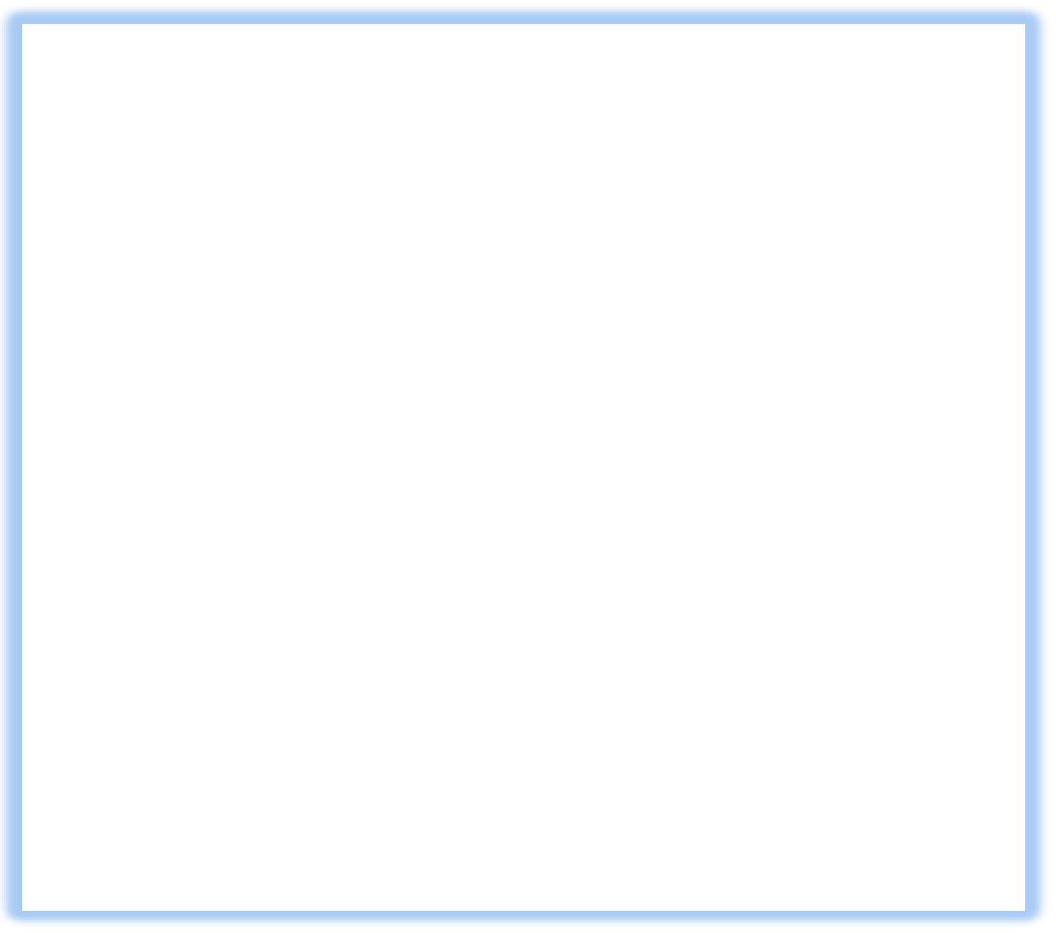




`
1: #include <stdio.h>
2:
3: long cube(long x); 4:
5: long input, answer;
6:
7: int main( void ) 8: {
9: printf(“Enter an integer value: ”); 10: scanf(“%d”, &input);
11: answer = cube(input);
12: printf(“\nThe cube of %ld is %ld.\n”, input, answer); 13:
14: return 0;
Arguments/formal parameter
Function names is cube
Variable that are requires is long
The variable to be passed on is X(has single arguments)— value can be passed to function so it can perform the specific task. It is called
Return data type
Actual parameters
Output
Enter an integer value:4 The cube of 4 is 64.
15: }
16:
17: long cube(long x) //called function 18: {
19: long x_cubed;
20:
21:
22:
23: }
x_cubed = x * x * x; return x_cubed;

Slide 10
Write a program in C to find the square of any number using the function. Test Data : Input any number for square : 20 Expected Output :
The square of 20 is : 400.00
Write a program in C to check a given number is even or odd using the function. Test Data : Input any number : 5 Expected Output :
The entered number is odd.

Slide 11


Function can be divided into 4 categories:
A function with no arguments and no return value
A function with no arguments and a return value
A function with an argument or arguments and returning no value
A function with arguments and returning a values

Slide 12
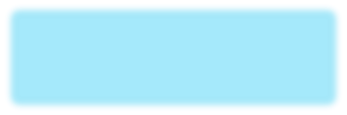
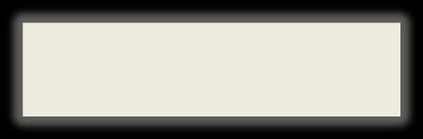

A function with no arguments and no return value
Called function does not have any arguments
Not able to get any value from the calling function Not returning any value
There is no data transfer between the calling function and called function.
#include<stdio.h> #include<conio.h> void printline();
void main()
{
printf("Welcome to function in C");
printline();
printf("Function easy to learn."); printline();
getch();
}
void printline()
{
int i; printf("\n"); for(i=0;i<30;i++)
{ printf("-"); } printf("\n");
}

Slide 13

A function with no arguments and a return value
Does not get any value from the calling function
Can give a return value to calling program
#include <stdio.h> #include <conio.h> int send();
void main()
{
int z; z=send();
printf("\nYou entered : %d.",z); getch();
}
int send()
{
int no1;
printf("Enter a no: "); scanf("%d",&no1); return(no1);
}
Enter a no: 46
You entered : 46.

Slide 14
A function with an argument or arguments and returning no value
A function has argument/s
A calling function can pass values to function called , but calling function not receive any value
Data is transferred from calling function to the called function but no data is transferred from the called function to the calling function
Generally Output is printed in the Called function
A function that does not return any value cannot be used in an expression it can be used only as independent statement.

Slide 15
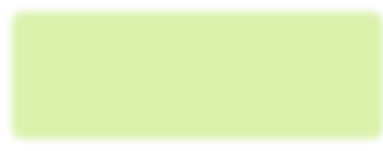
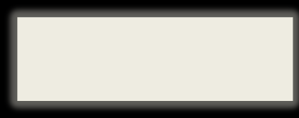

#include<stdio.h> #include<conio.h> void add(int x, int y);
void main()
{
add(30,15);
add(63,49);
add(952,321);
getch();
}
void add(int x, int y)
{
int result; result = x+y;
printf("Sum of %d and %d is %d.\n\n",x,y,result);
}

Slide 16
A function with arguments and returning a values
Argument are passed by calling function to the called function
Called function return value to the calling function
Mostly used in programming because it can two way communication
Data returned by the function can be used later in our program for further calculation.

Slide 17
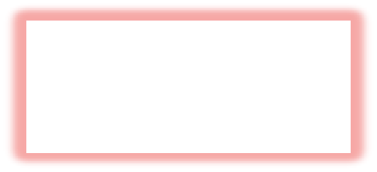
#include <stdio.h> #include <conio.h> int add(int x,int y);
void main()
{
int z;
z=add(952,321);
printf("Result %d. \n\n",add(30,55)); printf("Result %d.\n\n",z);
getch();
}
int add(int x,int y)
{
int result; result = x + y; return(result);
}
Result 85.
Result 1273.
Send 2 integer value x and y to add()
Function add the two values and send back the result to the calling function
int is the return type of function
Return statement is a keyword and in bracket we can give values which we want to return.

Slide 18


Variable that declared occupies a memory according to it size
It has address for the location so it can be referred later by CPU for manipulation T he „*‟ and „&‟ Operator
Int x= 10
Memory location name Value at memory location Memory location address
x
10
76858
We can use the address which also point the same value.

Slide 19

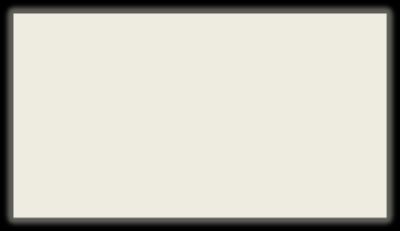
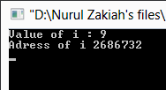
#include <stdio.h> #include <conio.h>
void main()
{
int i=9;
printf("Value of i : %d\n",i); printf("Adress of i %d\n", &i);
getch();
}
& show the address of the variable

Slide 20


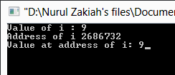
#include <stdio.h> #include <conio.h>
void main()
{
int i=9;
printf("Value of i : %d\n",i); printf("Address of i %d\n", &i); printf("Value at address of i: %d", *(&i));
getch();
}
* Symbols called the value at the address

Slide 21












#include <stdio.h> #include <conio.h>
int Value (int x);
int Reference (int *x);
int main()
{
int Batu_Pahat = 2; int Langkawi = 2;
Value(Batu_Pahat); Reference(&Langkawi);
printf("Batu_Pahat is number %d\n",Batu_Pahat); printf("Langkawi is number %d",Langkawi);
}
int Value(int x)
{
x = 1;
}
int Reference(int *x)
{
*x = 1;
}
Pass by reference
You pass the variable address
Give the function direct access to the variable
The variable can be modified inside the function

Slide 22
#include <stdio.h> #include <conio.h>
void callByValue(int, int);
void callByReference(int *, int *);
int main()
{
int x=10, y =20;
printf("Value of x = %d and y = %d. \n",x,y);
printf("\nCAll By Value function call...\n"); callByValue(x,y);
printf("\nValue of x = %d and y = %d.\n", x,y);
printf("\nCAll By Reference function call...\n"); callByReference(&x,&y);
printf("Value of x = %d and y = %d.\n", x,y);
getch(); return 0;
}

Slide 23
void callByValue(int x, int y)
{
int temp; temp=x; x=y; y=temp;
printf("\nValue of x = %d and y = %d inside callByValue function",x,y);
}
void callByReference(int *x, int *y)
{
int temp; temp=*x;
*x=*y;
*y=temp;
}

Slide 24
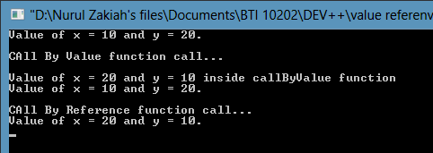

Slide 25
Exercise Program
An electricity board charges the following rates for the use of Electricity for the first 200 units 80 paise per unit for the next 100 units 90 paise per unit beyond 300 units Rs 1 per unit. All users are charged a minimum of Rs. 100 as meter charge. If the total amount is more than Rs 400, then an additional surcharge of 15% of total amount is charged. Write a program to read the name of the user, number of units consumed and print out the charges.

