Slide 1
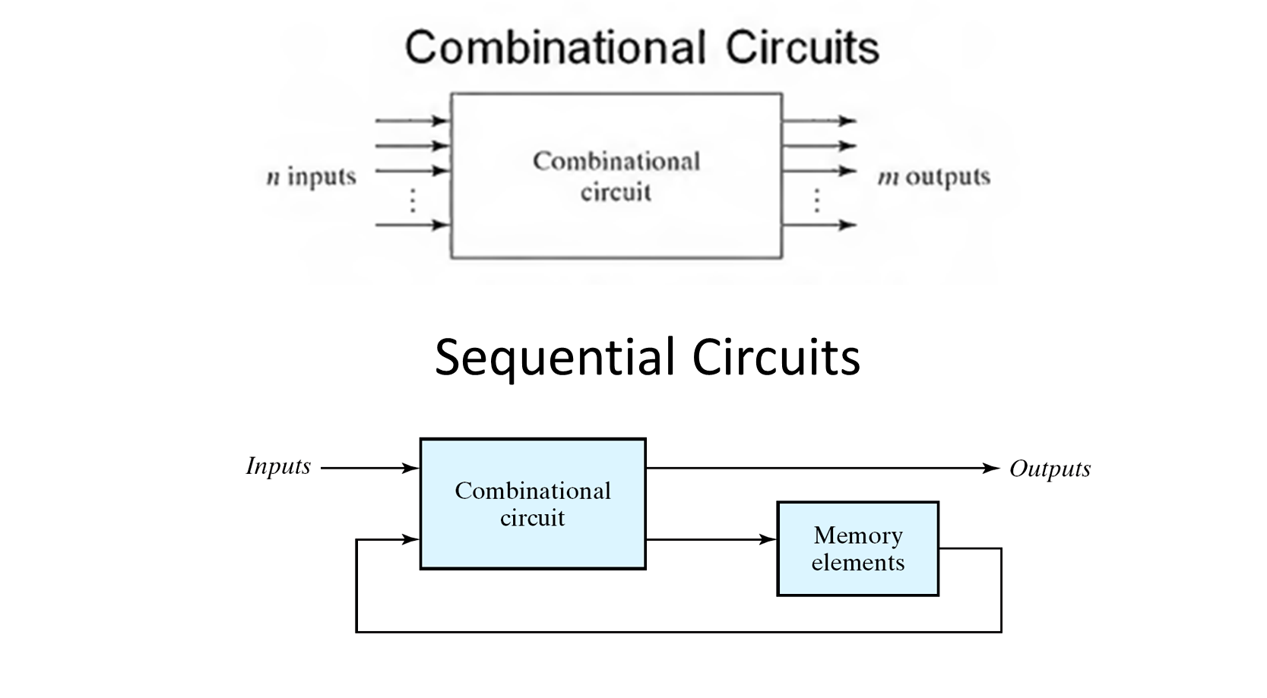

Slide 2
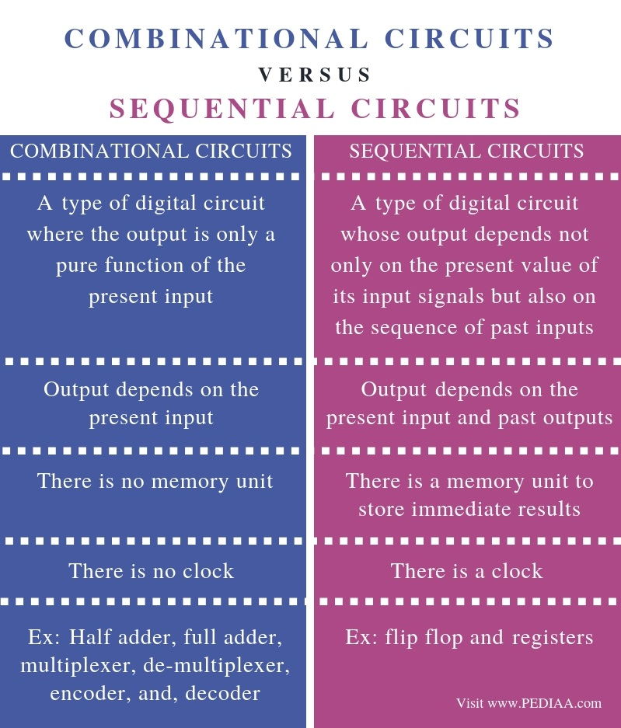

Slide 3
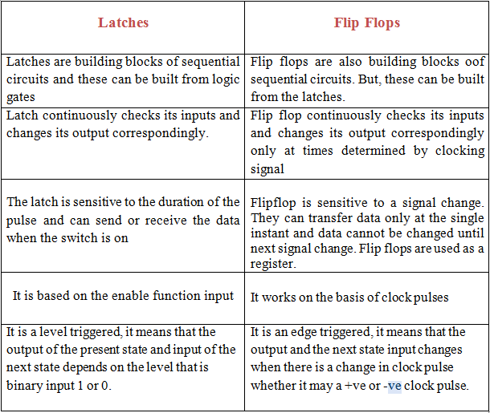

Slide 4
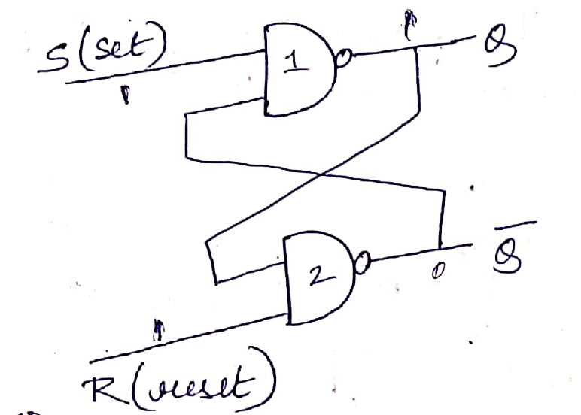
S-R LATCH (NAND BASED)

Slide 5
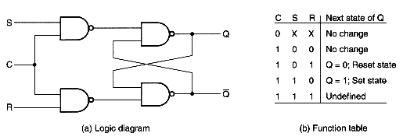
S-R FLIP FLOP

Slide 6
S-R FLIP FLOP

Slide 7
Storage Elements: Latches and Flip-Flops:
A storage element in a digital circuit can maintain a binary state indefinitely (as long as power is delivered to the circuit), until directed by an input signal to switch states.
Storage elements that operate with signal levels (rather than signal transitions) are referred to as latches ; those controlled by a clock transition are flip-flops.
Latches are said to be level sensitive devices; flip-flops are edge-sensitive devices.

Slide 9
Contd.
The memory elements are devices capable of storing binary info. The binary info stored in the memory elements at any given time defines the state of the sequential circuit. The input and the present state of the memory element determine the output.
There are two types of sequential circuits. Their classification depends on the timing of their signals:
Synchronous sequential circuits
This type of system uses storage elements called flip-flops that are employed to change their binary value only at discrete instants of time.
Asynchronous sequential circuits
This is a system whose outputs depends upon the order in which its input variables change and can be affected at any instant of time.

Slide 10
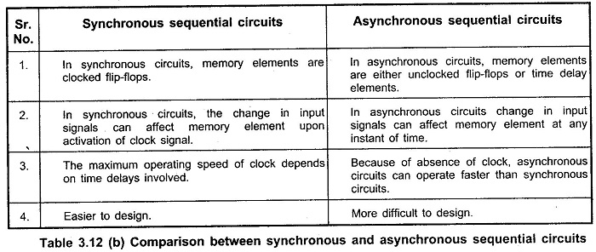

Slide 11
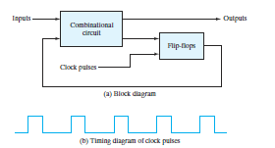
Synchronous clocked sequential circuit
The outputs are formed by a combinational logic function of the inputs to the circuit or the values stored in the flip-flops. The value that is stored in a flip-flop when the clock pulse occurs is also determined by the inputs to the circuit or the values presently stored in the flip-flop. The new value is stored (i.e., the flip-flop is updated) when a pulse of the clock signal occurs.

Slide 12
Gated S-R Latch or Clocked S-R flip flop
The operation of the basic SR latch can be modified by providing an additional input
signal that determines (controls) when the state of the latch can be changed by determining whether S and R (or S and R ) can affect the circuit.
E
E
Note: The case S = R = 1 gives an output in which the Q and Q’ gives same output, which is undetermined or possible. Ex: S = R = Q (PS) = 1 then Q (NS) = 1 and Q’ also 1, which is not possible.

Slide 13
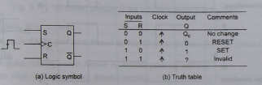

Edge Triggered SR
Positive edge triggered
Negative edge triggered

Slide 14
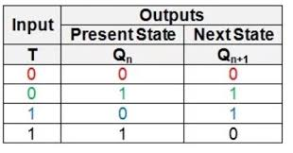
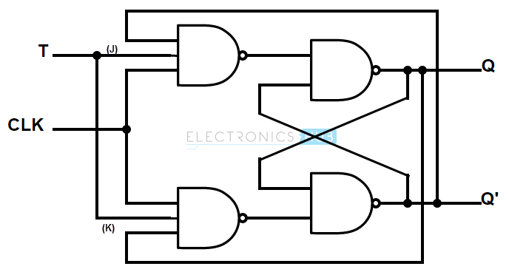
T flip flop
T or Toggle flip flop,
This flip flop is common in counter design
Output toggles if the input is T=1
..and holds its present state if the input is T=0

Slide 15
FLIP FLOP CONVERSIONS
SR to JK
SR to T
JK to T
JK to SR

Slide 16
PROCEDURE FOR CONVERSION
Draw the block diagram of the target flip flop from the given problem.
Write truth table for the target flip-flop.
Write excitation table for the available flip-flop.
Draw k-map for target flip-flop.
Draw the block diagram.

Slide 17
SR(Available) to JK(Target) Flip-Flop
Conversion Table
Input |  | Present State | Next State | Flip-Flop Inputs
J | K | Q n | Qn+1 | S | R
0 | 0 | 0 | 0 | 0 | X
0 | 0 | 1 | 1 | X | 0
0 | 1 | 0 | 0 | 0 | X
0 | 1 | 1 | 0 | 0 | 1
1 | 0 | 0 | 1 | 1 | 0
1 | 0 | 1 | 1 | X | 0
1 | 1 | 0 | 1 | 1 | 0
1 | 1 | 1 | 0 | 0 | 1

Slide 18
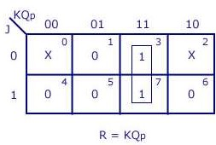
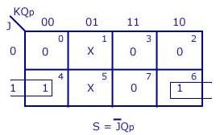
SR to JK
K-map Simplification

Slide 19
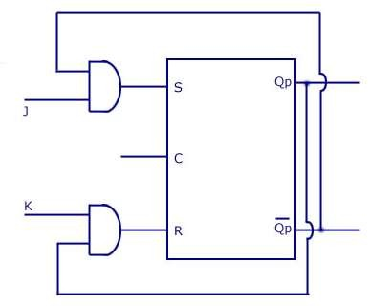
Logic Diagram (SR to JK)

Slide 20
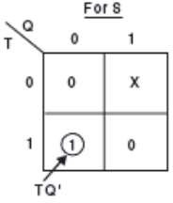
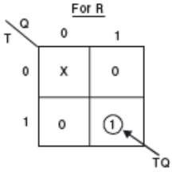
SR(Available) to T(Target)
Conversion Table
K- MAP SIMPLIFICATION
Input | Present state | Next state | Flip flop Inputs
T | Q n | Qn+1 | S | R
0 | 0 | 0 | 0 | X
0 | 1 | 1 | X | 0
1 | 0 | 1 | 1 | 0
1 | 1 | 0 | 0 | 1

Slide 21
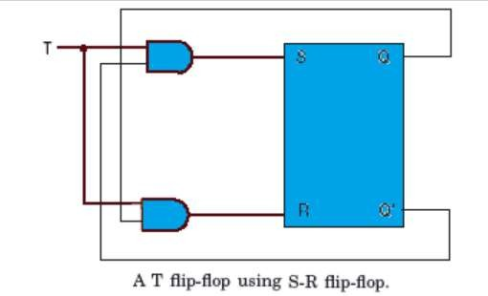
Logic Diagram (SR to T)

Slide 22
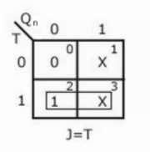
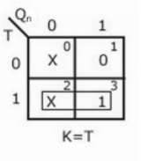
JK(Available) to T FF
Input | Present state | Next state | Flip flop Inputs
T | Q n | Qn+1 | J | K
0 | 0 | 0 | 0 | X
0 | 1 | 1 | X | 0
1 | 0 | 1 | 1 | x
1 | 1 | 0 | x | 1
K- MAP SIMPLIFICATION

Slide 23
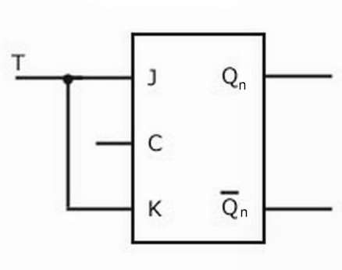
Logic Diagram (JK to T)

Slide 24
JK(Available) to SR(Target)Flip-flop
conversion
Conversion Table
Input |  | Present State | Next State | Flip-Flop Inputs
S | R | Q n | Qn+1 | J | K
0 | 0 | 0 | 0 | 0 | X
0 | 0 | 1 | 1 | X | 0
0 | 1 | 0 | 0 | 0 | X
0 | 1 | 1 | 0 | X | 1
1 | 0 | 0 | 1 | 1 | X
1 | 0 | 1 | 1 | X | 0
1 | 1 | 0 | X | X | X
1 | 1 | 1 | X | X | X

Slide 25
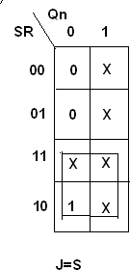
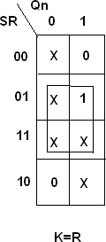
JK(Available) to SR(Target)Flip-flop conversion

Slide 26
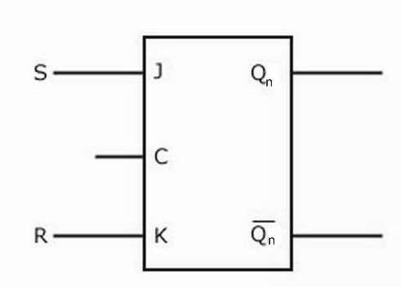
JK to SR
Logic Diagram

