Slide 1
Boolean Theory
Boolean theory provides the fundamentals for logic operators and operation to perform Boolean algebra.
Boolean algebra is a branch of mathematics that includes methods for manipulating logical variables and logical expressions.
The Greek philosopher Aristotle founded a system of logic based on only two types of propositions: true and false.
The English mathematician George Boole (1815–1864) sought to give symbolic form to Aristotle’s system of logic—hence the name Boolean algebra.
In the mid-twentieth century, Claude Shannon, an electrical engineer and mathematician, applied Boole’s ideas to digital circuits.

Slide 2
Logic Variables and Logic Functions
Like algebra, Boolean algebra is based on a set of rules that are derived from a small number of basic assumptions. Logic values involve elements that take on one of two values, 0 and 1. Therefore, a logic variable can only be equal to 0 or 1.
A logic function is an expression, that describes the logic operations between its logic variables. Similarly, a logic function can only be equal to 0 or 1.

Slide 3
BOOLEAN AXIOMS AND THEOREMS
The basic logic operations include logic sum (+), logic product (·), and logic complement (‘). i.e. OR, AND and NOT
If a logic variable is true, its logic complement is false.
In 1904 Huntington defined 6 postulates that must be satisfied, called Huntington’s postulates

Slide 4
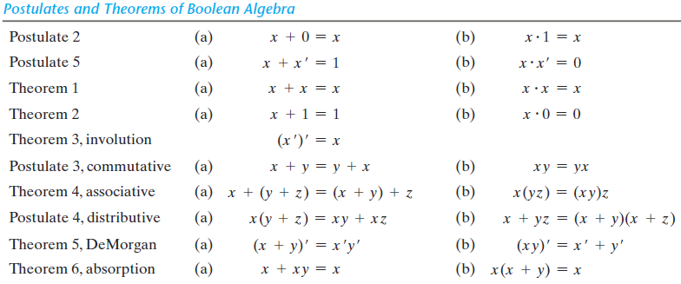

Slide 5
Postulates
1) Closure : Any logical operation yields a value in the set {0,1}.
2) Identity : (a) X + 0 = X (b) X·1=X
3) Commutative: (a) X+Y =Y+X (b) X·Y=Y·X
4) Distributive: (a) X·(Y+Z)=(X·Y)+(X·Z) (b) X+(Y·Z)=(X+Y) ·(X+Z)
5) Complements: (a) X+X’=1 (b) X·X’=0
6) Distinct: 0≠1

Slide 6
Theorems
Theorem 1: (a) X+X=X (b) X.X=X
Theorem 2: (a) X+1=1 (b)X·0=0
Theorem 3: Involution : (X’)’=X
Theorem 4: Associative : (a) X+(Y+Z)=(X+Y)+Z (b) X· (YZ)=(XY) ·Z
Theorem 5: DeMorgan : (a) (X+Y)’=X’Y’ (b) (XY)’=X’+Y’
Theorem 6: Absorption : (a) X+XY=X (b) X· (X+Y)=X
All the theorems you can proof by truth table as well as with expression

Slide 7
Duality Principle
The important property of Boolean algebra is called duality principle and it states that every algebraic expression deducible from the postulates of Boolean algebra remains valid if the operators and identity elements are interchanged.
Interchange elements ={0,1}
Interchange operator ={AND,OR}

Slide 8
Proof
Theorem 1.(a)
X + X = X
Proof:
X + X = (X + X).1
= (X + X)(X + X’)
= X + XX’
= X + 0
= X
Theorem 1.(b)
X·X = X
Proof:
X·X= XX + 0
= XX
= XX + XX’
= X(X + X’)
= X·1
= X

Slide 9
Theorems
Theorem 2.(a)
X + 1 = 1
Proof:
X + 1= 1·(X+1)
= (X + X’)(X+1)
= X + X’ ·1
= X + X’
= 1
Theorem 6.(a)
X + XY = X
Proof:
X + XY = X·1 + XY
= X(1+Y)
= X ·1
= X
Theorem 6.(b)
X(X+Y) = X
Proof:
X(X+Y) = XX + XY
=X+XY
= X(1+Y)
= X ·1
= X

Slide 10
DeMorgan’s Theorem (a)
Proof: (X+Y)’=X’Y’
According to the complementing law, P+P’=1 and P·P’=0.
So, if we take P=(X+Y), P’=(X+Y)’=X’Y’,
So, (X+Y)+X’ ·Y’=((X+Y)+X’)((X+Y)+Y’)
=(1+Y)(1+X)
=(1).(1)
=1

Slide 11
DeMorgan’s Theorem (b)
Proof: (XY)’=X’+Y’
According to the complementing law, P+P’=1 and P·P’=0.
So, if we take P=(XY), P’=(XY)’=X’+Y’,
So, XY+X’+Y’= (X’+Y’+X)(Y+X’+Y’)
= (1+Y’)(1+X’)
=1.1
=1

Slide 12
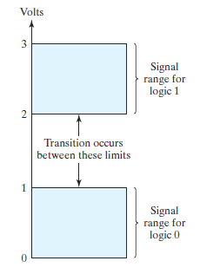
Logic Gates
Logic gates are electronic circuits that operate on one or more input signals to produce an output signal .
Electrical signals such as voltages or currents exist as analog signals having values over a given continuous range, say, 0 to 3 V, but in a digital system these voltages are interpreted to be either of two recognizable values, 0 or 1.

Slide 13

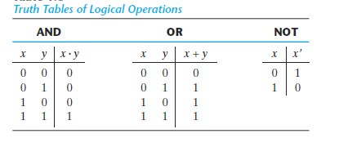

AND, OR, NOT Gates

Slide 14
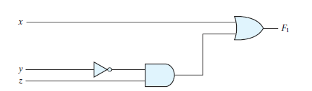
Boolean Functions
Boolean algebra is an algebra that deals with binary variables and logic operations. A Boolean function described by an algebraic expression consists of binary variables.
Exp: F₁=X+Y’Z
A Boolean function can be transformed from an algebraic expression into a circuit diagram composed of logic gates connected in a particular structure.
The operator precedence for evaluating Boolean expressions is (1) parentheses, (2) NOT, (3) AND, (4) OR

Slide 15
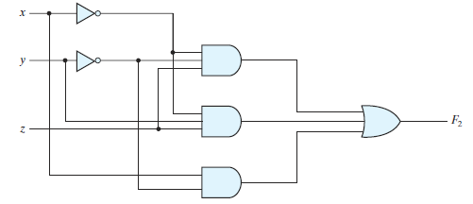
Literals, Variables and Terms
F₂= X’Y’Z + X’YZ + XY’
Variables = (X, Y, Z)
Literals = (X’, Y’, Z, X’, Y, Z, X, Y’)
Terms =(2 NOT term, 3 AND term and 1 OR term)

Slide 16
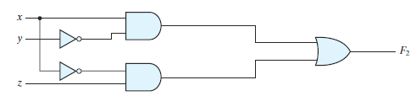
Minimization
Minimization means reducing the number of literals. We can minimize the expression with the help of postulates and theorems.
F₂ = X’Y’Z + X’YZ + XY’
= X’Z(Y’+Y) + XY’
= X’Z + XY’

Slide 17
Complement of a Function
The complement of a function may be derived from DeMorgan's theorem
DeMorgan’s theorems for any number of variables resemble the two variable case in form and can be derived by successive substitutions similar to the method used in the preceding derivation.
(A+B+C+D+……..F)’ = A’B’C’D’…….F’
(ABCD..F)’ = A’+ B’+ C’+ D’ + ……. + F’

Slide 18
Examples:
Find the complement of the functions F₁= X’YZ’ + X’Y’Z and F₂= X(Y’Z’ +YZ) by applying DeMorgan’s theorem:
F₁’ = (X’YZ’ + X’Y’Z’)’ = (X’YZ’)’(X’Y’Z)’
= (X + Y’ + Z)(X + Y + Z’)
F₂’ = [X(Y’Z’ +YZ)]’ = X’ + (Y’Z’ + YZ)’ = X’ + (Y’Z’)’(YZ)’
= X’ + (Y + Z)(Y’ + Z’)
= X’ + YZ’ + Y’Z

Slide 19
Canonical and Standard Forms
A binary variable may appear either in its normal form (x) or in its complement form (x’). Now consider two binary variables x and y combined with an AND operation. Since each variable may appear in either form, there are four possible combinations: X’Y’, X’Y, XY’, XY.
Each of this AND term is called a minterm or a standard sum.
In similar fashion, all combination with a OR operator is called maxterms.
Boolean functions expressed as a sum of minterms or product of maxterms are said to be in canonical form.
If you express the Boolean function in SOP and POS form then we call it standard form.
SOP form is used when output of logical expression is 1.
POS form is used when output of a logical expression is 0.

Slide 20
Note*
Generally, we use SOP form to calculate the sum of minterms and POS form to calculate product of maxterms. If your initial expression is given in POS form and you have to represent it in sum of minterms, you can convert your POS to SOP form to proceed for the sum of minterms representation.
Exp. You have given the following expression and asked to represent it in sum of minterms form
F = (A’+B)(A+B’) ------ POS Form
= A’.A+A’.B’+AB+B.B’ -------(Multiply the product)
= A’B’+AB --------(A.A’=0,B.B’=0) (SOP Form)
To convert SOP to POS, we use distributive law

Slide 21
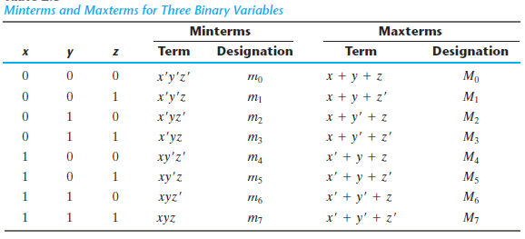
Three binary variable min terms and max terms

Slide 22
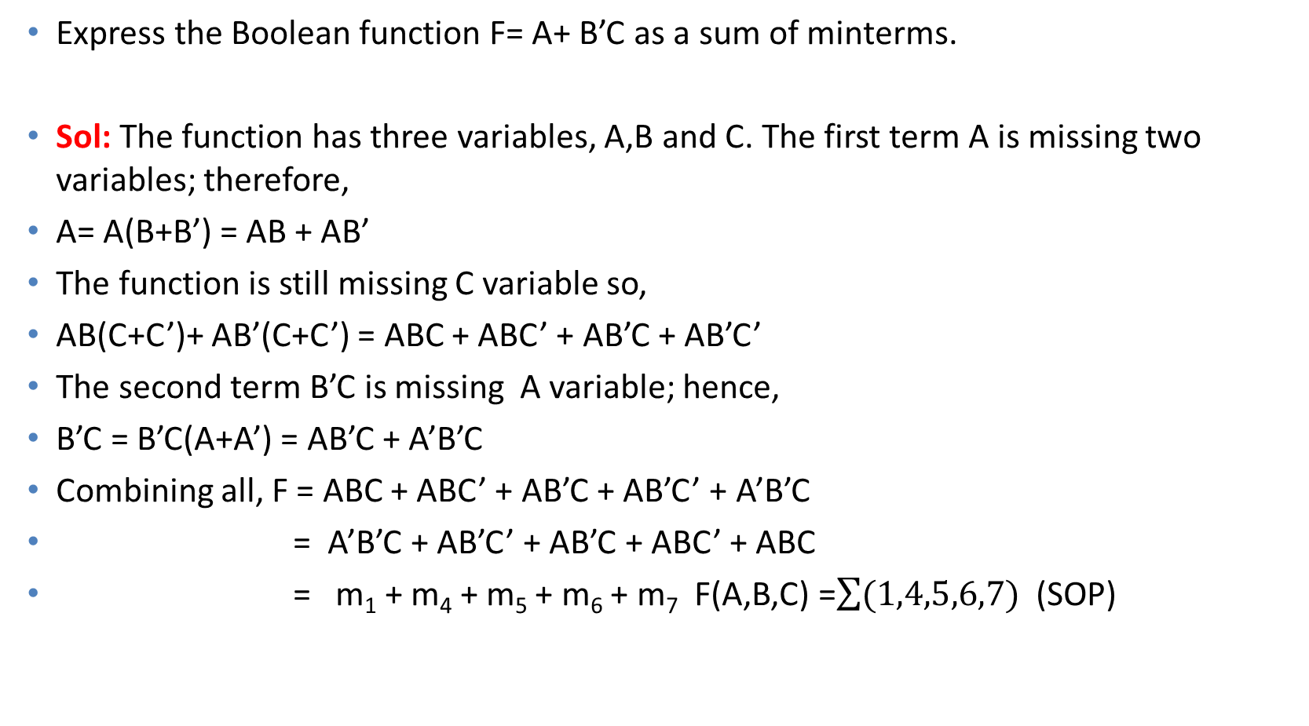
Exp:
Express the Boolean function F= A+ B’C as a sum of minterms.
Sol: The function has three variables, A,B and C. The first term A is missing two variables; therefore,
A= A(B+B’) = AB + AB’
The function is still missing C variable so,
AB(C+C’)+ AB’(C+C’) = ABC + ABC’ + AB’C + AB’C’
The second term B’C is missing A variable; hence,
B’C = B’C(A+A’) = AB’C + A’B’C
Combining all, F = ABC + ABC’ + AB’C + AB’C’ + A’B’C
= A’B’C + AB’C’ + AB’C + ABC’ + ABC
= m₁ + m₄ + m₅ + m₆ + m₇ F(A,B,C) =$\sum{(1,4,5,6,7)}$ (SOP)

Slide 23
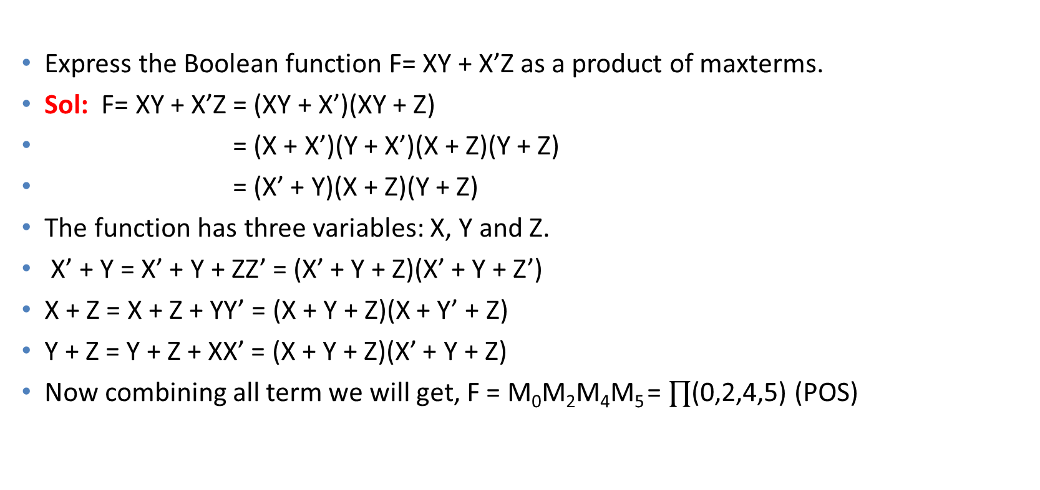
Exp
Express the Boolean function F= XY + X’Z as a product of maxterms.
Sol: F= XY + X’Z = (XY + X’)(XY + Z)
= (X + X’)(Y + X’)(X + Z)(Y + Z)
= (X’ + Y)(X + Z)(Y + Z)
The function has three variables: X, Y and Z.
X’ + Y = X’ + Y + ZZ’ = (X’ + Y + Z)(X’ + Y + Z’)
X + Z = X + Z + YY’ = (X + Y + Z)(X + Y’ + Z)
Y + Z = Y + Z + XX’ = (X + Y + Z)(X’ + Y + Z)
Now combining all term we will get, F = M₀M₂M₄M₅ = $∏$(0,2,4,5) (POS)

Slide 24
Consensus Theorem or Redundancy Theorem
Shortcut Method:
1) Three variable
2) Each Variable comes twice
3) One variable is complemented
If satisfy, remove the term without the complemented variable
For F1 that is BC and for F2 that is (B+C)
F1 = AB + A’C + BC
= AB + A’C + BC(A+A’)
= AB + A’C + ABC + A’BC
= AB + A’C
F2 = (A + B)(A’ + C)(B + C)
= (A + B)(A’ + C)(B + C + 0)
= (A + B)(A’ + C)(B + C + AA’)
= (A + B)(A + B + C)(A’ + C)(A’ + C + B)
= (A + B)(A’ + C)

Slide 25
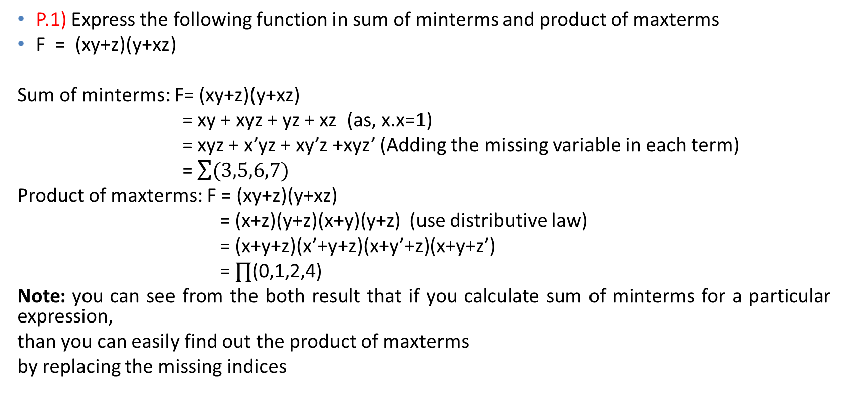
Some Problems and their Solutions
P.1) Express the following function in sum of minterms and product of maxterms
F = (xy+z)(y+xz)
Sum of minterms: F= (xy+z)(y+xz)
= xy + xyz + yz + xz (as, x.x=1)
= xyz + x’yz + xy’z +xyz’ (Adding the missing variable in each term)
= $\sum{(3,5,6,7)}$
Product of maxterms: F = (xy+z)(y+xz)
= (x+z)(y+z)(x+y)(y+z) (use distributive law)
= (x+y+z)(x’+y+z)(x+y’+z)(x+y+z’)
= $∏$(0,1,2,4)
Note: you can see from the both result that if you calculate sum of minterms for a particular expression,
than you can easily find out the product of maxterms
by replacing the missing indices

Slide 26
Contd.
P2) Minimize the following expression F= A’B(D’+C’D)+ B(A+A’CD)
Sol: F = A’B(D’ + C’D) + B(A + A’CD)
= B(A’D’ + A’C’D) + B(A + A’CD)
= B(A’D’ + A’C’D + A + A’CD)
= B(A’D’ + A + A’C’D + A’CD)
= B(A’D’ + A + A’D) [as, C+C’=1]
= B(A’D’ + A’D +A)
= B(A’ + A)
= B.1
= B.

Slide 27
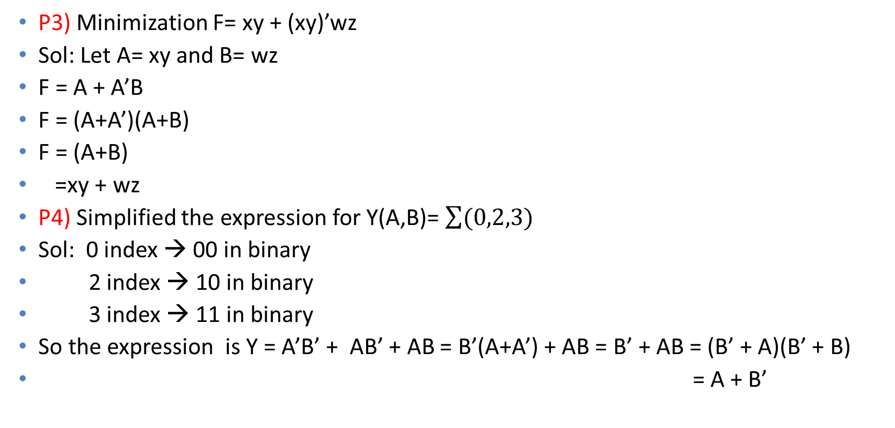
Contd.
P3) Minimization F= xy + (xy)’wz
Sol: Let A= xy and B= wz
F = A + A’B
F = (A+A’)(A+B)
F = (A+B)
=xy + wz
P4) Simplified the expression for Y(A,B)= $\sum{(0,2,3)}$
Sol: 0 index → 00 in binary
2 index → 10 in binary
3 index → 11 in binary
So the expression is Y = A’B’ + AB’ + AB = B’(A+A’) + AB = B’ + AB = (B’ + A)(B’ + B)
= A + B’

Slide 28
Contd.
P5) Simplify F = (A+B)(A+B’)(A’+B)(A’+B’)
Sol: F = (A+B)(A+B’)(A’+B)(A’+B’)
= (A + B.B’)(A’ + B.B’)
= (A + 0)(A’ +0)
= A.A’
=0

