Slide 1
Digital Logic Design

Slide 2
Ref Book
Digital Design by M. Morris Mano | Michael D. Ciletti

Slide 3
Continuous Time and Discrete Time Signals
A signal that is specified for every value of time t is a continuous time signal
A signal that is specified only at discrete values of t is a discrete time signal
Exp: Gross national product (GNP), monthly sales of a corporation, stock market daily average etc

Slide 4
Fig.1 (a) Continuous Time (b) Discrete Time Signal

Slide 5
Analog and Digital
The concept of continuous time is often confused with that of analog. The two are not same.
The same is true of the concepts of discrete and digital.
A signal whose amplitude can take on any value in a continuous range is an analog signal. This means that the signal can take on infinite number of values.
A digital signal, on the other hand is one whose amplitude can take on only two values (binary signals). For a signal to qualify as digital, the number of values need not to be restricted to two. It can be any finite number. Like M-ary signal

Slide 6
Signal Types
Fig.2 (a) Analog Continuous Time, (b) Digital, Continuous Time (c) Analog, Discrete Time (d) Digital, Discrete Time

Slide 7
A/D Converter
You can see this video: https://www.youtube.com/watch?v=zucfv7lU0Ws&pbjreload=10
Fig.3 A/D converter

Slide 8
Digital System
Digital systems are designed to store, process and communicate information in digital form.
Application:- i) Communication
ii) Business transaction
iii) Traffic control
iv) Spacecraft guidance
v) Medical treatment
vi) Weather monitoring

Slide 9
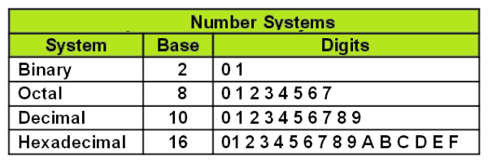
Number Systems
Decimal Number System (radix or base 10)
Binary Number System (radix or base 2)
Octal Number System (radix or base 8)
Hexa Decimal Number System (radix or base 16)

Slide 10
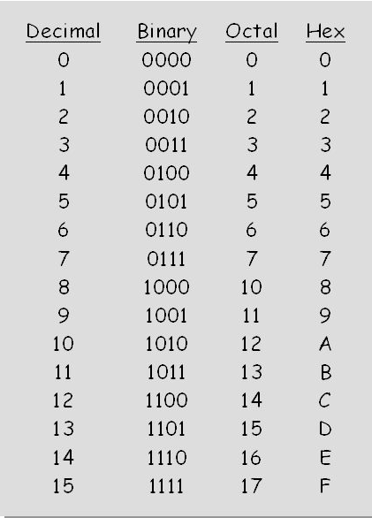
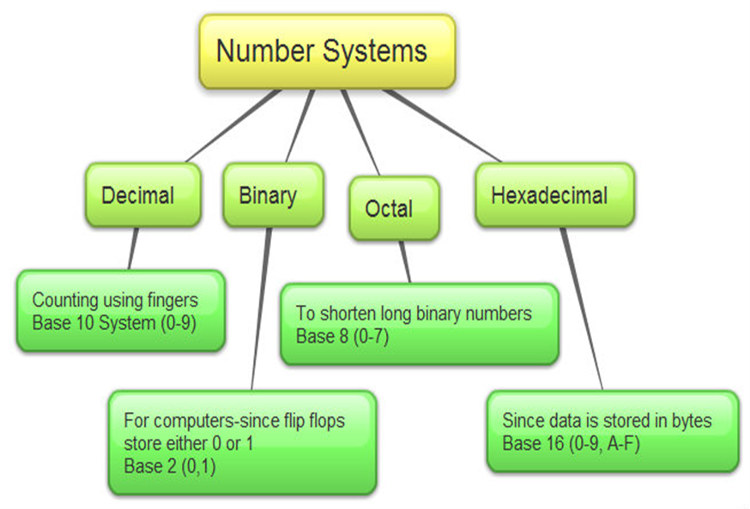
Different Number System and their use

Slide 11
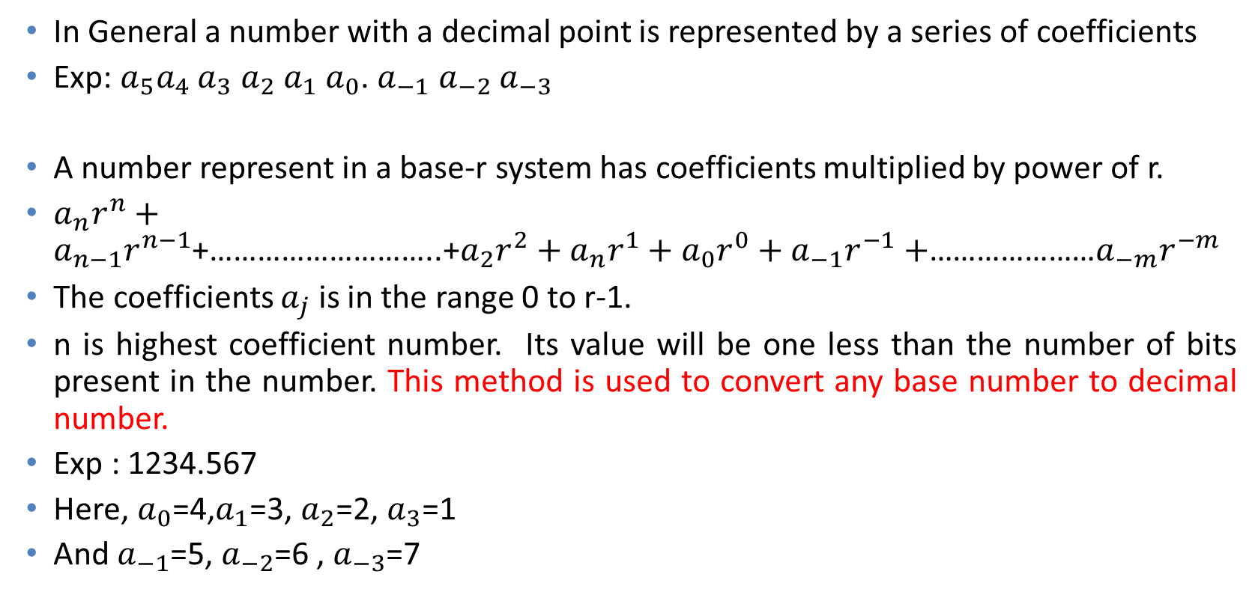
Positional Number System
In General a number with a decimal point is represented by a series of coefficients
Exp: $a_{5}a_{4}$ $a_{3}$ $a_{2}$ $a_{1}$ $a_{0}$. $a_{−1}$ $a_{−2}$ $a_{−3}$
A number represent in a base-r system has coefficients multiplied by power of r.
$a_{n}r^{n}+$ $a_{n−1}r^{n−1}$+………………………..+$a_{2}r^{2}+a_{n}r^{1}+a_{0}r^{0}+a_{−1}r^{−1}+$…………………$a_{−m}r^{−m}$
The coefficients $a_{j}$ is in the range 0 to r-1.
n is highest coefficient number. Its value will be one less than the number of bits present in the number. This method is used to convert any base number to decimal number.
Exp : 1234.567
Here, $a_{0}$=4,$a_{1}$=3, $a_{2}$=2, $a_{3}$=1
And $a_{−1}$=5, $a_{−2}$=6 , $a_{−3}$=7

Slide 12
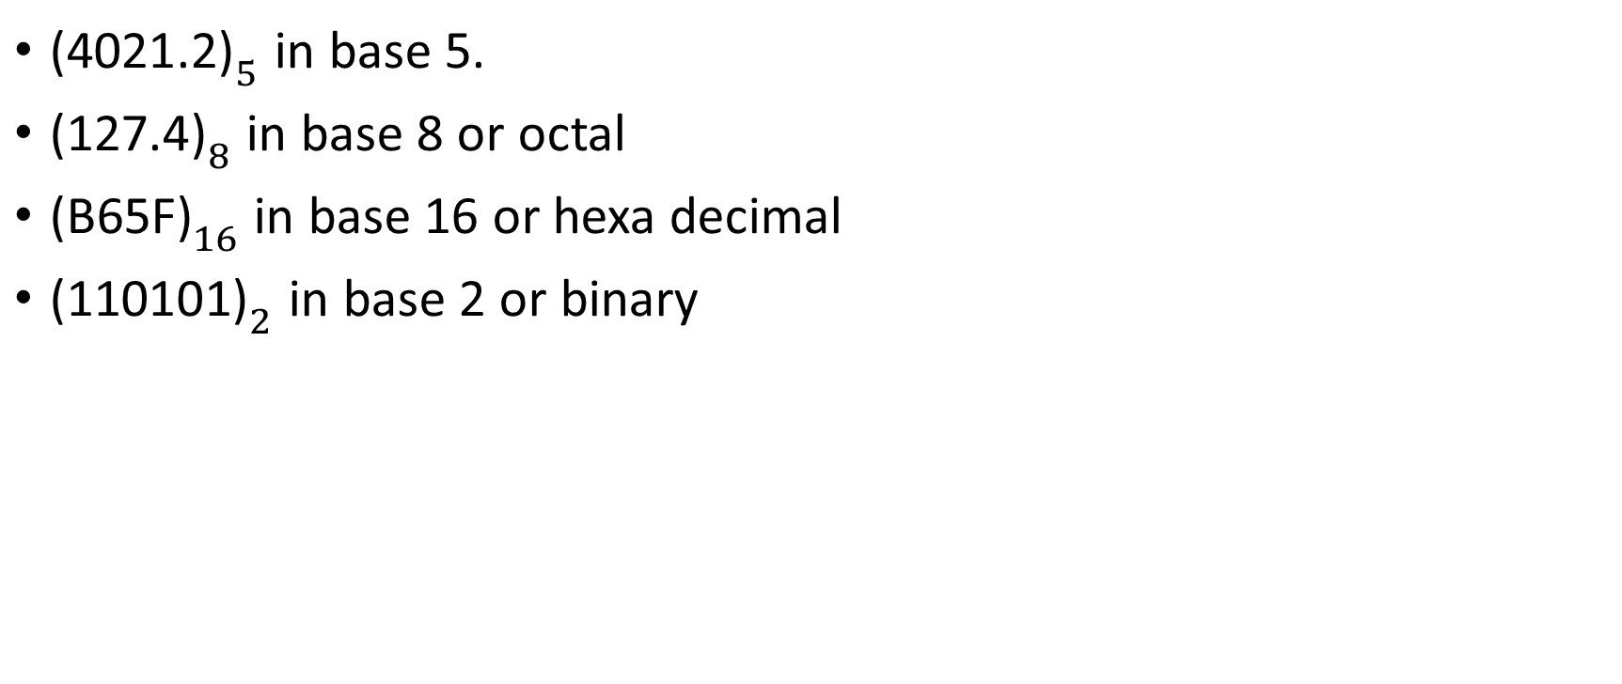
Exps:
${\text{(4021.2)}}_{5}$ in base 5.
${\text{(}\text{127.4}\text{)}}_{8}$ in base 8 or octal
${\text{(}\text{B}\text{65}\text{F}\text{)}}_{16}$ in base 16 or hexa decimal
${\text{(}\text{110101}\text{)}}_{2}$ in base 2 or binary

Slide 13
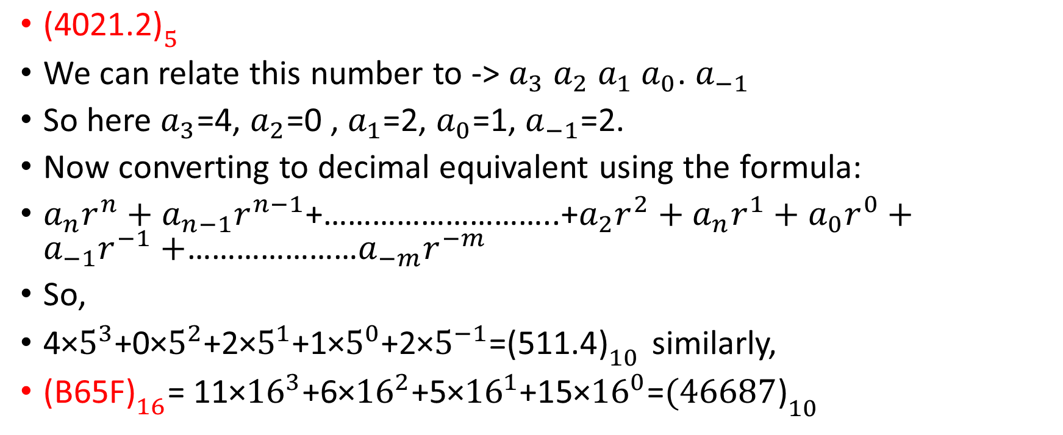
Solutions:
${\text{(4021.2)}}_{5}$
We can relate this number to -> $a_{3}$ $a_{2}$ $a_{1}$ $a_{0}$. $a_{−1}$
So here $a_{3}$=4, $a_{2}$=0 , $a_{1}$=2, $a_{0}$=1, $a_{−1}$=2.
Now converting to decimal equivalent using the formula:
$a_{n}r^{n}+$ $a_{n−1}r^{n−1}$+………………………..+$a_{2}r^{2}+a_{n}r^{1}+a_{0}r^{0}+a_{−1}r^{−1}+$…………………$a_{−m}r^{−m}$
So,
4×$5^{3}$+0×$5^{2}$+2×$5^{1}$+1×$5^{0}$+2×$5^{−1}$=${\text{(511.4)}}_{10}$ similarly,
${\text{(}\text{B}\text{65}\text{F}\text{)}}_{16}$= 11×${16}^{3}$+6×${16}^{2}$+5×${16}^{1}$+15×${16}^{0}$=${\text{(46687}\text{)}}_{10}$

Slide 14
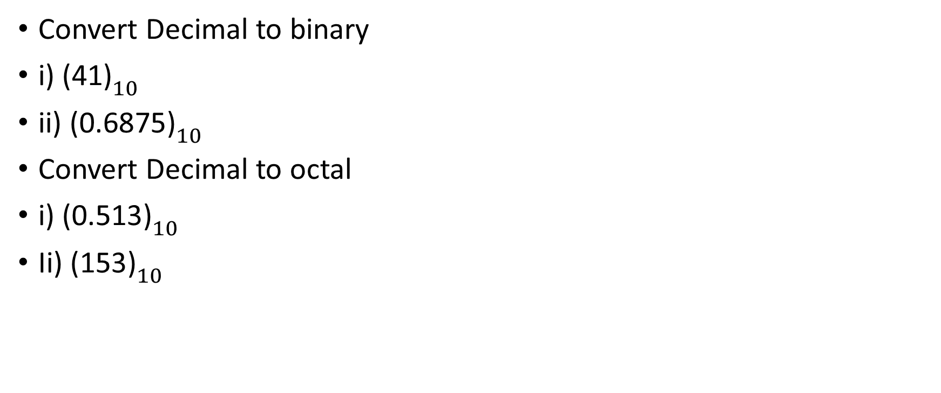
Number base conversion
Convert Decimal to binary
i) ${\text{(4}\text{1}\text{)}}_{10}$
ii) ${\text{(}\text{0.6875}\text{)}}_{10}$
Convert Decimal to octal
i) ${\text{(}\text{0.513}\text{)}}_{10}$
Ii) ${\text{(}\text{153}\text{)}}_{10}$

Slide 15
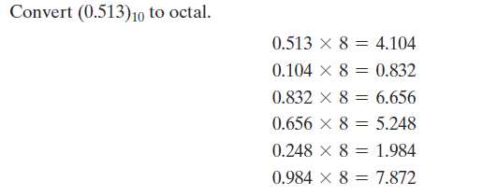
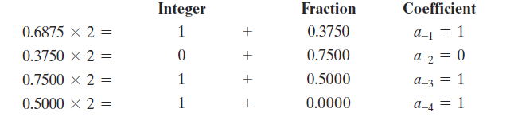

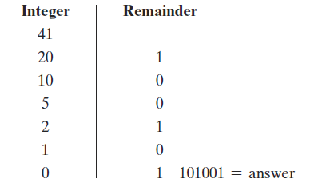
Solutions

Slide 16
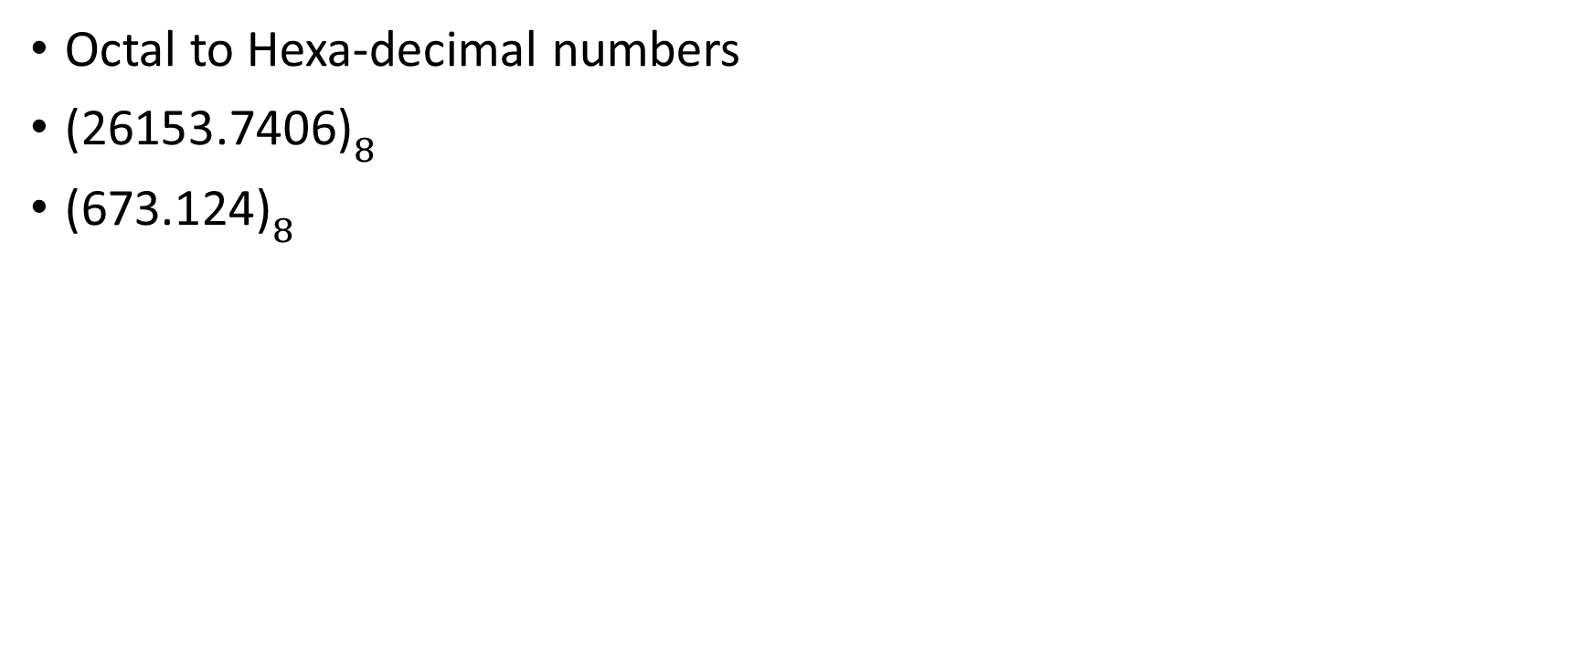
Contd.
Octal to Hexa-decimal numbers
${\text{(}\text{26153.7406}\text{)}}_{8}$
${\text{(}\text{673.124}\text{)}}_{8}$

Slide 17
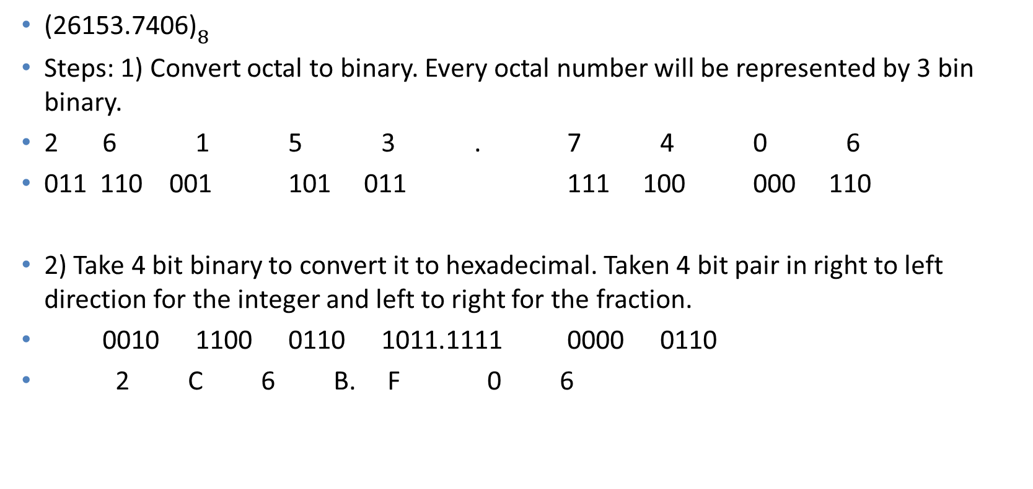
Solution
${\text{(26153.7406)}}_{8}$
Steps: 1) Convert octal to binary. Every octal number will be represented by 3 bin binary.
2 6 1 5 3 . 7 4 0 6
011 110 001 101 011 111 100 000 110
2) Take 4 bit binary to convert it to hexadecimal. Taken 4 bit pair in right to left direction for the integer and left to right for the fraction.
0010 1100 0110 1011.1111 0000 0110
2 C 6 B. F 0 6

Slide 18
Addition of two numbers in Decimal, Binary, Octal and Hexadecimal number systems:
1). [193]10 + [17845]10
2). [323]8 + [12345]8
3). [1AE3]16 + [EF3E5]16
4). [10011001]2+ [11101111]2

Slide 19
Subtraction of two numbers in Decimal, Binary, Octal and Hexadecimal number systems:
1). [56193]10 - [17845]10
2). [70123]8 - [12747]8
3). [F1AE3]16 - [BF3F5]16
4). [10011001] - [11101111]

Slide 20
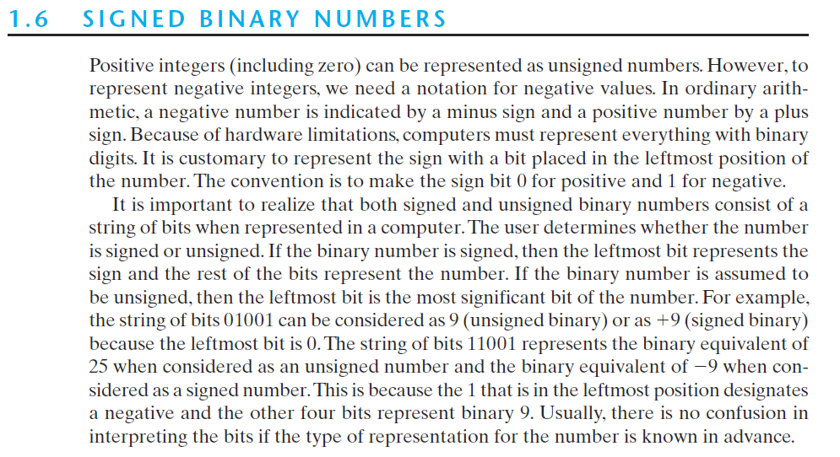

Slide 21
