Slide 2
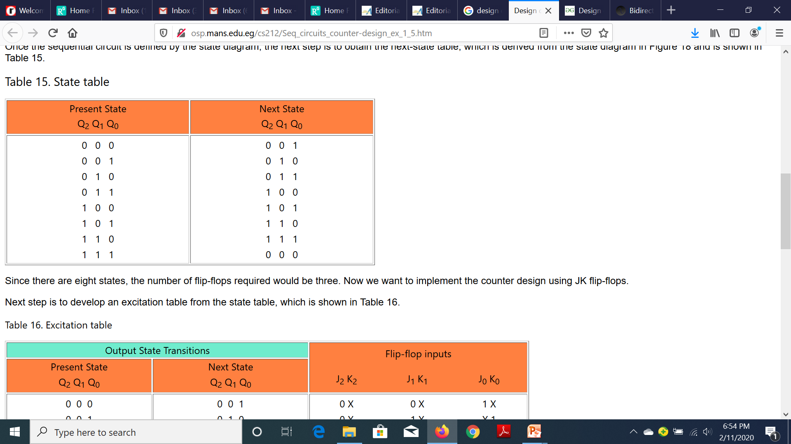

Slide 3
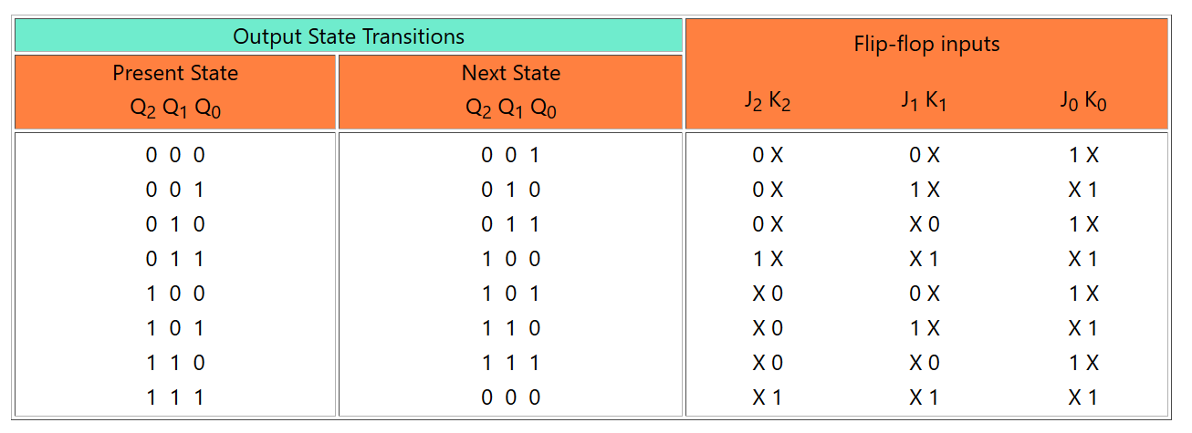

Slide 4


Slide 6
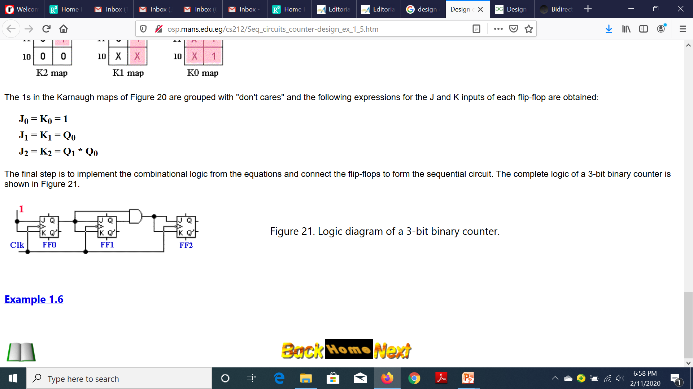

Slide 8
Designing Synchronous Counters
Example: A 3-bit Gray code counter (using JK flip-flops).
000
100
001
101
011
111
010
110

Slide 9
Designing Synchronous Counters
3-bit Gray code counter: flip-flop inputs.
Q₁Q₀
Q₁Q₀
Q₁Q₀
Q₂
Q₂
00 01 11 10
Q₂
00 01 11 10
00 01 11 10
0
1
1
0
1
1
X
X
0
1
1
X
X
X
X
X
X
X
X
X
X
1
JQ₂ = Q₁.Q₀'
JQ₁ = Q₂'.Q₀
JQ₀ = Q₂.Q₁ + Q₂'.Q₁'
= (Q₂ ⊕ Q₁)'
Q₁Q₀
Q₁Q₀
Q₁Q₀
Q₂
00 01 11 10
Q₂
00 01 11 10
Q₂
00 01 11 10
0
1
X
X
X
X
0
1
X
X
0
1
X
1
X
1
X
X
1
X
1
X
KQ₂ = Q₁'.Q₀'
KQ₁ = Q₂.Q₀
KQ₀ = Q₂.Q₁' + Q₂'.Q₁
= Q₂ ⊕ Q₁

Slide 10
Designing Synchronous Counters
3-bit Gray code counter: logic diagram.
JQ₂ = Q₁.Q₀' JQ₁ = Q₂'.Q₀ JQ₀ = (Q₂ ⊕ Q₁)'
KQ₂ = Q₁'.Q₀' KQ₁ = Q₂.Q₀ KQ₀ = Q₂ ⊕ Q₁
Q₀
Q₁
Q₂
J
Q
J
Q
J
Q
C
C
C
Q₁'
Q₂'
K
Q'
K
Q'
K
Q'
Q₀'
CLK

