Slide 1
Reliability & Safety
Uses of e-engineering

Slide 2
Reliability is the probability that an engineering system will perform its intended function satisfactorily for its intended life under specified environmental and operating conditions.
Reliability is basically a design parameter and must be incorporated into the system at the design stage.
Then, it is an inherent characteristic of the system, just as is its capacity or performance.
To analyze and measure the reliability and maintainability characteristics of a system, there must be a mathematical and a logical model of the system that shows the functional relationships among all the components, the subsystems, and the overall system.

Slide 3
Why is Reliability Important?
There are a number of reasons why reliability is an important product attribute, including:
Reputation. A company's reputation is very closely related to the reliability of its products. The more reliable a product is, the more likely the company is to have a favorable reputation.
Customer Satisfaction. While a reliable product may not dramatically affect customer satisfaction in a positive manner, an unreliable product will negatively affect customer satisfaction severely. Thus high reliability is a mandatory requirement for customer satisfaction.
Warranty Costs. If a product fails to perform its function within the warranty period, the replacement and repair costs will negatively affect profits, as well as gain unwanted negative attention. Introducing reliability analysis is an important step in taking corrective action, ultimately leading to a product that is more reliable.
Repeat Business. A concentrated effort towards improved reliability shows existing customers that a manufacturer is serious about its product, and committed to customer satisfaction. This type of attitude has a positive impact on future business.

Slide 4
Cost Analysis. Manufacturers may take reliability data and combine it with other cost information to illustrate the cost-effectiveness of their products. This life cycle cost analysis can prove that although the initial cost of a product might be higher, the overall lifetime cost is lower than that of a competitor's because their product requires fewer repairs or less maintenance.
Customer Requirements. Many customers in today's market demand that their suppliers have an effective reliability program. These customers have learned the benefits of reliability analysis from experience.
Competitive Advantage. Many companies will publish their predicted reliability numbers to help gain an advantage over their competitors who either do not publish their numbers or have lower numbers.

Slide 5
Human Equipment Interface
What is human equipment interface?
It includes any device or software that allows you to interact with a machine.
This can be as simple as the traditional single-touch display mounted on a machine or as technologically advanced as a multi-touch-enabled control panel or even connected mobile technology such as smartphones and smartwatches.

Slide 6

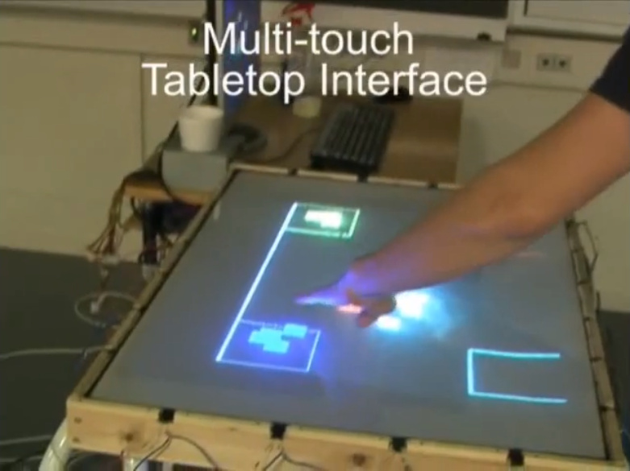

Slide 7
What does human-equipment interface include?
Elements with which the human being operates the machine, i.e. is able to execute functions.
Such elements particularly include control actuators such as buttons, levers, adjusting wheels, keyboards etc., and further elements which facilitate the machine's use, such as tool holders for the work piece.
Facilities for the exchange of information, such as displays which inform the user of the functional states of the machine.
Interaction between the human being and the machine can be regarded as a closed control loop.

Slide 8
Safety, Risk analysis, security
Risk: combination of the probability of an undesired event and its consequence.
Hazard: inherent property (or properties) of a risk source potentially causing consequences or effects.
Hazard analysis: systematic identification of potential hazards and critical accident scenarios associated with hazardous materials or activities. A comprehensive hazard analysis should be able to eliminate or control process hazards during the life-cycle of the plant. Engineering and administrative measures that are in place to control process parameters, and how these controls are degraded by technical failures, human failures or external events to lead to undesired events should be considered in this type of analysis.

Slide 9
Risk assessment: technical estimation of the nature and magnitude of a risk. It involves basically the answers to three questions: What can go wrong? How frequently does it happen? What are the consequences?
Risk management: systematic application of management policies, procedures and practices to the tasks of establishing the context, identifying, analyzing, planning, managing and mitigating risks in a way that will enable organizations minimizing loss and maximizing opportunities in a cost-effective way.

Slide 10
ALARP: a principle (“As Low as Reasonably Practicable”) usually applied to risks in some areas as radiation protection and chemical accident prevention, preparedness and response that fall below a defined level of “intolerable” risk. This principle recognizes that not all risks can be eliminated; there will be always a residual risk of an accident since it may not be practicable to take further actions to reduce the risk or to identify the potential accidents.
Safety assessment: evaluation of the actual and potential hazards to human health and to the environment associated with various activities must be assessed in order to protect the integrity.

Slide 11
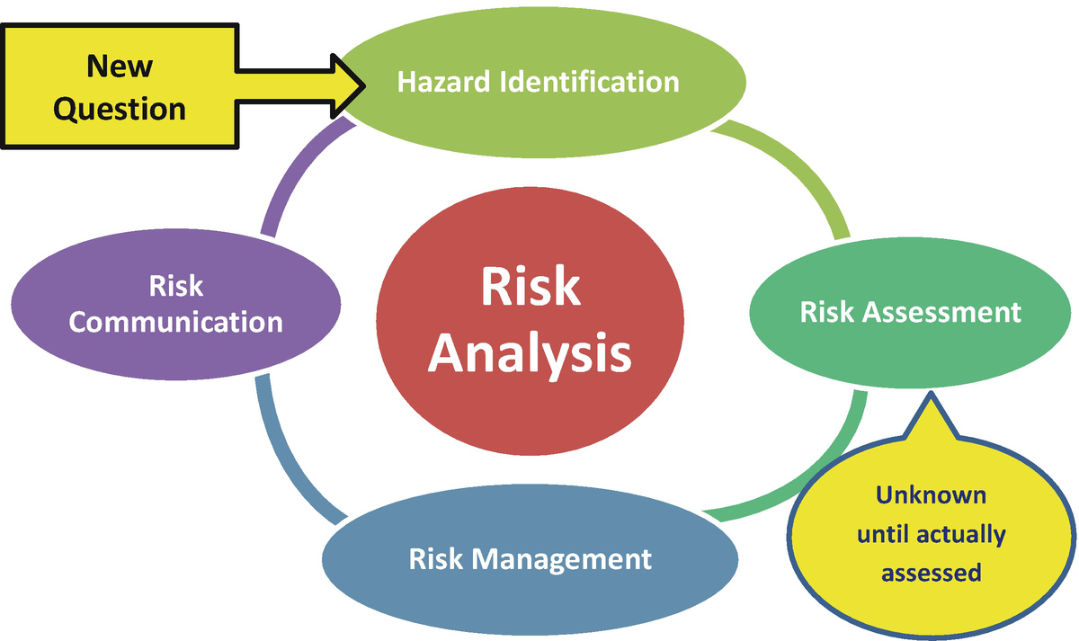
Hazard and Risk Analysis Techniques

Slide 12
Hazard and Risk Analysis Techniques
ETA (Event Tree Analysis): a technique that uses a graphical logic model that identifies and quantifies possible outcomes following an initiating event.
FTA (Fault Tree Analysis): a technique used for estimating the frequency of a hazardous incident (called the top event) through a logic model of the failure mechanisms of the system.
CCA (Cause Consequence Analysis): a method that uses diagrams for seeking the possible outcomes arising from the logical combination of selected input events or states.

Slide 13
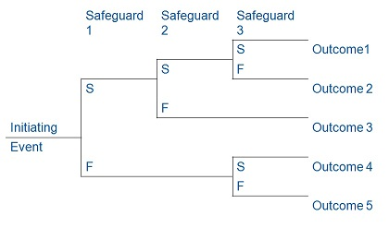
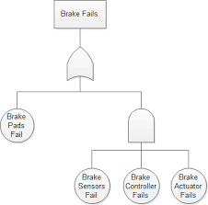
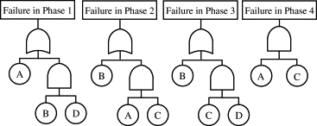
FAULT TREE
Cause consequence

Slide 14
PHA (Preliminary Hazard Analysis): a method designed to recognize early hazards and focuses on hazardous materials and major plant systems during the early stages of life-cycle of the plant, when only few details on the plant design and possibly no information about plant procedures may be available.
HAZOP (Hazard and Operability Study): a systematic procedure for identifying potential hazards and operability problems. The HAZOP procedure makes systematically questions over every part of a system to discover how deviations from the design intent can occur. The consequences of these deviations are then determined and, if significant, remedial actions are recommended.

Slide 15
FMEA (Failure Mode and Effects Analysis): a tool that aids in quantifying severity, occurrences and detection of failures, as well as guiding the recommendation of corrective actions, process improvements and risk mitigation plans.
Block Diagrams: a graphical representation of the components of a system and how they are related or connected.

Slide 16
Human Reliability Assessment
Human Reliability Assessment (HRA) is a method that involves systematic prediction of potential human errors when interacting with a system.
Once they are identified, actions are suggested to try eliminating or reducing their occurrence probabilities, in order to maximize safety and performance of the system or facility.
Results of HRA can be entered into risk management actions to reduce the risk to ALARP both by system re-design and implementation of controls and mitigations.

Slide 17
The HRA steps commonly include the identifying of:
• Error types
• Likelihood of error occurrence
• Opportunities to recover from errors
• Consequence of errors

Slide 18
System security
It is a process of ensuring confidentiality and integrity of the OS.
A system is said to be secure if its resources are used and accessed as intended under all the circumstances, but no system can guarantee absolute security from several of the various malicious threats and unauthorized access.
Security of a system can be threatened via two violations:
Threat: A program which has the potential to cause serious damage to the system.
Attack: an attempt to break security and make unauthorized use of an asset.

Slide 19
Security Measures Taken
Physical: the sites containing computer systems must be physically secured against armed and malicious intruders. The workstations must be carefully protected.
Human: only appropriate users must have the authorization to access the system.
Operating system: the system must protect itself from accidental or purposeful security breaches.
Networking system: almost all of the information is shared between different systems via a network. Intercepting these data could be just as harmful as breaking into a computer. Henceforth, network should be properly secured against such attacks.

Slide 20
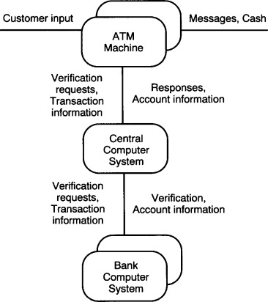
Use of e-engineering
Modeling
The system design model is used to illustrate the architecture of the hardware elements and their interfaces in a distributed system.
The rounded rectangles represent subsystems that will correspond to hardware nodes in the distributed architecture.

Slide 21
Simulation
The word “simulation” is often used as generic term for computer-aided engineering (CAE).
Several design simulation approaches have become standard components of product development in many industries, and they continue to grow in importance as inexpensive, faster computers and affordable, easy-to-use design simulation software allow users to address new technologies and applications.
Simulation models are sets of mathematical equations representing the behavior of the system in a physical domain of interest.

Slide 22
What is the use of simulation?
Reduce development costs and bring innovative products to the market faster.
Virtually test behavior of a product under various operating and environmental conditions.
Simulation brings manufacturers closer to the ultimate dream of building a single prototype.

Slide 23
Verification
Design verification is an essential step in the development of any product.
Also referred to as qualification testing, design verification ensures that the product as designed is the same as the product as intended.

Slide 24
Verification Methods
Demonstration: Demonstrations can be conducted in actual or simulated environments.
Inspection: Inspection is usually used to verify requirements related to physical characteristics.
Similarity: If a design includes features or materials that are similar to those of another product that has met or exceeded current specifications, an analysis to illustrate this similarity may be used to verify a requirement.
Testing: Testing can be one of the most expensive verification methods, depending on complexity as well as equipment and facility requirements.

